Slide 1
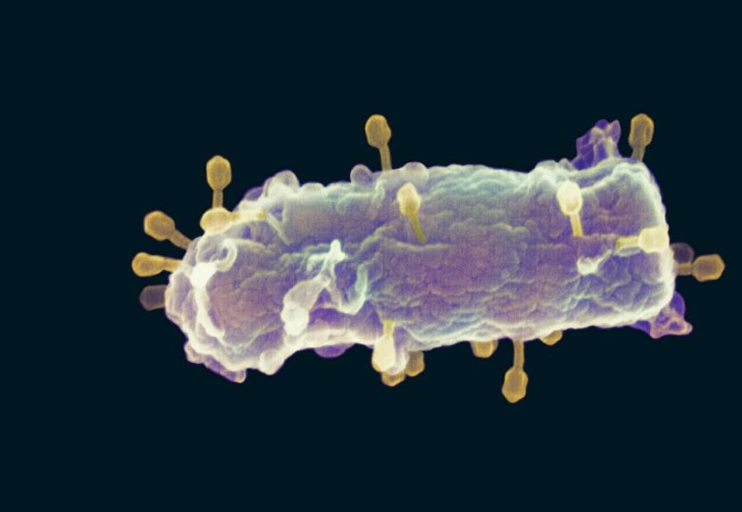
Viruses
0.5 µm
Notes:
Figure 19.1 Are the tiny viruses infecting this E. coli cell alive?
Viruses called bacteriophages can infect & set in motion a genetic takeover of bacteria, such as Escherichia coli
Viruses lead “a kind of borrowed life” between life-forms & chemicals
The origins of molecular biology lie in early studies of viruses that infect bacteria

Slide 2
Viruses lead “a kind of borrowed life” between life-forms & chemicals
Use nucleic acids used to store hereditary information
Have order & complexity in arrangement of biological molecules
Have the capacity to evolve
Cannot process energy through metabolic reactions without the host

Slide 3
Structure of Viruses
very small infectious particles
nucleic acid enclosed in a protein coat (capsid)
double- or single-stranded DNA
double- or single-stranded RNA
capsids from protein subunits called capsomeres
can have various structures
in some cases, also a membranous envelope
Notes:
viral genome
DNA OR RNA - Depending on its type of nucleic acid, a virus is called a DNA virus or an RNA virus
Some viruses have membranous envelopes that help them infect hosts
These viral envelopes surround the capsids of influenza viruses & many other viruses found in animals
Viral envelopes, which are derived from the host cell’s membrane, contain a combination of viral & host cell molecules

Slide 4
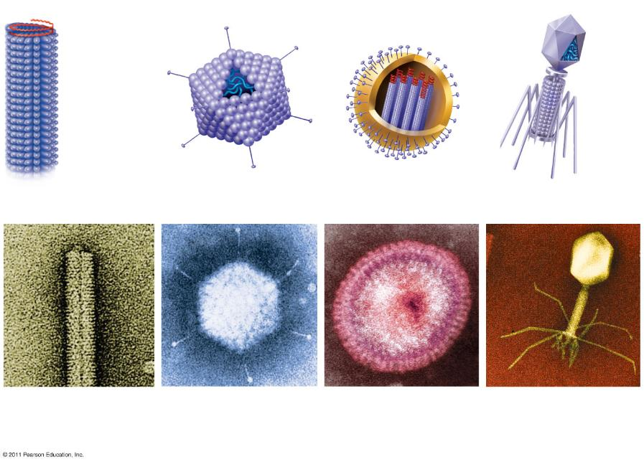
Capsomere
Membranous envelope
RNA
RNA
DNA
Capsid
DNA
Head
Capsomere of capsid
Tail sheath
Tail fiber
Glycoprotein
Glycoproteins
18 × 250 nm
70–90 nm (diameter)
80–200 nm (diameter)
80 × 225 nm
20 nm
50 nm
50 nm
50 nm
(a)
Tobacco mosaic virus
(b) Adenoviruses
(c) Influenza viruses
(d) Bacteriophage T4
Notes:
Figure 19.3 Viral structure.

Slide 5
Viruses replicate only in host cells
Viruses are obligate intracellular parasites, which means they can replicate only within a host cell
Each virus has a host range, a limited number of host cells that it can infect
Once a viral genome has entered a cell, the cell begins to manufacture viral proteins
The virus makes use of host enzymes, ribosomes, tRNAs, amino acids, ATP, and other molecules
Viral nucleic acid molecules and capsomeres spontaneously self-assemble into new viruses

Slide 6
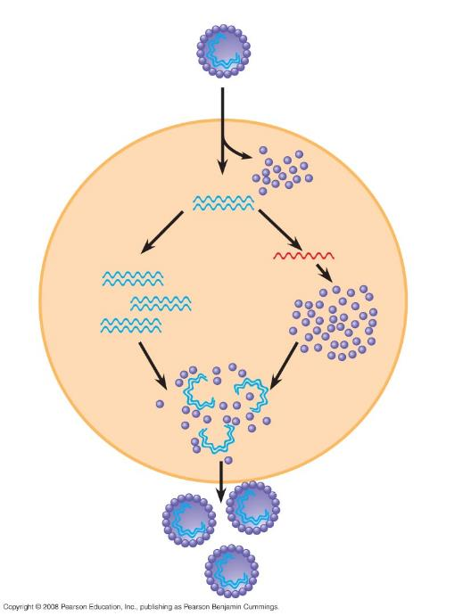
Entry and
uncoating
VIRUS
1
DNA
Capsid
Transcription
and manufacture
of capsid proteins
3
2
Replication
HOST CELL
Viral DNA
mRNA
Viral DNA
Capsid
proteins
Self-assembly of
new virus particles
& their exit from
the cell
4
Notes:
Once a viral genome has entered a cell, the cell begins to manufacture viral proteins
The virus makes use of host enzymes, ribosomes, tRNAs, amino acids, ATP, & other molecules
Viral nucleic acid molecules & capsomeres spontaneously self-assemble into new viruses

Slide 7
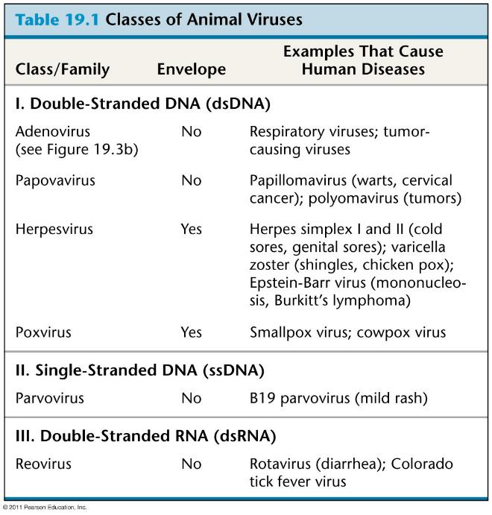
Gardasil
Notes:
Table 19.1 Classes of Animal Viruses (part 1)
There are two key variables used to classify viruses that infect animals:
DNA or RNA
Single-stranded or double-stranded

Slide 8
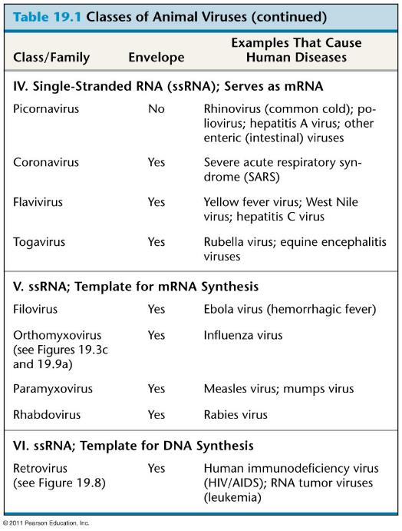
Table 19.1b
Notes:
Table 19.1 Classes of Animal Viruses (part 2)

Slide 9
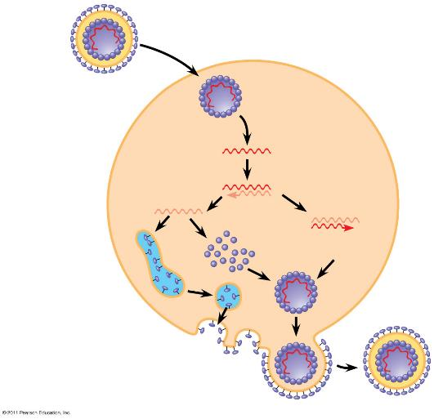
Viral Envelopes
Capsid
Capsid and viral genome enter the cell
RNA
Many viruses that infect animals have a membranous envelope
Viral glycoproteins on the envelope bind to specific receptor molecules on the surface of a host cell
Some viral envelopes are formed from the host cell’s plasma membrane as the viral capsids exit
Envelope (with glycoproteins)
HOST CELL
Viral genome (RNA)
Template
mRNA
ER
Capsid proteins
Copy of genome (RNA)
Glyco- proteins
New virus
Notes:
Figure 19.7 The replicative cycle of an enveloped RNA virus.

Slide 10
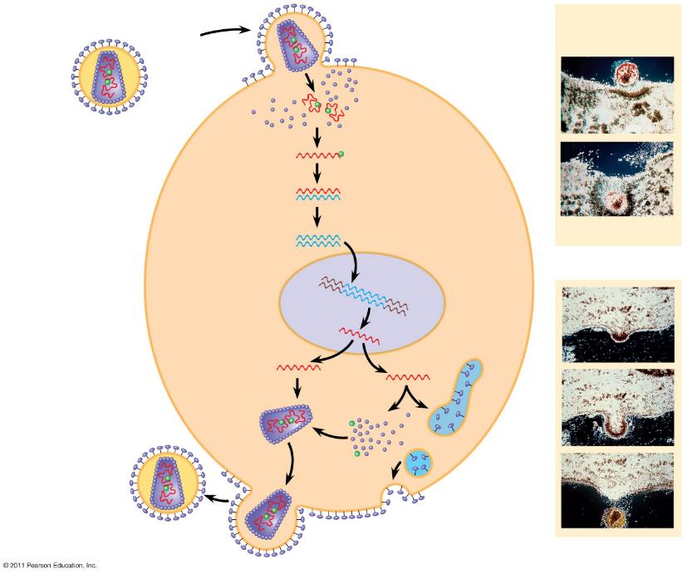
Glycoprotein
Viral envelope
Membrane of white blood cell
Capsid
HIV
RNA (two identical strands)
HOST CELL
Reverse transcriptase
HIV
Reverse transcriptase
Viral RNA
HIV (human immunodeficiency virus) is the retrovirus that causes AIDS (acquired immunodeficiency syndrome)
RNA-DNA hybrid
DNA
0.25 μm
HIV entering a cell
NUCLEUS
Provirus
Chromosomal DNA
RNA genome for the next viral generation
mRNA
New virus
New HIV leaving a cell
Notes:
Figure 19.8 The replicative cycle of HIV, the retrovirus that causes AIDS.
The viral DNA that is integrated into the host genome is called a provirus
Unlike a prophage, a provirus remains a permanent resident of the host cell
The host’s RNA polymerase transcribes the proviral DNA into RNA molecules
The RNA molecules function both as mRNA for synthesis of viral proteins & as genomes for new virus particles released from the cell

Slide 11
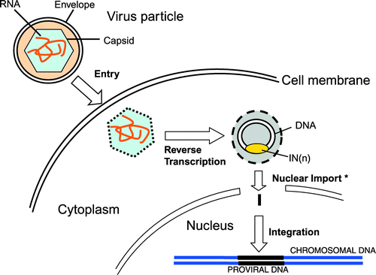
Definition of a Retrovirus
Any of a family of RNA viruses that have an enzyme (reverse transcriptase) capable of making a complementary DNA copy of the viral RNA, which then is integrated into a host cell’s DNA.
https://www.liebertpub.com/doi/full/10.1089/hum.2007.148

Slide 12
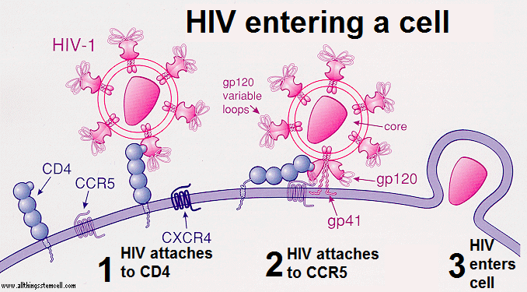
Notes:
CD4 is a glycoprotein that serves as a co-receptor for the T-cell receptor. CD4 is found on the surface of immune cells such as T helper cells, monocytes, macrophages, and dendritic cells. It was discovered in the late 1970s and was originally known as leu-3 and T4 before being named CD4 in 1984.
C-C chemokine receptor type 5, also known as CCR5 or CD195, is a protein on the surface of white blood cells that is involved in the immune system as it acts as a receptor for chemokines.

Slide 13
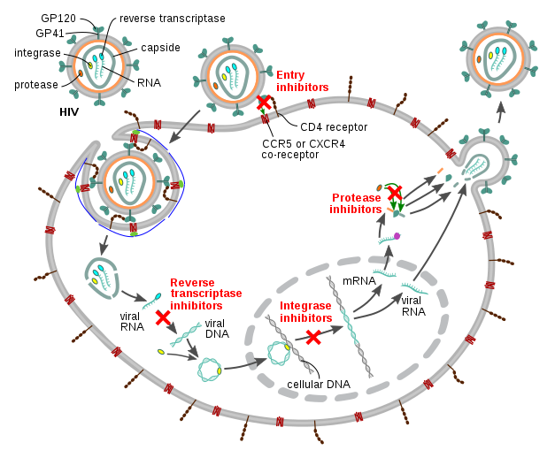

Slide 14
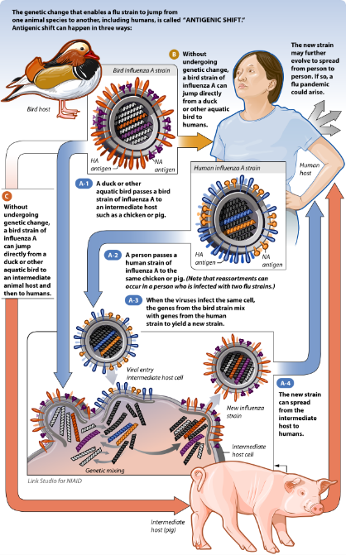
Emerging Viruses
Recently, a general outbreak (epidemic) of a flu appeared in Mexico and the United States, caused by H1N1 influenza virus
Flu epidemics are caused by new strains of influenza virus to which people have little immunity
Antigenic Shift
Notes:
Jumps from birds to swine to humans are important in the cycle.
Raising different types of livestock together with birds is a bad thing.

Slide 15
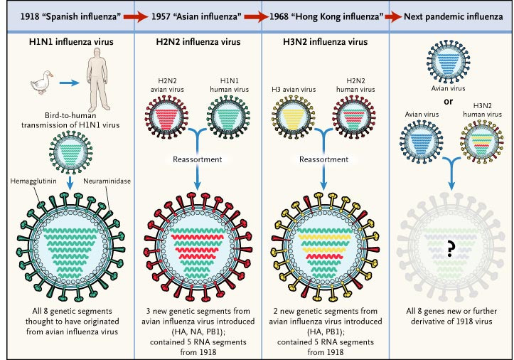

Slide 16
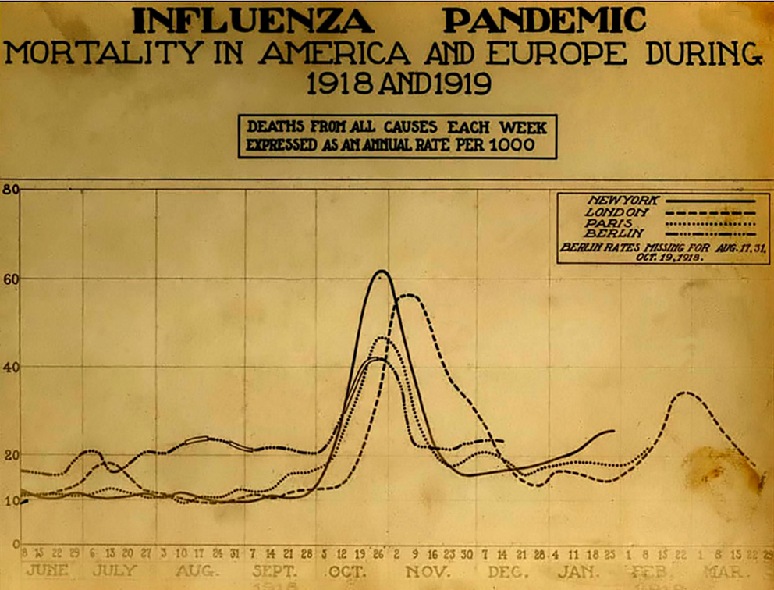
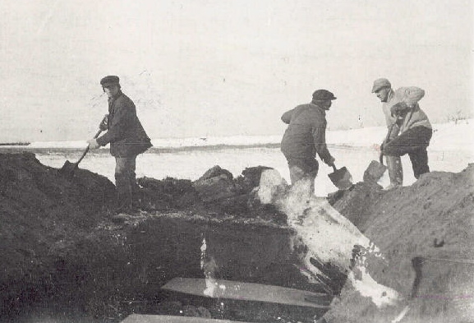
https://origins.osu.edu/milestones/pandemic-flu-spanish-flu-1918-H1N1-WW1-vaccine
1918 Flu Killed 50 million people
1% of world population

Slide 17
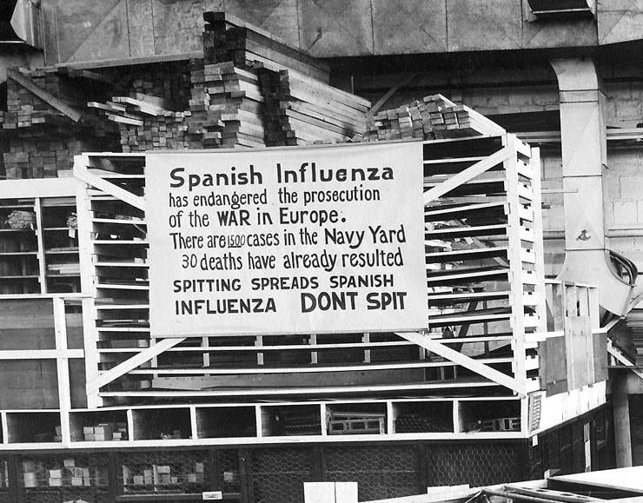
https://news.usni.org/2020/03/25/navy-marines-struggled-with-1918-influenza-pandemic

Slide 18
2014 Ebola Outbreak, West Africa
WHO Ebola Response Team. N Engl J Med 2014. DOI: 10.1056/NEJMoa1411100 http://www.nejm.org/doi/full/10.1056/NEJMoa1411100?query=featured_ebola#t=articleResults

Slide 19
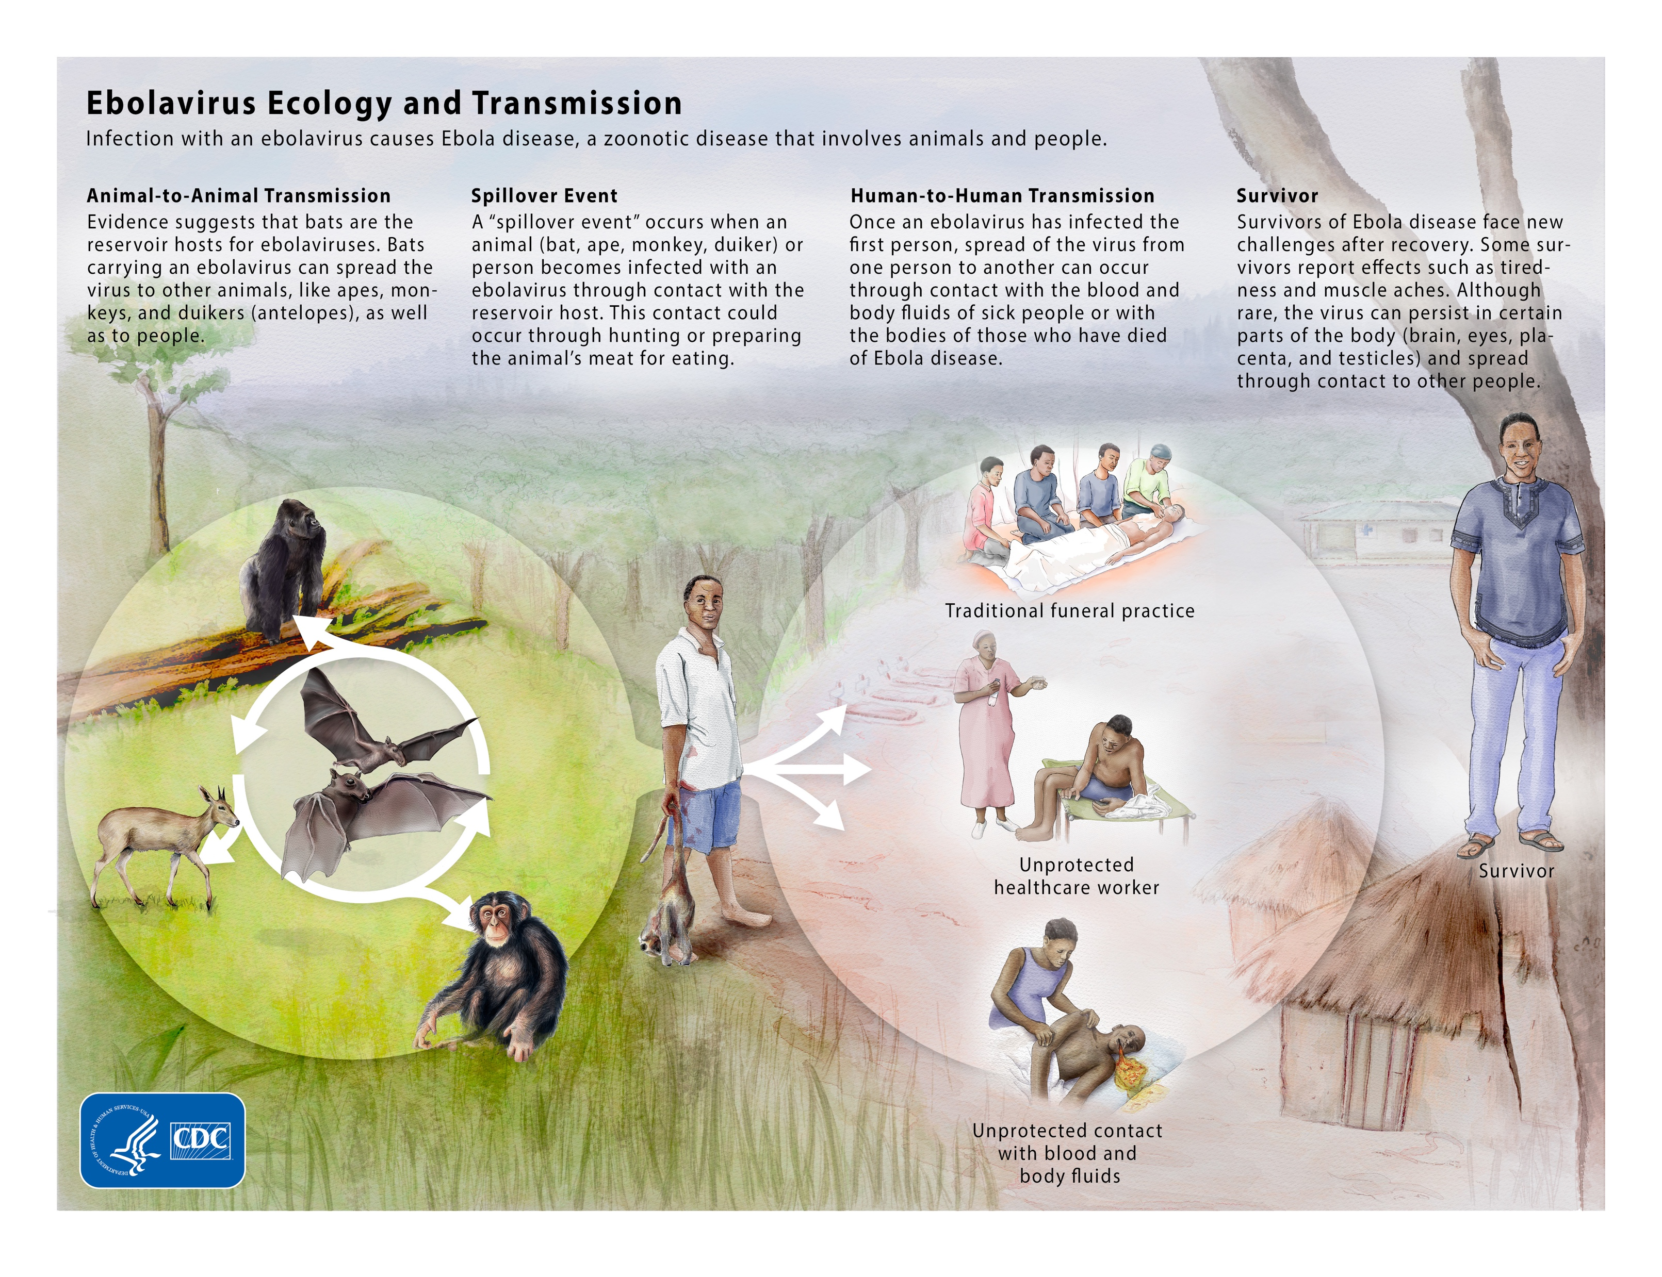

Slide 20
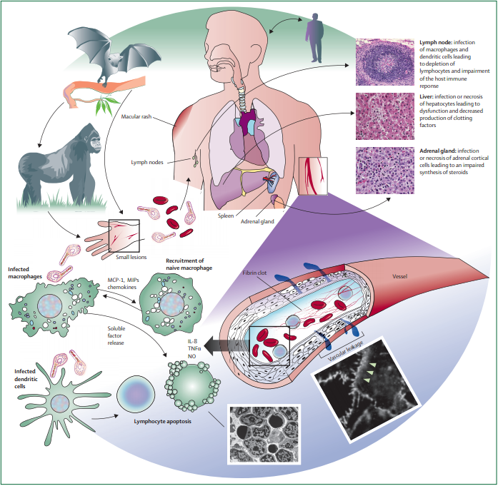
https://www.sinobiological.com/research/virus/ebola-virus-disease-hemorrhagic-fever

Slide 21
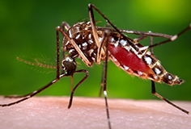
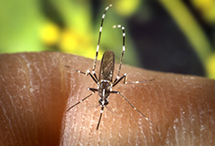
Zika Virus (Zika)
Single stranded RNA virus
Closely related to dengue, yellow fever, Japanese encephalitis, and West Nile viruses
Primarily transmitted through the bite of an infected Aedes species mosquito (Ae. aegypti and A. albopictus)
Aedes aegypti
Aedes albopictus
Notes:
Zika virus was first discovered in a monkey in the Zika Forest of Uganda in 1947.
Before 2007, at least 14 cases of Zika had been documented, although other cases were likely to have occurred and were not reported.
Before 2015, Zika virus disease (Zika) outbreaks occurred in areas of Africa, Southeast Asia, and the Pacific Islands. Because the symptoms of Zika are similar to those of many other diseases, many cases may not have been recognized.

Slide 22
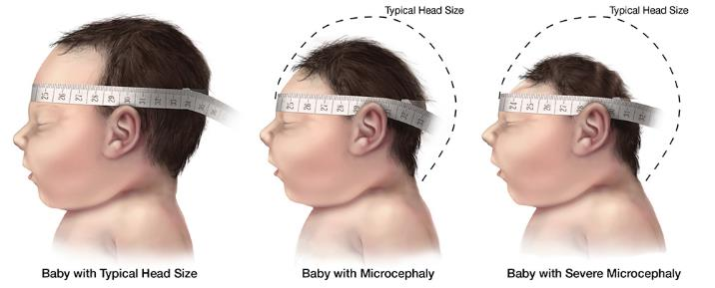
Behind the Concern: Microcephaly
Recent research by CDC has officially linked Zika virus to microcephaly. The research concludes that the newborns of mothers who had a Zika virus infection while pregnant might be at an increased risk of microcephaly and miscarriages, although it does not mean that every woman who has Zika while pregnant will have a child with microcephaly

Slide 23
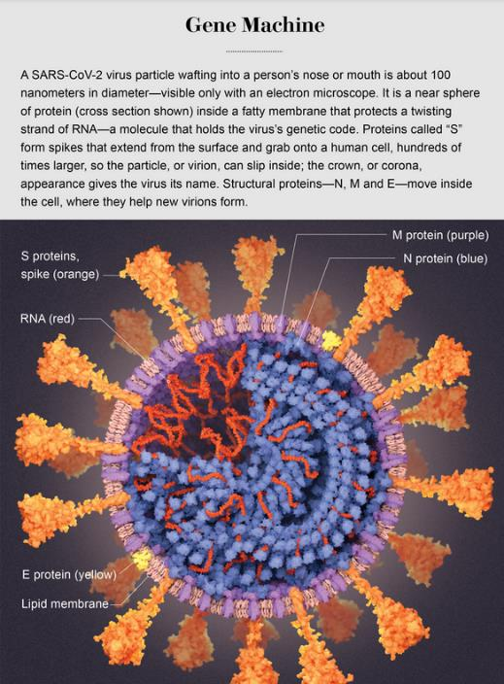

Slide 24
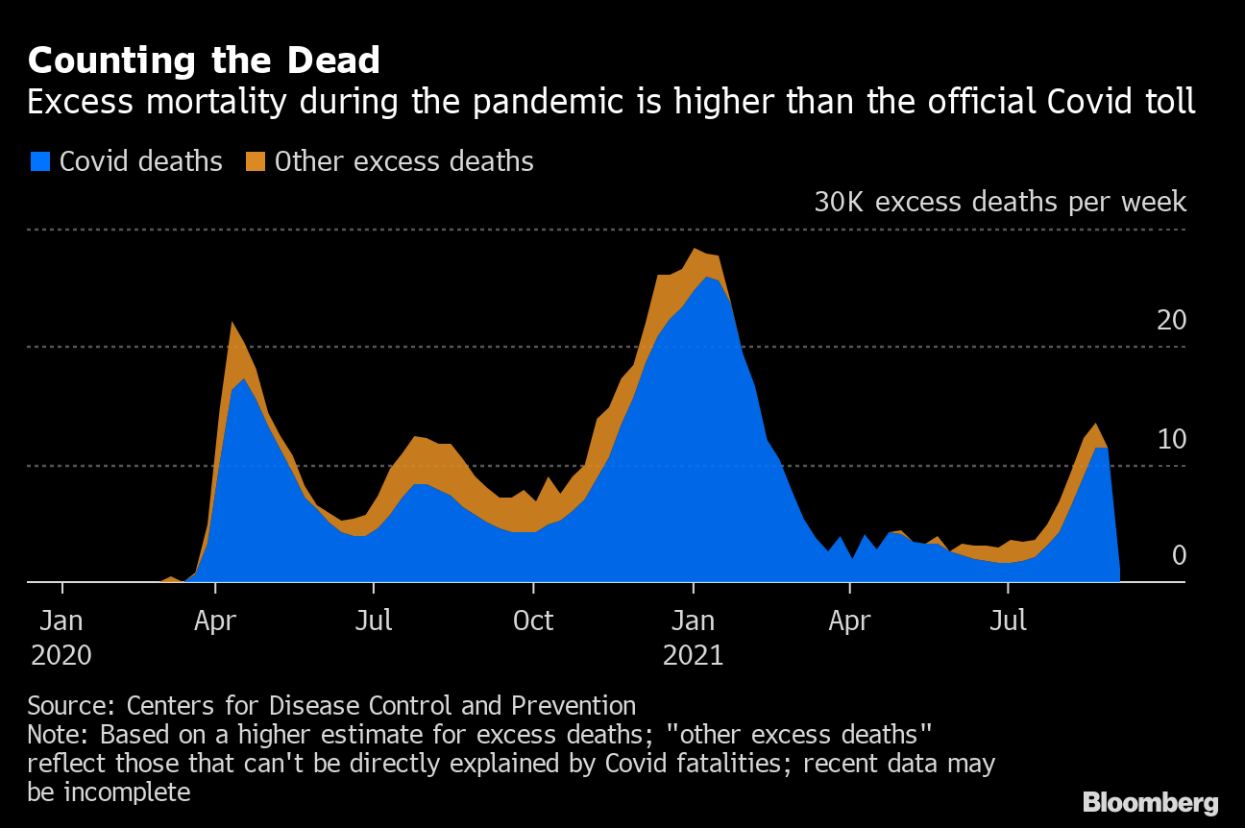
https://www.smithsonianmag.com/smart-news/the-covid-19-pandemic-is-considered-the-deadliest-in-american-history-as-death-toll-surpasses-1918-estimates-180978748/

Slide 25
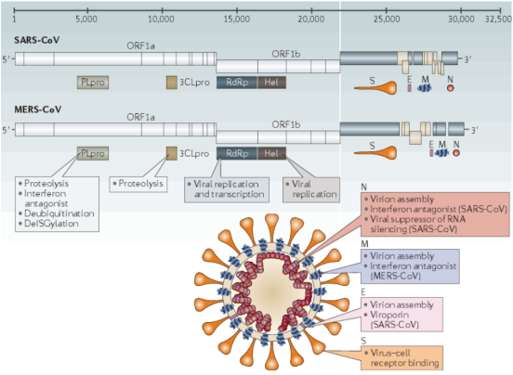
SARS COV-2 Genome
Single RNA with 13–15 (12 functional) open reading frames (ORFs) containing ~30,000 nucleotides

Slide 26
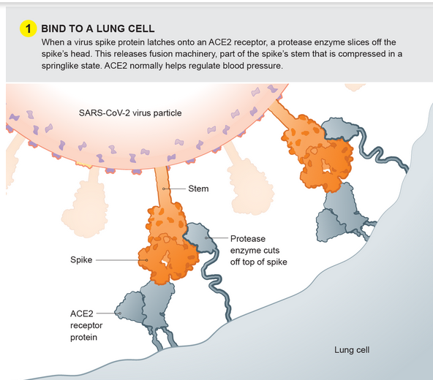

Slide 27
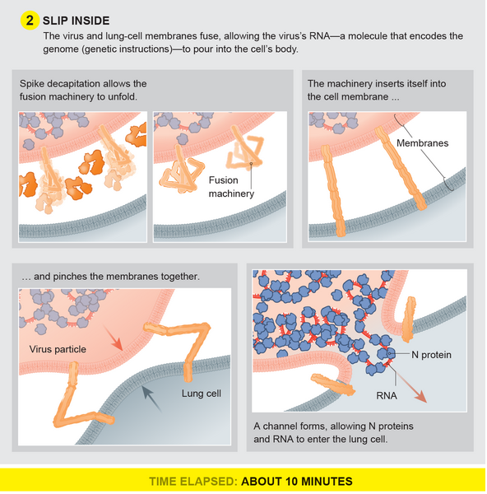

Slide 28
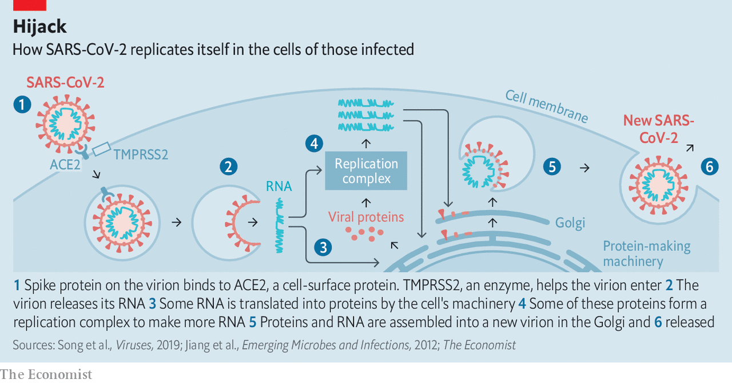
Replicate and Breakout

Slide 29
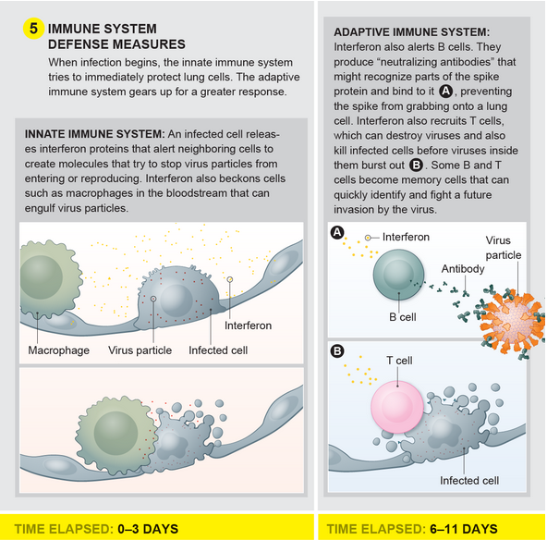

Slide 30
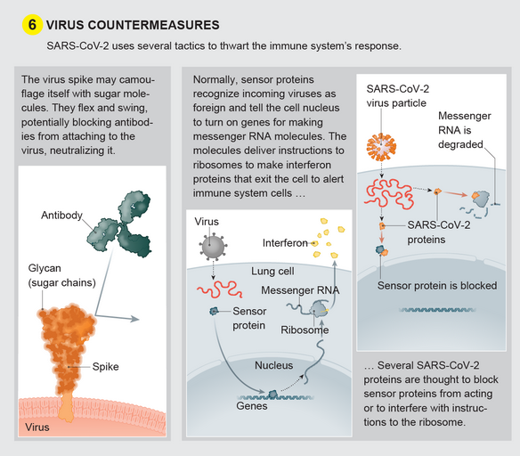

Slide 31
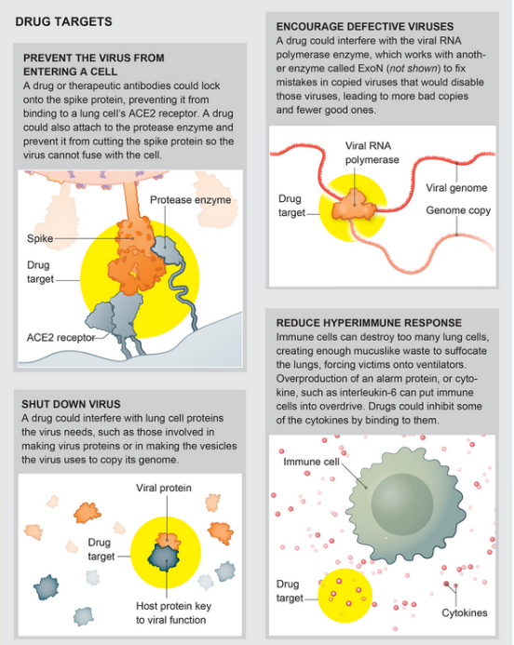

Slide 32
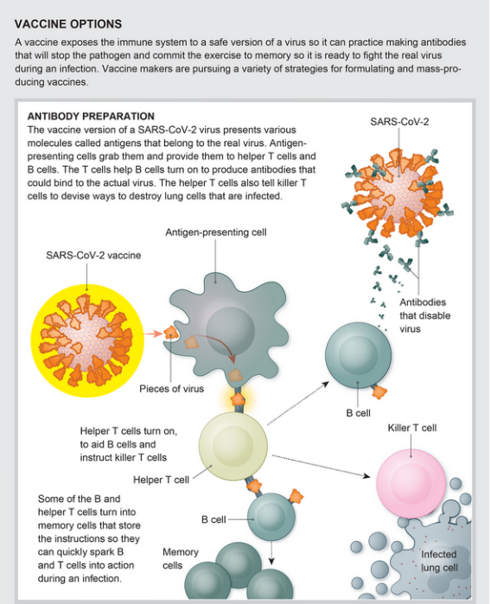

Slide 33
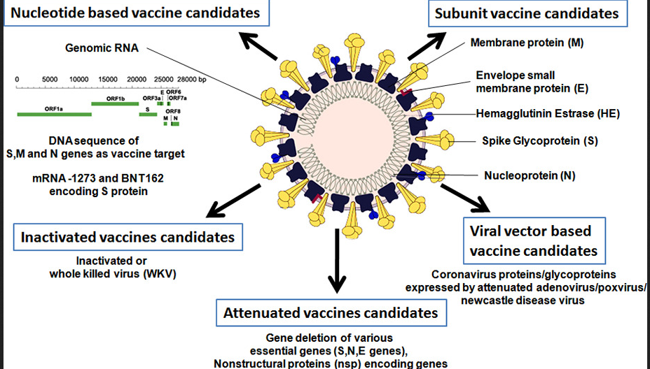

Slide 34
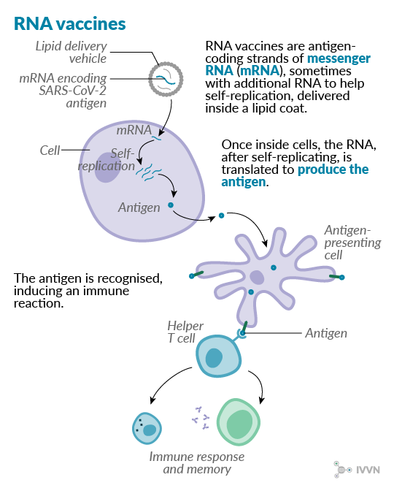

Slide 35
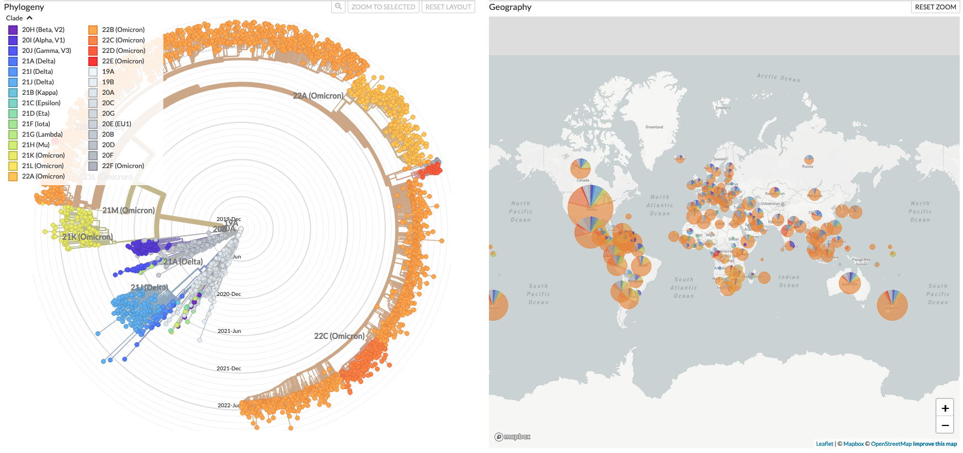
COVID Phylogeny
Animation → https://nextstrain.org/ncov/gisaid/global/6m

