Slide 1
Adaptive Introgression
Beneficial gene flow between the same or different species
Increases genetic diversity, and introduces genetic variants leading to fitness increase in the recipient population
Surprisingly common
Can lead to faster evolution (than waiting for mutation)
Genomics offers a new perspective

Slide 2
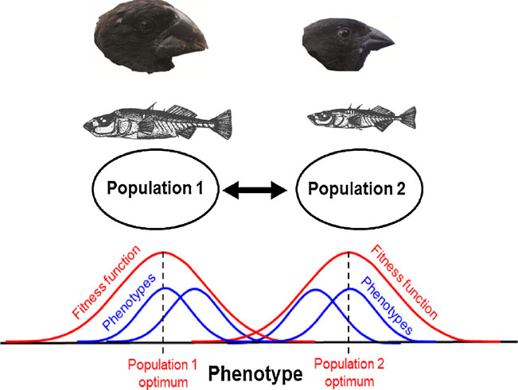
Why do we see these patterns?
Different genotypes/phenotypes are localy adapted to different environments and intermediate phenotypes have reduced fitness (selection against immigrants and hybrids).
Effects of selection are usually locus specific, whereas effects of population demography operate genome-wide.
Some hybrids reproduce and contribute immigrant genes to future generations → gene flow.
Can result in fitness increase

Slide 3
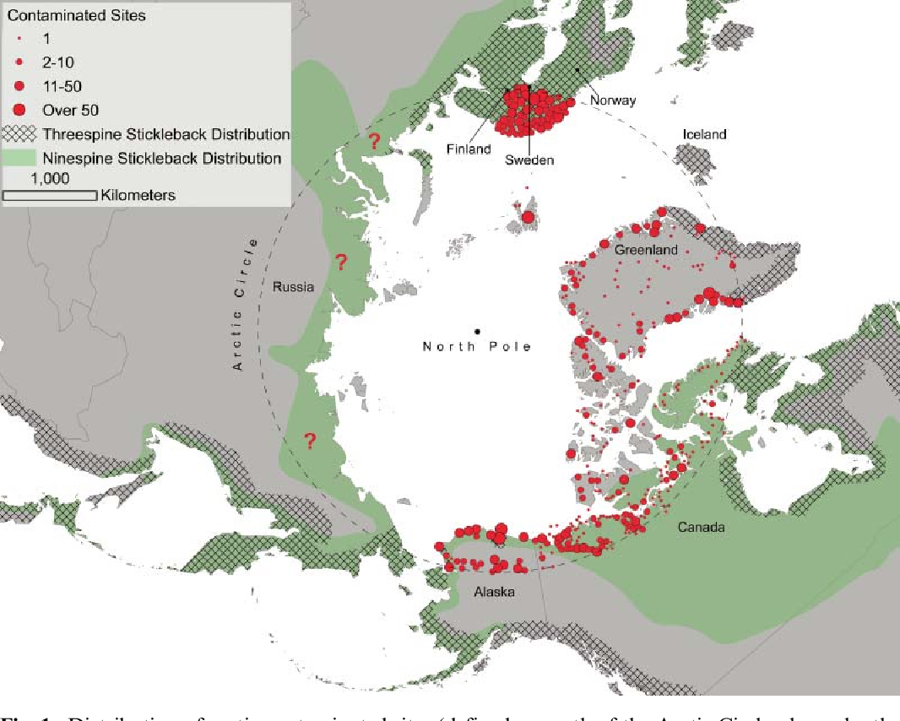
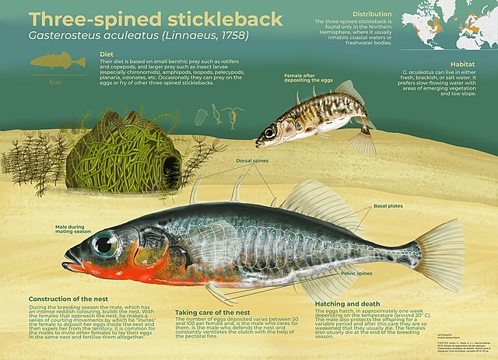
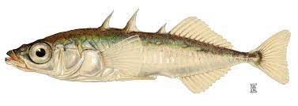
The ninespine stickleback as a model organism in arctic ecotoxicology
F. V. Hippel, E. Trammell,
I. KatsiadakiPublished 1 July 2016 Environmental Science, BiologyEvolutionary Ecology Research

Slide 4
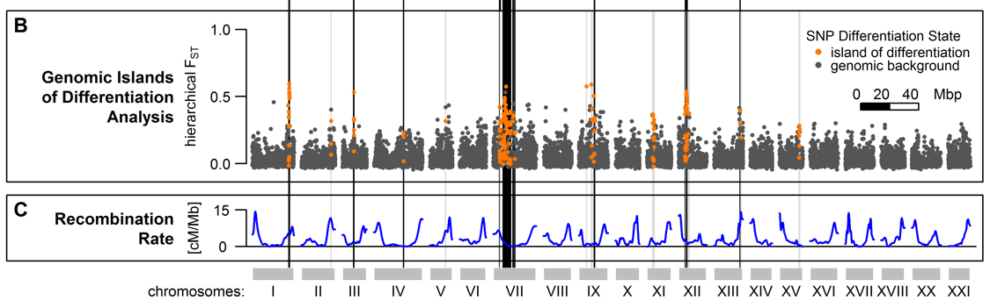
F_{ST} reveals islands of genetic differentiation
Marques, David A., et al. (2016) Genomics of Rapid Incipient Speciation in Sympatric Threespine Stickleback. PLoS Genet 12.2:e1005887.

Slide 5
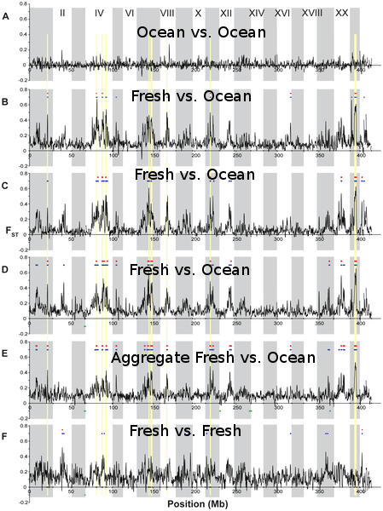
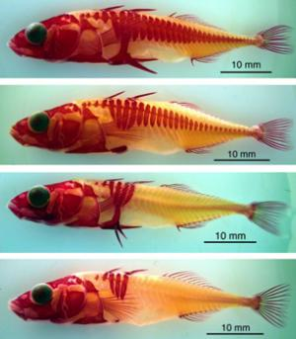
These islands of differentiation correspond to differentially selected loci
Multiple comparisons reveal morphology associated with these types loci has evolved repeatedly in parallel in different freshwater populations.
The ancestral marine population is an import source of this variation (i.e., locally adapted freshwater alleles occur at low frequency there too).
RAD-Seq – developed by Eric Johnson, Bill Cresko, and collaborators at the University of Oregon in 2006 – first method to make genomic scale studies inexpensive and accessible to population geneticists.

Slide 6
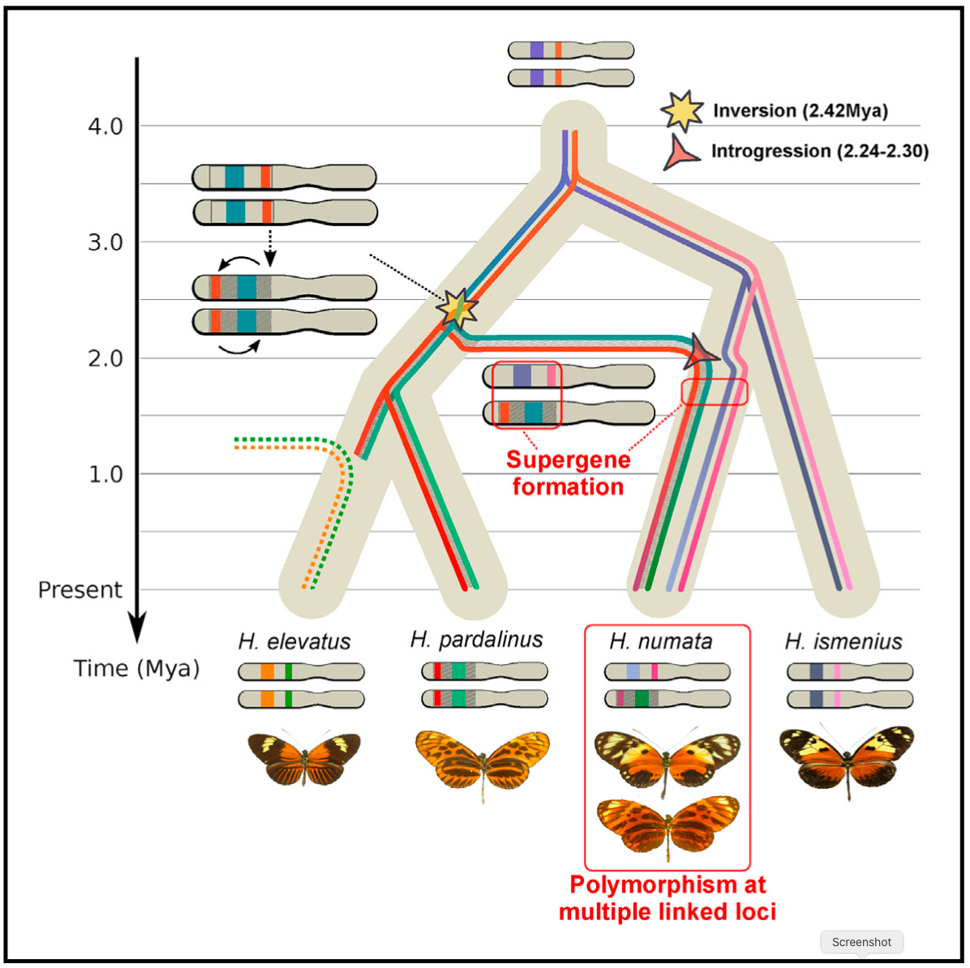
Heliconius Butterfly Wing Patterns
Jay, P., Whibley, A., Frézal, L., de Cara, M.Á.R., Nowell, R.W., Mallet, J., Dasmahapatra, K.K. and Joron, M., 2018. Supergene evolution triggered by the introgression of a chromosomal inversion. Current Biology, 28(11), pp.1839-1845.

Slide 7
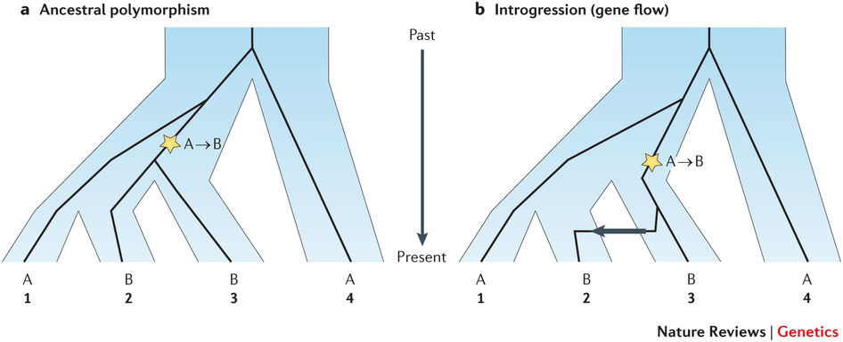
Testing for Hybridization Using Genomic Data
ABBA-BABA Tests
Understanding the origin of species with genome-scale data: modelling gene flow
Vitor Sousa & Jody Hey. Nature Reviews Genetics 14, 404–414 (2013)

Slide 8
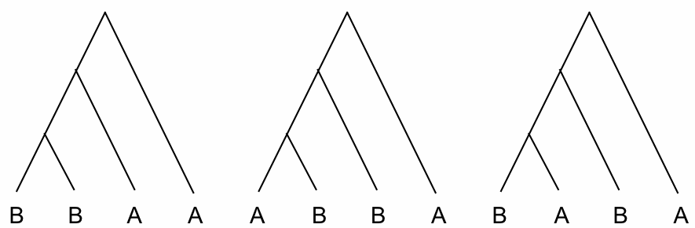
Three possible gene trees for any given bi-allelic SNP
4 populations + outgroup
Alternate lineage sorting patterns
inconsistent with true gene tree
*
*
*
*
No gene flow
No stochastic lineage sorting
True gene tree
If no introgression, ABBA & BABA trees should be equal in frequency (red lines equal different patterns generated by ancestral polymorphism).
If introgression occurred, expect excess of ABBA trees compared to BABA trees.
∗ = mutation
A = ancestral state in outgroup

Slide 9
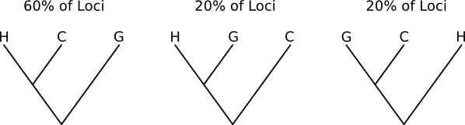
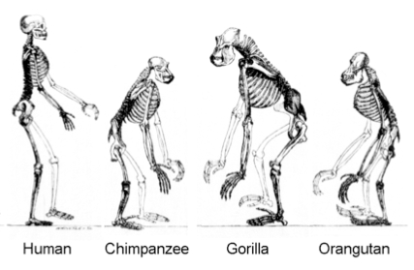
(Human, Chimp), Gorilla
∗∗∗Effects of ancestral polymorphism and ILS are pervasive across the genome∗∗∗

Slide 10
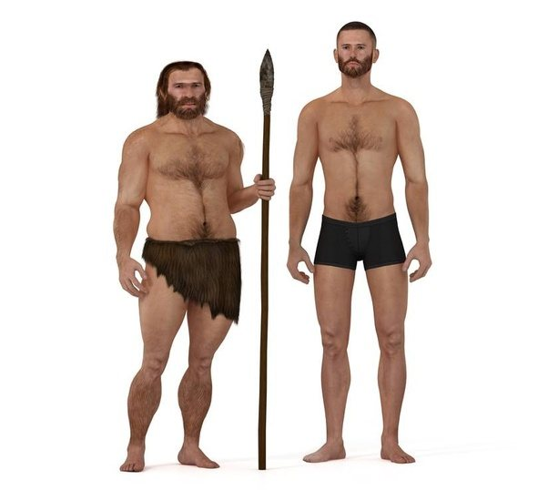
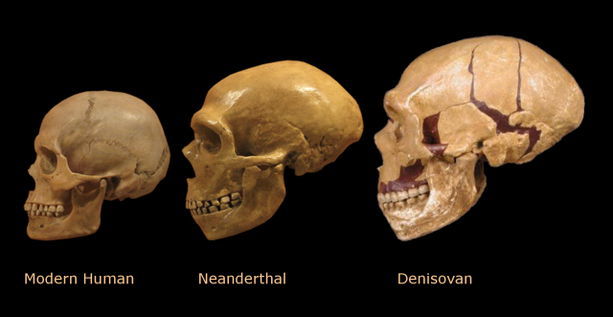
Did modern humans hybridize with Neanderthal people and other ancient humans?

Slide 11
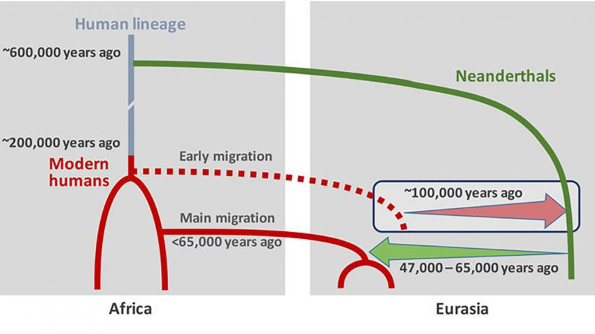
Humans mated with Neandertals much earlier and more frequently than thought. Science By Ann Gibbons, Feb. 17, 2016 , 1:00 PM
~2% of your DNA is perhaps from Neanderthal

Slide 12
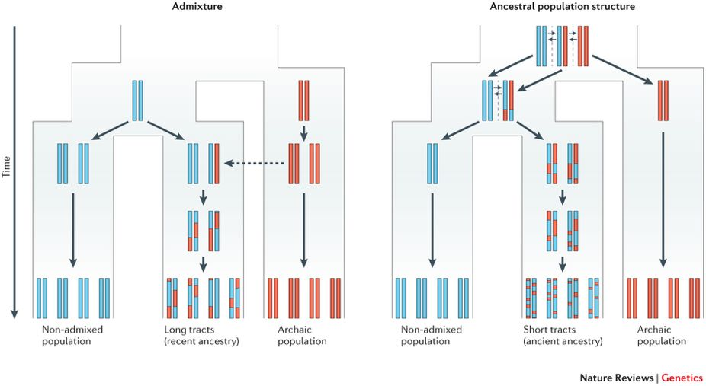
Racimo, F., Sankararaman, S., Nielsen, R., & Huerta-Sánchez, E. (2015). Evidence for archaic adaptive introgression in humans. Nature Reviews Genetics, 16(6), 359.
Because there is less time for recombination to break down the migrant tracts (red) in the admixed population (left), the expected tract length in this case will be longer than in the case of ancestral population structure (right).

Slide 13
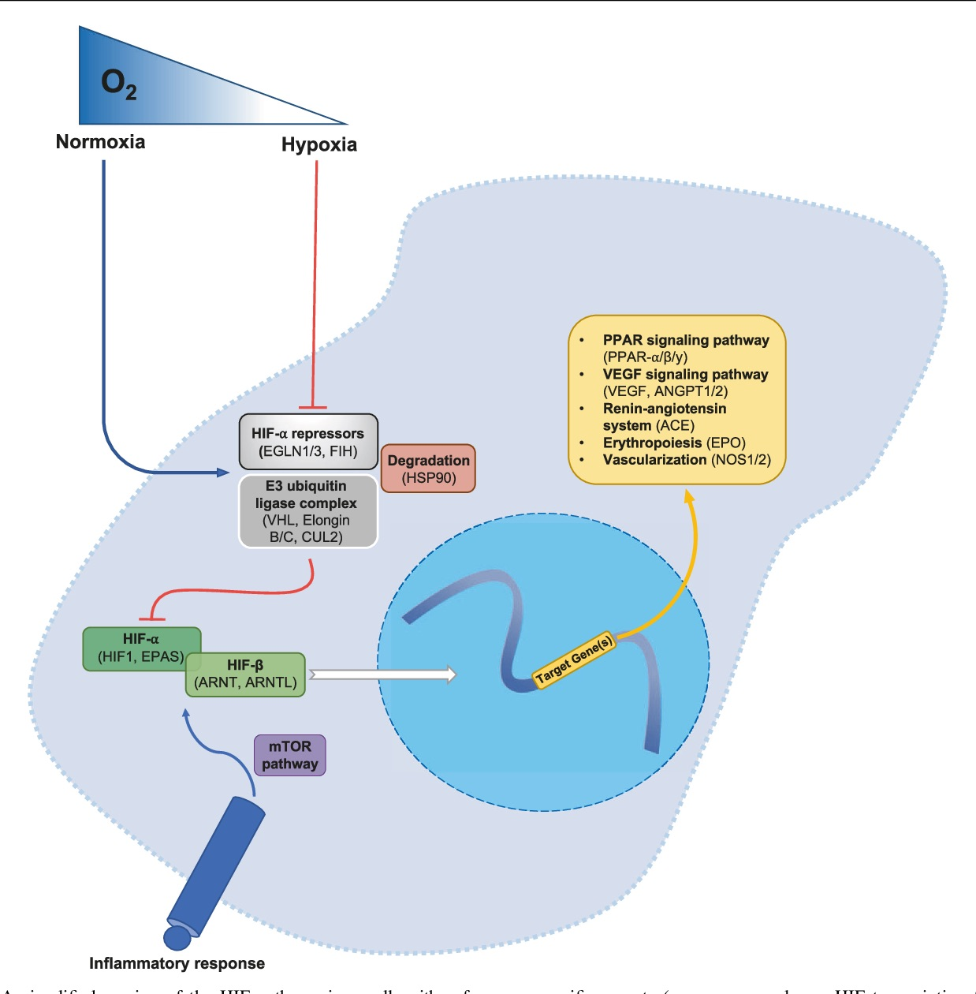
Hypoxia-Inducible Factor Pathway
Graham 2019 - Heredity

Slide 14
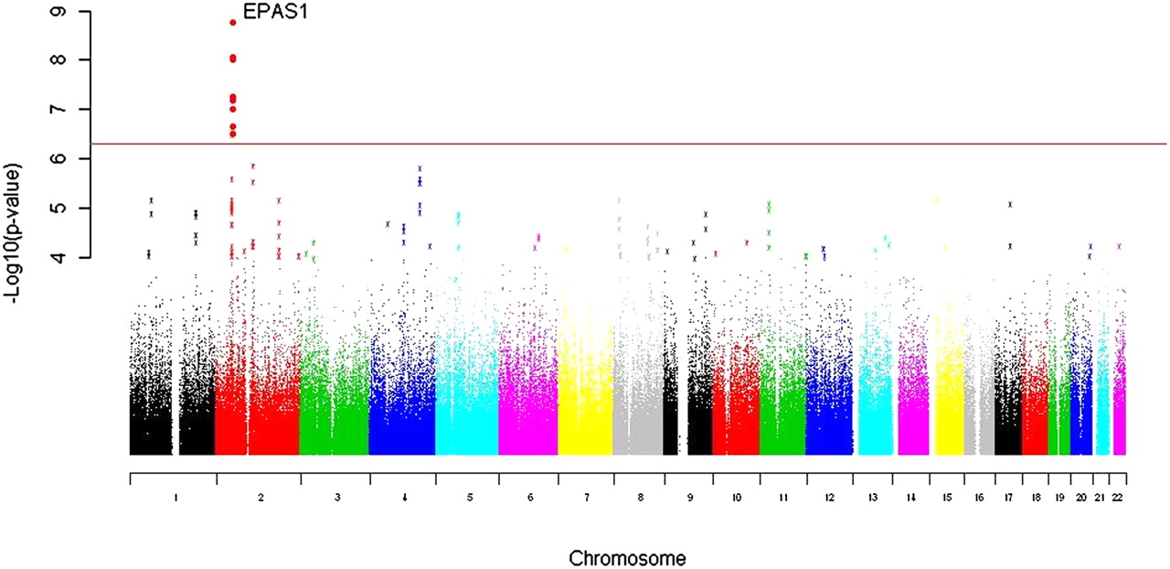
Beall, C.M., Cavalleri, G.L., Deng, L., Elston, R.C., Gao, Y., Knight, J., Li, C., Li, J.C., Liang, Y., McCormack, M. and Montgomery, H.E., 2010. Natural selection on EPAS1 (HIF2α) associated with low hemoglobin concentration in Tibetan highlanders. Proceedings of the National Academy of Sciences, 107(25), pp.11459-11464.

Slide 15
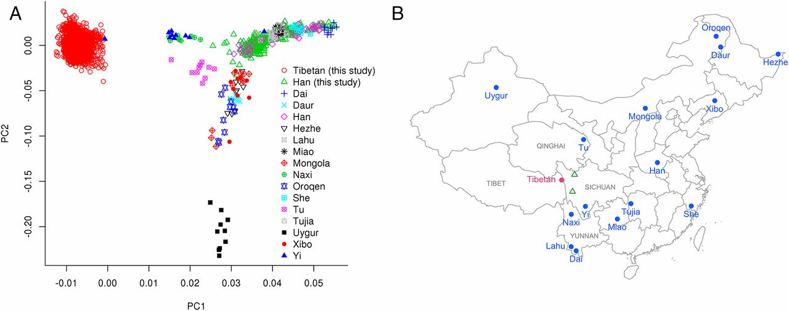
Yang, J., Jin, Z.B., Chen, J., Huang, X.F., Li, X.M., Liang, Y.B., Mao, J.Y., Chen, X., Zheng, Z., Bakshi, A. and Zheng, D.D., 2017. Genetic signatures of high-altitude adaptation in Tibetans. Proceedings of the National Academy of Sciences, 114(16), pp.4189-4194.

Slide 16
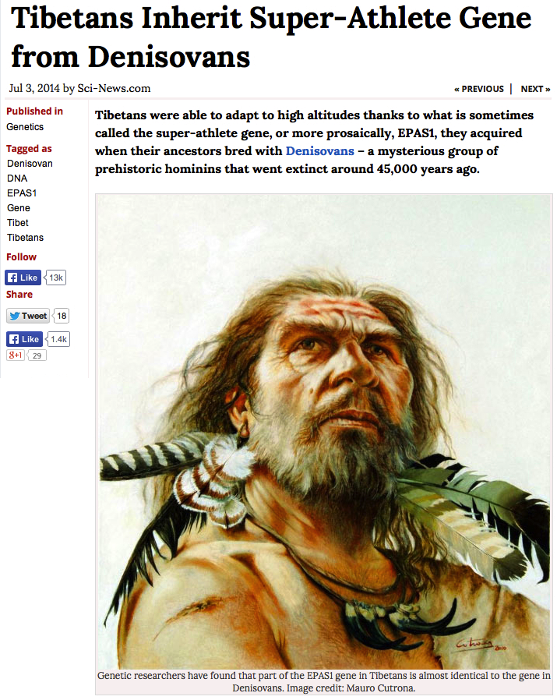
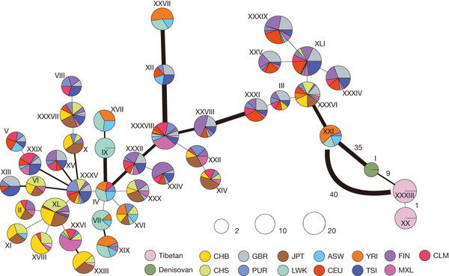
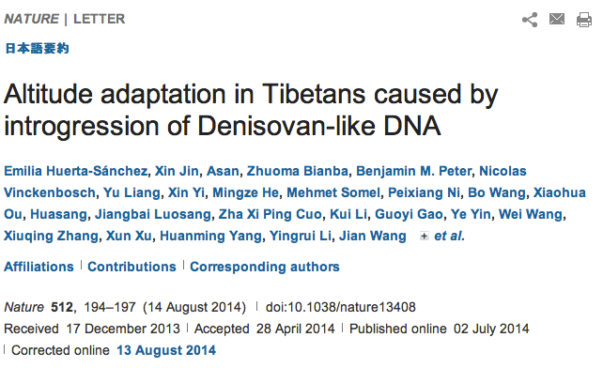
EPAS1

Slide 17
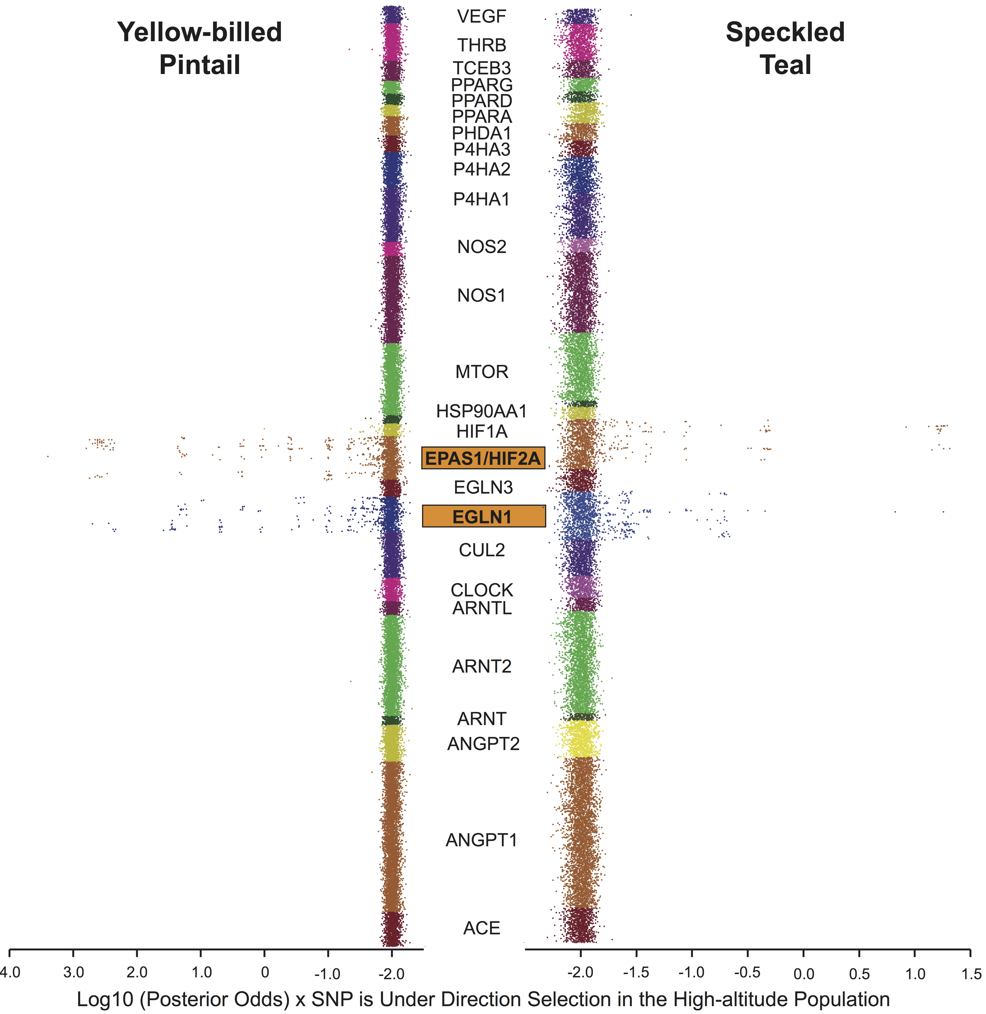
Yellow-billed Pintail has lower average F_{ST} → more power to detect outliers.
Speckled Teal has higher average F_{ST} → slightly less power to detect outliers.
HIF Pathway – 26 Genes by Sequence Capture - Heredity Graham et al. 2021

Slide 18
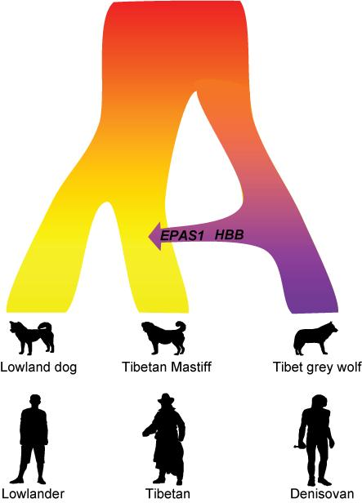

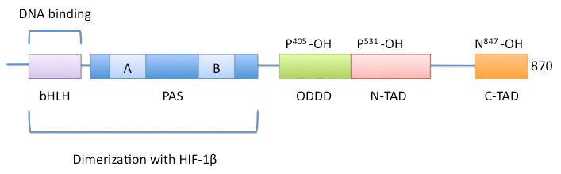
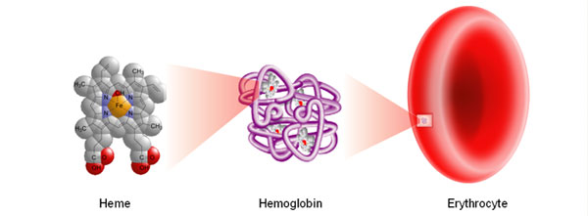
News Release 6-Dec-2016
Tibetan Mastiff gained high altitude adaptation after domestication by wolf interbreeding
Same gene, same mechanism -- interbreeding -- as in humans
https://www.eurekalert.org/news-releases/523086
EPAS1
HBB

Slide 19
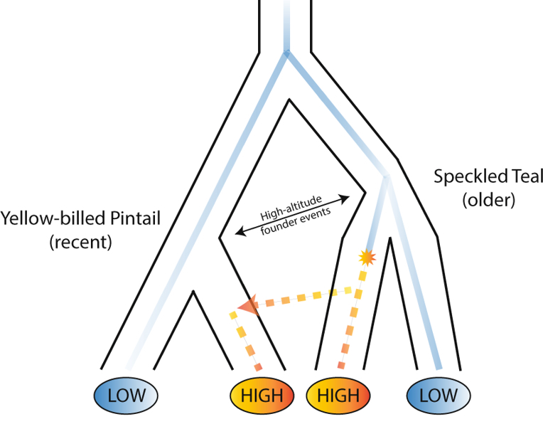
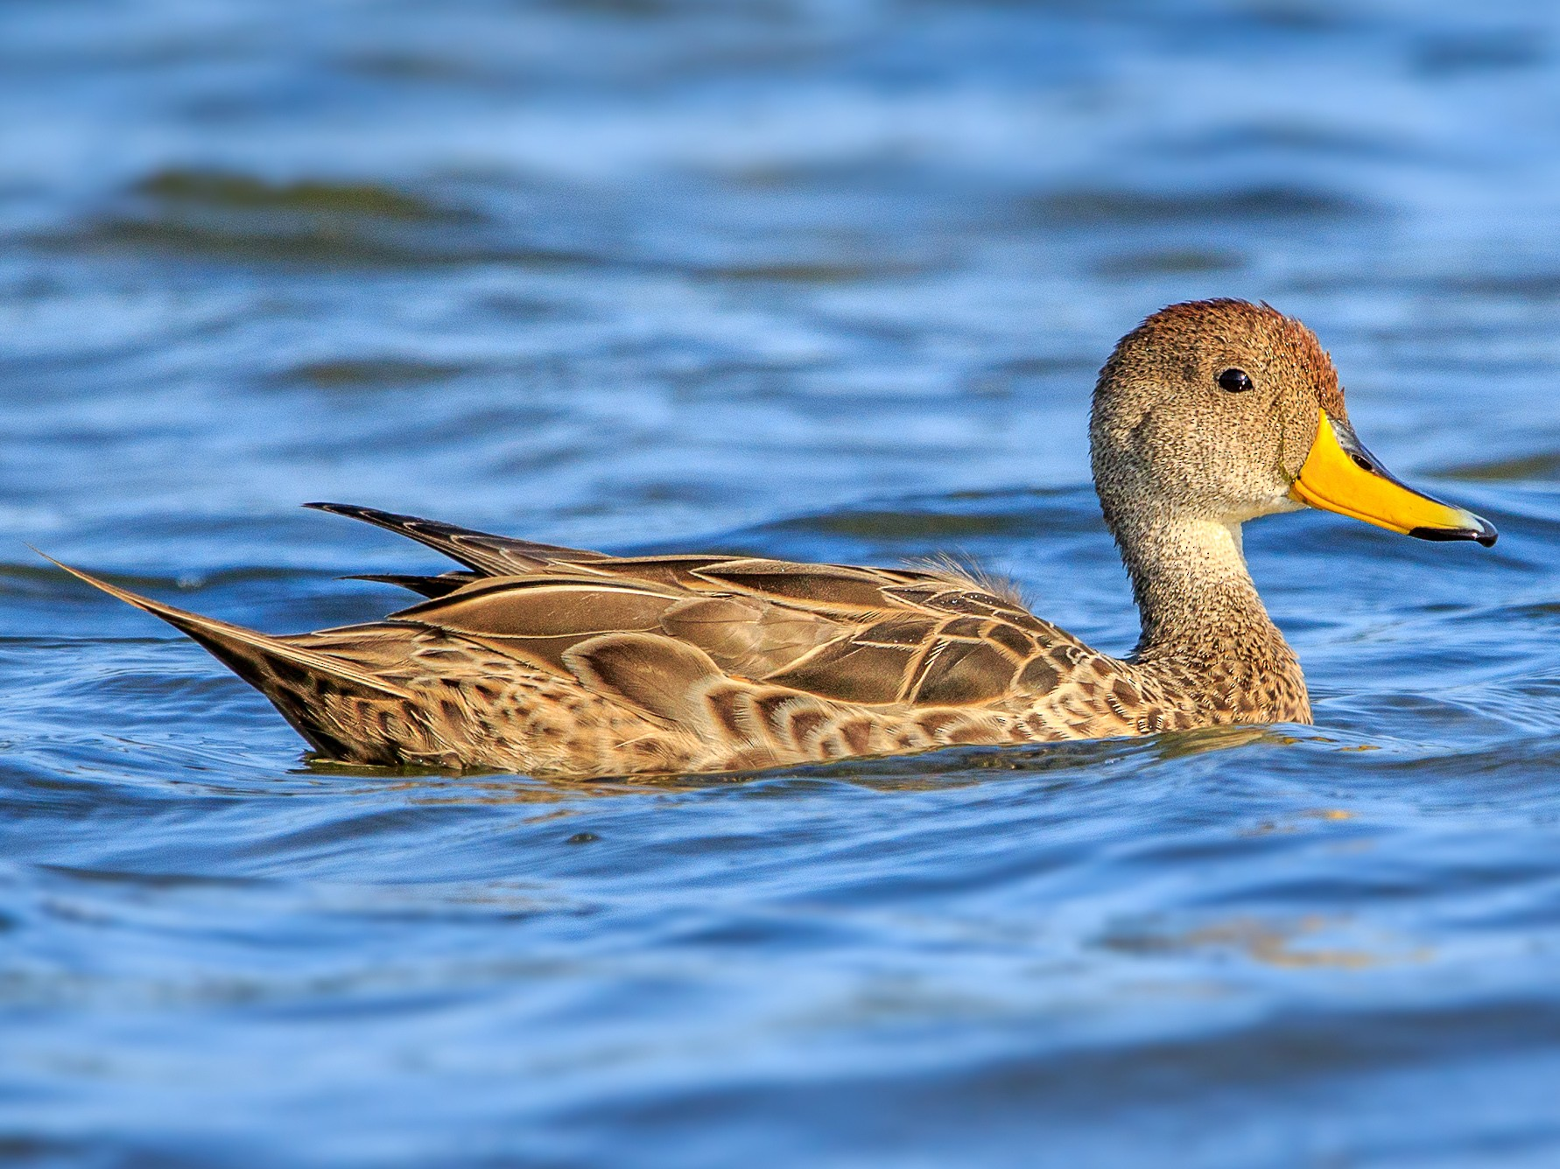
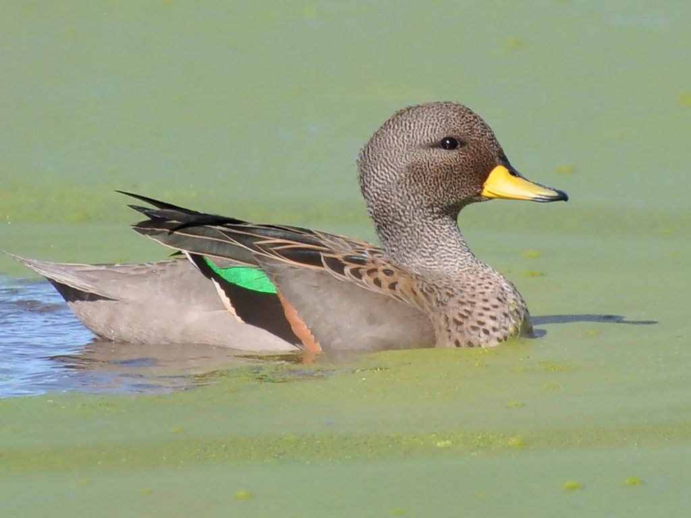

Slide 20
Some Questions
Did EPAS1 also introgress in the ducks?
Tibetan people have significantly lower [Hb] than other highland native people.
Lower [Hb] is correlated with the presence of the Denisovan EPAS1 allele, and Tibetans with the lowest [Hb] perform better at exercise at high altitude.
But how does Hb mass differ?

