Slide 1
Adaptive Introgression
University of Miami
Spring 2025

Slide 2
Adaptive Introgression
Beneficial gene flow between the same or different species
Increases genetic diversity, and introduces genetic variants leading to fitness increase in the recipient population
Surprisingly common
Can lead to faster evolution (than waiting for mutation)
Genomics offers a new perspective

Slide 3
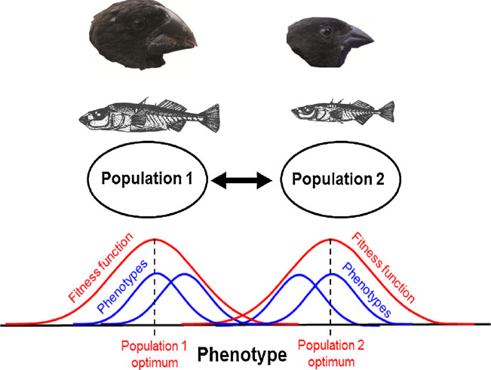
Why do we see these patterns?
Different genotypes/phenotypes are locally adapted to different environments and intermediate phenotypes have reduced fitness (selection against immigrants and hybrids).
Effects of selection are usually locus specific, whereas effects of population demography operate genome-wide.
Some hybrids reproduce and contribute immigrant genes to future generations → gene flow.
Can result in fitness increase

Slide 4
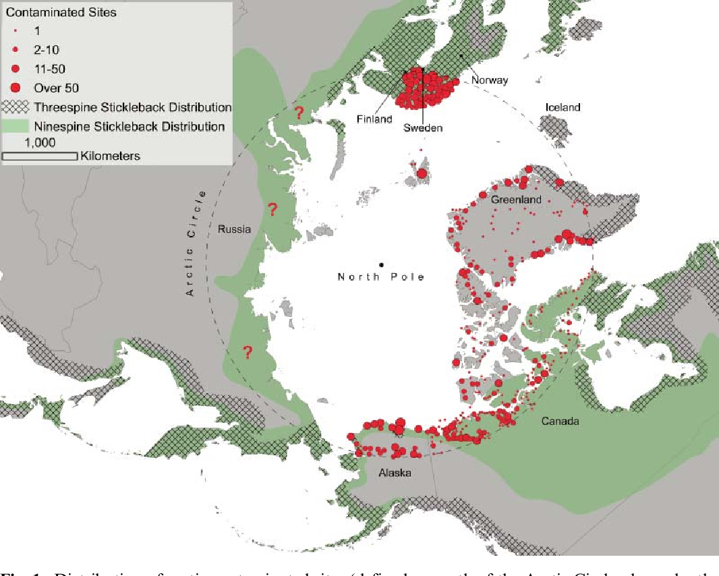
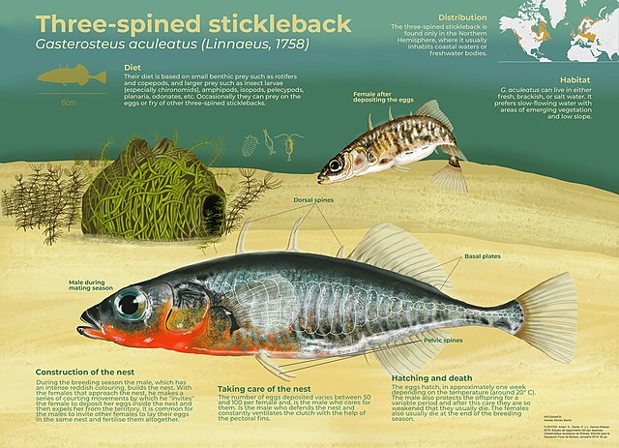
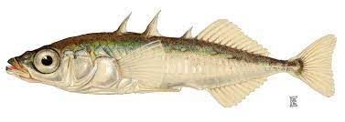
The ninespine stickleback as a model organism in arctic ecotoxicology
F. V. Hippel, E. Trammell,
I. KatsiadakiPublished 1 July 2016 Environmental Science, BiologyEvolutionary Ecology Research

Slide 5
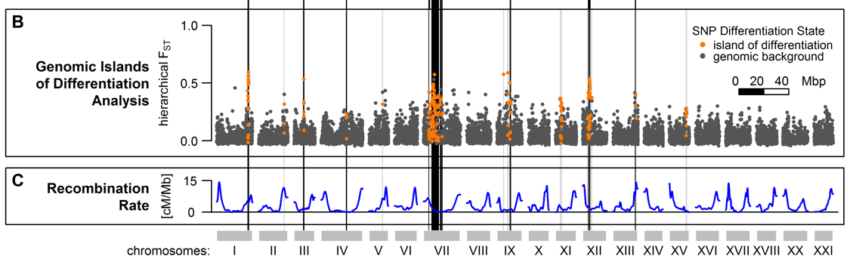
F_{ST} reveals islands of genetic differentiation
Marques, David A., et al. (2016) Genomics of Rapid Incipient Speciation in Sympatric Threespine Stickleback. PLoS Genet 12.2:e1005887.

Slide 6
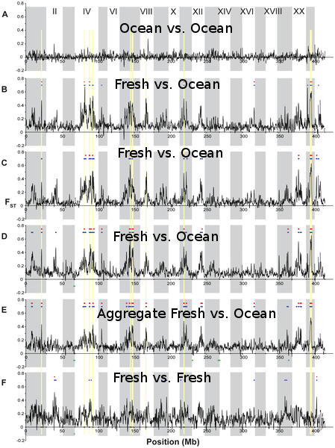
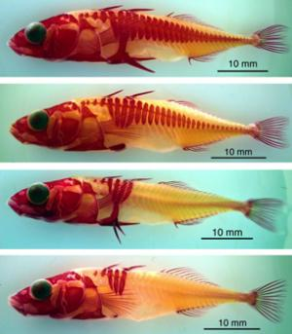
These islands of differentiation correspond to differentially selected loci
Multiple comparisons reveal morphology associated with these types loci has evolved repeatedly in parallel in different freshwater populations.
The ancestral marine population is an import source of this variation (i.e., locally adapted freshwater alleles occur at low frequency there too).
RAD-Seq – developed by Eric Johnson, Bill Cresko, and collaborators at the University of Oregon in 2006 – first method to make genomic scale studies inexpensive and accessible to population geneticists.

Slide 7
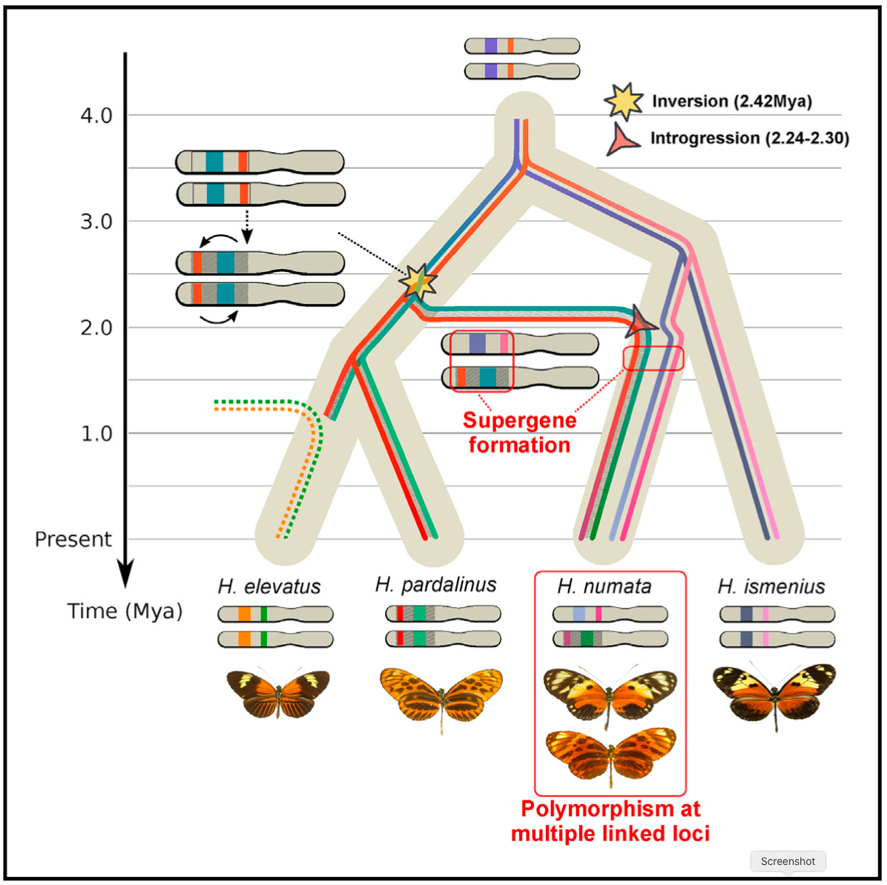
Heliconius Butterfly Wing Patterns
Jay, P., Whibley, A., Frézal, L., de Cara, M.Á.R., Nowell, R.W., Mallet, J., Dasmahapatra, K.K. and Joron, M., 2018. Supergene evolution triggered by the introgression of a chromosomal inversion. Current Biology, 28(11), pp.1839-1845.

Slide 8
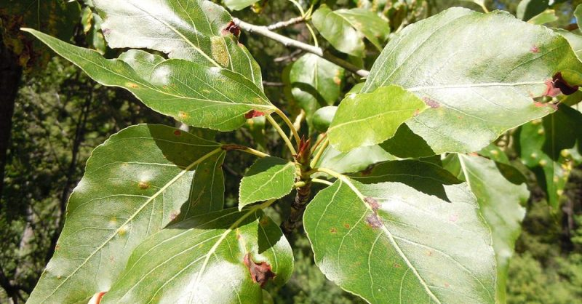
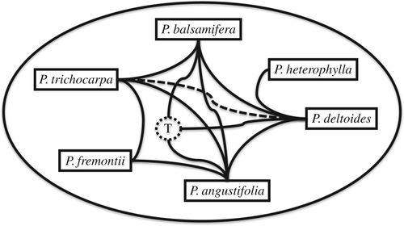
Suarez-Gonzalez, A., Lexer, C., & Cronk, Q. C. (2018). Adaptive introgression: a plant perspective. Biology letters, 14(3), 20170688.
Suarez‐Gonzalez, A., Hefer, C. A., Lexer, C., Douglas, C. J., & Cronk, Q. C. (2018). Introgression from Populus balsamifera underlies adaptively significant variation and range boundaries in P. trichocarpa. New Phytologist, 217(1), 416-427.
Northern range extension of P. trichocarpa [Black Cottonwood] depends, at least in part, on introgression from P. balsamifera (Balsam Poplar).
Admixture with P. balsamifera can lead to potentially maladaptive early phenology, and a reduction in growth and disease resistance in P. trichocarpa.
An introgressed chromosome 9 haplotype block from P. balsamifera restores the late phenology and high growth parental phenotype in admixed P. trichocarpa.
May be strongly advantageous in maximizing carbon assimilation and disease resistance in the southernmost populations where admixture has been detected.

Slide 9
Examples in Humans
HLA from Denisovan & Neanderthal enhanced the immune system (Abi-Rached et al. 2011).
MC1R from Neanderthals, adaptation to sunlight intensity (Ding et al. 2014).
EPAS1 associated with reduced [Hb] in Tibetans inherited from Denisovans (Huerta-Sanchez et al. 2014)
Archaic mtDNA (Bücking et al. 2019).
Numerous examples of maladaptive introgression.

Slide 10
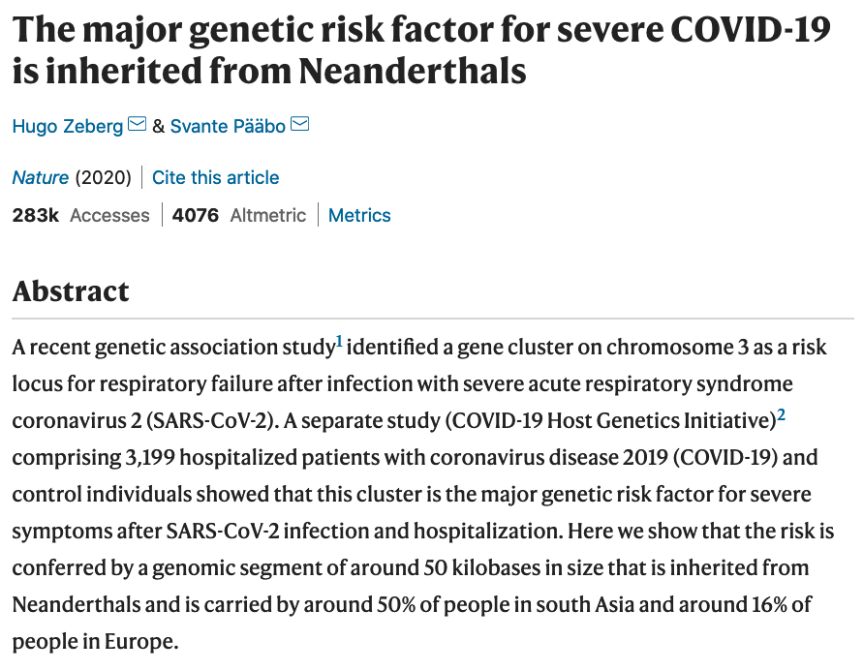
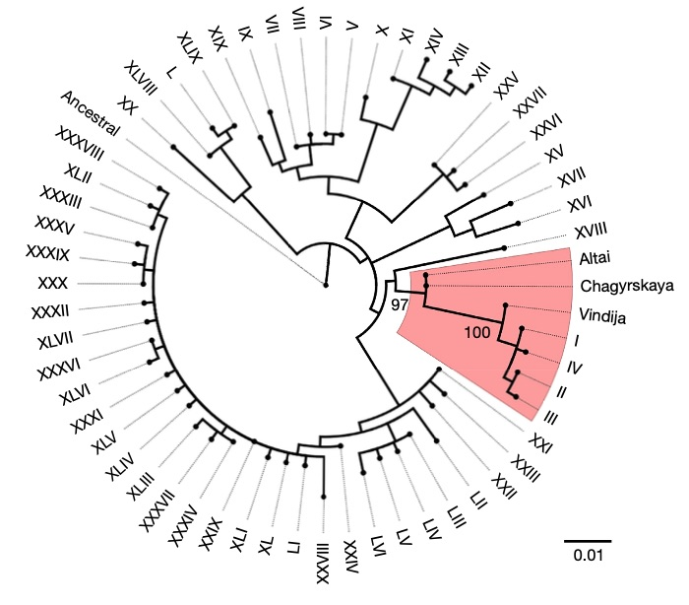
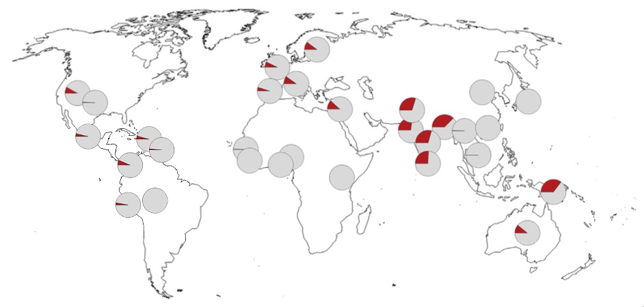
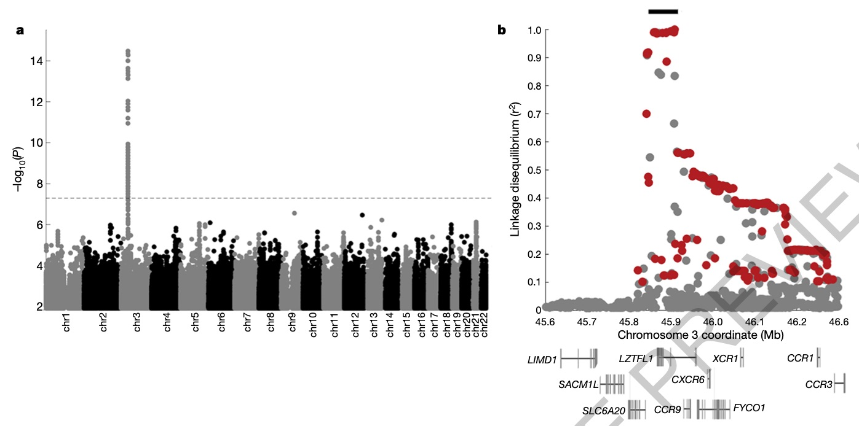

Slide 11
Two genes/clusters of particular interest
Reviewed by: Storz, J. F., & Signore, A. V. (2021). Introgressive hybridization and hypoxia adaptation in high-altitude vertebrates. Frontiers in Genetics 12:696484.
Endothelial PAS domain-containing protein 1 (EPAS1), also known as hypoxia-inducible factor-2alpha HIF-2α
One of the most striking examples of positive selection in humans.
32.7 kb segment in Tibetans introgressed from Denisovans, who inhabited high altitude.
Probably involved selection on standing variation---interestingly, there is no evidence for other AI loci in the Tibetan population.
EPAS1 also introgressed from Tibetan wolf to Tibetan mastiff; this allele appears to have existed prior in a now extinct wolf-like canid.
Hemoglobin subunit beta (beta globin, β-globin, HBB)
β13Gly→Ser and β14Leu→Met introgressed from Tibetan wolf to Tibetan mastiff.
Hbs of Tibetan wolf and Tibetan mastiff have higher intrinsic O₂-affinity relative to the Hbs of low-altitude domestic dogs.
Hbs of Tibetan wolf and Tibetan mastiff also have stronger Bohr effects (i.e., a higher sensitivity to pH) relative to the Hbs of domestic dogs.

Slide 12
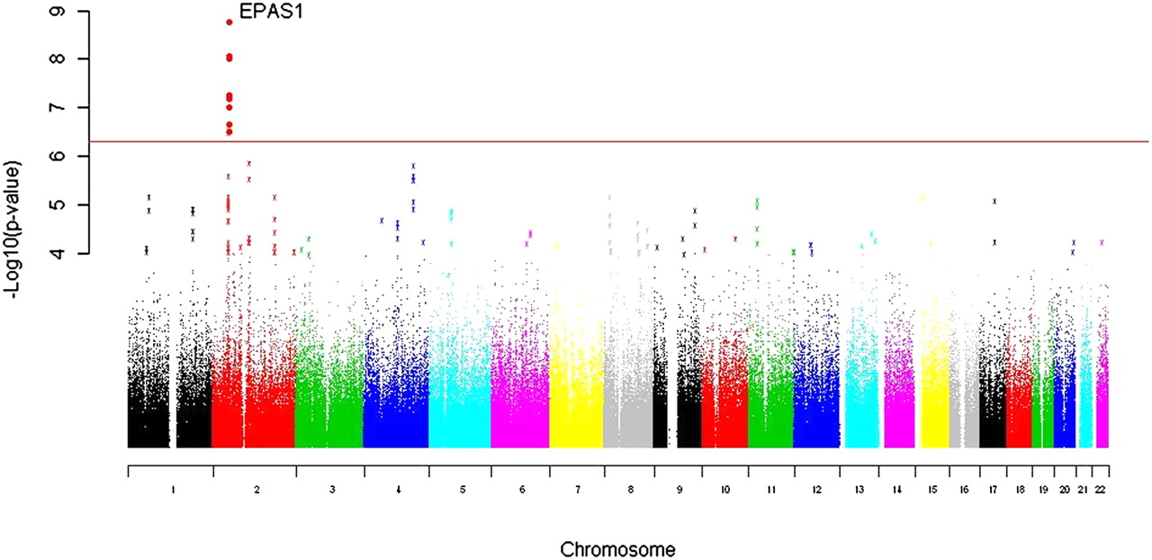
Beall, C.M., Cavalleri, G.L., Deng, L., Elston, R.C., Gao, Y., Knight, J., Li, C., Li, J.C., Liang, Y., McCormack, M. and Montgomery, H.E., 2010. Natural selection on EPAS1 (HIF2α) associated with low hemoglobin concentration in Tibetan highlanders. Proceedings of the National Academy of Sciences, 107(25), pp.11459-11464.

Slide 13
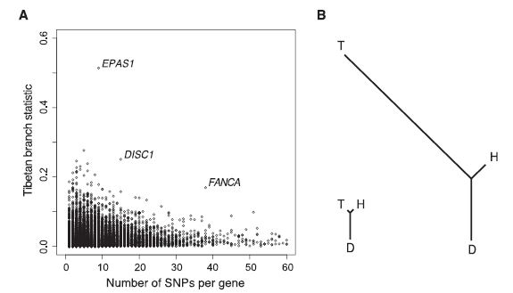
Sequencing of 50 Human Exomes Reveals Adaptation to High Altitude
Yi et al. (2010)
https://bio.davidson.edu/Courses/genomics/2012/McGuire/altitudegene.html

Slide 14
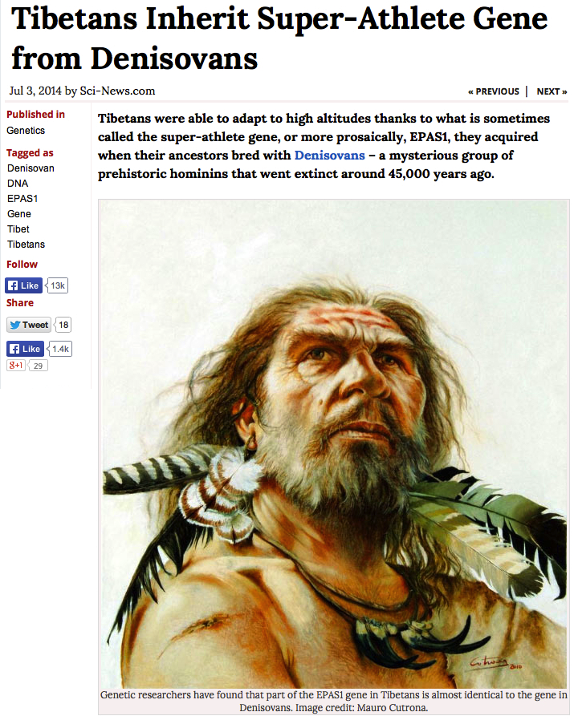
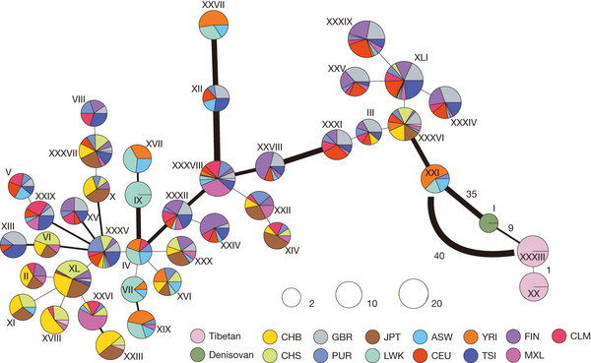
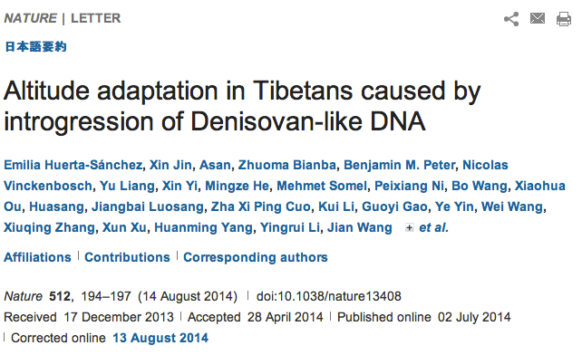
EPAS1

Slide 15
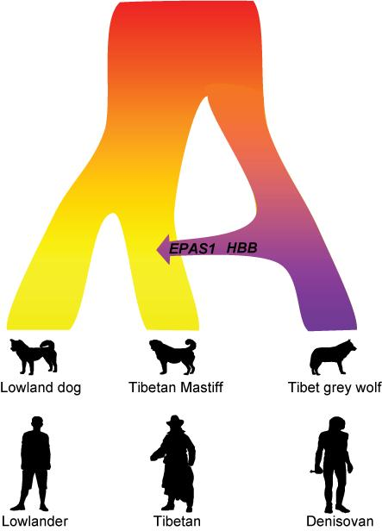

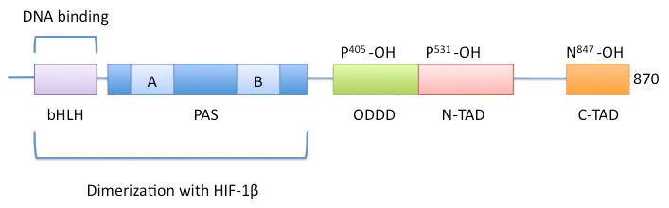
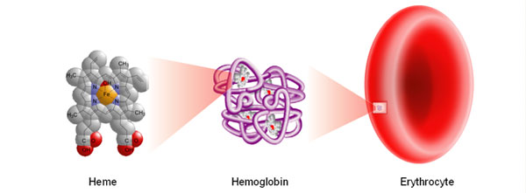
News Release 6-Dec-2016
Tibetan Mastiff gained high altitude adaptation after domestication by wolf interbreeding
Same gene, same mechanism -- interbreeding -- as in humans
https://www.eurekalert.org/news-releases/523086
EPAS1
HBB

Slide 16
Analytical tools
Nucleotide diversity (π)
Site-frequency spectrum (SFS)
ABBA-BABA
Fst within and between species – best done between (1) weakly differentiated populations within species to identify outliers, and (2) between deeply differentiated species to identify introgressed regions that identical by descent (IBD).
Population Branch Statistic (PBS) – Yi et al. 2010
Volcano Finder (Setter et al. 2019)
Linkage disequilibrium (LD) and recombination rate if known can be used to determine when these events occurred.

Slide 17
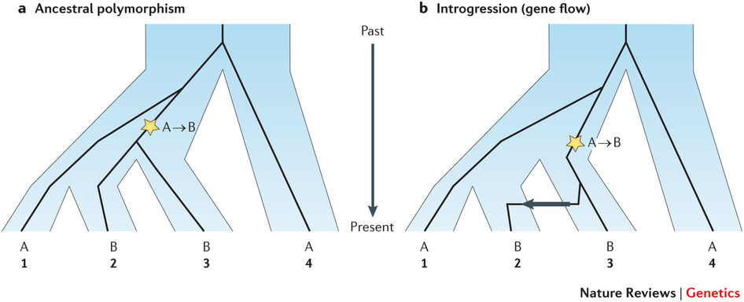
Testing for Hybridization Using Genomic Data
ABBA-BABA Tests
Understanding the origin of species with genome-scale data: modelling gene flow
Vitor Sousa & Jody Hey. Nature Reviews Genetics 14, 404–414 (2013)

Slide 18
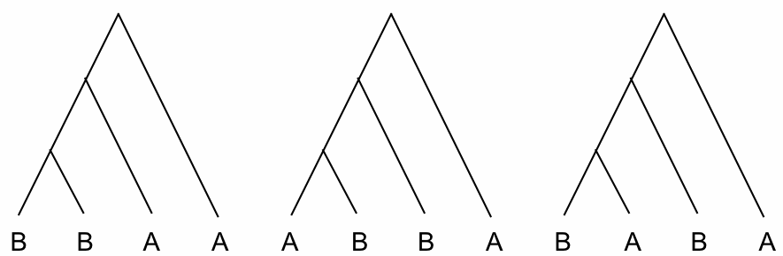
Three possible gene trees for any given bi-allelic SNP
4 populations + outgroup
Alternate lineage sorting patterns
inconsistent with true gene tree
*
*
*
*
No gene flow
No stochastic lineage sorting
True gene tree
If no introgression, ABBA & BABA trees should be equal in frequency (red lines equal different patterns generated by ancestral polymorphism).
If introgression occurred, expect excess of ABBA trees compared to BABA trees or vice versa.
∗ = mutation
A = ancestral state in outgroup

Slide 19
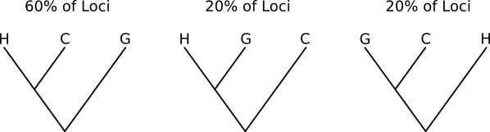
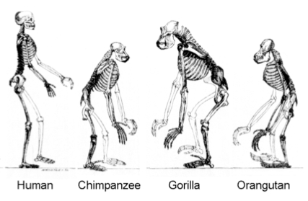
(Human, Chimp), Gorilla
∗∗∗Effects of ancestral polymorphism and ILS are pervasive across the genome∗∗∗

Slide 20
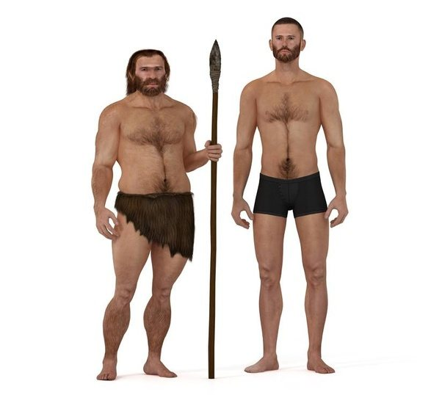
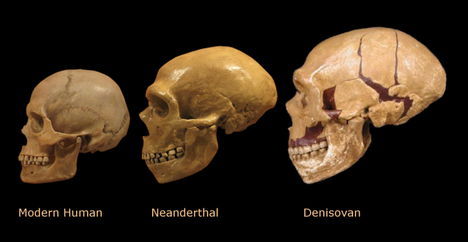
Did modern humans hybridize with Neanderthal people and other ancient humans?

Slide 21
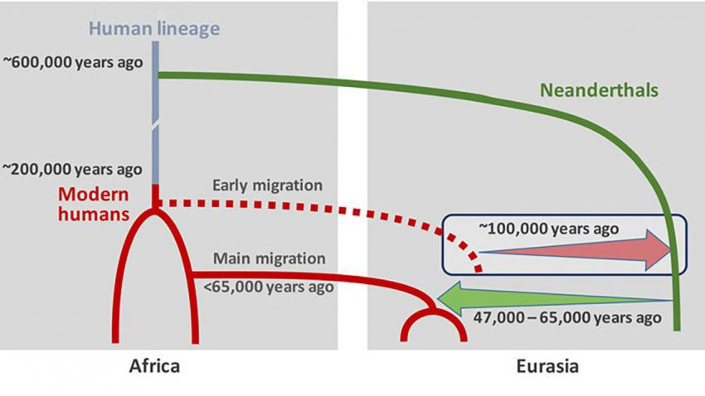
Humans mated with Neandertals much earlier and more frequently than thought. Science By Ann Gibbons, Feb. 17, 2016 , 1:00 PM
~2% of your DNA is perhaps from Neanderthal

Slide 22
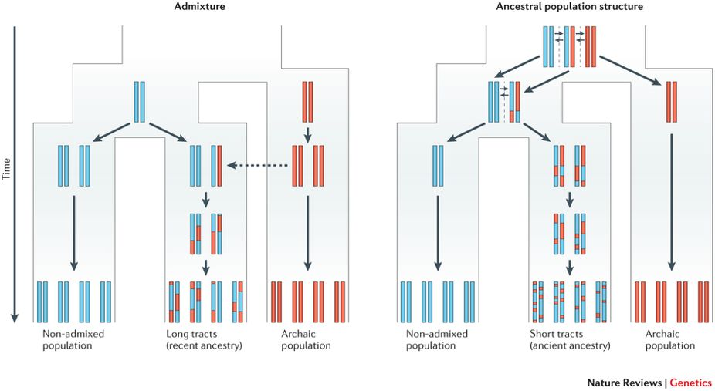
Racimo, F., Sankararaman, S., Nielsen, R., & Huerta-Sánchez, E. (2015). Evidence for archaic adaptive introgression in humans. Nature Reviews Genetics, 16(6), 359.
Because there is less time for recombination to break down the migrant tracts (red) in the admixed population (left), the expected tract length in this case will be longer than in the case of ancestral population structure (right).

Slide 23
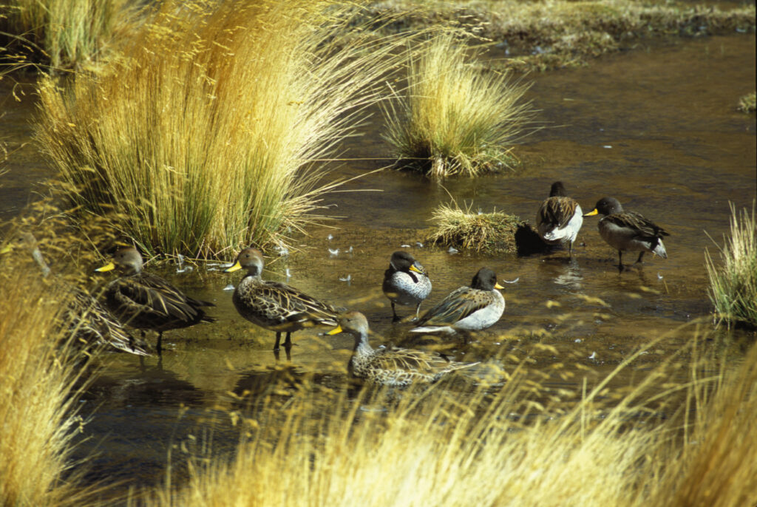
In the previous lecture we learned that…
Yellow-billed Pintail and Speckled Teal have strong F_{ST} outliers in the β-globin
and in the HIF-pathway genes
EPAS1 and EGLN1
Salta, Argentina - 2001

Slide 24
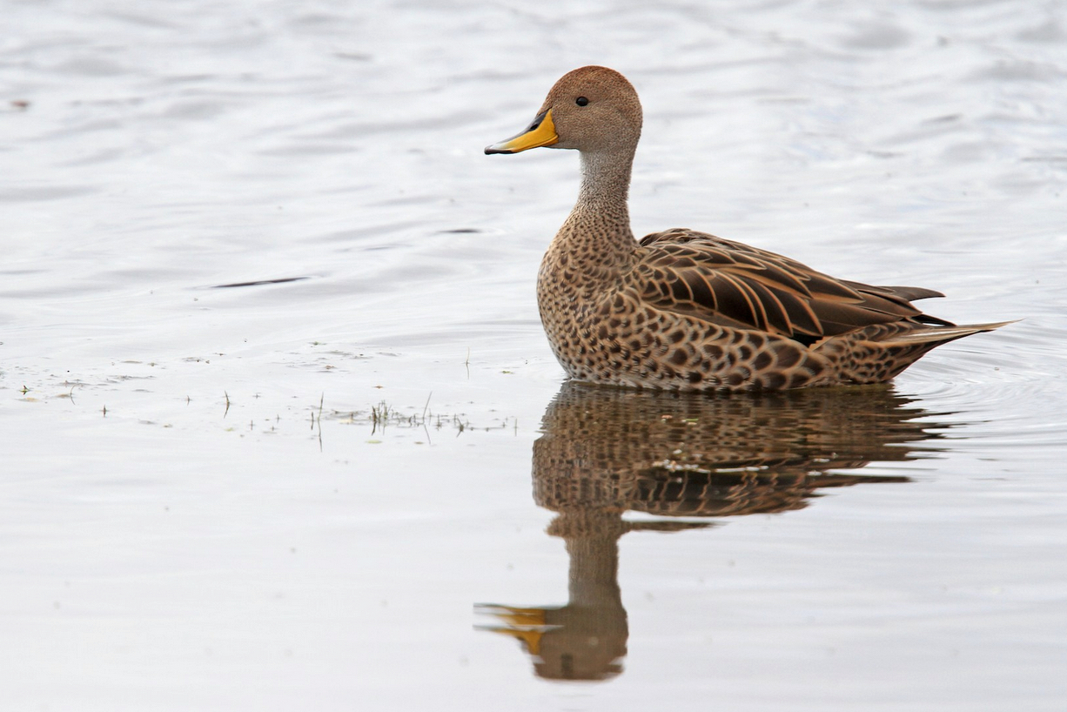
Yellow-billed Pintail – Anas georgica
© Like Seitz 2013 - eBird

Slide 25
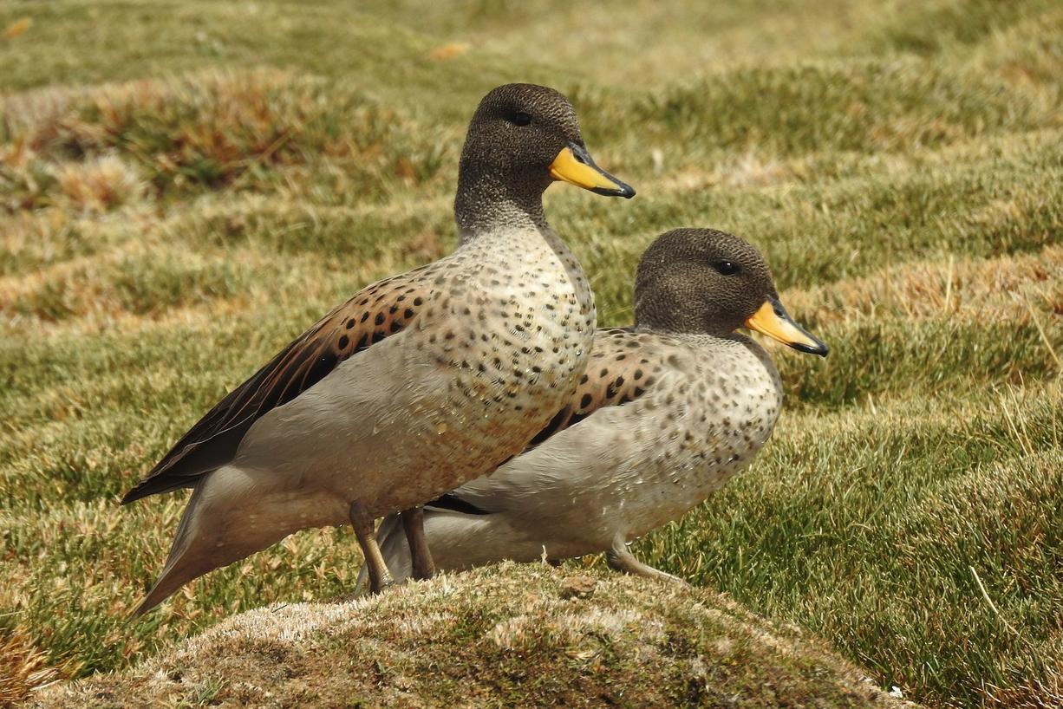
Yellow-billed Teal – Anas flavirostris
© Pablo Gutiérrez Maier 2021 - eBird

Slide 26
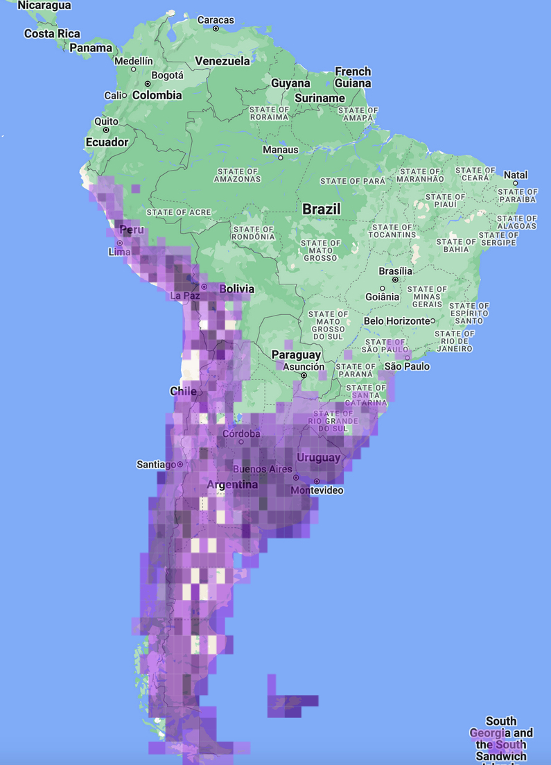
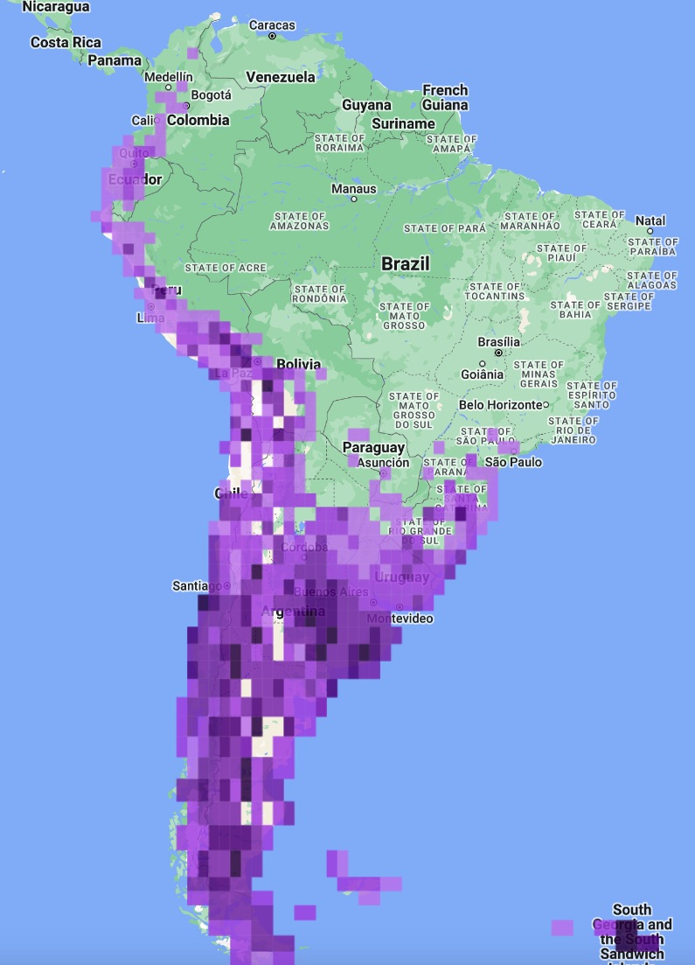

Yellow-billed Teal: N ≈ 1,000,000
Yellow-billed Pintail: N ≈ 100,000-1,000,000

Slide 27
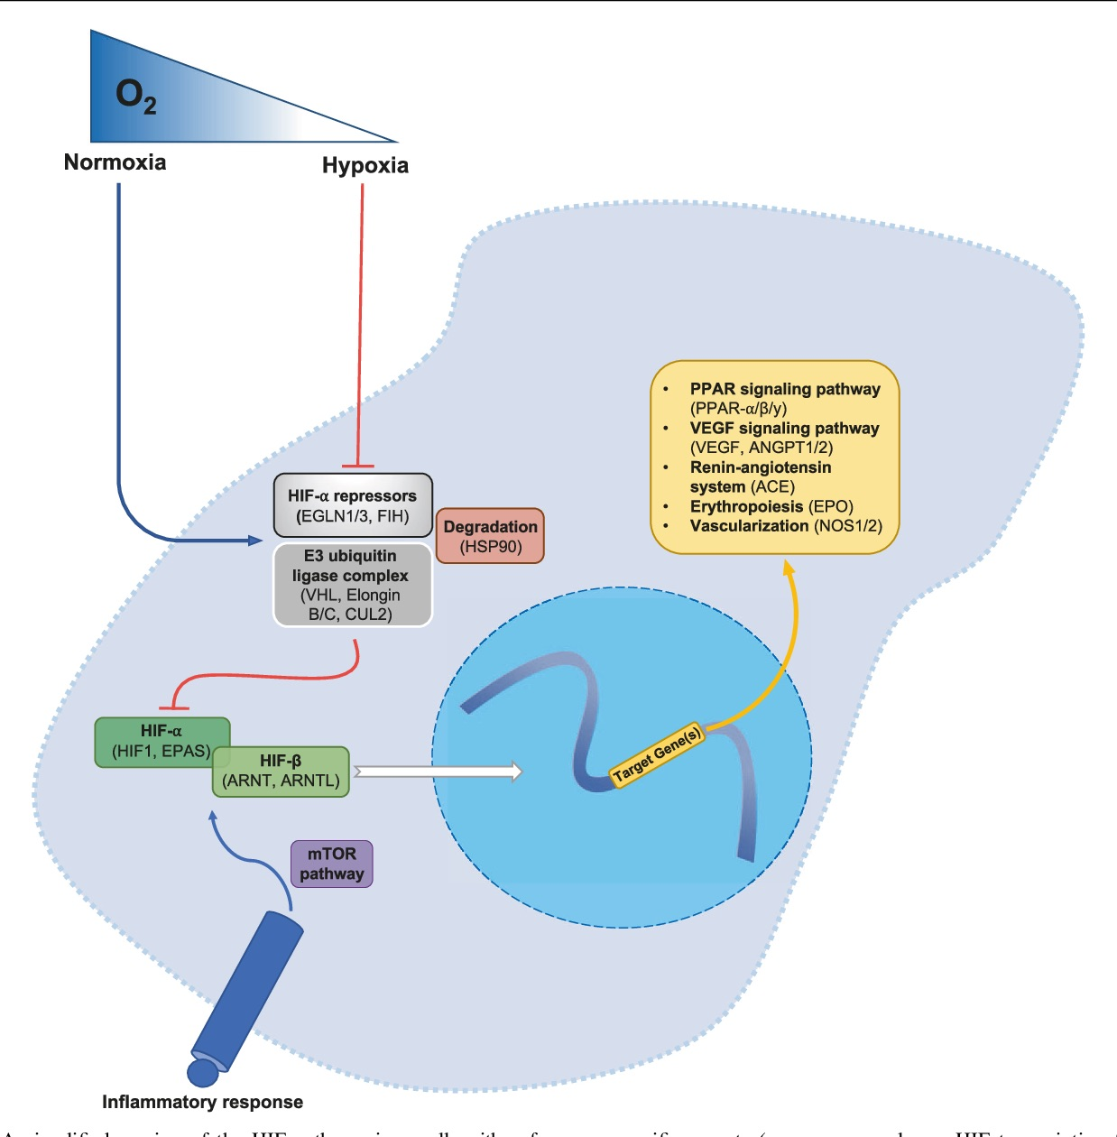
Hypoxia-Inducible Factor Pathway
Graham, A.M. and McCracken, K.G., 2019. Convergent evolution on the hypoxia-inducible factor (HIF) pathway genes EGLN1 and EPAS1 in high-altitude ducks. Heredity 122(6) 819-832.

Slide 28
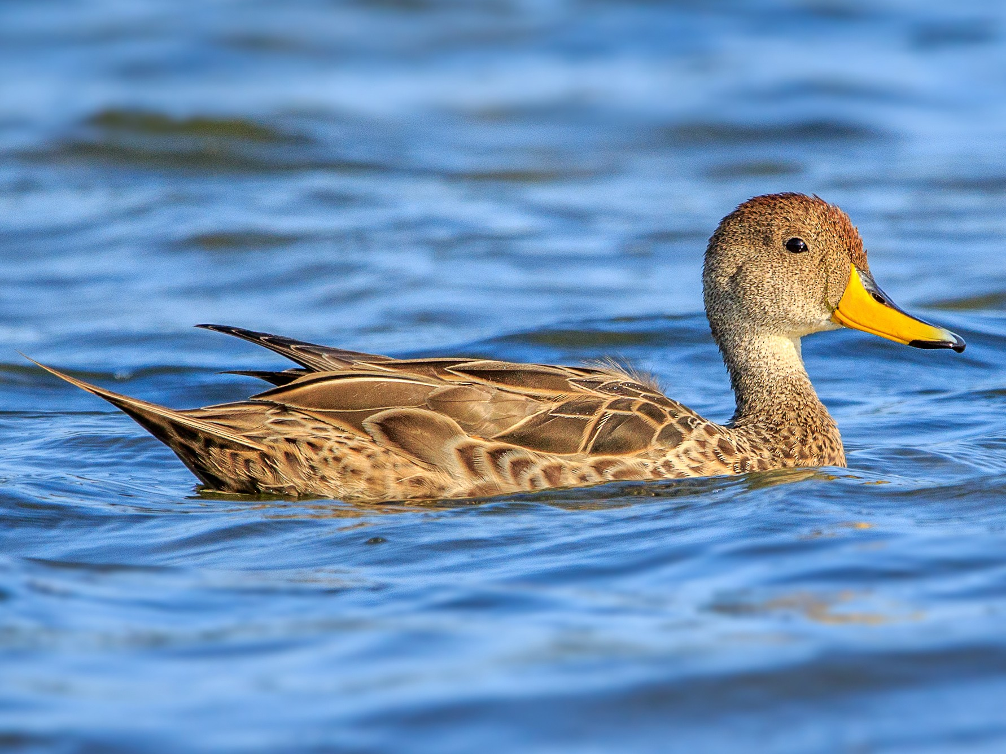
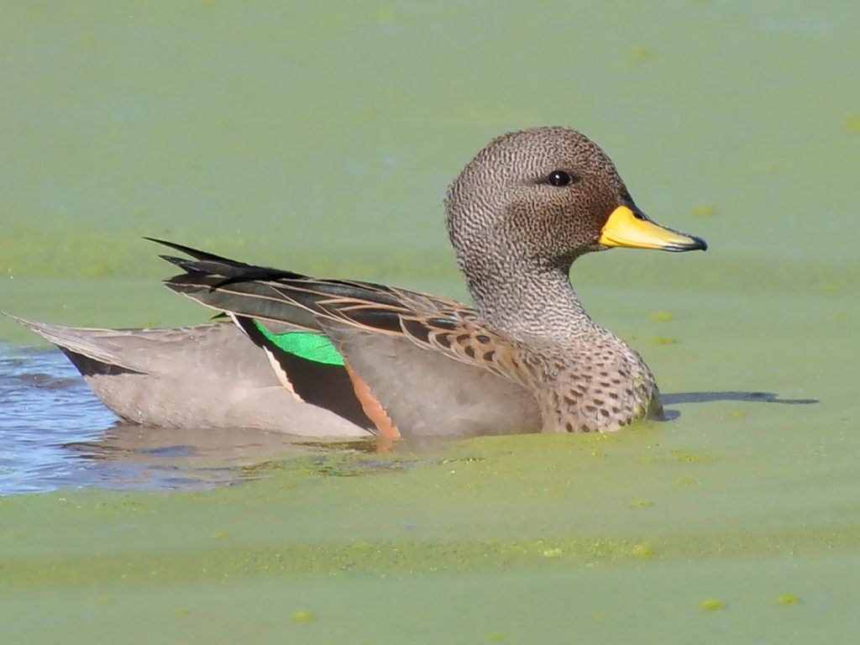
Yellow-billed Pintail
Speckled Teal
Graham, A.M. and McCracken, K.G., 2019. Convergent evolution on the hypoxia-inducible factor (HIF) pathway genes EGLN1 and EPAS1 in high-altitude ducks. Heredity 122(6) 819-832.

Slide 29
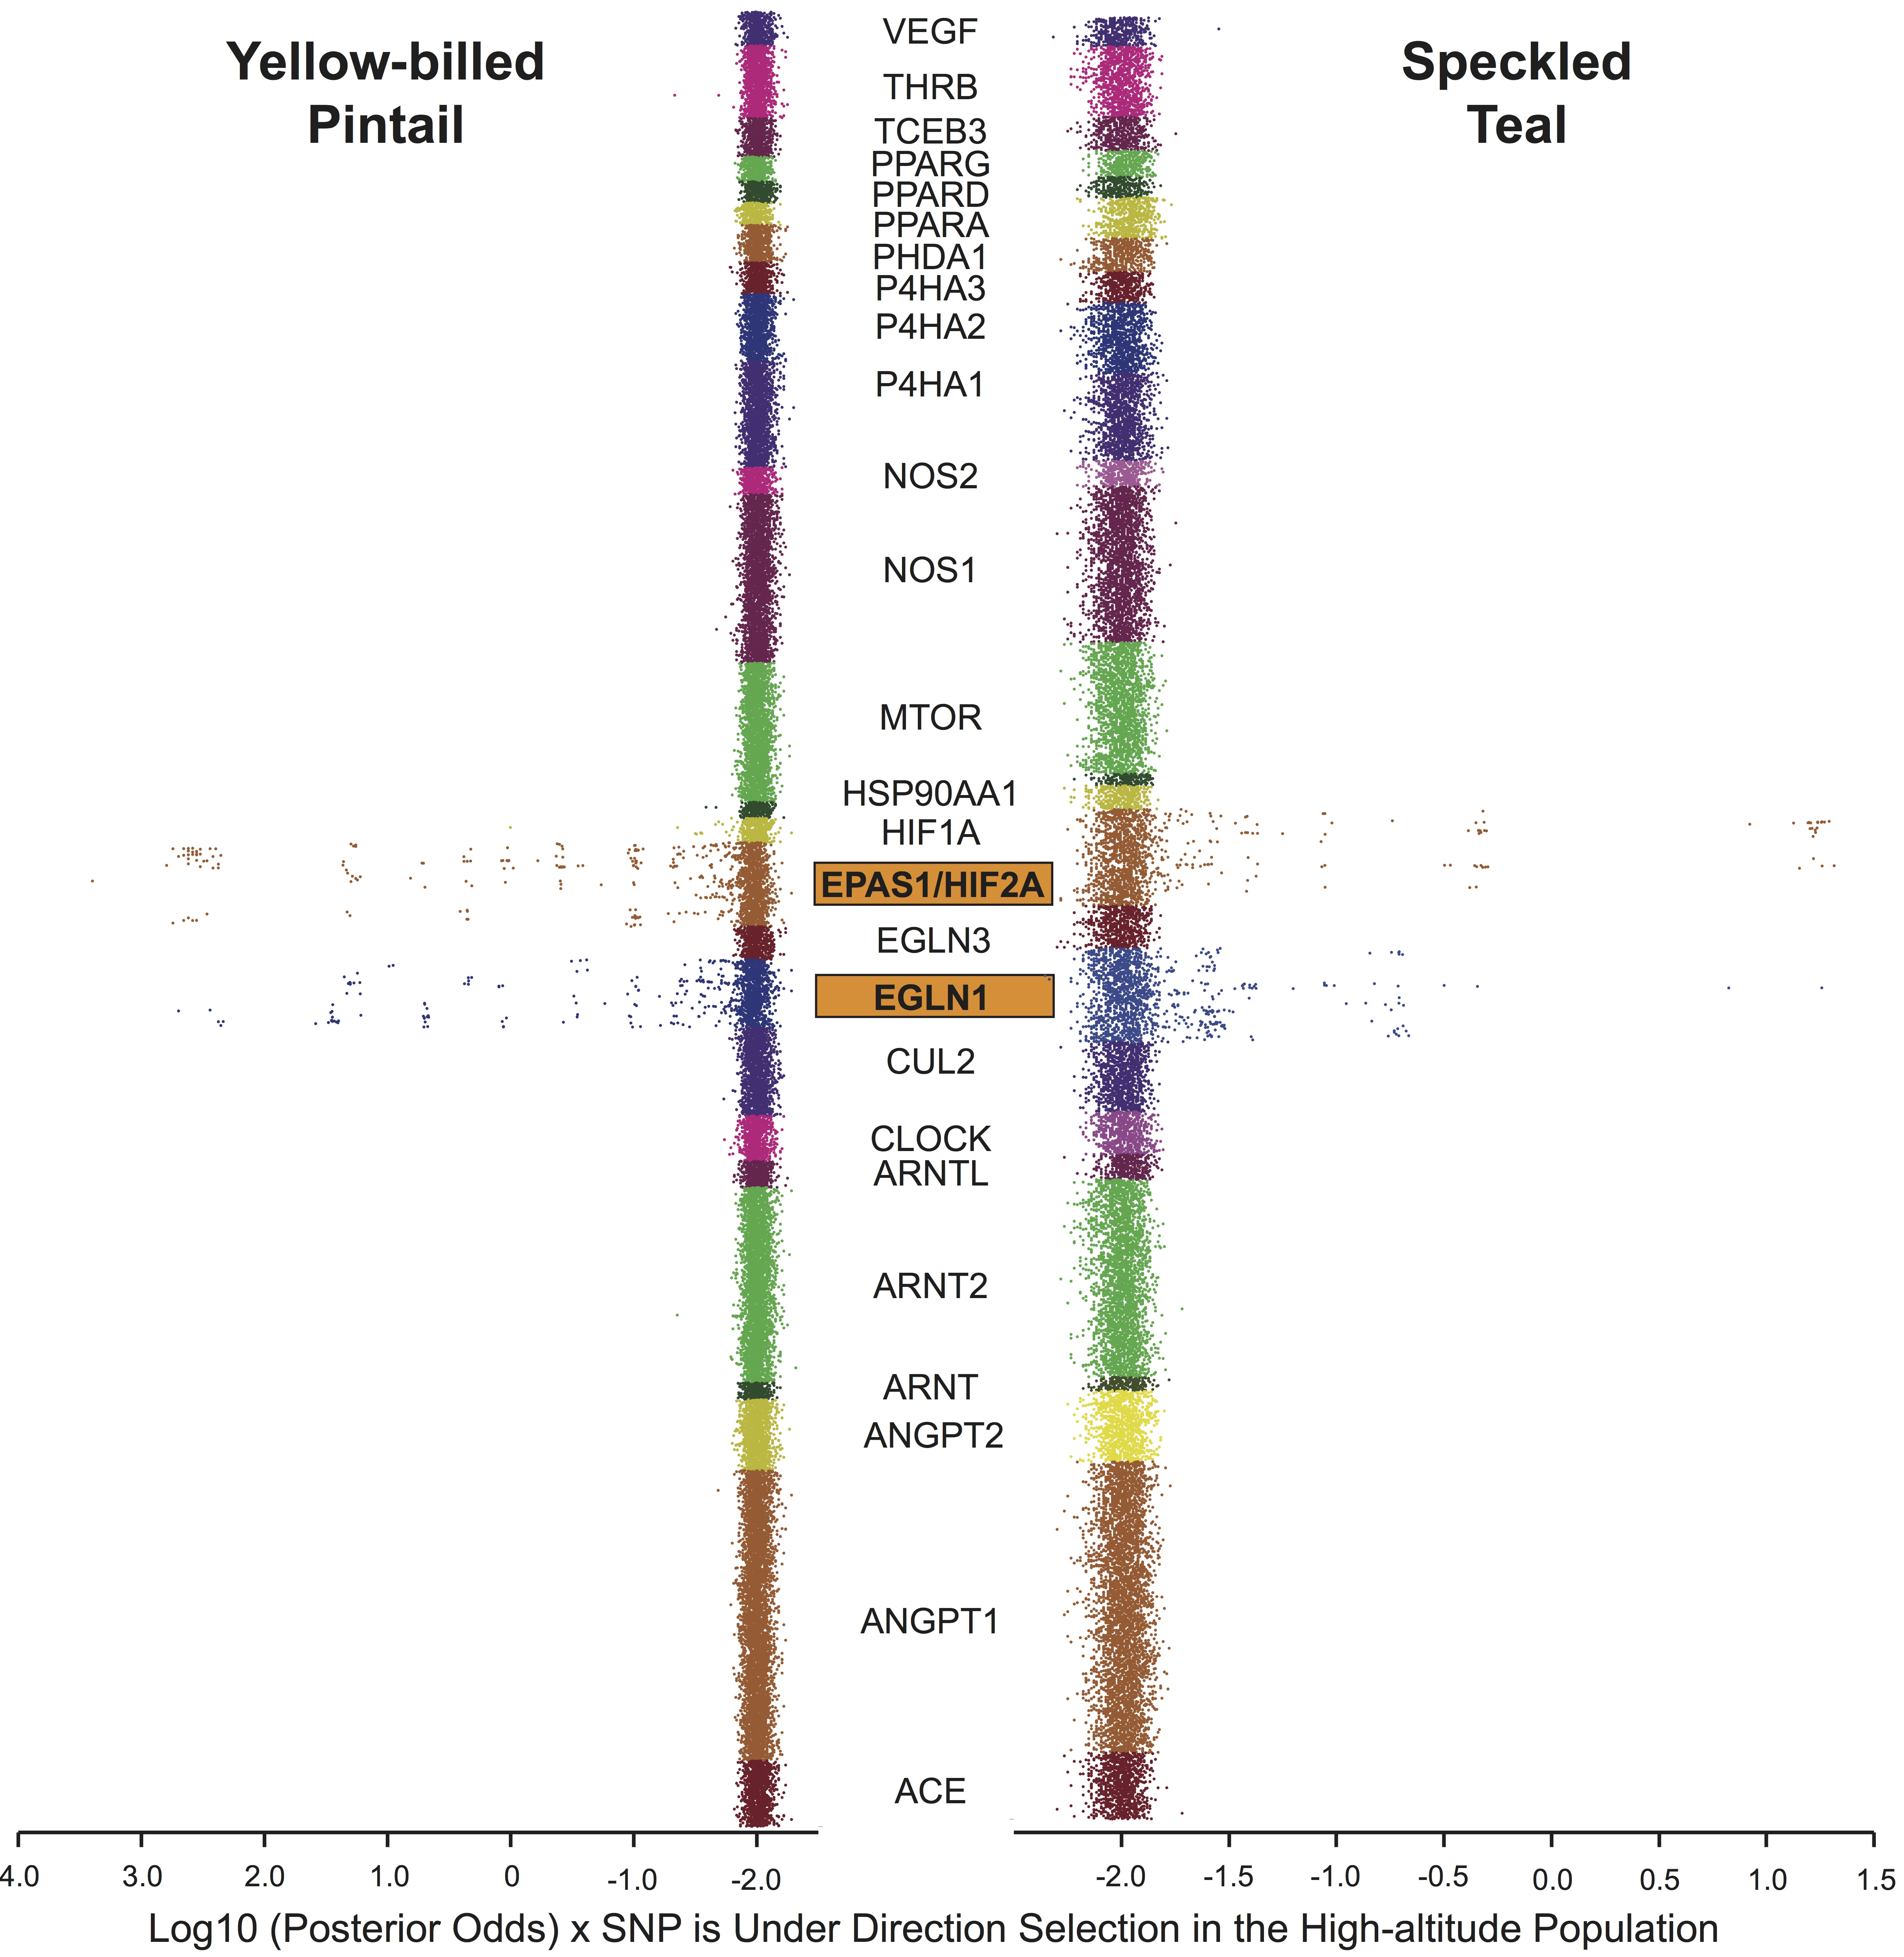
Yellow-billed Pintail has lower average F_{ST} → more power to detect outliers.
Speckled Teal has higher average F_{ST} → slightly less power to detect outliers.
Graham, A.M. and McCracken, K.G., 2019. Convergent evolution on the hypoxia-inducible factor (HIF) pathway genes EGLN1 and EPAS1 in high-altitude ducks. Heredity 122(6) 819-832.

Slide 30
Graham, A.M. and McCracken, K.G., 2019. Convergent evolution on the hypoxia-inducible factor (HIF) pathway genes EGLN1 and EPAS1 in high-altitude ducks. Heredity 122(6) 819-832.

Slide 31
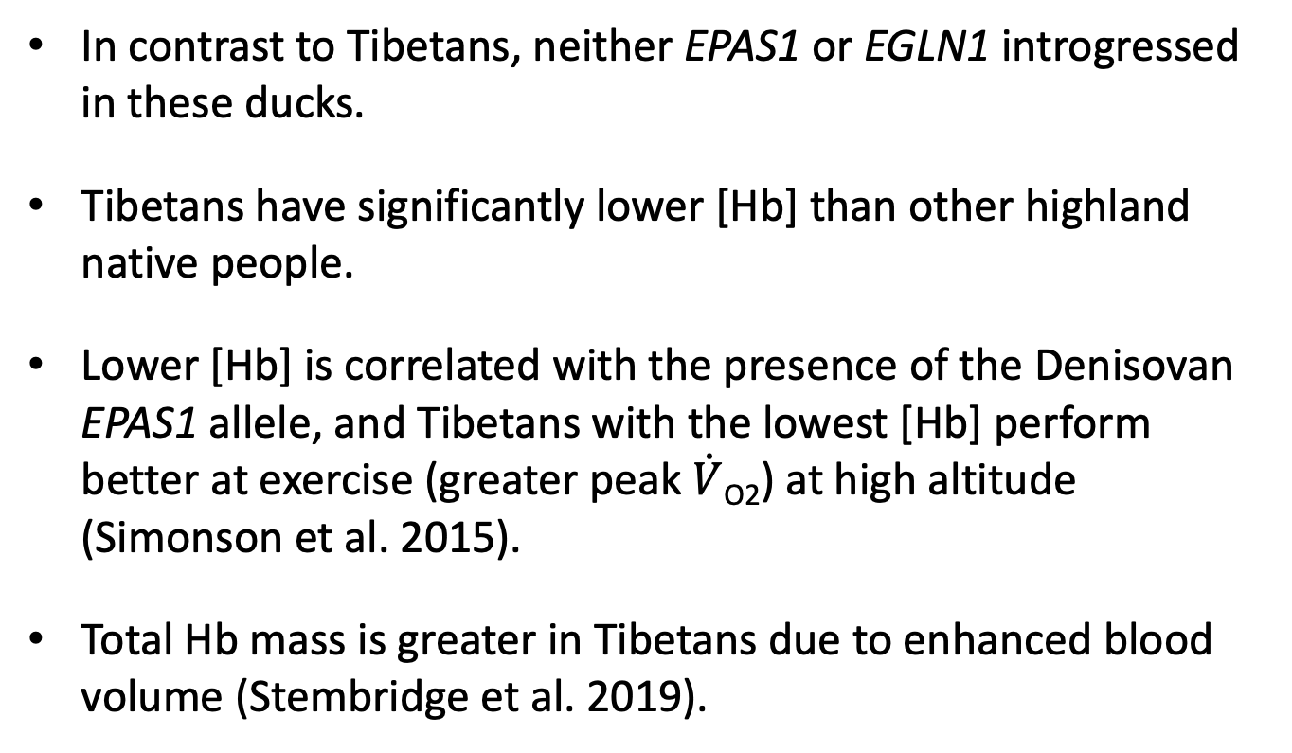
Conclusions HIF Pathway
In contrast to Tibetans, neither EPAS1 or EGLN1 introgressed in these ducks.
Tibetans have significantly lower [Hb] than other highland native people.
Lower [Hb] is correlated with the presence of the Denisovan EPAS1 allele, and Tibetans with the lowest [Hb] perform better at exercise (greater peak $\dot{V}$_{O2}) at high altitude (Simonson et al. 2015).
Total Hb mass is greater in Tibetans due to enhanced blood volume (Stembridge et al. 2019).

Slide 32
Natarajan, C., Projecto-Garcia, J., Moriyama, H., Weber, R.E., Muñoz-Fuentes, V., Green, A.J., Kopuchian, C., Tubaro, P.L., Alza, L., Bulgarella, M. and Smith, M.M., 2015. Convergent evolution of hemoglobin function in high-altitude Andean waterfowl involves limited parallelism at the molecular sequence level. PLoS Genetics 11(12) e1005681.

Slide 33
2 AAs with very high F_{ST} convergent on the 3’ end of the β^{A} chain
4 AAs with high F_{ST} convergent on the β^{ε} chain
1 AA with low-mod F_{ST} convergent on 5’ end of the β^{A} chain
Graham, A.M., Peters, J.L., Wilson, R.E., Muñoz-Fuentes, V., Green, A.J., Dorfsman, D.A., Valqui, T.H., Winker, K. and McCracken, K.G., 2021. Adaptive introgression of the beta-globin cluster in two Andean waterfowl. Heredity 127(1) 107-123.

Slide 34
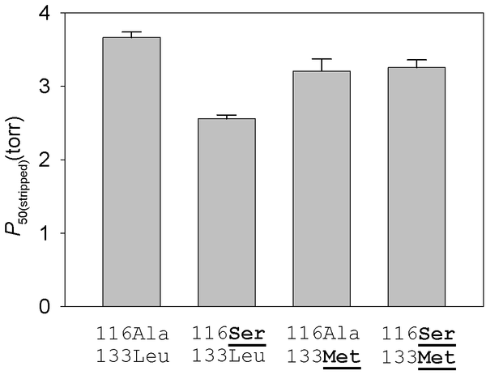
Natarajan, C., Projecto-Garcia, J., Moriyama, H., Weber, R.E., Muñoz-Fuentes, V., Green, A.J., Kopuchian, C., Tubaro, P.L., Alza, L., Bulgarella, M. and Smith, M.M., 2015. Convergent evolution of hemoglobin function in high-altitude Andean waterfowl involves limited parallelism at the molecular sequence level. PLoS Genetics 11(12) e1005681.

Slide 35
Graham, A.M., Peters, J.L., Wilson, R.E., Muñoz-Fuentes, V., Green, A.J., Dorfsman, D.A., Valqui, T.H., Winker, K. and McCracken, K.G., 2021. Adaptive introgression of the beta-globin cluster in two Andean waterfowl. Heredity 127(1) 107-123.

Slide 36
F_{ST} reveals islands of genetic differentiation
Since we are comparing different species, comparing F_{ST} between species also can be very useful.
Marques, David A., et al. (2016) Genomics of rapid incipient speciation in sympatric threespine stickleback. PLoS Genetics 12.2:e1005887.

Slide 37
Graham, A.M., Peters, J.L., Wilson, R.E., Muñoz-Fuentes, V., Green, A.J., Dorfsman, D.A., Valqui, T.H., Winker, K. and McCracken, K.G., 2021. Adaptive introgression of the beta-globin cluster in two Andean waterfowl. Heredity 127(1) 107-123.

Slide 38
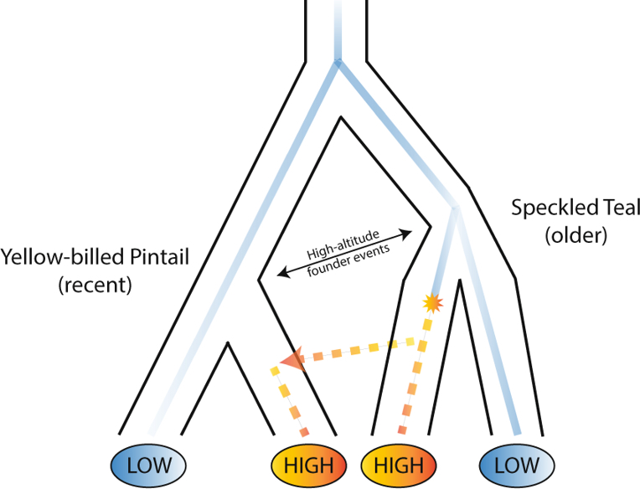
Graham, A.M., Peters, J.L., Wilson, R.E., Muñoz-Fuentes, V., Green, A.J., Dorfsman, D.A., Valqui, T.H., Winker, K. and McCracken, K.G., 2021. Adaptive introgression of the beta-globin cluster in two Andean waterfowl. Heredity 127(1) 107-123.

Slide 39
LD decay is consistent with old selective sweep on speckled teal and much more recent selective sweep on pintail, therefore more LD.

Slide 40
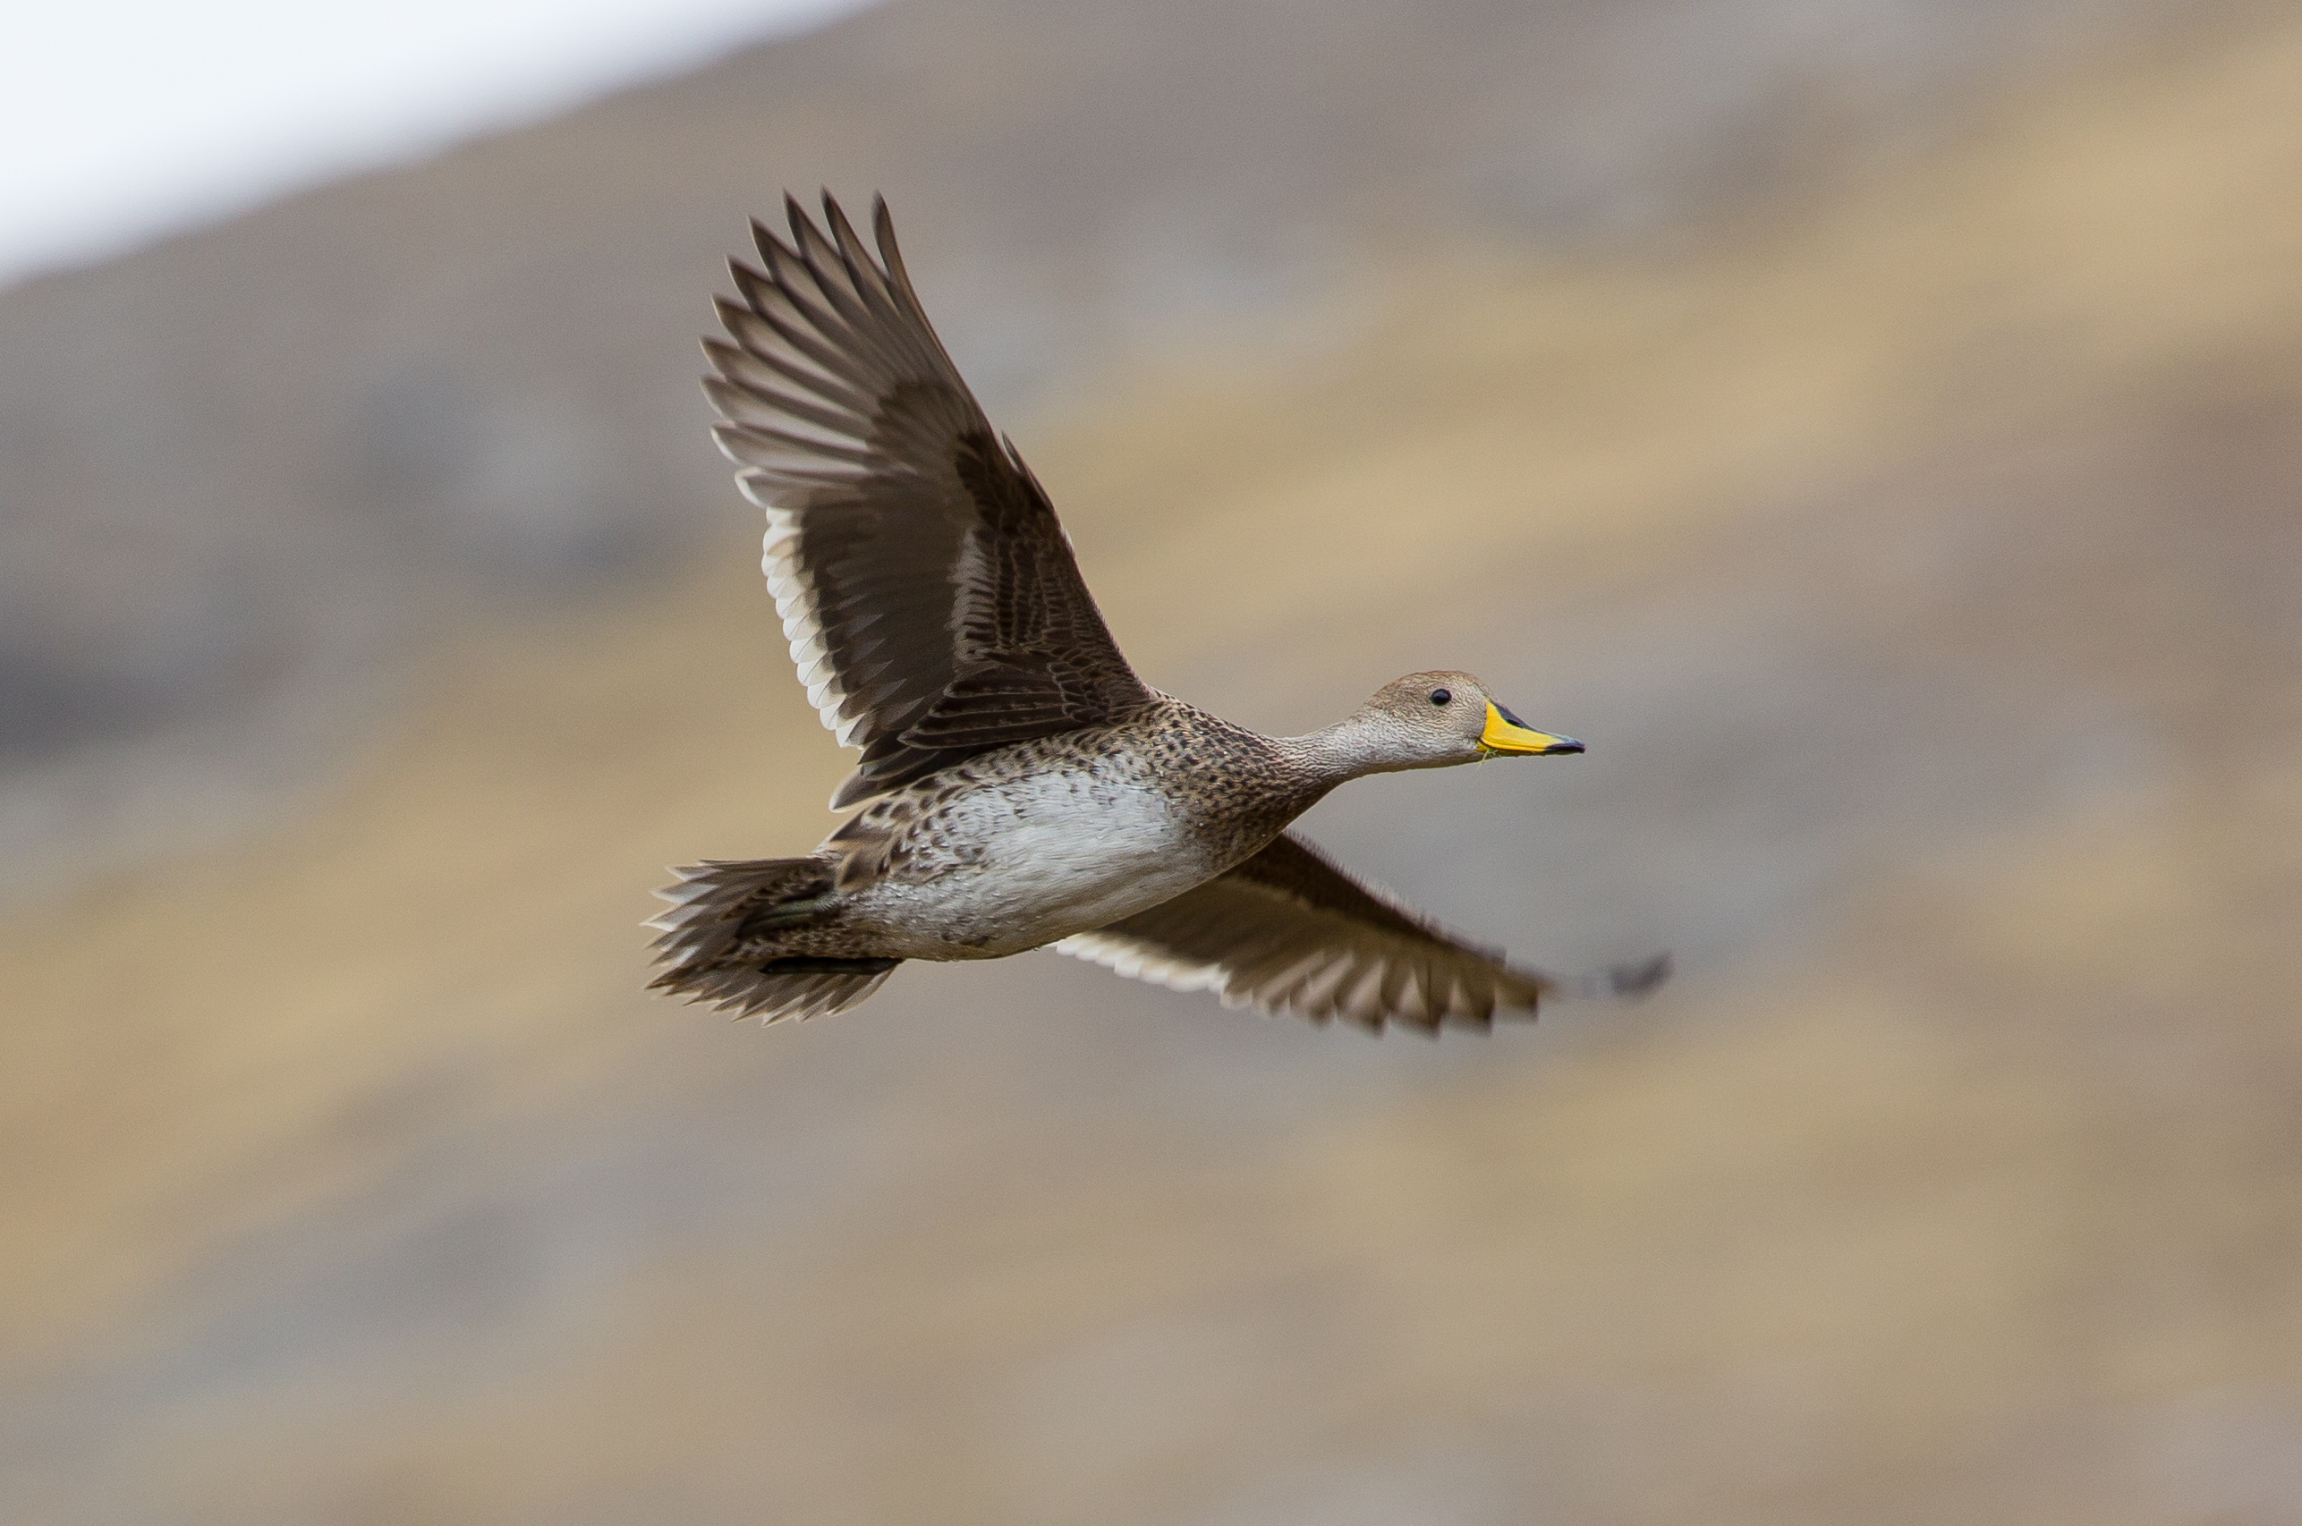
Yellow-billed Pintail
© Bruce Moffat 2014
McCracken, K.G., Bulgarella, M., Johnson, K.P., Kuhner, M.K., Trucco, J., Valqui, T.H., Wilson, R.E. and Peters, J.L., 2009. Gene flow in the face of countervailing selection: adaptation to high-altitude hypoxia in the βA hemoglobin subunit of yellow-billed pintails in the Andes. Molecular Biology and Evolution, 26(4), pp.815-827.

Slide 41
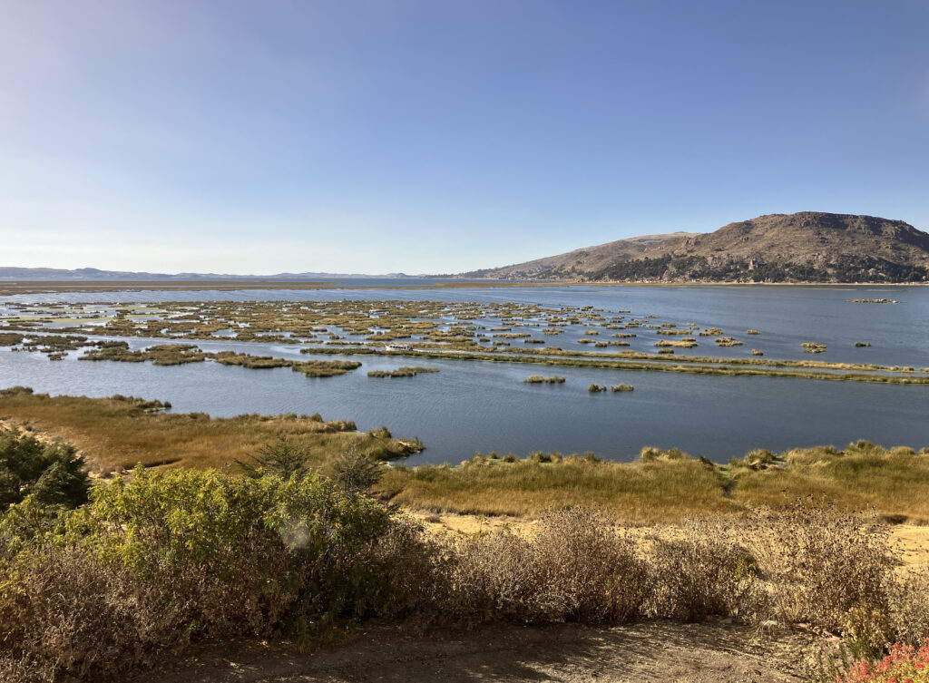
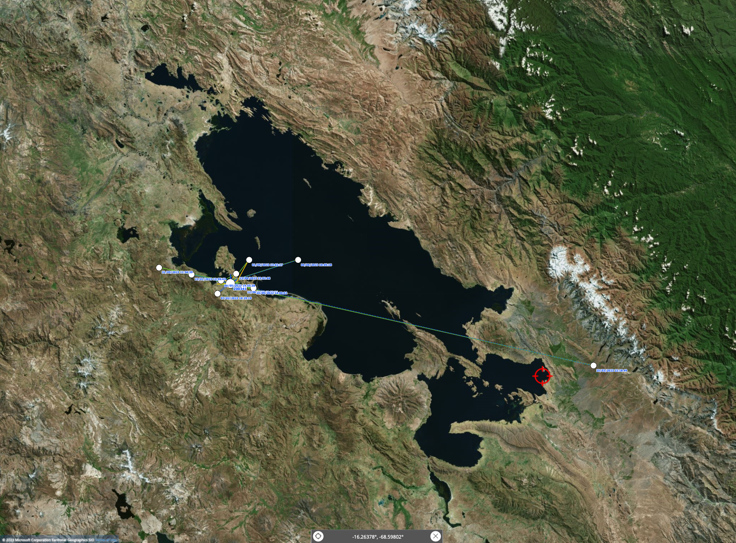
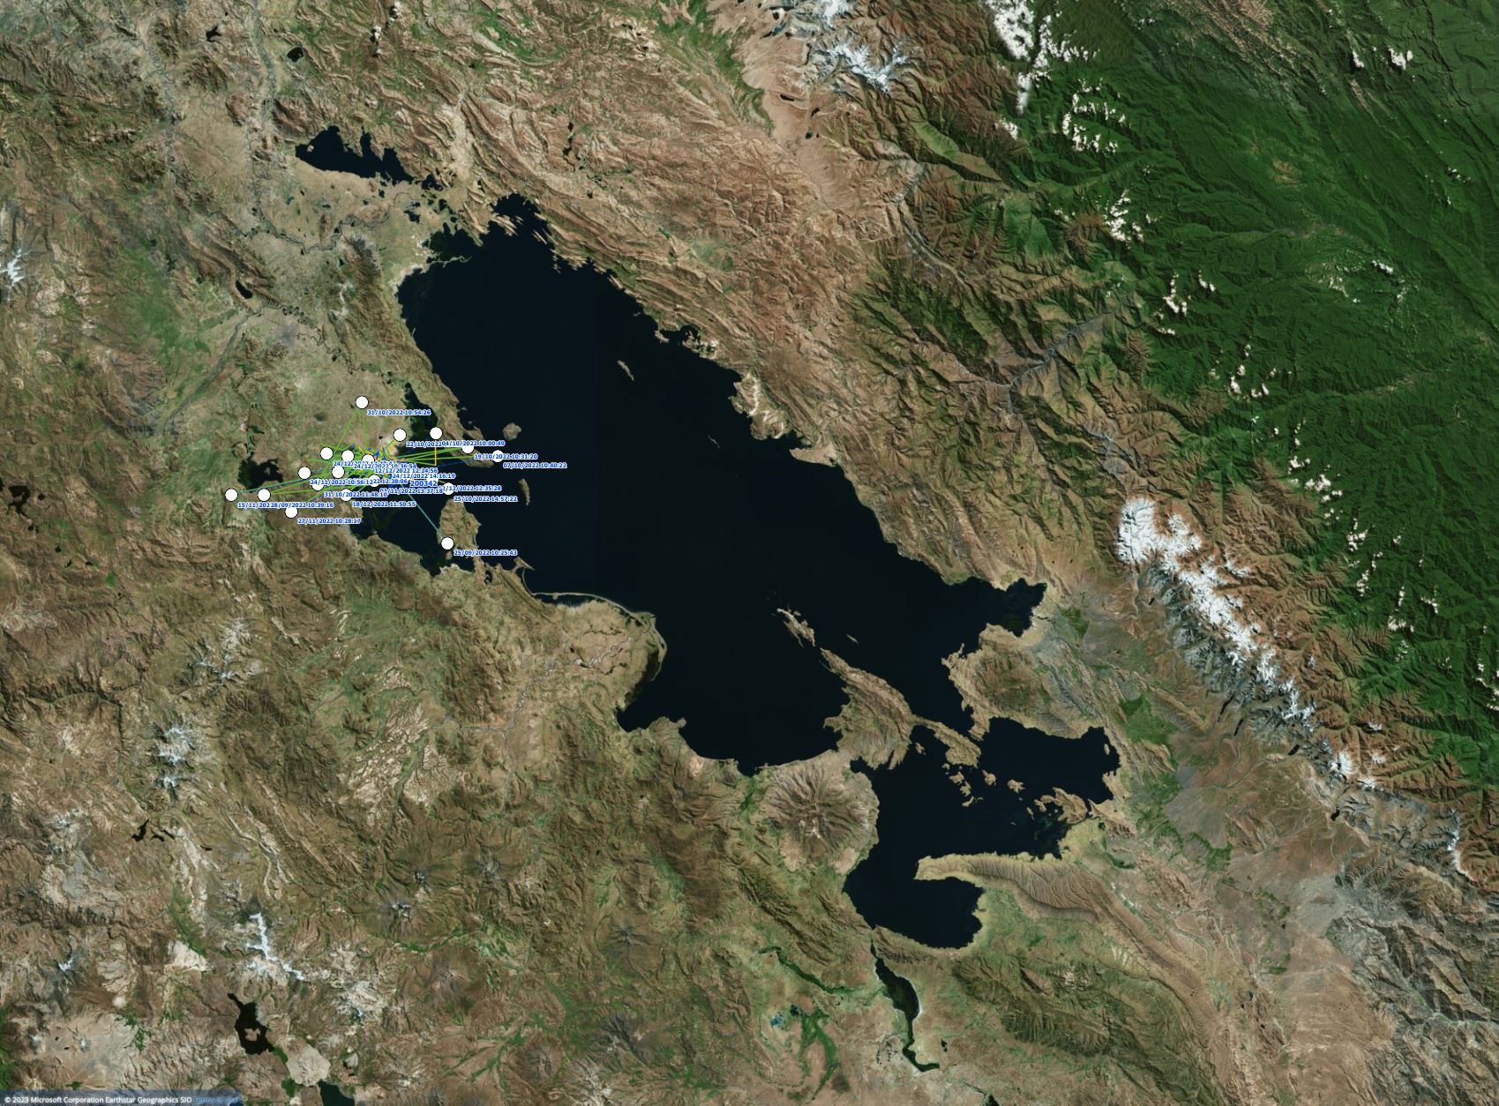
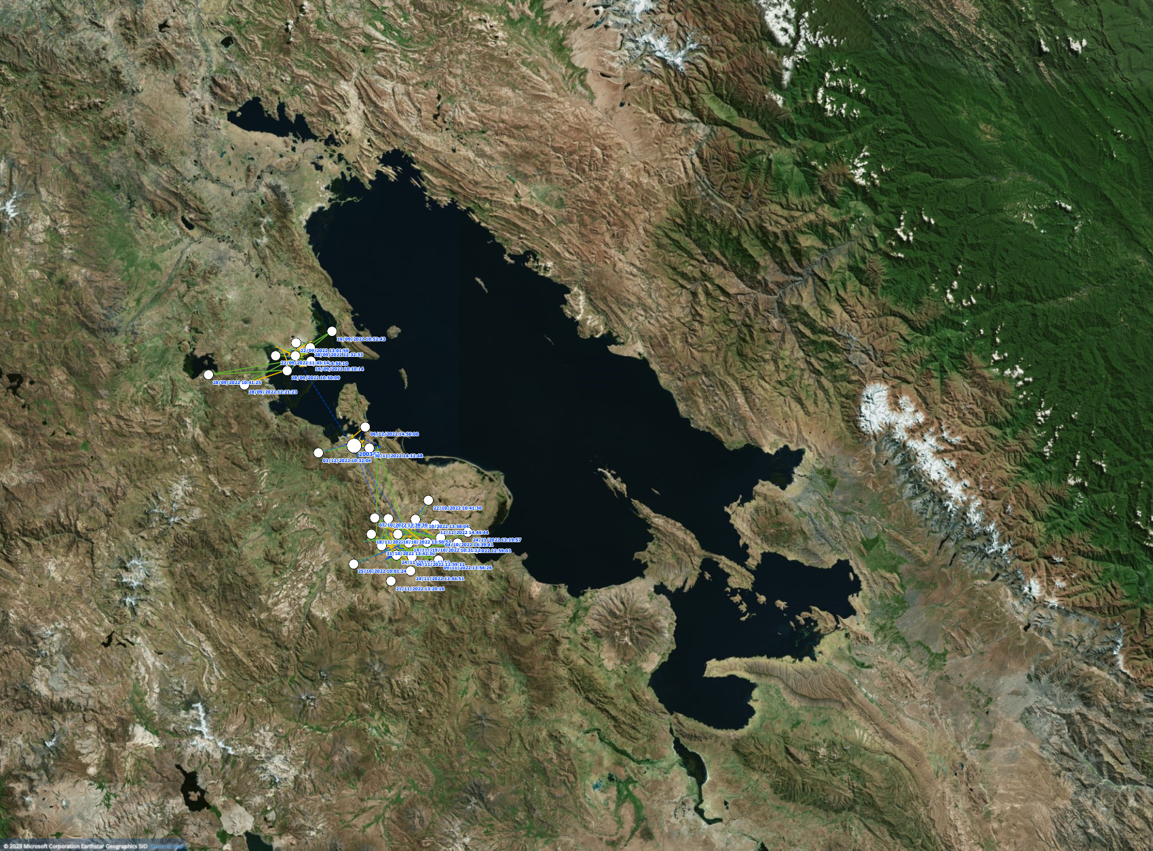
Yellow-billed Pintails tagged in 2022 with 12 g GPS-PTTs

