Slide 1
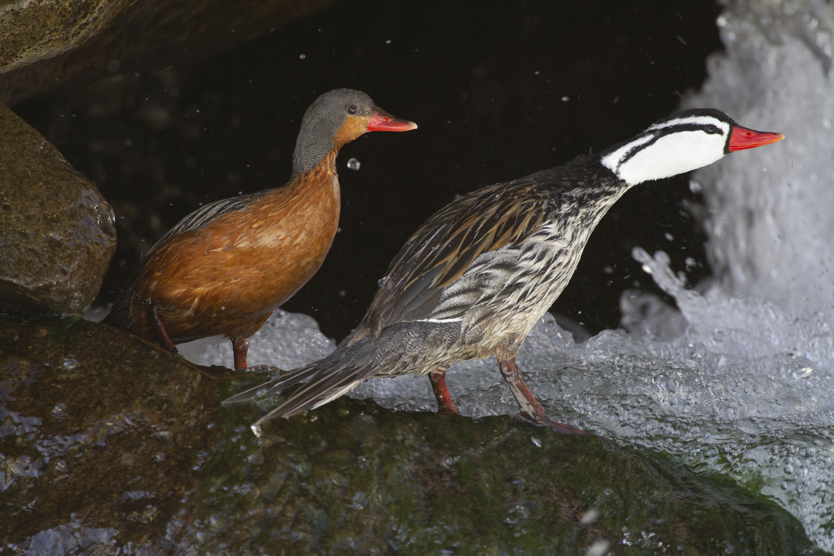
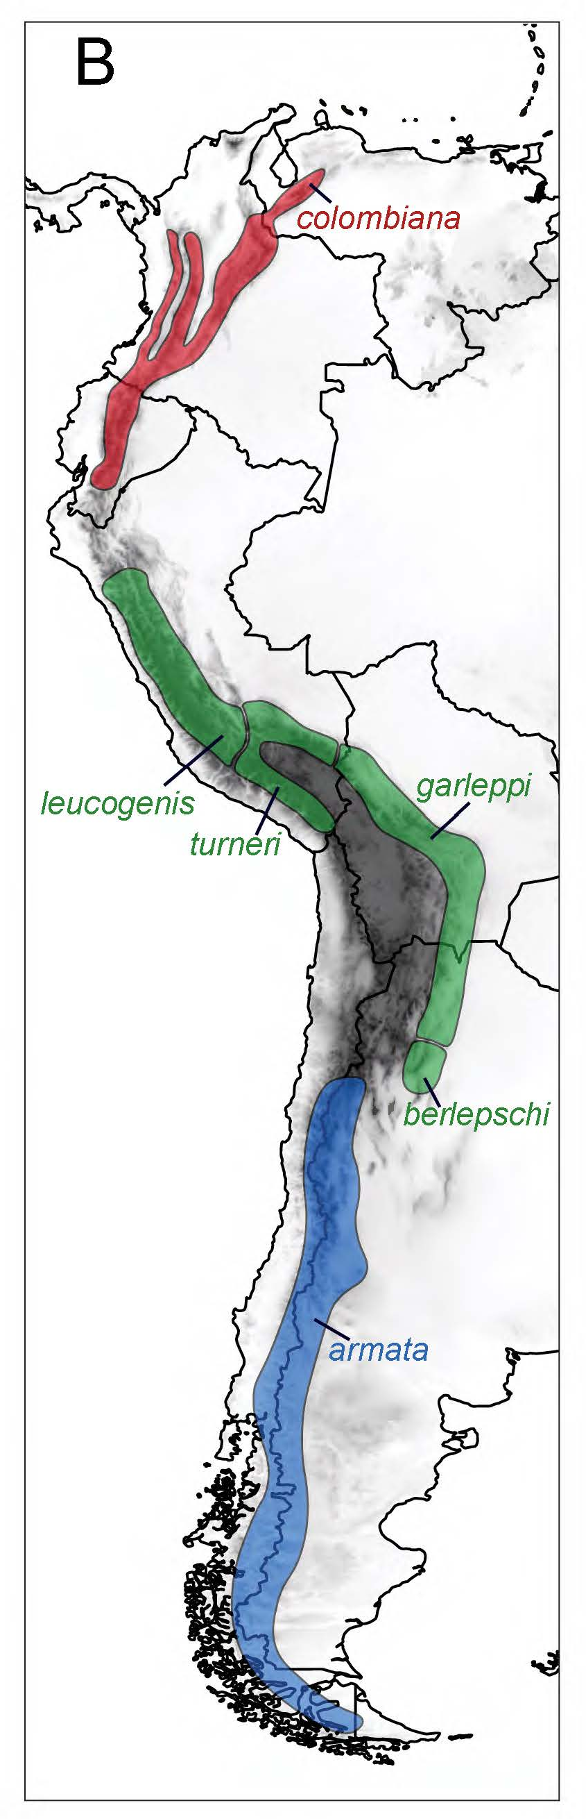
Torrent Duck - A High-altitude Diving Bird
Pato de los Torrentes
Merganetta armata
Long-term resident of the high Andes
~0 to 4,500 meters

Slide 2

Lower O₂ Consumption Rate than Other HA Ducks
Ivy, C. M., S. L. Laguë, J. M. York, B. A. Chua, L. Alza, R. Cheek, N. J. Dawson, P. B. Frappell, K. G. McCracken, W. K. Milsom, and G. R. Scott. (2019) Control of breathing and respiratory gas exchange in ducks native to high altitude in the Andes. Journal of Experimental Biology 222, jeb198622.

Slide 3
Body Temperature (T_{b}) Suppression (but not at LA)
Ivy et al. 2024

Slide 4
Ventilation – Increases Tidal Volume in Hypoxia but not Breathing Frequency
McCracken et al. 2024

Slide 5

High Hb-O₂ Affinity
Natarajan, C., J. Projecto-Garcia, H. Moriyama, R. E. Weber, V. Muñoz-Fuentes, A. J. Green, C. Kopuchian, P. L. Tubaro, L. Alza, M. Bulgarella, M. M. Smith, R. E. Wilson, A. Fago, K. G. McCracken, and J. F. Storz. (2015) Convergent evolution of hemoglobin function in high-altitude Andean waterfowl involves limited parallelism at the molecular sequence level. PLoS Genetics 11:e1005681.

Slide 6
High Blood-O₂ Storage Capacity
McCracken et al. 2024

Slide 7
High Arterial O₂ Content
McCracken et al. 2024

Slide 8

Fatty acid metabolism & carbohydrate metabolism are typical of other long-term HA resident species; slightly higher at HA.
ATP Synthase activity is slightly enhanced.
No change in cytochrome c oxidase activity.
Torrent Duck typical of a long-term HA resident species.
Laguë, S. L., C. M. Ivy, J .M. York, N. J. Dawson, B. A.Chua, L. Alza, G. R. Scott, K. G. McCracken, and W. K. Milsom (2025). Gas exchange, oxygen transport, and metabolism in high-altitude birds. Philosophical Transactions of the Royal Society B: Biological Sciences 380:20230424.

Slide 9
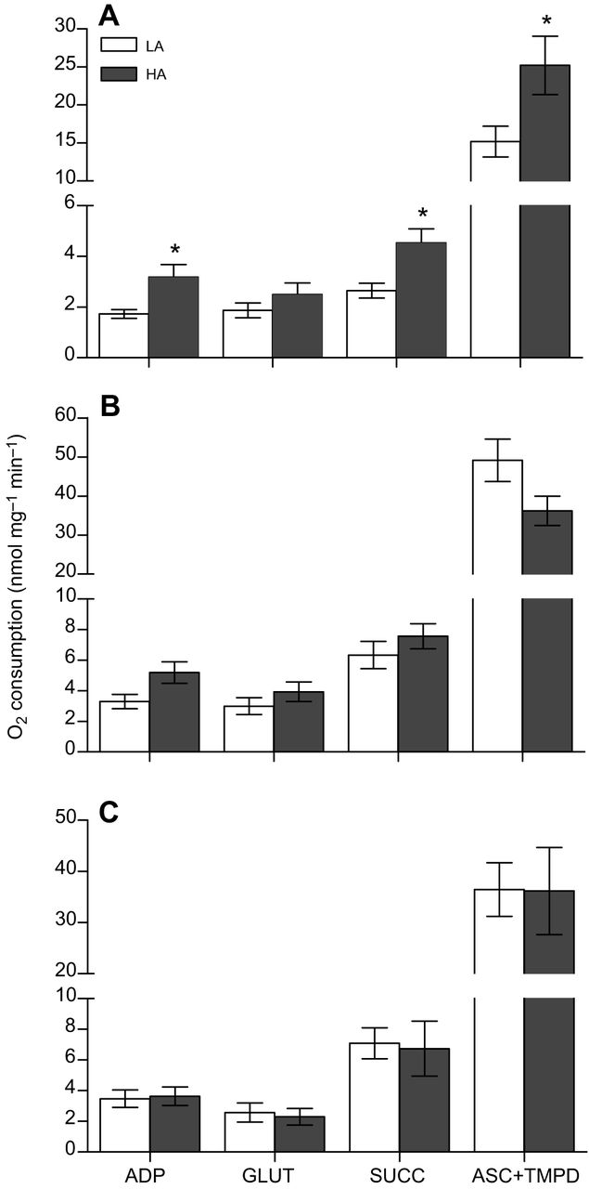

Overall OXPHOS Capacity
In the Torrent Ducks, OXPHOS respiration rates were significantly higher at HA in permeabilized fibers of the gastrocnemius.
*within the same population
Gastrocnemius
Neal J. Dawson, Catherine M. Ivy, Luis Alza, Rebecca Cheek, Julia M. York, Beverly Chua, William K. Milsom, Kevin G. McCracken, & Graham R. Scott (2016). Mitochondrial physiology in the skeletal and cardiac muscles is altered in torrent ducks, Merganetta armata, from high altitudes in the Andes. J Exp Biol 219 (23):3719-3728.
Left ventricle
Pectoralis

