Slide 2
Eugenics
Set of beliefs and practices that aim to improve the genetic quality of a human population.
---Wikipedia

Slide 3
Characteristics of the eugenics movement
Began in the late 19th century
Started in the U.K. and spread to many countries.
Espoused by many well-known people from across the political spectrum.

Slide 4
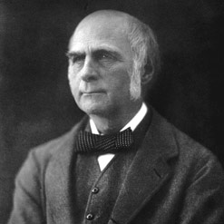
Francis Galton
Charles Darwin’s cousin
Among first to recognize that continuous traits are statistically correlated between parents and offspring, even though he didn’t understand how.
Wrote booked called “Hereditary Genius” in 1869.
1st used the word eugenics in an 1883 book called “Inquiries into Human Fertility & Its Development”
Developed the standard deviation, regression line, and correlation coefficient (r).

Slide 5
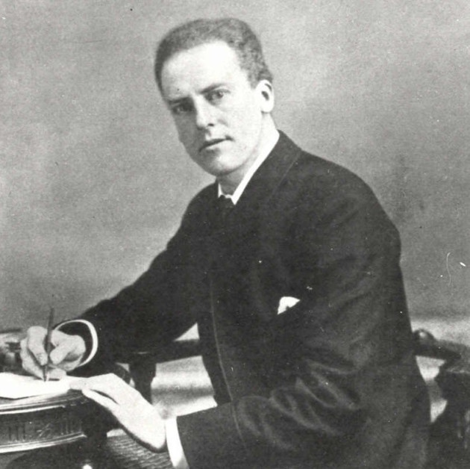
Karl Pearson
Student of Francis Galton
Founded the journal “Annals of Eugenics”, which is now the “Annals of Human Genetics”
Developed many statistics used in study of quantitative traits: Pearson’s correlation coefficient; Chi-square test; Principal components analysis (PCA); 1st use of histogram

Slide 6
Beloved Historical Figures Who were Pro-Eugenics
Teddy Roosevelt
H. G. Wells
George Bernard Shaw
Winston Churchill
Francis Crick
R. A. Fisher

Slide 7
Some day we will realize that the prime duty, the inescapable duty of the good citizens of the right type is to leave his or her blood behind him in the world; and that we have no business to permit the perpetuation of citizens of the wrong type. The great problem of civilization is to secure a relative increase of the valuable as compared with the less valuable or noxious elements in the population… The problem cannot be met unless we give full consideration to the immense influence of heredity…
I wish very much that the wrong people could be prevented entirely from breeding; and when the evil nature of these people is sufficiently flagrant, this should be done. Criminals should be sterilized and feebleminded persons forbidden to leave offspring behind them… The emphasis should be laid on getting desirable people to breed…
---Theodore Roosevelt

Slide 8
The unnatural and increasingly rapid growth of the feeble-minded and insane classes, coupled as it is with a steady restriction among all the thrifty, energetic and superior stocks, constitutes a national and race danger which it is impossible to exaggerate. I am convinced that the multiplication of the feeble-minded, which is proceeding now at an artificial rate, unchecked by any of the old restraints of nature, and actually fostered by civilised conditions, is a terrible danger to the race.
… simple surgical operation so the inferior could be permitted freely in the world without causing much inconvenience to others.
---Winston Churchill

Slide 9

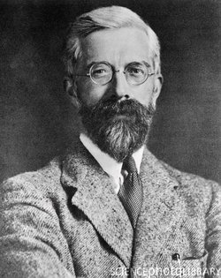
Numerous chapters devoted to eugenics

Slide 10
Forced sterilizations in the U.S.
Indiana - 1st eugenic U.S. sterilization law in 1907
Upheld by Supreme Court in 1927
State programs targeted institutionalized, mentally disabled women
Rationalized by protecting vulnerable women from unwanted pregnancy
>60,000 sterilized before WWII
Reilly, P. R. (2015). Eugenics and involuntary sterilization: 1907–2015. Annual review of genomics and human genetics, 16(1), 351-368.

Slide 11
Forced sterilizations in the U.S.
Sterilizations practiced extensively on Native American women without free/informed consent.
~70,000 between 1970-1976
Indian Health Service (HIS), a division of the U.S. Department of Health & Human Services
Continued into the late 1970s
~25-50% of Native American Women vs. ~15% of white women
https://en.wikipedia.org/wiki/Sterilization_of_Native_American_women

Slide 12
Why did popularity of eugenics decline?

Slide 13
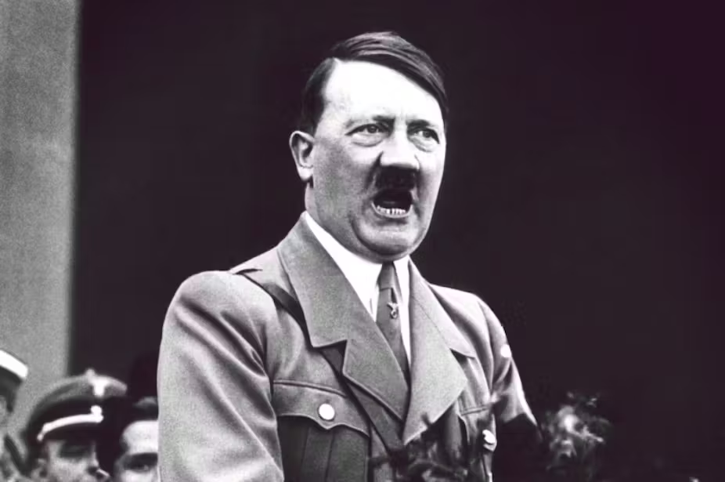
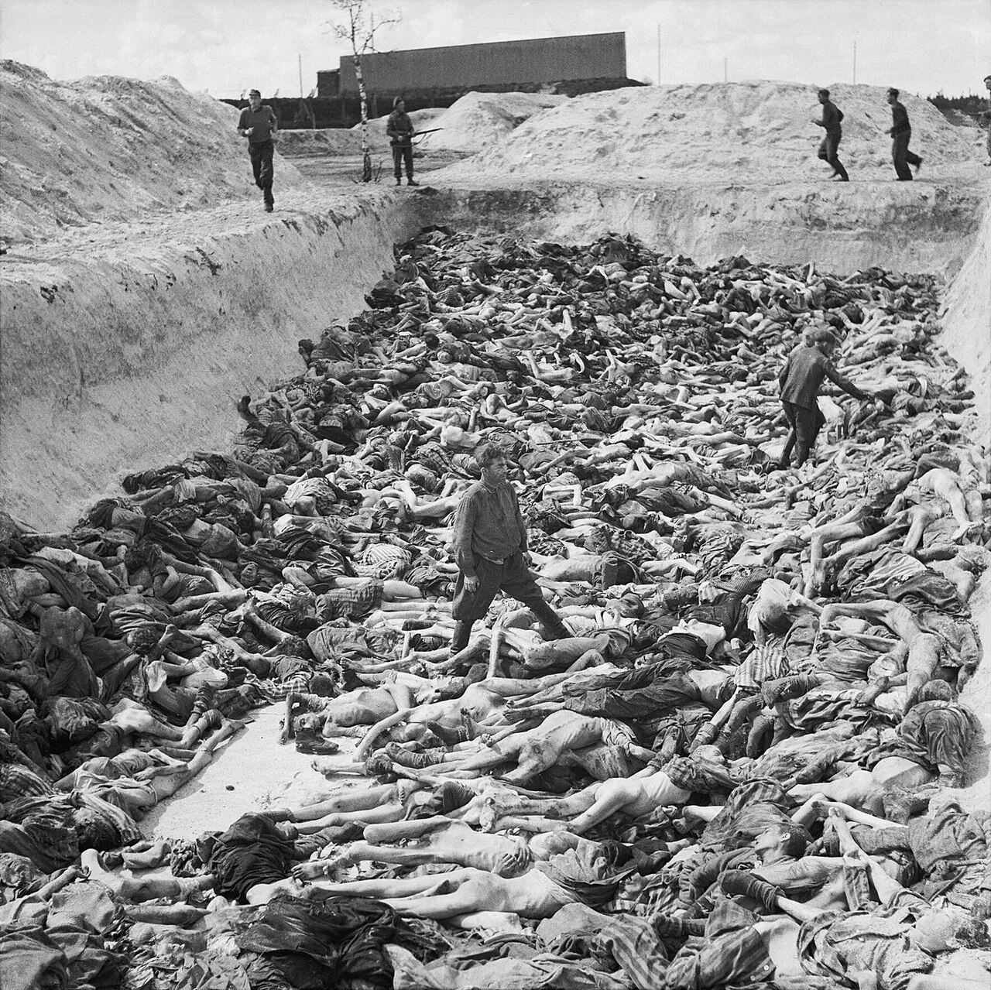
Why did popularity of eugenics decline?

Slide 14
What about other mass murders?

Slide 15
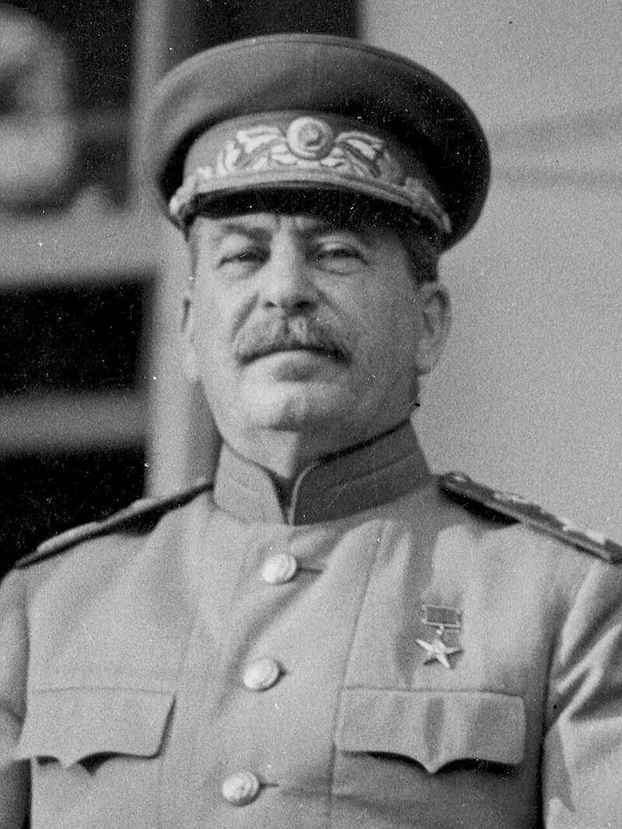
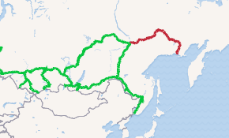
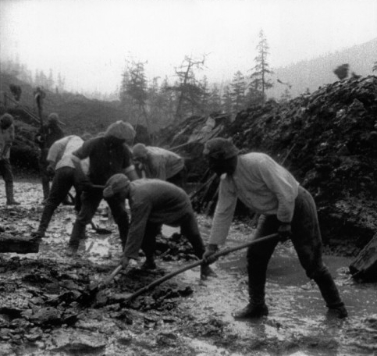
What about other mass murders?
18,000,000 people went to Stalin’s gulags
~10% died
e.g., Road of Bones built 1932-1953

Slide 16
Where is eugenics still practiced?
India - women offered $10-20 as an incentive
Peru - Fujimori government sterilized ~300,000 indigenous people in 1990s.
Canada - as late as 2015, First Nations women sterilized without consent.
China - 1-child policy led to forced abortion and involuntary sterilization; Maternal and Infant Health Care Law ("Eugenics Law") of 1995, stated purpose of improving the quality of the population by mandating sterilization for people with serious genetic defects.
https://aeon.co/essays/eugenics-today-where-eugenic-sterilisation-continues-now

Slide 17
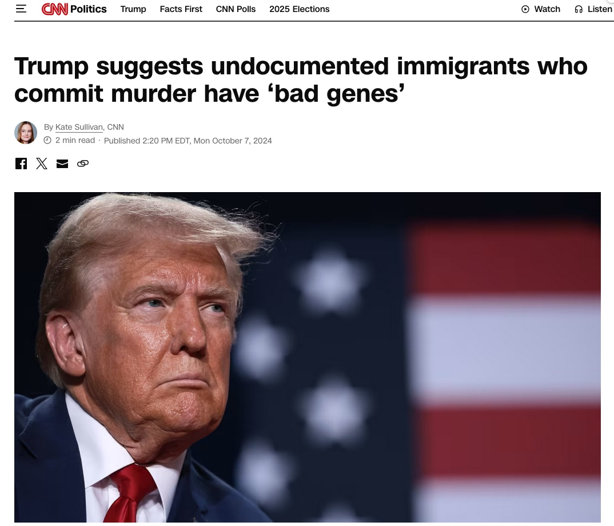
Why is this relevant now?

Slide 18

Are there bad genes?
Of course, but do they occur in one group of people and not another group?

Slide 19
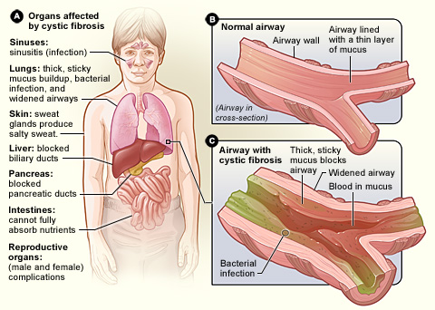
Are there bad genes?
Cystic Fibrosis - most common single-gene genetic disorder, found in all human populations:
1/3,500 White Americans
1/17,000 African Americans
1/31,000 Asian Americans

Slide 20
Single-gene disorders
Single-gene disorder | Lowest | Highest
Cystic fibrosis | Asian | White
Huntington’s disease | Asian & Hispanic | White
Phenylketonuria | African | European
Hemophilia | African & Asian | White & Hispanic
Retinoblastoma | Similar | Similar
Muscular dystrophy | Other | White
Hyperchloresterolemia | Asian | African
Data Sourced from PubMed - NIH Funded Studies

Slide 21
Multi-factorial genetic disorders…
Major-effect locus | Lowest Risk | Highest Risk
APOE (Alzheimer’s) | Hispanic | Black/White
HLA-DRB1 (Arthritis) | Varies by loci among ethnic groups | Varies by loci among ethnic groups
BRCA1 & BRCA2 (Cancer) | Asian, Hispanic, & Caucasian | African
9p21 (CAD) | African Americans | European/East Asian
HLA-DRB1 & HLA-DQB1 (Type I Diabetes) | African American, Hispanic | Non-Hispanic White
CACNA1A (Migraine Headaches) | African American, Asian | Caucasian
Polygenic (Spina bifida) | Non-Hispanic Black | Hispanic, Non-Hispanic White
Data Sourced from PubMed - NIH Funded Studies

Slide 22
Some examples of good genes.
CCR5, a 32-bp deletion, reduces the risk of AIDS infection, a variant more common in Caucasians & Hispanics.
Several loci at high frequency in the Amish are protective from Alzheimer’s.
HLA from Denisovan & Neanderthal enhanced the immune system (Abi-Rached et al. 2011).
MC1R from Neanderthals, adaptation to sunlight intensity (Ding et al. 2014).
EPAS1 associated with reduced [Hb] in Tibetans inherited from Denisovans (Huerta-Sanchez et al. 2014)

Slide 23
No single ethnic group can claim all good genes or bad genes!

Slide 24
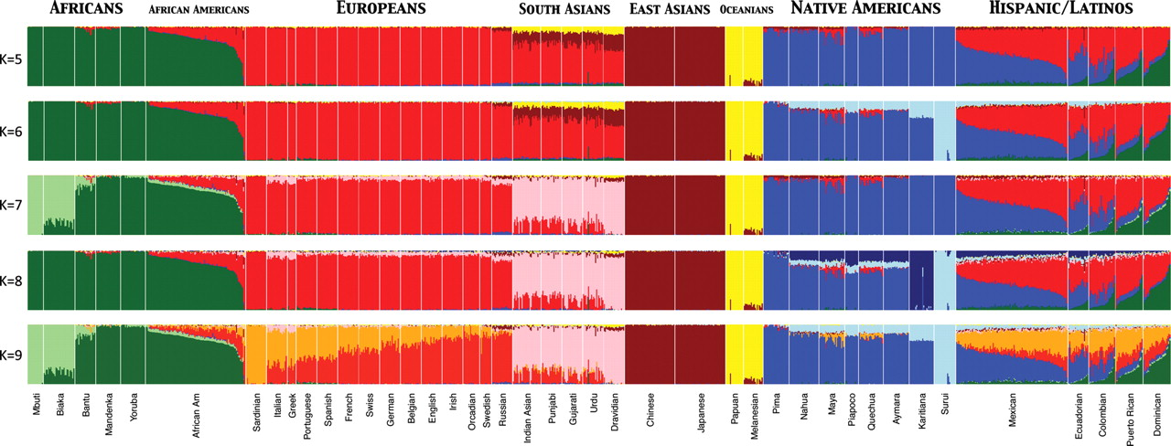
Assignment Tests Reveal Variable Levels of Admixture & Heterozygosity Across Human Populations
Used ADMIXTURE clustering algorithm to infer genomic assignments/ individual
K = number of assumed populations
73,901 autosomal SNP markers & 1,112 individuals from 42 global pops
Which of these populations have the highest average heterozygosity?
Henn B M et al. Hum. Mol. Genet. 2010;19:R221-R226
© The Author 2010. Published by Oxford University Press. All rights reserved. For Permissions, please email: journals.permissions@oxfordjournals.org

Slide 25
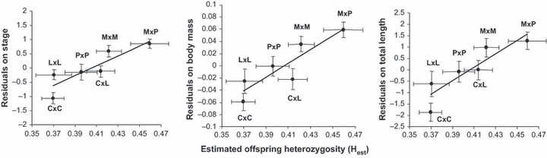
Is there a relationship between fitness and heterozygosity?
Luquet, E., David, P., Lena, J.P., Joly, P., Konecny, L., Dufresnes, C., Perrin, N. and Plénet, S., 2011. Heterozygosity–fitness correlations among wild populations of European tree frog (Hyla arborea) detect fixation load.
Molecular Ecology, 20(9), pp.1877-1887.
Notes:
The relationships between average estimated multilocus heterozygosity (Hest) of each cross and average larval performances (stage, body mass and total length).The residual trait values are difference between trait values and corresponding mean treatment. Points are means of crosses ± standard errors.
IF THIS IMAGE HAS BEEN PROVIDED BY OR IS OWNED BY A THIRD PARTY, AS INDICATED IN THE CAPTION LINE, THEN FURTHER PERMISSION MAY BE NEEDED BEFORE ANY FURTHER USE. PLEASE CONTACT WILEY'S PERMISSIONS DEPARTMENT ON PERMISSIONS@WILEY.COM OR USE THE RIGHTSLINK SERVICE BY CLICKING ON THE 'REQUEST PERMISSIONS' LINK ACCOMPANYING THIS ARTICLE. WILEY OR AUTHOR OWNED IMAGES MAY BE USED FOR NON-COMMERCIAL PURPOSES, SUBJECT TO PROPER CITATION OF THE ARTICLE, AUTHOR, AND PUBLISHER.

Slide 26
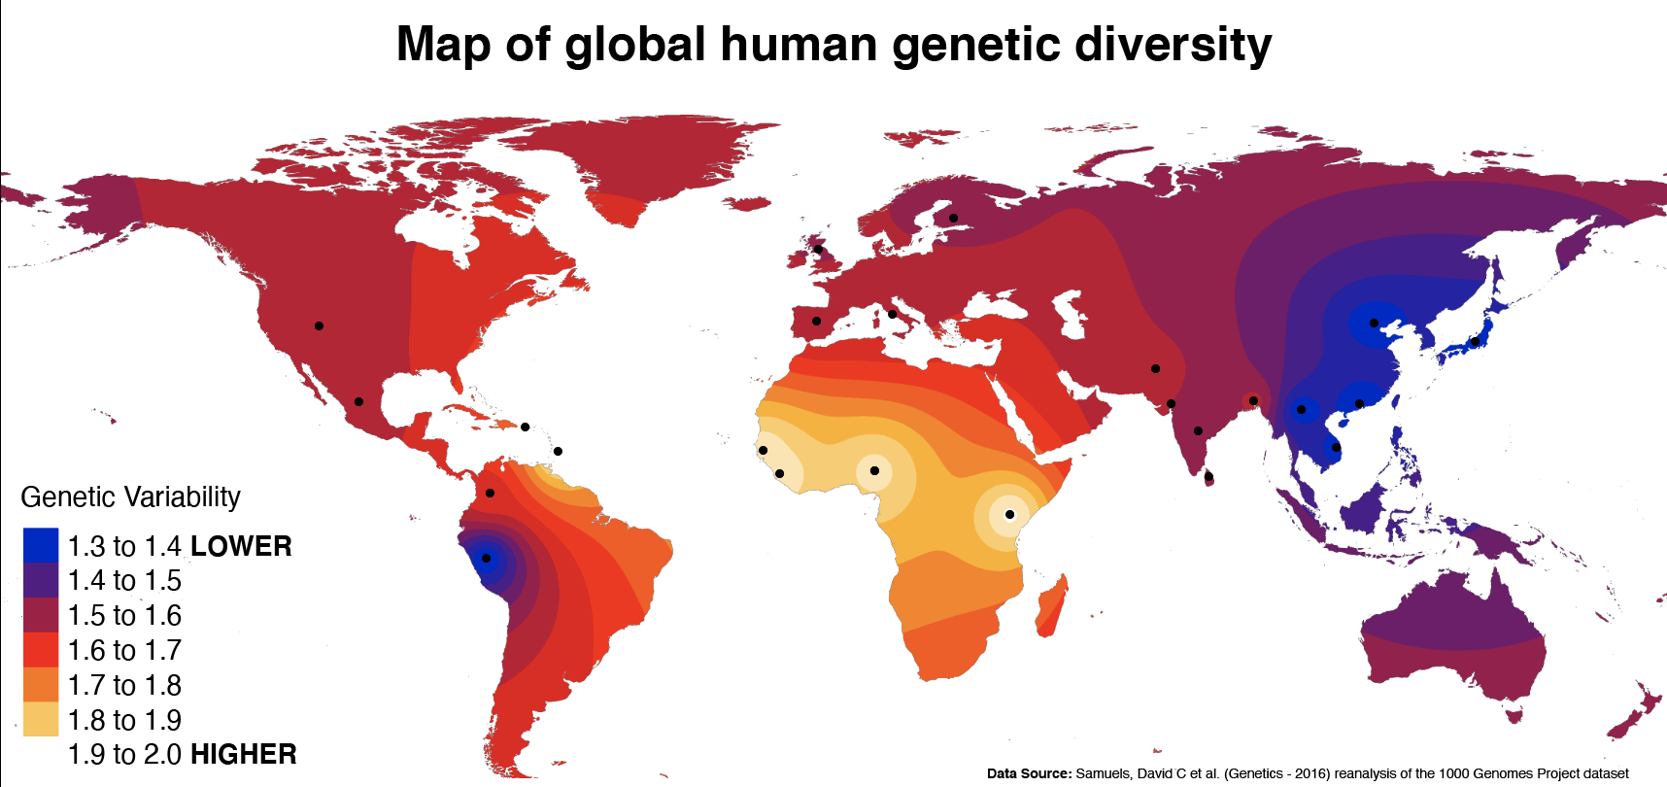
Which human populations have the highest level of genetic diversity?
How might you boost your F1’s heterozygosity?

Slide 27
Can we eliminate the bad genes and keep only the good genes?
Mutation always introduces deleterious mutations.
Meiotic segregation (if heterozygotes have the highest fitness, meiotic segregation will produce homozygotes with lower fitness).
Genetic drift can increase frequency of deleterious mutations (e.g., through a founder event or bottleneck).
Migration can under rare circumstances introduce maladapted variants into a population, or…
Inbreeding will result in increased homozygosity of inbred individuals and potentially lower fitness.
This is the Genetic Load

Slide 28
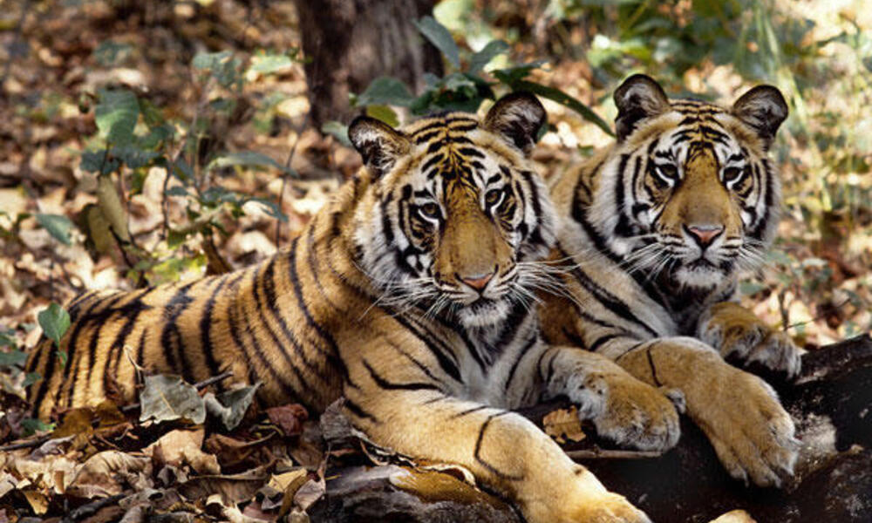
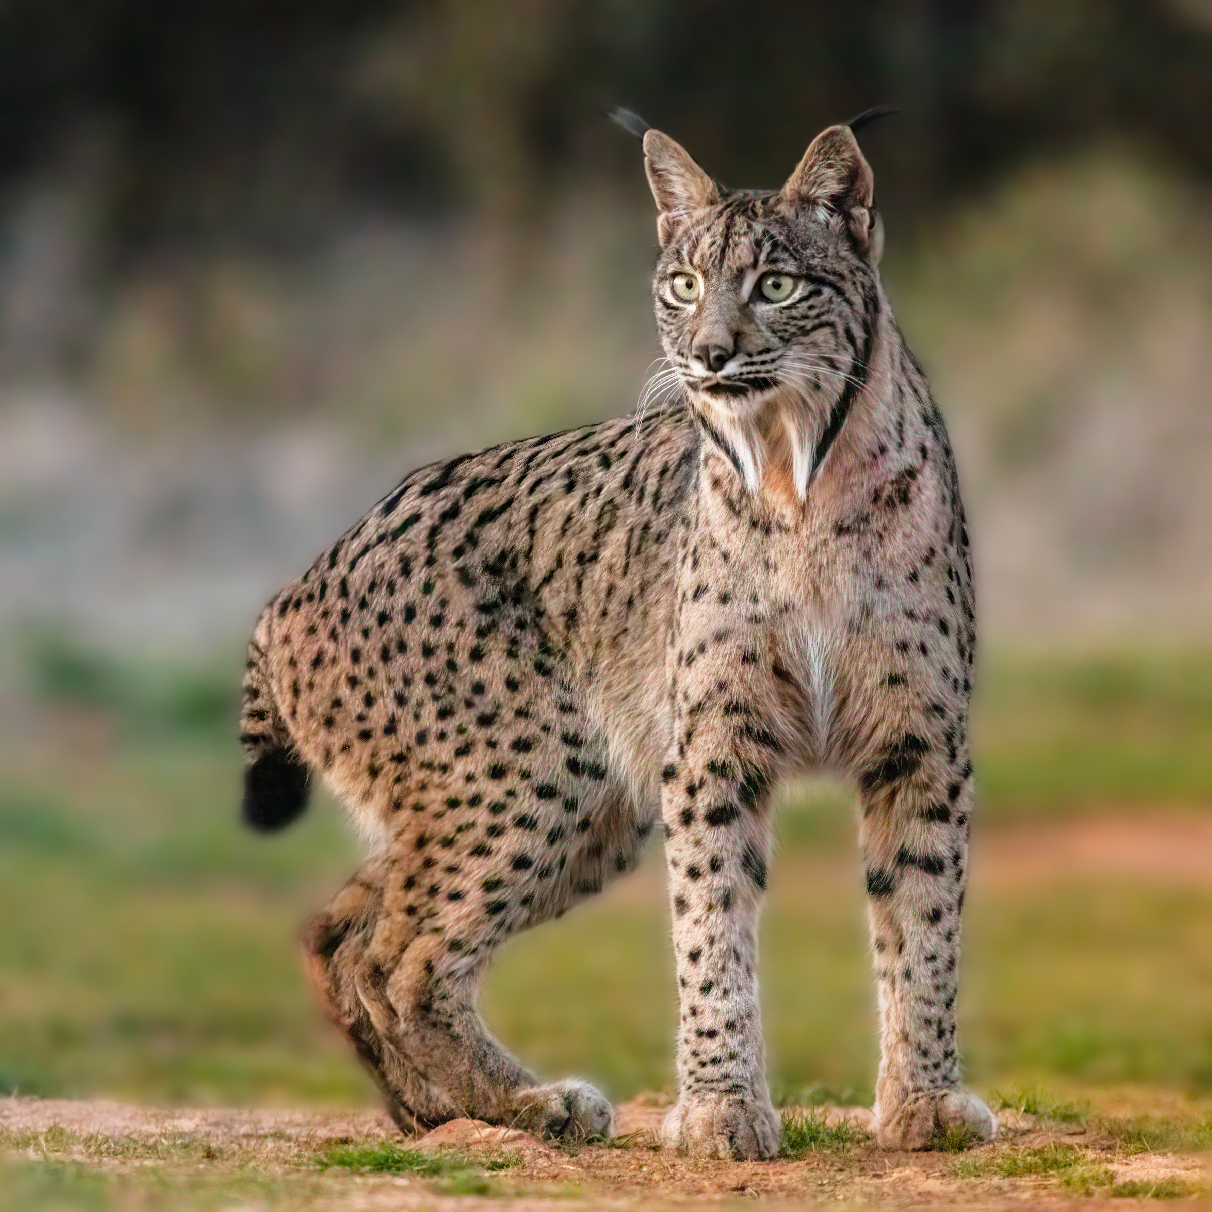
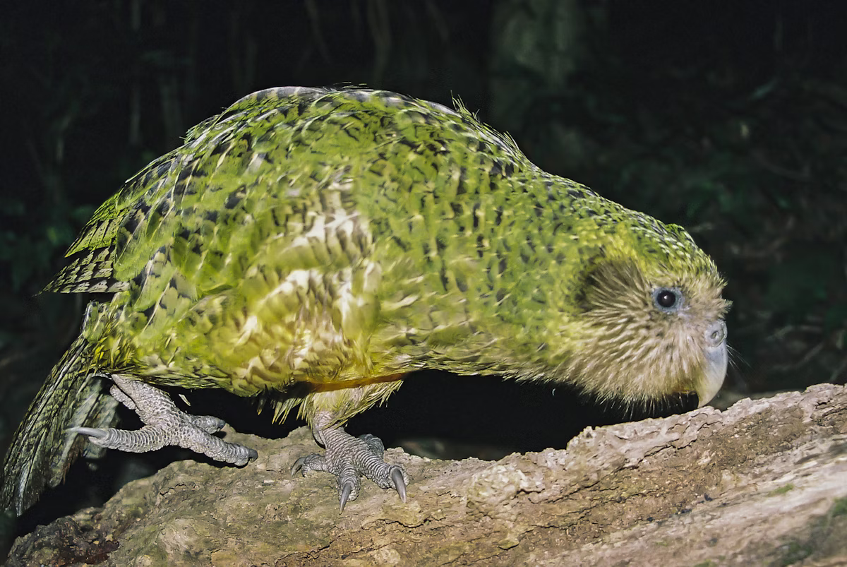
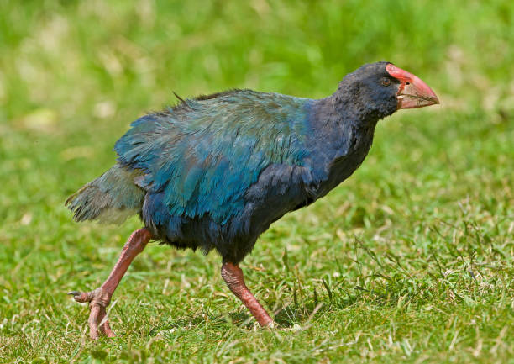
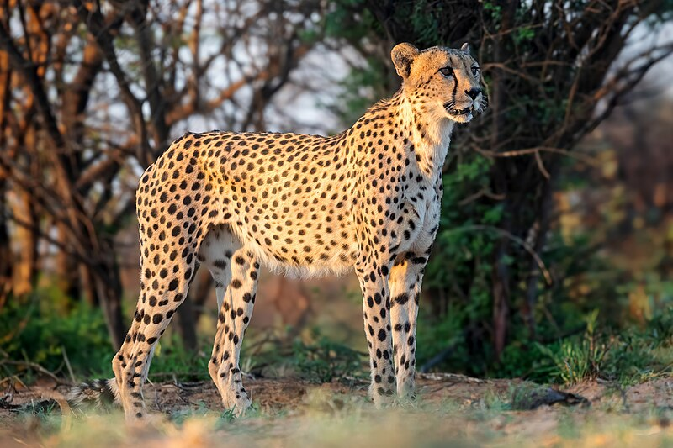
Answer:
Not really, inbreeding always leads to bad genetic outcomes.

Slide 29
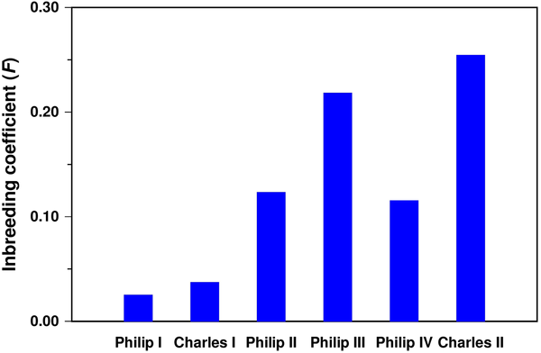
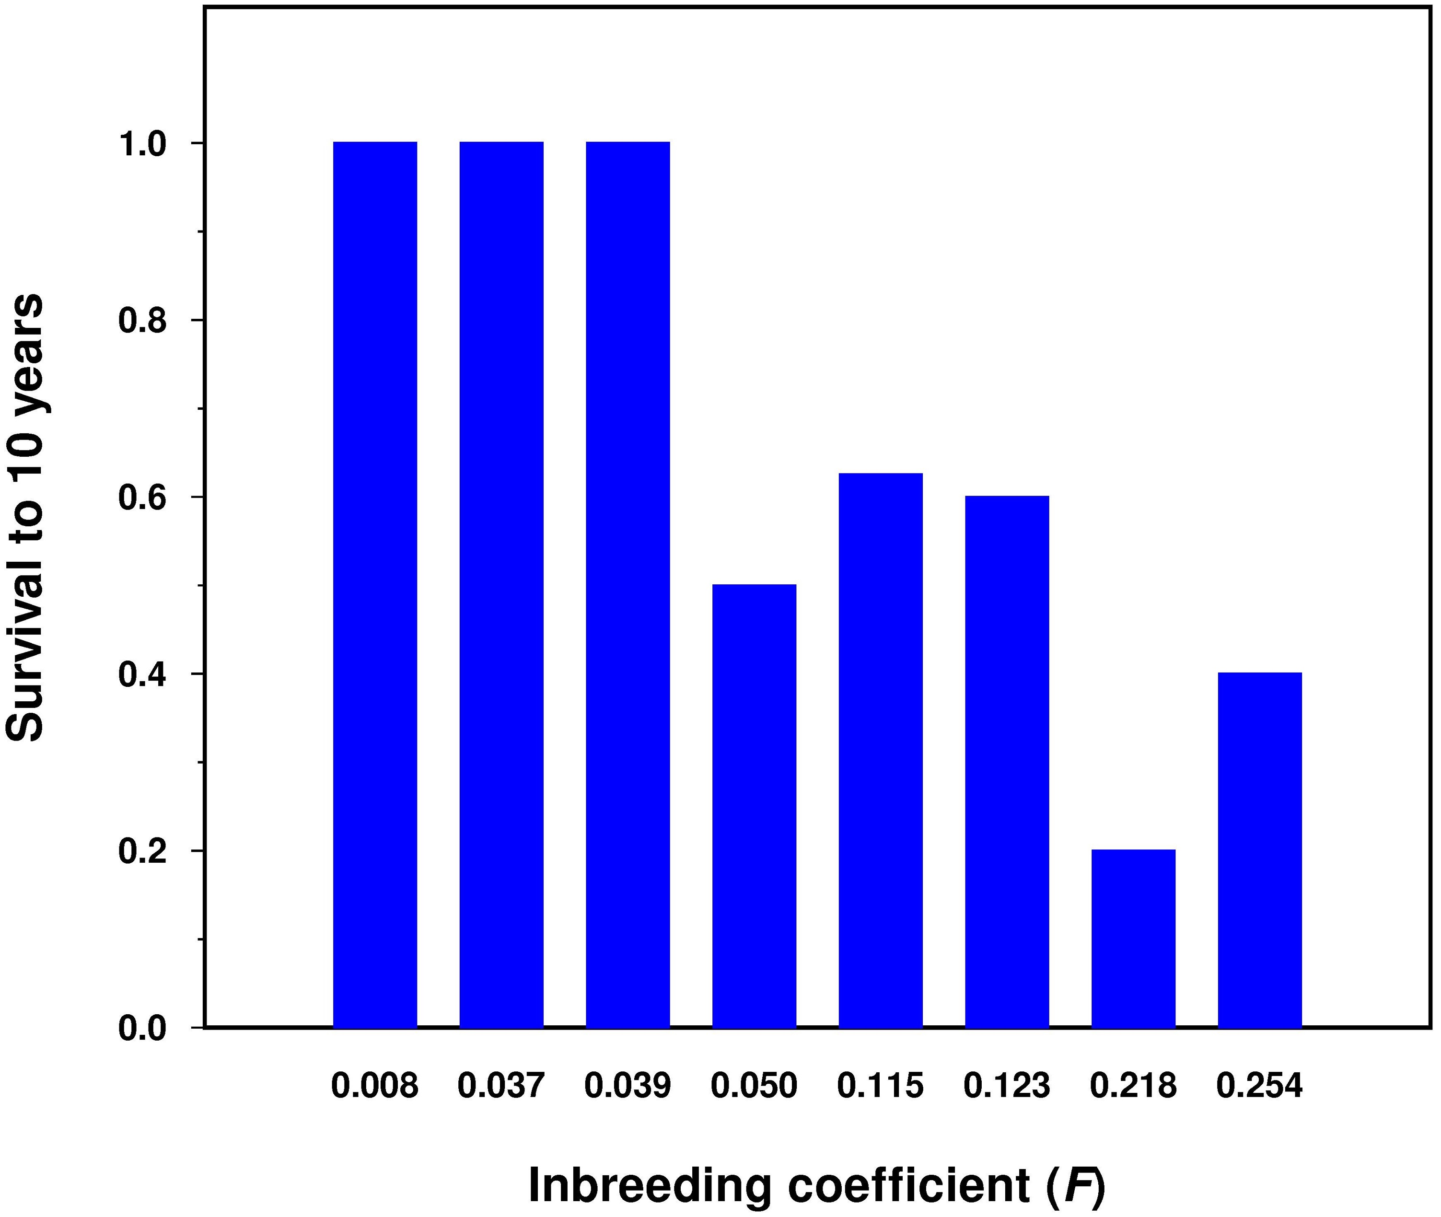
Figures 2 & 4. Inbreeding coefficient (F) of the Spanish Habsburg kings.
Alvarez G, Ceballos FC, Quinteiro C (2009) The Role of Inbreeding in the Extinction of a European Royal Dynasty. PLOS ONE 4(4): e5174. https://doi.org/10.1371/journal.pone.0005174
https://journals.plos.org/plosone/article?id=10.1371/journal.pone.0005174

Slide 30
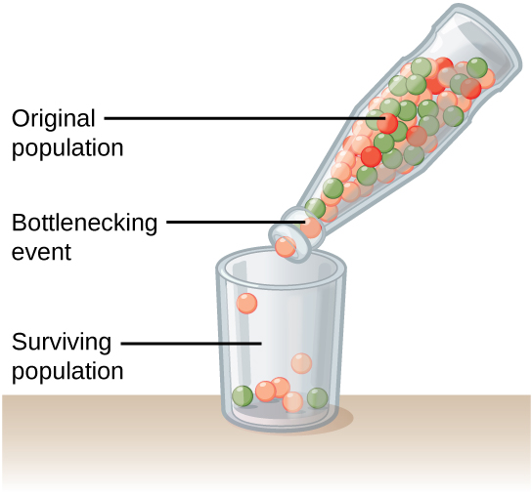
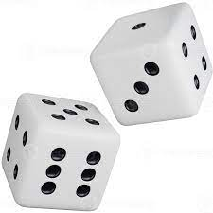
Genetic drift doesn’t pick favorites, deleterious genes can become fixed in a population, and beneficial genes can be lost.
www.khanacademy.org/

Slide 31

So what is Eugenics in the end?
Not scientifically based
Historical misuse of science to justify malevolent social policy, mostly pre WWII
Racism veiled in science, or just racism

Slide 32

Positive thoughts
Don’t succumb to inbred thinking
Remember opposites attract
Consider your F1---higher heterozygosity = higher fitness = stronger babies!
Use your new knowledge of human population genetics to embrace diversity
Do not steal, do not lie, do not be lazy (Inca Proverb)
Fight fear, division, and dishonesty
Be kind, don’t be unkind
Photo: Smithsonian Magazine

