Slide 1
Migration/Gene Flow
University of Miami
Spring 2026

Slide 2
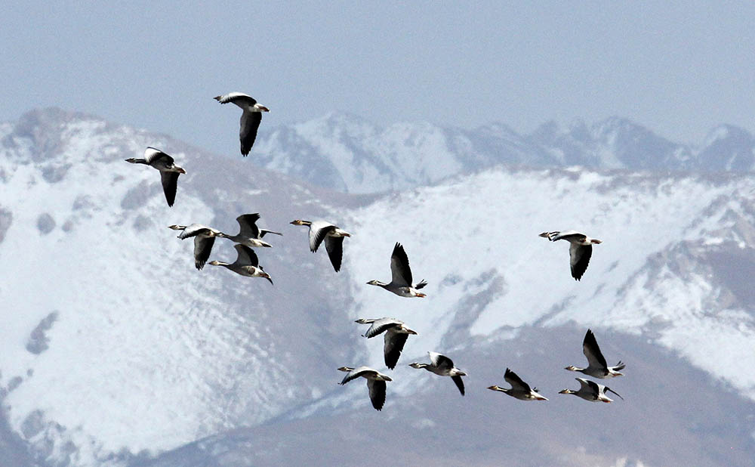
What do you imagine when you think about migration?
Bar-headed geese migrating over the Himalayas

Slide 3
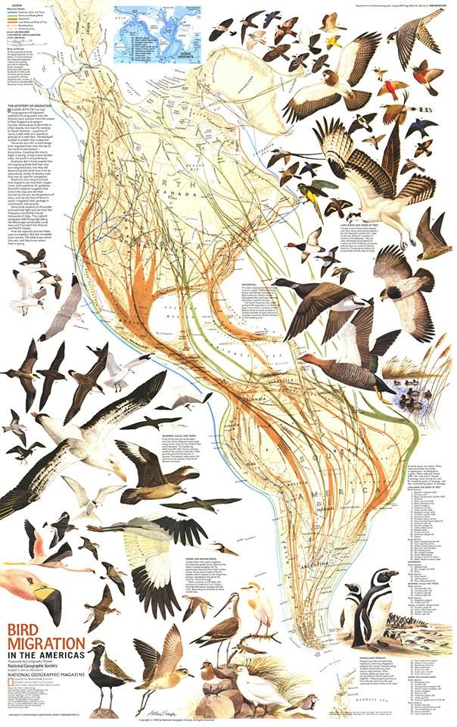

Slide 4
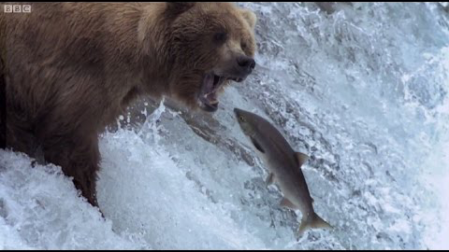

Slide 5
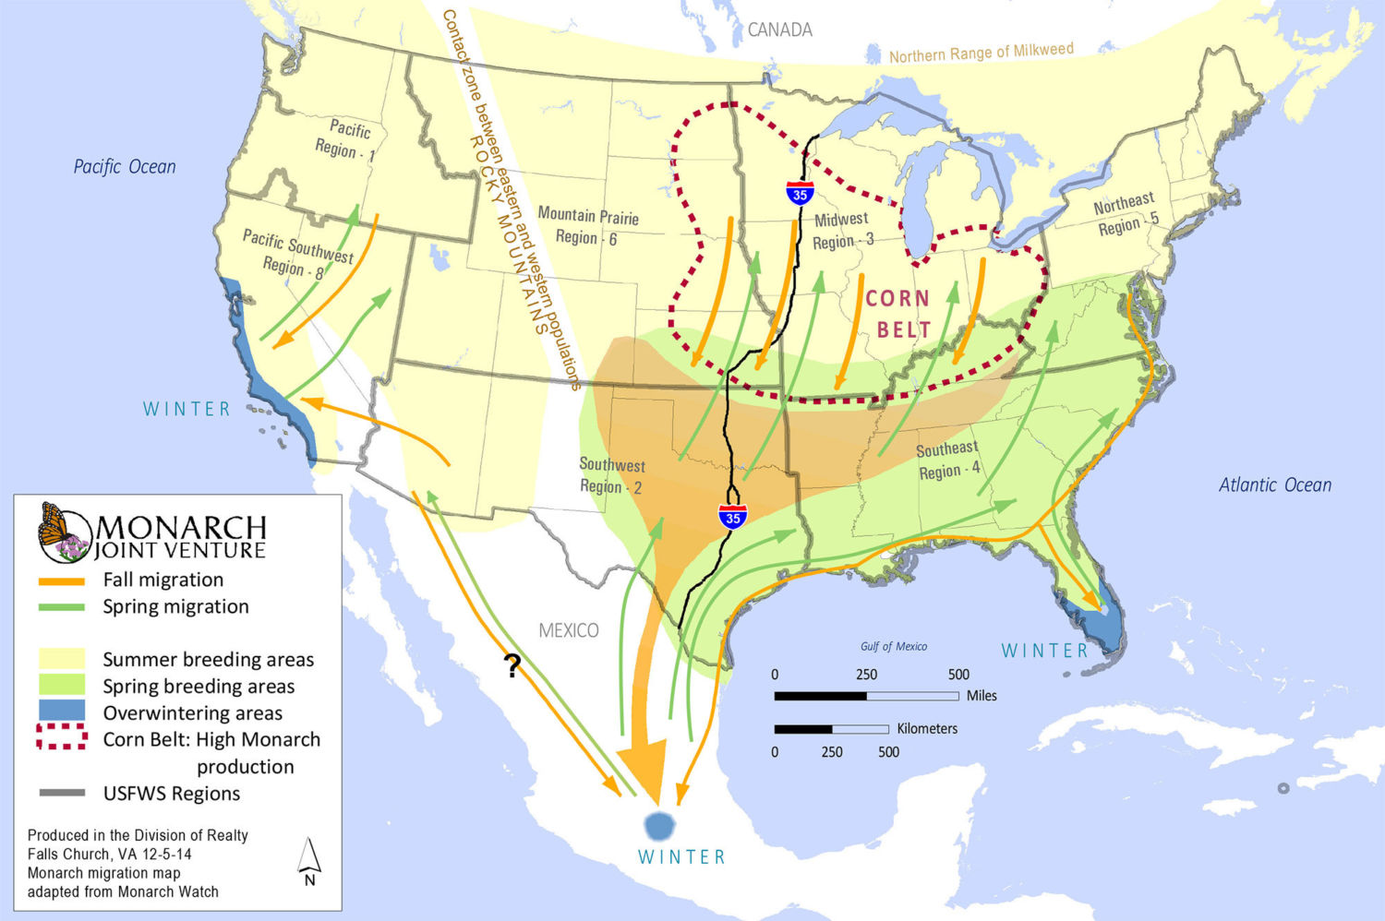
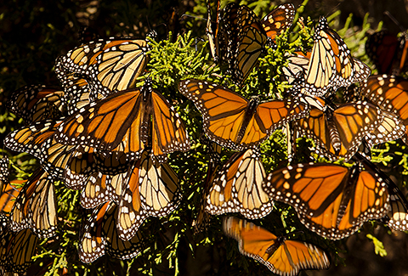

Slide 6
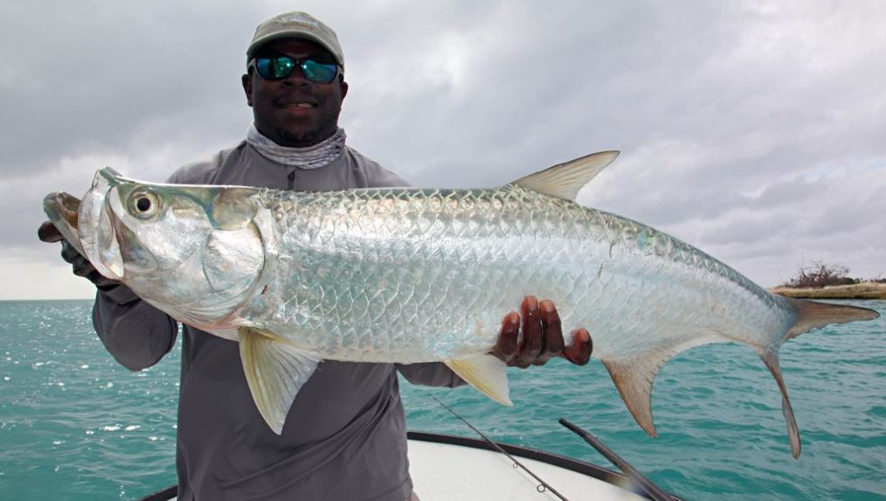
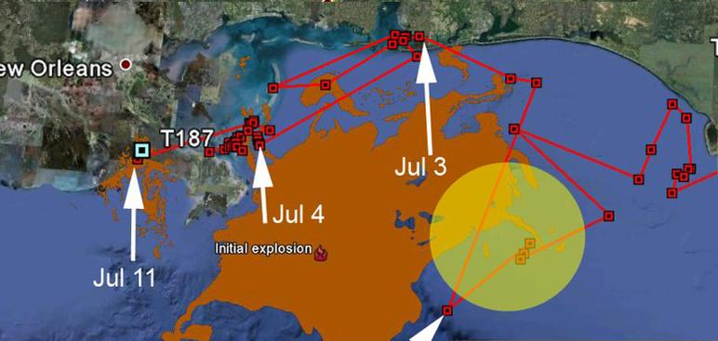
http://www.itarpon.org/eastern-gulf1.html
This 192 lb. Tarpon was Tagged off of the western coastline of Florida. The Orange area is a drawing of the Deepwater Horizon Oil Spill area. The Yellow is likely a tarpon spawning area. This fish was tagged in 2011, a year after the Deepwater Horizon explosion.

Slide 7
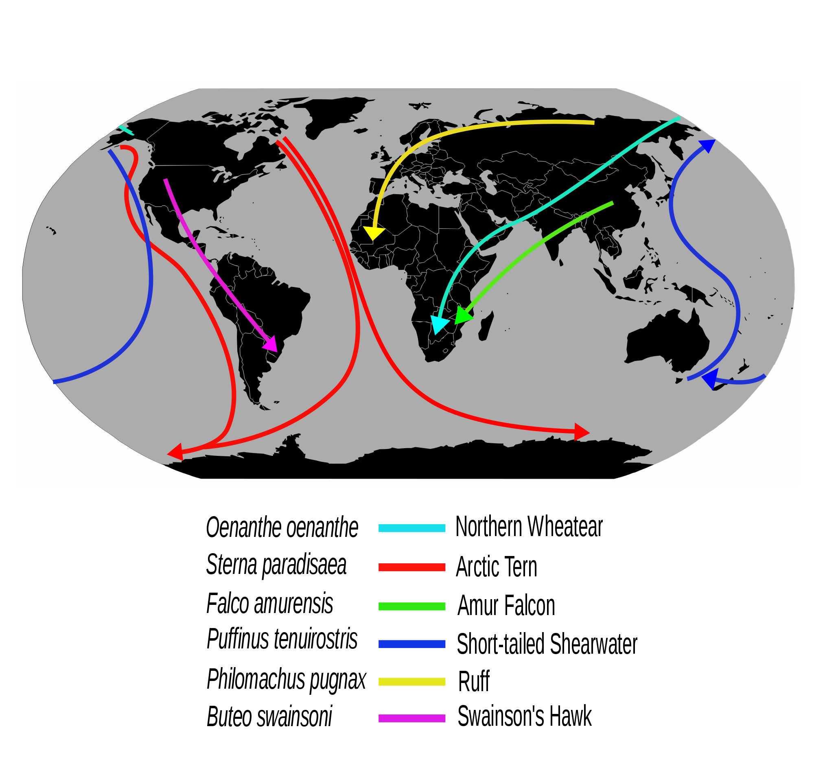

Slide 8
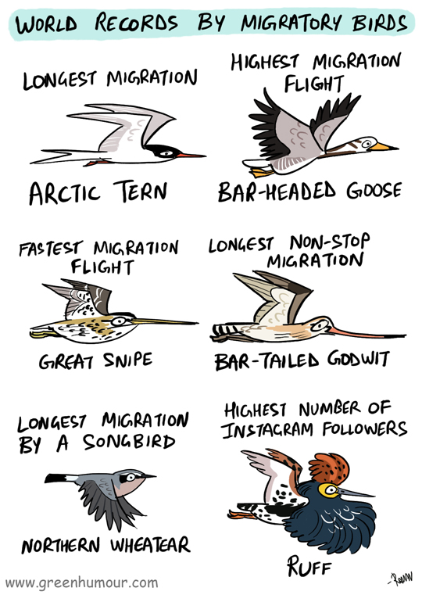

Slide 9
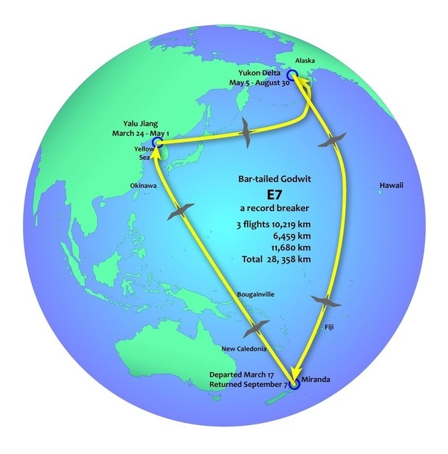
https://www.quora.com/When-a-flock-of-birds-flies-south-in-a-V-formation-do-they-stop-to-feed-or-to-rest

Slide 10
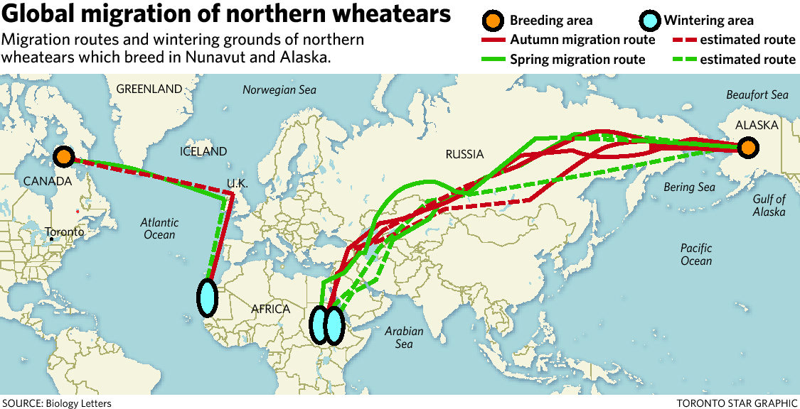
THE STAR
25-gram songbird makes miracle migration to Africa each year
By Leslie ScrivenerFeature Writer, Tue., Feb. 14, 2012
https://www.thestar.com/news/insight/2012/02/14/25gram_songbird_makes_miracle_migration_to_africa_each_year.html

Slide 11
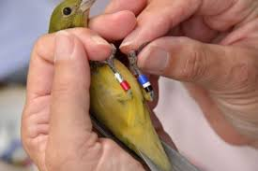

How do we obtain these movement data?
Bird Banding

Slide 12
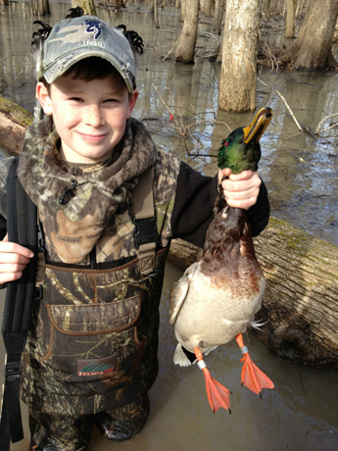
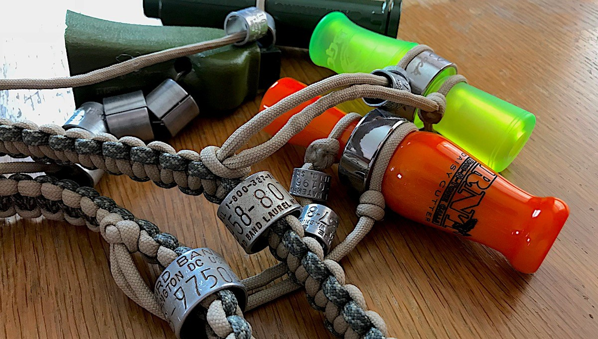
Hunters

Slide 13
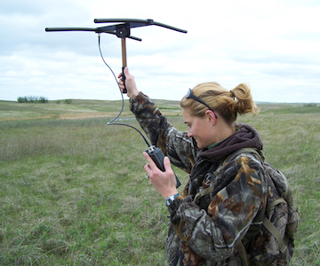
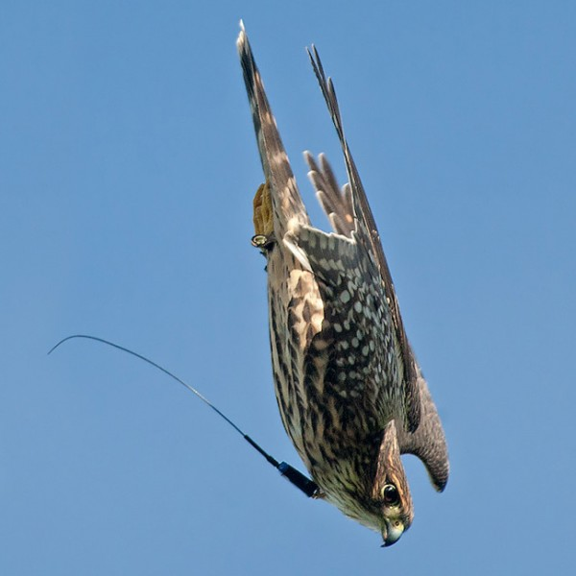
VHF
Transmitters

Slide 14
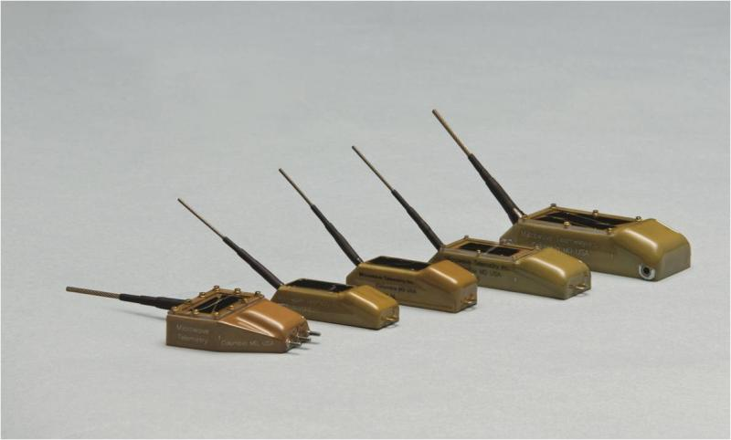
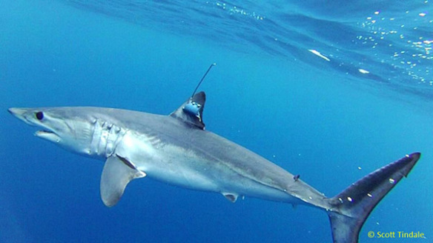
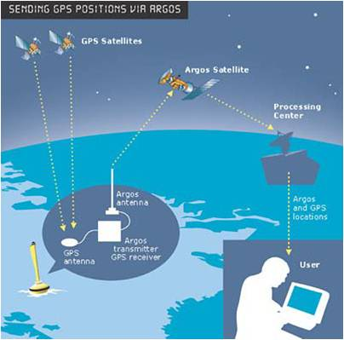
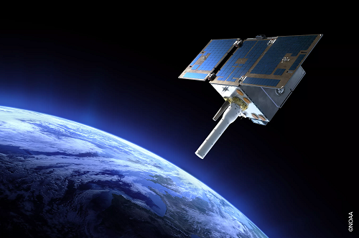
Satellite
Transmitters
GPS+Argos

Slide 15
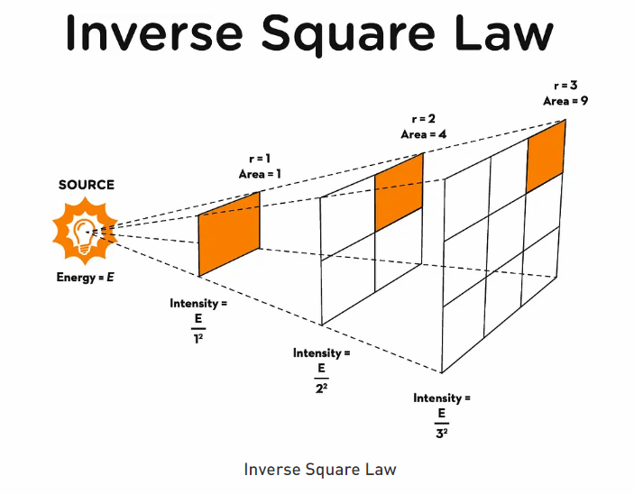
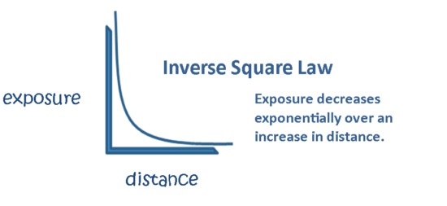

Slide 16
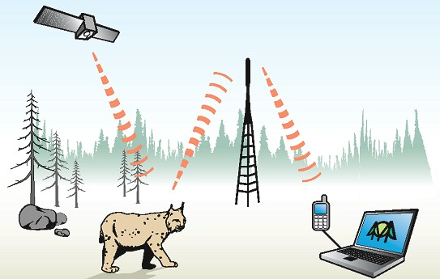
GPS + GSM Network

Slide 17
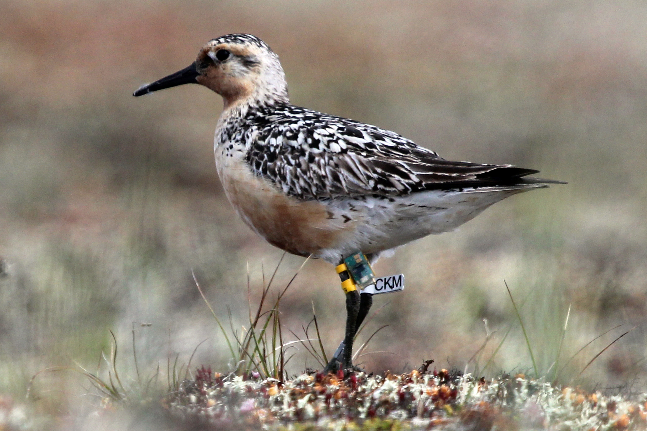
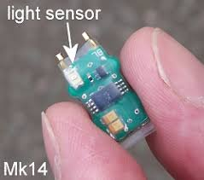
Geolocators

Slide 18
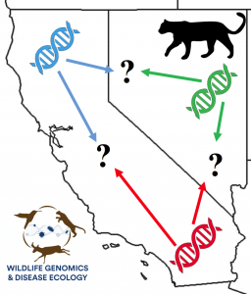
Genetic Migration = Gene Flow
Requires movement of individuals between populations with subsequent interbreeding.
Requires than offspring of such unions be recruited into the population by backcrossing to either parental population.
Not just migration in the sense of seasonal movements.
Dispersal in the classic sense (i.e., movement of individuals between populations) is just one part.

Slide 19

Population Subdivision for Two Populations
2N_{e}μ
Genetic variation; Allele or genotype frequencies
Mutation
Genetic Drift
Migration
2N_{e}μ
Genetic variation; Allele or genotype frequencies
Mutation
Genetic Drift
Mutation and genetic drift (and selection) act independently in each population.
Gene flow homogenizes allele frequencies, offsets drift by increasing Ne.

Slide 20
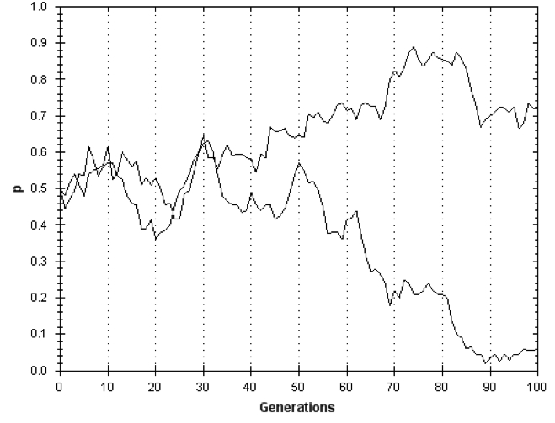
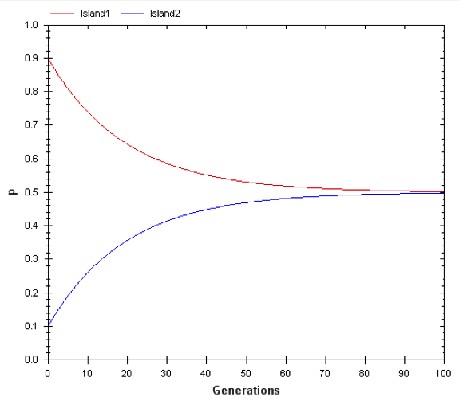
Mutation & genetic drift are independent in different subpopulations.
Gene flow homogenizes allele frequencies.
Genetic drift causes allele frequencies
to become more different
(populations diverge)
Gene flow causes allele frequencies
to become more similar
(populations homogenize)

Slide 21
Allele Frequencies
No detectable gene flow
High F_{ST}
Large effects of drift
*Low gene flow is difficult to detect
Intermediate gene flow
Medium F_{ST}
Intermediate effects of drift
Highest gene flow
Low F_{ST}
Small effects of drift
*High gene flow is hard to measure

Slide 22
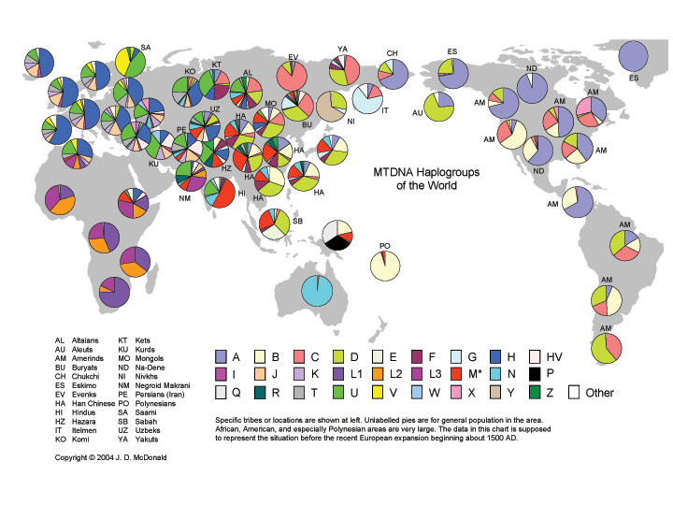

Slide 23
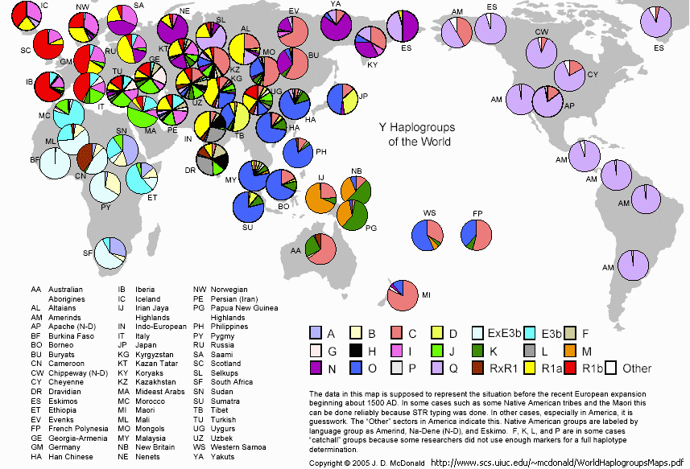

Slide 24
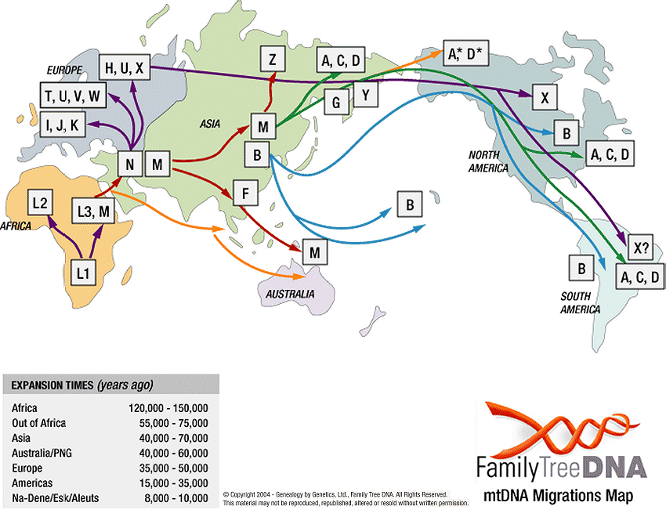

Slide 25
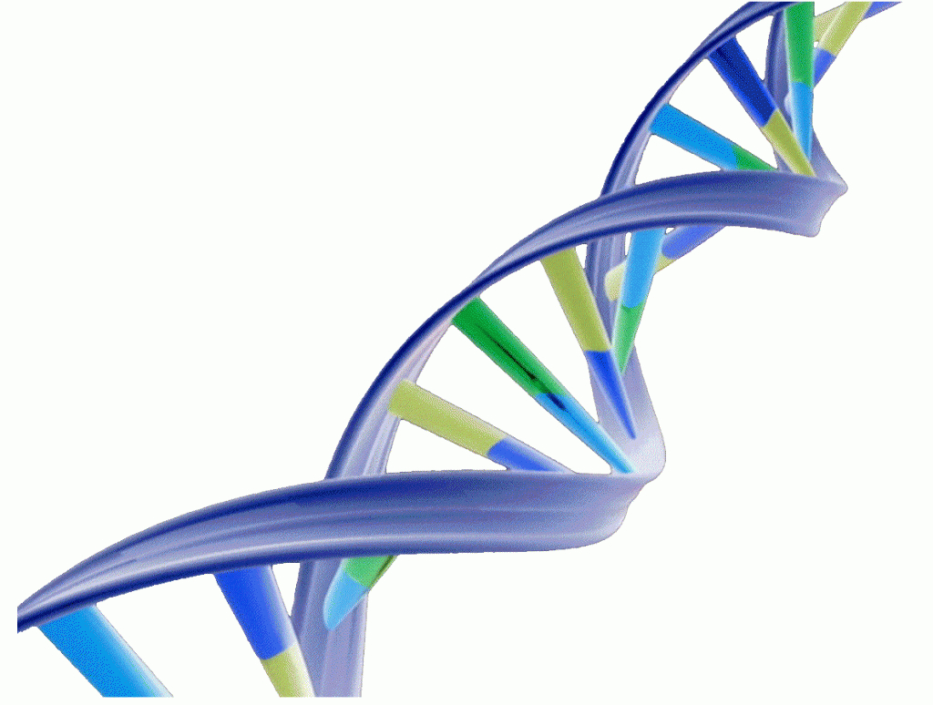
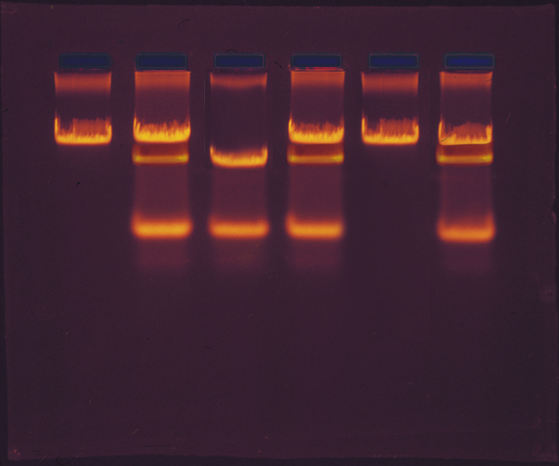
How do we measure gene flow
using DNA polymorphism?

Slide 26
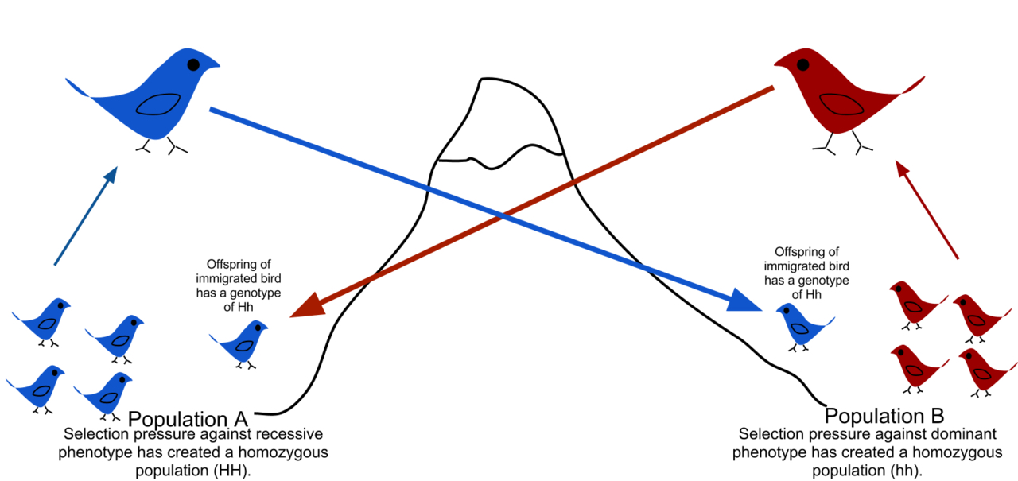
Gene flow is the transfer of alleles from one population to another.
Transfer of h allele
Transfer of H allele
Blue dominant to Red
H dominant to h
Each population has low frequency of heterozygotes due to immigrants backcrossing to other population. Can be difficult to detect in large population if migration rates are low.

Slide 27
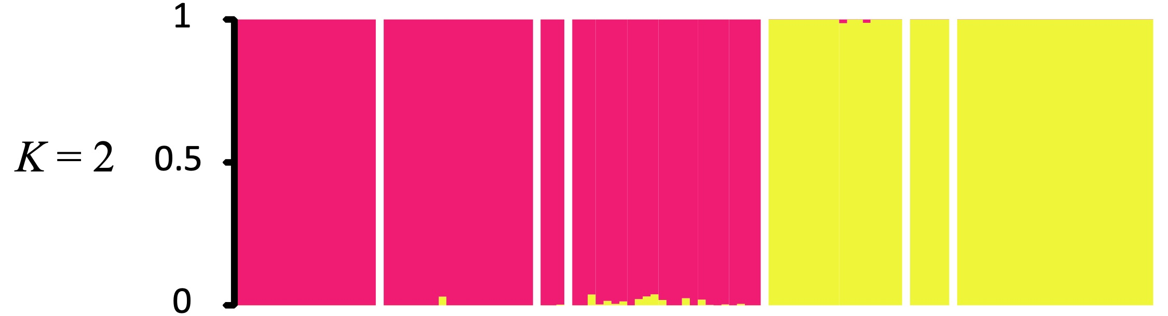
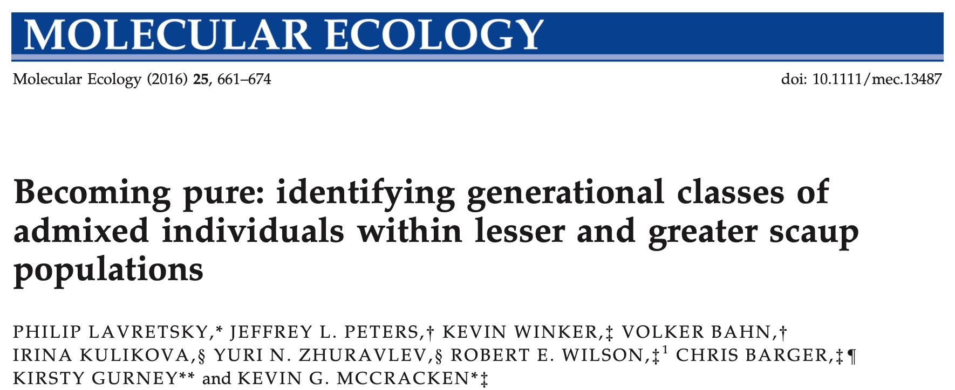
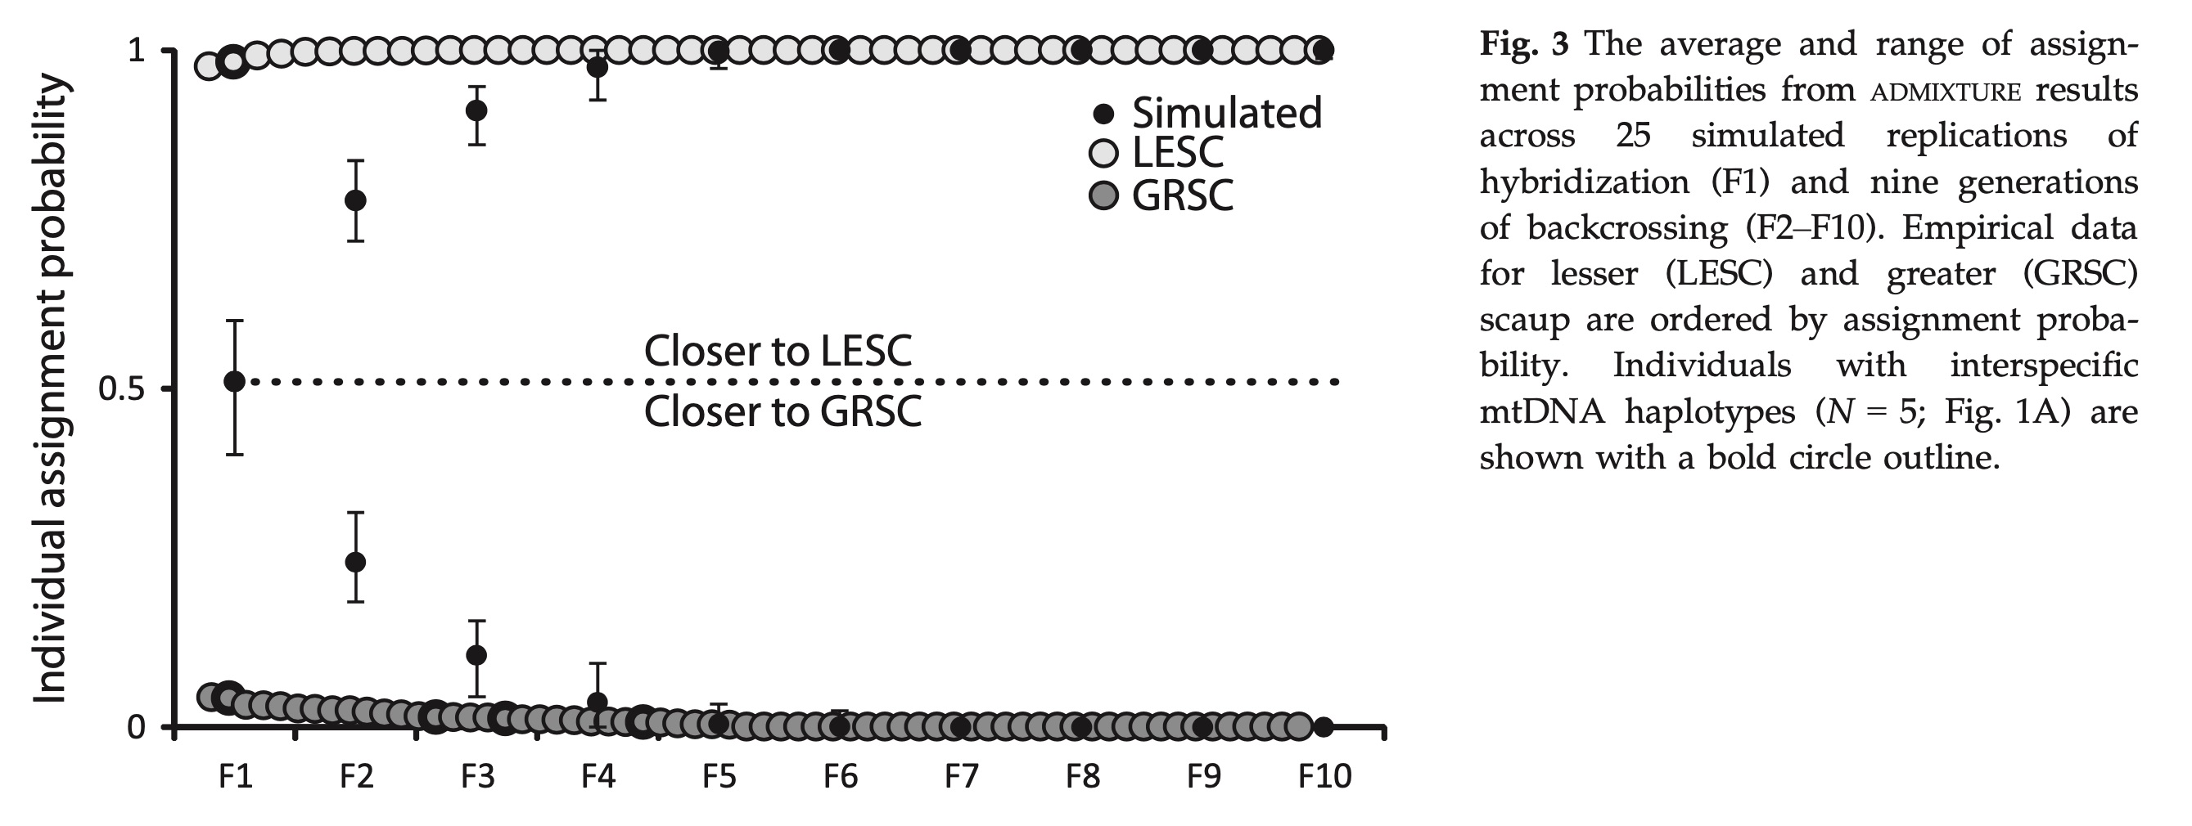
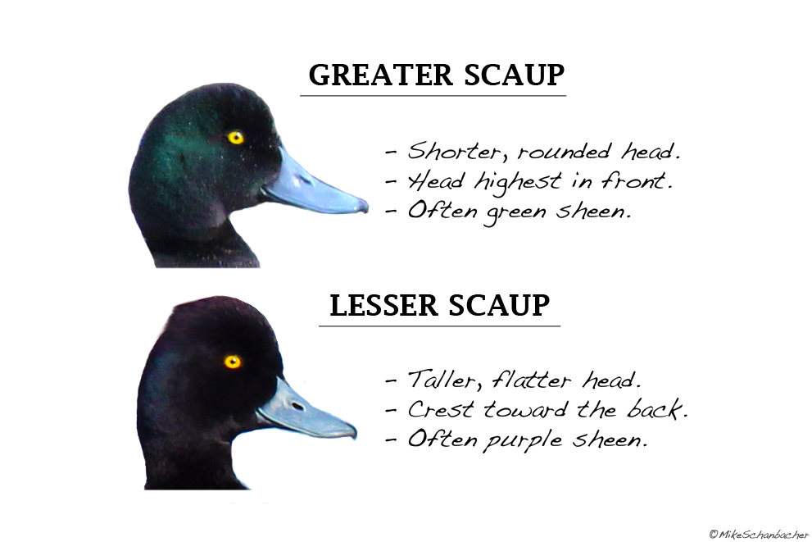
Hybrid-mediated gene flow – backcrossing to a parental population makes hybrids difficult to detect

Slide 28
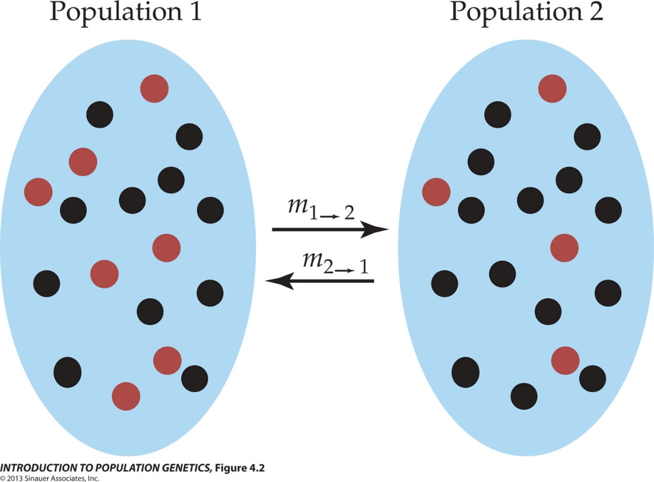
The Wright-Fisher Model with Migration
Assumes two populations constant size, N
Models changes in allele frequencies into future generations (forward in time)
  Occasionally, an individual from one population is replaced by an individual from another population
  m_{1→2} is the probability that an individual from population 1 migrates to population 2.
  m_{2→1} is the probability that an individual from population 2 migrates to population 1.
Migration causes allele frequencies to become more similar between populations.
  Migration opposes drift and reduces F_{st}
Peters

Slide 29
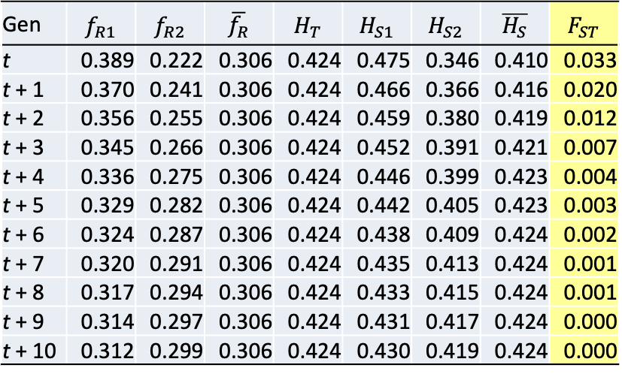

The Wright-Fisher Model with Migration
How will F_{ST} change over time?
$$F_{ST}= \frac{H_{T}−H_{S}}{H_{T}}$$
Gen | $$f_{R1}$$ | $$f_{R2}$$ | $$\overline{f_{R}}$$ | $$H_{T}$$ | $$H_{S1}$$ | $$H_{S2}$$ | $$\overline{H_{S}}$$ | $$F_{ST}$$
t | 0.389 | 0.222 | 0.306 | 0.424 | 0.475 | 0.346 | 0.410 | 0.033
t + 1 | 0.370 | 0.241 | 0.306 | 0.424 | 0.466 | 0.366 | 0.416 | 0.020
t + 2 | 0.356 | 0.255 | 0.306 | 0.424 | 0.459 | 0.380 | 0.419 | 0.012
t + 3 | 0.345 | 0.266 | 0.306 | 0.424 | 0.452 | 0.391 | 0.421 | 0.007
t + 4 | 0.336 | 0.275 | 0.306 | 0.424 | 0.446 | 0.399 | 0.423 | 0.004
t + 5 | 0.329 | 0.282 | 0.306 | 0.424 | 0.442 | 0.405 | 0.423 | 0.003
t + 6 | 0.324 | 0.287 | 0.306 | 0.424 | 0.438 | 0.409 | 0.424 | 0.002
t + 7 | 0.320 | 0.291 | 0.306 | 0.424 | 0.435 | 0.413 | 0.424 | 0.001
t + 8 | 0.317 | 0.294 | 0.306 | 0.424 | 0.433 | 0.415 | 0.424 | 0.001
t + 9 | 0.314 | 0.297 | 0.306 | 0.424 | 0.431 | 0.417 | 0.424 | 0.000
t + 10 | 0.312 | 0.299 | 0.306 | 0.424 | 0.430 | 0.419 | 0.424 | 0.000
0.1111
0.1111
Migration homogenizes allele frequencies and causes F_{st} to decrease over time.
Peters

Slide 30
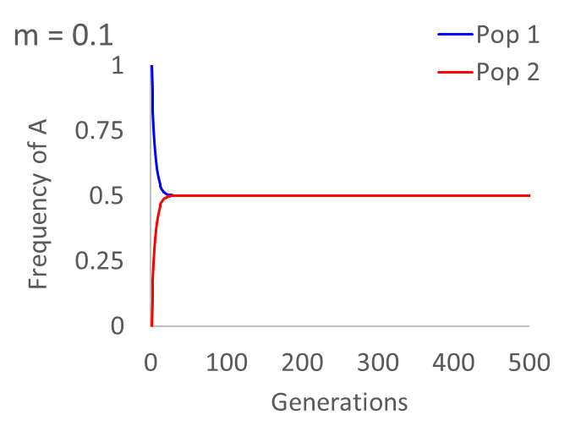
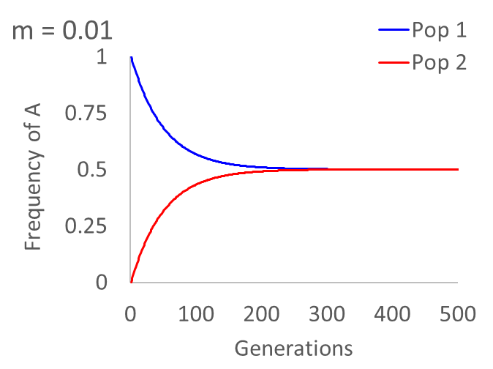
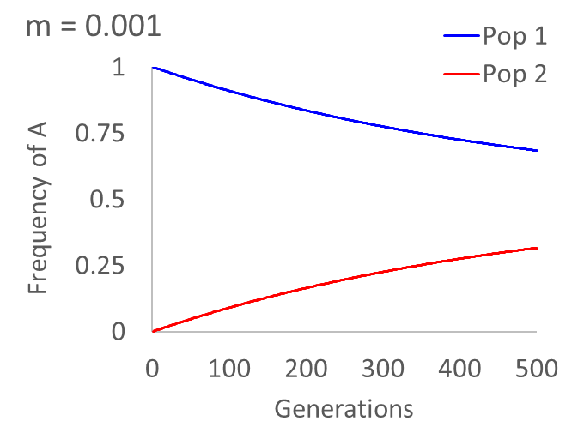
The Wright-Fisher Model with Migration
How do migration rates influence the homogenization of allele frequencies?
The lower the migration rate, the more generations that are required for allele frequencies to become the same.
Peters

Slide 31
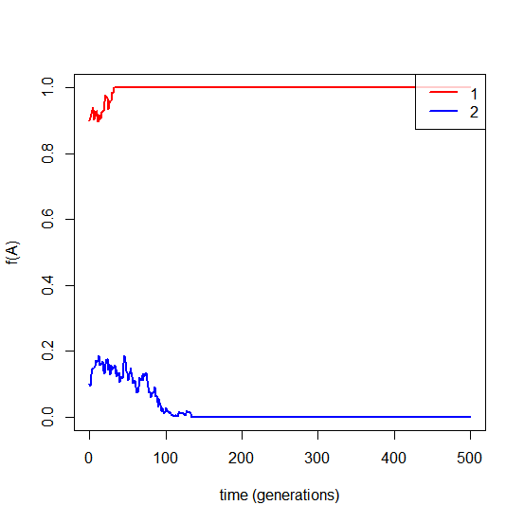
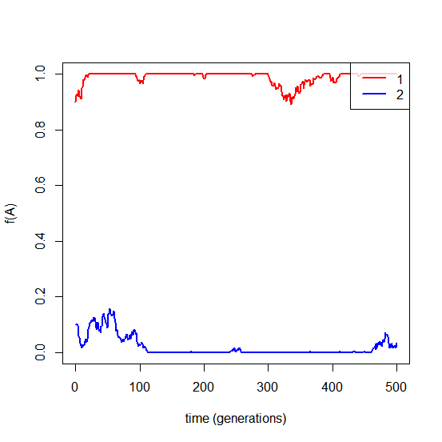
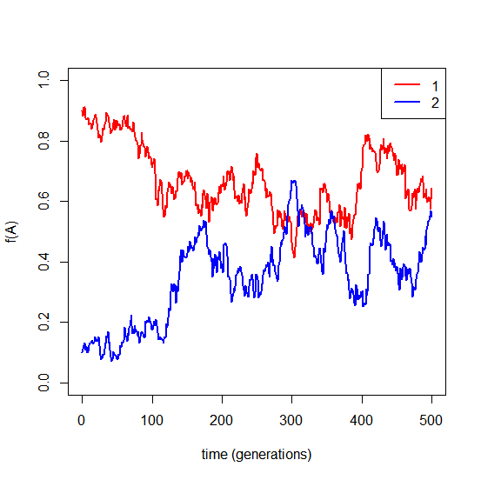
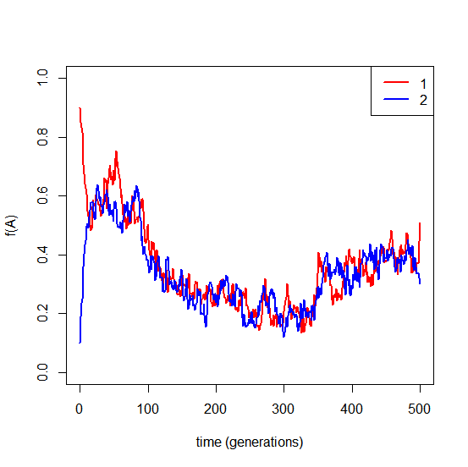
The Wright-Fisher Model with Genetic Drift and Migration
N_{e} = 200, m = 0.0
N_{e} = 200, m = 0.0001
N_{e} = 200, m = 0.005
N_{e} = 200, m = 0.1
No migration: Allele frequencies are independent in the subpopulations.
Low migration: Allele frequencies can drift to fixation, but are reintroduced through migration.
Moderate migration: Allele frequencies are influenced by drift in the other subpopulation.
High migration: Allele frequencies are strongly dependent; behaves as if large effective population size.
Peters

Slide 32

Continent Island Model
Continent-Island model: gene flow is unidirectional from continent to island (similar to source-sink models in ecology)
Population 1 (continent)
Population 2
(island)
m
m = proportion of individuals in the recipient population that are migrants each generation
Important model for real continent-island situations & for fragmented landscapes
p_{t} is the frequency of the p allele in the island population
p_{m} is the frequency of the p allele in the migrants (the frequency in the continent population)
p_{t+1} is the frequency of the p allele in the island population one generation in the future
Peters

Slide 33





Continent Island Model
If p_{1(cont)} = p_{m} = 1.0, p_{1(island)} = p_{t} = 0.0, and m = 0.001 (0.1% of the island population consists of migrants from the continental population each generation), what is p_{t+1} after one generation?
Change in p over 10 generations?
p_{t} | 0
p_{t+1} | 0.001
p_{t+2} | 0.001999
p_{t+3} | 0.002997
p_{t+4} | 0.003994
p_{t+5} | 0.00499
p_{t+6} | 0.005985
p_{t+7} | 0.006979
p_{t+8} | 0.007972
p_{t+9} | 0.008964
p_{t+10} | 0.009955
What about the next generation?
Peters

Slide 34
Long-term Change in Allele Frequencies
(5000 Generations)
If p_{1(cont)} = p_{m} = 1.0, p_{1(island)} = p_{t} = 0.0, and m = 0.001
~
~
Equilibrium is reached when p_{t+1} = p_{t} = p; thus p = p_{m}
The higher the m, the higher and the more rapidly equilibrium is reached.
Eventually, the island population will be genetically identical to the continental population.
Assumes no mutation, no genetic drift, and no selection.
Peters

Slide 35
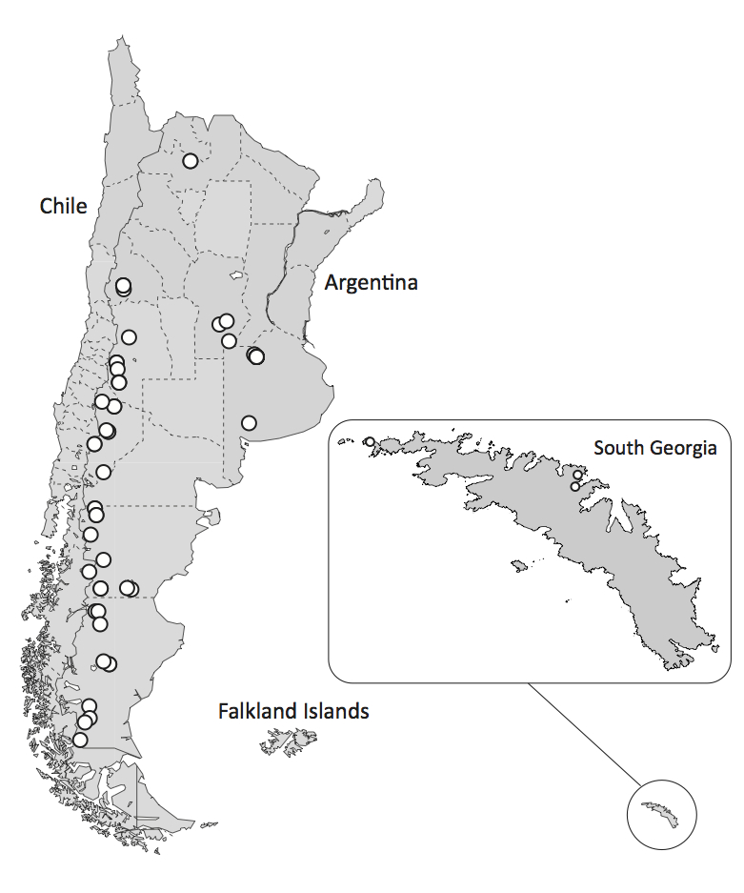
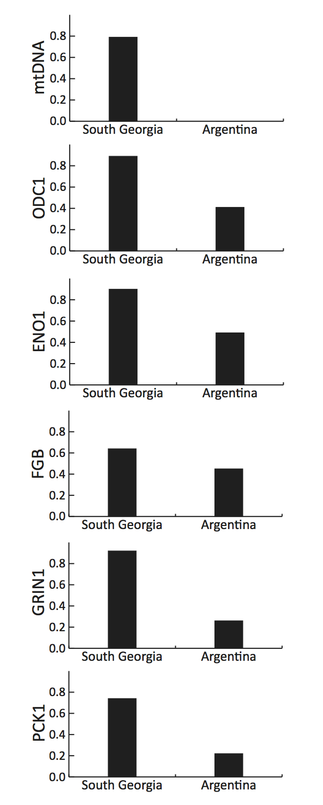
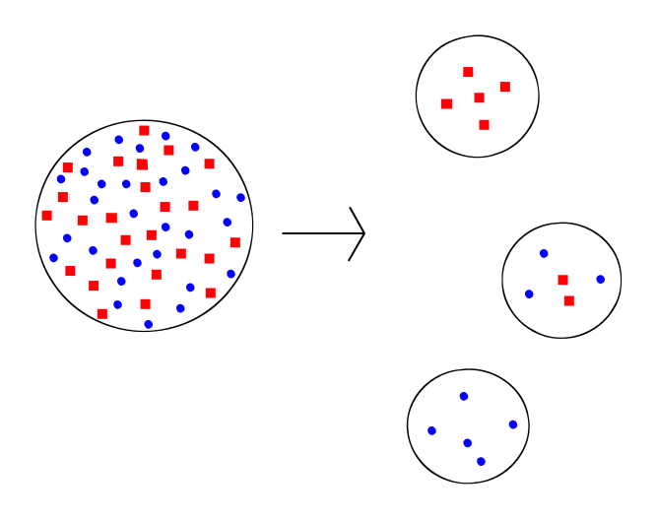
Island model and a founder event:
Continental
gene pool
Large N_{e}
Frequency of most common allele is shown at right.
Islands
reflect effects of genetic drift
Small N_{e}
McCracken, K. G., R. E. Wilson, J. L. Peters, K. Winker, and A. R. Martin (2013) Late Pleistocene colonization of South Georgia by Yellow-billed Pintails predates the Last Glacial Maximum. Journal of Biogeography 40:2348-2360.

Slide 36

Wright’s Island Model
Assumptions:
m & (q in this diagram) are the same for all populations.
Can solve for p_{t+1} and Nm as described previously, but must incorporate the contribution from all populations.

Slide 37





Assuming drift-migration equilibrium, it is possible to calculate the number of migrants from F_{st}
Nm is the effective number of migrants (individuals) per generation.
*

Slide 38

For the Island Model, with equal sample sizes at drift-migration equilibrium:
F_{ST}
Nm
1 migrant per generation prevents fixation

Slide 39
Assumptions
Diploid population
Island model of population structure
Mutation follows infinite alleles model (no homoplasy)
Drift-migration equilibrium
No selection
Constant population size
Satisfying all these assumptions is usually unrealistic.

Slide 40

Stepping Stone Models
Assumption:
Populations only exchange genes with neighboring populations
Isolation-by-Distance (IBD) effect.
Isolation-by-Distance: Decreased probability of mating or gene flow as the geographic distance between individuals or populations increases.

Slide 41

Highest migration rates
Produce strongest correlations among allele frequencies with lowest Fst.
Magnitude of gene flow and distance between populations determine the similarity in allele frequencies in stepping-stone models.
r is the correlation among allele frequencies between two populations (the higher the r, the lower the F_{ST})

Slide 42



Isolation by Distance
Typically plotted against geographic distance as F_{ST}/(1 - F_{ST}) to obtain a linear relationship.
The rise and fall of isolation by distance in the anadromous brook charr Salvelinus fontinalis Mitchill
http://theses.ulaval.ca/archimede/fichiers/20348/ch04.html

Slide 43


The “ring species” is another kind of
stepping stone model:
Greenish Warbler (Phylloscopus trochiloides) forms a ring around the Himalayas
– Darren Irwin (UBC)
Coventional “cline” in allele frequencies
Open “ring species”
Closed “ring species” red & green don’t interbreed where they contact

Slide 44

https://commons.wikimedia.org/wiki/File:Ring_Species_(gene_flow_around_a_barrier).png

Slide 45


Cline
Species that fit stepping stone models of population structure, including Isolation by Distance and Ring Species, display clinal patterns of genetic variation.
Cline = continuous gradient of phenotypic or genetic differences, usually as a result of (1) isolation by distance (neutral), or (2) selection acting on environmental heterogeneity.
Herring Gulls interbreed in a ring around the Arctic.
1: Larus argentatus argentatus
2: Larus fuscus (sensu stricto)
3: Larus fuscus heuglini
4: Larus argentatus birulai
5: Larus argentatus vegae
6: Larus argentatus smithsonianus
7: Larus argentatus argenteus
Liebers, Dorit; de Knijff, Peter & Helbig, Andreas J. (2004): The herring gull complex is not a ring species. Proc. Roy. Soc. B 271: 893-901

Slide 46




Cline - Isolation by Distance - Neutral Variation
Lazuli Bunting
Indigo Bunting
Carling, MD and RT Brumfield (2008) Haldane’s rule in an avian system: Using cline theory and divergence population genetics to test for differential introgression of mitochondrial, autosomal and sex-linked loci across the Passerina bunting hybrid zone. Evolution 62:2600-2615.

Slide 47

Frequency of cold-adapted LDH allele
in Fundulus heteroclitus
LDH catalyzes reversible conversion of pyruvate to lactate
https://schoolbag.info/biology/living/115.html

Slide 48

J of Evolutionary Biology, Volume: 30, Issue: 8, Pages: 1512-1515, First published: 08 August 2017, DOI: (10.1111/jeb.13112)
Notes:
Four scenarios of divergence and gene flow under which to consider the detection of barrier loci in speciation. We now know that elevated genomic divergence in regions of the genome can arise from a variety of processes other than divergent selection and differential introgression during speciation. The divergence time of the taxa under consideration and the presence or absence of contemporary gene flow between the taxa have a large influence on our ability to infer process from patterns of genomic differentiation. RI, reproductive isolation.
IF THIS IMAGE HAS BEEN PROVIDED BY OR IS OWNED BY A THIRD PARTY, AS INDICATED IN THE CAPTION LINE, THEN FURTHER PERMISSION MAY BE NEEDED BEFORE ANY FURTHER USE. PLEASE CONTACT WILEY'S PERMISSIONS DEPARTMENT ON PERMISSIONS@WILEY.COM OR USE THE RIGHTSLINK SERVICE BY CLICKING ON THE 'REQUEST PERMISSIONS' LINK ACCOMPANYING THIS ARTICLE. WILEY OR AUTHOR OWNED IMAGES MAY BE USED FOR NON-COMMERCIAL PURPOSES, SUBJECT TO PROPER CITATION OF THE ARTICLE, AUTHOR, AND PUBLISHER.

Slide 49



Figure 4.3. The coalescence process in a model with migration
Moving back in time, lineages move to the other population with probability, m.
Probability that an individual was not a migrant one generation ago = $1−m$
Probability that an individual was not a migrant r generation ago = ${(1−m)}^{r}$
*This equilibrium model without population splitting or changes in population size assumes infinite divergence times
Peters
Notes:
IntroPopGen-Fig-04-03-0.jpg

Slide 50

Figure 4.3. The coalescence process in a model with migration
Applications to real populations
Migration rates can be scaled to the substitution rate (µ) or to the effective population size (2N_{e})
  Define $M=m/μ$ or $M=2N_{e}m$
  When we scale to µ, M can be estimated from the genealogy as the probability of migration relative to the probability of mutation
  In other words are variants arising from mutation or introduction through migration
  Falls apart when $m$ is very high
*Assumes infinite divergence times
Peters
Notes:
IntroPopGen-Fig-04-03-0.jpg

Slide 51

Figure 4.3. The coalescence process in a model with migration
Applications to real populations
We can determine the effective number of migrants ($2N_{e}m$) from coalescence genealogies without knowing the substitution rate
  We simultaneously estimate $θ$ ($4N_{e}μ$) and M ($m/μ$) from the genealogy
    $θ=4N_{e}(m/M)$
    $θM=4N_{e}m$
    $\frac{θM}{2}=2N_{e}m$
    $2N_{e}m$ is the effective number of migrants
    This is the biologically meaningful parameter
*Assumes infinite divergence times
Peters
Notes:
IntroPopGen-Fig-04-03-0.jpg

Slide 52


Figure 4.3. The coalescence process in a model with migration
Immigrant
Green-winged Teal
Immigrant
*Assumes infinite divergence times
*Migrants are easy to detect because the lineages are sorted and deeply divergent.
Peters

Slide 53


Figure 4.3. The coalescence process in a model with migration
Gadwall
Recent divergence, high migration rates, or both
?
*Assumes infinite divergence times
*Migrants are difficult to discern because the lineages are not sorted and not deeply divergent.
Peters

Slide 54


Isolation-with-migration (IM) models
Simultaneously estimate 6 parameters in a 2-population model, each scaled to the substitution rate μ
Estimate parameters from many genealogies consistent with the data
Examine many combinations of divergence and migration rates
Determine which combinations best fit the data
Best accomplished using many loci to account for the stochastic effects of genetic drift
Peters

Slide 55

Isolation-with-migration models
N_{e} = 510,000 individuals
N_{e} = 430,000 individuals
N_{A} = 240,000 individuals
T = 64,000 years ago
2Nm = 0 migrants/generation
2Nm = 18 migrants/generation
Gadwall
Peters, Winker, & McCracken. 2012. PLoS One 7:e319722.
Peters

Slide 56
2N_{e}μ
Genetic variation; Allele or genotype frequencies
Mutation
Genetic Drift
Migration
2N_{e}μ
Genetic variation; Allele or genotype frequencies
Mutation
Genetic Drift
The influence of gene flow on the genetic diversity of a population depends on 2N_{e}m, which is the effective number of immigrant copies each generation
Peters

Slide 57
Summary – Migration & Gene Flow
Gene flow adds genetic diversity through the immigration of new alleles.
Gene flow homogenizes allele frequencies among populations, increases N_{e}, and reduces effects of drift.
Stepping stone gene flow result in a correlation between geographic distance and genetic differentiation.
If populations in drift-migration equilibrium, it is possible to calculate Nm from F_{st}.
Nm is the effective number of immigrants per generation (2Nm is the number of immigrant gene copies).
Nm > 1 between populations prevents fixation.

