Slide 1
Inbreeding & Inbreeding Depression
University of Miami
Spring 2026

Slide 2
Inbreeding
Inbreeding is the mating between related individuals sharing common ancestry
Opposite of outcrossing
This can be preferential through assortative mating with close relatives or accidental, especially when the population size is small.

Slide 3
Inbreeding Depression
While inbreeding may be useful for retaining desirable traits or eliminating undesirable traits…
It can result in inbreeding depression, referring to loss of size, vigor, fitness, or fertility.

Slide 4

Recall the factors Affecting Ne:
If all individuals leave the same # offspring:
V_{k} = 0, and N_{e} = 2N
Ne is maximized by equalizing reproductive output!
Maximizing number of offspring or occurrence/absence of a particular trait is not necessarily the best strategy, and will result in loss of genetic diversity.

Slide 5
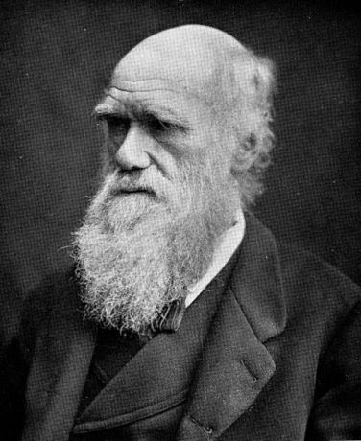
Harmful effects recognized by Darwin
Not denied by persons breeding animals.
Attributable to the combination of morbid tendencies common to both parents.
A source of mischief there is no doubt.
---Darwin 1896

Slide 6
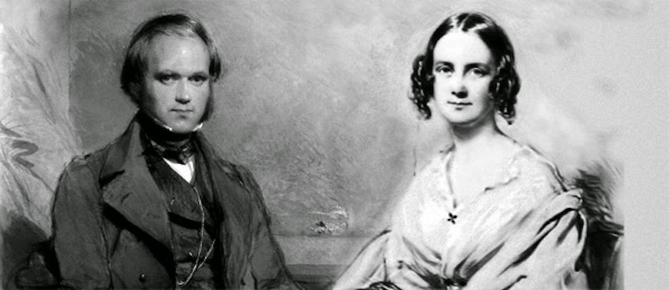
Darwin married his 1st cousin Emma Wedgewood
10 children total
Three died before age 10
Six of the others married long-term
50% had children
50% did not

Slide 7
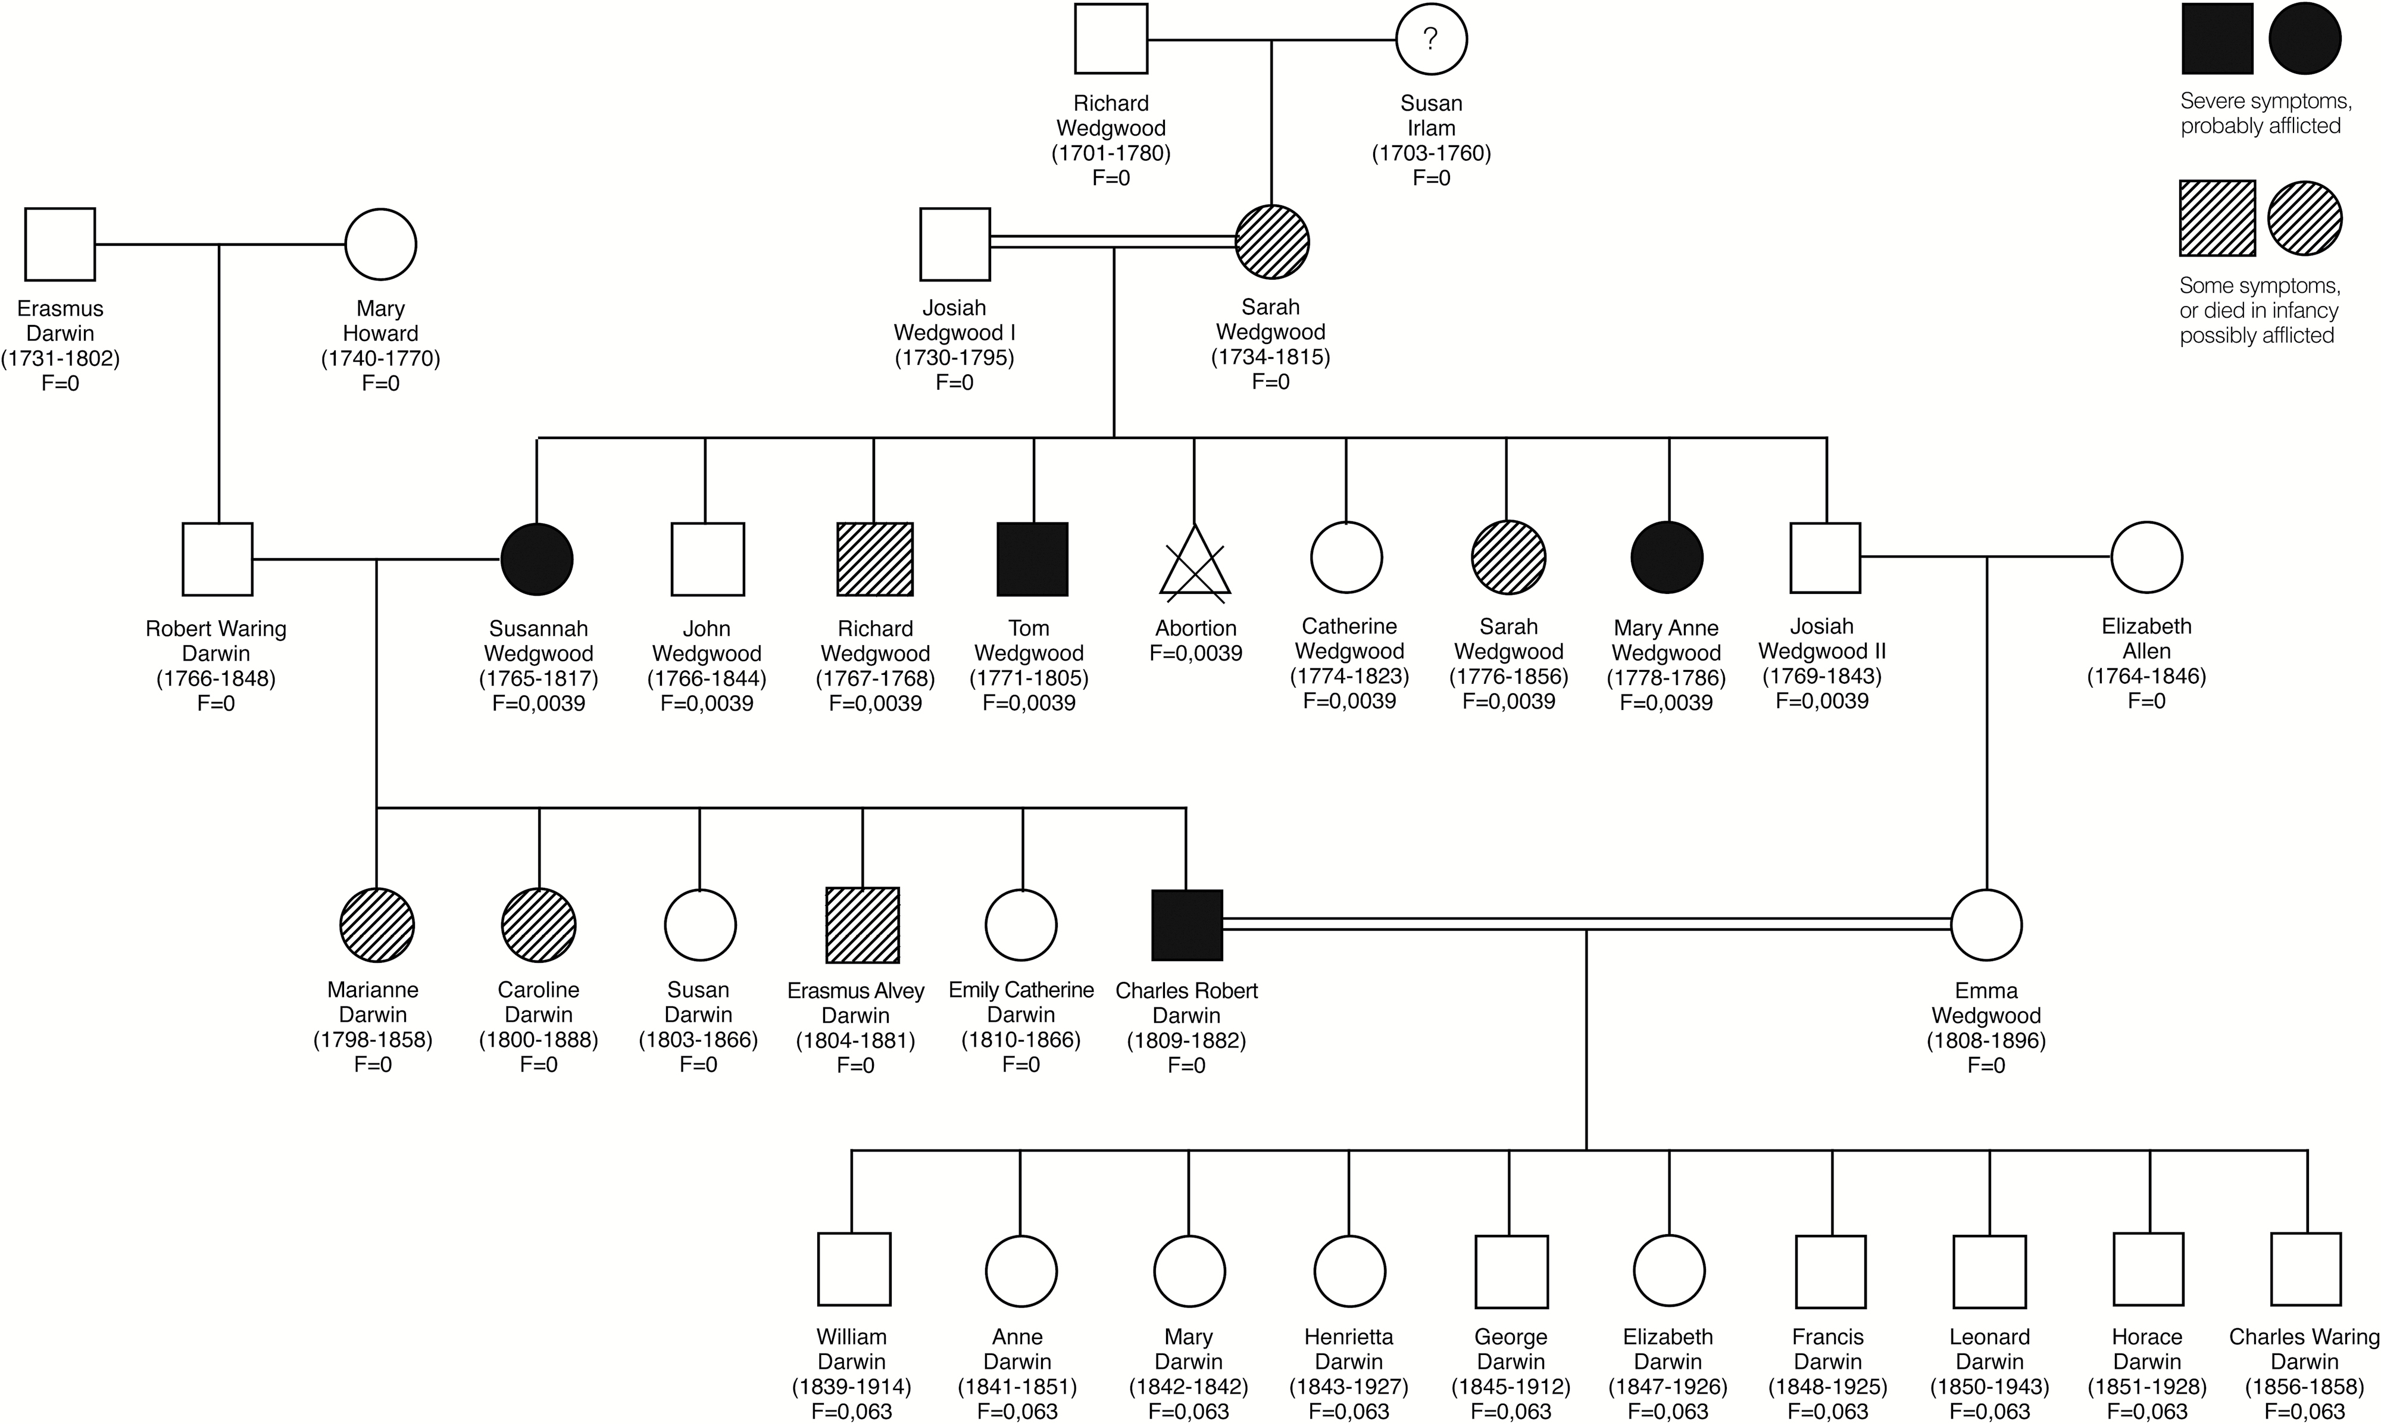

Figure 1. The Darwin-Wedgwood family tree. Charles’ elder brother Erasmus and two elder sisters had significant ...
Grandfather
3rd Cousins
Mother
Darwin’s 1st Cousin
6.3% chance of receiving identical gene copies
X
X
X
Notes:
Figure 1. The Darwin-Wedgwood family tree. Charles’ elder brother Erasmus and two elder sisters had significant illnesses. Their mother Susannah had severe illness, as did her younger brother Tom. The youngest sibling of that generation, Mary Ann, died at the age of 8 with MELAS symptoms, a recognised mitochondrial disorder. Their mother (CD’s grandmother) also had chronic illness.
Unless provided in the caption above, the following copyright applies to the content of this slide: © 2017 The Linnean Society of London, Biological Journal of the Linnean Society

Slide 8
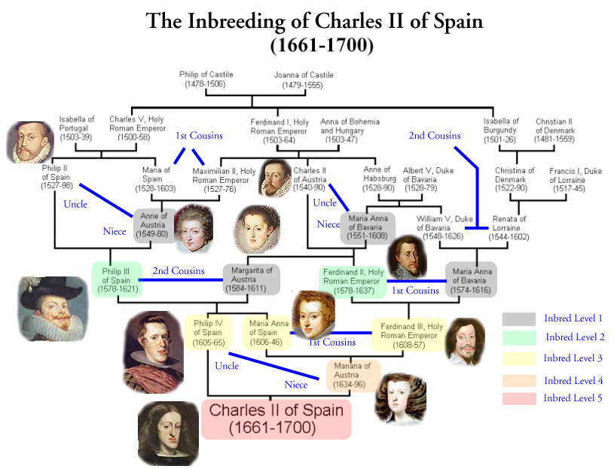
Two centuries of inbreeding
F = 0.025
F = 0.254

Slide 9
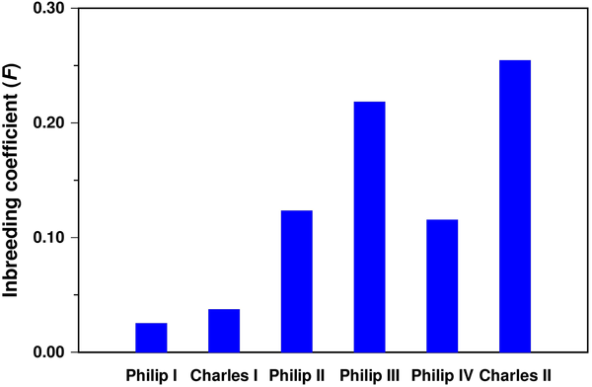
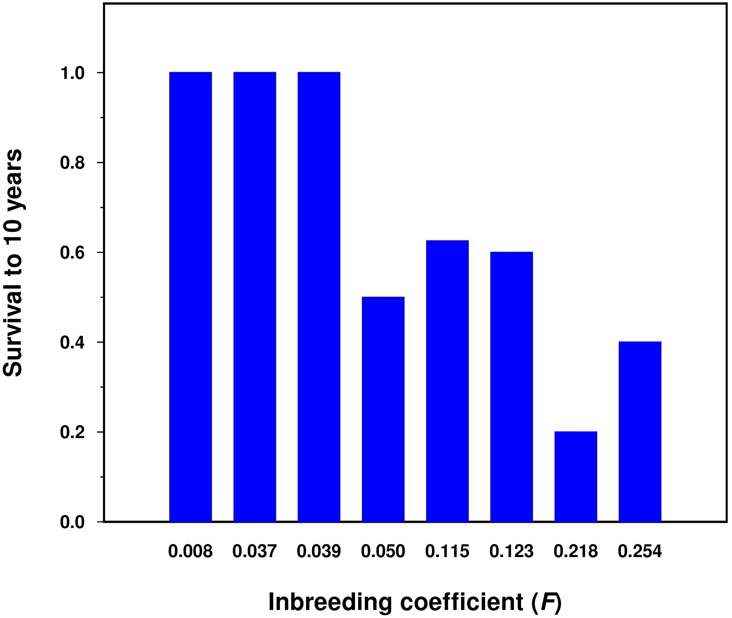
Figures 2 & 4. Inbreeding coefficient (F) of the Spanish Habsburg kings.
Alvarez G, Ceballos FC, Quinteiro C (2009) The Role of Inbreeding in the Extinction of a European Royal Dynasty. PLOS ONE 4(4): e5174. https://doi.org/10.1371/journal.pone.0005174
https://journals.plos.org/plosone/article?id=10.1371/journal.pone.0005174

Slide 10
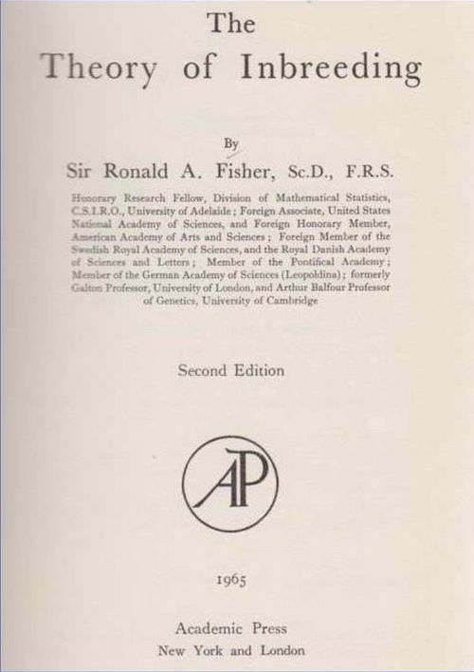
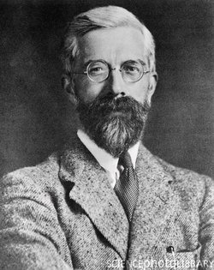
One of the first important books about inbreeding was published by R.A. Fisher (1949)

Slide 11

Genetic drift can cause inbreeding
Recall in our earlier lecture, that genetic drift always causes variation to be lost.
Heterozygosity is always reduced.
Inbreeding Coefficient = probability that two copies of a gene are identical by descent (IBD).
Generation t-1
Generation t
Identical by descent
Identical by state

Slide 12
Three main phenomena measured by inbreeding coefficients
Genetic drift (F_{ST})
Nonrandom mating (F_{IS})
Homozygostity

Slide 13
Facts about inbreeding
Occurs in large & small populations
Commonly occurs by self-fertilization
Geographic proximity (e.g., trees)
Occurs in small populations even with random mating.
If N_{e} = 10, all individuals will be cousins after a few generations.
Increased homozygosity can lead to inbreeding depression (the reduction in fitness)
Can contribute to extirpation

Slide 14
Inbreeding defined by pedigree
For example, if mother & father share a recent common ancestor.
All individuals in a populations share a common ancestor far enough back in time (see next slide).
Manifest as increased homozygosity and decreased heterozygosity, due to alleles being identical by descent (IBD).
Generation t-1
Generation t
Identical by descent
Identical by state

Slide 15
The Wright - Fisher Population Model of Genetic Drift
Most Recent Common Ancestor (MRCA)
6
Generations Ago
5
4
3
2
1
0
Present
# of ancestral copies stays the same or decreases with time
= copies went extinct = genetic variation lost

Slide 16
Allozygous vs Autozygous
Allozygous Two alleles descended from different ancestral alleles in the base population
Autozygous Identical by descent

Slide 17
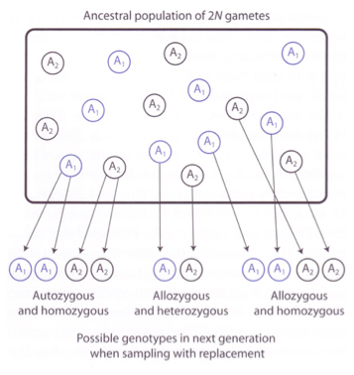
IBD

Slide 18
Inbreeding coefficient F
F = probability that two alleles at any locus are IBD from a recent common ancestor(s) of two parents.
For, 1st cousin marriage, coefficient of relationship = 12.5% identity, thus…
For male 1/8 probability that gene is IBD
For female 1/8 probability that same gene is IBD
½ that she transmits that gene to child
1/8 x 1/8 x 1/2 = 1/32 (e.g., second cousins)

Slide 19
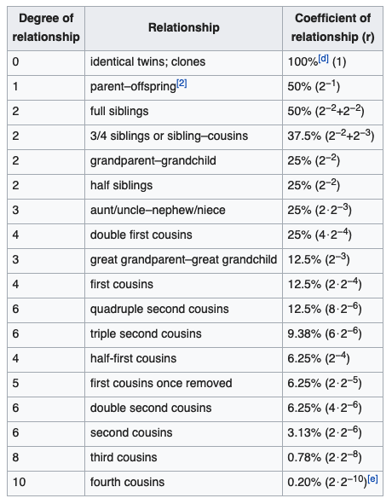
Coefficient of relationship
---Wikipedia

Slide 20
The % heterozygosty remaining with different modes of inbreeding. Rate of loss of heterozygosity (LOH) increases with the relatedness of the parents.
Table 13.2 Allendorf et al. 2013
Generation | Half-Sib | Full-Sib | Selfing
0 | 1.000 | 1.000 | 1.000
1 | 0.875 | 0.750 | 0.500
2 | 0.781 | 0.625 | 0.250
3 | 0.695 | 0.500 | 0.125
4 | 0.619 | 0.406 | 0.062
5 | 0.552 | 0.328 | 0.031
10 | 0.308 | 0.114 | 0.008

Slide 21
Methods for calculating F
Sewall Wright’s path analysis
Gene drop simulation
Molecular markers

Slide 22
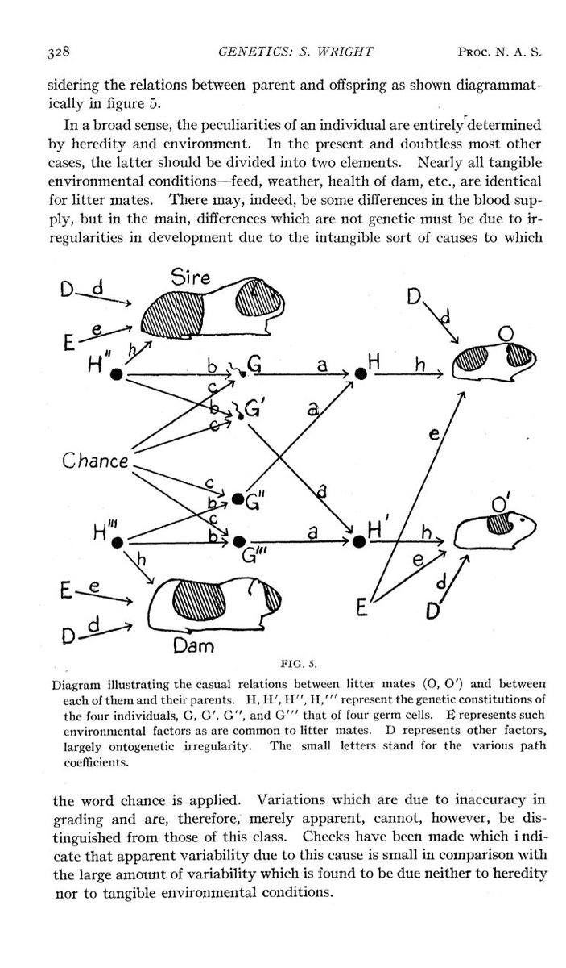
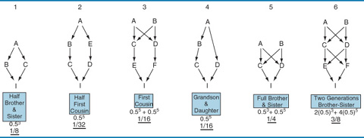
Examples calculating the inbreeding coefficient F from a path analysis
F = Σ(¹/₂)^{N}(1+F_{CA})
where N is the # individuals in the loop
and F_{CA} is inbreeding coefficient of the common ancestor

Slide 23
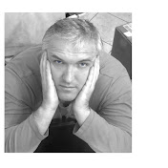
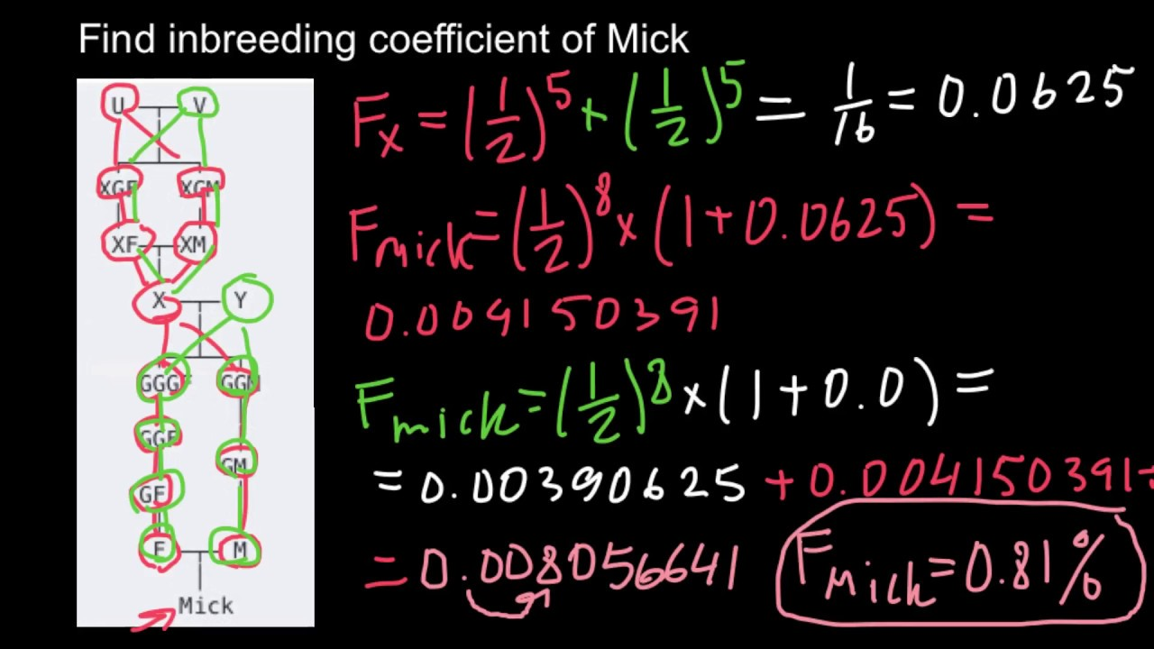
YouTube Video
Nikolay's Genetics Lessons - Published on Oct 6, 2015
https://youtu.be/1H8mhSHCWxw

Slide 24
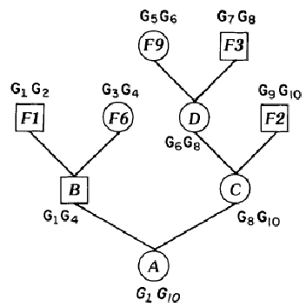
Gene Drop Simulation
Illustration of gene dropping simulation. Allocation of unique hypothetical alleles (G) to founders (F) and genotype assign to descendants (A, B, C, D) by Mendelian segregation of founder alleles.
Nejati Javaremi, Ardeshir & Khaldari, Majid & Berg, Peer & Pakdel, Abbas & Mehrabani Yeganeh, Hasan. (2013). Management of genetic diversity using gene dropping method based on pedigree information. Archiv fur Tierzucht. 56. 10.7482/0003-9438-56-050.

Slide 25
Estimating F with Molecular Markers
Difficult to use pedigree if relationships among individuals are not available.
Also, pedigrees can be shallow, have gaps, and be inaccurate.
Estimate F using degree of homozygosity relative to others in populations, where F equals the expected increase in homozygosity due to IBD.
This approach requires MANY molecular markers; and the more the better.
In principal, markers can be used to infer pedigree but often doesn’t work because there can be significant gaps.

Slide 26
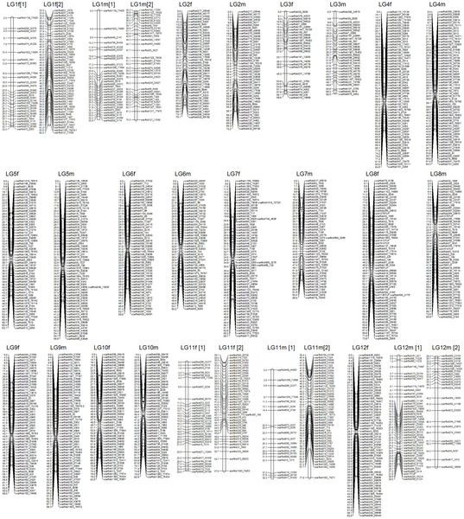
Figure 1. Japanese flounder male (left) and female (right) maps.
Song W, Pang R, Niu Y, Gao F, Zhao Y, et al. (2012) Construction of High-Density Genetic Linkage Maps and Mapping of Growth-Related Quantitative Trail Loci in the Japanese Flounder (Paralichthys olivaceus). PLOS ONE 7(11): e50404. https://doi.org/10.1371/journal.pone.0050404
https://journals.plos.org/plosone/article?id=10.1371/journal.pone.0050404

Slide 27
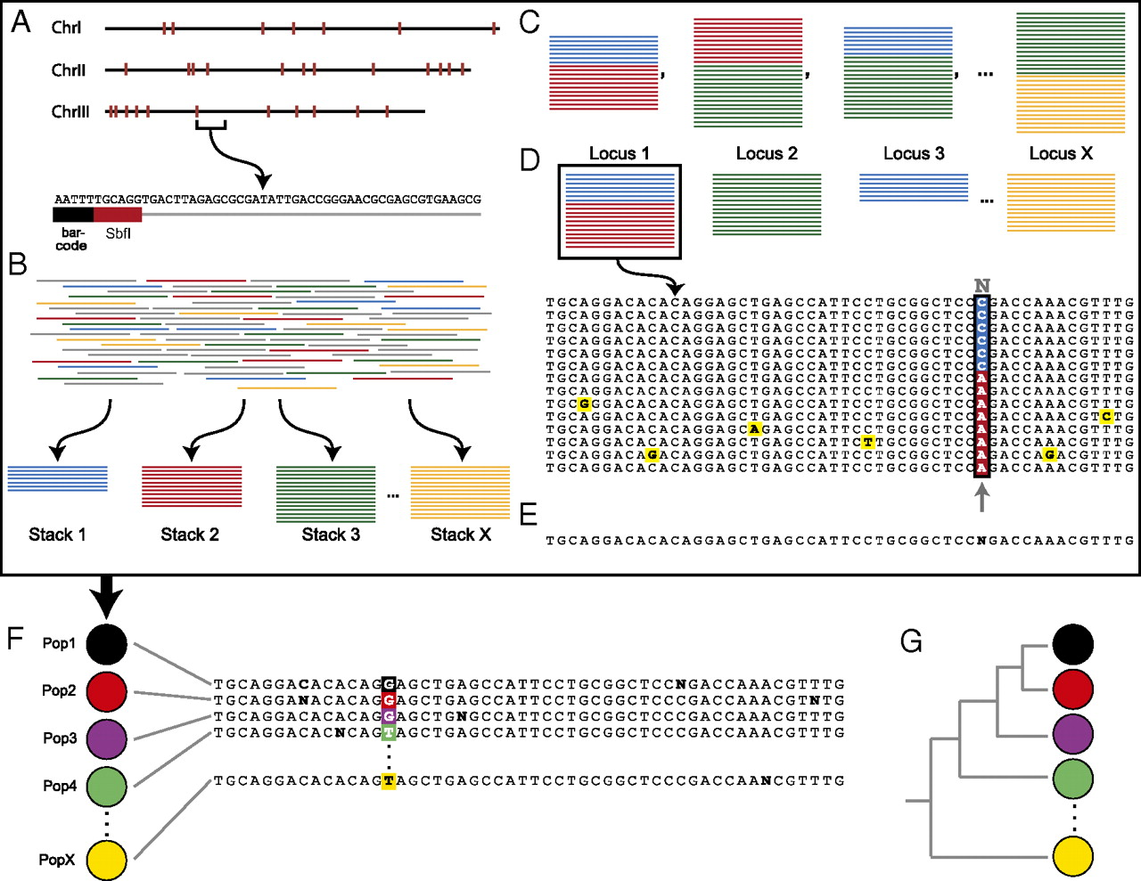

In silico RAD tag genotyping within (A–E), and SNP discovery between (F and G), populations.
Kevin J. Emerson et al. PNAS 2010;107:37:16196-16200
©2010 by National Academy of Sciences
Notes:
In silico RAD tag genotyping within (A–E), and SNP discovery between (F and G), populations. (A) W. smithii has three nuclear chromosomes, each of which contains multiple SbfI cut sites (red marks). The genomic DNA is digested, barcoded with a population-specific sequence, and amplified, resulting in multiple sequence reads from each of the RAD tag sites in the genome. Each sequence consists of a population-specific 5-bp barcode (black), the enzyme-recognition sequence (red), and the downstream sequence. (B) The de novo RAD tag pipeline compares all the sequenced reads and builds stacks of exactly matching tags. (C) Pairwise comparisons are made between all stacks, i.e., blue vs. red, red vs. green, blue vs. green, and so on. (D) Loci were defined as a set of stacks such that for each stack, there is another stack in the locus that is at most one nucleotide divergent. Each locus is then examined one nucleotide position at a time. If the nucleotide at that position is at a significantly high frequency within the population, it is considered to be the consensus nucleotide; if not, it is replaced with an N, resulting in (E) the consensus sequence for that RAD tag site within the population. (F) This process is repeated for each of the populations. (G) The resulting RAD tag consensus sequences are then used for phylogenetic analysis.

Slide 28
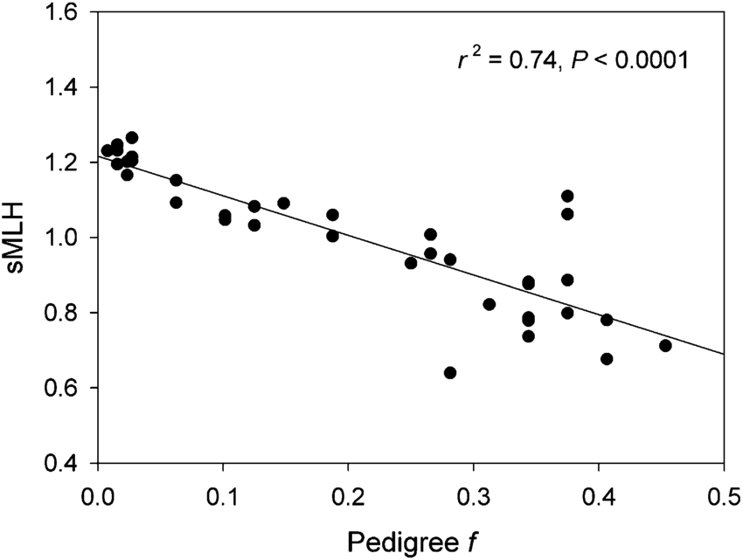
Correlation between pedigree-based inbreeding coefficient (f) and RAD standardized multilocus heterozygosity (sMLH) for 36 oldfield mouse individuals. The r² for the equivalent relationship based on 12 microsatellites is substantially lower at 0.276.
Hoffman, Joseph & Simpson, Fraser & David, Patrice & Rijks, Jolianne & Kuiken, Thijs & Thorne, Michael & Lacy, Robert & Dasmahapatra, Kanchon. (2014). High-throughput sequencing reveals inbreeding depression in a natural population. Proceedings of the National Academy of Sciences of the United States of America. 111. 10.1073/pnas.1318945111.

Slide 29
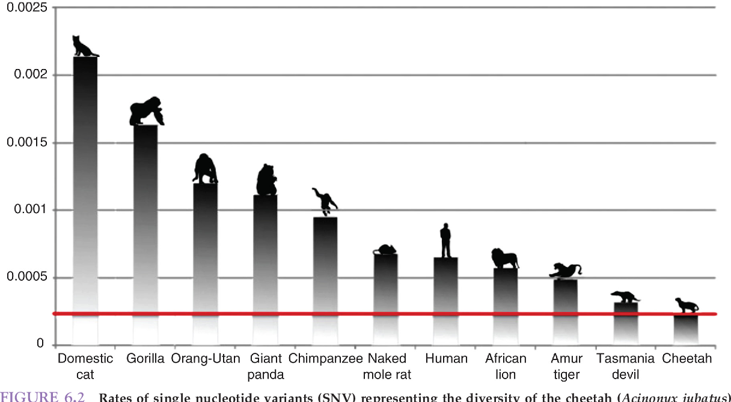
Domestic cat
24% Homozygous
Cheetah
95 % Homozygous
Rates of single nucleotide variants
Dobrynin, P., Liu, S., Tamazian, G. et al. Genomic legacy of the African cheetah, Acinonyx jubatus . Genome Biol 16, 277 (2015). https://doi.org/10.1186/s13059-015-0837-4

Slide 30
Causes of Inbreeding Depression
The reduction in biological fitness observed due to inbreeding as a result of either:
Increased homozygosity – leading to greater expression of recessive alleles.
  This mechanism is thought to be most important.
Decreased heterozygosity – resulting loss of fitness at loci where heterozygotes have a selection advantage over homozygotes.
  This is probably less frequent.
Expect all species to show some level of inbreeding depression.

Slide 31
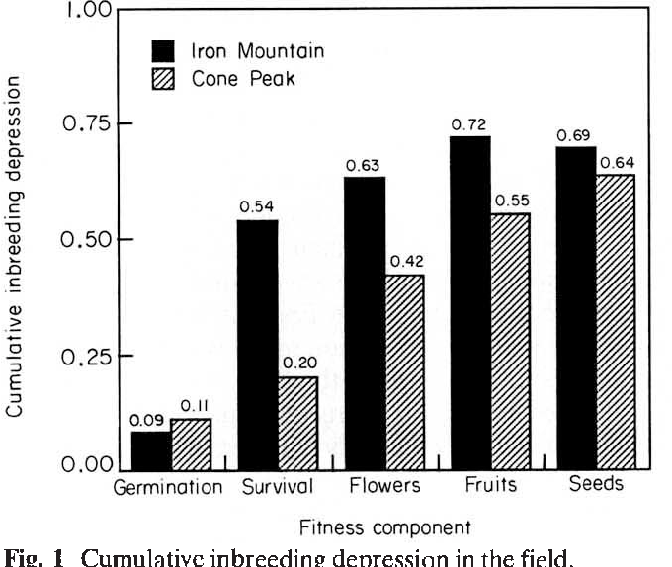
Cumulative inbreeding depression through the lifecycle in the monkeyflower, as proportional reduction in fitness of selfed vs. outcrossed progeny (1 – w_{s}/w_{o}).
Willis (1993) - Heredity

Slide 32
Increased homozygosity increases exposure to deleterious alleles
 | AA | Aa | aa
Expected | p² + pqF | 2pq – 2 pqF | q² + pqF
F = 0 | 0.810 | 0.180 | 0.010
F = 0.10 | 0.819 | 0.162 | 0.019
Table Chapter 13 Allendorf et al. 2013
Expected proportion of individuals affected by deleterious allele nearly doubles with just 10% increase in inbreeding.

Slide 33
How is IB depression measured?
Mean # of lethal equivalents (LEs) per genome.
Estimated by regressing survival on the inbreeding coefficient F.
S = e^{−(A + BF)}
where e^{−A} = survival of outbred population
B = rate of fitness decline with inbreeding (i.e., slope or inbreeding load), reflecting # LEs per gamete

Slide 34
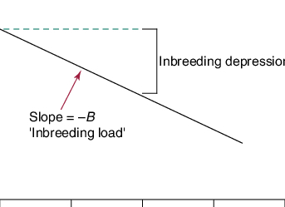
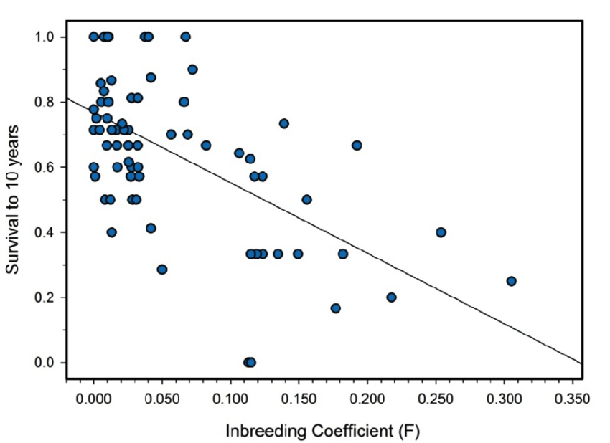
Survival and inbreeding coefficient (F) of offspring of 71 marriages from the Habsburg royal dynasty
Alvarez, Gonzalo & Quinteiro, Celsa & Ceballos, Francisco. (2011). Inbreeding and Genetic Disorder. 10.5772/18373.

Slide 35
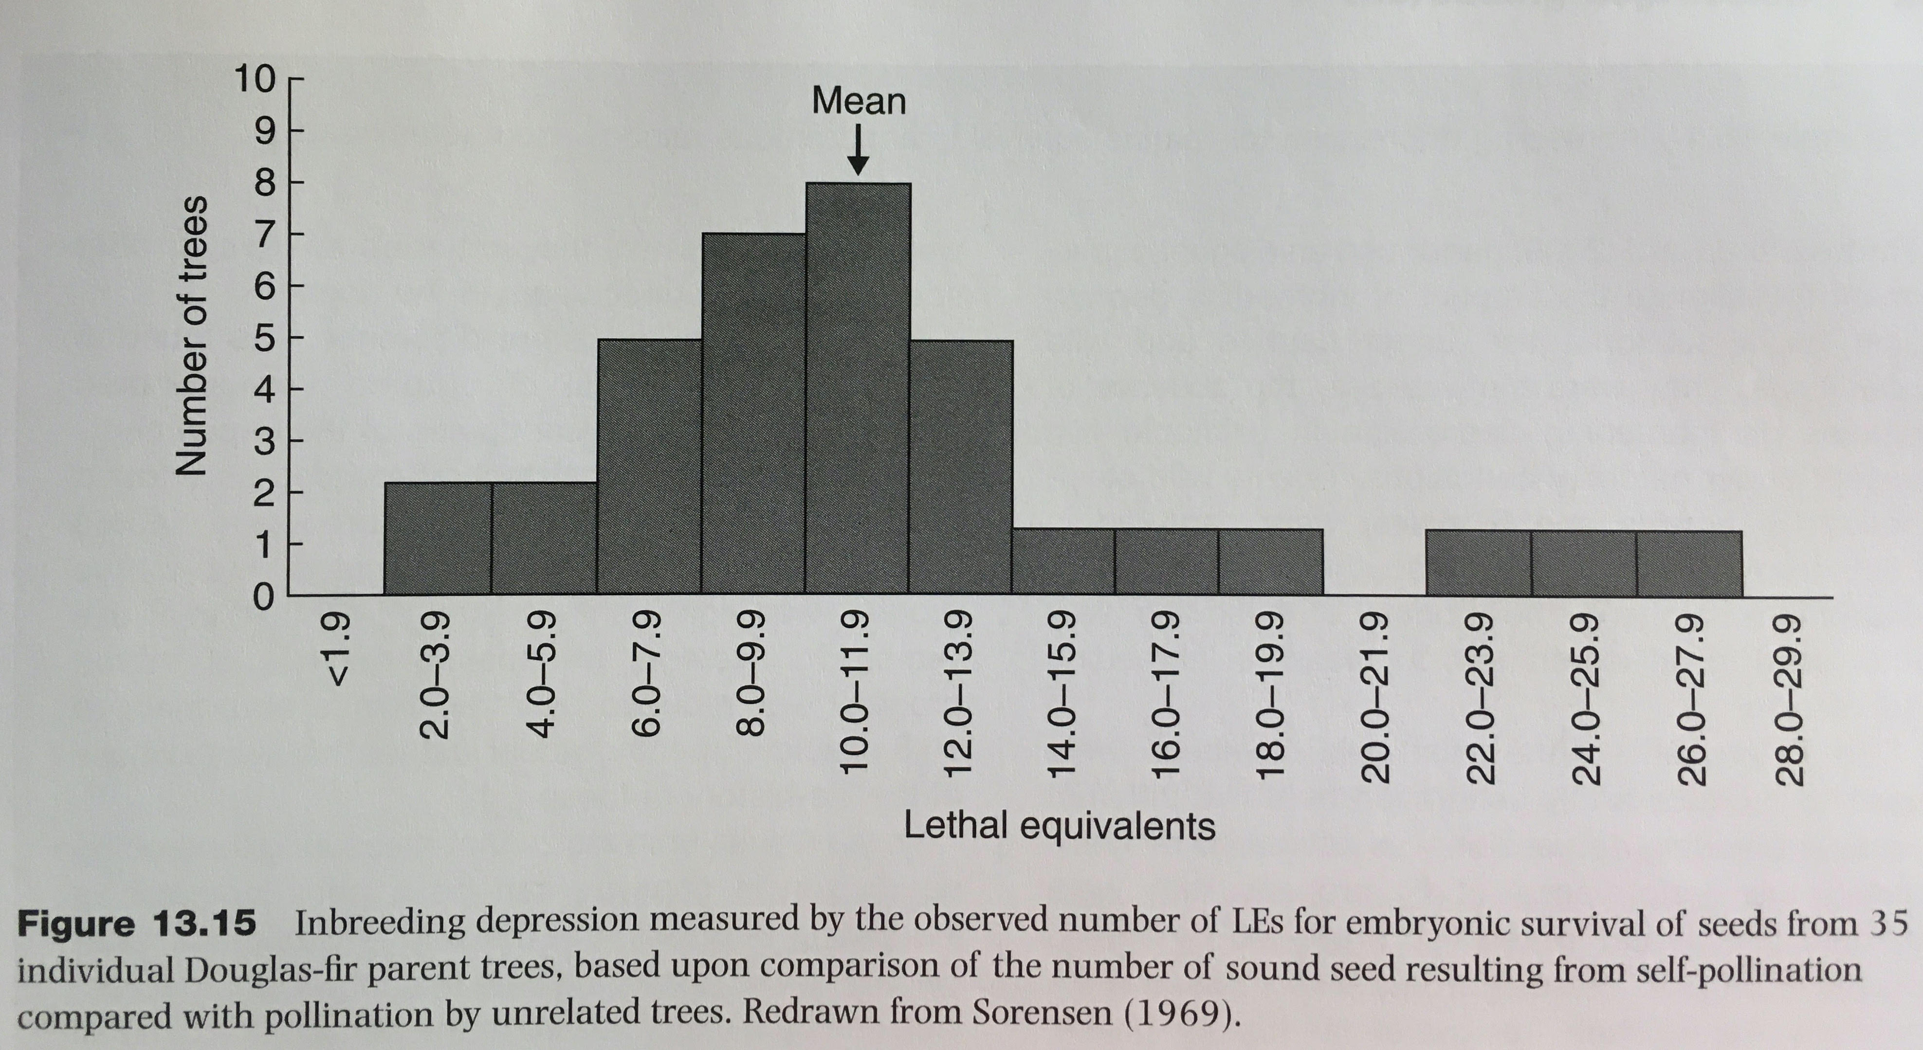
Some plants have extraordinary levels of inbreeding depression
Equivalent to 90% reduction in survival due to selfing.
Fig. 13.15 Allendorf et al. 2013

Slide 36
Inbreeding depression
Generally more severe in wild than captive populations.
Makes experimental inferences from captivity complicated.
More severe when populations are stressed or challenged by forces such as extreme weather, pollution, or disease.
Can result from few loci of major effects from a small number of ancestors.

Slide 37
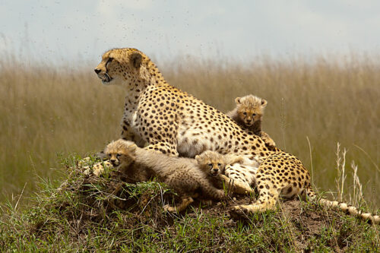
Example of the Cheetah
Causes of inbreeding have included bottlenecks and habitat loss, leading to population size declines across the former range.
Reproductive problems
Susceptibility to disease
Developmental problems
High mortality
https://evolution.berkeley.edu/evo-news/will-evolution-doom-the-cheetah/

Slide 38
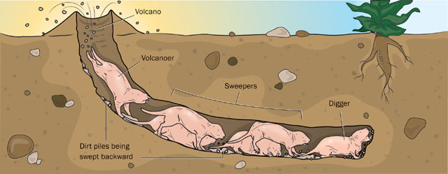
The naked mole rat goes to great lengths to prevent matings between closest relatives.
https://animaldiversity.org/accounts/Heterocephalus_glaber/

Slide 39
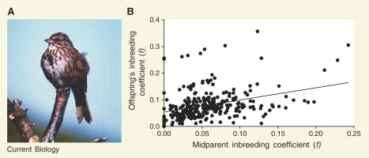
Inbred parents can have a propensity to produce offspring that will also inbreed
Current Biology - Marta Szulkin & Ben C. Sheldon
Volume 16, Issue 18, 19 September 2006, Pages R810-R812

Slide 40
What is the genetic load?
Relative difference in fitness between fittest genotype and the average phenotype.
First used by Muller (1950) in reference to radiation induced mutagenesis.
Comes about because natural selection is not always effective at removing deleterious alleles and does not remove all such alleles.

Slide 41
Causes of genetic load
Mutation introduces deleterious mutations
Segregation (if heterozygotes have the highest fitness, meiotic segregation will produce homozygotes with lower fitness).
Drift can increase frequency of deleterious mutations (e.g., through a founder event or bottleneck).
Migration of allele into population where it is less well adapted.
Inbreeding resulting in increased homozygosity of inbred individuals.

Slide 42
Can inbreeding depression be avoided if deleterious recessive alleles can be removed?
Not really, as all populations accumulate deleterious alleles through mutation.
Plus the power to detect inbreeding depression statistically can be very low.
Especially if pedigrees are unknown, or effects only specific life history stages.
Non-inbred individuals must also be compared.

Slide 43
Can inbreeding depression can be avoided if deleterious recessive alleles can be removed?
However, populations can ‘adapt’ to inbreeding if most such recessive alleles are purged by selection (e.g., Muller’s Ratchet).
But, inbreeding depression caused by LOH cannot be purged because overdominant loci (heterozygote advantage) will always suffer from reduced fitness as homozygosity increases.

Slide 44
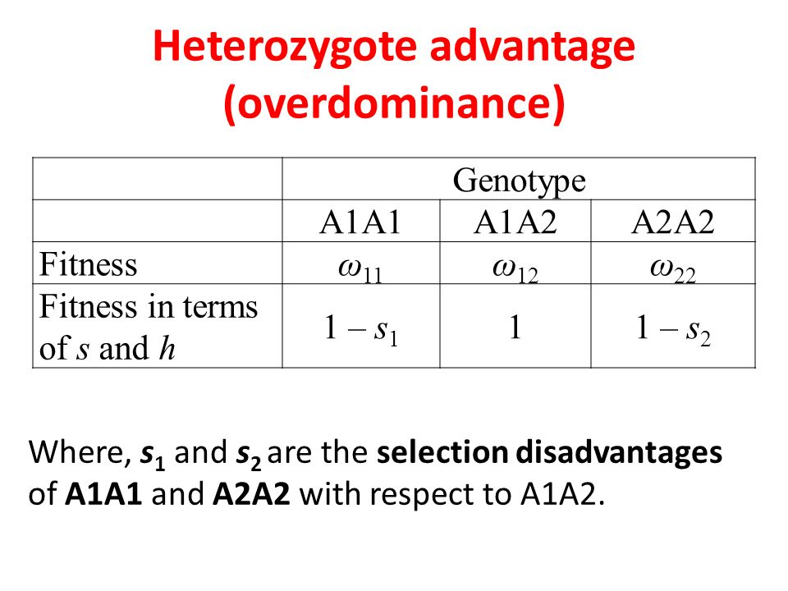
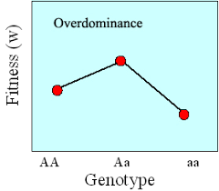

Slide 45
While deleterious alleles can reach substantial frequencies in large populations…
Small populations can be purged of pre-existing deleterious alleles by selection via repeated bottlenecks or prolonged periods of small population size.
Good News
Time

Slide 46
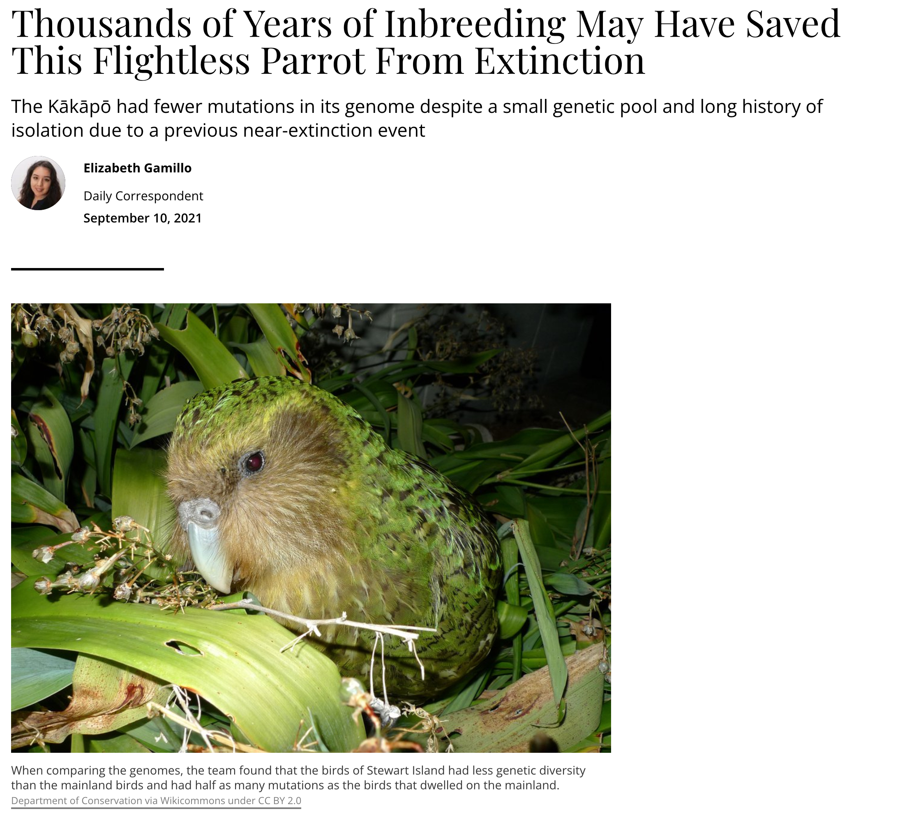
https://www.smithsonianmag.com/smart-news/kakaps-small-genetic-pool-may-have-saved-it-extinction-180978624/

Slide 47
Genetic Rescue
Conservation strategy that enhances survival of small inbred populations with low genetic diversity experiencing inbreeding depression.
Introduces animals (immigrants) from healthy populations with high genetic diversity.
Improves fitness and reduces inbreeding depression.
Can lead to population recovery

Slide 48
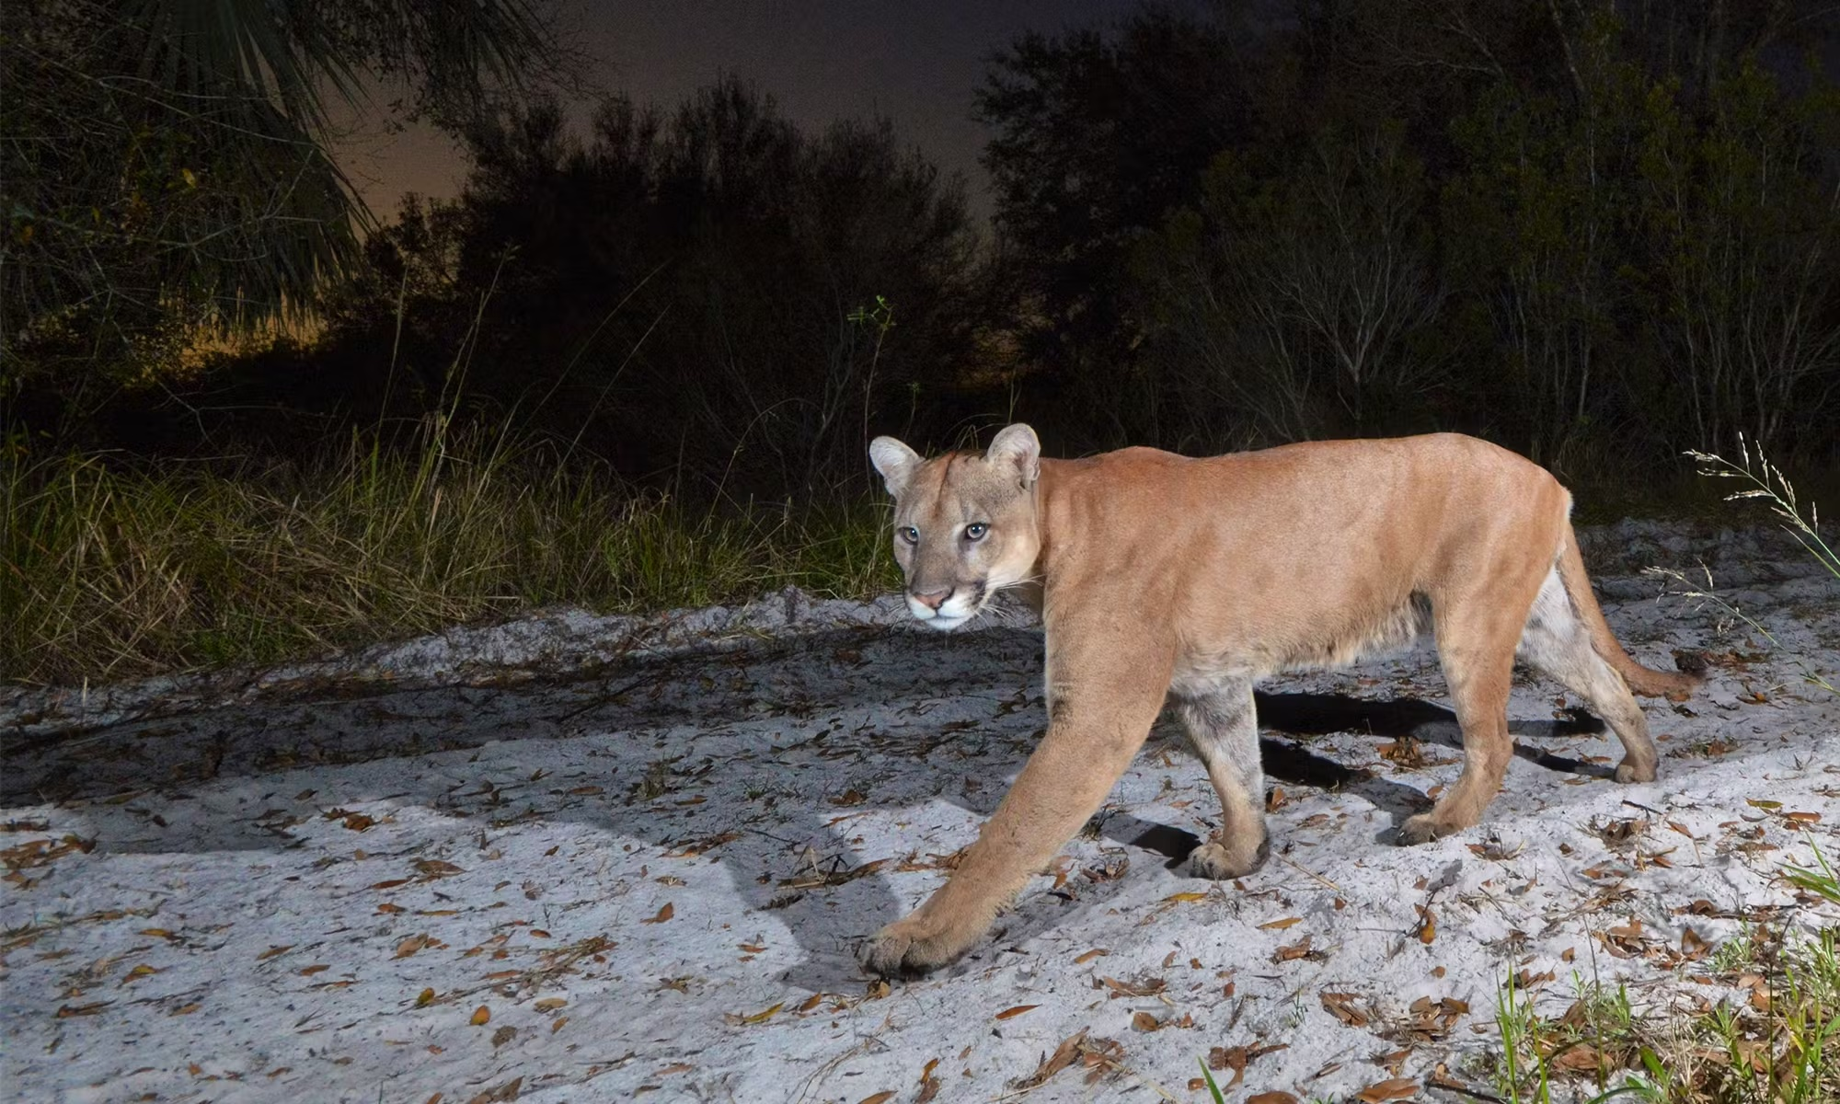
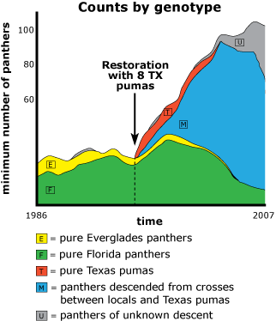
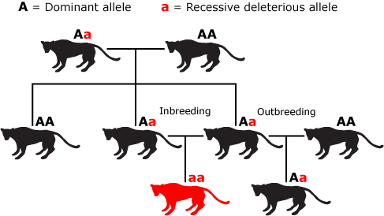
Example of the Florida Panther
https://evolution.berkeley.edu/evo-news/genetic-variation-helps-rescue-endangered-panthers/

Slide 49
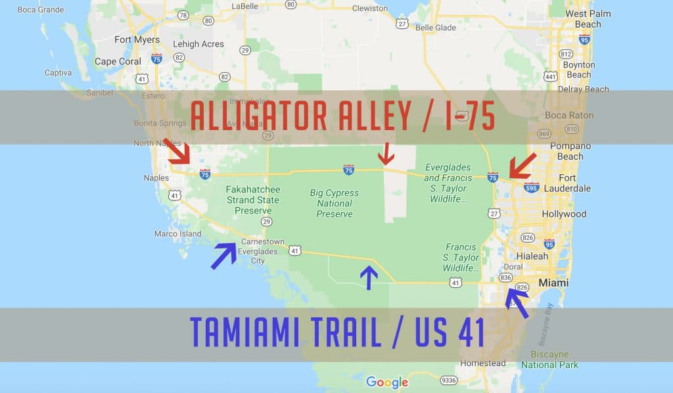
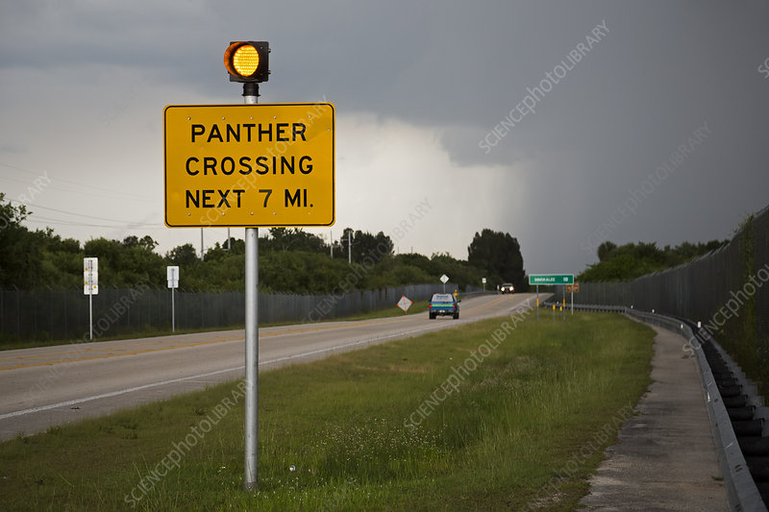

Slide 50
