Slide 1
Human Population Genetics
University of Miami
Spring 2026

Slide 2
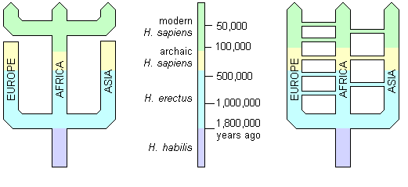
Two Models of Human Evolution
Replacement hypothesis (Out-of-Africa): transition from archaic to anatomically modern humans in Africa, followed by migration to the rest of the world.
Multiregional hypothesis: Anatomically modern humans trace their origin to multiple hominin groups (Homo erectus) living in multiple regions throughout the world, but connected by gene flow.
Out of Africa
Multiregional
Credit: J. L. Peters

Slide 3
Review: Bottlenecks & Founder Events
Population bottleneck = a severe reduction in population size
Genetic consequences of a bottleneck
The post-bottleneck population will have less genetic variation than the pre-bottleneck population.
  The survivors will carry a subset of genetic variation.
  Drift will cause a further loss of diversity, especially while the population is small.
Allele frequencies will differ between pre- and post-bottleneck population.
Credit: J. L. Peters

Slide 4
mtDNA phylogeny: maternal lineage
Africa
Asia
America
Europe
Full mitochondrial genomes
Restriction fragment length polymorphisms in total mitochondrial DNA
Cann et al. 1987. Nature 325:31-36.
Credit: J. L. Peters

Slide 5
mtDNA phylogeny
Africa
Asia
America
Europe
Time to most recent common ancestor (TMRCA) for African lineages 2.3-times older than rest of the world.
Present-day mtDNA variation throughout the world traces back to an African ancestor.
Larger effective population size in Africa.
Consistent with Out of Africa hypothesis, but not multiregional hypothesis.
N_{e} (Asia) = 80,000 females
N_{e} (America) = 50,000 females
N_{e} (Europe) = 40,000 females
TMRCA = 57,000 YBP
TMRCA = 130,000 YBP
N_{e} (Africa) = 90,000 females
Credit: J. L. Peters

Slide 6
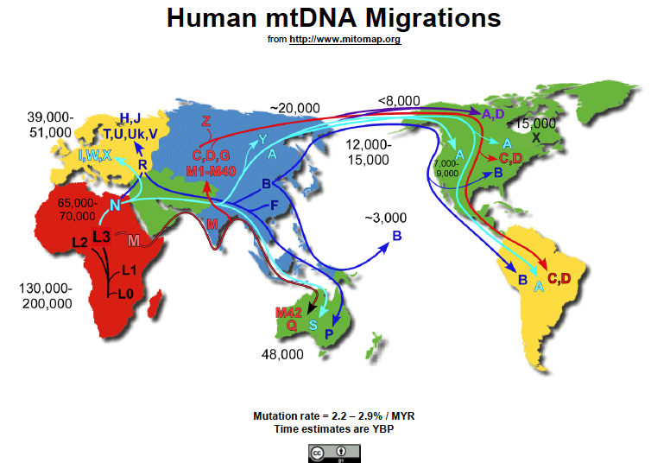

Slide 7
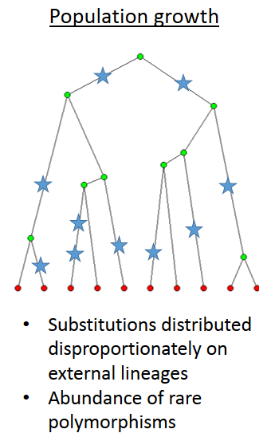
Review: Effects of Variation in Population
N_{e}
Time
Changes in Population Size produce waves of coalescence
Coalescence
events
Time
Credit: J. L. Peters

Slide 8
Bayesian Skyline Plots:
Full mitochondrial genomes (Lab 7)
Fairly stable N_{e}
Rapid expansion ~12,000 YBP
Relatively stable N_{e} in Africa consistent with lack of a bottleneck.
Rapid expansions in Asia & America (& Europe) consistent with bottleneck associated with founder event.
Consistent with Out of Africa hypothesis, but not multiregional hypothesis.
Rapid expansions ~40,000 YBP & 20,000 YBP
Credit: J. L. Peters

Slide 9
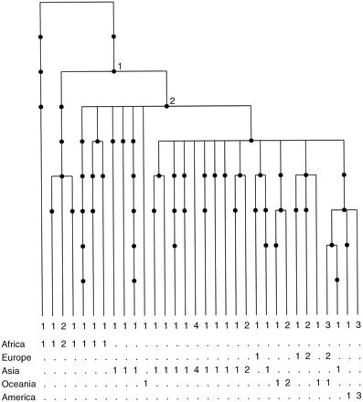
Y-chromosome phylogeny: paternal lineage
Is there independent evidence supporting the out-of-Africa hypothesis?
Y-chromosome diversity traces back to African ancestor
Thompson et al. 2000.
Credit: J. L. Peters

Slide 10
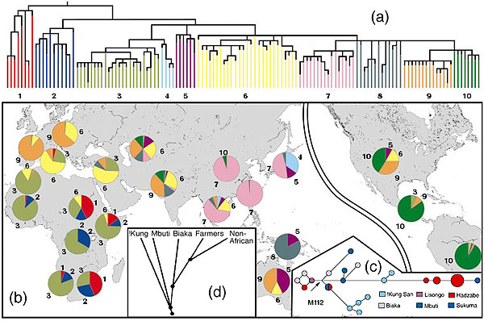
Y-chromosome phylogeny
Y-chromosome diversity traces back to African ancestor
Credit: J. L. Peters

Slide 11
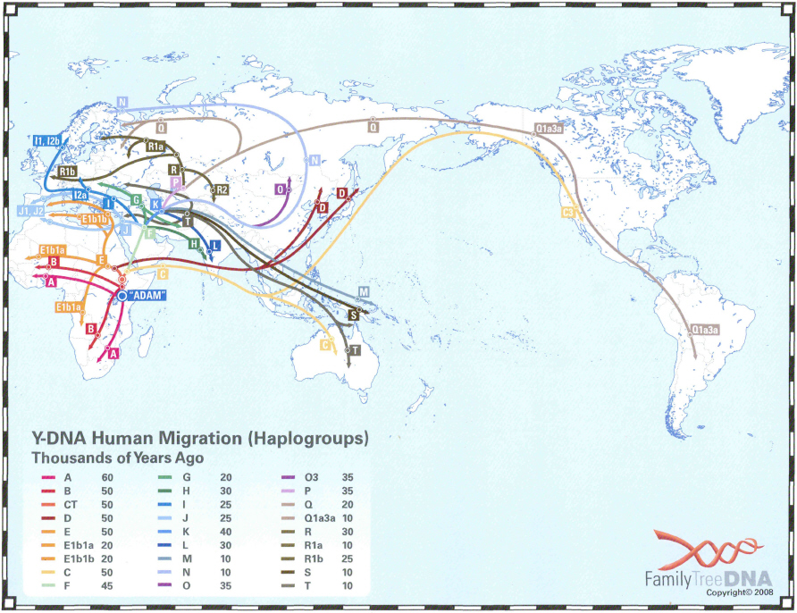
https://phillipsdnaproject.com/faq-sections/114-haplogroup-migration-map
Y-chromosome data is consistent with mtDNA & independently supports out-of-Africa but not multi-regional hypothesis
Credit: J. L. Peters

Slide 12
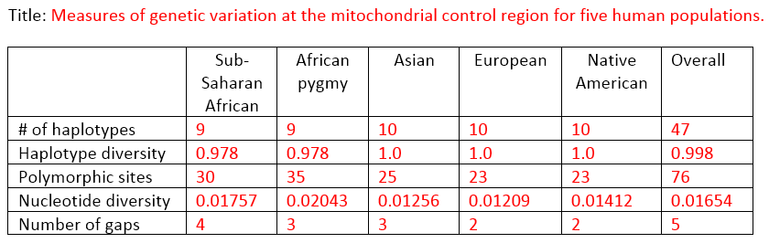
Genetic diversity
Replacement hypothesis (Out-of-Africa): expect higher genetic variation in Africa.
Multiregional hypothesis: differences in genetic variation not expected.
We found higher mitochondrial DNA diversity in African populations.
Consistent with out-of-Africa hypothesis.
Credit: J. L. Peters

Slide 13
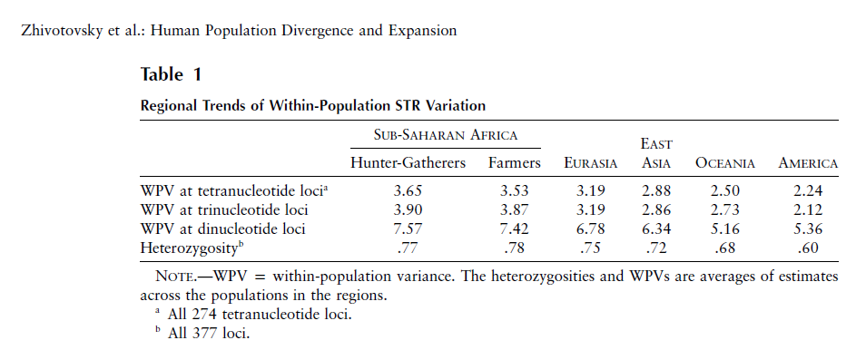
Genetic diversity: 377 microsatellite loci
Replacement hypothesis (Out-of-Africa): expect higher genetic variation in Africa.
Multiregional hypothesis: differences in genetic variation not expected.
Higher nuclear DNA diversity in Africa.
Consistent with out-of-Africa hypothesis.
Credit: J. L. Peters

Slide 14
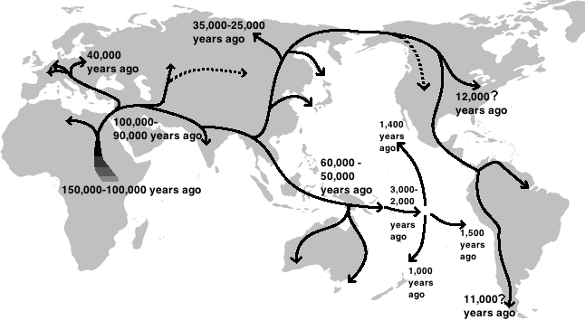
Human global expansion
Out-of-Africa hypothesis strongly supported by multiple lines of population genetics evidence.

Slide 15
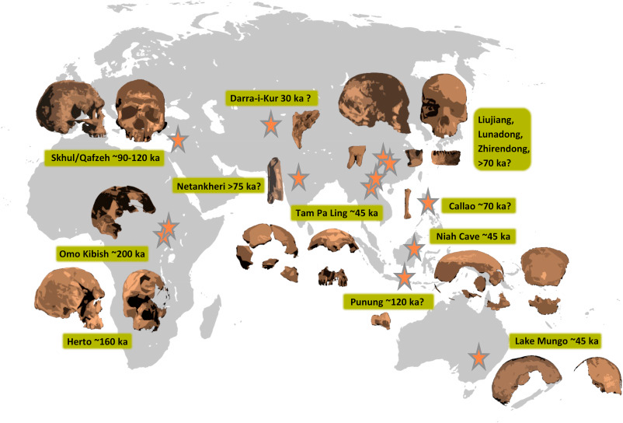
Human global expansion: fossil evidence
“Genetic and fossil evidence has accumulated in support of an African origin for modern humans. Competing models differ primarily by the number of dispersals, their geographic route, and the extent to which expanding modern humans interacted with other hominins.”
Reves-Centeno, H. 2016. Out of Africa and into Asia: Fossil and genetic evidence on modern human origins and dispersals. Quaternary International 416:249-262
Credit: J. L. Peters

Slide 16
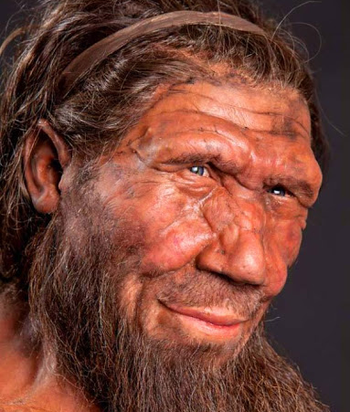
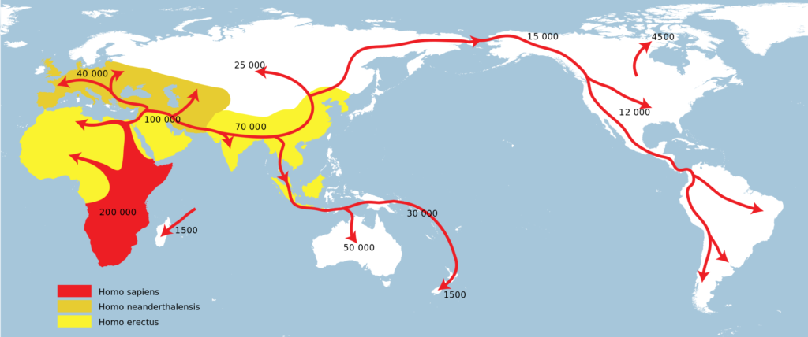
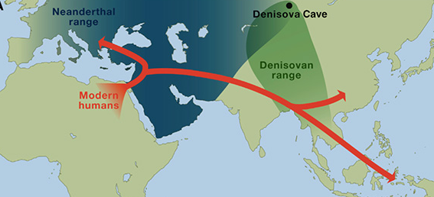
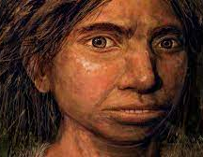
Human migration & archaic hominids
As anatomically modern humans spread across the globe, they came into contact with other forms of archaic humans.
(Extinction ~100,000 YBP)
https://www.zmescience.com/science/news-science/neanderthal-dna-influence-06102017/
https://www.uctv.tv/shows/CARTA-Ancient-DNA-and-Human-Evolution-Neandertal-and-Denisovan-Genomes-and-What-They-Tell-Us-A-Map-of-Neandertal-Genes-in-Present-Day-Humans-The-Phenotypic-Legacy-of-Neandertal-Interbreeding-on-Modern-Humans-30971

Slide 17
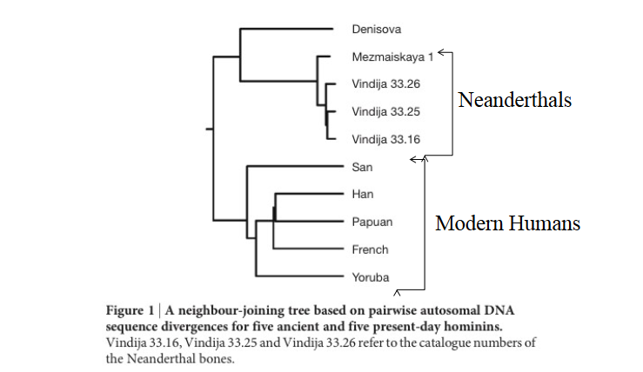
Ancient DNA (extracted from fossils) phylogeny
Reich et al. 2010. Genetic history of an archaic hominin group from Denisova Cave in Siberia. Nature 468:1053-1060.
Credit: J. L. Peters

Slide 18
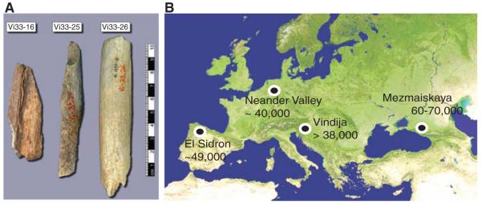
Whole genome sequencing of Neanderthal
Did anatomically modern humans interbreed with archaic hominids?
Green et al. 2010. A Draft Sequence of the Neandertal Genome. Science 325:710-722.
Credit: J. L. Peters

Slide 19
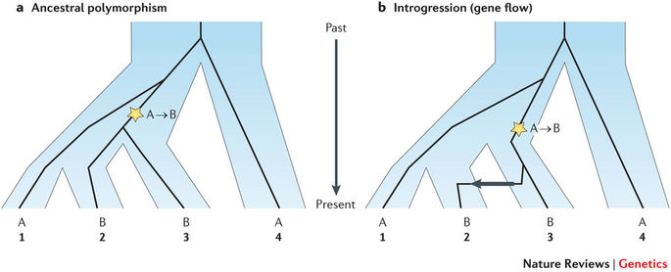
Shared polymorphisms can results from ancestral polymorphism, also known as incomplete lineage sorting, or introgression (gene flow).
Incomplete lineage sorting—Some members of a group share a more recent common ancestor with members of another group than they do with other members of the same group.
Credit: J. L. Peters

Slide 20
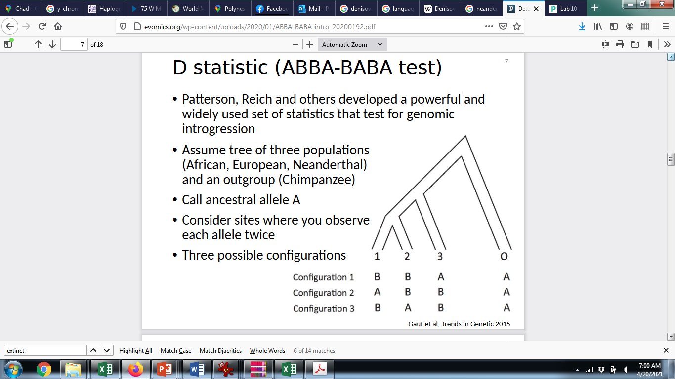
ABBA-BABA test
Compare four genomes, including an outgroup (O), two “ingroup” taxa (1,2), and a taxon (3) that is suspected to have hybridized with one (but not both) of the ingroup taxa.
Examine all SNPs that occur at a frequency of 50%
  Each allele is shared between two taxa
  The allele found in the outgroup is always called “A”; the alternative allele is “B”
Three possible configurations of allele sharing
  BBAA—B is shared between taxa 1 & 2.
    The ingroup is monophyletic.
  ABBA—B is shared between taxa 2 & 3.
  BABA—B is shared between taxa 1 & 3,
Green et al. 2010. A Draft Sequence of the Neandertal Genome. Science 325:710-722.
Credit: J. L. Peters

Slide 21
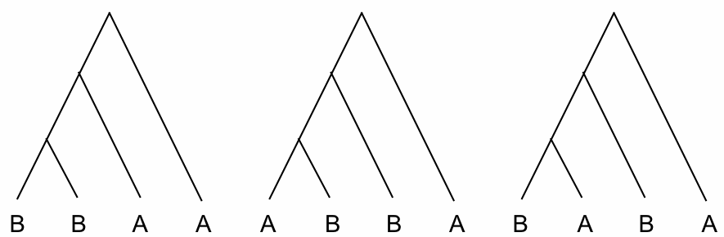
Three possible gene trees for any given bi-allelic SNP
4 populations + outgroup
Alternate lineage sorting patterns
inconsistent with true gene tree
*
*
*
*
No gene flow
No stochastic lineage sorting
True gene tree
If no introgression, ABBA & BABA trees should be equal in frequency (red lines equal different patterns generated by ancestral polymorphism).
If introgression occurred, expect excess of ABBA trees compared to BABA trees.
∗ = mutation
A = ancestral state in outgroup

Slide 22
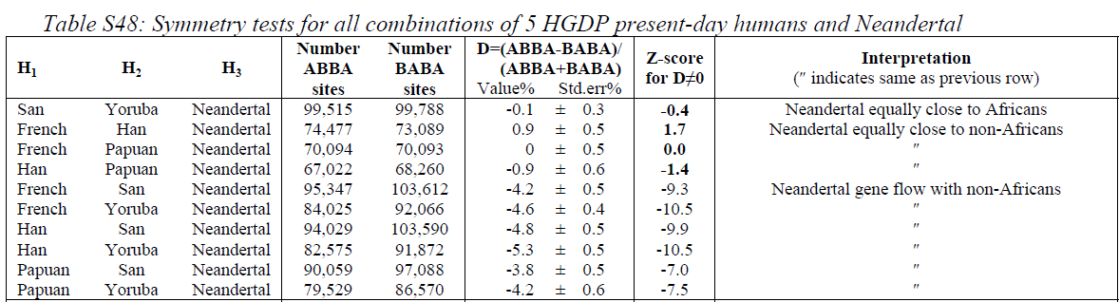
ABBA-BABA results
ABBA = BABA
ABBA < BABA
ABBA < BABA
San (Africa)
Yoruba (Africa)
Neanderthal
Chimp
Yoruba (Africa)
Neanderthal
Chimp
Han (Asia)
Yoruba (Africa)
Neanderthal
Chimp
French (Europe)
Credit: J. L. Peters
Significant gene flow between Neanderthal and humans from Europe, Asia, and Papua, but not Africans

Slide 23
Human migration & archaic hominids
As anatomically modern humans spread across the globe, they came into contact with other forms of archaic humans and interbred extensively.
Interbreeding
https://www.zmescience.com/science/news-science/neanderthal-dna-influence-06102017/
Credit: J. L. Peters

Slide 24
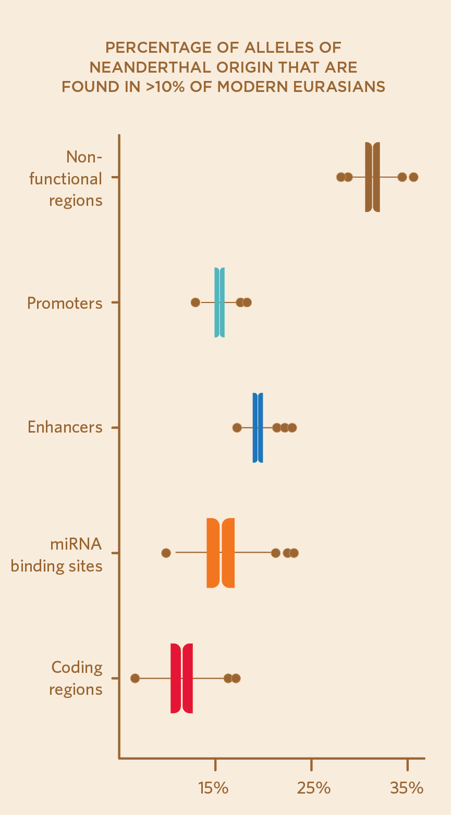
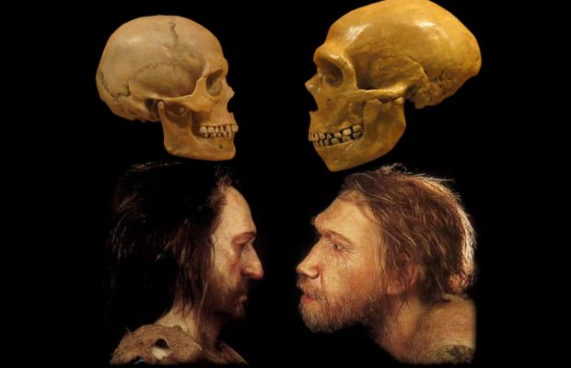
Proportion of human genome derived from Neanderthal ancestry
Africans: 0.0%
East Asians: 2.3-2.6%
Western Eurasians: 1.8-2.4%
*Note that estimates for some populations reach as high as 7% of genome
Prüfer et al. (2017)
https://www.the-scientist.com/neanderthal-dna-in-modern-human-genomes-is-not-silent-66299
Credit: J. L. Peters

Slide 25
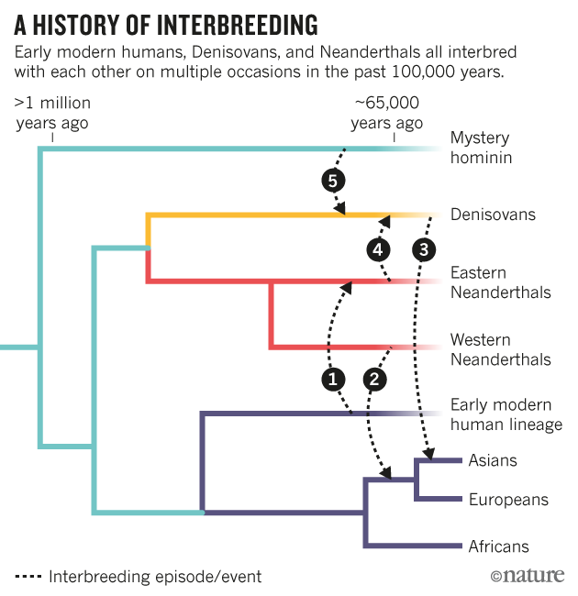
Credit: J. L. Peters

Slide 26
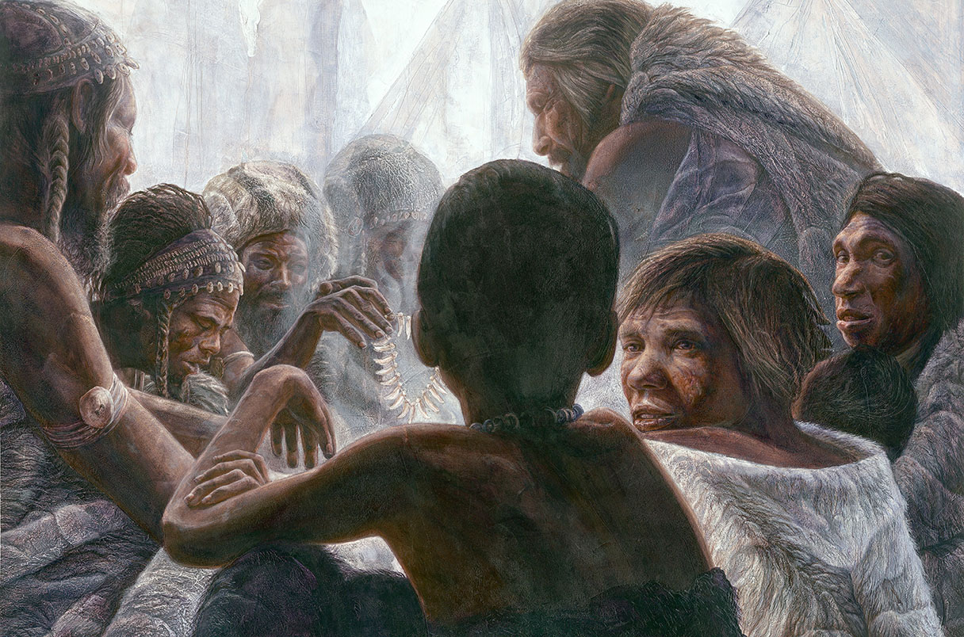
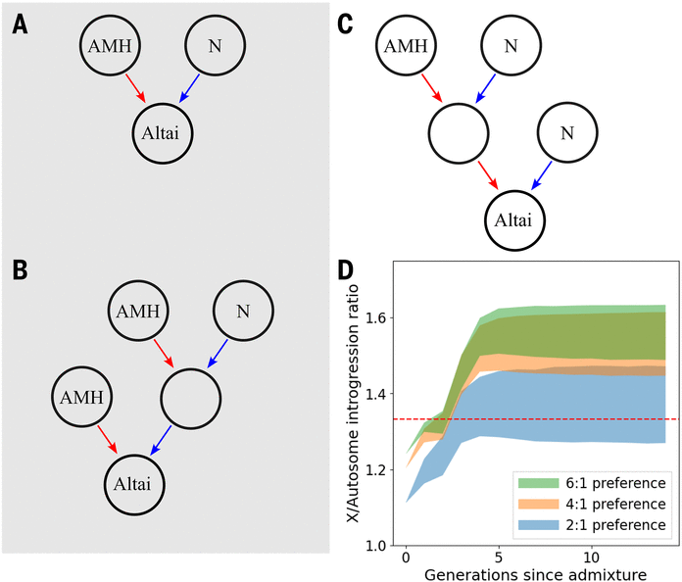
Surprising partner preference found in matings between Neanderthals and modern humans
Male Neanderthals tended to pair up with female modern humans, but whether intercourse was consensual is unclear
Science 26 Feb 20262:00 PM ET By Bridget Alex
https://www.science.org/content/article/surprising-partner-preference-found-matings-between-neanderthals-and-modern-humans
X-chromosome is relatively depleted of Neanderthal DNA compared to autosomes
Platt et al. (2026) Interbreeding between Neanderthals and modern humans was strongly sex biased. Science 391(6788):922-925

Slide 27
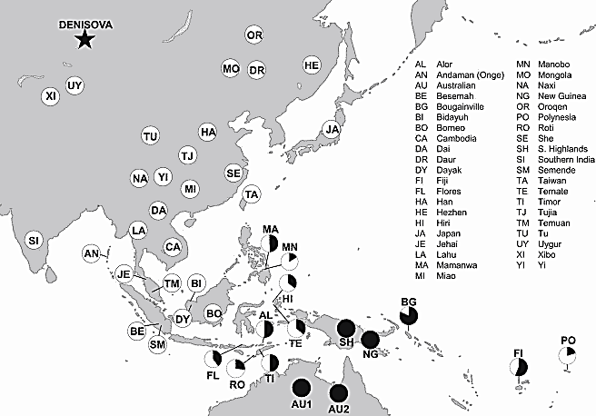
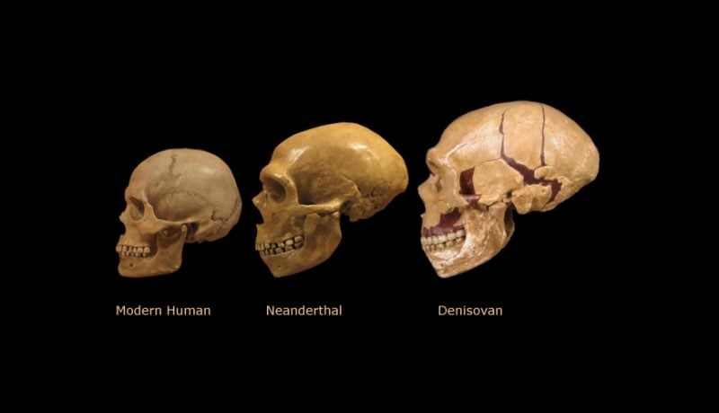
Denisovan admixture
Denisovan admixture proportions
(filled circles indicate 5% Denisovan; others are scaled accordingly)
Credit: J. L. Peters
Reich et al. 2011. Denisova Admixture and the First Modern Human Dispersals into Southeast Asia and Oceania. Am J Hum Genet. 89: 516–528.

Slide 28
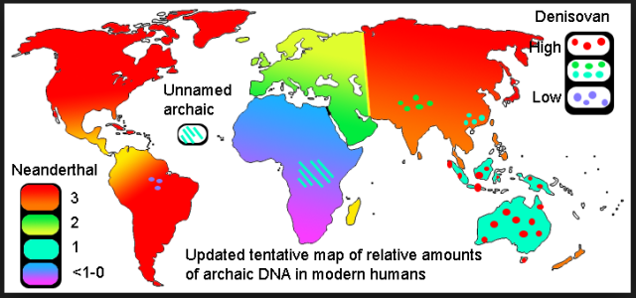
Geographic distribution of introgressed DNA
https://evolutionistx.wordpress.com/2016/04/21/updated-tentative-map-of-neanderthal-dna/
Credit: J. L. Peters

Slide 29
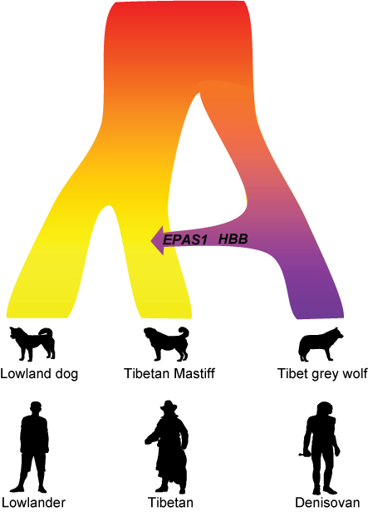
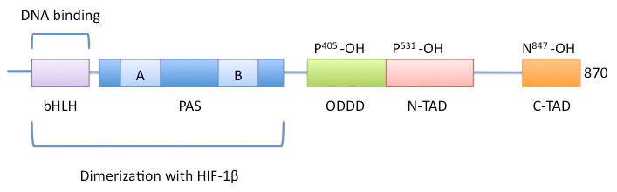
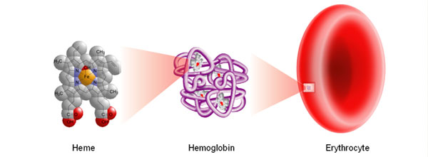
Introgression of adaptive alleles
Ancient interbreeding with the Tibet grey wolf adapted the Tibetan Mastiff to high altitude.
A similar evolutionary mechanism occurred in parallel in the Tibetan people, who received their high altitude adaptation after inbreeding with the Denisovans.
https://phys.org/news/2016-12-tibetan-mastiff-gained-high-altitude.html#jCp
Example of parallel evolution
Two genes associated with high-altitude adaptation
EPAS1
HBB

Slide 30
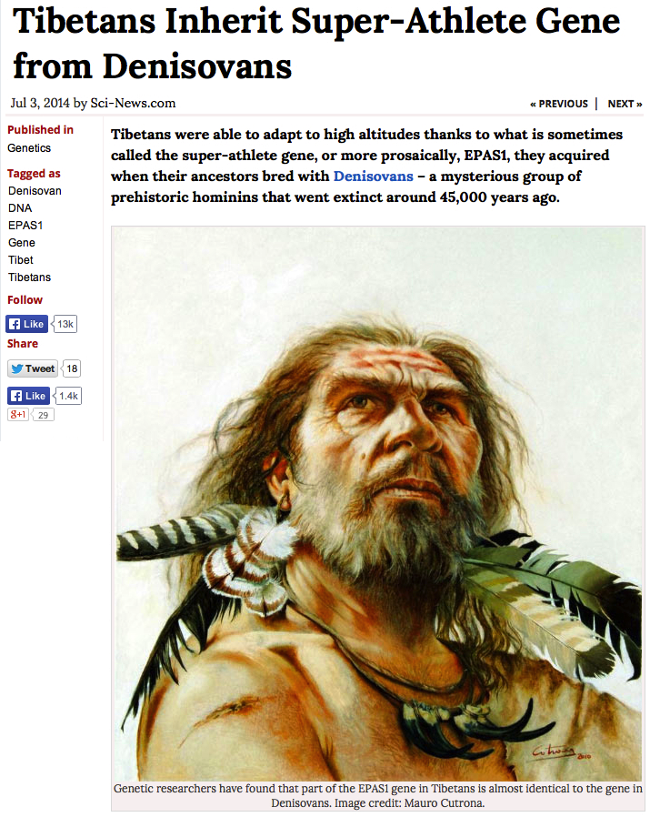
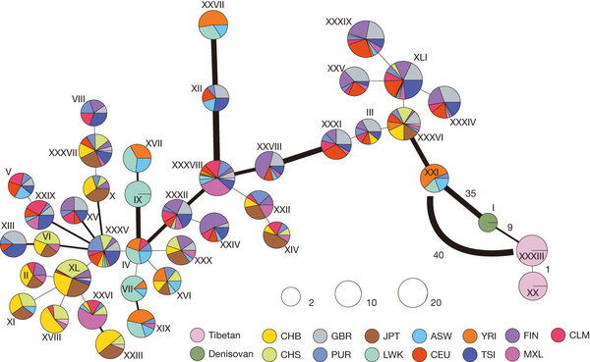
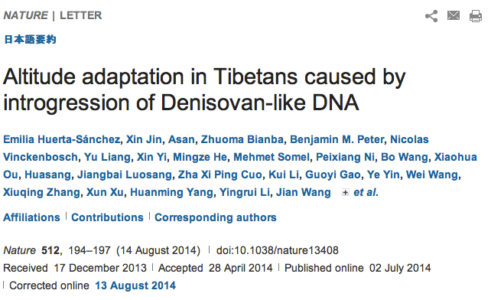
EPAS1

Slide 31
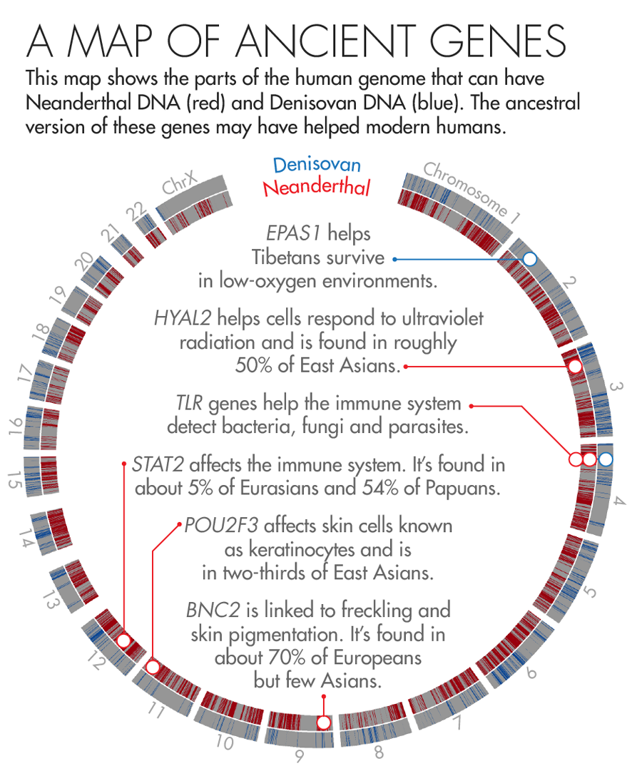
Adaptive introgression from archaic hominids
https://www.quantamagazine.org/how-neanderthal-dna-helps-humanity-20160526/

Slide 32
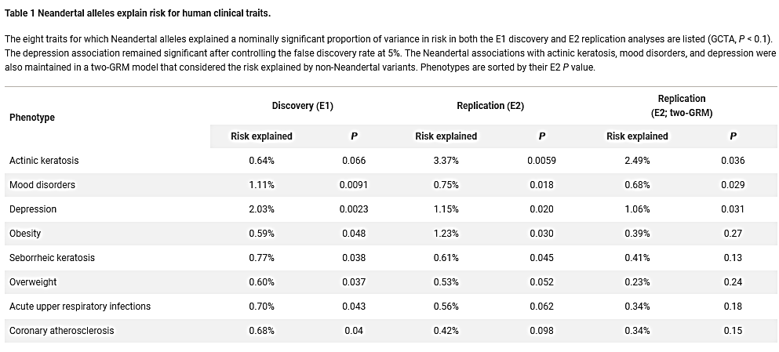
Negative consequences of introgression from archaic hominids
Simonti et al. 2016. The phenotypic legacy of admixture between modern humans and Neandertals. Science 351:737-741
Credit: J. L. Peters

Slide 33
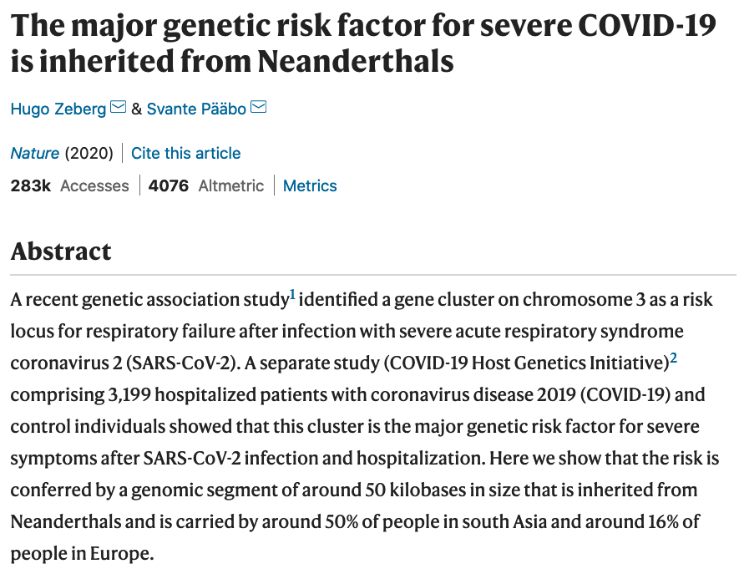
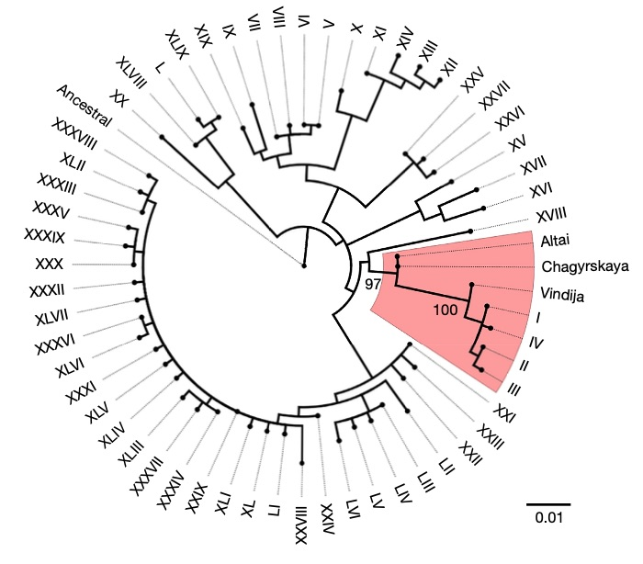
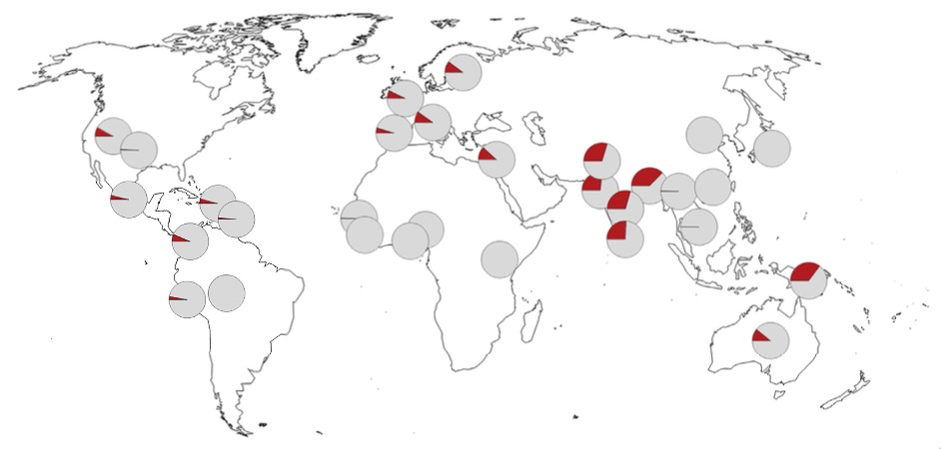
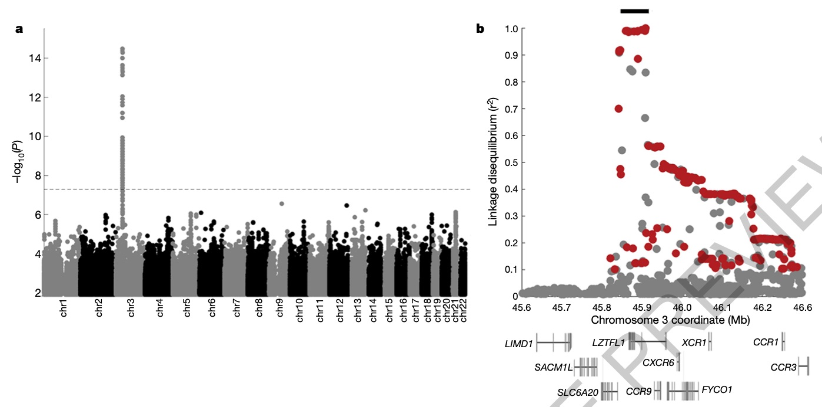

Slide 35
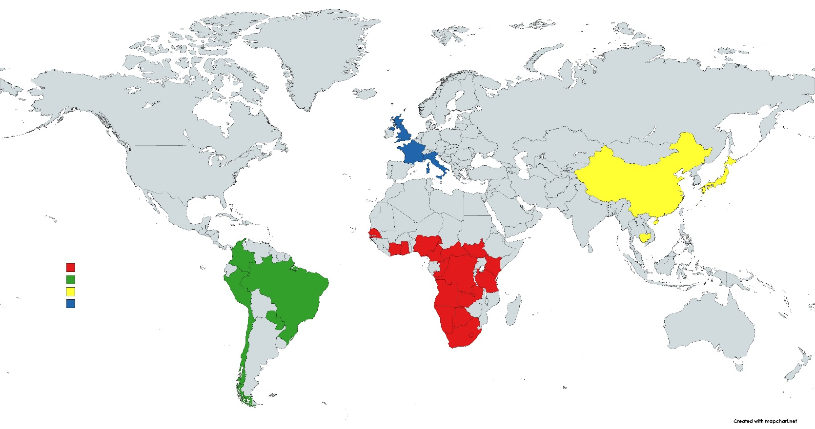
Consider 4 groups of humans.
These groups present as if they were discrete population units.
However, such an analysis ignores the majority of global diversity.
Principal Component Analysis of 645 microsatellite loci
Data from: Pemberton, DeGiorgio, & Rosenberg. 2013. Population Structure in a Comprehensive Genomic Data Set on Human Microsatellite Variation. G3 (Bethesda) 3(5): 891–907
Credit: J. L. Peters

Slide 36
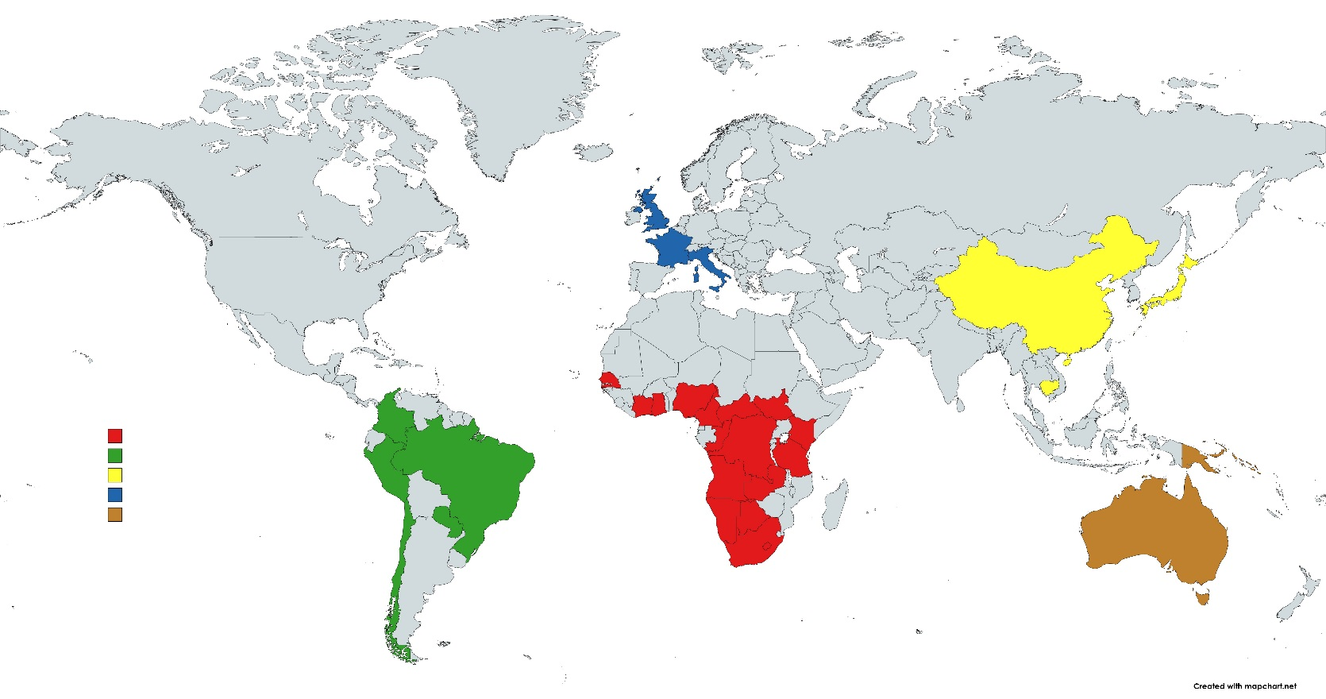
Principal Component Analysis of 645 microsatellite loci
Humans from Oceania & Australia are a fifth genetic cluster.
Data from: Pemberton, DeGiorgio, & Rosenberg. 2013. Population Structure in a Comprehensive Genomic Data Set on Human Microsatellite Variation. G3 (Bethesda) 3(5): 891–907
Credit: J. L. Peters

Slide 37
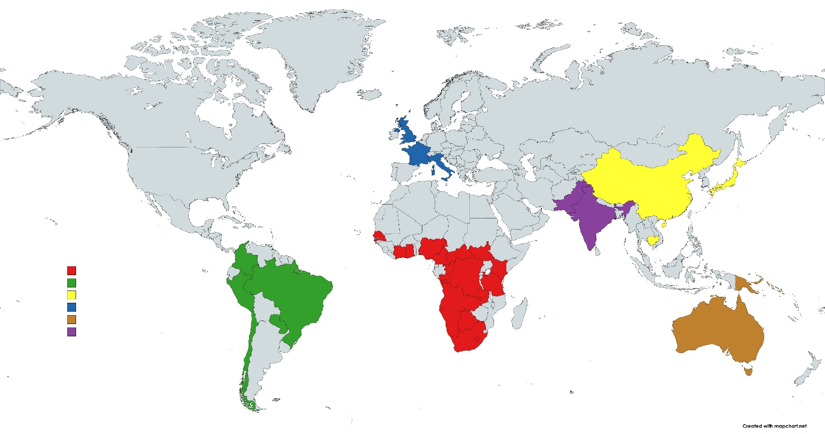
Principal Component Analysis of 645 microsatellite loci
South Asians are genetically intermediate between Europeans and East Asians.
Data from: Pemberton, DeGiorgio, & Rosenberg. 2013. Population Structure in a Comprehensive Genomic Data Set on Human Microsatellite Variation. G3 (Bethesda) 3(5): 891–907
Credit: J. L. Peters

Slide 38
Principal Component Analysis of 645 microsatellite loci
Taiwanese are genetically intermediate between East Asians & Oceanians.
Data from: Pemberton, DeGiorgio, & Rosenberg. 2013. Population Structure in a Comprehensive Genomic Data Set on Human Microsatellite Variation. G3 (Bethesda) 3(5): 891–907
Credit: J. L. Peters

Slide 39
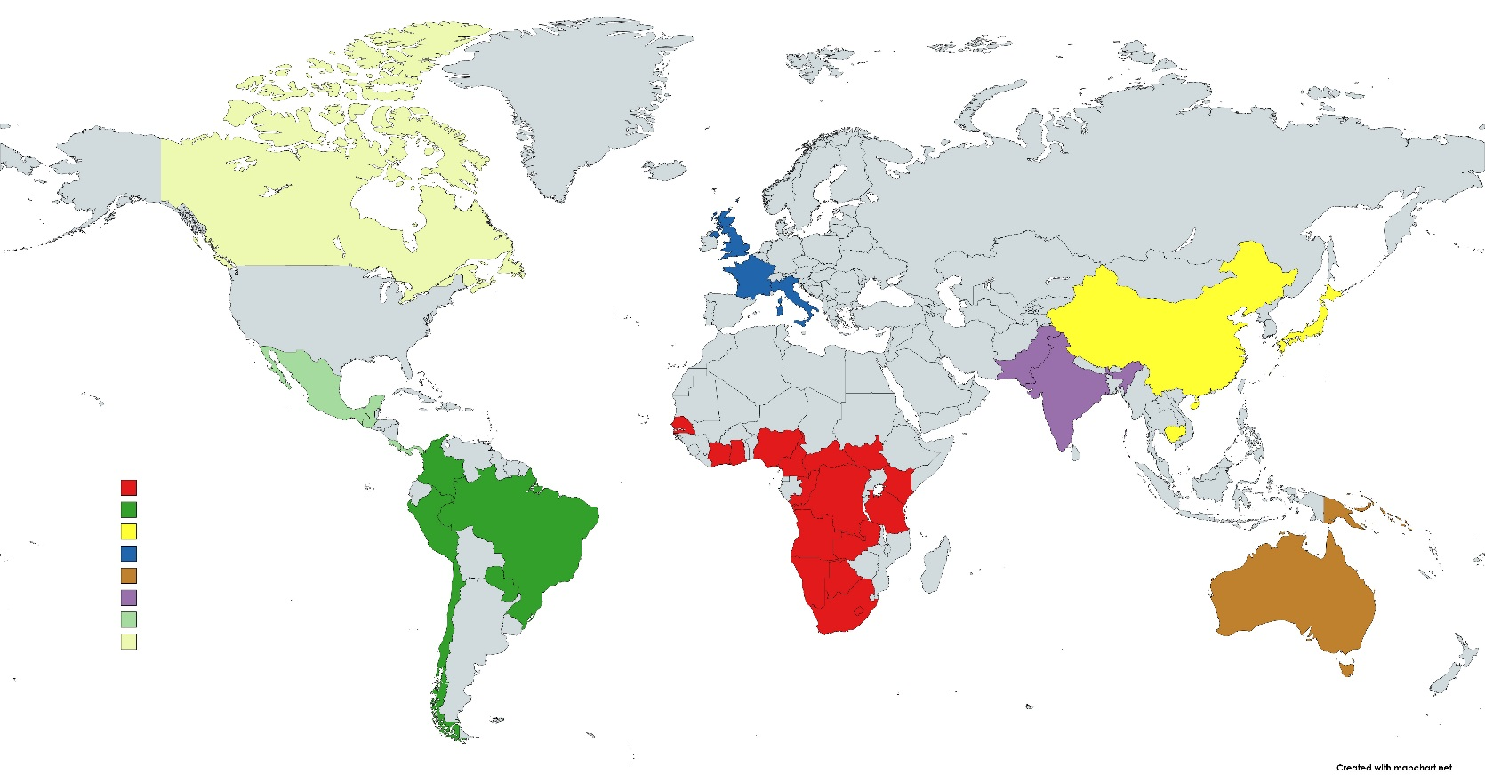
Principal Component Analysis of 645 microsatellite loci
Native North Americans are genetically closer to East Asians & Europeans than are native South & Central Americas.
Data from: Pemberton, DeGiorgio, & Rosenberg. 2013. Population Structure in a Comprehensive Genomic Data Set on Human Microsatellite Variation. G3 (Bethesda) 3(5): 891–907
Credit: J. L. Peters

Slide 40

Principal Component Analysis of 645 microsatellite loci
Northeast Africans are genetically closer to Europeans and South Asians than are southern and central Africans.
Data from: Pemberton, DeGiorgio, & Rosenberg. 2013. Population Structure in a Comprehensive Genomic Data Set on Human Microsatellite Variation. G3 (Bethesda) 3(5): 891–907
Credit: J. L. Peters

Slide 41
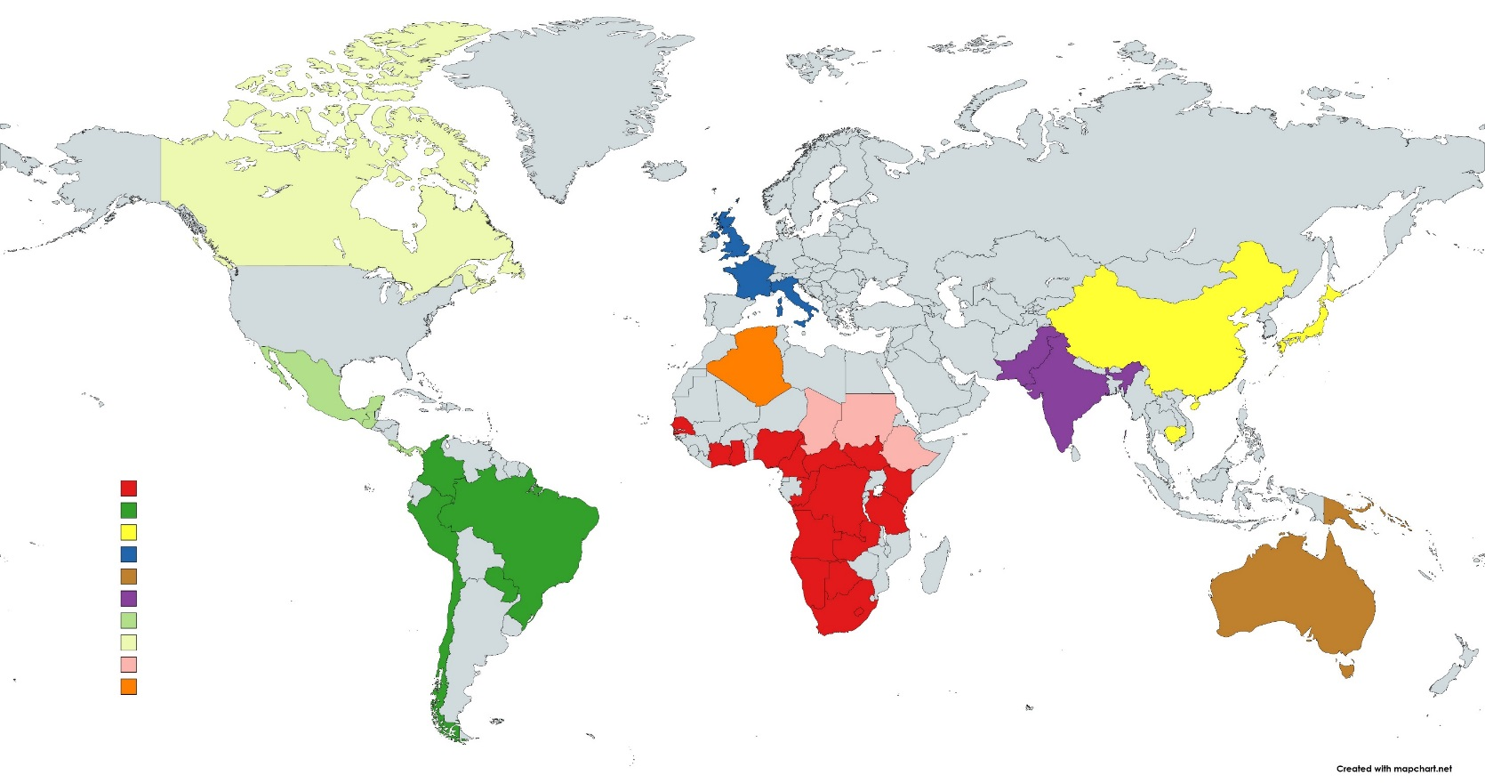
Principal Component Analysis of 645 microsatellite loci
Algerians are genetically intermediate between Europeans and Africans.
Data from: Pemberton, DeGiorgio, & Rosenberg. 2013. Population Structure in a Comprehensive Genomic Data Set on Human Microsatellite Variation. G3 (Bethesda) 3(5): 891–907
Credit: J. L. Peters

Slide 42

Principal Component Analysis of 645 microsatellite loci
Middle Easterners are intermediate between Europeans, South Asians, & Algerians.
Data from: Pemberton, DeGiorgio, & Rosenberg. 2013. Population Structure in a Comprehensive Genomic Data Set on Human Microsatellite Variation. G3 (Bethesda) 3(5): 891–907
Credit: J. L. Peters

Slide 43
Native humans from northeastern Russia, Alaska, northern Canada, and Greenland are genetically intermediate between more southern Native Americans and East Asians.
Credit: J. L. Peters

Slide 44
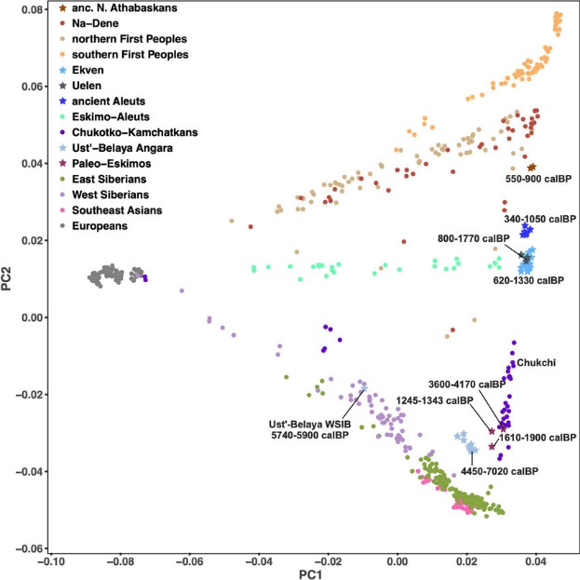
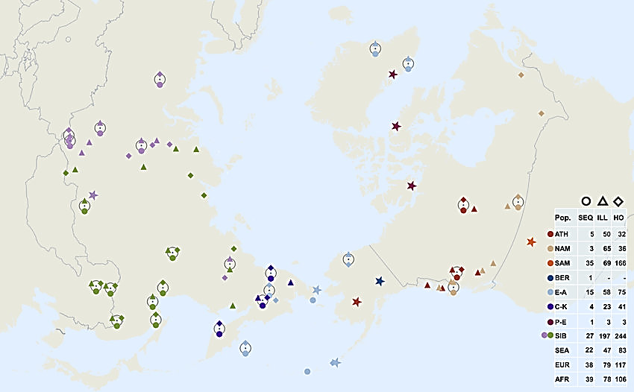
Native humans from northeastern Russia, Alaska, northern Canada, and Greenland are genetically intermediate between more southern Native Americans and East Asians.
North America
Americas
Ancient Northern Canada, Greenland, Alaska, & NE Russia
Europe
Northeast Siberia
Southeast Asia
524,830 loci
Flegontov et al. 2019. Palaeo-Eskimo genetic ancestry and the peopling of Chukotka and North America. Nature. 570. 10.1038/s41586-019-1251-y.
Credit: J. L. Peters

Slide 45
Principal Component Analysis
Indonesians & Malaysians are genetically intermediate between East Asians & Oceanians.
Credit: J. L. Peters

Slide 46
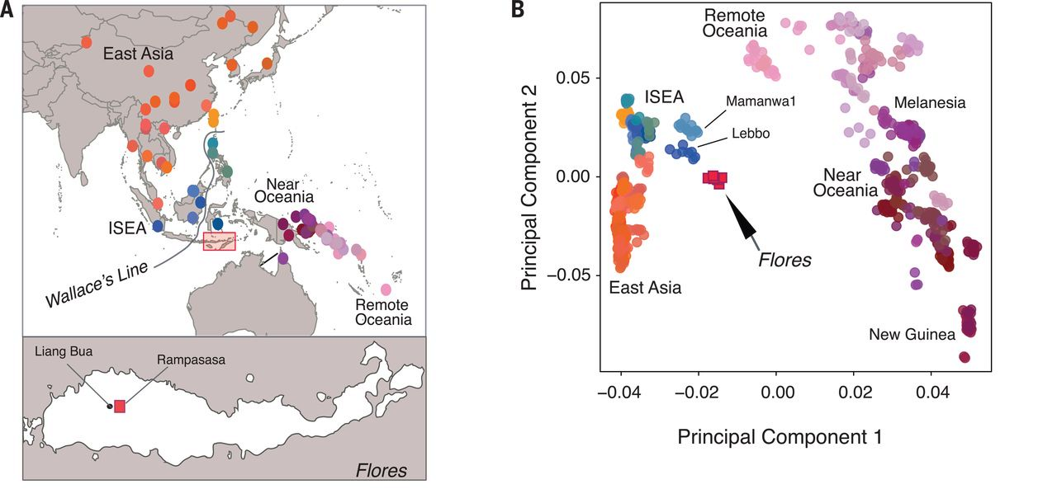
Indonesians & Malaysians are genetically intermediate between East Asians & Oceanians.
Credit: J. L. Peters

Slide 47
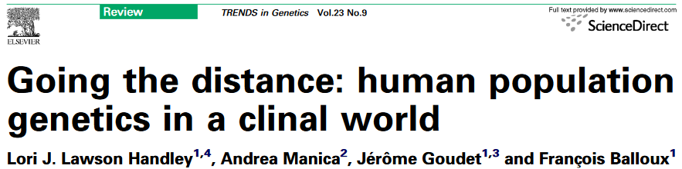
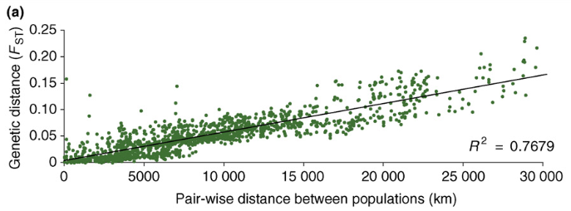

Lecture 04.4
Credit: J. L. Peters

Slide 48
Rather than discrete human populations that can be easily delineated, …
…genetic variation is clinal, and attempts to delineate population (i.e., racial) boundaries become subjective.
Credit: J. L. Peters

Slide 49

Fine-scale population structure exists within “racial” groups (lecture 05.4)
Population structure within Europe
Note the pattern of isolation-by-distance
  Populations that cluster geographically also cluster genetically
  PC1 separates populations along a north-south gradient.
  PC2 separates populations along an east-west gradient.
Novembre et al. (2008) Nature 456, 98-101

Slide 50

Extensive admixture between “racial” groups
Figure 1. Population structure of Caribbean and neighboring populations of humans.
Moreno-Estrada A, Gravel S, Zakharia F, McCauley JL, et al. (2013) Reconstructing the Population Genetic History of the Caribbean. PLoS Genet 9(11): e1003925.
Credit: J. L. Peters

Slide 51

Credit: J. L. Peters

