Slide 1
Phylogeny & Systematics 2
University of Miami
Fall 2026

Slide 2
How do we code trees and character data into data files?
How do we search tree space to find the best trees(s)?
For 100 taxa there are 10¹⁸² possible unrooted trees!
This is a Big Computational Problem!
The best tree(s) may be difficult to identify.
Only a subset can be searched, even with the most powerful computers.

Slide 3
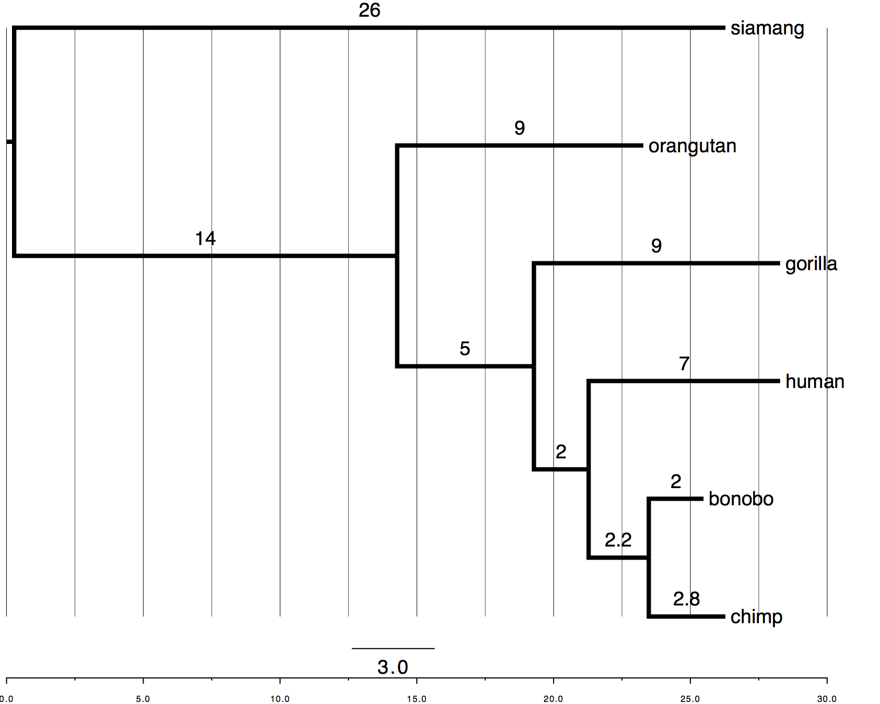
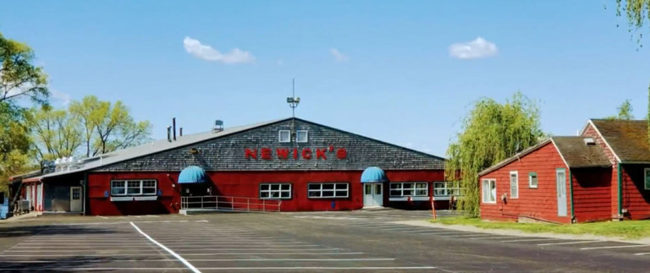
How do we code trees into data files?
Newick Tree Format
<newick id="startingTree">
((((human:7.0,(bonobo:2.0, chimp:2.8):2.2):2.0, gorilla:9.0):5.0, orangutan:9.0):14.0, siamang:26.0);
</newick>
Wikipedia Definition:
Newick Tree Format (or Newick notation or New Hampshire tree format) is a way of representing graph-theoretical trees with edge lengths using parentheses and commas. It was adopted by James Archie, William H. E. Day, Joseph Felsenstein, Wayne Maddison, Christopher Meacham, F. James Rohlf, and David Swofford, at the Society for the Study of Evolution Meeting in 1986, at Newick's restaurant in Dover, New Hampshire, U.S.

Slide 4
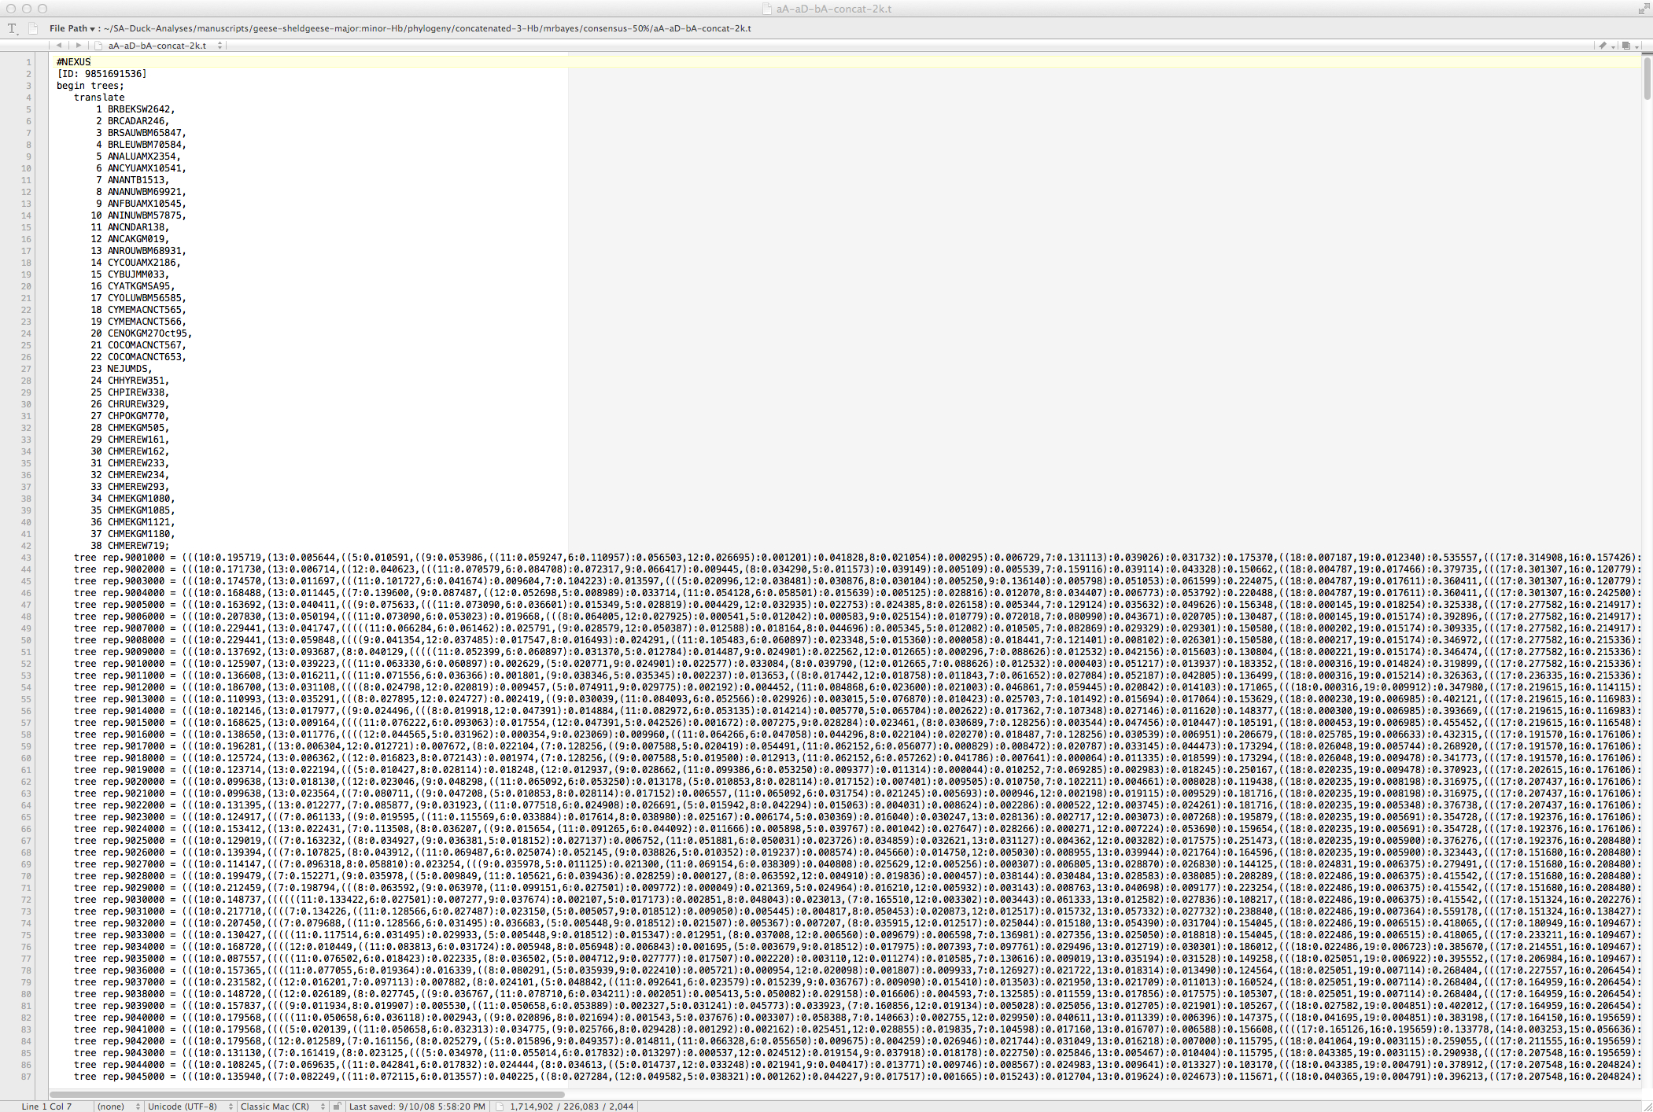

Slide 5
Finding the “best” tree – a historical timeline:
Long tradition of using characters (morphological and molecular).
Beginning with Ernst Haeckel (1866)
1950-1960s - first computers, clustering algorithms developed – Phenetics
Willi Hennig (1966) - Cladistics via principle of parsimony
    PAUP - Phylogenetic Analysis Using Parsimony (Dave Swofford)
Maximum Likelihood (1980-1990s) - Joe Felsenstein (Phylip) & PAML (Yang)
Bayesian – MrBayes (John Huelsenbeck)
Multilocus Coalescent (BEAST & Others)
Computationally fast methods are critical for genomic scale data
e.g., RAxML - Randomized Axelerated Maximum Likelihood

Slide 6
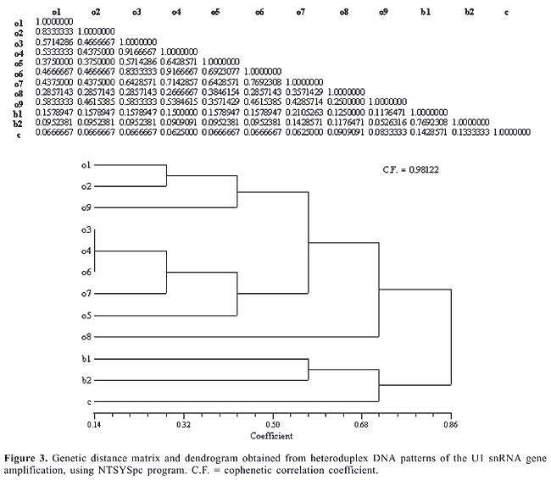
Genetic Distance – Build Tree with Distance Matrix and Clustering Algorithm:
1. Create a matrix describing genetic distances between all pairs of taxa.
2. Select tree that minimizes total distance (distances can be weighted or unweighted and may or may not conform to molecular clock).
http://www.funpecrp.com.br/gmr/year2006/vol3-5/gmr0187_full_text.htm

Slide 7
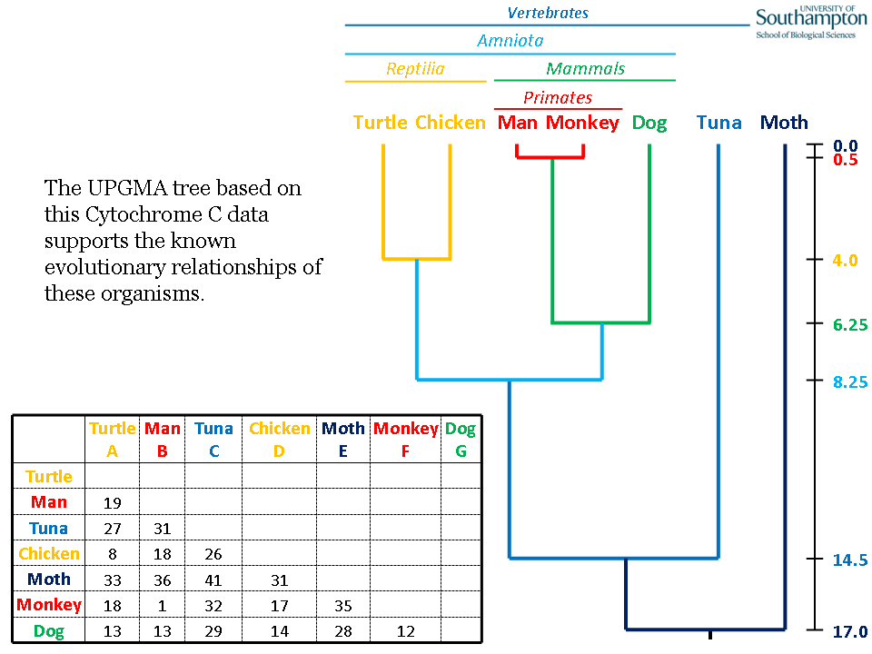
Ultrametric distance trees like UPGMA incorporate a molecular clock.
http://www.slimsuite.unsw.edu.au/teaching/upgma/

Slide 8
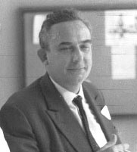
Cladistics vs. Phenetics Debate
Proponents of distance method quickly yielded to cladistics:
Criticisms of phenetic approaches by cladists:
Classifications based on overall similarity, not specific characters.
Cladists took issue with equal weighting of characters.
Phenetic analyses were unrooted, as there is no distinction between ancestral and derived characters.
Cladists used parsimony, shunned distance.
Willi Hennig
Cladistics

Slide 9
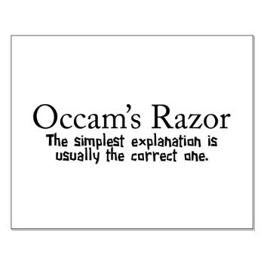

Minimize number of steps required to evolve characters on the tree, repeat for every character. Shortest tree is the best tree by principle of parsimony.
taxon 1
taxon 2
outgroup
taxon 1
taxon 2
Most parsimonious
outgroup
Less parsimonious

Slide 10
taxon 1
taxon 2
Character State
*
Inferred point of evolution
outgroup
*
taxon 1
taxon 2
outgroup
Synapomorphy
*
taxon 1
taxon 2
*
Symplesiomorphy
outgroup
Autapomorphy

Slide 11
Cladistic principles:
Synapomorphy: shared derived homologous characters inferred to have been present in the nearest common ancestor of two or more taxa, but not in earlier ancestors outside this group.
INFORMATIVE---ONLY THESE CHARACTERS ARE USEFUL
Symplesiomorphy: shared ancestral homologous characters inferred to have been present in the nearest common ancestor of two or more taxa, and in earlier ancestors outside this group.
NON-INFORMATIVE---NOT USEFUL
Autapomorphy: unique derived character present in one of two sister groups.
NON-INFORMATIVE---NOT USEFUL
Parsimony: Map characters on the tree by principle of parsimony. Sum all character steps to obtain tree length/likelihood.

Slide 12
taxon 1
taxon 2
Character State
*
Inferred point of evolution
outgroup
*
taxon 1
taxon 2
outgroup
Synapomorphy
*
taxon 1
taxon 2
*
Useful
Symplesiomorphy
outgroup
Autapomorphy

Slide 13
A
B
C
A
B
C
A
B
C
True Tree
w/Synapomorphy
True Tree
w/Symplesiomorphy
True Tree w/
Autapomorphy
B
A
C
C
B
A
Incorrect Tree
ILS or Introgression
Incorrect Tree
ILS or Introgression

Slide 14
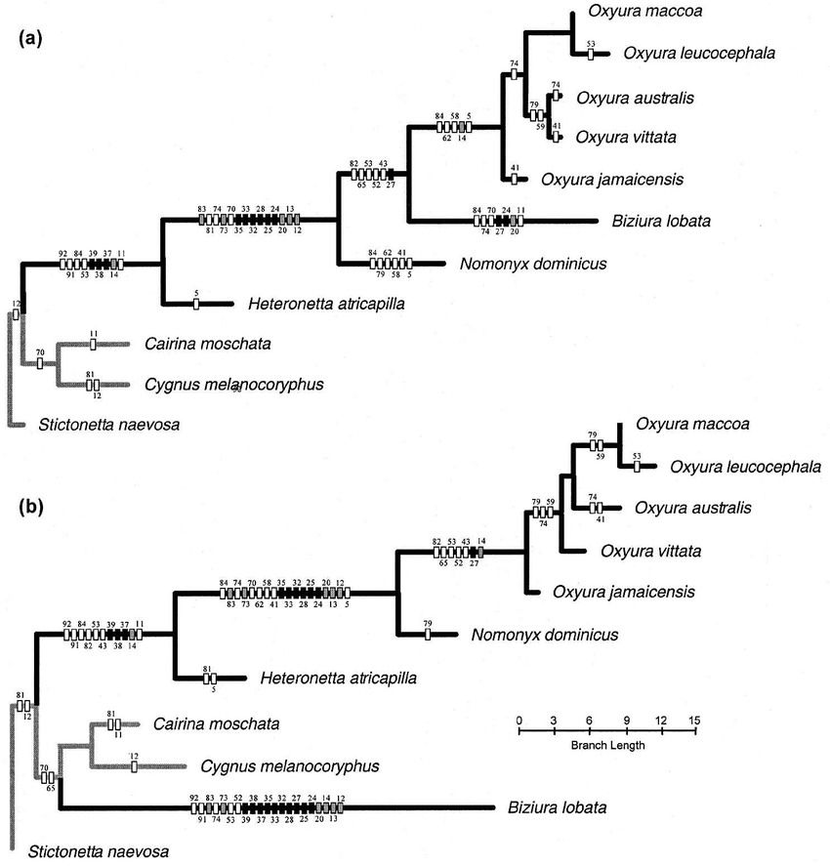
Systematic Biology48(4):683-714

Slide 15
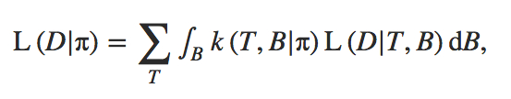

Maximum Likelihood/Bayesian methods:
Similar character based approaches but use‘statistical’ methods such as maximum likelihood and attempts to model DNA evolution as we know it (assuming different frequencies of nucleotides, substitution rates, etc.).
Maximum Likelihood – goal is to find the best tree (assign a score to each tree)
Bayesian Estimate – goal is to estimate a parameter (e.g., clade support) from a set of trees
Trees have likelihood, but clades have posterior probabilities.
(similar to bootstrap resampling probabilities)
<-- a posterior probability from set of trees

Slide 16
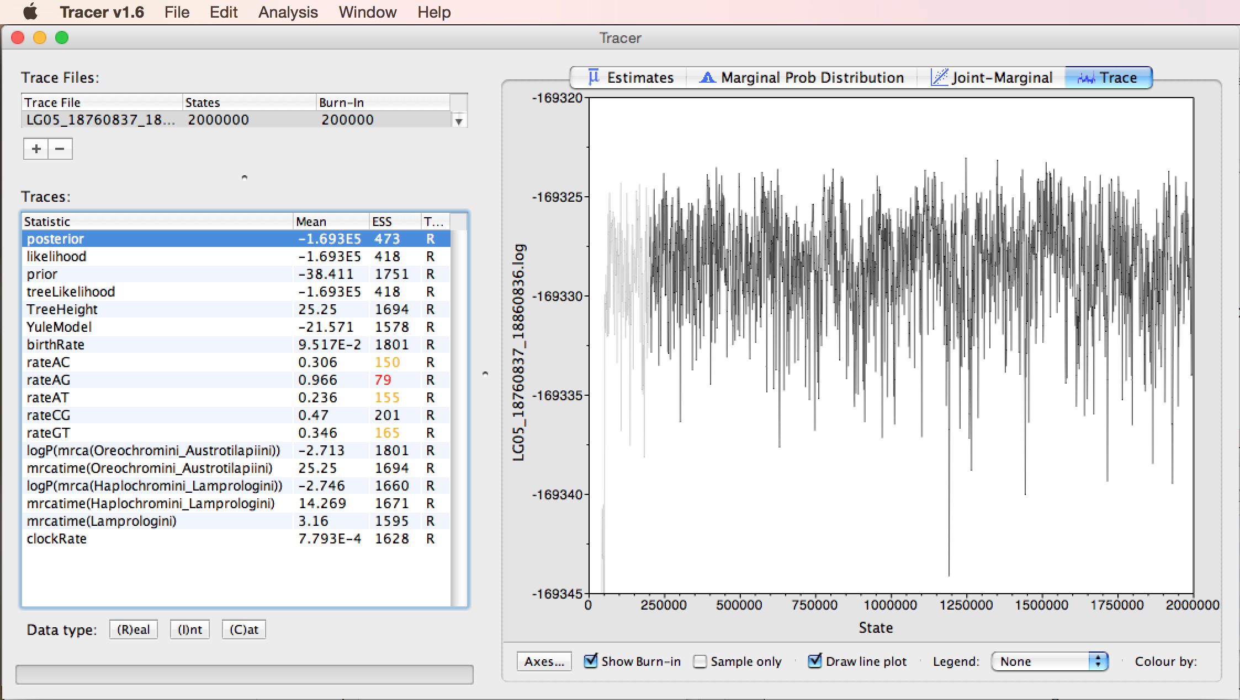
Likelihood for large set of ~2,000,000 sampled trees (1st 200,000 discarded as burn-in)

Slide 17
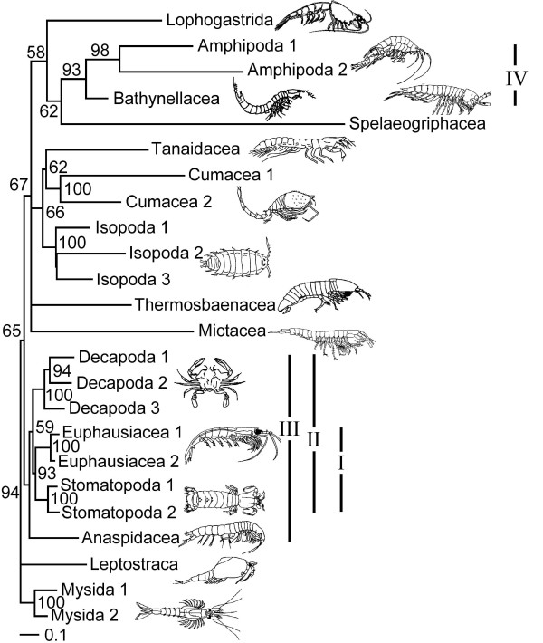
Branch Support – Clade Credibility Values are Bayesian
Values on branches
indicate proportion (%) of trees in posterior sample (i.e., n = 1000 from MrBayes analysis) supporting the particular clade.
A Bayesian approach
Clade support value is a posterior probability
Drawn from a set of trees
Pr (Clade | Set of Trees)
Jenner, R. A., Dhubhghaill, C. N., Ferla, M. P., & Wills, M. A. (2009) Eumalacostracan phylogeny and total evidence: limitations of the usual suspects. BMC Evolutionary Biology, 9:21.

Slide 18
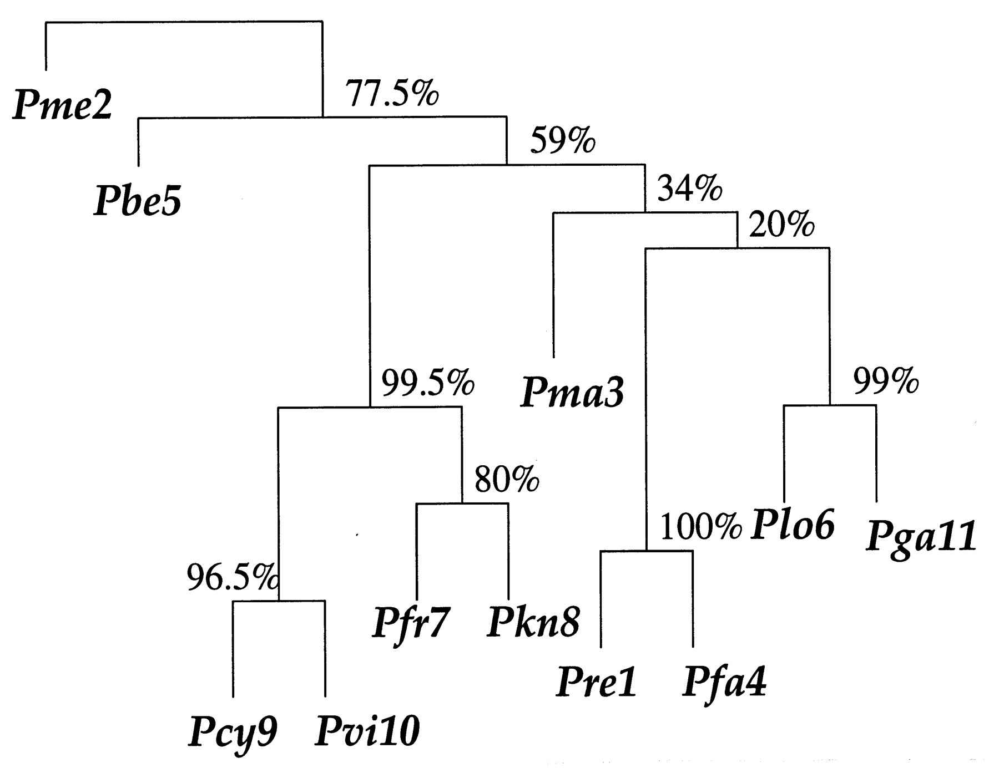
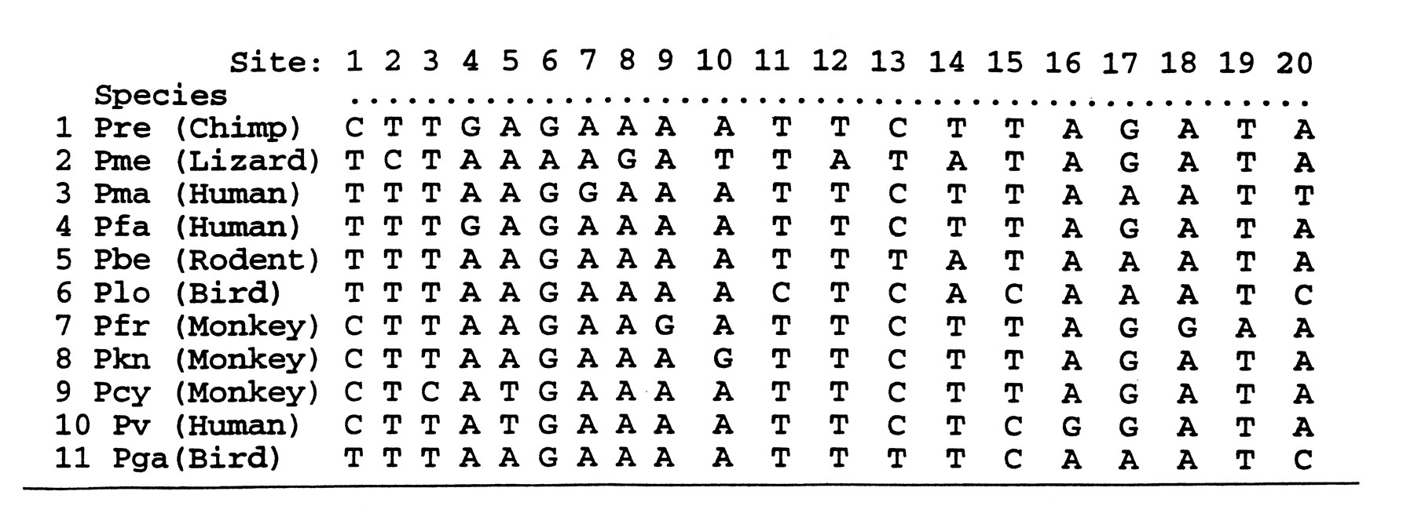
Branch Support by Bootstrap
Randomly resample sites from the original sequence alignment, with replacement, until a new alignment of the same size is formed.
Construct a phylogenetic tree for each of these new, "bootstrapped" datasets.
Calculate support for each clade in the original tree, a "bootstrap value", which is the percentage of bootstrap trees that contain that same branch.
Efron, B., Halloran, E., & Holmes, S. (1996). Bootstrap confidence levels for phylogenetic trees. Proceedings of the National Academy of Sciences, 93(23), 13429-13429.

Slide 19
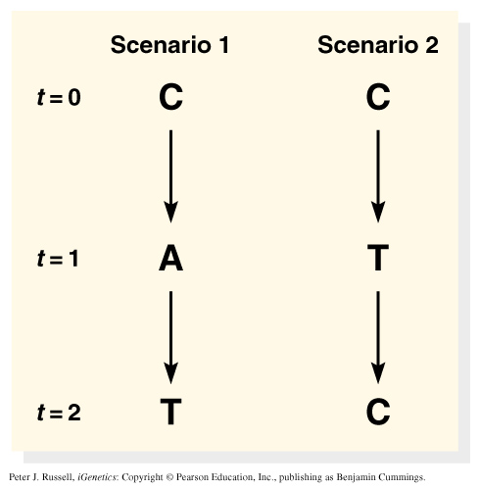
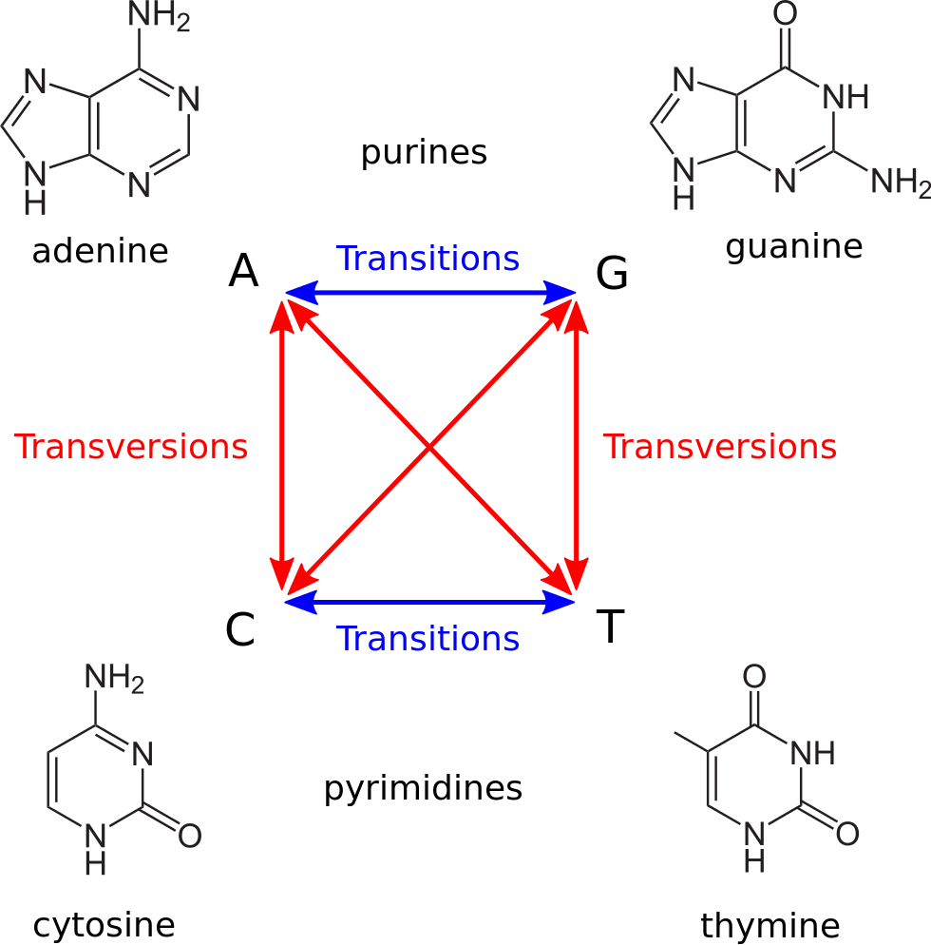
Models of nucleotide substitution:
Alignment of sequences with many differences underestimates the actual number of substitutions.
Different types of substitutions have different rates.

Slide 20
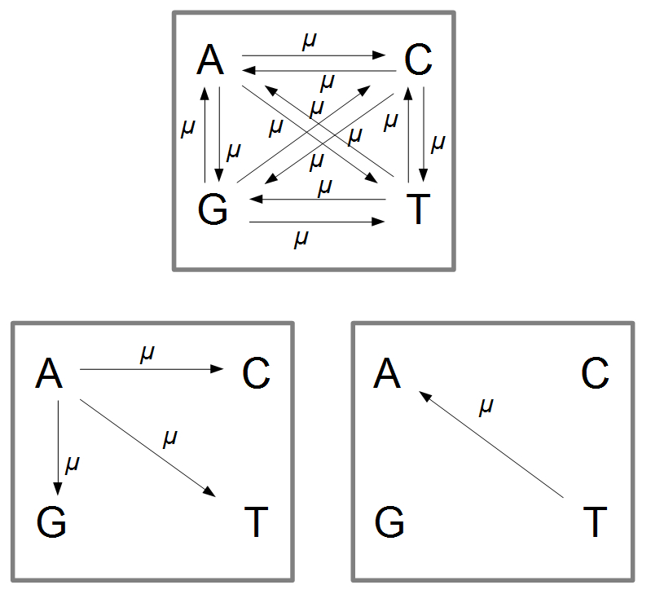
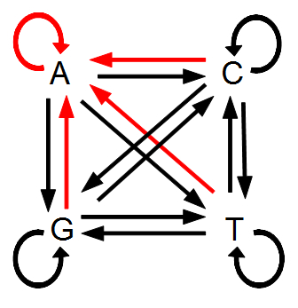
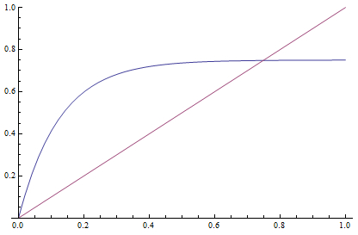
Jukes-Cantor (1969) Models of Nucleotide Substitution:
Simplest model
Equal base frequencies, all substitutions equally likely
P_{C(t)} = 1/4 + (3/4)e^{-4αt} where α = rate of substitution
# substitutions/site = D = -3/4ln(1-4/3d)
d = % difference (raw count)
JC Model
Raw Distance
http://treethinkers.org/jukes-cantor-model-of-dna-substitution/

Slide 21
Jukes-Cantor (JC, nst=1)
equal base frequencies, all substitutions equally likely (Jukes and Cantor 1969)
Felsenstein 1981 (F81, nst=1)
variable base frequencies, all substitutions equally likely (Felsenstein 1981)
Kimura 2-parameter (K80, nst=2)
equal base frequencies, one transition rate and one transversion rate (Kimura 1980)
Hasegawa-Kishino-Yano (HKY, nst=2)
variable base frequencies, one transition rate and one transversion rate (Hasegawa et. al. 1985)
Tamura-Nei (TrN)
variable base frequencies, equal transversion rates, variable transition rates (Tamura Nei 1993)
Kimura 3-parameter (K3P)
variable base frequencies, equal transition rates, two transversion rates (Kimura 1981)
Transition model (TIM)
variable base frequencies, variable transition rates, two transversion rates
Transversion model (TVM)
variable base frequencies, variable transversion rates, transition rates equal
Symmetrical model (SYM)
equal base frequencies, symmetrical substitution matrix (A to T = T to A) (Zharkikh 1994)
General time reversible (GTR, nst=6)
variable base frequencies, symmetrical substitution matrix (e.g., Lanave et al. 1984, Tavare 1986, Rodriguez et. al. 1990)

Slide 22
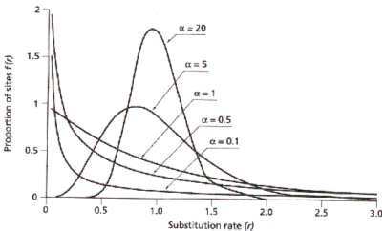
Nucleotide Substitution Rates
Need to also consider rate variation among sites in a sequence:
  gamma distribution (G): gamma distributed rate variation among sites (α = shape parameter)
  proportion invariable sites (I): extent of static, unchanging sites in a dataset

Slide 23
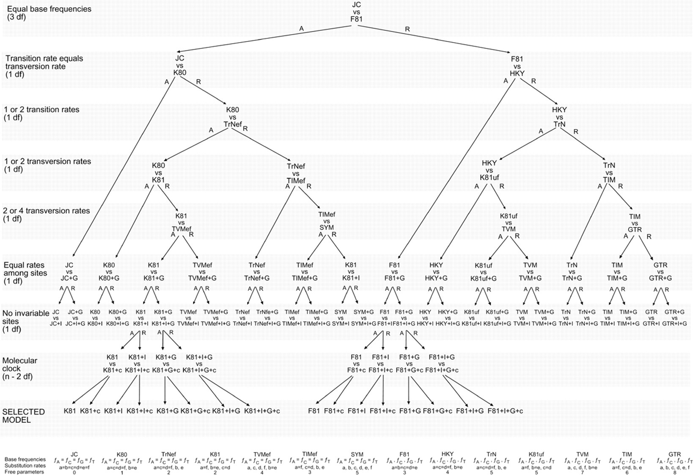
Lots of DNA substitution models to choose from:

Slide 24
Perform hierarchical likelihood ratio test to choose among substitution models
Akaike Information Criterion (AIC)
Measure of relative quality of statistical models for given data.
Tradeoff between goodness-of-fit (likelihood) and complexity of the model (degrees of freedom).
Adding parameters to a model usually improves fit, but also adds complexity. A simpler model may be preferable.
AIC = 2k – 2ln(L), where k = # free parameters
AICc is corrected for sample size.

Slide 25
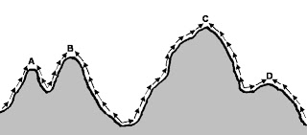
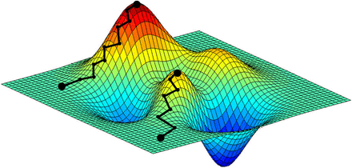
Nothing we discussed so far today describes how we efficiently search through ~10¹⁸⁰ possible trees.
Exhaustive Search Algorithm – search all possible trees, useful for up to ~10 taxa
Heuristic Search Algorithm – search a subset of trees, use algorithm to find global optimum (usually involves random # seed to build tree followed by breaking branches in tree and reevaluating –lnL using Markov Chain Monte Carlo (MCMC; # chains and heating help algorithm run faster).

Slide 26
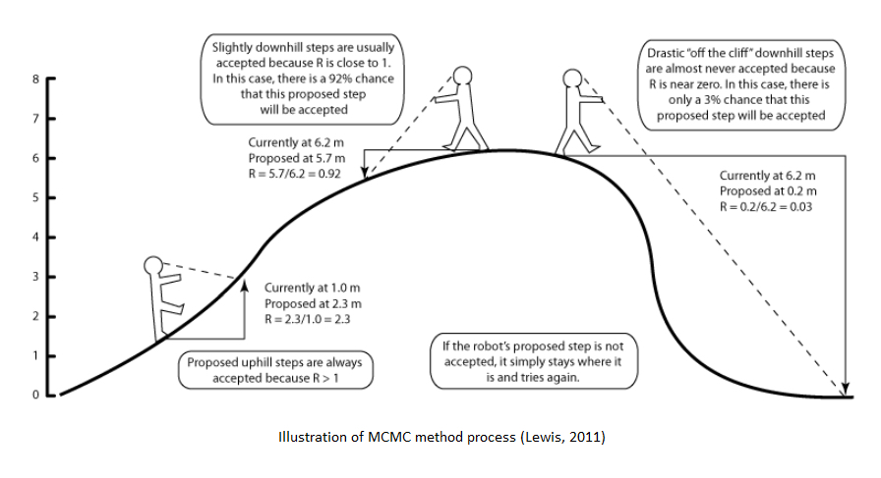
Robot analogy for Markov Chain Monte Carlo

Slide 27
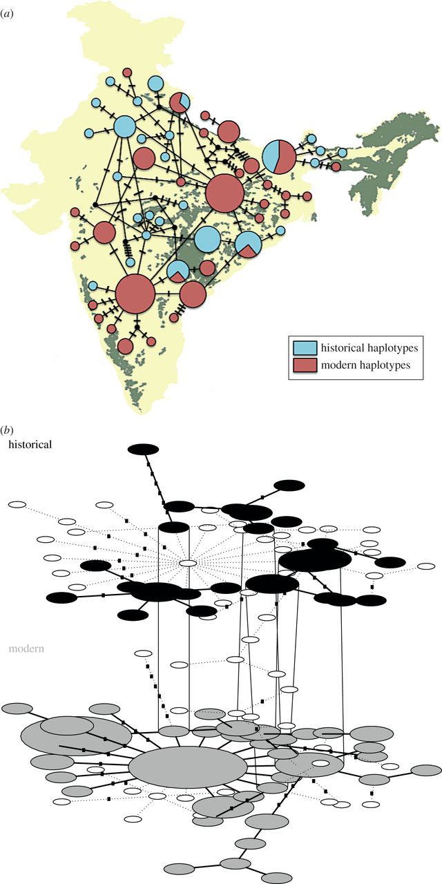
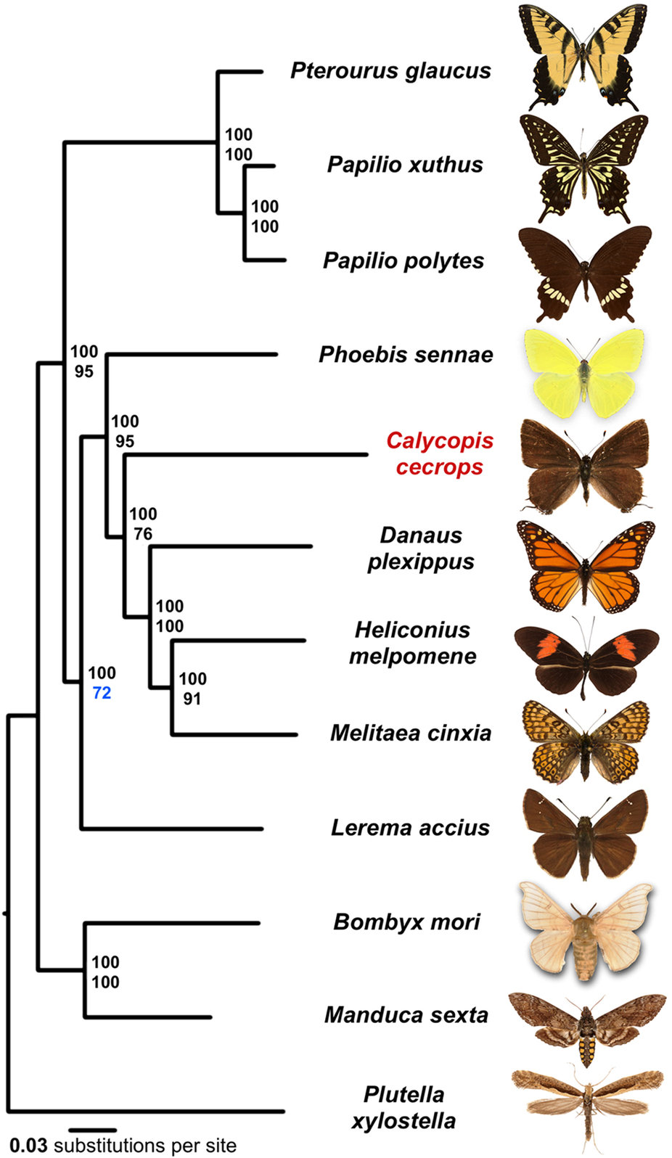
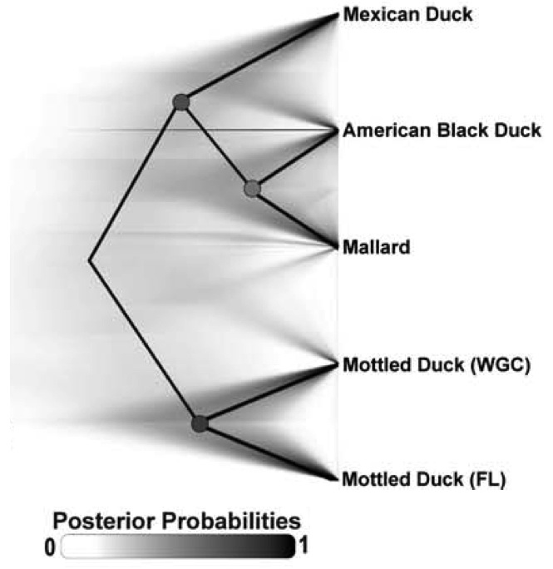
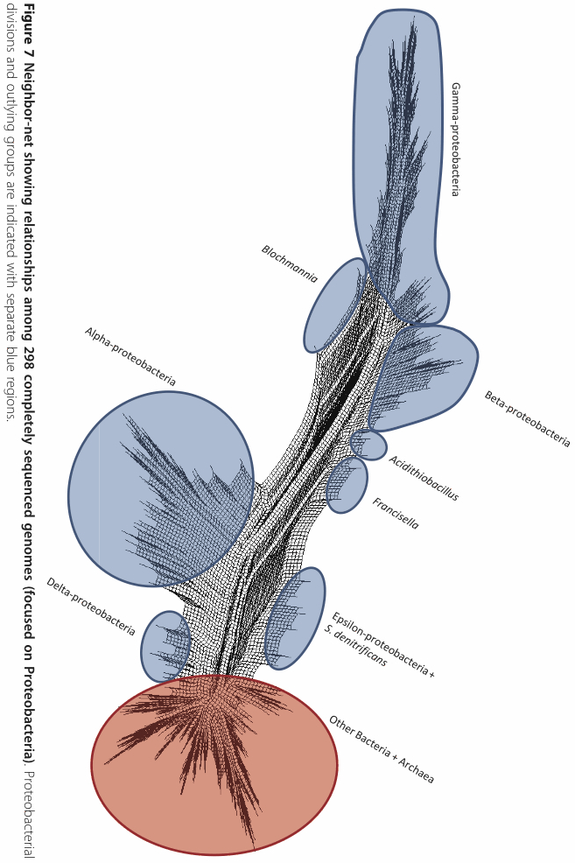
Some of the tools people are using to analyze large genomic datasets:
Mondol et al. 2013
TempNet
Cong et al. 2016
RAXML
Morrison et al. 2013
SplitsTree
Lavretsky et al. 2015
SNAPP

Slide 28
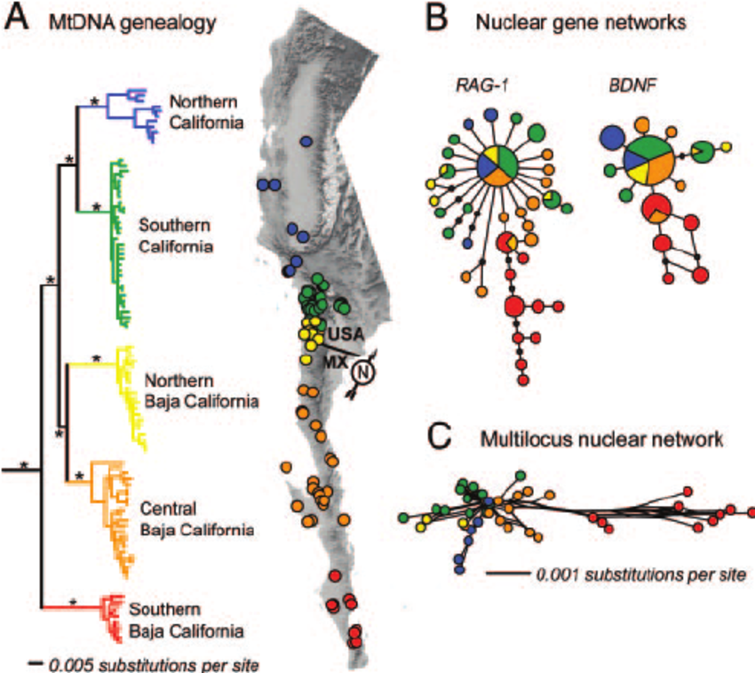
Trees vs. Networks
Leaché, A. D., Koo, M. S., Spencer, C. L., Papenfuss, T. J., Fisher, R. N., & McGuire, J. A. (2009). Quantifying ecological, morphological, and genetic variation to delimit species in the coast horned lizard species complex (Phrynosoma). Proceedings of the National Academy of Sciences, 106(30), 12418-12423.

Slide 29
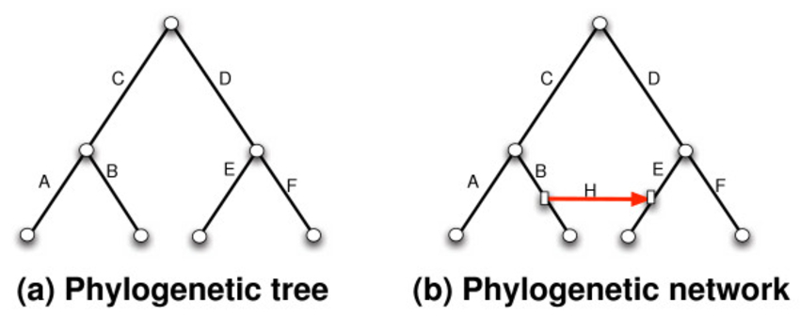
Networks
Created a reticulation, reflects uncertainty, typical of what we encounter from homplasy…

Slide 30
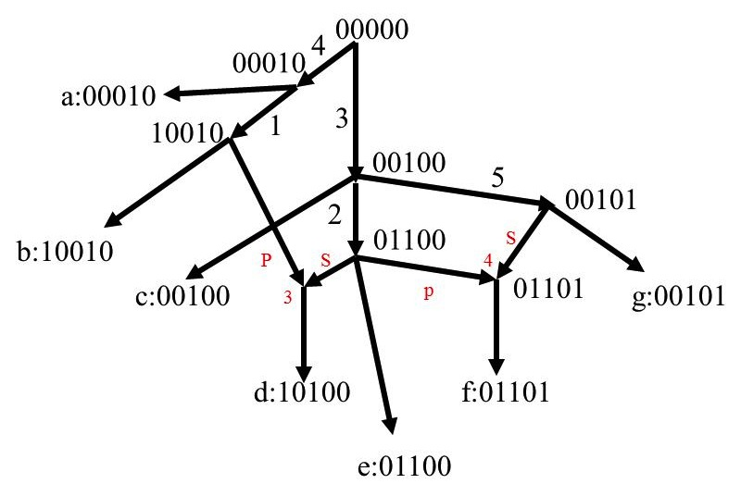

Slide 31
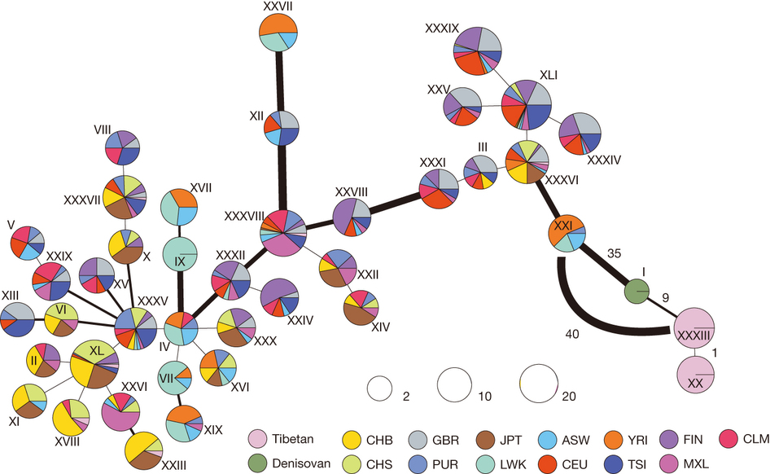
Huerta-Sánchez (2014) Altitude adaptation in Tibetans caused by introgression of Denisovan-like DNA. Nature 512: 194-197.

Slide 32
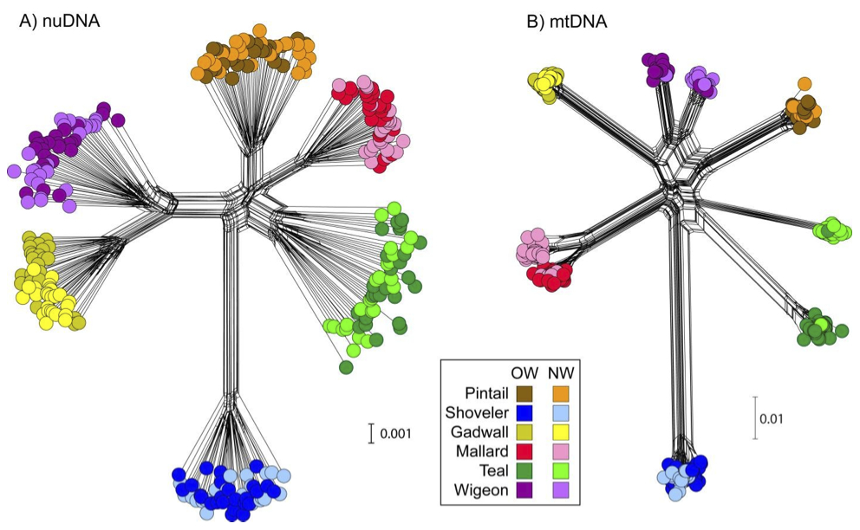
SplitsTree4 - Software
Peters, J. L., K. Winker, K. C. Millam, P. Lavretsky, I. Kulikova, R. E. Wilson, Y. N. Zhuravlev, and K. G. McCracken (2014) Mito-nuclear discord in six congeneric lineages of Holarctic ducks (genus Anas). Molecular Ecology 23:2961-2974

Slide 33
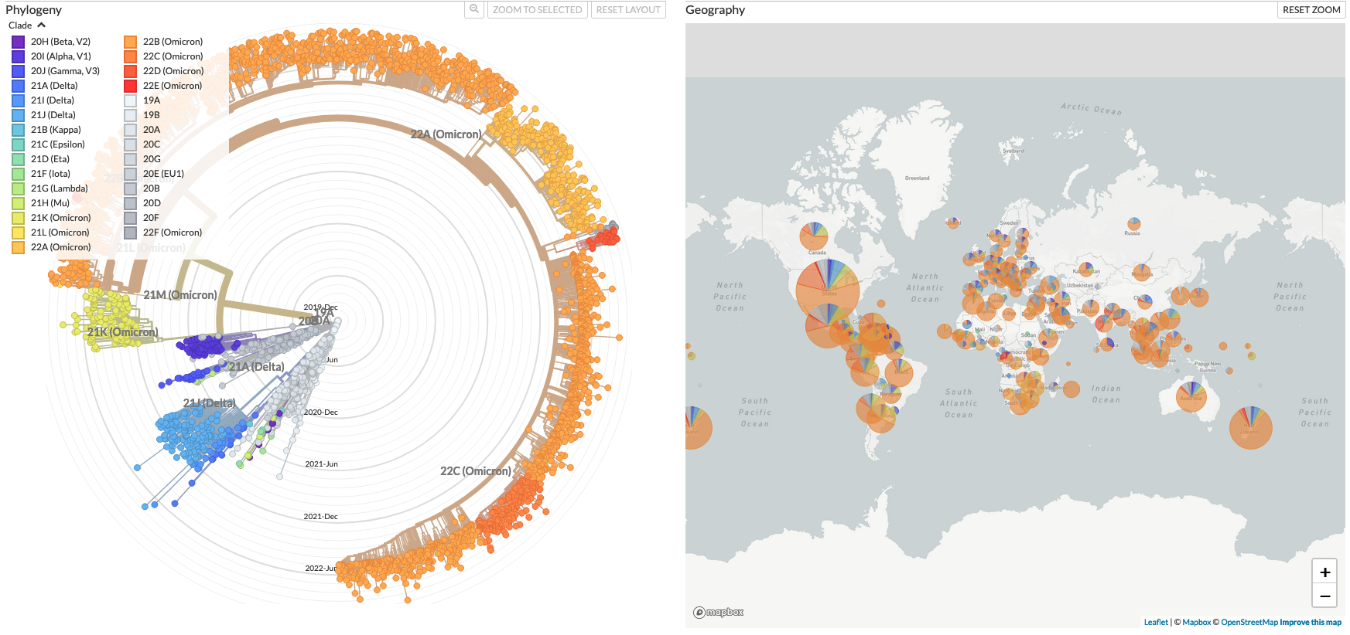
COVID Phylogeny
Animation → https://nextstrain.org/ncov/gisaid/global/6m

Slide 34
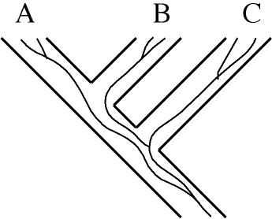
Incomplete Lineage Sorting
Gene trees vs. species trees:
A gene tree does not necessarily reflect the species tree.
Common ancestor or two gene lineages can predate species split because of ancestral polymorphism.
Leading to incomplete lineage sorting, i.e., trees derived from different genes
or linkage groups may conflict and/or show different patterns.
Species tree = straight lines
(A, B), C
Gene tree = curvy lines
(B,C), A

Slide 35
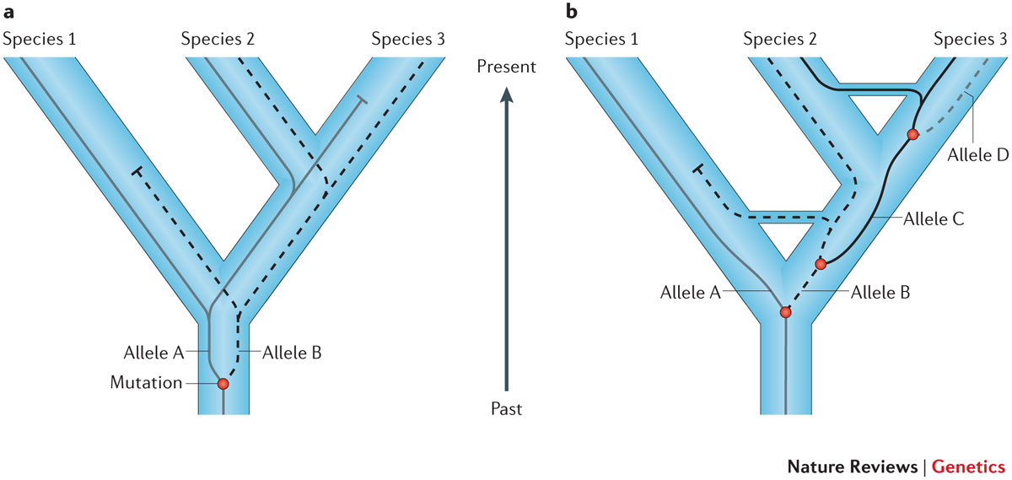
Nature Reviews Genetics (2014) 15:347-359

Slide 36
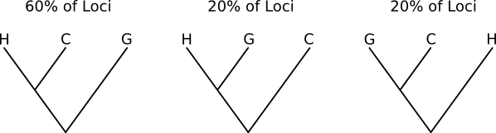
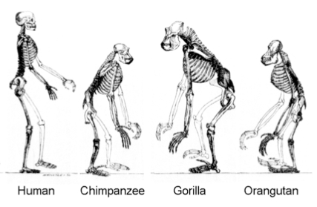
(Human, Chimp), Gorilla
∗∗∗Effects of ancestral polymorphism and ILS are pervasive across the genome∗∗∗

Slide 37
Worst case scenario is three-way tie with equal frequencies of different gene trees
A
B
C
B
C
A
A
C
B
or
or
3-way polytomy

Slide 38
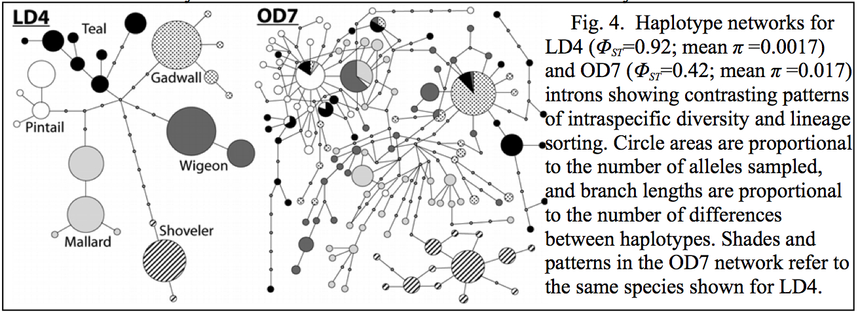
Peters, J. L., K. Winker, K. C. Millam, P. Lavretsky, I. Kulikova, R. E. Wilson, Y. N. Zhuravlev, and K. G. McCracken (2014) Mito-nuclear discord in six congeneric lineages of Holarctic ducks (genus Anas). Molecular Ecology 23:2961-2974.
Sorted
Not Sorted

Slide 39
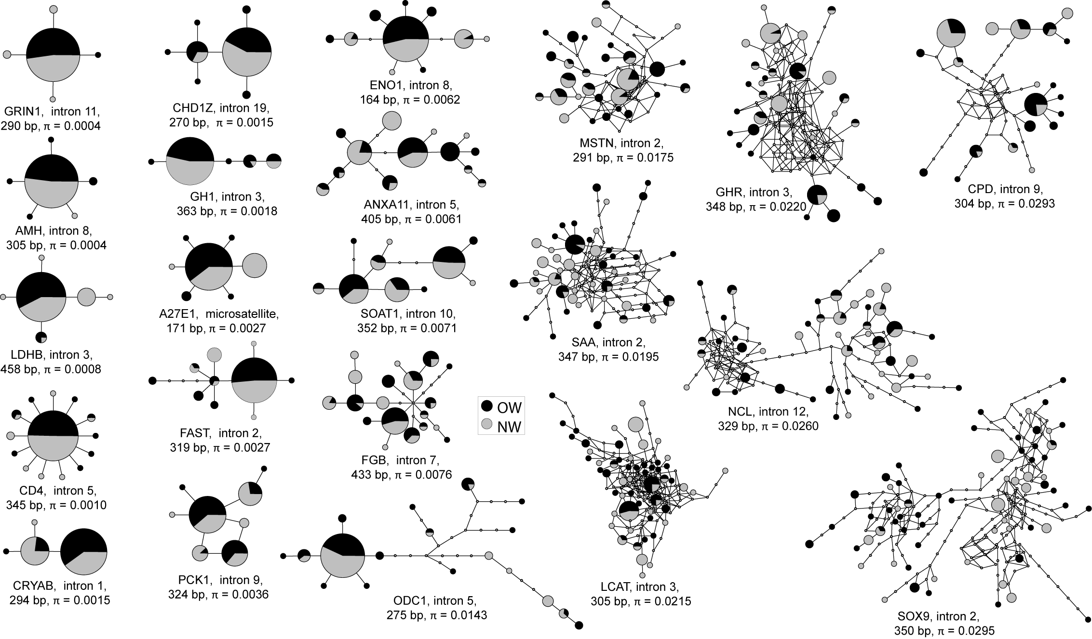
Peters, J. L., T. E. Roberts, K. Winker, and K. G. McCracken (2012) Heterogeneity in genetic diversity among non-coding loci fails to fit neutral coalescent models of population history. PLoS ONE 7:e31972.

Slide 40
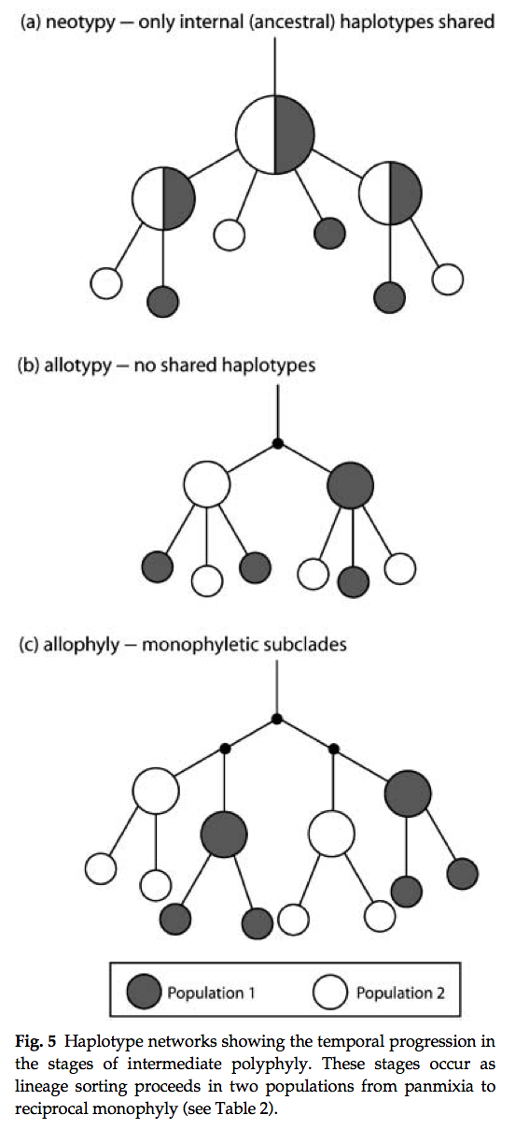
Stages of intermediate polyphyly
1) Not sorted (alleles shared), clades not monophyletic
2) Sorted (alleles not shared), clades not monophyletic
3) Sorted (alleles not shared), clades monophyletic
Omland, K.E., Baker, J.M. and Peters, J.L. (2006) Genetic signatures of intermediate divergence: population history of Old and New World Holarctic ravens (Corvus corax). Molecular Ecology, 15(3), pp.795-808.

Slide 41
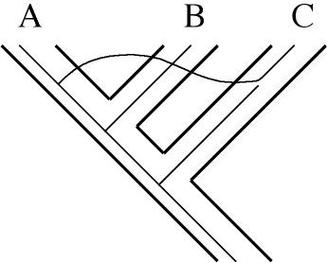
Hybridization - Gene Flow - Introgression
Gene flow between species or populations also may obscure the true species tree and give you a different tree resembling trees generated by patterns of incomplete lineage sorting:
See Lecture #13
A
B
C
A
C
B
or

Slide 42
Introgression can be neutral, deleterious, or adaptive
Adaptive introgression = beneficial gene flow between the same or different species
Increases genetic diversity, and introduces genetic variants leading to fitness increase in the recipient population
Surprisingly common
Can lead to faster evolution (than waiting for mutation)
Will great a visible signature of IBD (low diversity) at site of introgressed alleles.

Slide 43
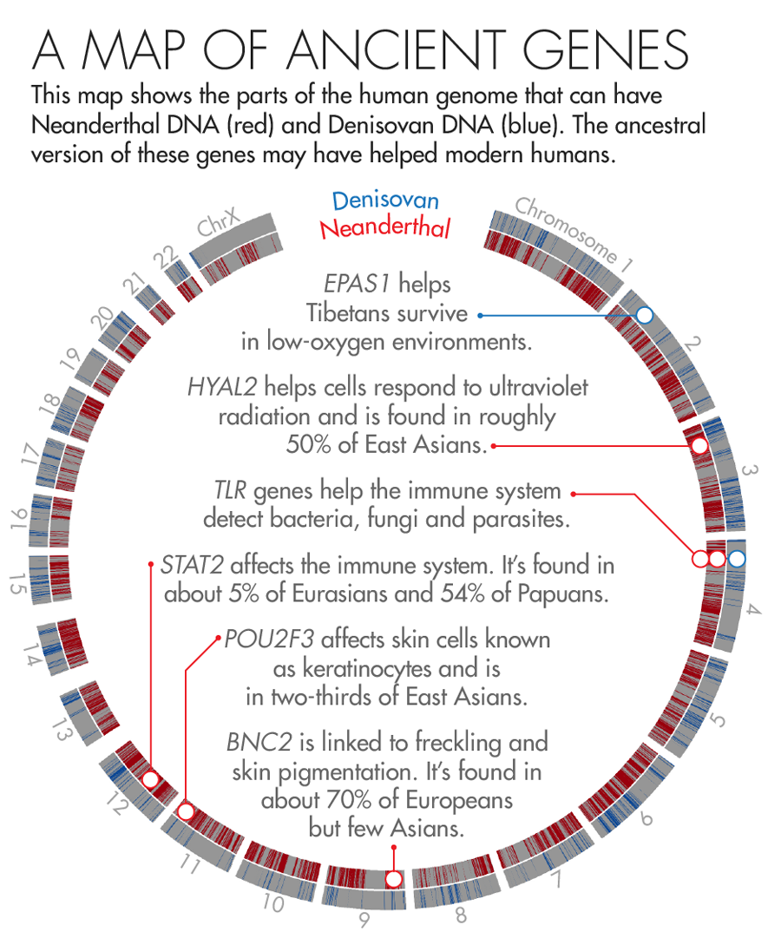
Adaptive introgression from archaic hominids
https://www.quantamagazine.org/how-neanderthal-dna-helps-humanity-20160526/

