Slide 1
Interactions & Conflict
University of Miami
Spring 2026

Slide 2
Gene Interactions
Different genes can interact in a positive or negative way to produce specific trait(s), e.g., quantitative traits.
Gene x environment (G x E) interactions also contribute to phenotype.

Slide 3
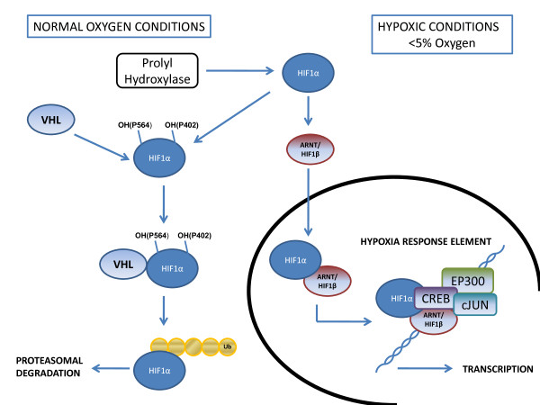
Overview of the hypoxia inducible factor (HIF) pathway.
https://www.researchgate.net/figure/Overview-of-the-hypoxia-inducible-factor-HIF-pathway-In-normoxic-conditions-HIF-1a_fig1_222009574

Slide 4
Epistasis
Epistasis = a form of gene interaction requiring two or more loci, whereby effect of one gene is dependent on another.
Sometimes you hear the term one gene “masked” by the other, but this is a narrow definition.
One classic example includes the genes controlling mammalian pelage color.

Slide 5
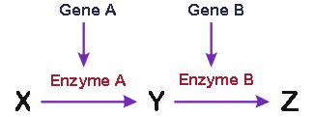
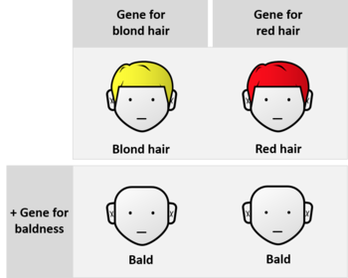
Epistasis
No new phenotype is produced, but one gene (epistatic) masks the phenotypic expression of another gene (hypostatic).
Dominant epistasis, A masks the effect of B.
Recessive epistasis, caused by recessive alleles, aa masks the effect of B at another locus.
Can occur with two genes, requiring A and B to produce a phenotype (duplicate dominant or recessive epistasis).
The gene for baldness is epistatic

Slide 6
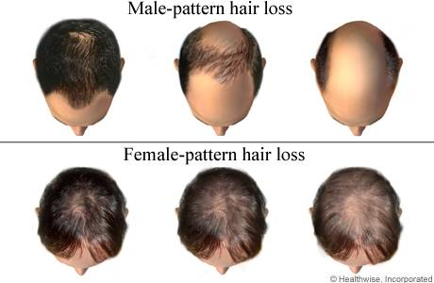
For the male, one allele is sufficient to produce the ”hair loss” phenotype.
For the female, two “hair loss” alleles are required.

Slide 7



Testosterone levels have been shown to be interacting factor!

Slide 8

Recessive epistasis, coat color determination in rodents:
Three loci involved (agouti = color banded hairs, ~grey):
C allele determines pigment (C- = pigment, cc = albino)
A allele determines agouti factor (A- = banded, aa = solid)
B allele determines color (B- = black, bb = brown)
A allele is epistatic over B locus, inserts bands of color between black and brown (appears grey).
C allele is epistatic over A and B loci, as cc is albino regardless of its genotype at the A and B loci.
----cc
A---C-
aaB-C-

Slide 9
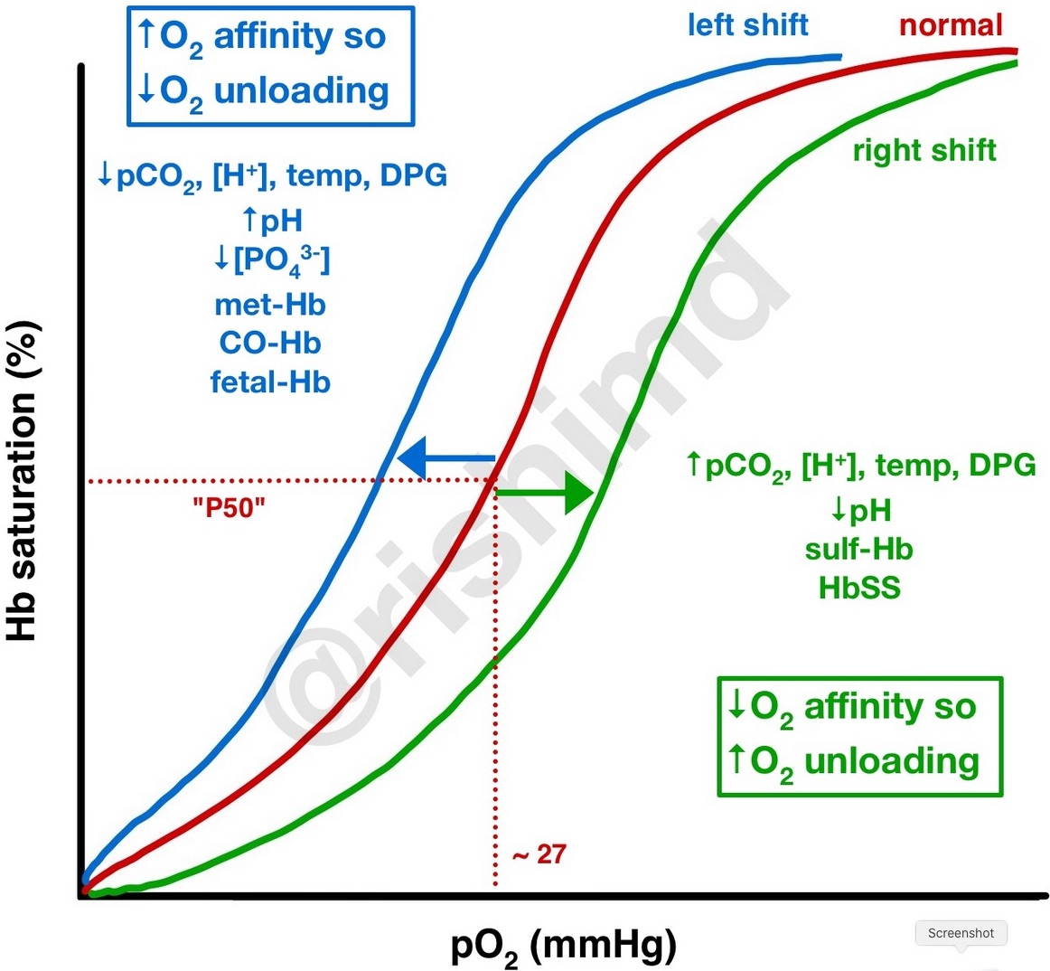
https://rk.md/2017/oxyhemoglobin-dissociation-curve/

Slide 10
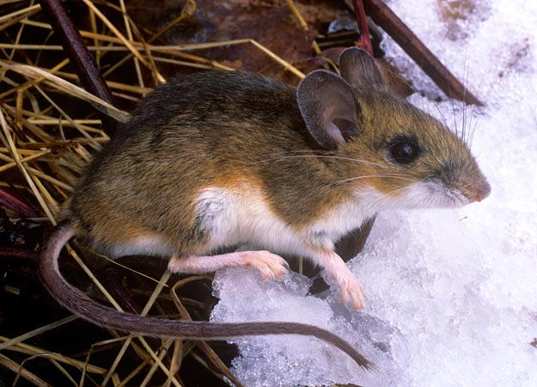
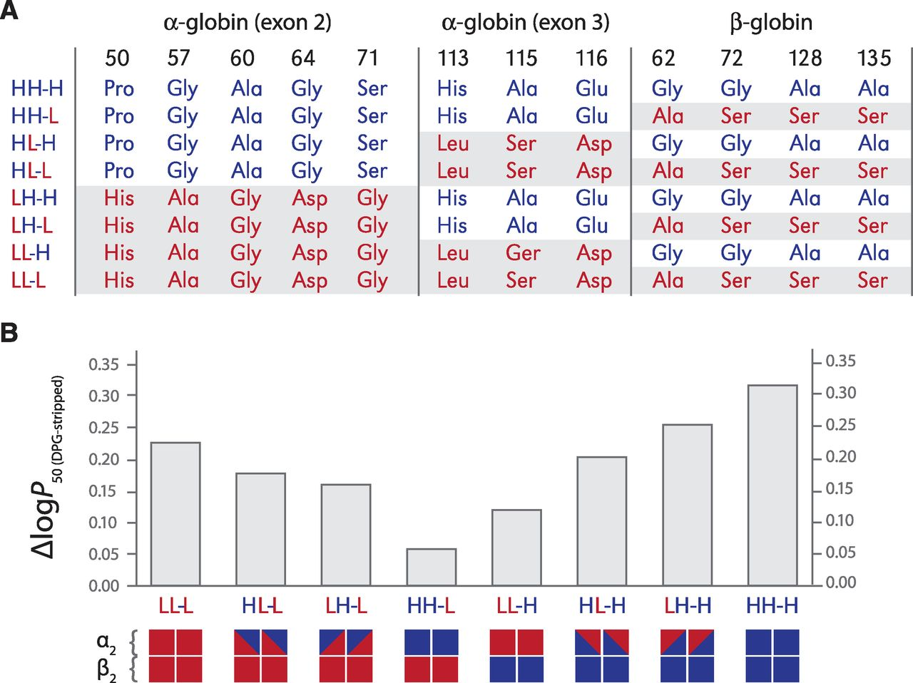
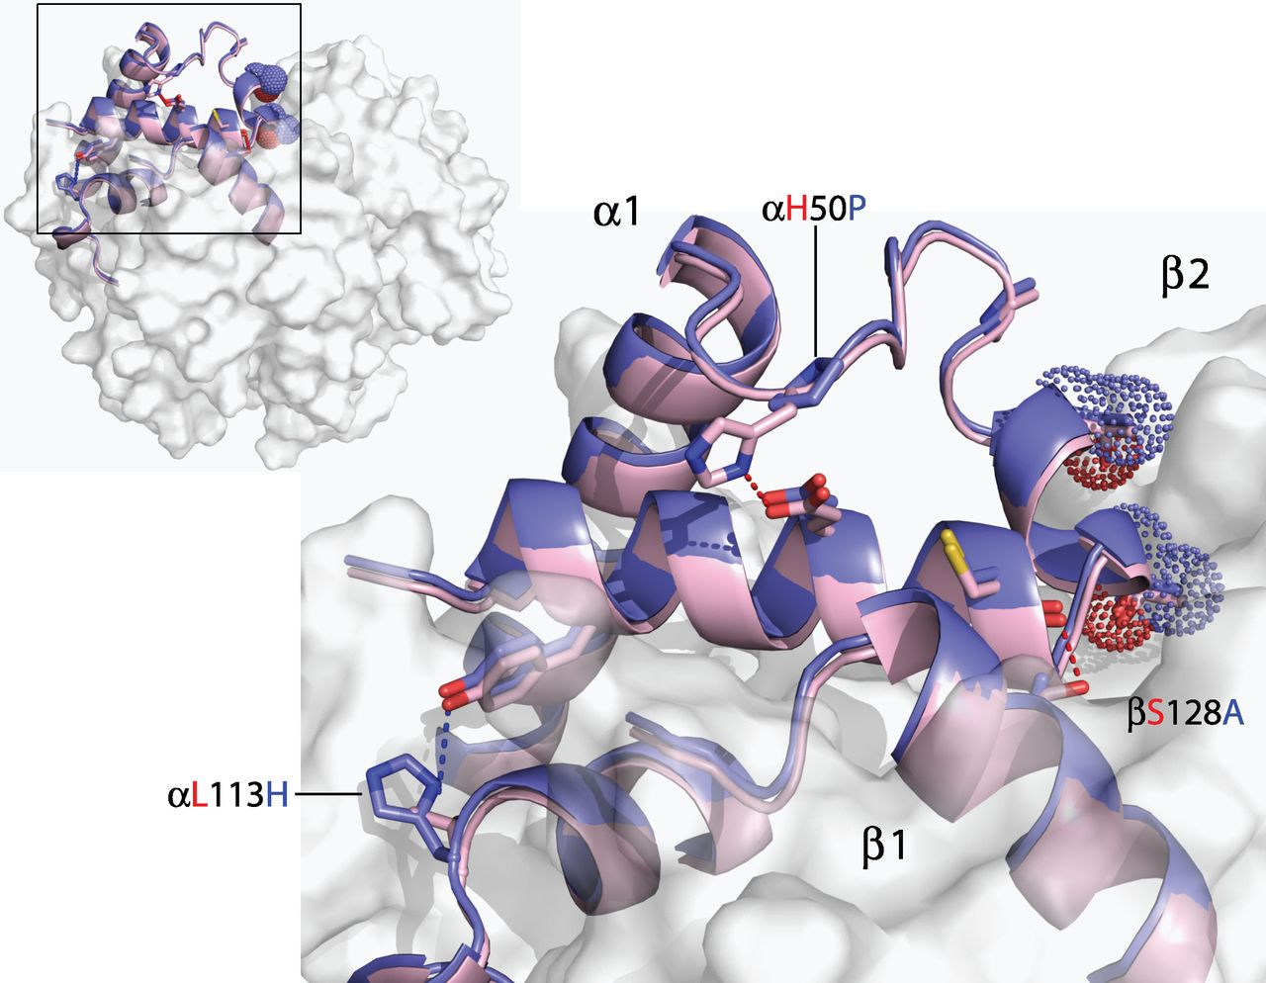
We can also see examples of epistasis within the same protein coded by the same gene(s).
Natarajan, C., Inoguchi, N., Weber, R. E., Fago, A., Moriyama, H., & Storz, J. F. (2013). Epistasis among adaptive mutations in deer mouse hemoglobin. Science, 340(6138), 1324-1327.

Slide 11
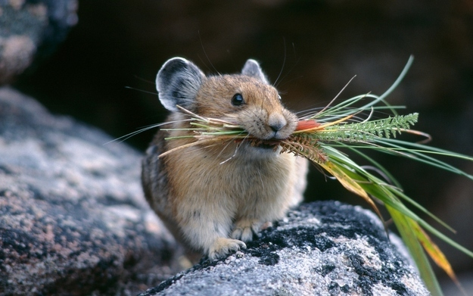
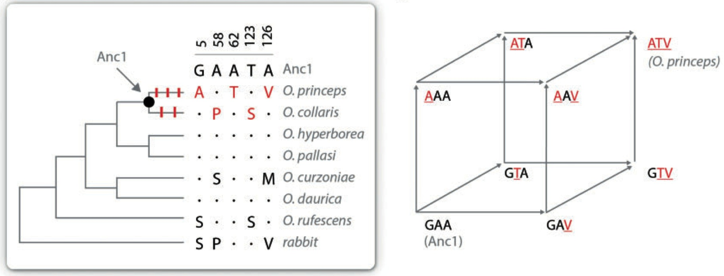
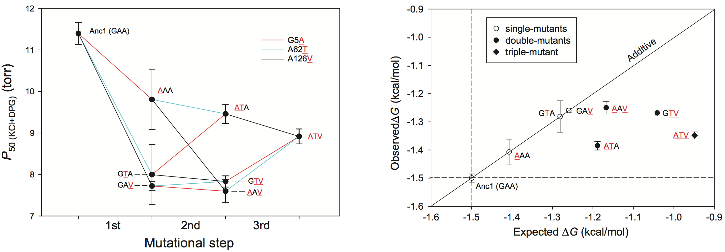
Not all mutational pathways have the same effect on phenotype.
Tufts, D.M., Natarajan, C., Revsbech, I.G., Projecto-Garcia, J., Hoffmann, F.G., Weber, R.E., Fago, A., Moriyama, H. and Storz, J.F., (2015) Epistasis constrains mutational pathways of hemoglobin adaptation in high-altitude pikas. Molecular Biology and Evolution, 32:287-298.

Slide 12
The point of the previous slide…
There are more evolutionary dead ends, than viable paths to change the pika’s Hb-O₂ affinity at high altitude.

Slide 13
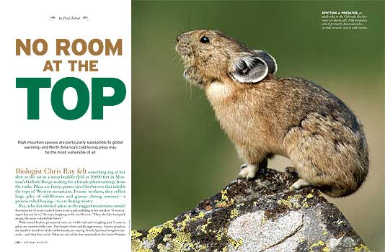

Slide 14
Convergent phenotypes are predictable!
For example, most high-altitude birds and mammals have high-affinity hemoglobins [PHENOTYPE IS SAME].
But DNA substitutions can be idiosyncratic and less predictable [GENOTYPES DIFFER].
The specific amino acid changes observed are usually different.

Slide 15
How does epistasis influence recombination rate?
  If interactions between two genes are favorable (we call this positive epistasis), then recombination rate may be selected against, and decrease.
  If the interactions are deleterious (negative epistasis), then recombination rate may be favored, and increase.
  Recombination rates (like everything else) are subject to selection and evolve up or down.

Slide 16
Brief primer on recombination…
X
X
Did recombination occur?
Heterozygosity is required to detect recombination

Slide 17
For two linked loci interacting in pathway to produce the same phenotype…
linkage pattern favorable
linkage pattern unfavorable
recombination suppressed
recombination favored
X

Slide 18
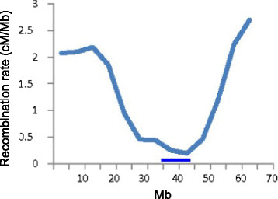
  Recombination rates (like everything else) are subject to selection and evolve up or down…
  … and this varies across the genome.

Slide 19

Why is recombination beneficial?
Recombination is not always beneficial. It can be costly (recombination load) because it reshuffles beneficial combinations of alleles that are well suited to the environment.
But environments are variable and changing, so allelic combinations that are well suited to one environment may not be well suited to future environments.
A theory for the evolution of sexual reproduction!
  Otto, S. P., & Lenormand, T. (2002). Resolving the paradox of sex and recombination. Nature Reviews Genetics, 3, 252-261.
Sally Otto (UBC)

Slide 20
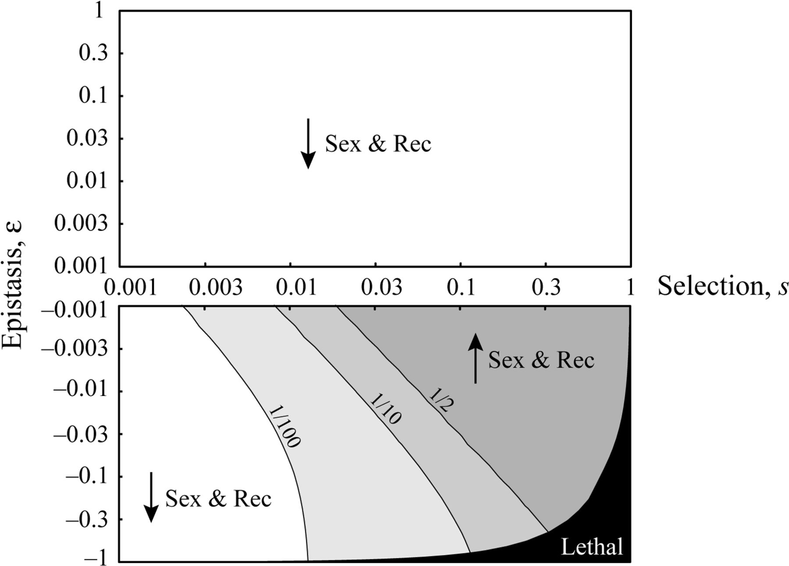
Recombination is favored when selection is strong and epistasis is weak and negative.
Otto, S. P., & Gerstein, A. C. (2006). Why have sex? The population genetics of sex and recombination. Biochemical Society Transactions 34:519-522.

Slide 21
Some other concepts of selection that are not explicitly genetic.

Slide 22
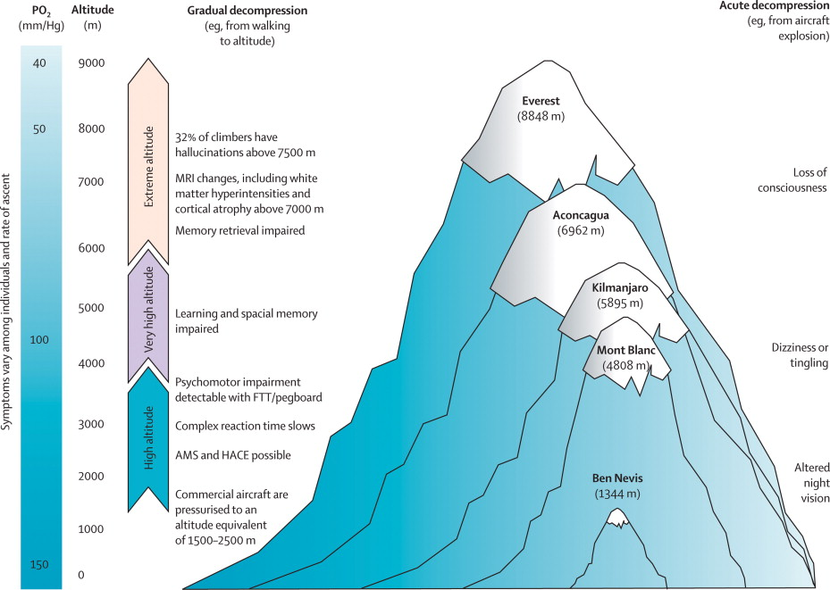
Selection in Niche Space
Species live in heterogeneous environments and each environment has different fitness optima, therefore selection coefficients differ in different environments.
http://www.zo.utexas.edu/courses/bio301/chapters/Chapter13/Chapter13.html

Slide 23
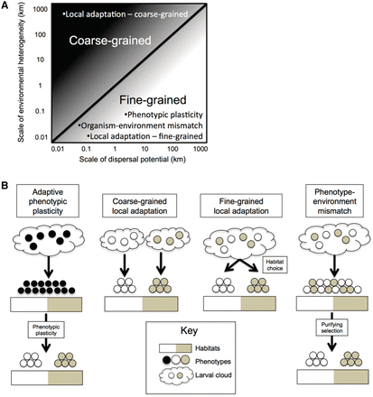
Coarse-grained vs. Fine-grained Environmental Selection
Sotka, E. E. (2012). Natural selection, larval dispersal, and the geography of phenotype in the sea. Integrative and Comparative Biology, 52, 538-545.

Slide 24
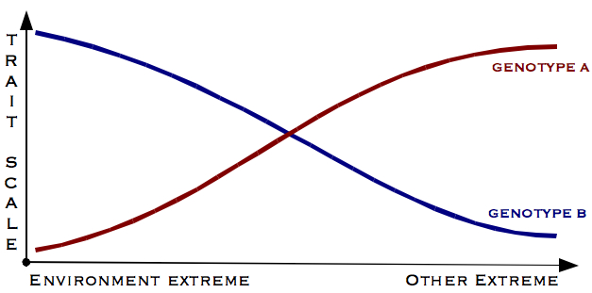
Reaction Norm
Describes the pattern of phenotypic expression of a genotype across a range of environments, usually describing how different species or populations respond to varying environments.
Can be used to determine whether species exhibit plasticity, genetic variation, and gene x environment interactions.

Slide 25
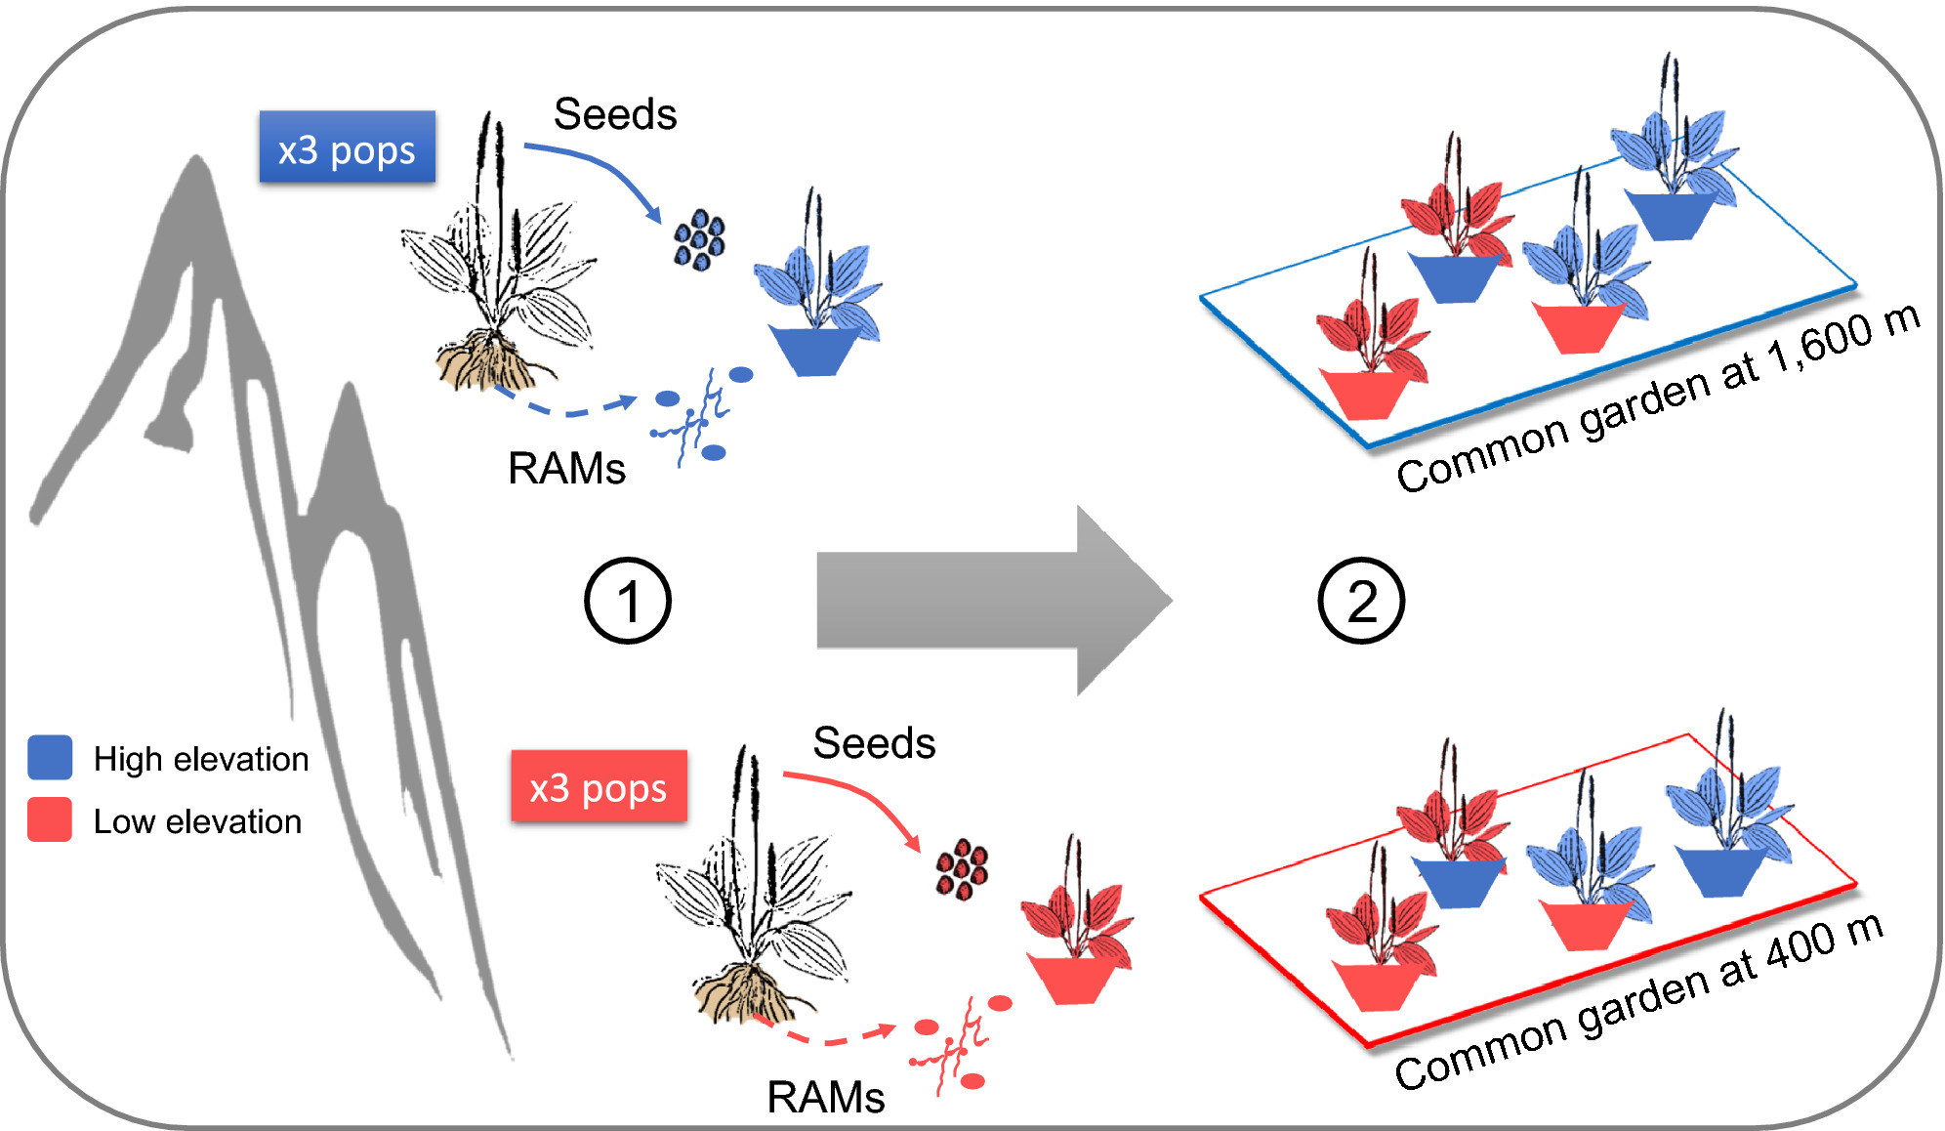
Common garden experiments with reciprocal transplants are powerful research tools
Formenti, L., Caggìa, V., Puissant, J., Goodall, T., Glauser, G., Griffiths, R., & Rasmann, S. (2021). The effect of root‐associated microbes on plant growth and chemical defence traits across two contrasted elevations. Journal of Ecology, 109(1), 38-50.
Notes:
Experimental setup for the common garden reciprocal transplant. Seeds and root‐associated microbes (RAMs) were collected from three transects in the Alps at both high and low elevation, and from 10 plants per populations (1). RAMs and plant ecotypes were then fully crossed at both high‐ and low‐elevation common garden sites (2). Each plant was grown in 1 L plastic pots filled with standardized and sterile growing medium inoculated with 75 ml of soil + RAMs from either elevation. All plants were covered with nylon netting to prevent natural herbivory
IF THIS IMAGE HAS BEEN PROVIDED BY OR IS OWNED BY A THIRD PARTY, AS INDICATED IN THE CAPTION LINE, THEN FURTHER PERMISSION MAY BE NEEDED BEFORE ANY FURTHER USE. PLEASE CONTACT WILEY'S PERMISSIONS DEPARTMENT ON PERMISSIONS@WILEY.COM OR USE THE RIGHTSLINK SERVICE BY CLICKING ON THE 'REQUEST PERMISSIONS' LINK ACCOMPANYING THIS ARTICLE. WILEY OR AUTHOR OWNED IMAGES MAY BE USED FOR NON-COMMERCIAL PURPOSES, SUBJECT TO PROPER CITATION OF THE ARTICLE, AUTHOR, AND PUBLISHER.

Slide 26
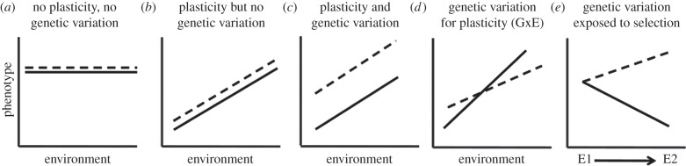
Pop1
Pop2
https://www.researchgate.net/figure/261255912_fig3_Phenotypic-plasticity-and-reaction-norms-In-panel-a-phenotype-does-not-vary-with-the

Slide 27
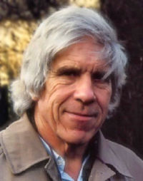
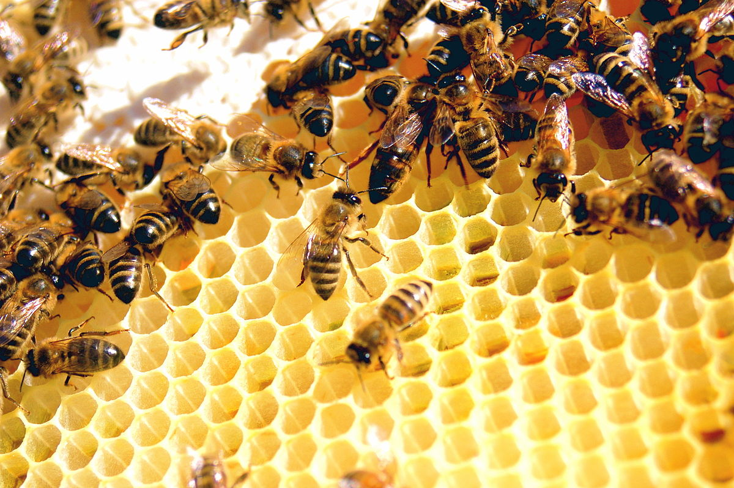
Hamilton’s Rule for Kin Selection
Kin selection favors the reproductive success of relatives.
Can occur even at cost to own survival or reproduction.
Altruism = act costly to yourself that benefits others.
Involves inclusive fitness, which includes fitness contribution of kin.
Costly actions should be performed if:
C < r x B
C = cost to the actor
r = relatedness
B = benefit to the recipient
W. D. Hamilton

Slide 28
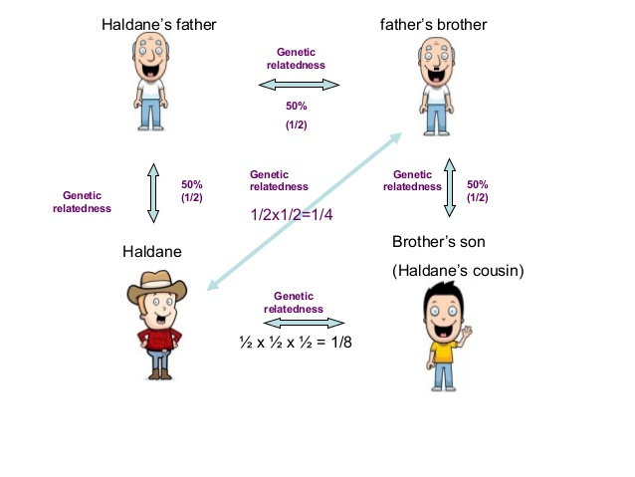
https://www.slideshare.net/KASHMEERA-N-A/ethology-seminarkashmeera

Slide 29
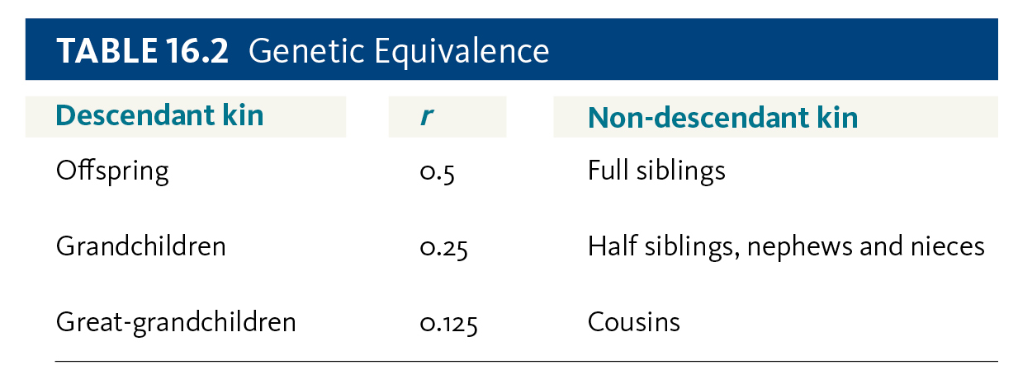
Individuals often help relatives
Haldane famously joking that he would willingly die for two brothers or eight cousins.
H. Lanier

Slide 30
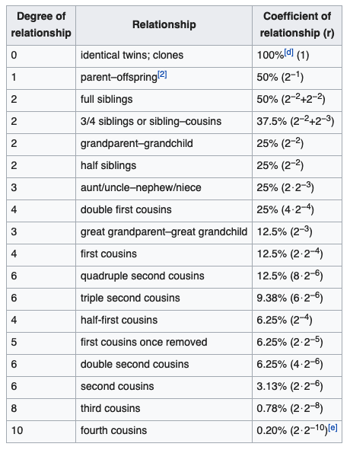
Coefficient of relationship
---Wikipedia

Slide 31
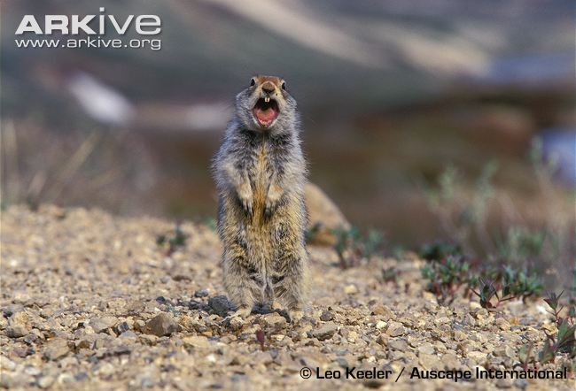
Example of Kin Selection:
Arctic Ground Squirrel gives an alarm call that puts itself at risk.
However, most nearby squirrels are likely closely related.
Some squirrels alter the call if no relatives are nearby.

Slide 32
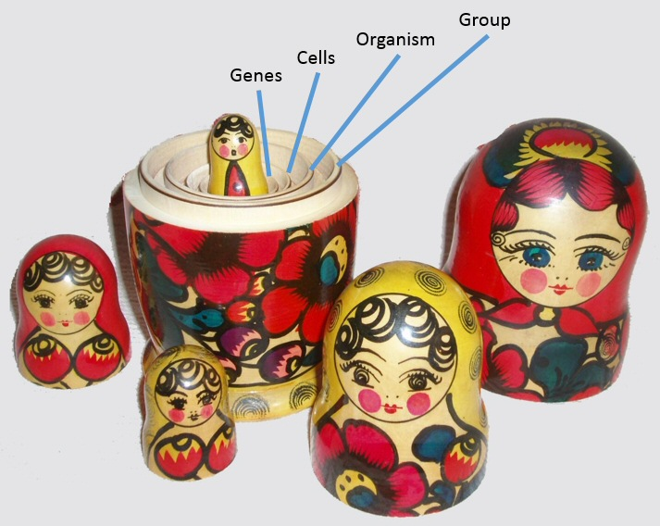
Group Selection
Selection that acts at the level of the group, not the individual or kin.
First advocated by V.C. Wynne-Edwards & Konrad Lorenz.
John Maynard Smith and G. C. Williams cast strong doubt beginning in the 1960s. Renewed interest by David Sloan Wilson, Elliott Sober, and E. O. Wilson in 1990s---arguing that multi-level selection may accommodate aspects of group selection.
Requires that non-altruistic behavior receive a social penalty.
Hamilton’s Rule Revised
C < rB_{k} + B_{e}
---but it is not this simple
benefit to group
benefit to kin x relatedness

Slide 33
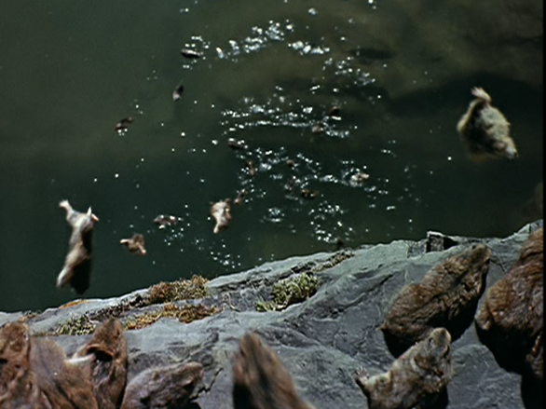
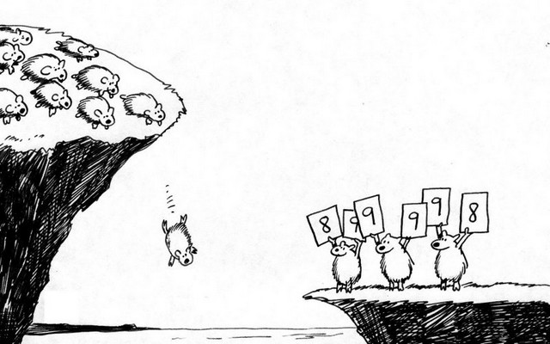
In Disney’s 1958 classic, White Wilderness, lemmings were portrayed as undergoing a mass migration when ends when they leap into the Arctic Ocean. While this footage was staged, under what conditions might genes evolve to reduce population size for the good of a species (i.e., “suicide genes”)?

Slide 34
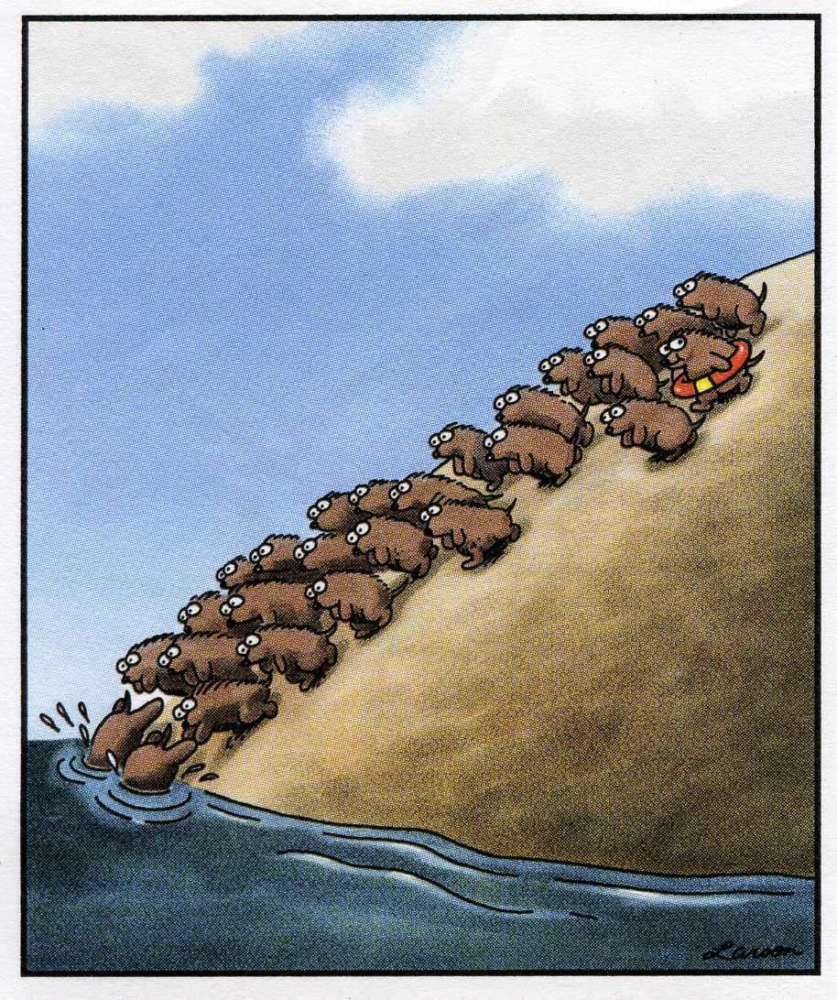
Suicide can not be an adaptation because suicide genes would be removed from population
Imagine two genes in the population:
“Suicide gene”
“Selfish gene”
Notes:
CBE example bout lemming committing suicide

Slide 35
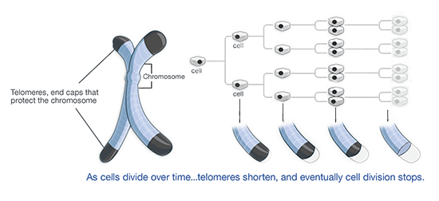
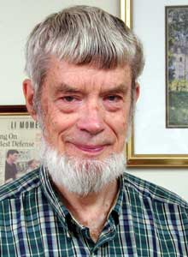
Antagonistic Pleiotropy
One gene controls more than one trait, and at least one trait is beneficial to fitness and one is detrimental to fitness.
First proposed by G. C. Williams in 1957 as explanation for senescence.
Example of fitness trade-off, preventing organisms from reaching perfection.
Example---high annual mortality in rodents prevents cancer, but the opposite is true in primates.

Slide 36
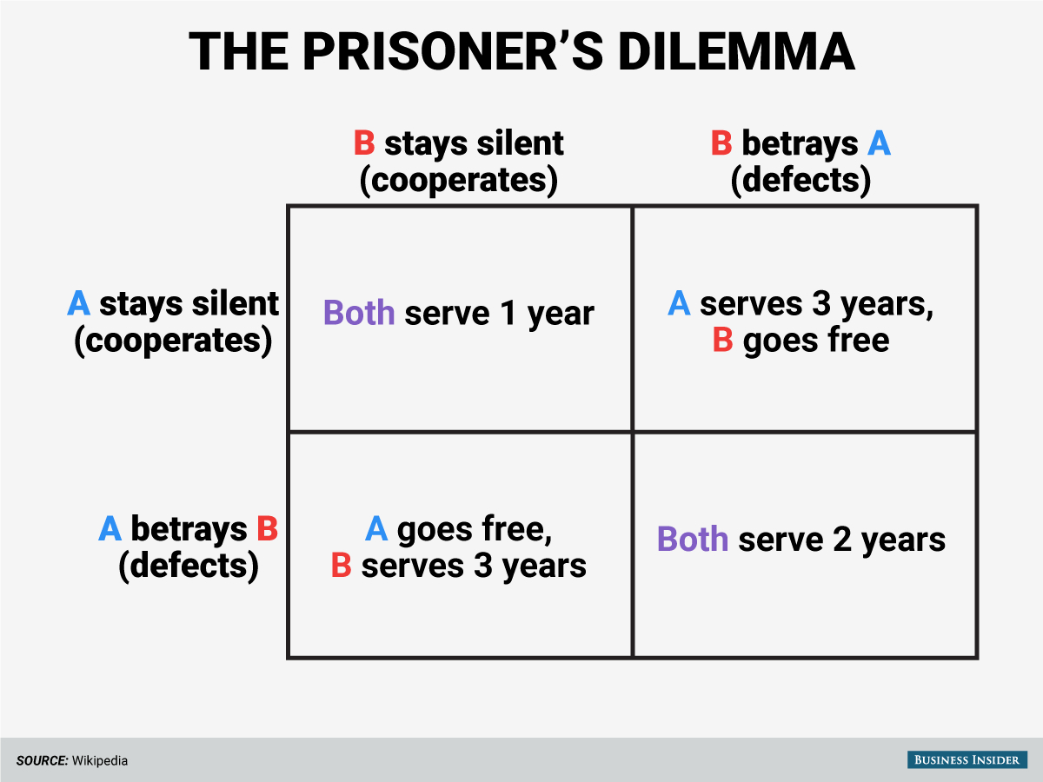
Resolving Conflicts
Conflict is ubiquitous in evolution, whether for mates of resources.
It can be within the same species or among species.
Game Theory Example
If the prisoners always cooperate (p = 0) they are always better off (d).
A mutation that causes prisoners to always betray would increase in frequency, however if every prisoner betrays (p = 1) it would be evolutionary unstable.
To find the ESS of p, in which every individual betrays with probability p, and cooperates with 1 – p.
G (gain) = p²(–b) + p(1 – p)c + (1 – p)p(0) + (1 – p)²d
p = c – d / c – d + b
d
0
c
-b

Slide 37
Selfish Genetic Elements
Some genes cause heterozygotes to produce an excess of games through meiotic drive---Mendel’s Laws do not apply.
Sperm carrying the normal haplotype become inactivated.
Can lead to rapid fixation. However, may not become fixed if males homozygous for the driving allele are sterile (e.g., t-haplotype on chromosome 17 in Drosophila).
Fixation rate depends on strength (r) of the meiotic drive.
Involves two loci.

Slide 38
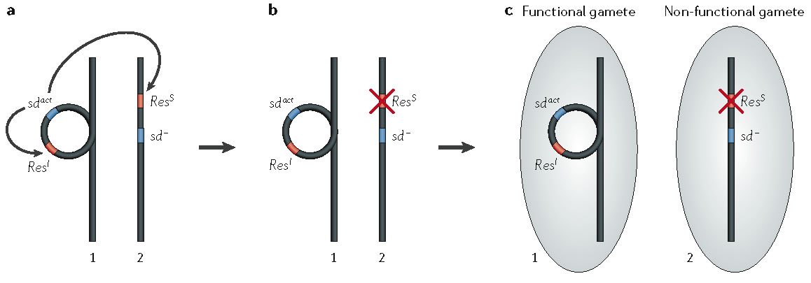
Driving Locus
Responding Locus
Sensitive
Responding Locus
Insensitive
Segregation Disorder (SD) System in Drosophila
http://johnmm.bol.ucla.edu/geneDrive.htm

Slide 39
Evolution of Sex Ratio
First explained by Fisher’s Principle - Genetical Theory of Natural Selection (1930)
Most species are 1:1, but many eusocial insects are not.
Suppose male births are less common than female.
A newborn male then has better mating prospects than a newborn female, and therefore can expect to have more offspring.
Therefore parents genetically disposed to produce males tend to have more than average numbers of grandchildren born to them.
Therefore the genes for male-producing tendencies spread, and male births become more common.
As the 1:1 sex ratio is approached, the advantage associated with producing males dies away.
The same reasoning holds if females are substituted for males throughout. Therefore 1:1 is the equilibrium ratio.
1:1 is an evolutionary stable strategy (ESS)

Slide 40
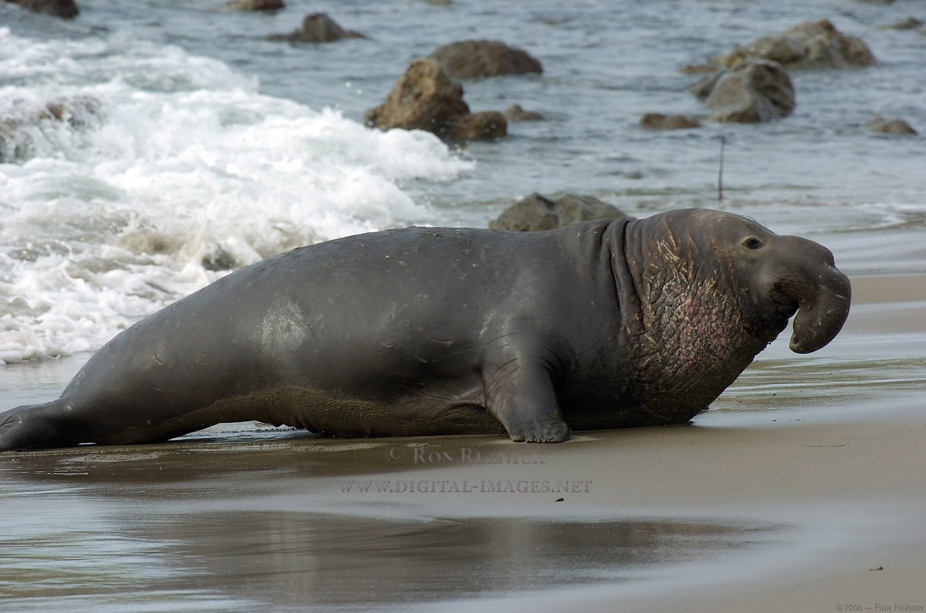
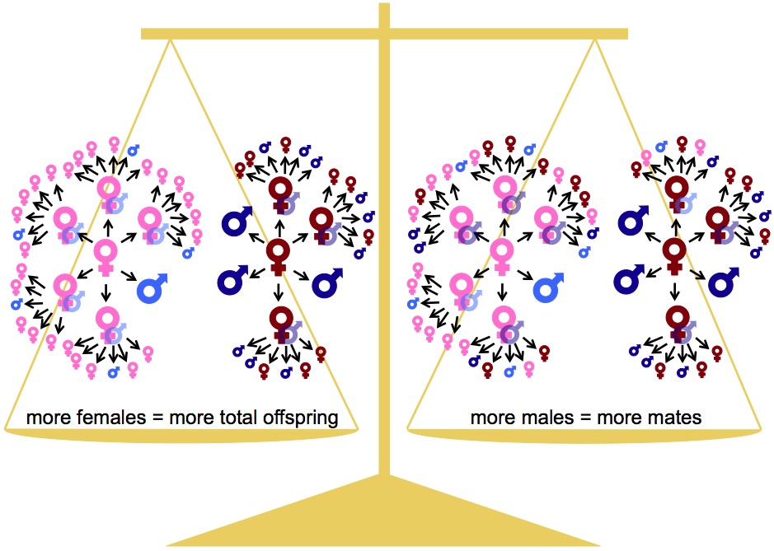
Evolution of Sex Ratio
In undivided populations, equal proportions generally are favored.
In highly divided populations, female-biased sex rations are often preferred because more offspring can be produced if one male can mate with many females.
If fewer females produce offspring in these divided populations, there is more competition among males and more equal sex ratios evolve.
Allison Neal: http://www.uvm.edu/~aneal/sexratio.html

Slide 41
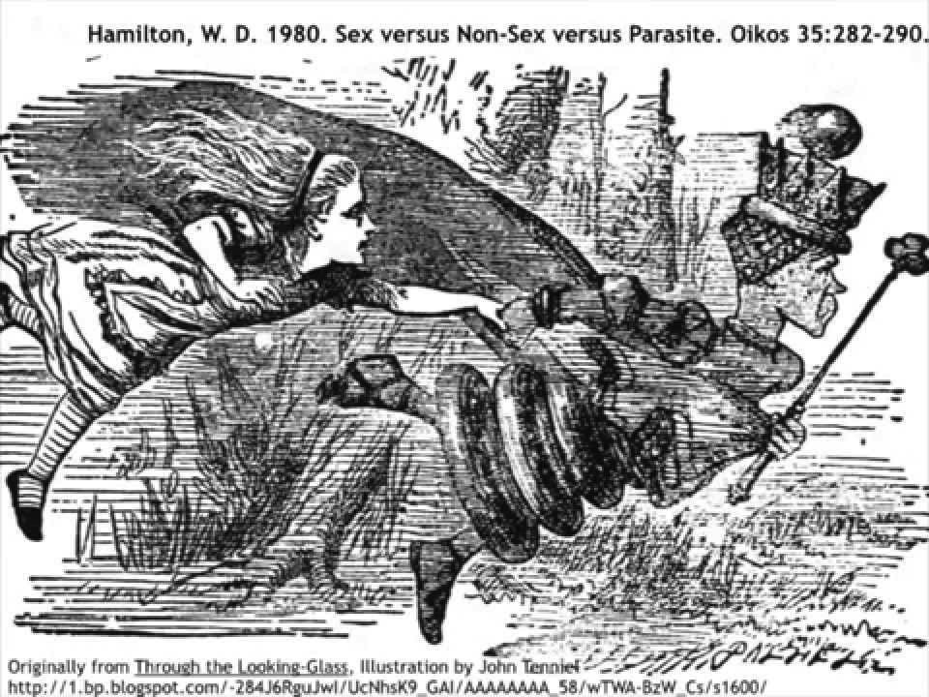
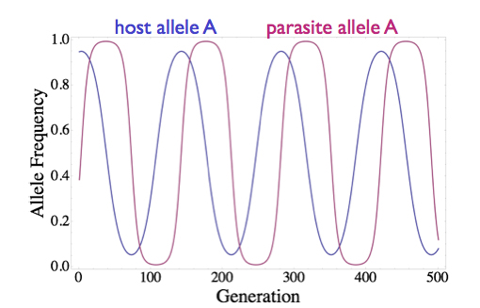
Red Queen Hypothesis for Evolution of Sex
First proposed by Leigh Van Valen to explain “Law of Extinction”, then by W. D. Hamilton and others to explain the evolution of sex.
Sex results in a faster generational response to selection by making offspring unique, more easily adapting to changing conditions.
Hosts and parasites can coevolve quickly in antagonistic way influencing which become dominant or rare.

Slide 42
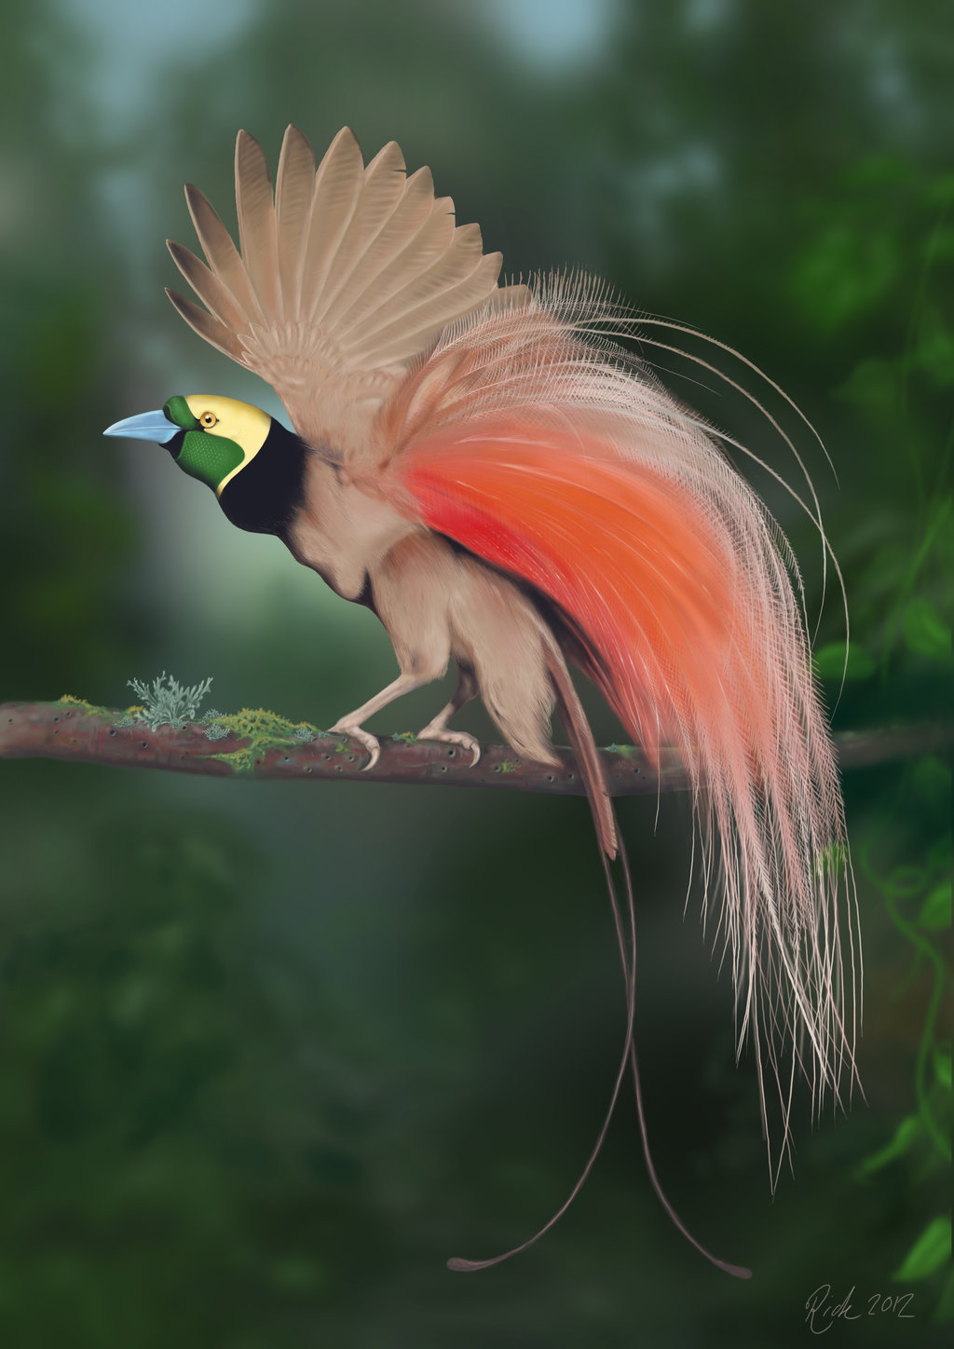
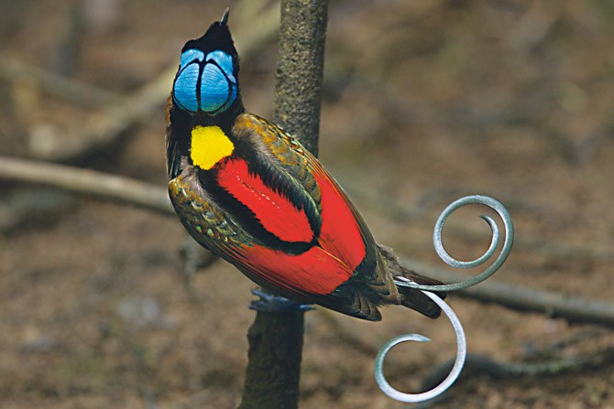
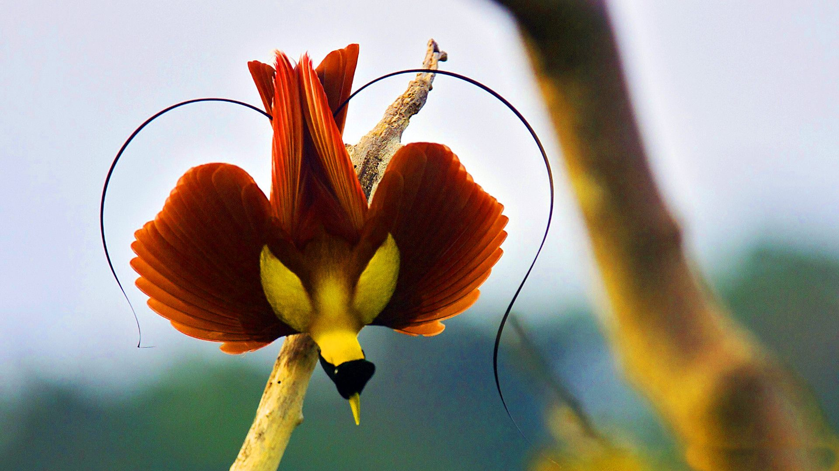
Sexual Selection
One sex chooses mates of the other sex on the basis of phenotypic characteristics and/or perceived genetic information.
Some individuals have better reproductive success than others.
First articulated by Darwin & Wallace and then by Fisher.
Do these ornaments signal fitness or are they just attractive?

Slide 43
