Slide 1
BIL 160
Biology II - Evolution & Biodiversity
Spring 2026
Dr. Kevin McCracken
Course Website:
www.duckdna.org/evolution_biodiversity/
Contact:
kevin.g.mccracken@gmail.com
907-378-2100

Slide 2
Announcement
Workshop begins:
Thursday 22 January at 5:05 PM
No workshop this week
Your workshop leader will email you with instructions where to meet by the Wed before!
Purchase this book & read Intro:
The Evolution of Beauty: How Darwin's Forgotten Theory of Mate Choice Shapes the Animal World and Us (2017) by Richard O. Prum 1st Edition. Anchor. New York. ISBN-13: 978-0385537216

Slide 3
Today’s Lecture Outline
Biological examples
Evolution is a “Why” science.
Epistemology (Theory of Knowing)
What is Science?
Theory, Fact, Hypothesis
The Evidence for Evolution

Slide 4
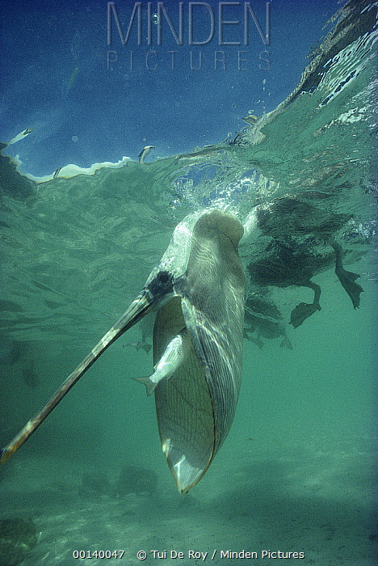
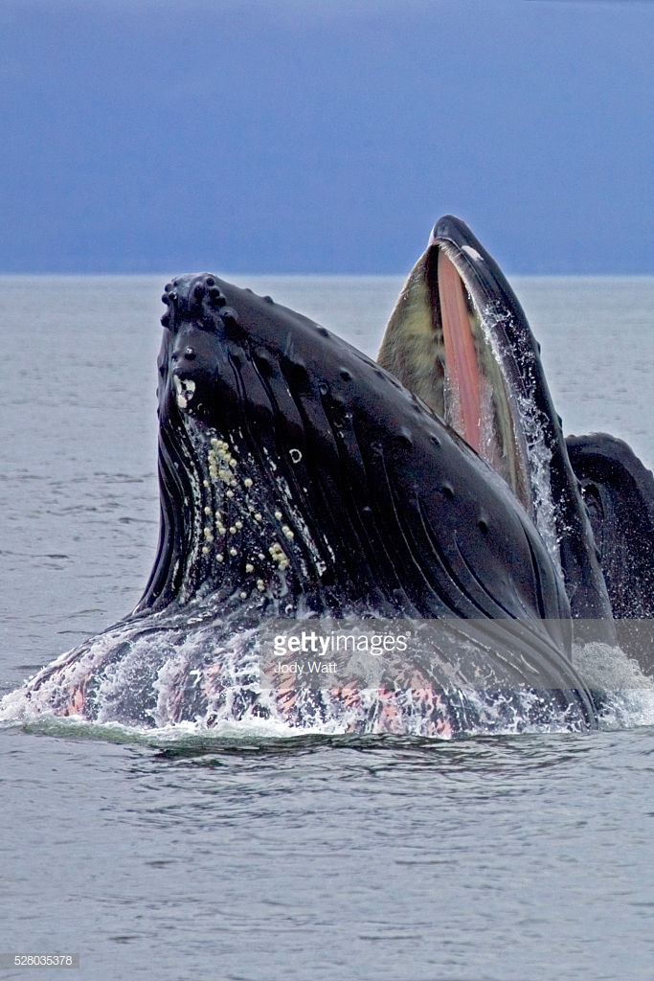
Convergent evolution between whales and pelicans.
Notes:
Why do pelicans catch fish with a big mouth net?

Slide 5
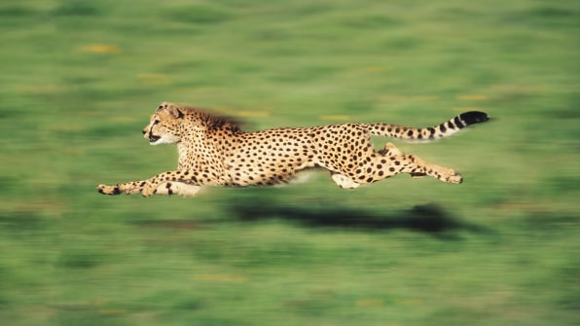
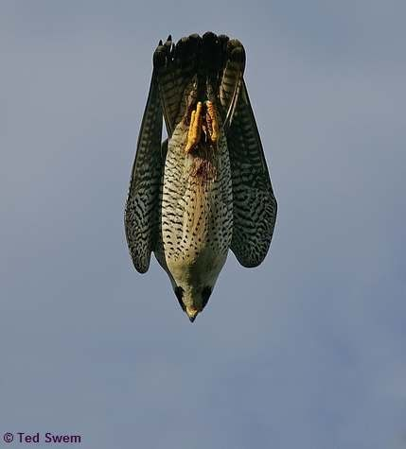
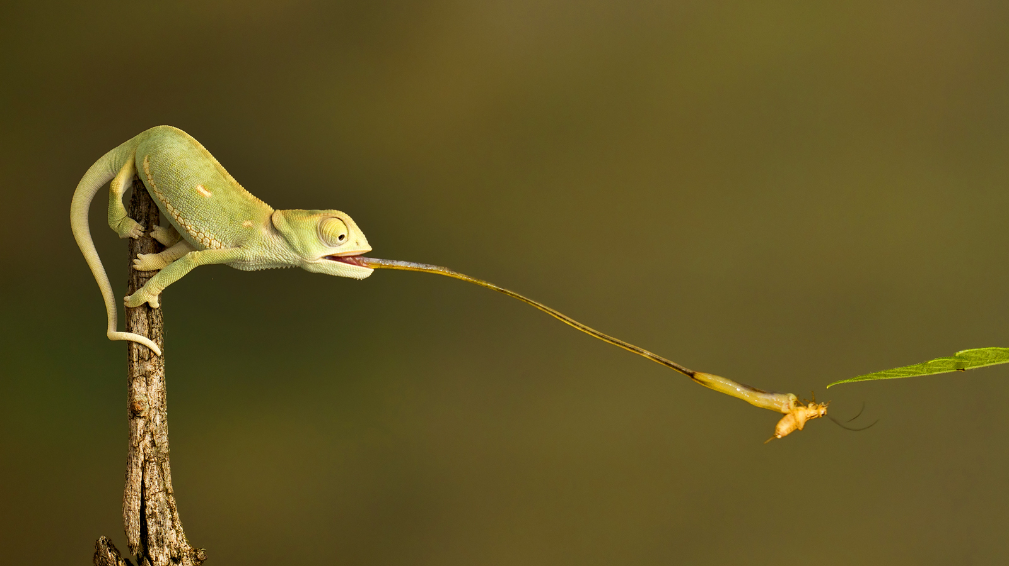
50-75 mph
240 mph
>150 times faster
acceleration

Slide 6
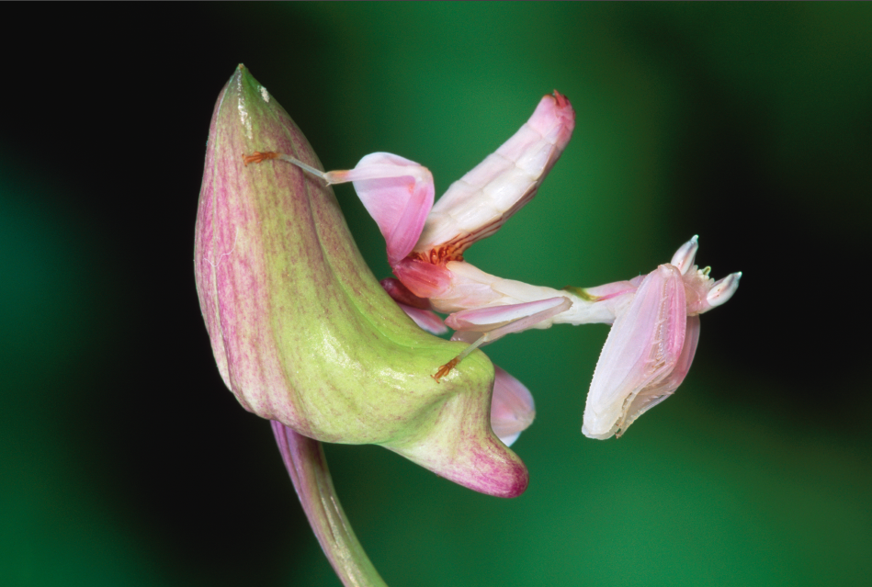
Mantis has evolved to look like the flower it inhabits.
Notes:
Orchis Mantis

Slide 7
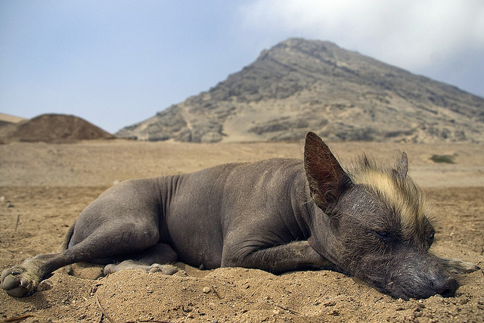

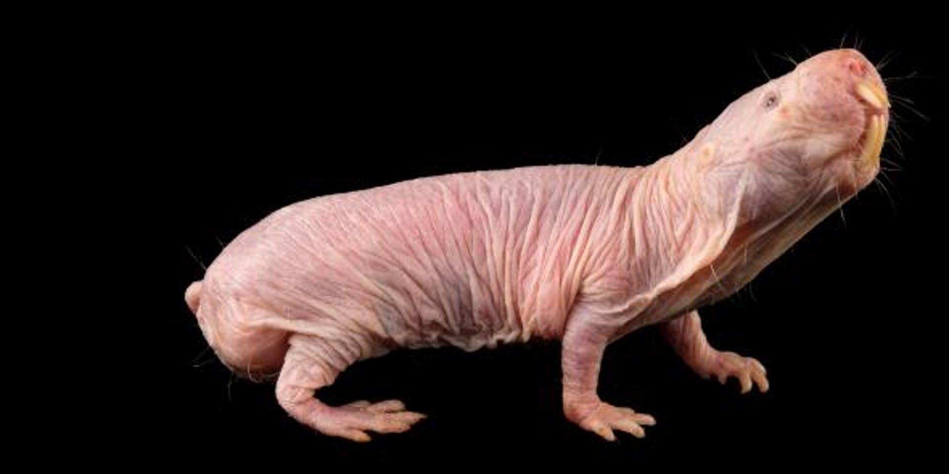
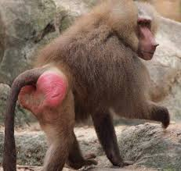
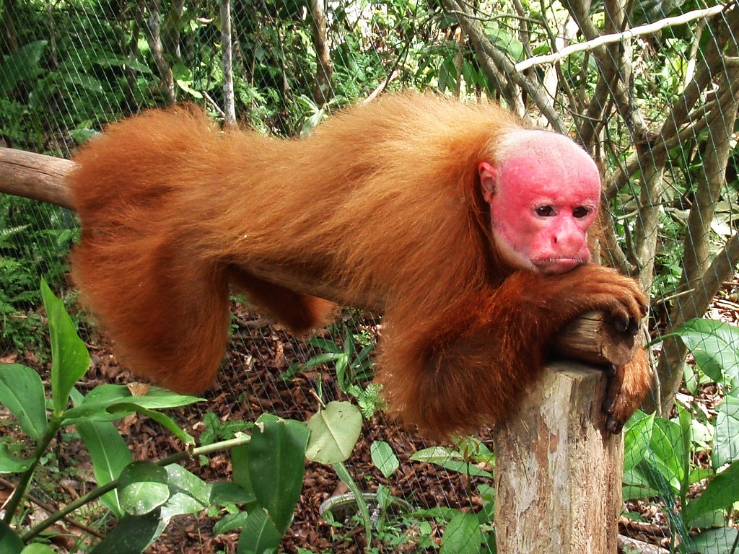
Why did these mammals lose their fur?

Slide 8
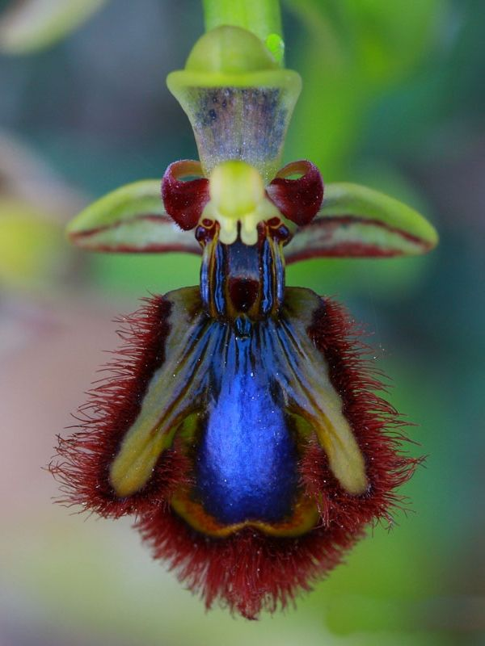
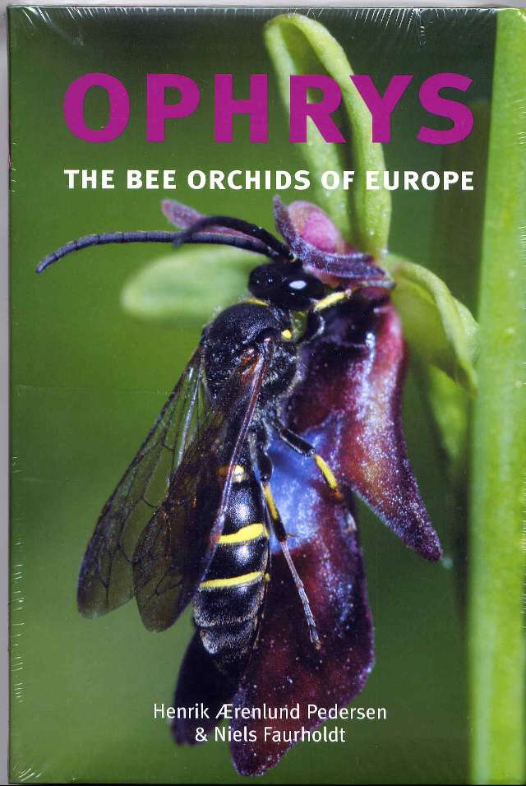
Bee orchids mimic female insects, fooling the male into
”mating” with the flower and thereby pollinating.
Notes:
National Geographic photo
10 Species of Hammer Orchid. Each pollinated by a different species of Thynnid wasp. Thynnid wasps unusual in that the female is flightless and the male carries the female away to food while copulating with her

Slide 9
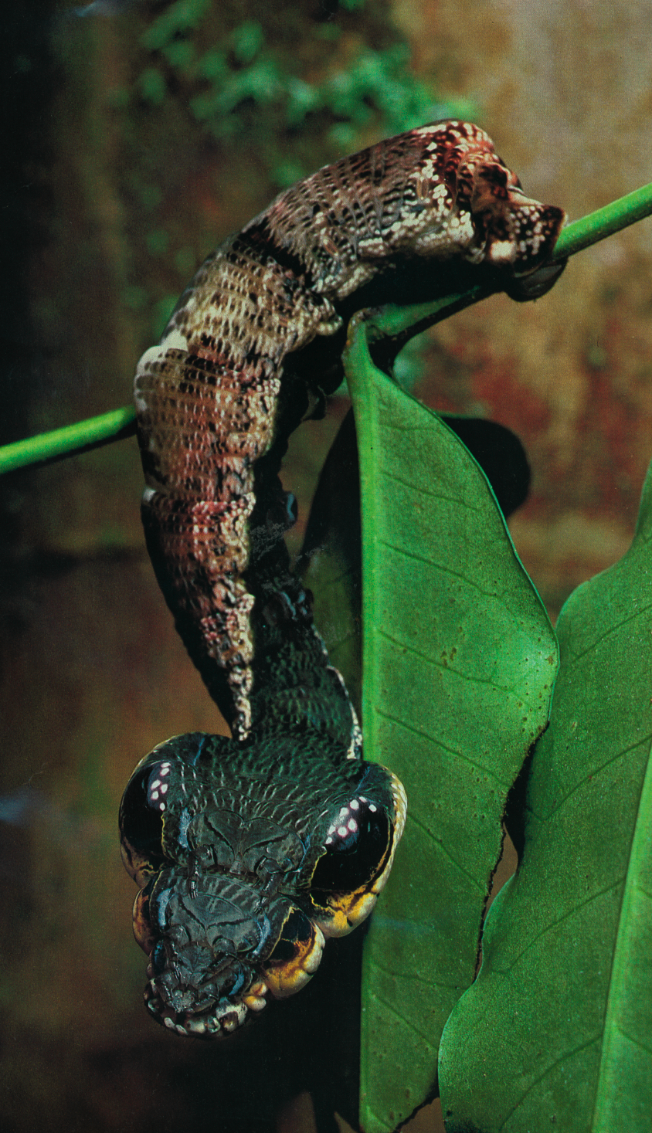
Hawkmoth caterpillar mimics snake head.
Notes:
Hawkmoth caterpillar mimics snake head
Hemeroplanes triptolemus – it evens harmlessly strikes at potential predators

Slide 10
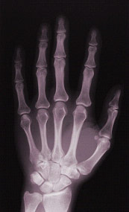
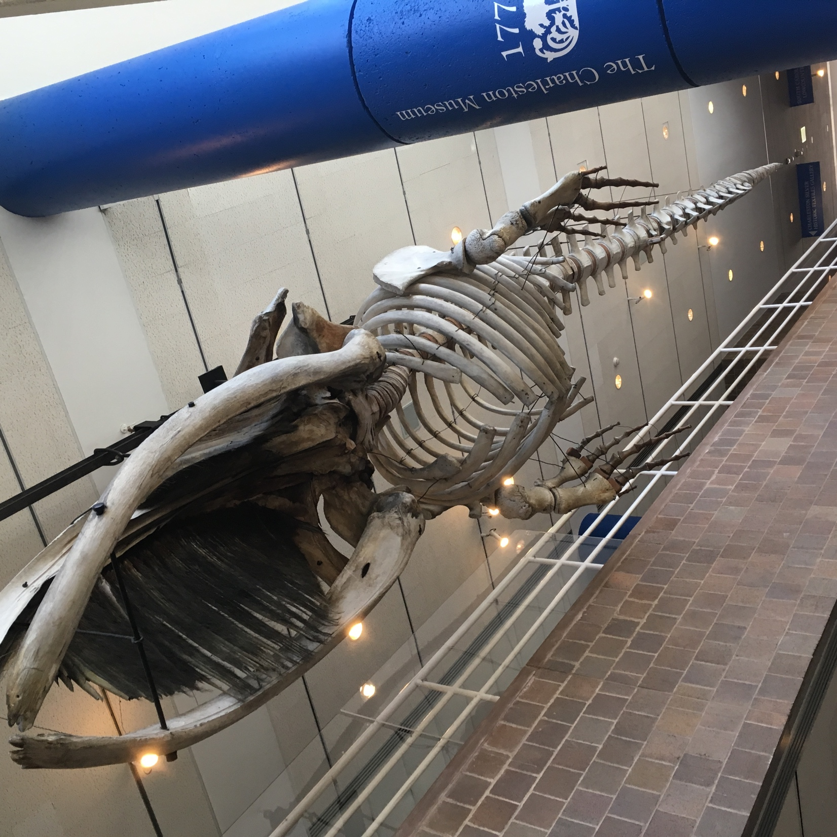
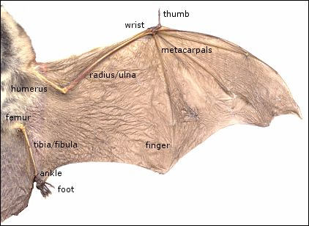
All of these forelimbs have same underlying bone structure.
IMG_5485 2
Concept of Homology
Notes:
Why do human hands, bat wings and seal flippers, appendages with different functions, have the same underlying bone structure?
Read section on Whale Evolution in C1

Slide 11
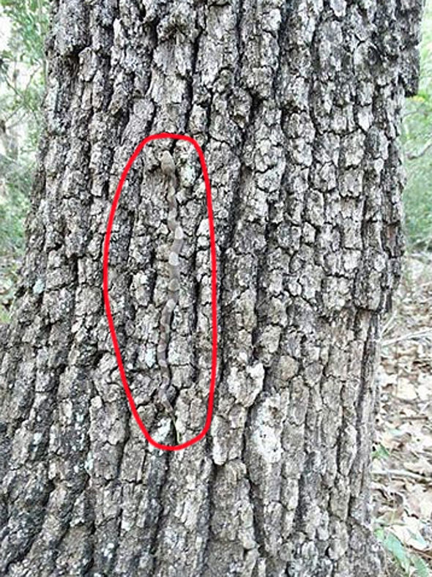
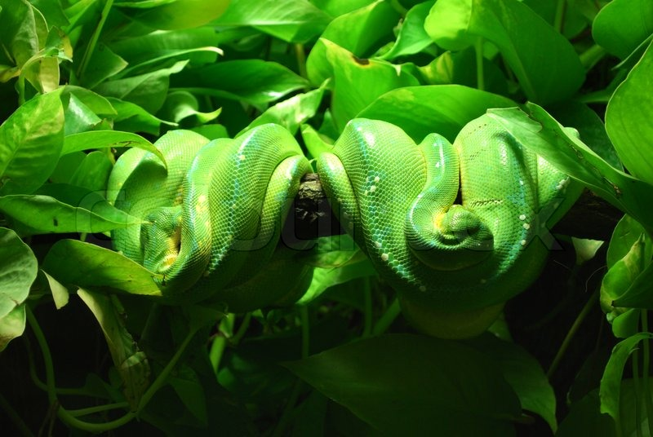
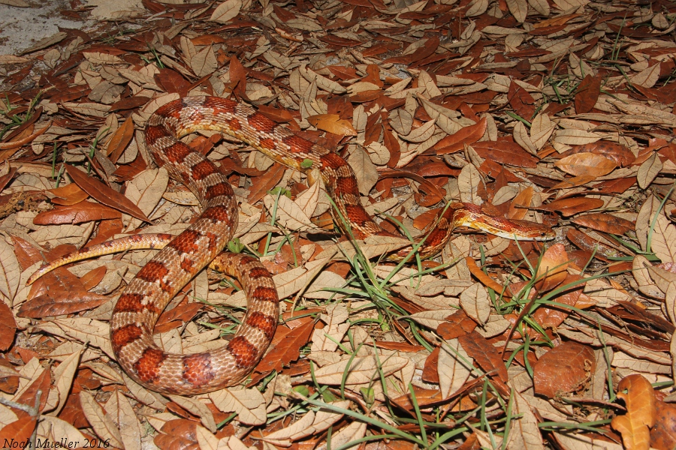
Why do snakes have colors and patterns that resemble the vegetation they inhabit?
Photo taken by (Luca Galuzzi) * http://www.galuzzi.it)
Notes:
Why do snakes have skin colors and patterns that resemble the trees they inhabit?

Slide 12
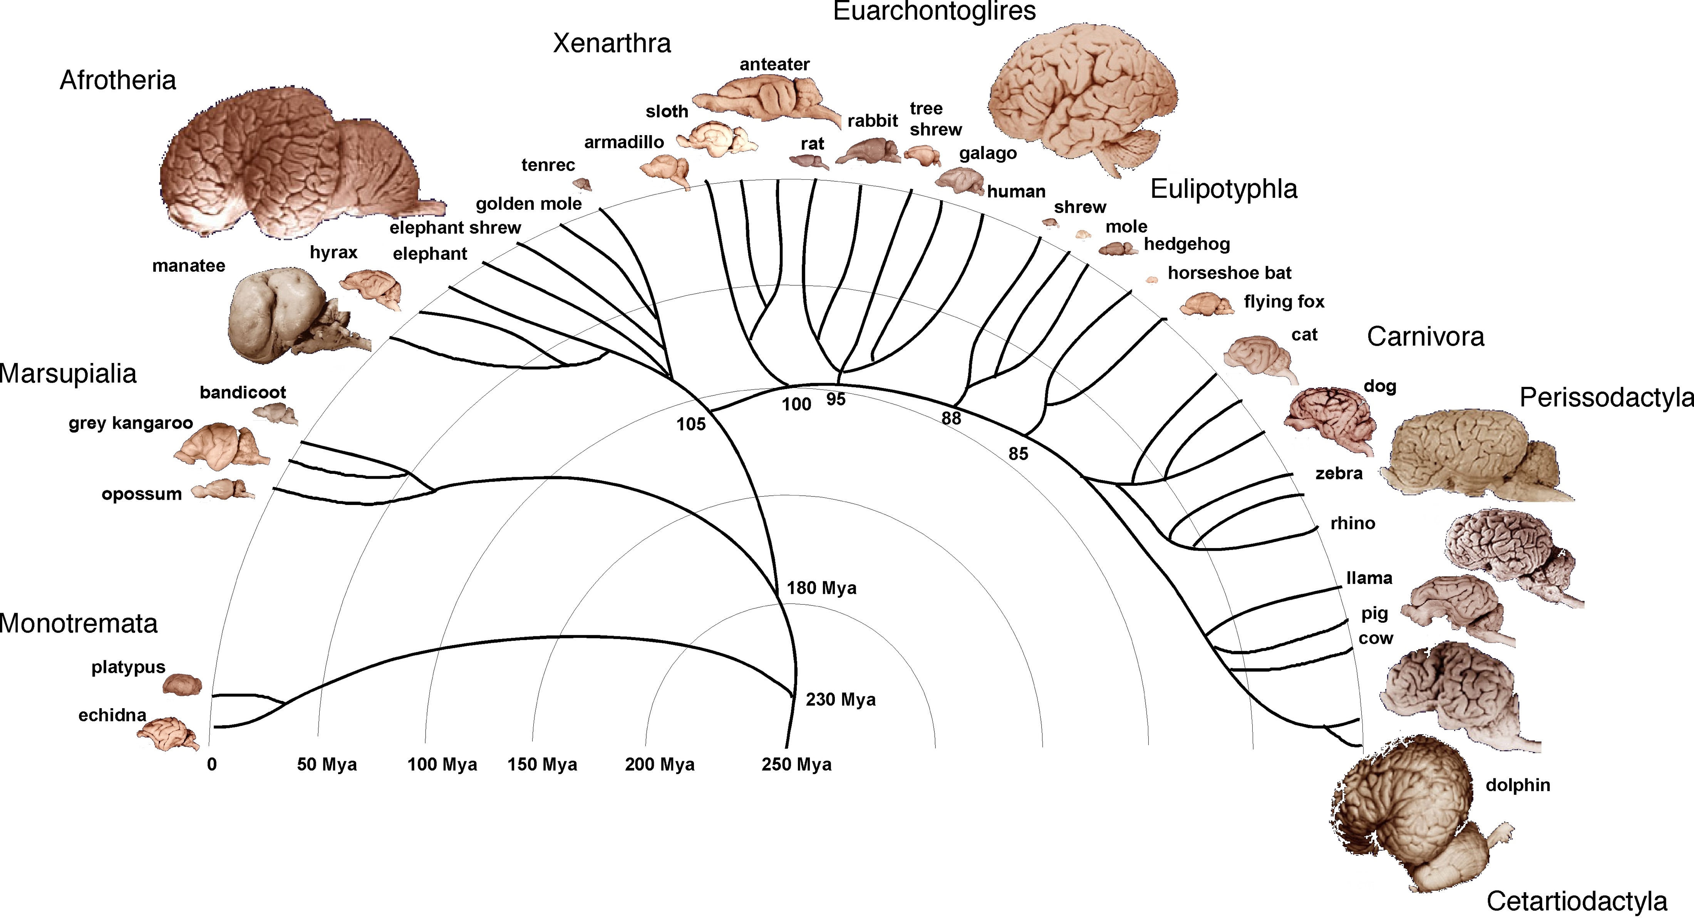
Why does brain size vary by 100,000 in mammals?

Slide 13
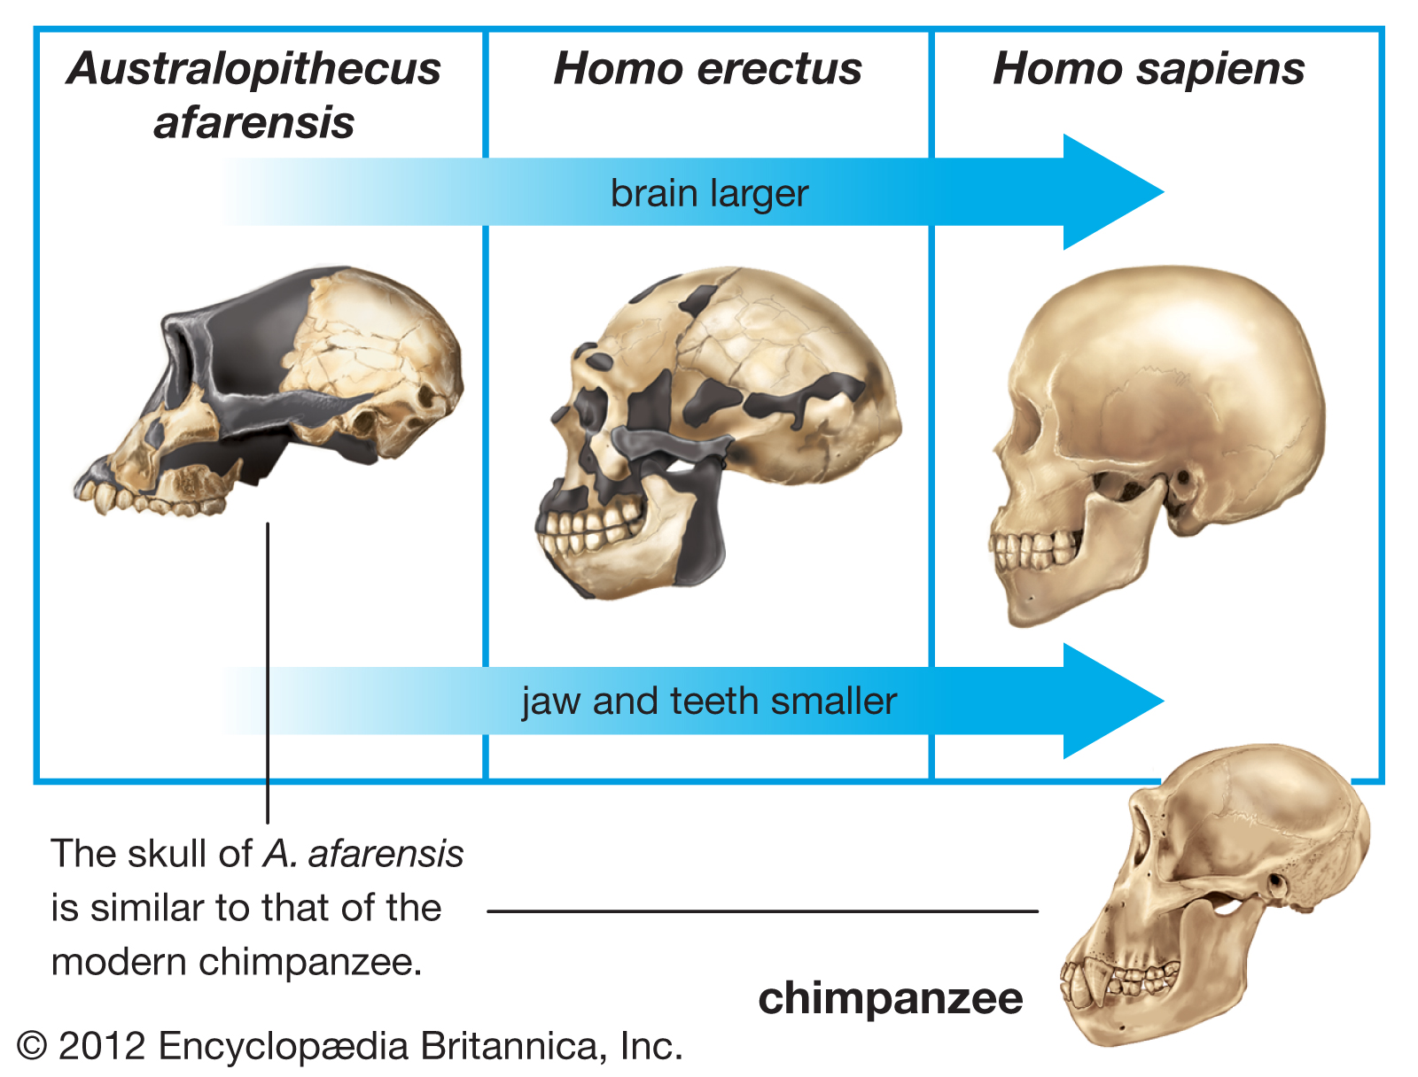
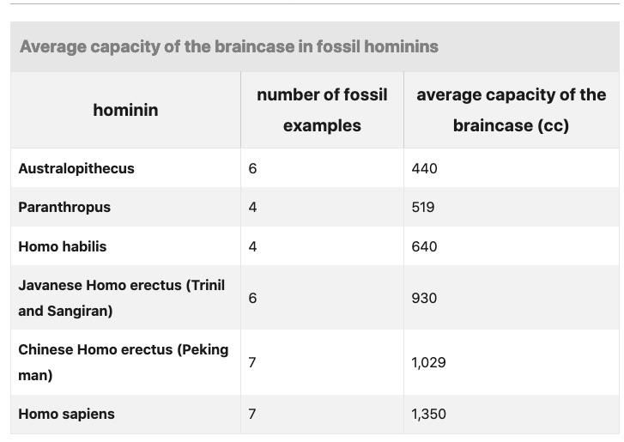
https://www.britannica.com/science/human-evolution/Increasing-brain-size

Slide 14
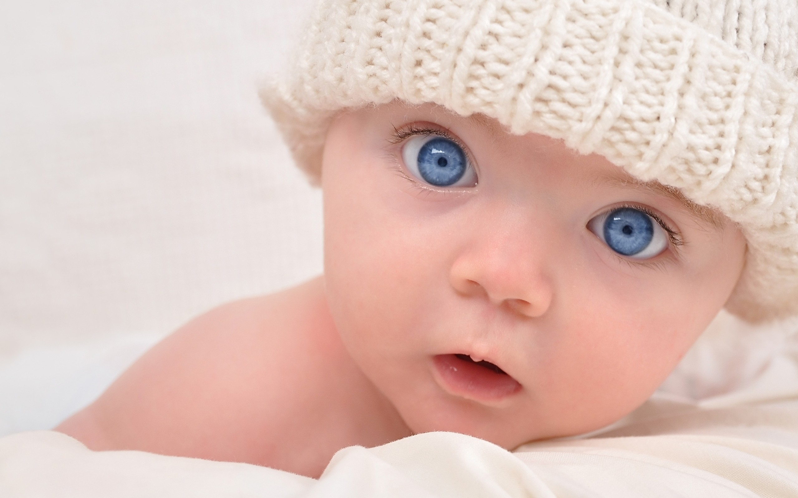
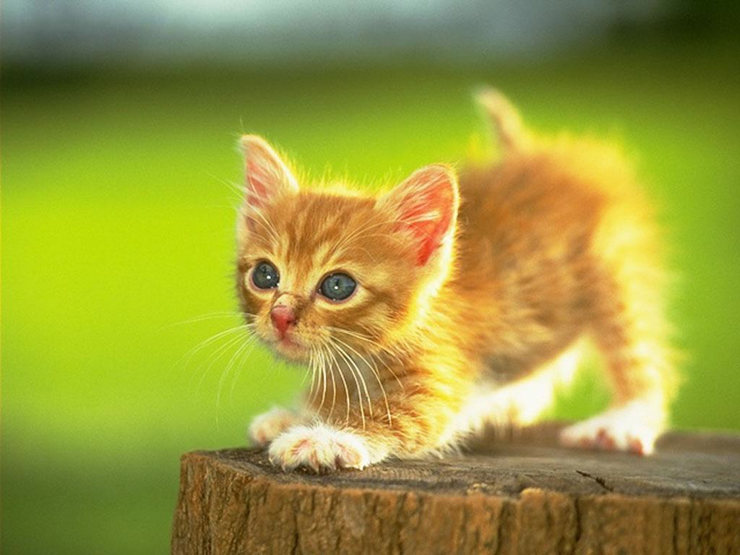
What is different and what is similar about these faces?
Notes:
(a) large head relative to body size, rounded head; (b) large, protruding forehead; (c) large eyes relative to face, eyes below midline of head; (d) rounded, protruding cheeks; (e) rounded body shape; and (f) soft, elastic body surfaces

Slide 15
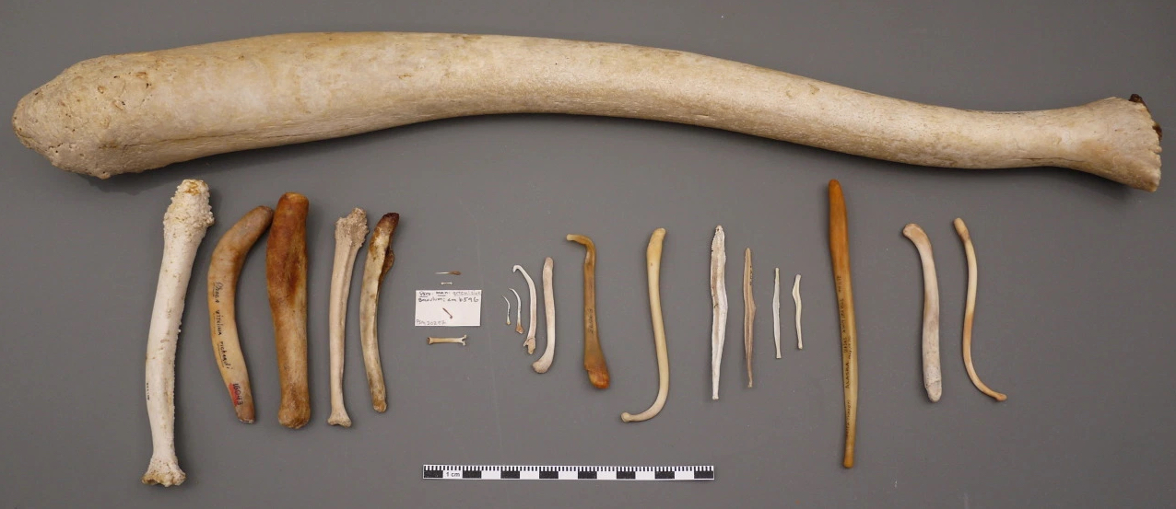
Why don’t humans have one of these, yet most primates do, including the chimps, bonobos, and gorillas?
https://prettydeadstuff.wordpress.com/2015/02/06/taigas-den-zooophagous-oldowan-oosik/

Slide 16
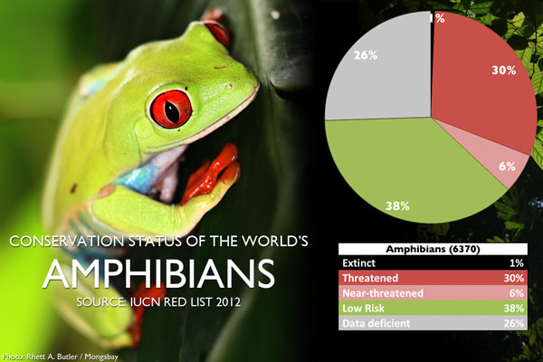
What has happened to the world’s frogs?
https://www.tropicalconservationfund.org/biodiversity.html

Slide 17
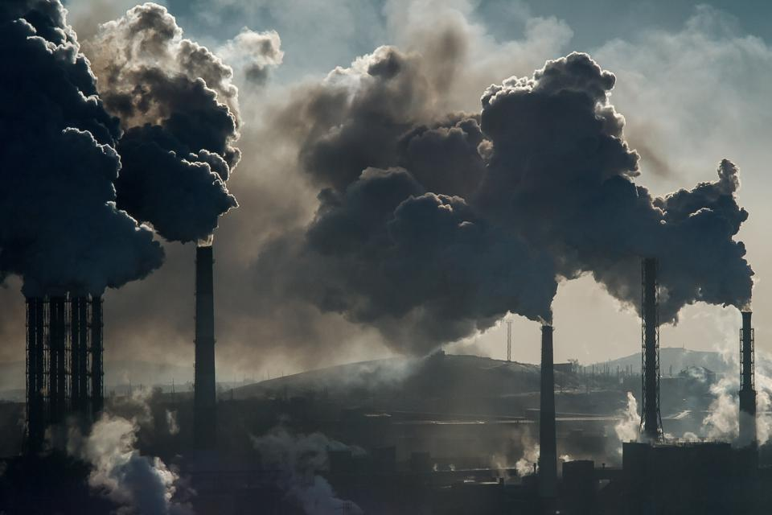
What will happen if we continue with this?

Slide 18
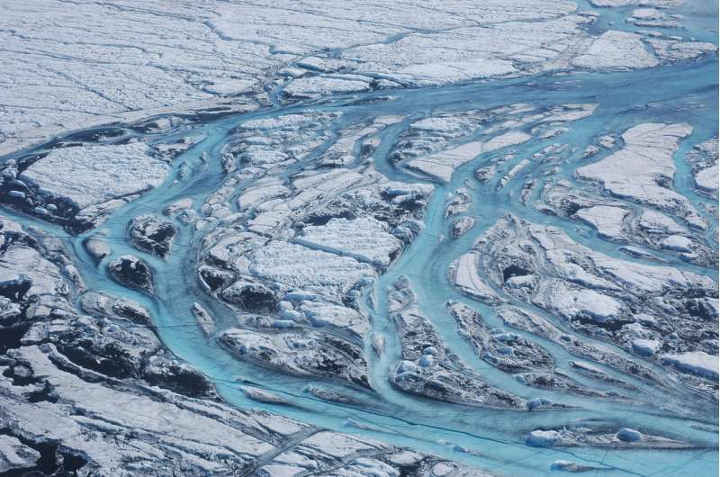
… and don’t slow down this?
https://phys.org/news/2018-12-greenland-ice-sheet-centuries.html

Slide 19

Have you visited Stiltsville?

Slide 20
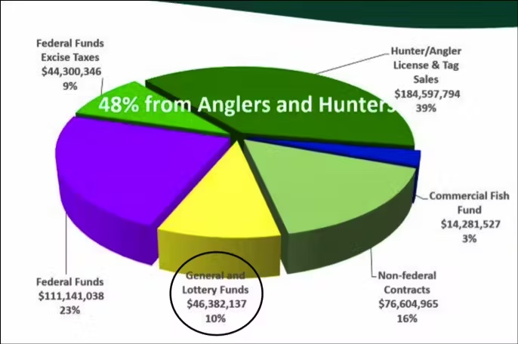
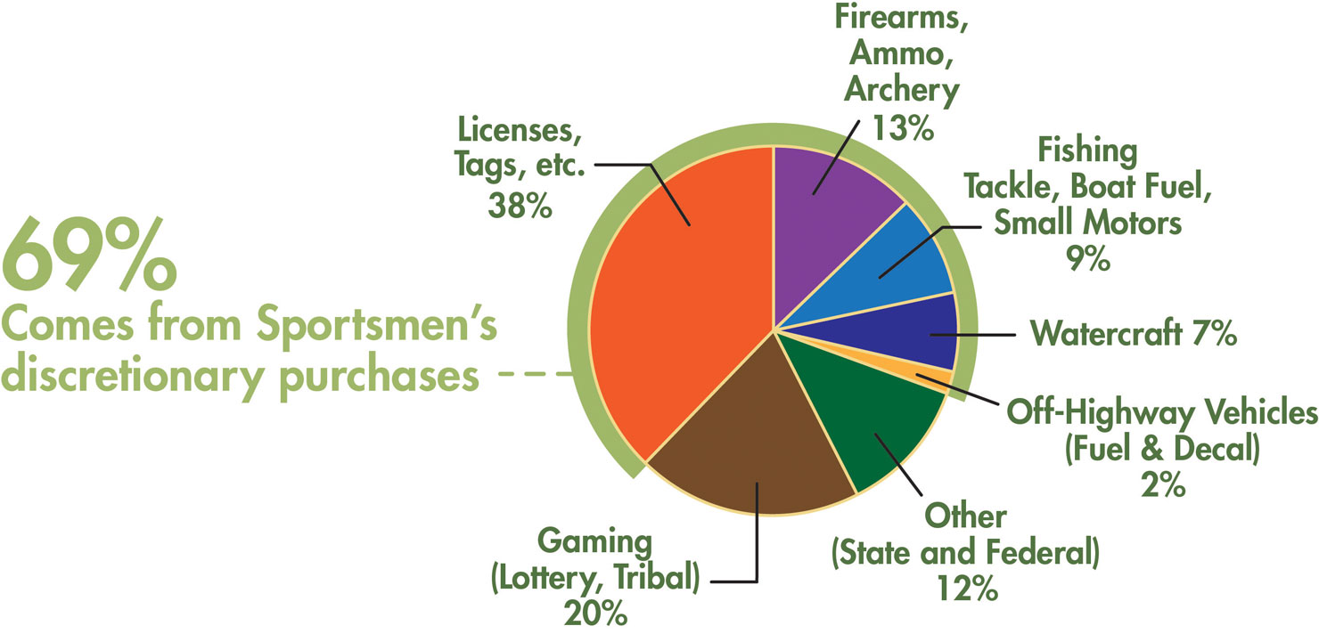
Where does funding for conservation come from?
https://defenders.org/blog/2022/09/follow-money-closer-look-wildlife-conservation-funding
https://www.hunter-ed.com/ethically-hunting-arizona/studyGuide/Funding-Sources/203004_185599/

Slide 21
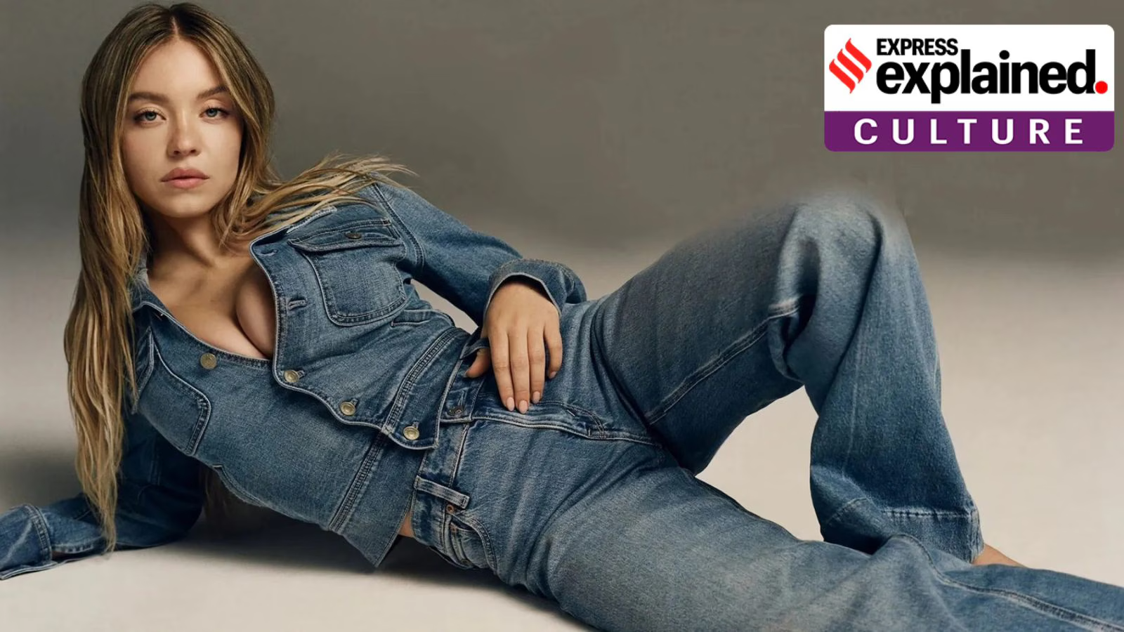
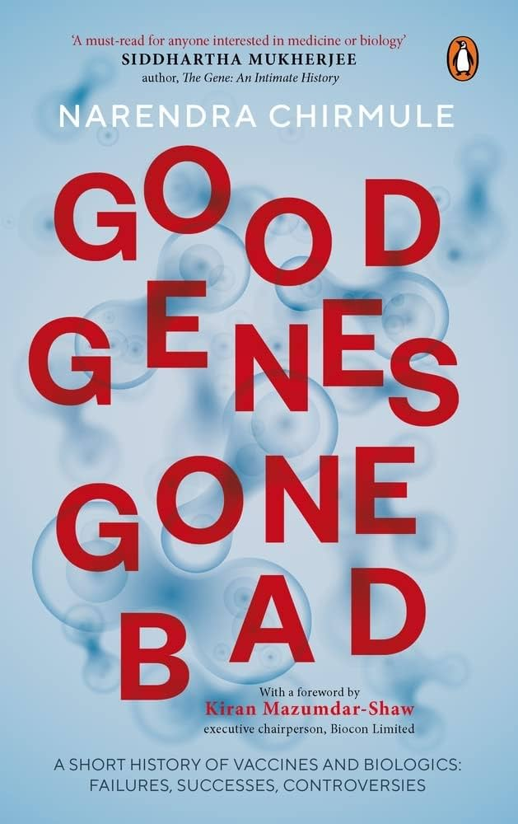
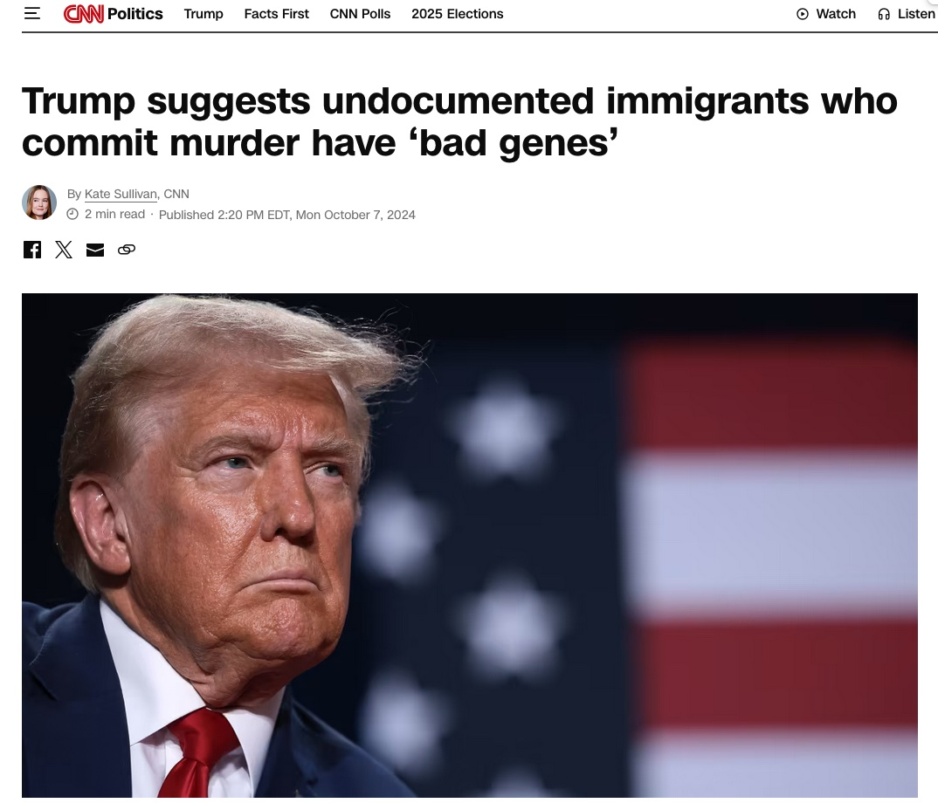
Why the talk about good and bad genes recently?

Slide 22
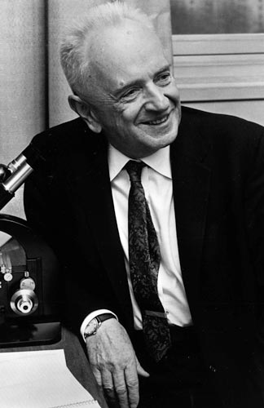
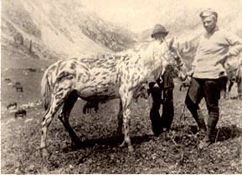
“Nothing in biology makes sense except in the light of evolution”
– T. Dobzhansky.
Notes:
Biology is science

Slide 23
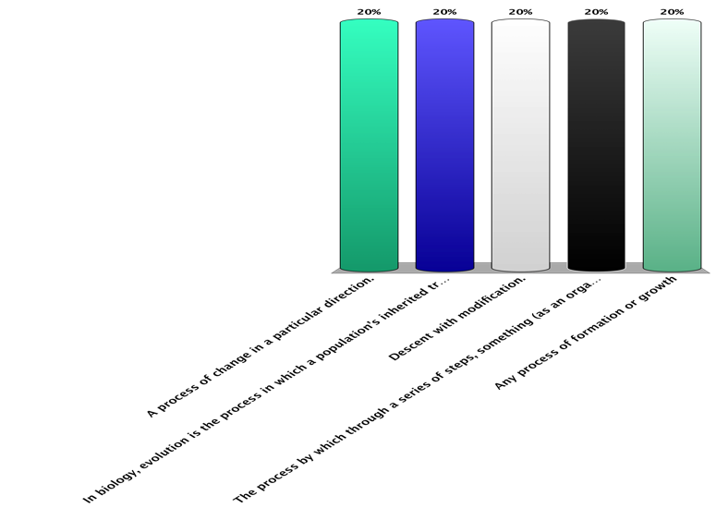
What is biological Evolution?
Less specific
Non-genetic
Any process of formation or growth.
A process of change in a particular direction.
The process by which through a series of steps, something (as an organism) attains its distinctive character.
Descent with modification.
Any change in the inherited traits of a population that occurs from one generation to the next.
The process in which a population’s inherited traits become more or less common over successive generations through changes in gene frequencies, due to natural selection.
More specific
Genetic

Slide 24
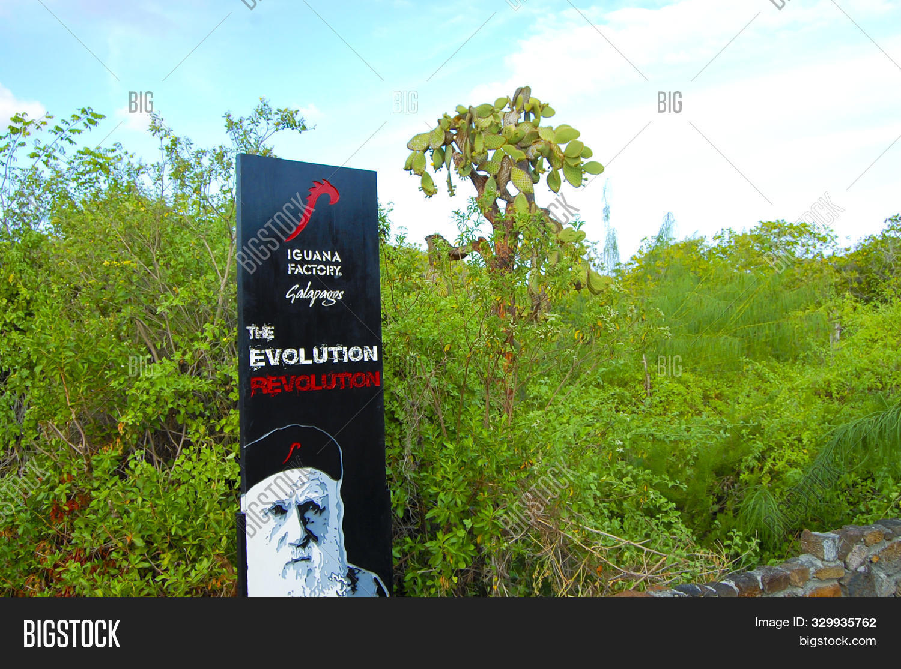

Evolution has taken root in popular culture!

Slide 25
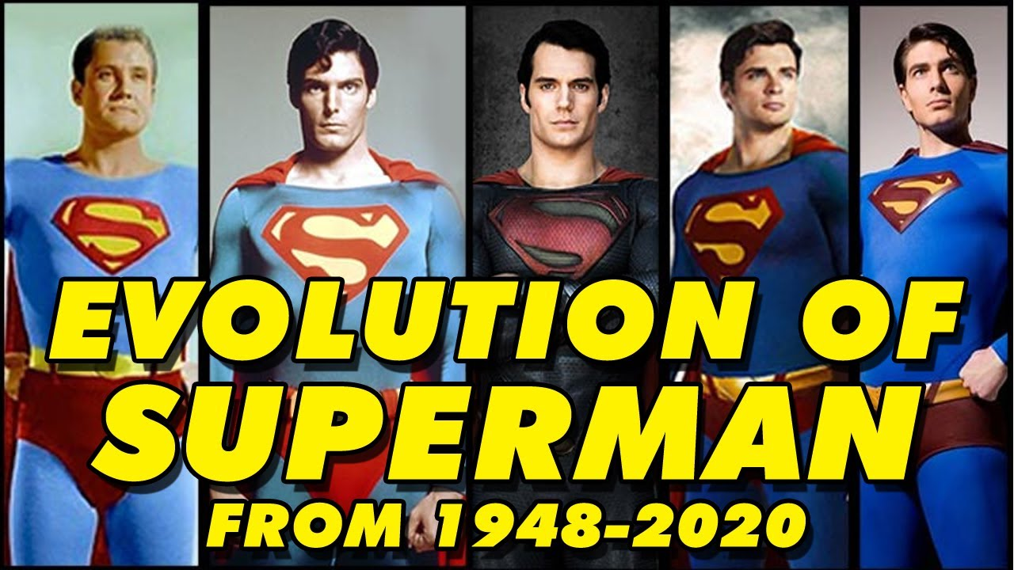

Slide 26
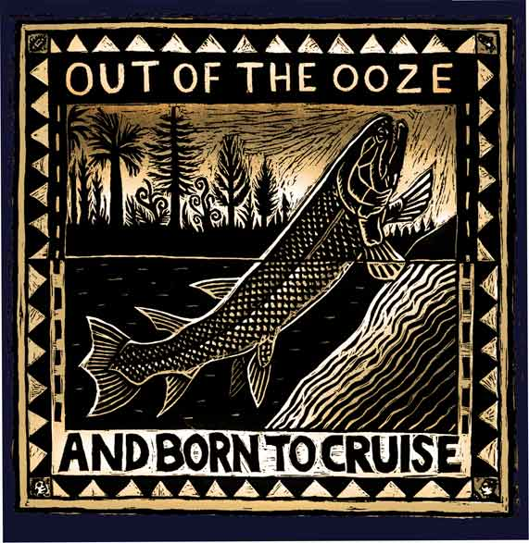
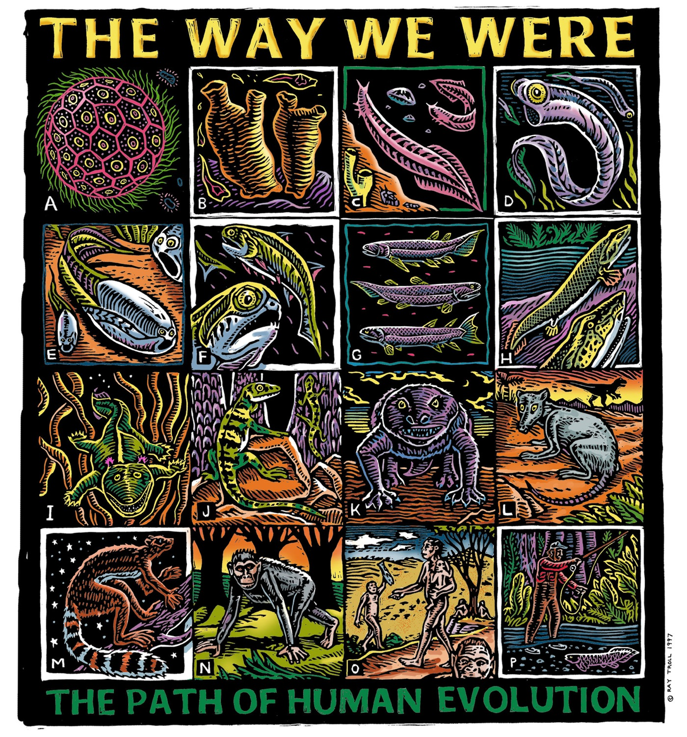
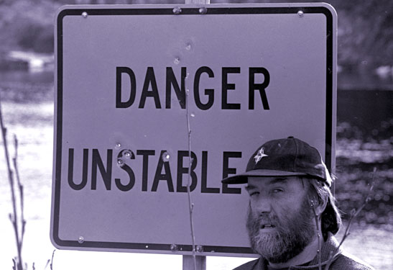
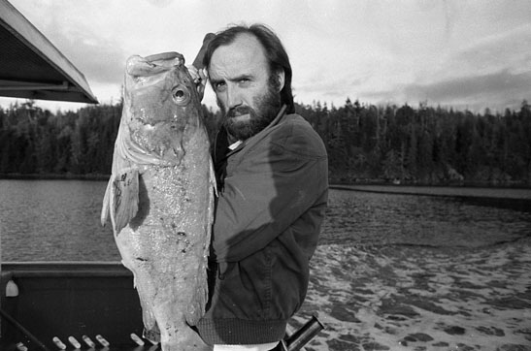
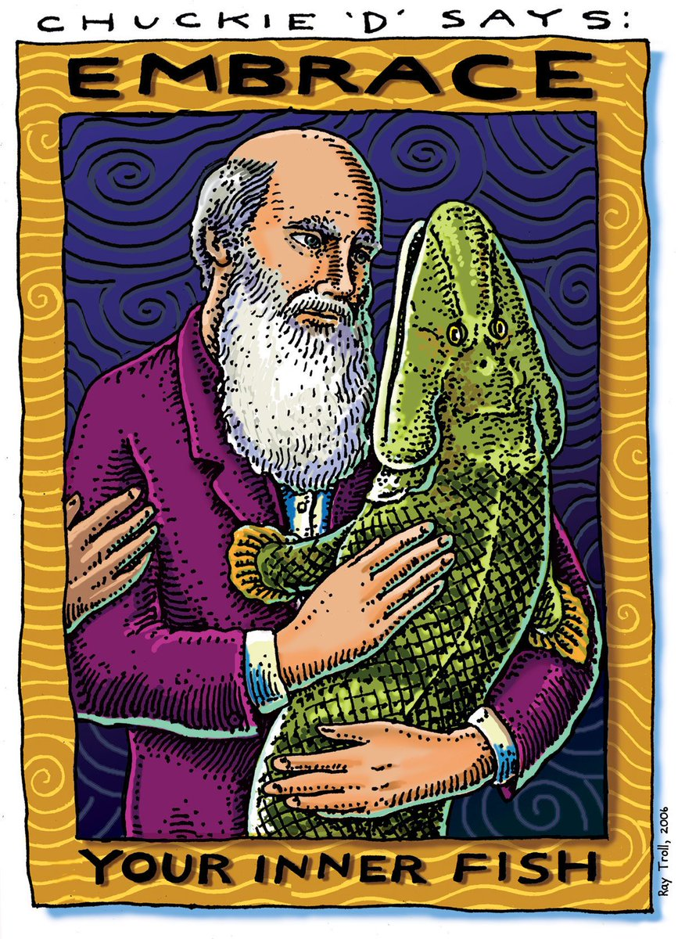

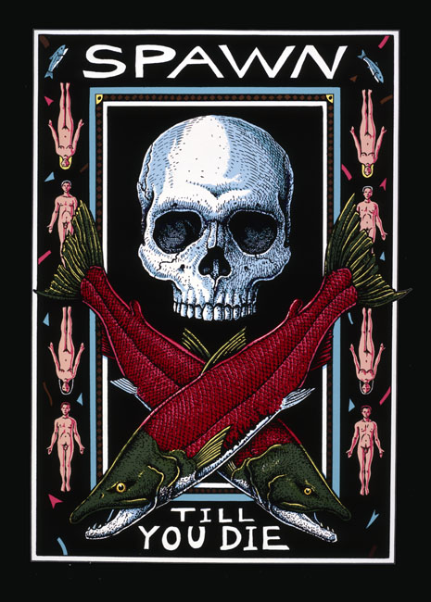
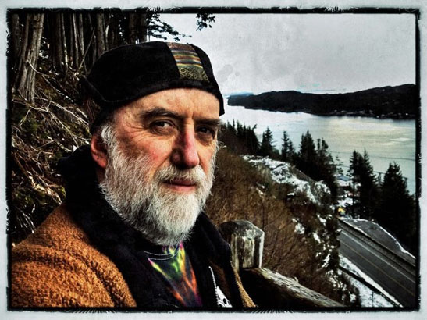
Evolution according to the artist Ray Troll

Slide 27
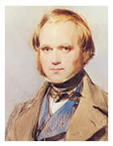
What was Darwin’s big idea?
Descent with Modification
Advanced our understand beyond
that of a gradual change.
Moved beyond geological
concept.
Set stage for genic understanding.
pattern => process
Notes:
Implies inheritance, implies changes in morphology

Slide 28
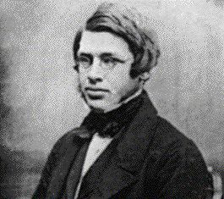
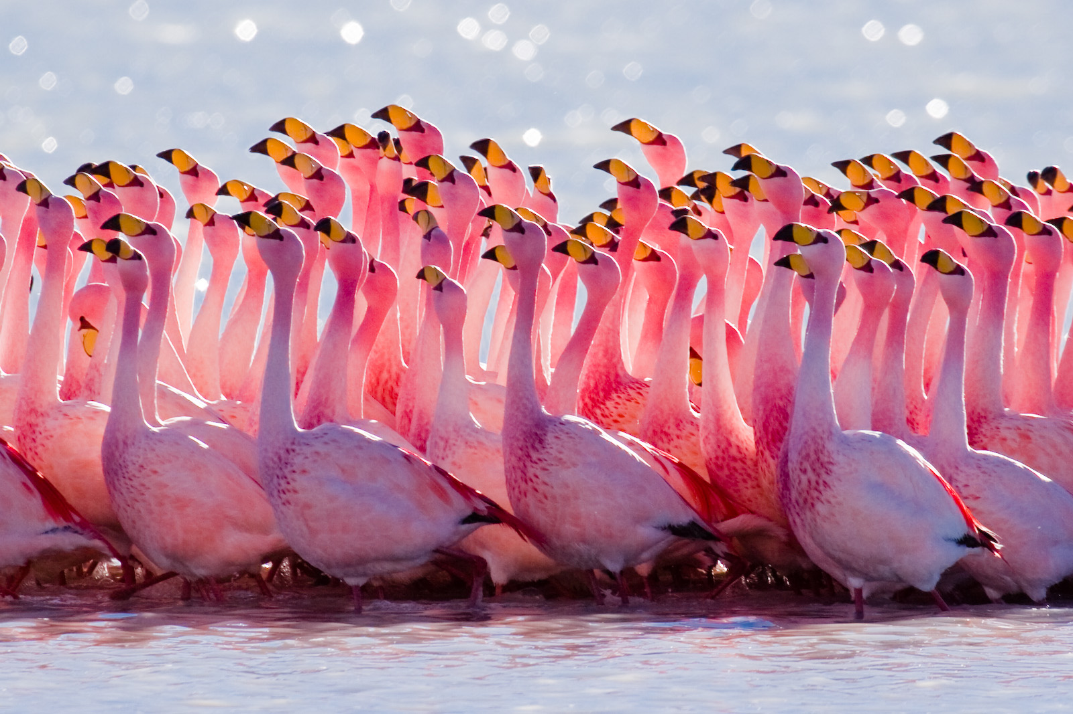
Darwin’s and Wallace’s insights
1. Evolution is a population process
-> populations evolve,
individuals don’t evolve

Slide 29
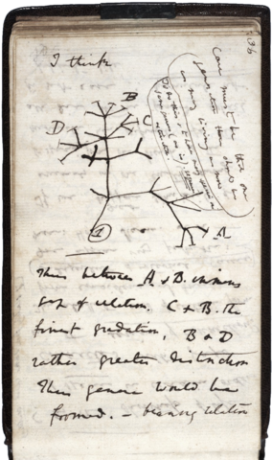
Darwin’s and Wallace’s insights
2. All organisms have a common ancestor
From Darwin’s notebook July 1837
Notes:
1858 Origin of Species was published

Slide 30
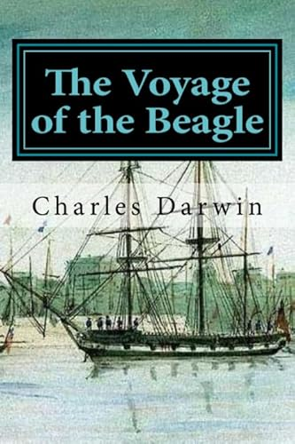

Darwin influenced by his voyage on the Beagle 1831-1836.

Slide 31

What happened to Alfred Russell Wallace?
https://www.youtube.com/watch?v=H8q3my7ujws

Slide 32

The evolution controversy

Slide 33
How do you know something?
Authority – parents, boss, scientific experts, clergy, TV
Revelation – truth is revealed; source may be supernatural
Logic – discern valid conclusions from premises (math)
Intuition/Introspection – self reflection
Science – empirically verify claims based on natural causes
From Declawing the Dinosaurs by Patricia Hawley; cms.educ.ttu.edu/personnel-folder/patricia-hawley
Notes:
How are each of these used to make sense of your Scientific vs Religious life?

Slide 34
Things that you know are…..
Facts – a confirmed observation, a data point.
Beliefs – a mental conviction. Acceptance of the existence or occurrence of something whether it is true or not. Beliefs can misrepresent the facts if they are untrue.
Truths –
1. One’s faith or loyalty can be pledged in a promise or agreement; a solemn covenant; a belief can be regarded as true, as in revealed truth.
2. That which is in accordance with reality, as the scientific process reveals supported by facts.
From Declawing the Dinosaurs by Patricia Hawley; cms.educ.ttu.edu/personnel-folder/patricia-hawley
Notes:
Example of a fact – if you jump, you will fall; gene frequencies in a finite population will change over time
Example of a belief – I believe that my ancestors can influence my life
Truth – We hold these truths to be self-evident, that all men are created equal, that they are endowed by their creator with certain unalienable rights, that among theses are Life, Liberty and the pursuit of happiness….
Where do you get your facts?
Where do you get your beliefs?
Where do you get your truths?

Slide 35

Fact – a confirmed observation
Example: If you jump in the air, you will come back down to earth
Adapted from - E. Scott, Evolution vs Creationism

Slide 36
Which are changeable?
Facts
Beliefs
Truths
b & c
all of the above

Slide 37

Image via Wikimedia Commons.
“There is a world of difference between truth and facts. Facts can obscure the truth.”
- Maya Angelou
“When revealed truth conflicts with science, how does one choose?”
– Eugenie Scott, Evolution vs. Creationism

Slide 38
How do we know something in science?
There is no revealed truth.
Direct experimentation – control confounding variables (deductive process)
Indirect experimentation – inference based on application of principles and laws in which we have confidence (inductive process)

Slide 39

Is this really how it works?

Slide 40

The scientific process is complex

Slide 41
Law?
Theory?
Fact?
Hypothesis?

Slide 42
Theory – a comprehensive explanation of some aspect of nature that is supported by a vast body of evidence
- National Academy of Sciences 2008:11
Examples: Evolutionary Theory
Newton’s Theory of Gravity
Theory of General Relativity
Adapted from - E. Scott, Evolution vs Creationism

Slide 43
Law – An empirical generalization that (often mathematically) states what will happen under certain conditions
Examples: Newton’s Law of Universal Gravitation
Mendel’s Laws of Heredity
Hardy-Weinberg Law
Adapted from - E. Scott, Evolution vs Creationism

Slide 44

Should gravity be regarded as a theory or a law?
Law of gravity - describes the attraction between two objects, something which we understand to be a fact.
Theory of gravity - describes why the objects attract each other, much of which is yet to be understood.

Slide 45

Hypothesis – a statement of the relationships among things that can be tested and confirmed or not based on experimentation
Example: If giraffe necks evolved to access food higher on trees that is inaccessible to other herbivores, then giraffes can be predicted to eat higher on trees than other herbivores.
Adapted from - E. Scott, Evolution vs Creationism

Slide 46

Giraffe example is interesting because it classically illustrates a discredited theory of evolution, i.e. inheritance of acquired traits?
Lamarck

Slide 47


Also a remarkable example example of physiological evolution.
The study of evolution inspires “wonder”.
Wonder can be a good career incentive!

Slide 48
wonder
Noun
a feeling of surprise mingled with admiration, caused by something beautiful, unexpected, unfamiliar, or inexplicable.
Verb
desire or be curious to know something.
feel doubt.

Slide 49
Theory – a comprehensive explanation of some aspect of nature that is supported by a vast body of evidence
- National Academy of Sciences 2008:11
Law – An empirical generalization that states what will happen under certain conditions
Hypothesis – statement of the relationships among things that can be tested and confirmed or not based on experimentation
Fact – confirmed observations
Adapted from - E. Scott, Evolution vs Creationism

Slide 50
Critique of these statements:
“Evolution is just a theory”
“If evolution is the truth, why isn’t it a law?”

Slide 51
Support for evolution derived from:
Fossil record
Homologies
Direct observation

Slide 52


Landmarks in the Development of Evolutionary Theory
Early Philosophy
Plato (427-347 BC)
Fixed Essences
  -Transcendent ideal forms that are only imperfectly imitated by their earthly representations

Slide 53

Aristotle (384-322 BC)
Species have fixed essences
Variations are accidental imperfections and unimportant
Gives rise to concept of type specimens

Slide 54

https://en.wikipedia.org/wiki/Aristotle’s_theory_of_universals

Slide 55

Aristotle (384-322 BC)
Scala Naturae – the “Great Chain of Being”; This plan was thought to be a gradation from inanimate objects to barely animate forms of life through bacteria, fungi, plants, animals, humans, and the gods.
By Didacus Valades (Diego Valades) - Rhetorica Christiana, Public Domain, https://commons.wikimedia.org/w/index.php?curid=1688250

Slide 56

Augustine of Hippo
(354-430 AD)
“Augustine took the view that if a literal interpretation of the Bible contradicts science and our God-given reason, the Biblical text should be interpreted metaphorically.”
Augustine of Hippo, De Genesi ad literam 1:19–20, Chapt. 19 [408], De Genesi ad literam, 2:9; from Wikipedia

Slide 57
Augustine of Hippo
(354-430 AD)
Usually, even an non-Christian knows something about the earth, the heavens, and the other elements of this world, about the motion and orbit of the stars and even their size and relative positions, about the predictable eclipses of the sun and moon, the cycles of the years and the seasons, about the kinds of animals, stones, and so forth, and this knowledge he holds to as being certain from reason and experience.
Now, it is a disgraceful and dangerous thing for an infidel to hear a Christian, while presumably giving the meaning of Holy Scripture, talking nonsense on these topics….If they find a Christian mistaken in a field which they themselves know well, and hear him maintaining his foolish opinions about the Scriptures, how then are they going to believe those Scriptures in matters concerning the resurrection of the dead, the hope of eternal life, and the kingdom of heaven? How indeed, when they think that their pages are full of falsehoods on facts which they themselves have learnt from experience and the light of reason?
(Augustine 1982:42-43; The Literal Meaning of Genesis, vol. 1. Transl. by J. H. Taylor)

Slide 58


Special Creation
James Ussher (1581-1656)
-quantified special creation
  1. All organisms created by God during the six days of creation as in the book of Genesis.
  2. The ideal “types” were the progenitors of all living things today.
  3. Each species created independently
  4. Species remain unchanged after their creation; variation within each type is limited.

Slide 59

Scala Naturae
Since order is superior to disorder, creation must follow a plan.
Humans are the link between animals and angels.
The scala naturae was unchanging because change implies imperfection in God’s plan.

Slide 60
Special Creation
James Ussher (1581-1656)
  As estimated by James Ussher from Biblical texts, creation occurred Sunday 23 October 4004 BC.
  Adam and Eve were driven from paradise on Monday 10 November 4004 BC.
  The ark touched down on Mt Ararat in Turkey on Wednesday 5 May 2348 BC

Slide 61

Geological time scale overlaid on 6000 year timeline.
=> Humans evolved just in time to vote for Barack Obama.
=> Italian Renaissance was interrupted by the Cambrian Explosion.

Slide 62

The Beginnings of Systematics
Jon Ray (1627-1705)
1686-1688 Historia Plantarum Generalis:
Wisdom of God Manifested in the Works
of Creation
English naturalist who classified plants based on observed similarities and differences
Defined the term “species”
Notes:
English naturalist

Slide 63


The Beginnings of Systematics
Carl von Linne (Linneaus) (1707-1788)
1735 Systema Naturae
-> developed the current classification scheme for organisms including binomial nomenclature
-> “Type” specimens based on Platonic ideas that species have fixed essences
-> Types are still used today

Slide 64

Thomas Malthus 1766-1834
1798 Essay on the Principle of Population
as it affects the Future Improvement of Society
Argued that that populations increase at a rate faster than resources can support.
Strong influence on Darwin, i.e., struggle for existence
Malthus’s ideas echoed in writings of Jonathan Swift.

Slide 65

Malthusian Population Catastrophe

Slide 66




Slide 67

The Rumblings of Change
Jean-Baptiste Pierre Antoine de Monet, Chevalier de Lamarck (1744-1829)
1809 Philosophie Zoologique
-> first to put forth a hypothesis of evolution - Transformational Hypothesis of Evolution.
->The mechanism of change was inheritance of acquired characteristics.

