Slide 1


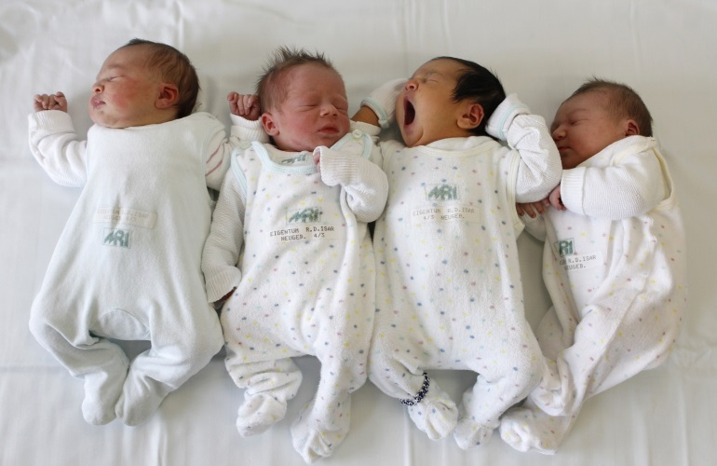
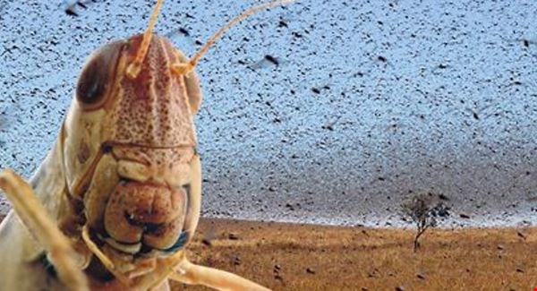
Population Ecology I
Distribution, Demography, & Life Tables
Notes:
Add pictures

Slide 2
Outline
Today:
Factors limiting distributions
Demography
  Life tables
  Case study of the Tuatara!
Next:
Population growth
Human Demography
Factors limiting populations

Slide 3
Filters on species presence
All species
Dispersal filter
Species that can get there
Abiotic filters
Species that can get there and
survive the abiotic conditions
Biotic filters
Species that can get there, survive the abiotic conditions, survive the competition and predation, and can locate their mutualists
Behavioral filters
Species that can get there, survive abiotic
conditions and biotic interactions,
and mate successfully etc.

Slide 4
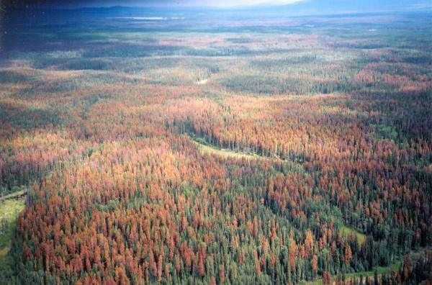
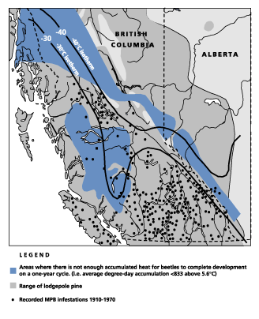
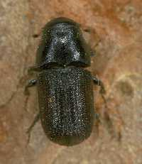
Abiotic limitation Example 1: Temperature
http://www.mountainpinebeetletreatment.com/wp-content/uploads/2012/08/black-hills-gone-red.jpg
Dendroctonus ponderosae
(mountain pine beetle)
http://www.ext.colostate.edu/pubs/insect/05528.html
Range of the mountain pine beetle (dots) limited by temperature as measured by degree-day accumulation (grey areas) and by minimum temperatures (isotherm lines)
More limited in AK than S. Canada
Credit: C. Mulder
Notes:
Ask the question: these data are from 1910-1970. Assuming it has warmed since then, what do you think the range is now?

Slide 5
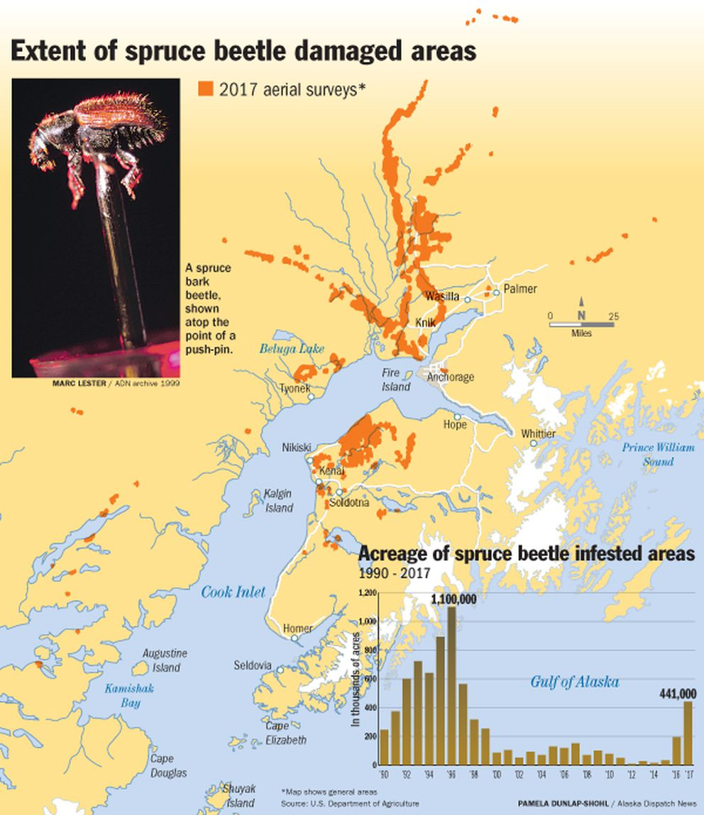
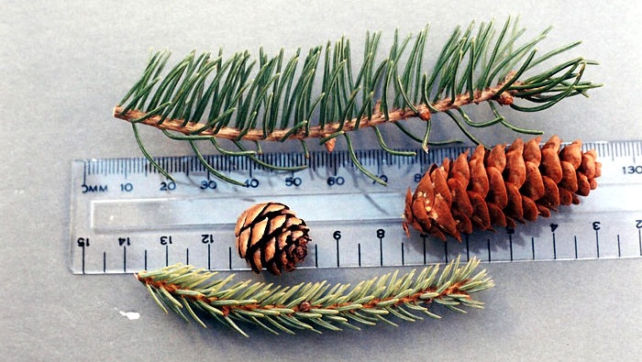
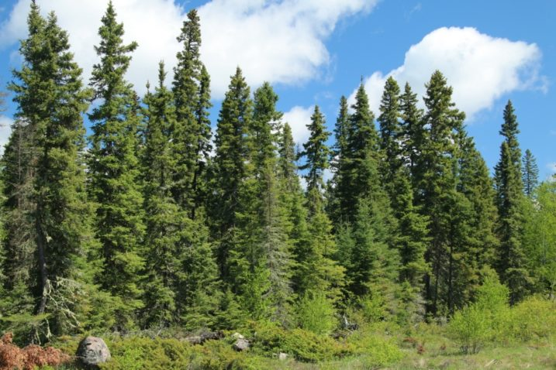
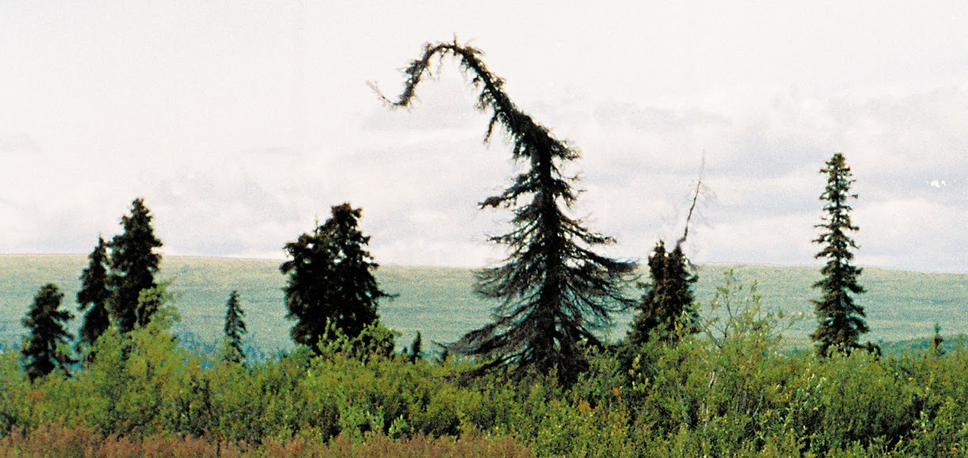
White spruce
Black spruce
Prefers to feed on white spruce, rarely on black spruce.
White spruce
Black spruce

Slide 6
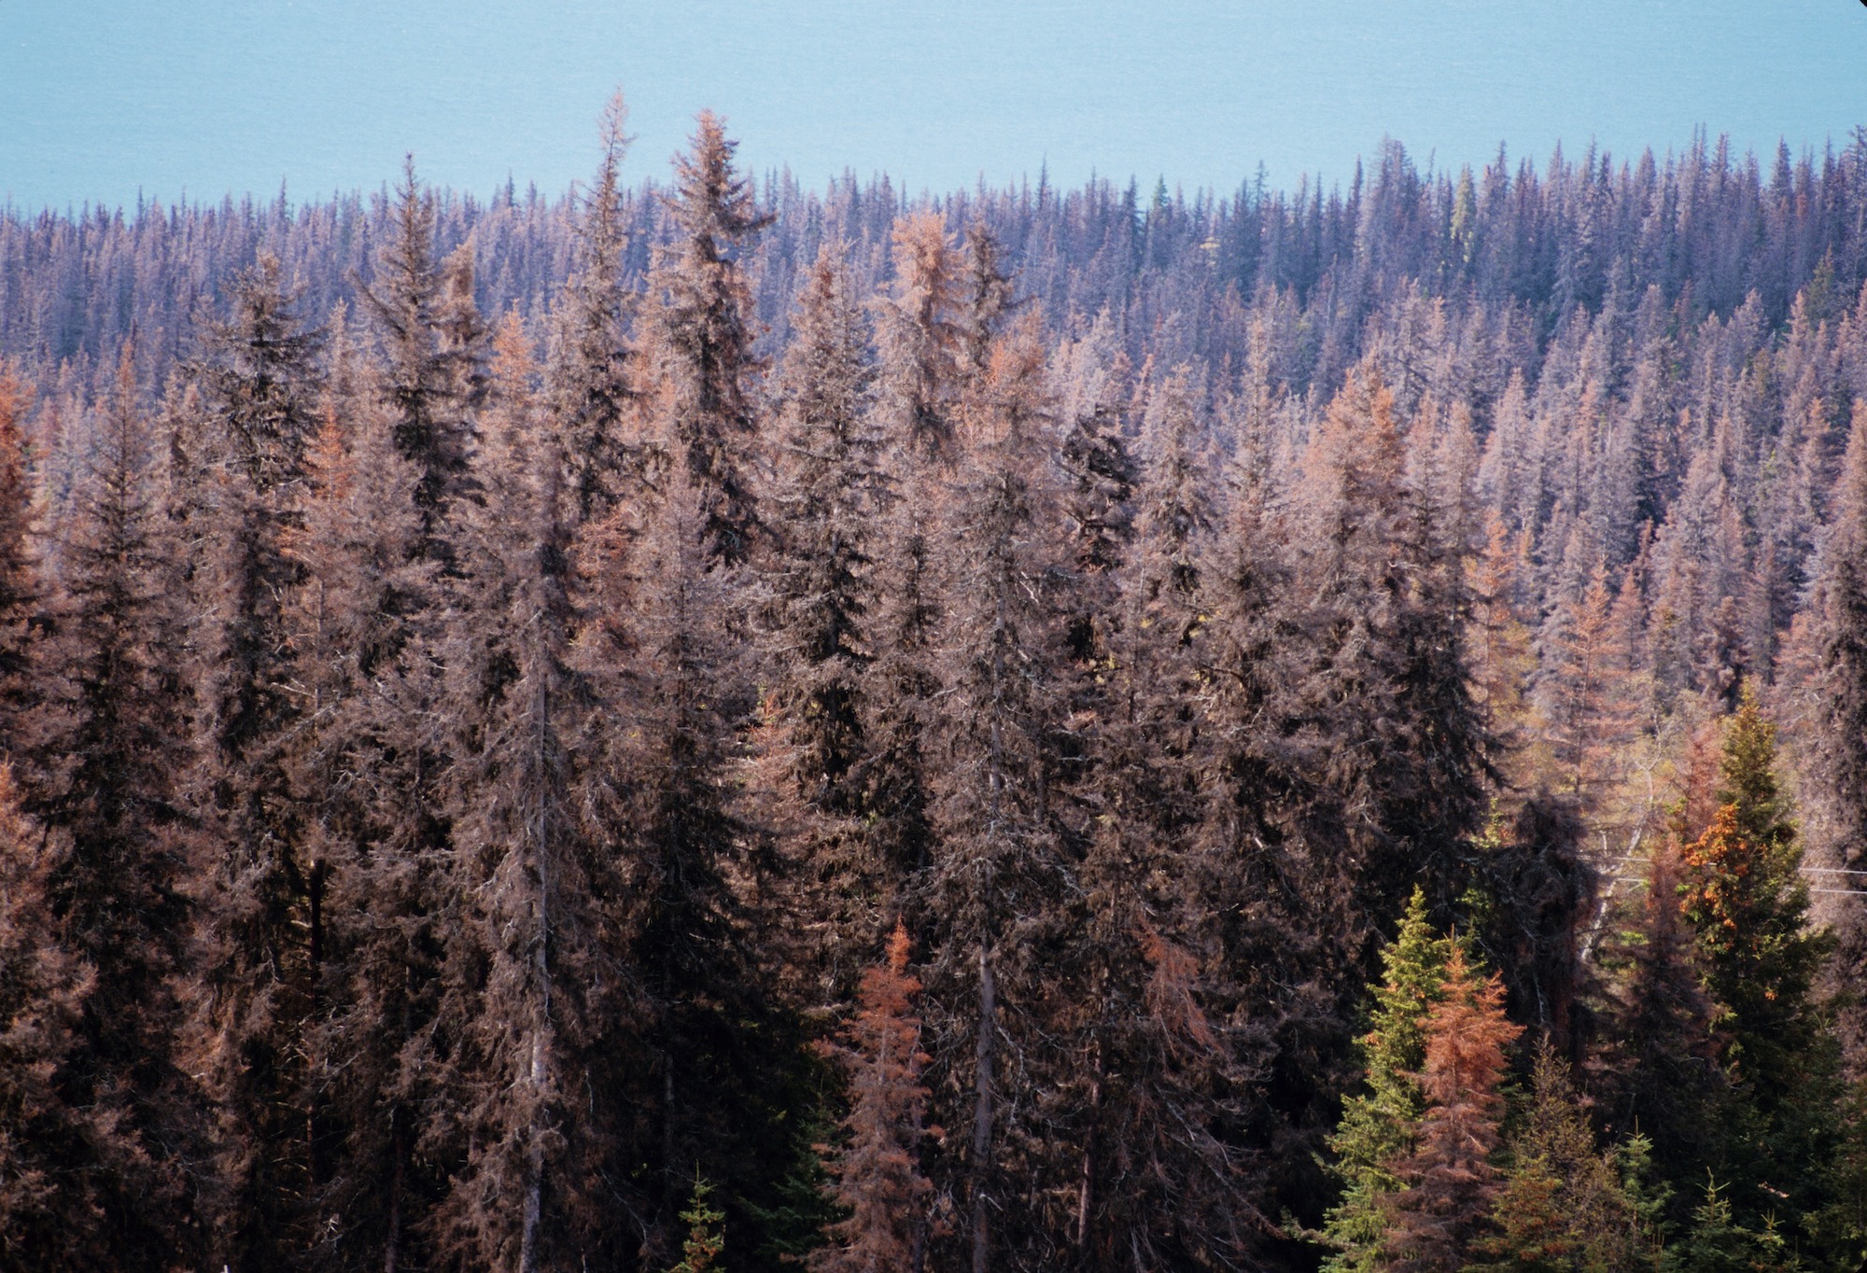
https://www.mesym.com/
Global warming (i.e., increased avg temps) increases # pine beetles and dead trees.
Increased frequency of wildfires contributes to warming climate
Increased # dead trees, increases frequency of wildfires.

Slide 7
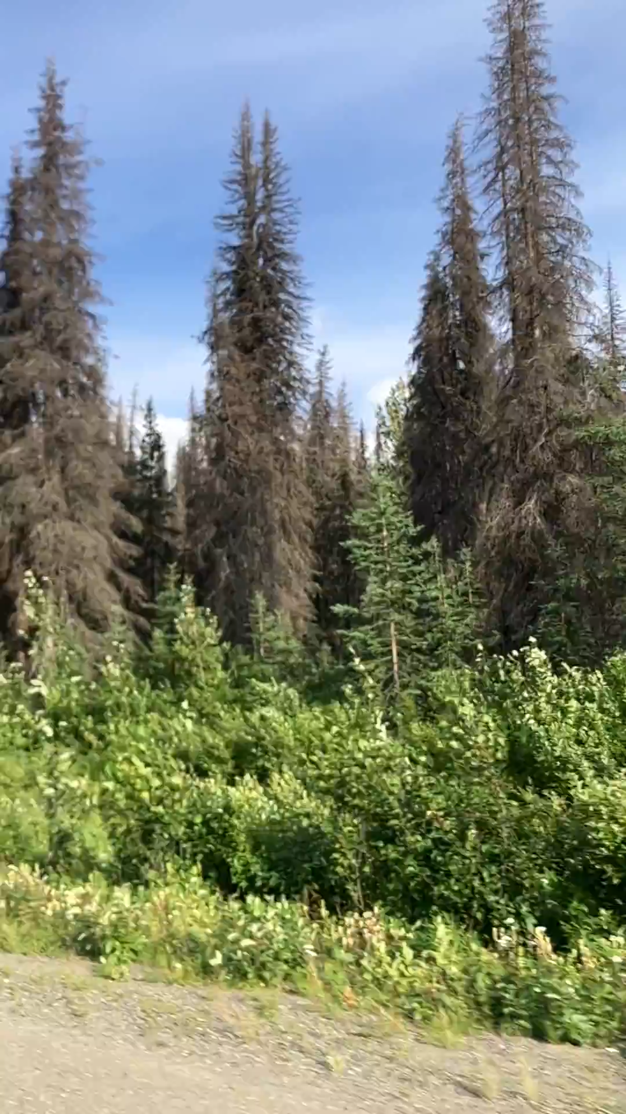

Slide 8
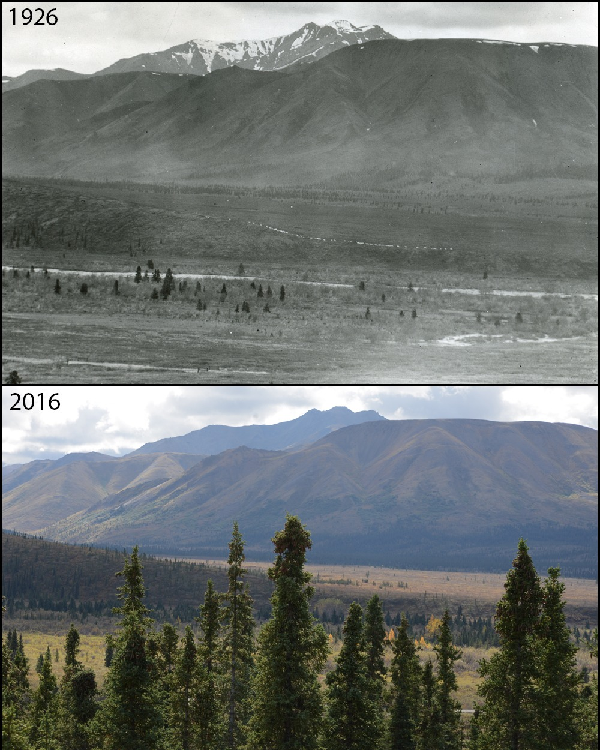
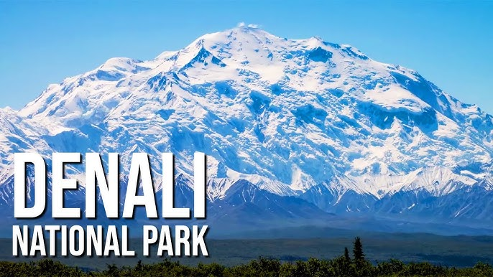


Slide 9
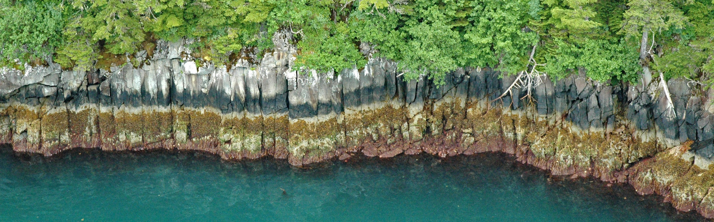
Abiotic limitations Example 2: Flooding frequency
On this coastline in Prince William Sound, presence of organisms such as barnacles, limpets and algae are driven by tidal flooding height, frequency, and duration

Slide 10
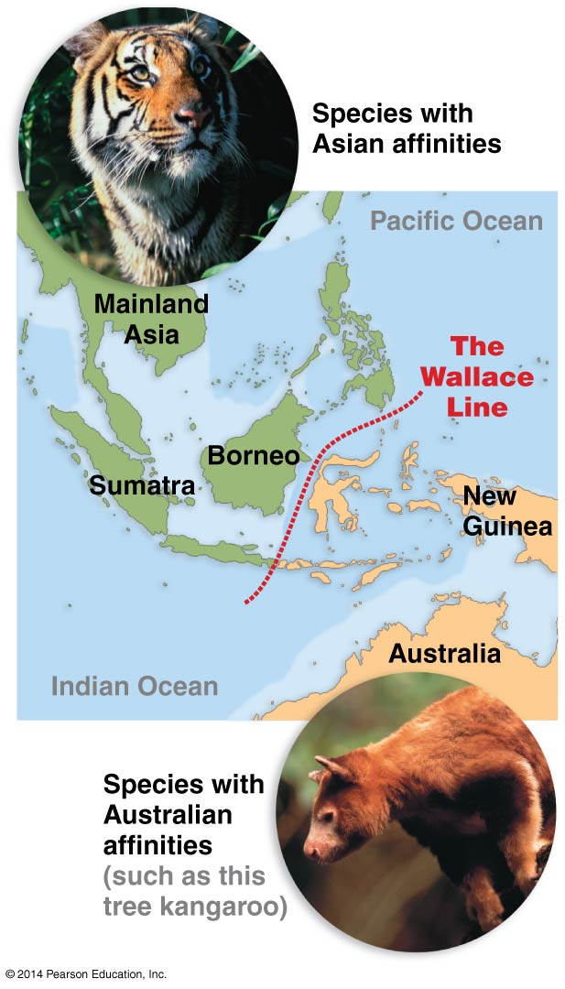
Dispersal limitation
Species’ ability to disperse is limited by major geographical barriers like mountains and oceans
Historical barriers may differ from current ones
Exampe:
  Wallace’s Line

Slide 11
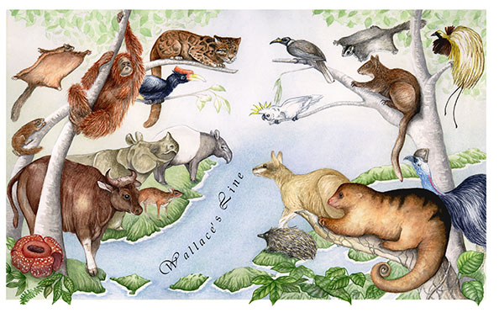
https://cienciasdejoseleg.blogspot.com/2017/08/sida-en-conejos-y-lecciones-para-humanos.html

Slide 12
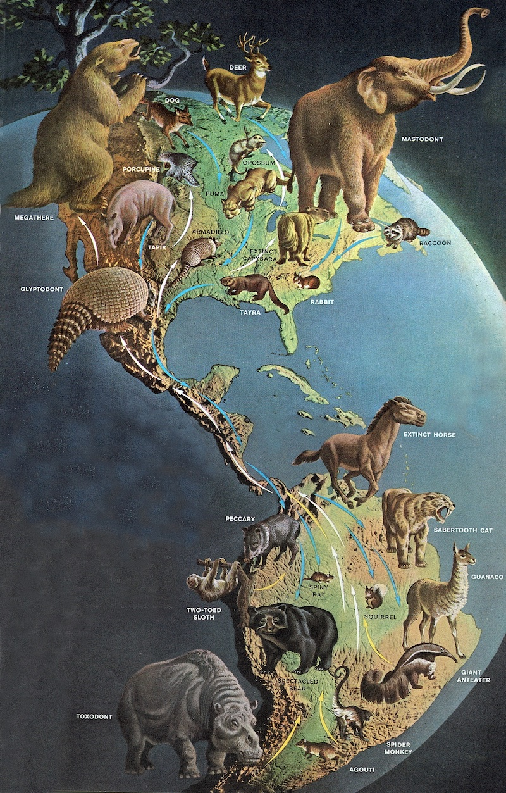
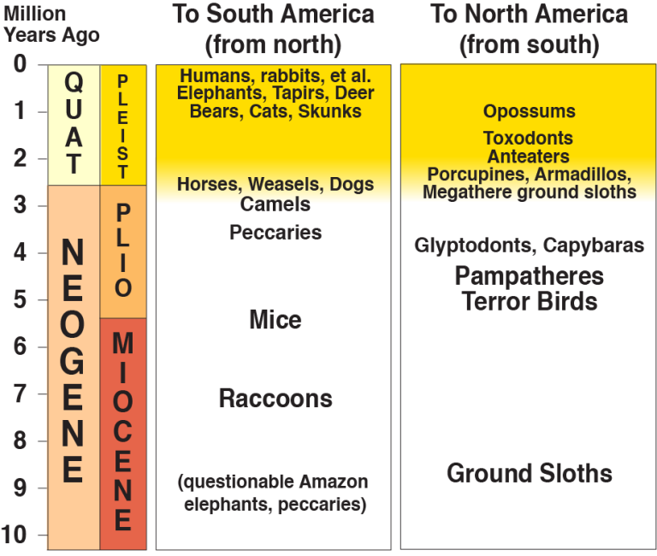
https://raftingmonkey.com/2019/05/23/making-the-interchange-great-again/
Great American Interchange

Slide 13
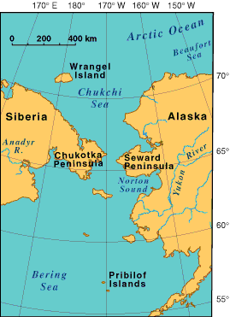
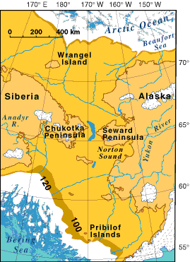
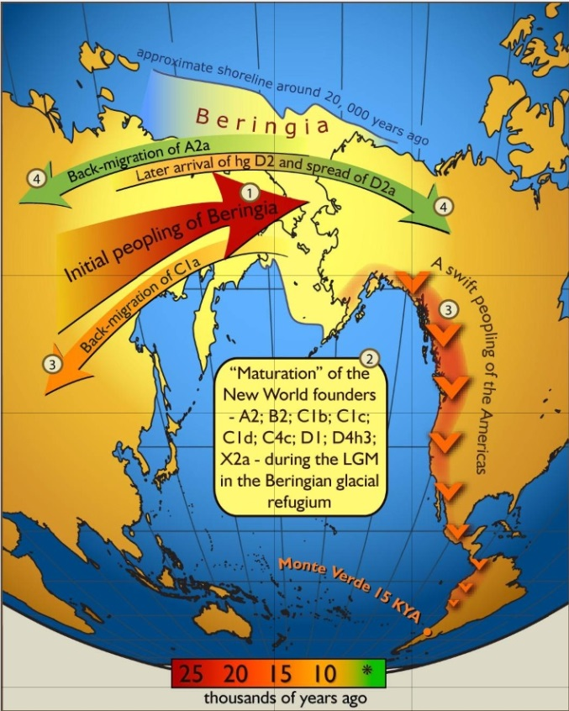
Dispersal limitation: Bering Land Bridge
Current coastline
"Beringia –
Late Wisconsin Glaciation".
Licensed under Public Domain
"Map of gene flow in and out of Beringia" by Erika Tamm et al - Tamm E, Kivisild T, Reidla M, Metspalu M, Smith DG, et al. (2007) Beringian Standstill and Spread of Native American Founders. PLoS ONE 2(9): e829.
The Bering land bridge connected North America and Asia during several periods during the Pleistocene Ice Ages and was a route for human migration to the Americas.

Slide 14
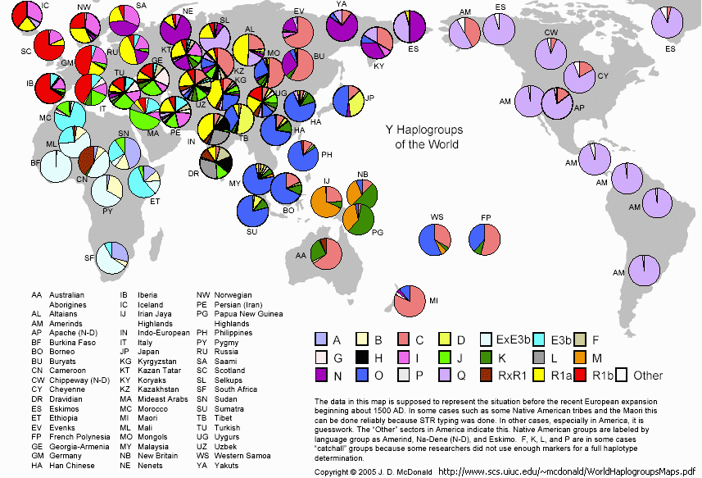

Slide 15
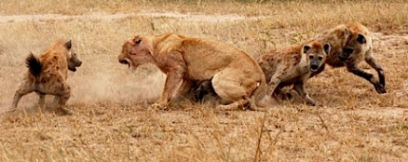
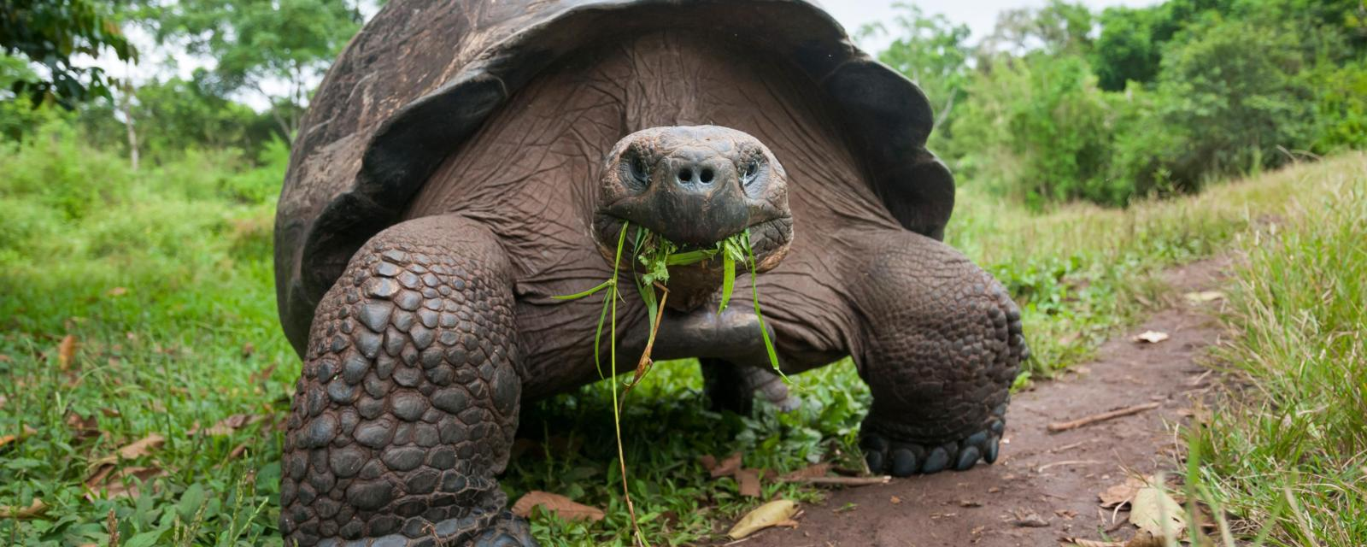
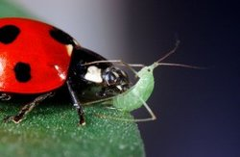
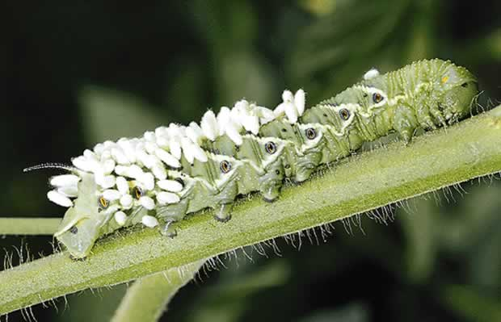
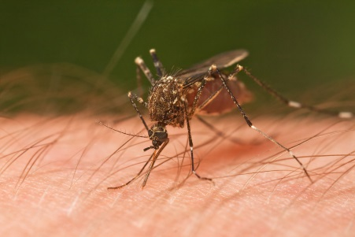
Biotic interactions: competition and predation
A species needs to be able to compete against species that use similar resources
A species needs to be able to survive the presence of consumers: herbivores, carnivores, parasites, or parasitoids
*parasitoid = kills host
B. Gunther
bbc.com
G. Shepard
J.R. Meyer
JJ Harrison

Slide 16
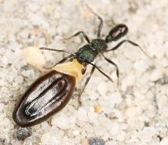
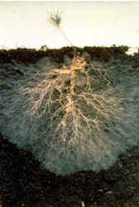
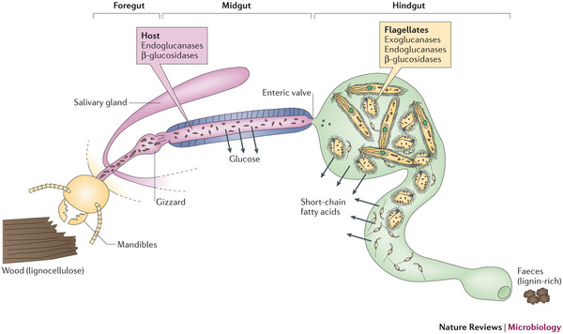
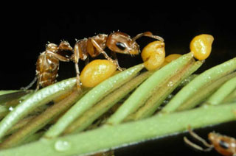
Biotic interactions: mutualisms
Most species have mutualistic relationships w/other species
For plants, fungal root associations such as mycorrhizae, animal pollinators, and animal seed dispersers are common
For animals, microbial symbionts in the gut are common
Many behavioral mutualisms also exist between animals, and even between animals and plants
Ant as seed disperser
Mycorrhizae on pine seedling
http://www4.ncsu.edu/~bsguenar/Rhytidoponera%20metallica/Rhytidoponera-metallica-a1.jpg
http://www.matsiman.com/images/myceliaonroot.JPG
Gut symbionts in termites
http://www.nature.com/nrmicro/journal/v12/n3/images_article/nrmicro3182-f1.jpg
Ant-acacia mutualism
http://www.discoverlife.org/ed/ecolibrary/images/Ant,Bullhorn_Acacia,food_bodies,EL_DP161.320.jpg

Slide 17
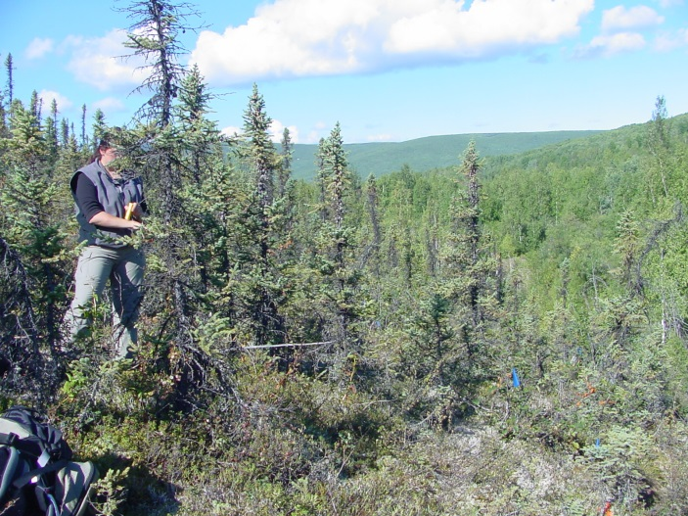
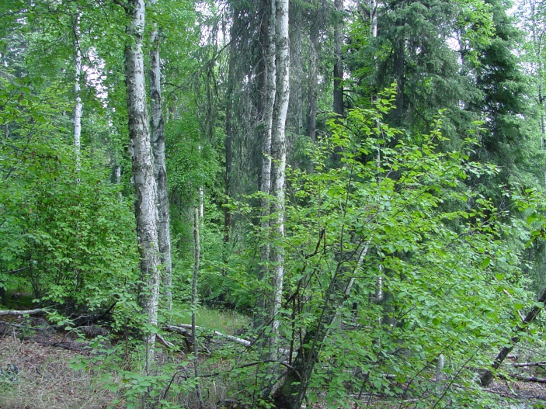
Abiotic and biotic factors may play different roles over different parts of the range
Black Spruce (Picea mariana):
  At one end of the range abiotic factors limit distribution.
  At the other end of the range, competition with species like White Spruce (Picea glauca) limit distribution.
  Abiotic and biotic factors can interact (have different effects when combined than predicted from the individual effects)
At cold, north-facing sites, black spruce has little competition because of poor soil conditions
At warm, south-facing sites, deciduous trees and white spruce outcompete black spruce.
Notes:
Ask a question about this in the homework: which data support the notion that black spruce is limited by abiotic factors at one end, and biotic factors at the other?

Slide 18
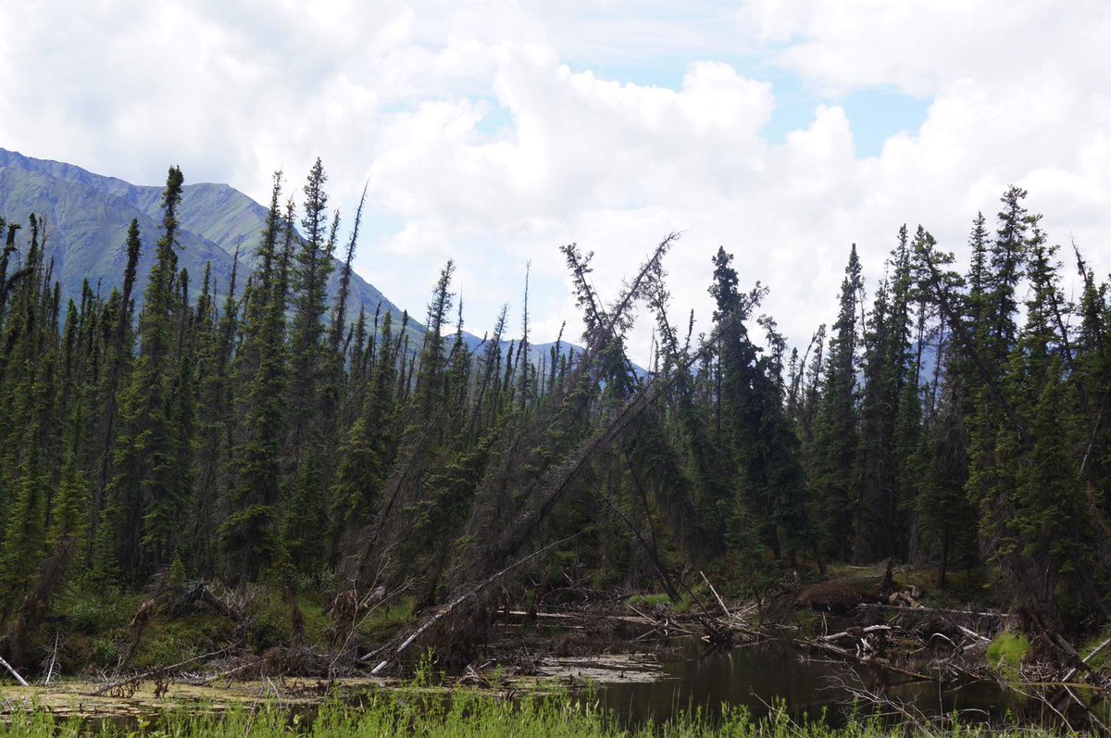

Black Spruce grows on permafrost, whereas White Spruce will not.
When the permafrost melted it created this expanding pond boreal, and the Black Spruce are tipping over.
The original Dr. Seuss tree!

Slide 19
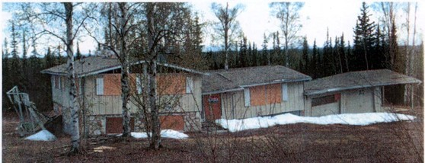
Not just Black Spruce… House built on permafrost, Fairbanks, Alaska.

Slide 20
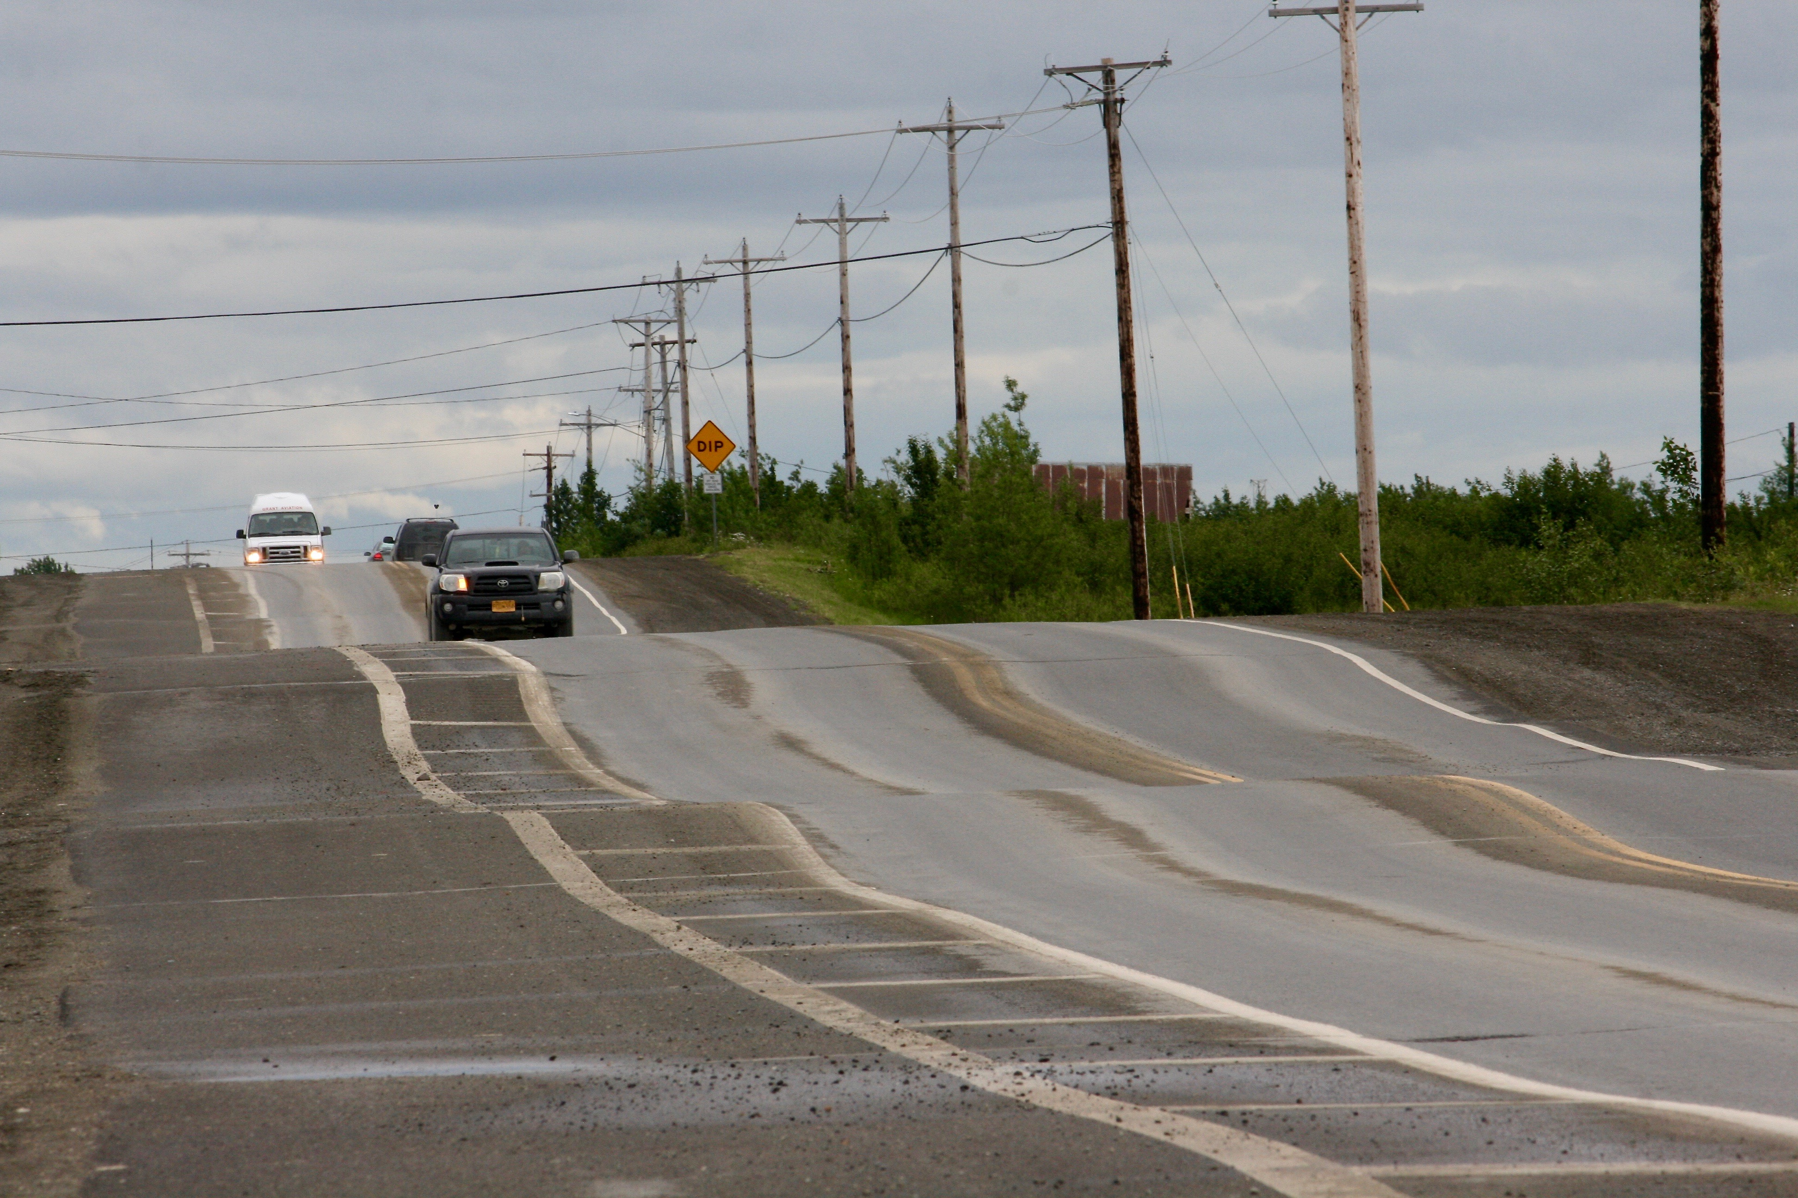
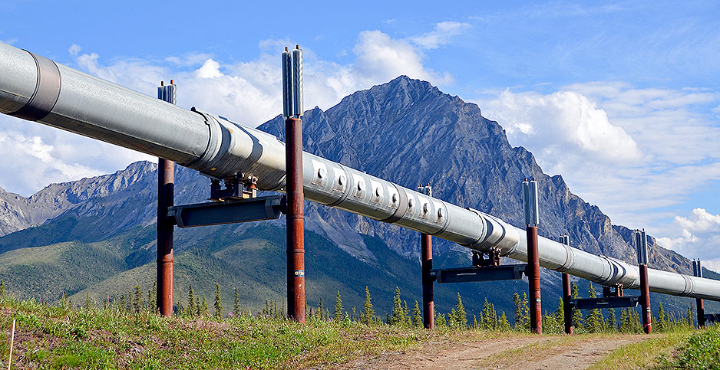
Road ruined by melting permafrost, Bethel, Alaska.
https://www.arctictoday.com/
TransAlaska Pipeline is built on stilts with radiators for this reason, so the hot oil won’t melt the permafrost.

Slide 21
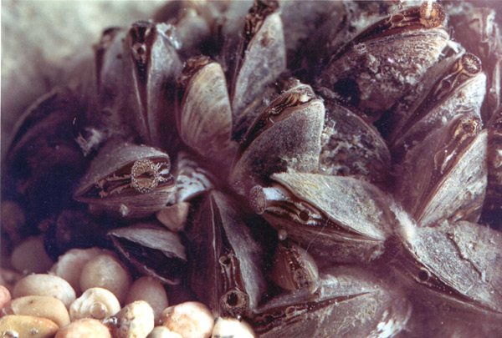
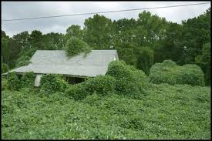
Invasive species
Non-native species (or native species expanding into new habitat) that increase rapidly in abundance and have a negative impact on native species
The vast majority were introduced by people, either on purpose (e.g., as food for people or animals, pets, for ornamentals, etc.) or by accident (on tires, in ballast water)
The vast majority of non-native (exotic) species are NOT invasive, that is, they do not have big impacts on their new environments
The small portion that do are often devastating (e.g., Kudzu)
Zebra mussels (Dreissena polymorpha)
http://www.ec.gc.ca/EnviroZine/english/issues/35/feature3_e.cfm
Kudzu (Peuraria montana var. lobata)
http://www.jjanthony.com/kudzu/houses.html
Notes:
Add another picture – e.g. of kudzu or other famous example.

Slide 22
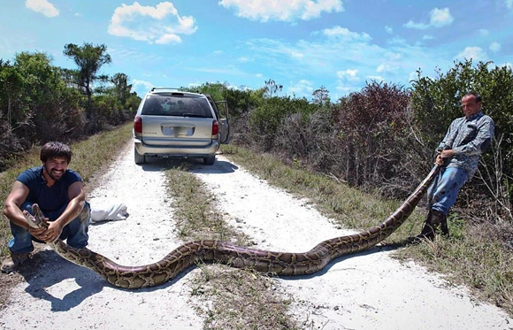
Florida snake hunters have now killed >1,000 Burmese pythons
Posted By Colin Wolf on Tue, May 22, 2018 at 3:14 PM – Orlando Weekly
But 10,000s probably exist, legacy of Hurricane Andrew.

Slide 23
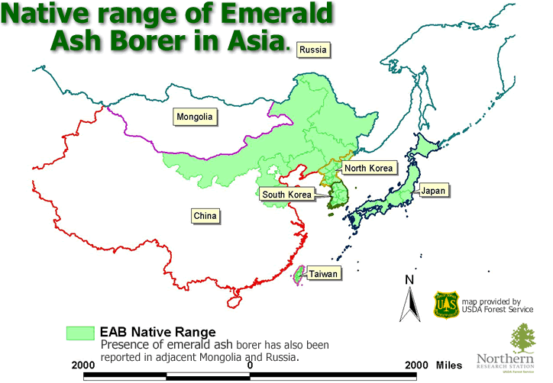
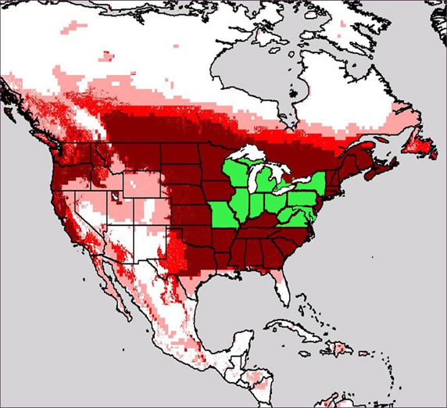
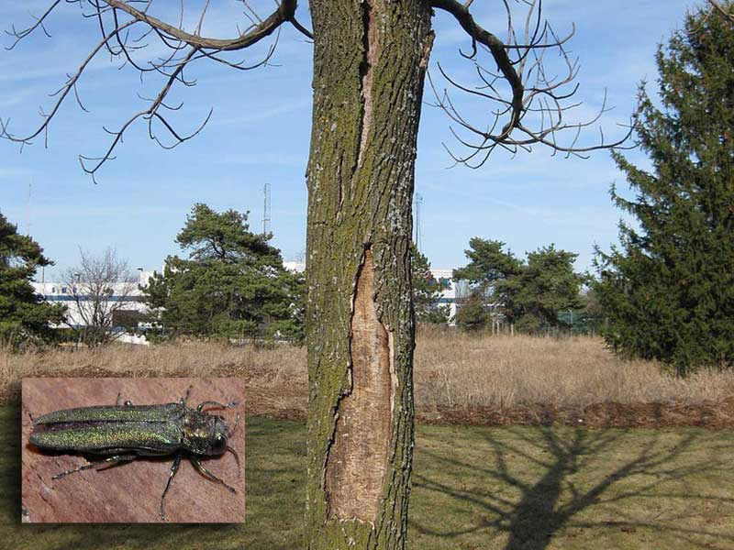
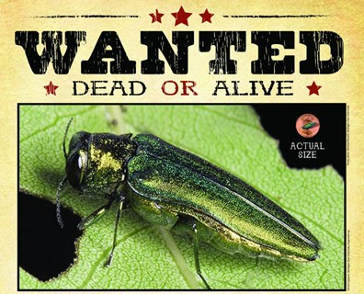
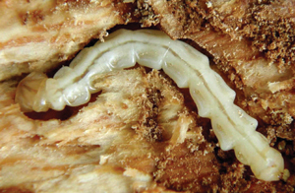
Invasive species and dispersal limitation
Thriving populations of invasive species in locations where they were not previously found indicate that dispersal limitation was previously preventing their expansion
Example of ecological release.
Photo credit: P. Lester
Zebra mussels
Credit: C. Mulder

Slide 24
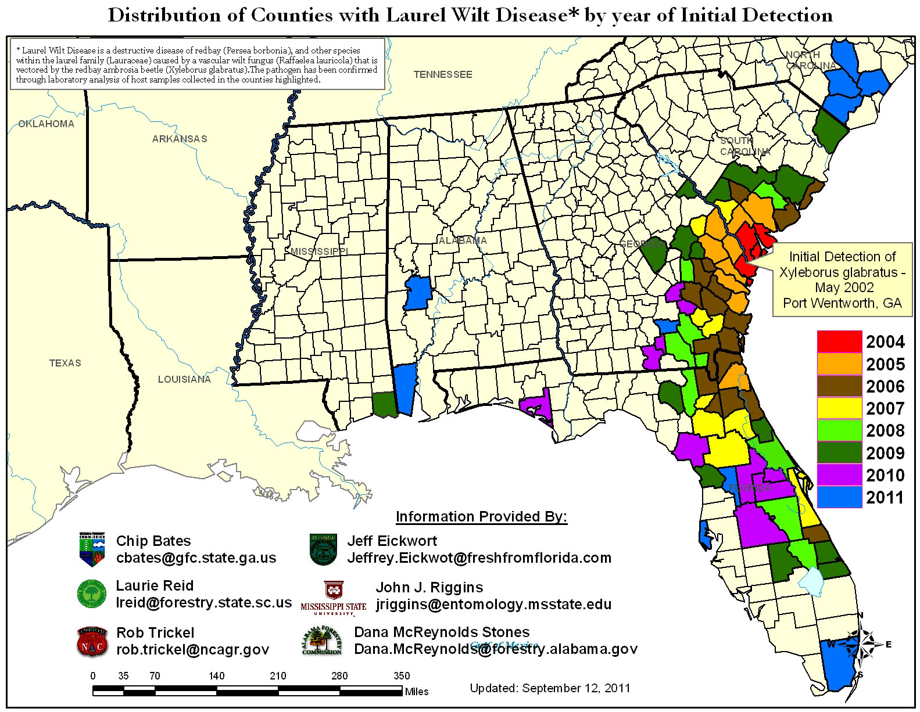
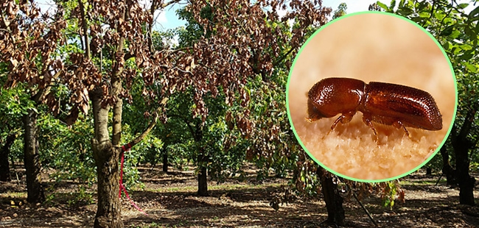
Laurel Wilt Disease has devastated the Florida Avocado Industry
https://trec.ifas.ufl.edu/people/jonathan-crane/lw-ab-website/
https://cisr.ucr.edu/invasive-species/redbay-ambrosia-beetle-and-laurel-wilt
https://ucanr.edu/blogs/blogcore/postdetail.cfm?postnum=43159

Slide 25
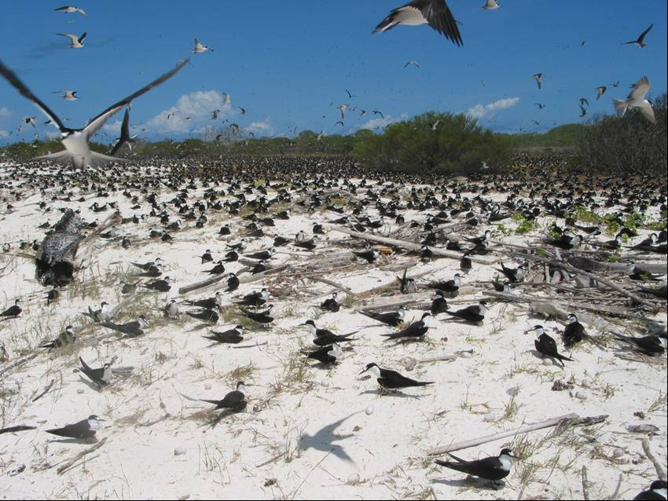
Population ecology
A population is all the members of one species in one area
  The area usually consists of those individuals that potentially interact
Population ecology examines changes in
  Population size (how many there)
  Population structure (e.g., ratio or males to females, age distribution)
  Distribution (species range)
Demography is the study of factors that determine the size and structure of a population through time
Sooty Terns, Eparses Islands (Indian ocean). Photo: C. Suehs
N_{e}
μ
m
s
r
F_{ST}
Can also study this with population genetics
LD

Slide 26
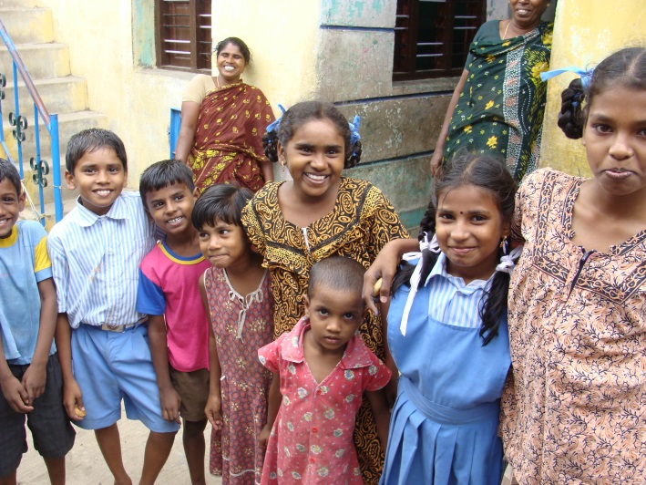
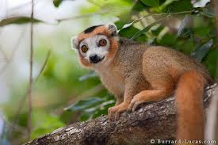
Basic understanding of population ecology is fundamental to understanding human population and conservation issues
Why do people in rich countries have fewer children than in poor countries?
If each woman in India has only 2 children starting this year, will population growth stop?
Is a newly discovered population of an endangered species increasing or decreasing?
What stage of the lifecycle should protection be aimed at for this species?
All of these questions require population ecology to answer them.
https://saveafamilyplan.files.wordpress.com/2011/11/dsc03004.jpg
http://img.burrard-lucas.com/madagascar/full/crowned_lemur.jpg
Notes:
Add pictures

Slide 27

Population dynamics: number of individuals
Change in population size is a function of 4 main processes:
Births
Deaths
Immigration (individuals that come into the population from another population)
Emigration (individuals that leave the population to go to another one)
Change in population size over a given time period is given by births minus deaths plus immigration minus emigration
ΔN = B – D + I – E

Slide 28

How do these 4 factors relate to population change?
ΔN = B – D + I – E
For ΔN > 0, what has to be true?
  ΔN = B – D + I – E > 0
  B + I > D + E population is increasing
For Δ N < 0, what has to be true?
  ΔN = B – D + I – E < 0
  B + I < D + E population is decreasing
For ΔN = 0, what has to be true?
  ΔN = B – D + I – E = 0
  B + I = D + E population is stable
  HOW HARD CAN THIS BE?
  Let’s look at an example of the U.S. Population and then some LIFE TABLES
https://s3.amazonaws.com/lowres.cartoonstock.com/death-insurance-insurance_companies-actuaries-actuary_tables-calculations-jmo2100_low.jpg

Slide 29


Slide 30
Plotting survivorship
Imagine a population with a constant survivorship of 0.5 per year (50%). Everyone is born in year 0.
How does population size, Nx, change over time?
1000
# of survivors (N_{x})
0
1
2
3
4
Year

Slide 31
When plotted on linear axes, what does a constant survivorship of 0.5 look like?
Plot A
Plot B
Plot C
A
B
C

Slide 32
When plotted on log axes (log₁₀ for y-axis), what does a constant survivorship of 0.5 look like?
Plot A
Plot B
Plot C
A
B
C

Slide 33
Survivorship is usually plotted on a log scale; this gives a straight line for a constant survivorship

Slide 34
Putting this in terms of an individual:
We just looked at the population size.
But we can express the same information in terms of probability that an individual will survive to a specific age.

Slide 35


Slide 36

What does the survivorship curve look like for?
Humans
Birds
Trees

Slide 37
Life tables: survivorship
Age | # Alive | Survivorship (%)
0 | 1000 | 1.000
1 | 424 | 0.424
2 | 308 | 0.308
3 | 158 | 0.158
4 | 57 | 0.057
We can also express this information in a table:
Survivorship is the proportion of offspring that survive, on average, from birth to a given age
Survivorship follows cohorts – a group of the same age (approximately).
Survivorship is expressed as a proportion (range: 0-1)
Data from Table 54.1 in Freeman

Slide 38
Life tables: survivorship and fecundity
Age | Survivorship (l_{x}) | Fecundity (m_{x}) | Mean # offspring at age x (l_{x} * m_{x})
0 | 1.000 | 0.00 | 0.00
1 | 0.424 | 0.08 | 0.03
2 | 0.308 | 2.94 | 0.91
3 | 0.158 | 4.13 | 0.65
4 | 0.057 | 6.50 | 0.37
Fecundity is the average number of female offspring produced by each female
Males usually ignored because they usually do not limit reproduction (at least not in many animals; most plants have both sexes)
Age-specific fecundity is the number of offspring produced at a given age
Proportion that survive to a given age multiplied by the number of offspring at that age provides the mean number of offspring born for each female born
Data from Table 54.1 in Freeman
Notes:
Add a survivorship curve, then put it in a table

Slide 39
Using life tables to predict whether a population is increasing, decreasing, or stable (assuming no immigration or emigration)
Age | Survivorship (l_{x}) | Fecundity (m_{x}) | Mean # offspring at age x
0 | 1.000 | 0.00 | 0.00
1 | 0.424 | 0.08 | 0.03
2 | 0.308 | 2.94 | 0.91
3 | 0.158 | 4.13 | 0.65
4 | 0.057 | 6.50 | 0.37
Mean lifetime reproduction (female / female) |  |  | 1.96
We can tell whether a population is increasing or decreasing by looking at mean total lifetime reproduction
If a female exactly replaces herself with one (female) offspring, then the population will be constant
If she produces (on average) > 1 female offspring then the population will grow
If she produces (on average) <1 female offspring then the population will decline
Data from Table 54.1 in Freeman

Slide 40
Life table in population ecologist language:
Age | Survivorship (l_{x}) | Fecundity (m_{x}) | Mean # offspring at age x
0 | 1.000 | 0.00 | 0.00
1 | 0.424 | 0.08 | 0.03
2 | 0.308 | 2.94 | 0.91
3 | 0.158 | 4.13 | 0.65
4 | 0.057 | 6.50 | 0.37
Mean lifetime reproduction (female / female) |  |  | 1.96
Survivorship: l_{x} = N_{x} / N₀
Age-specific fecundity: m_{x}
Net reproductive rate of the population:
R₀ = Σ l_{x}m_{x}
x
i=0
Is this value >, < or = to 1.0?
Data from Table 54.1 in Freeman

Slide 41
Using life tables for conservation
Age | Survivorship (l_{x}) | Fecundity (m_{x}) | Mean # offspring at age x (l_{x} * m_{x})
0 | 1.000 | 0.00
1 | 0.5 | 0.00
2 | 0.33 | 1.5
3 | 0.1 | 4.0
4 | 0.02 | 0
You have just discovered a new species. The population is quite small, and you have to decide whether to capture some for captive breeding (with all risks that entails) or whether you should leave it alone and protect it from intruders.
You manage to get survival and fecundity data on this population

Slide 42
At what age does this species first reproduce?
Age 0
Age 1
Age 2
Age 3
Age | Survivorship (l_{x}) | Fecundity (m_{x}) | Mean # offspring at age x (l_{x} * m_{x})
0 | 1.000 | 0.00
1 | 0.5 | 0.00
2 | 0.33 | 1.5
3 | 0.1 | 4.0
4 | 0.02 | 0

Slide 43
How is this population doing?
Increasing
Decreasing
Stable
Can’t tell
Age | Survivorship (l_{x}) | Fecundity (m_{x}) | Mean # offspring at age x (l_{x} * m_{x})
0 | 1.000 | 0.00
1 | 0.5 | 0.00
2 | 0.33 | 1.5
3 | 0.1 | 4.0
4 | 0.02 | 0

Slide 44
Using life tables for conservation
Decreasing
Age | Survivorship (l_{x}) | Fecun-dity (m_{x}) | Mean # offspring at age x (l_{x} * m_{x})
1 | 1.000 | 0.00 | 0
2 | 0.5 | 0.00 | 0
3 | 0.33 | 1.5 | 0.495
4 | 0.1 | 4.0 | 0.4
5 | 0.02 | 0 | 0
Total 0.895

Slide 45



Case study: the Tuatara (Sphenodon punctatus)
Adult tuatara
Endemic to New Zealand, the last remaining species in the order Sphenodontia, which had many species some 200 million years ago (most extinct 60 million years ago)
Adults are ~500-1000 g
Very low metabolic rate
They were found on the mainland until rats and other mammalian predators were introduced
Now limited to a few offshore islands, and introduced to multiple other islands from which predators have been removed.
http://en.wikipedia.org/wiki/
Cook Strait, New Zealand: Tuatara habitat. Photo: H. Jones

Slide 46


Tuatara life history characteristics
Life history characteristics:
  They do not reproduce until age 10-20 years X
  They only produce offspring every 4 years X
  Females produce 6-8 eggs X
  From fertilization to young takes >2 years: X
    Mating is mid summer (Jan-March)
    Eggs laid following spring / early summer (Oct-Dec)
    Incubation 12-15 months (development stops in winter months) X
  Live up to 70 years in captivity, possibly up to 100 years in the wild? X
http://www.teara.govt.nz/browse
https://shadmia.wordpress.com/tag/henry-the-tuatara/

Slide 47

https://www.sciencelearn.org.nz/resources/1976-what-do-we-see

Slide 48
Let’s make a few assumptions
Based on known info:
  Tuataras not reproductively actively (mate) until age 15
  They only produce offspring every 4 years
  From fertilization to young >2 years
  Age of 1st reproduction = 17
  Females produce 6 eggs on average at a time
Assume as follows:
Assume that survival is low in year 1 (50%) and year 2 (75%), when young are subject to cannibalism
Assume that survival is high after age 2 (95%)
Assume any Tuatara who makes it to age 25 will die following year
Notes:
Give them this info, then work through the math (next slide), then give them a scenario where they have to figure out what to do ane the gi

Slide 49
Age | N | lx | mx | lx*mx
0 | 1000 | 1 | 0 | 0
1 | 500 | 0.5 | 0 | 0
2 | 375 | 0.375 | 0 | 0
3 | 356 | 0.35625 | 0 | 0
4 | 338 | 0.338438 | 0 | 0
5 | 322 | 0.321516 | 0 | 0
6 | 305 | 0.30544 | 0 | 0
7 | 290 | 0.290168 | 0 | 0
8 | 276 | 0.275659 | 0 | 0
9 | 262 | 0.261876 | 0 | 0
10 | 249 | 0.248783 | 0 | 0
11 | 236 | 0.236344 | 0 | 0
12 | 225 | 0.224526 | 0 | 0
13 | 213 | 0.2133 | 0 | 0
14 | 203 | 0.202635 | 0 | 0
15 | 193 | 0.192503 | 0 | 0
16 | 183 | 0.182878 | 0 | 0
17 | 174 | 0.173734 | 6 | 1.042405
18 | 165 | 0.165048 | 0 | 0
19 | 157 | 0.156795 | 0 | 0
20 | 149 | 0.148955 | 0 | 0
21 | 142 | 0.141508 | 6 | 0.849046
22 | 134 | 0.134432 | 0 | 0
23 | 128 | 0.127711 | 0 | 0
24 | 121 | 0.121325 | 0 | 0
25 | 115 | 0.115259 | 6 | 0.691553
 |  |  |  | 2.583004
Baby survival is 50% in year and 75% in year 2 (0.5 * 0.75 = 0.375)
Adult survival is 95%
They do not mate until age 15
It takes 2 years from mating to egg laying
They only produce offspring every 4 years
Females produce 6 eggs
They die at 25
Notes:
Could do this in EXCEL instead

Slide 50
Tuatara conservation: problems
Scenario:
Tuatara have been reintroduced to an island on which they once occurred. However, the population is crashing rapidly, and the only way to prevent it from being extirpated (going extinct locally) is to keep reintroducing animals. This is not a viable long-term solution.
You have been hired as consulting teams to come up with a way to save this population. After several years of monitoring you identify the following problems:
Due to the presence of introduced birds, the survival rates of Tuatara in the first year has reduced from 50% to 25%, and in the second year from 75 % to 50%
Due to poor food quality, annual survival after the second year has dropped from 95% to 80%
Due to poor conditions, on average only 3 eggs survive per nest

Slide 51
Some possible interventions:
Baby survival: Control introduced birds so that the survival in the first year is brought back up to 40% and in the second year to 70%.
Adult survival: Supplemental food to older Tuatara so that survival rate is brought back up to 90% after year 2
Age of 1st breeding: Provide hormones and supplemental food to young females so they are induced to breed at age 11
Breeding frequency: Provide hormones and supplemental food to older females so they breed every 2 years instead of every 4
Clutch size: Provide supplemental food to adult females so that # of eggs goes from 3 to 5
Using the life table, how might you prioritize each of these interventions?
Notes:
After this slide, run through the different scenarios in EXCEL to see which one works best. Could have students take the problem home and just start with this on Wednesday. Consider removing the change in age of first breeding scenario….

Slide 52




