Slide 1
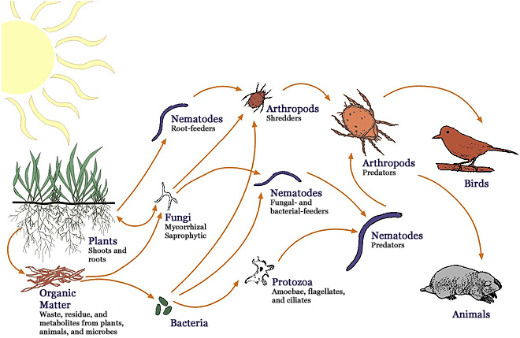
Community Ecology I: Interactions & Competition
http://lifeunderyourfeet.org/en/soileco/intro/biogeochemistry.asp
Notes:
Add pictures

Slide 2
Outline
Community definition
Competition & species interactions
Predation, herbivory, & parasitism
Mutualism & commensalism
Competition and the niche
Niche definitions
Asymmetric competition and competitive exclusion
Character displacement
Resource partitioning
Testing hypotheses

Slide 3
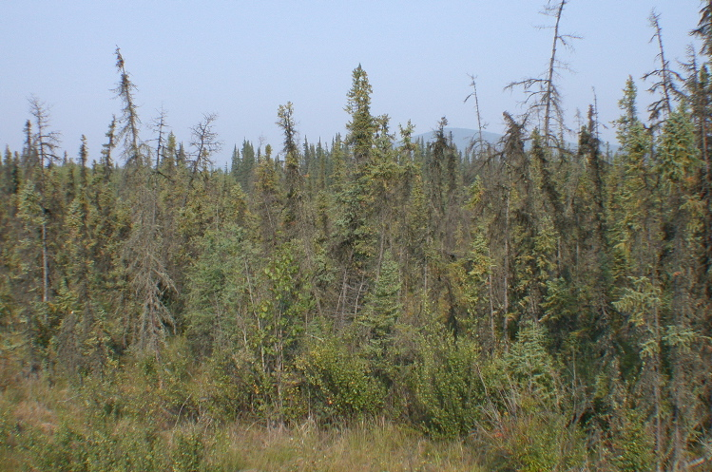
Community
Defined as all interacting species, usually in a given area
Communities can be defined at multiple scales
Usually refers to a subgroup (e.g., “the bird community” or “the soil community”)
Always includes >1 species
Black Spruce Community in the Boreal Forest
Photo: C. Mulder

Slide 4
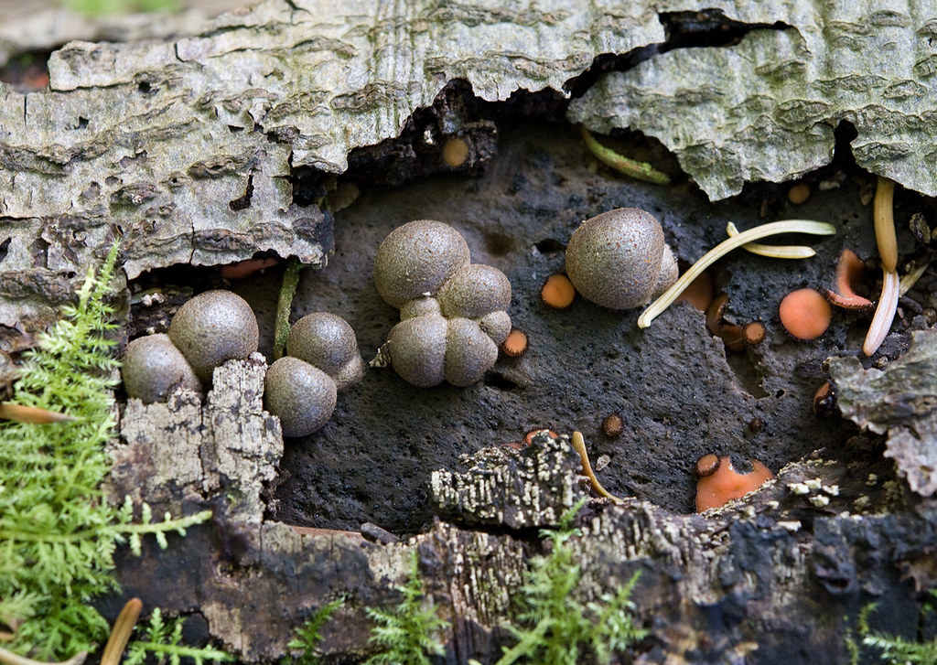
Community
Some questions focus on interactions between a few species (competition, predation, mutualism)
Some questions focus on properties of the community (how many species, relative abundance of each species, structure of the food web, etc.)
Fungal community on a rotting tree trunk
https://www.flickr.com/photos/stephenbuchan/2967549190

Slide 5
Competition
A negative x negative (-/-) interaction that occurs when two species share resources and resources are limiting
Opposite of mutualism (beneficial +/+ interaction)
If a resource is limiting, then adding more of the resource will result in increased fitness (survival, growth, production of offspring)

Slide 6
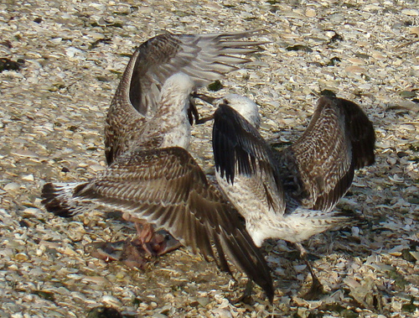
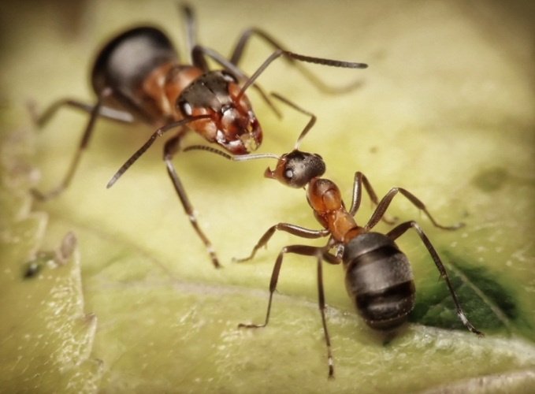
Intraspecific & interspecific competition
Intraspecific = competition between individuals of the same species (intra = within)
Interspecific = competition between individuals of different species (inter = between)
Strength of competition measured by effect presence of one species has on the fitness of the other
Two individuals of the same species fighting for territory
Two species of arboreal ants fighting

Slide 7
Which of the following probably is NOT a good example of competition?
Four species of rodents all consume seeds of the same plant
Three species of plants attract the same group of pollinators
Two individuals of the same species of deer drink from the same stream
Two male muskoxen try to gain access to the same female muskox for mating

Slide 8
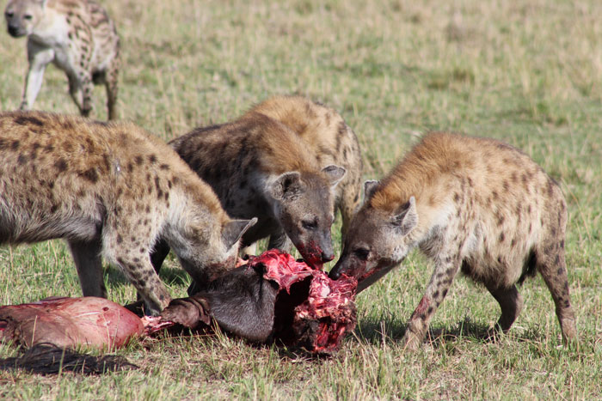
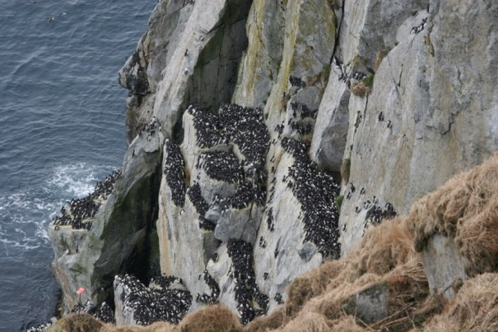
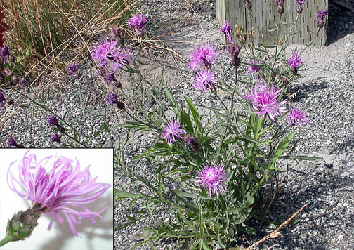
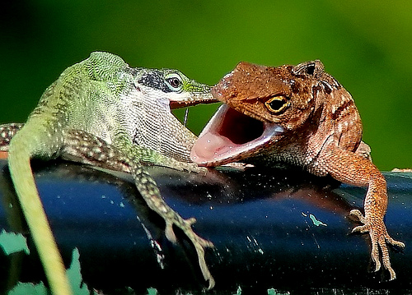
Types of competition
For food or other consumable resources
For space (nest sites, attachment locations)
Chemical competition (e.g., allelopathy)
Territorial competition
Sexual competition
https://africageographic.com/blog/hyenas-bucking-the-trends-and-wearing-bling/
Photo: S. Ebbert
https://www.fs.usda.gov/detail/r10/communityforests/?cid=fsbdev2_038536
http://farm3.static.flickr.com/2131/2414493787_76812dee65.jpg?v=0

Slide 9
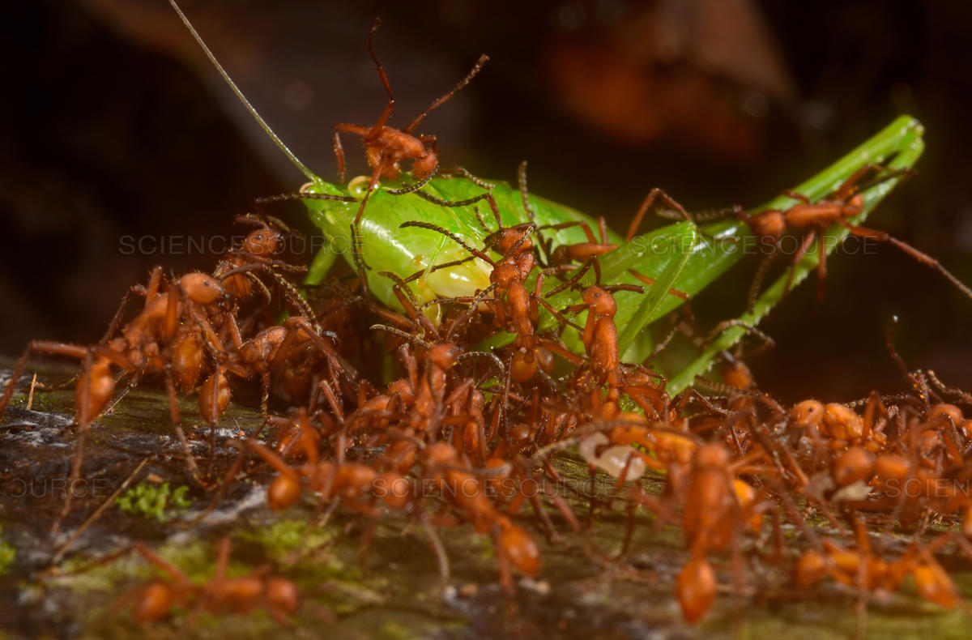
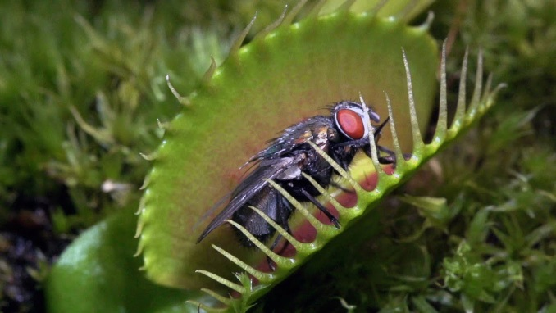
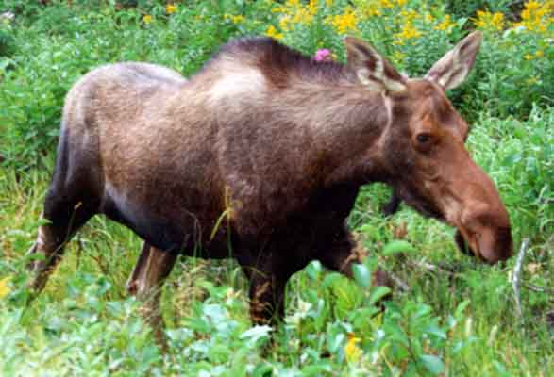
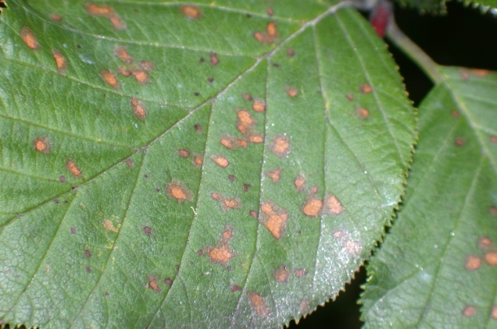
Consumption
1. Predation:
Consumption of all or most of a living organism resulting in death
Prey is alive when first attacked (unlike detritivory)
Always a +/- interaction
2. Herbivory:
Most herbivores attack large numbers of plant “prey” during their lifetime
Don’t usually kill them (may be +/0 or even +/+)
Effects are not always negative for the fitness of the prey
e.g., grazing can induce plant growth
https://www.sciencesource.com/archive/Army-ants-attacking-katydid-SS2782586.html
https://i.ytimg.com/vi/MnY_cCRELvs/maxresdefault.jpg
http://www.servicecanada.gc.ca/images/moose.jpg
Photo: B. Roy

Slide 10
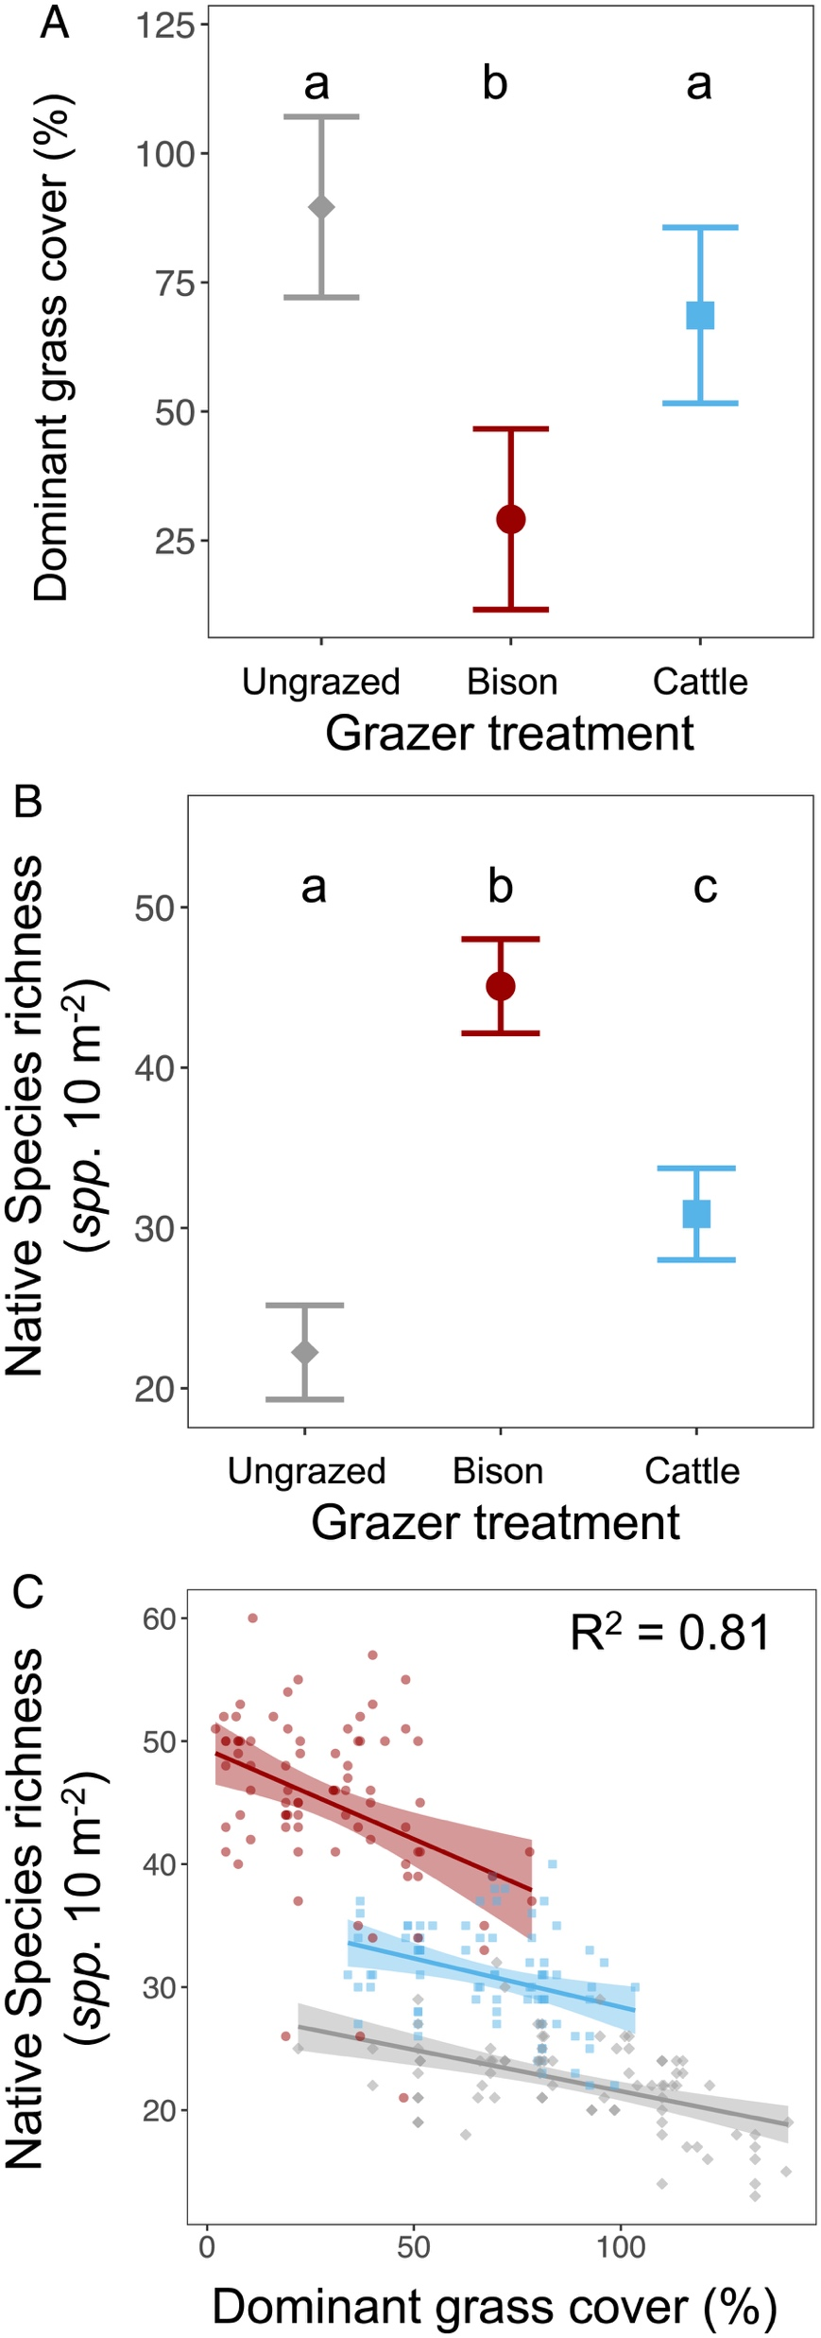
https://doi.org/10.1073/pnas.2210433119

Slide 11

Yellowstone’s free-moving large bison herds provide a glimpse of their past ecosystem function
Chris Geremia, E. William Hamilton, Jerod A. Merkle
Science
28 August 2025
“Bison stabilized net aboveground production while accelerating nitrogen turnover, increasing aboveground nitrogen pools while carbon pools remained stable, which improved landscape nutritional quality. Effects were strongest in wet, nutrient-rich habitats that received higher bison densities and grazing than is recommended in rangeland management, while soil and plant conditions suggested landscape resilience.”

Slide 12
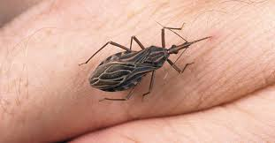
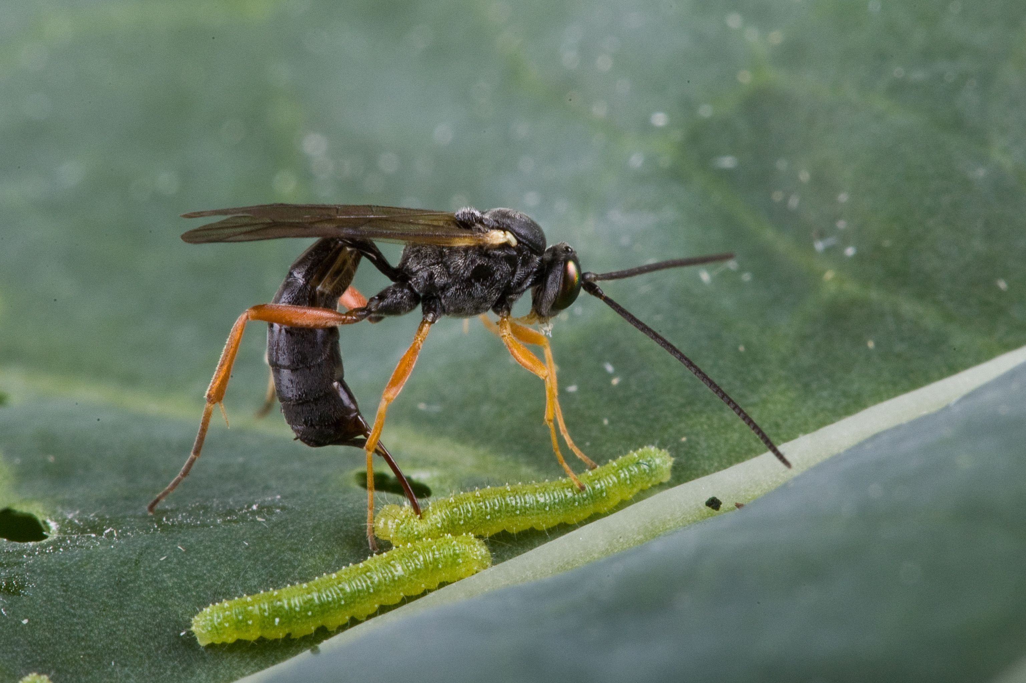
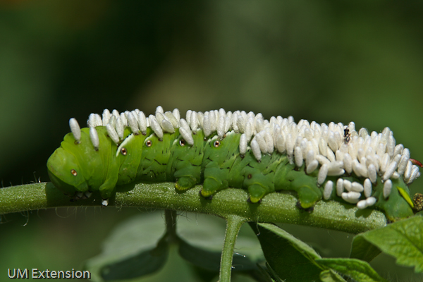
Consumers
3. Parasites
Consume only part of their prey (host)
Usually only have one (or at most a few) host individuals during their lifetime
Usually harmful but not lethal
Usually have a shorter life-cycle than their host
4. Parasitoids
Intimately associated with an individual host (like parasites)
Do not cause immediate death of the host (like parasites and grazers)
Are lethal in long run (like predators)
These are mostly insects in the order Hymenoptera or Diptera
They account for at very large number insect species!
Assassin Bug (Reduviiidae)
Parasitoid wasps ~650,000 spp

Slide 13
Definition of Mutualism
. A positive/positive (+/+) beneficial interaction…. At least on average (over space, time, and multiple individuals)
Obligate mutualism:
The partner dies without the other one present
Facultative mutualism:
The partner does not do as well without the other one present
A mutualism can be obligate for one, both or neither.

Slide 14
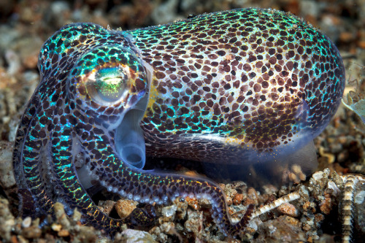
Definition of Mutualism
Mutualisms are part of the life of most (all?) organisms.
Almost all plants have mutualisms with bacteria and fungi.
Most animals have beneficial microbes somewhere in their bodies (e.g., gut microbial community).
Bioluminescent bacteria in Hummingbird Bobtail Squid
https://comicvine.gamespot.com/forums/off-topic-5/impurests-guide-to-animals-90-hummingbird-bobtaile-1723277/

Slide 15
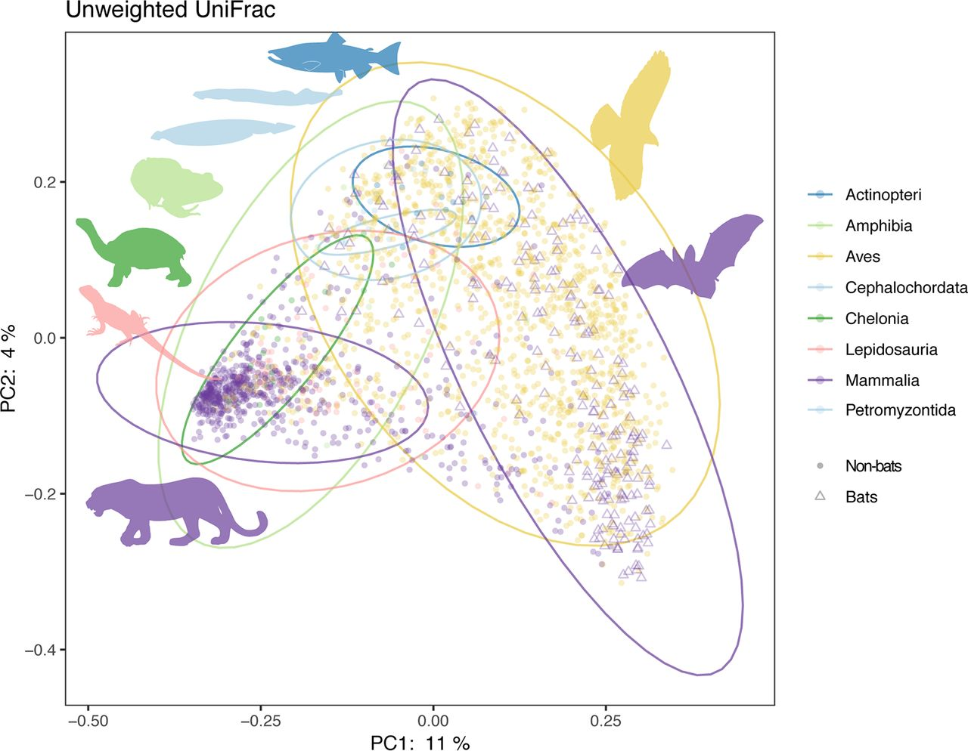
Gut Microbiomes
Song et al. (2020). Comparative Analyses of Vertebrate Gut Microbiomes Reveal Convergence between Birds and Bats.
mBio 11:10.1128/mbio.02901-19. https://doi.org/10.1128/mbio.02901-19

Slide 16
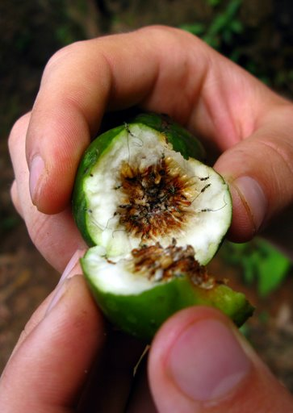
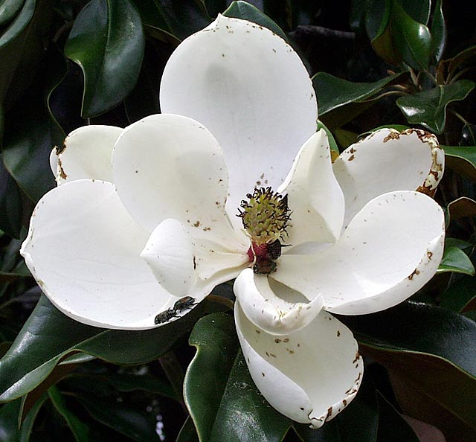
Mutualism
General vs. specific:
A +/+ relationship can be specific to a particular set of species (e.g., fig-wasp)
A +/+ relationship can be available to lots of species (e.g., generalist plant and its pollinators)
Usually the relationship is specific for both partners OR general for both partners
Highly specialized fig-wasp mutualism
Flower that attracts a wide range of pollinators

Slide 17
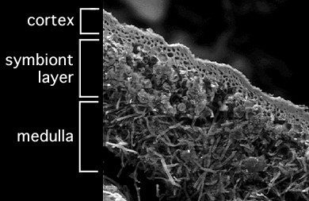
Mutualism
Symbiotic vs. free-living
Symbionts are part of a mutualistic relationship where one partner is living (at least in part) inside the other (e.g., gut bacteria)
e.g., the lichen
Fungi have a thin layer of algae near their surface; these cells produce photosynthates
The fungi provide a place to live
A lichen, consisting of algae living inside a fungus

Slide 18
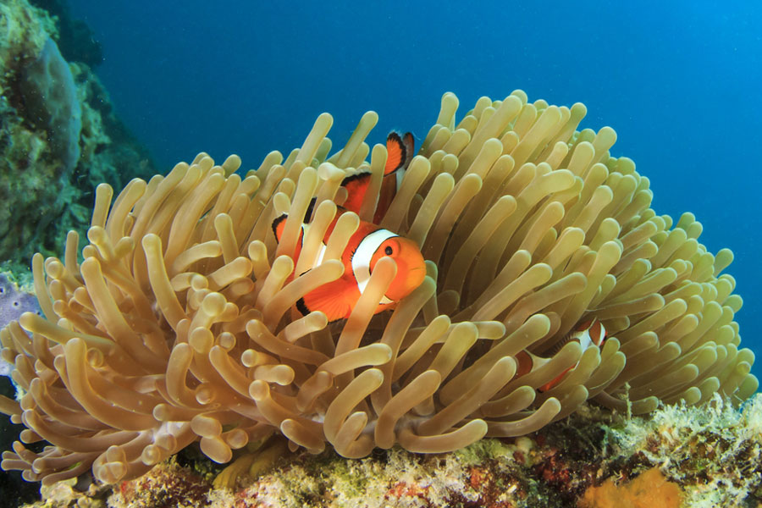
What type of mutualism is more likely to be obligate?
A very specific one
A very generalist one
A facultative one
Sea Anemone & Clownfish
https://www.leisurepro.com/blog/explore-the-blue/5-marine-symbiotic-relationships/

Slide 19
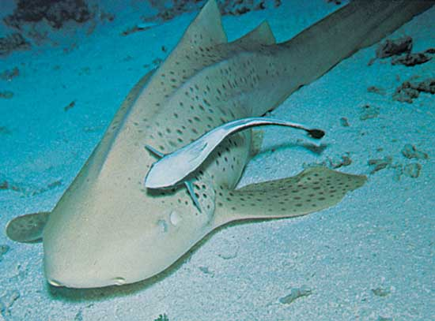
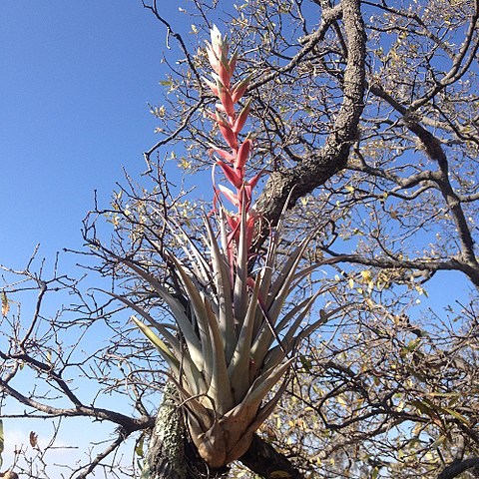
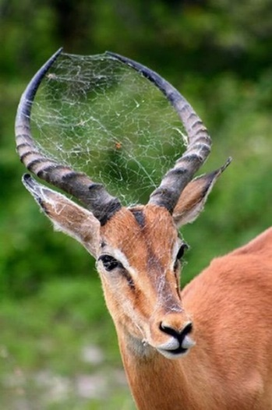
Commensalism
A relationship that is positive in one direction and neutral in the other (+/0)
Nurse Shark & Remora
Epiphytes & Trees
Horns & Spider

Slide 20
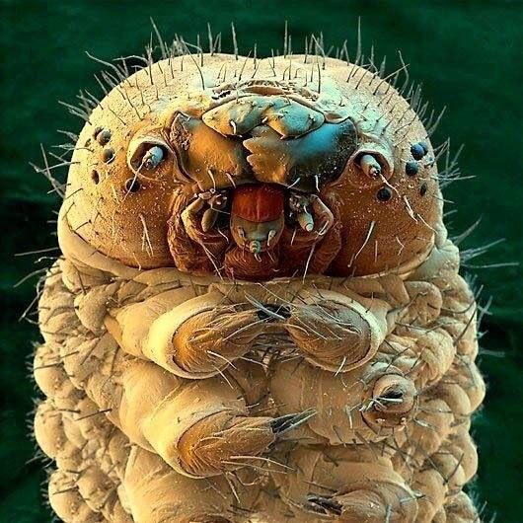
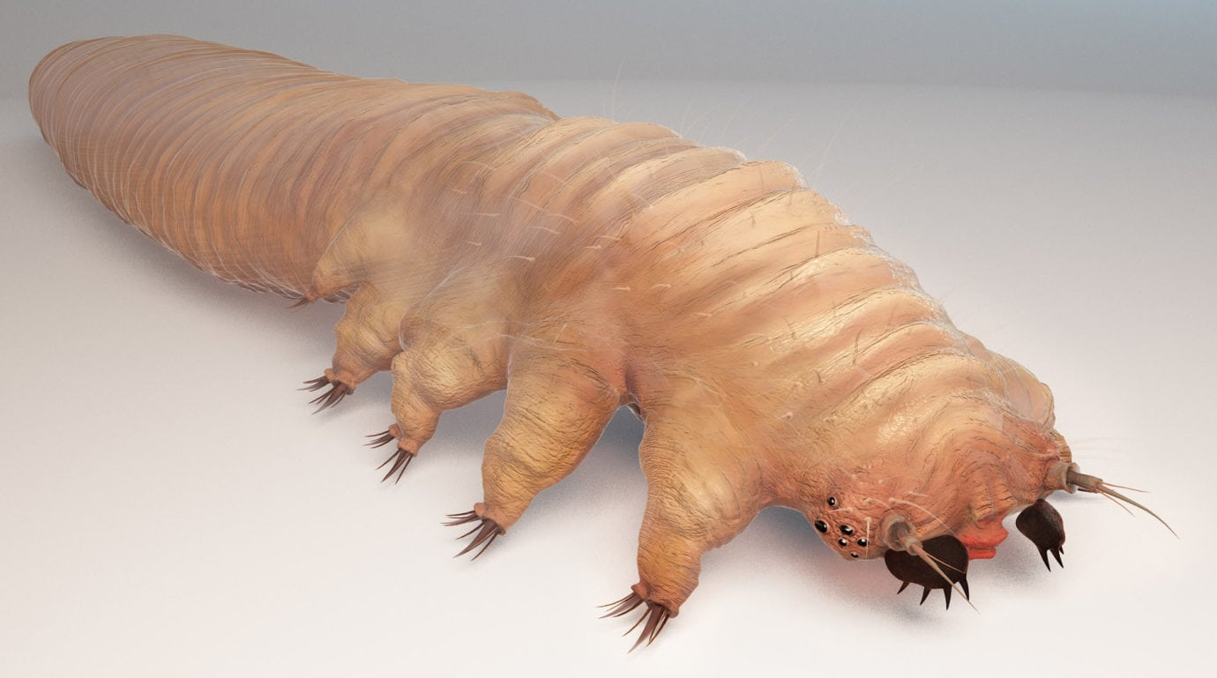
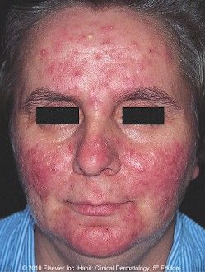
Demodex mites – commensals, parasites, or mutualists?
reddit.com
eyelovecares.org
Two species of Demodex mites inhabit hair follicles in your skin, 1-2 per follicle.
You have 5M hair follicles!
Eats the beneficial oily, waxy substances secreted by your sebaceous glands.
May contribute to +/+ bacterial community that benefits your skin
But can have parasitic (+/-) effects if population grows out of control!

Slide 21
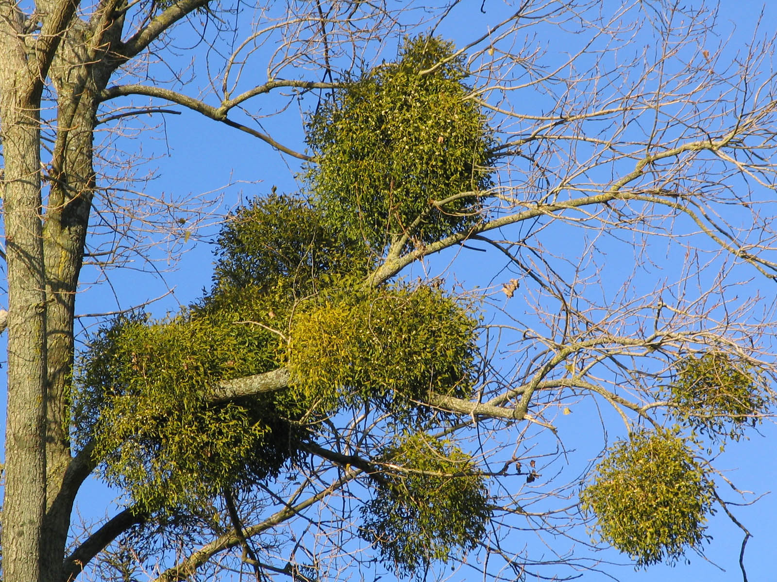

Mistletoe plants obtain water and nutrients from their hosts. This is an example of
Herbivory
Parasitism
Mutualism
Commensalism

Slide 22
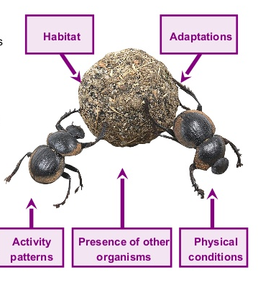
Niches
A niche includes:
Habitat in which the organism lives
Abiotic components
Biotic components
Resources the organism uses
What, when, and how?
Interactions with other organisms
Predators
Prey
Mutualists
Parasites
http://naturalresources.anthro-seminars.net/wp-content/uploads/2016/01/11-ecology-15-638.jpg

Slide 23
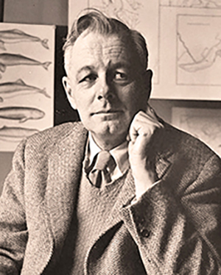
Niches
G Evelyn Hutchinson’s niche concept:
This niche is “an n-dimensional hypervolume in which [a species] can maintain a viable population”
Each dimension represents a required resource or physical gradient that affects survival and reproduction
Niche represents a set of conditions where the species CAN occur. Whether it does depends on… Whether it can get there (dispersal) and interactions with other species
http://www.zo.utexas.edu/courses/bio301/chapters/Chapter13/Chapter13.html

Slide 24
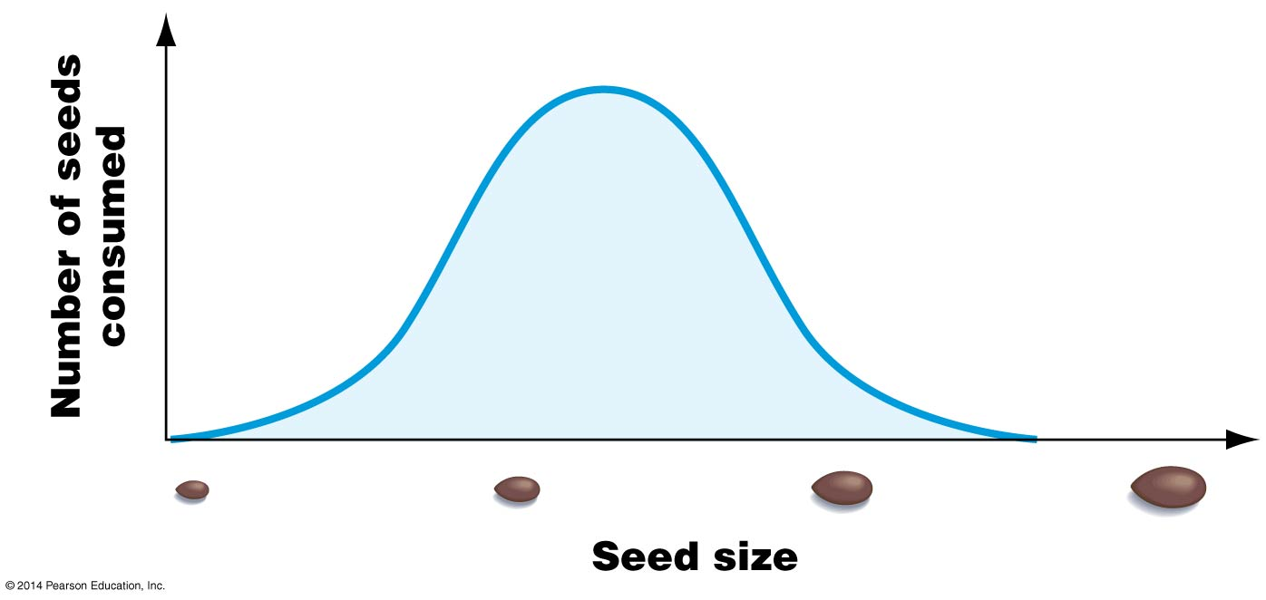
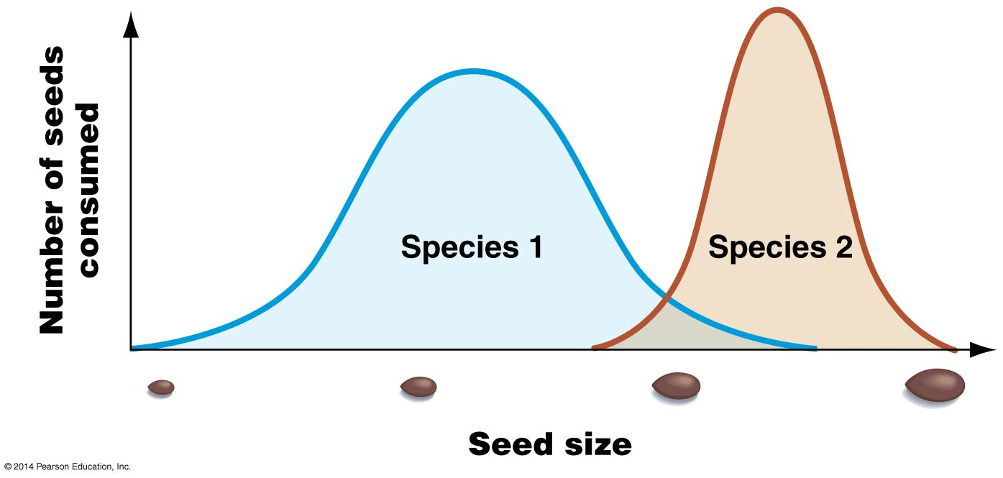
Let’s think about niche one dimension at a time….
Are these species competing for many
seeds of the same size?

Slide 25
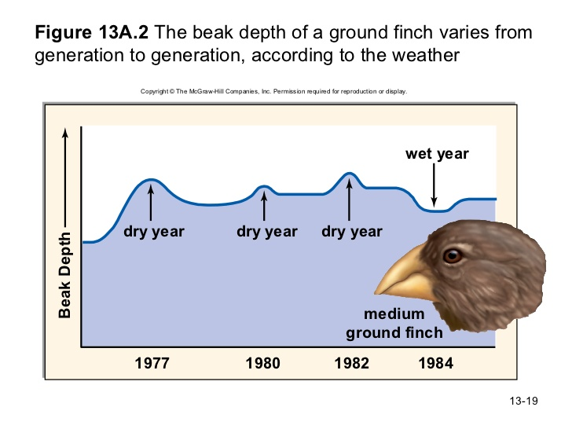
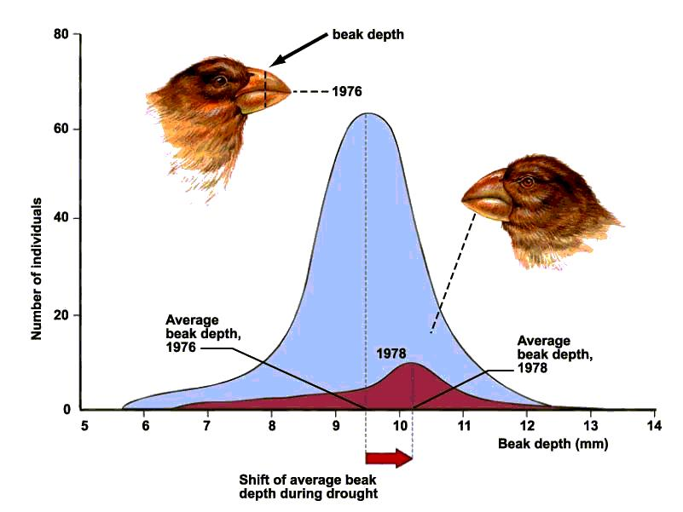
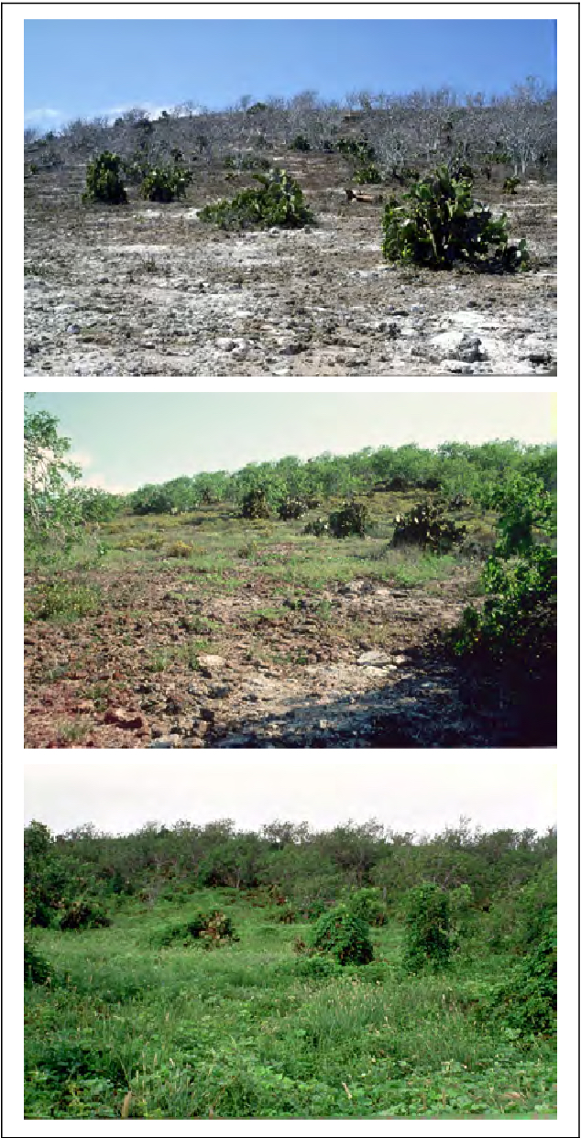
https://www.slideshare.net/wmk423/bio-100-chapter-13
https://moosmosis.org/2016/07/14/natural-selection-in-action-darwins-finches/

Slide 26
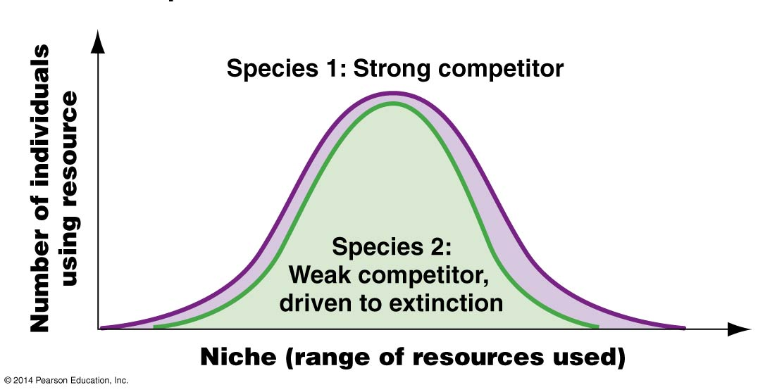
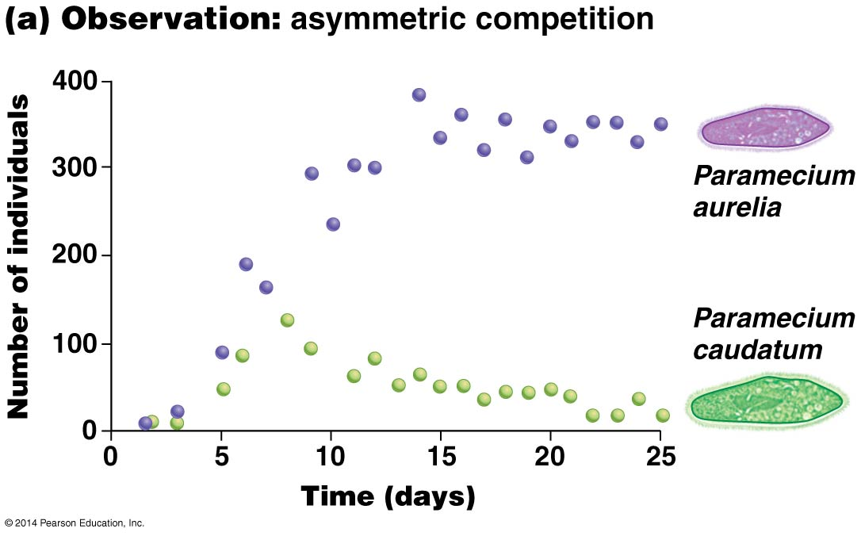
Competitive Exclusion Principle
When two species are limited by the same resource (or same few resources), and one is a better competitor for these resources, that species “wins”
The other species is driven to (local) extinction
If species are very similar in their competitive abilities, both may coexist

Slide 27
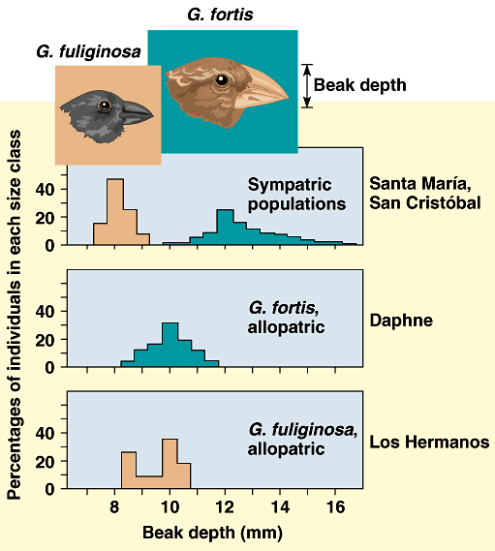
Or species experience character displacement
Sympatric
Allopatric
Allopatric

Slide 28
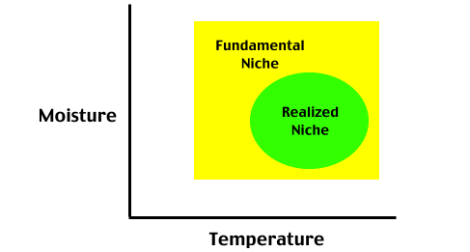
Fundamental vs. realized niche
Fundamental:
Ecological niche in which the organism CAN survive (if it could get there)
Realized:
Part of the fundamental niche where an organism DOES survive
http://www.physicalgeography.net/fundamentals/images/niche.gif
Credit: C. Mulder

Slide 29
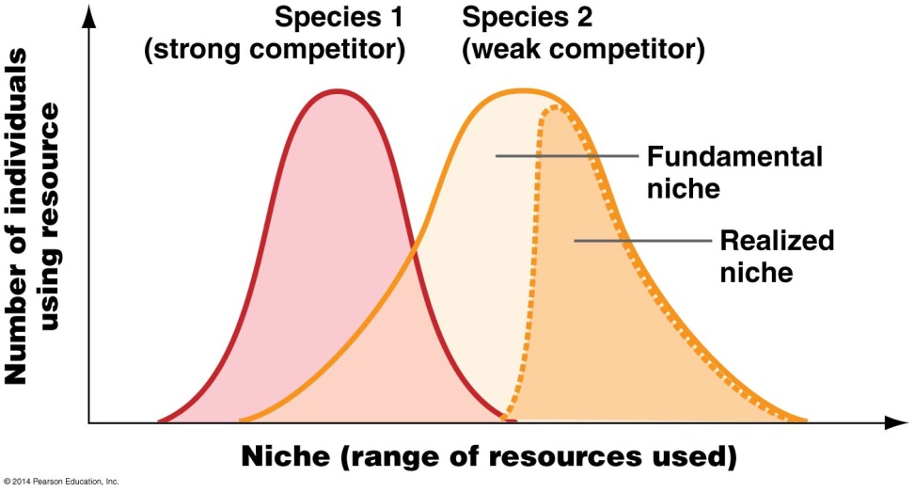
Asymmetric competition & restricted habitat use
When niche overlap is NOT complete, one species may be driven out of part of its range by the other
Credit: C. Mulder

Slide 30
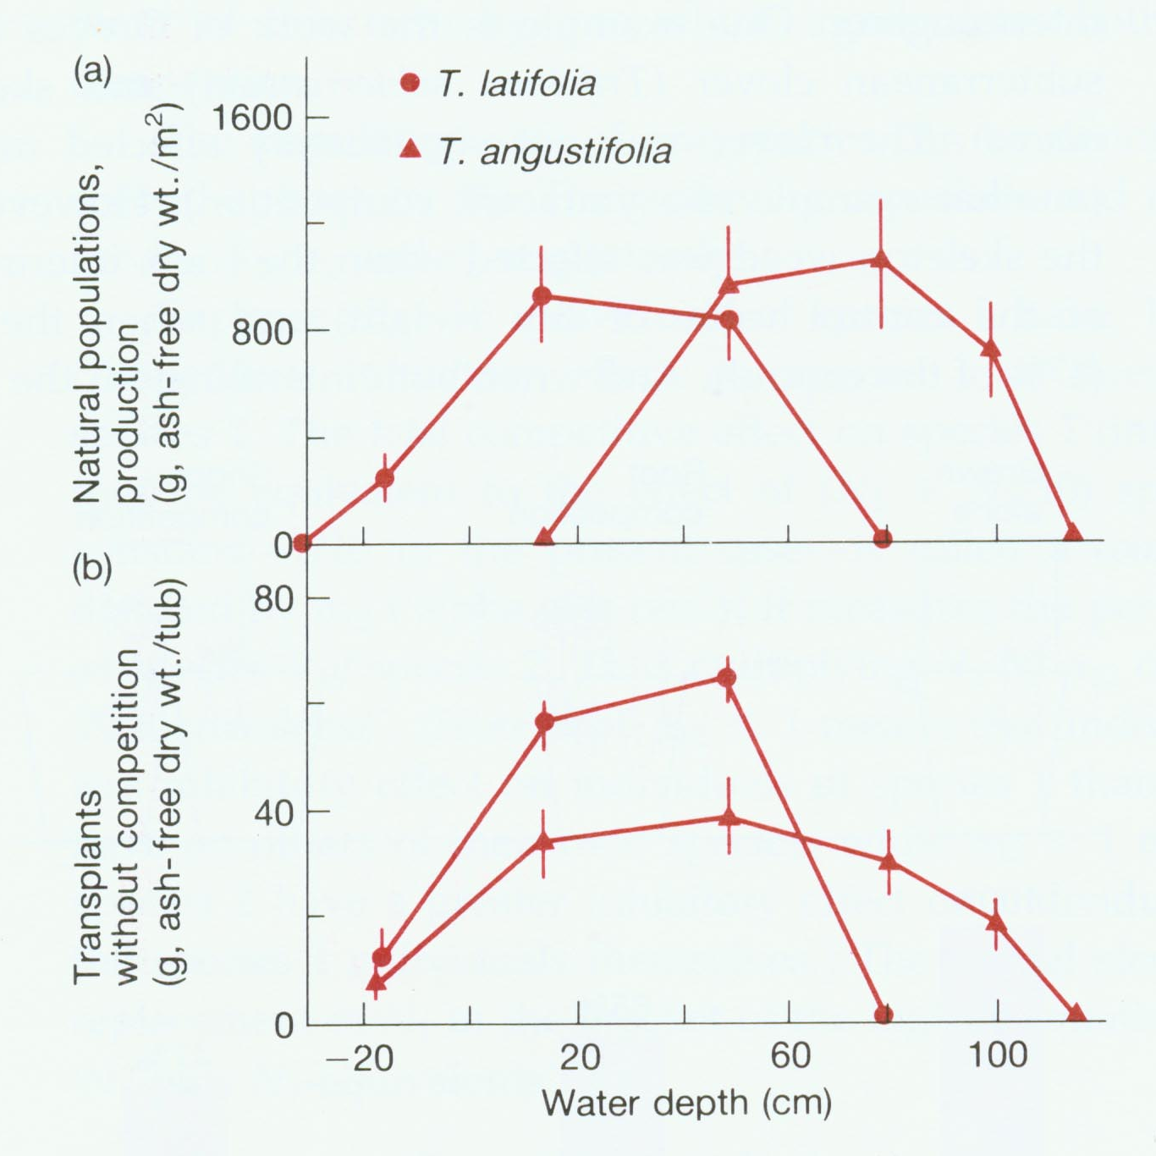
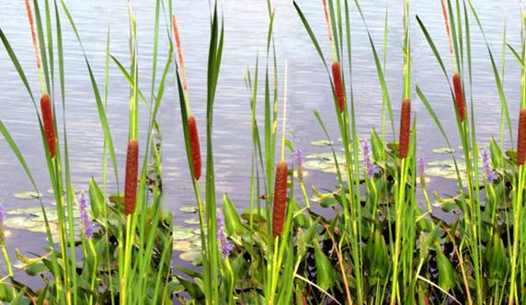
Together
*Less overlap water depth
Separate
*More overlap water depth
Credit: C. Mulder
From Begon et al 1990

Slide 31
Typha angustifolia
Shifts to deeper average water in presence of competitor, by vacating shallower water.
Typha latifolia
Average water depth remains similar. Out performs T. angustifolia in shallow water.
Credit: C. Mulder
From Begon et al 1990

Slide 32
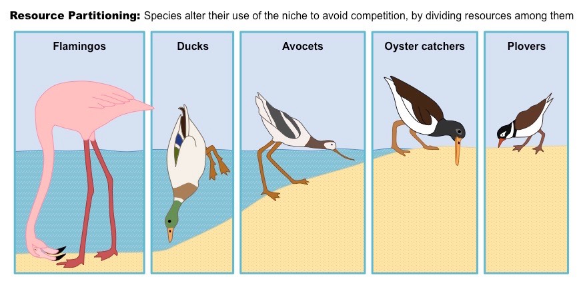
To coexist, niches must differ in some way
Different depths, different distances from land, different access to prey
Small molluscs, crustaceans, vegetable matter
Aquatic plant, seeds, snails, insects
Insects, seeds, small marine invertebrates
Bivalves, worms, crabs
Insects, small invertebrates

Slide 33
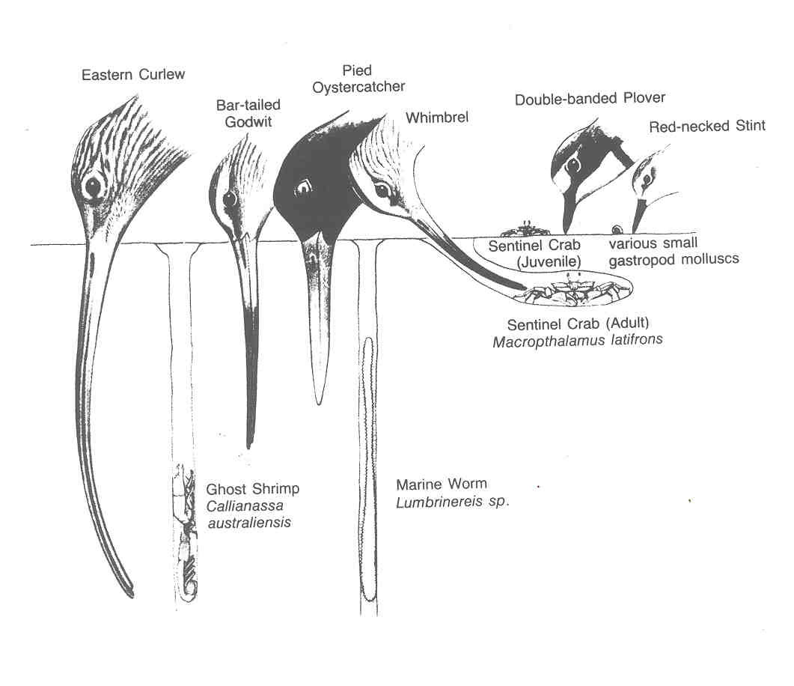
Resource Partitioning in Shorebirds
http://waders.org.au/studying-waders/wader-courses/

Slide 34
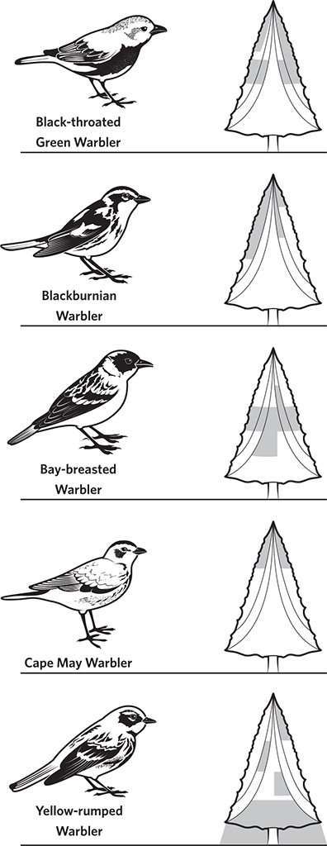
Classic Study of Warblers
by Robert MacArthur
illustrated
Niche Segregation
Different closely-related species forage in different parts of the same tree
https://publicism.info/nature/birds/8.html

Slide 35
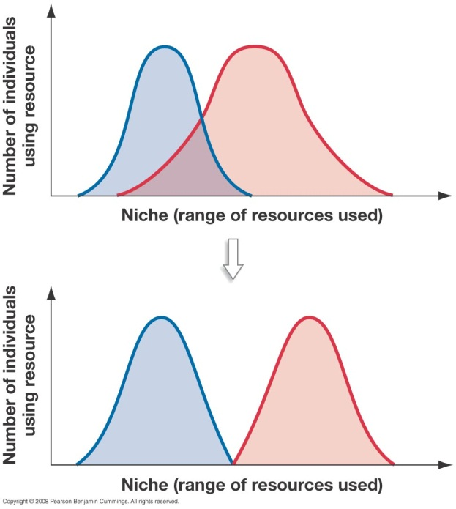
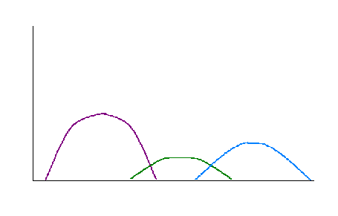
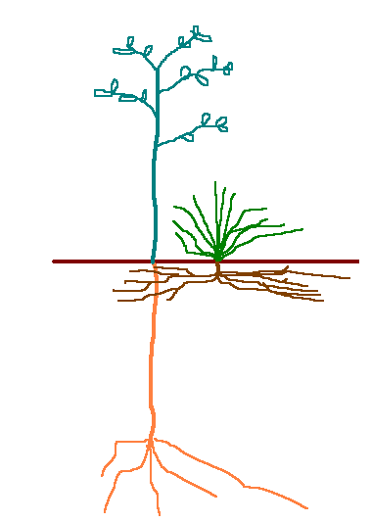
Niche Complementarity: Lots of ways to reduce niche overlap
Niche overlap reduced by:
Use of different physical space
Temporal segregation
Resources utilized
A
B
C
Abundance
Time

Slide 36




Mayfly hatch in Wisconsin
https://www.reddit.com/r/WTF/comments/6o9c6u/the_mayfly_hatch_in_central_wisconsin/
https://gateslodge.com/hatch-chart/

Slide 37


How can you know whether a distribution pattern is due to competition
or to something else?
Chthamalus Barnacles in
upper intertidal zone
Daily exposure to air
Mean tide level
Chthamalus Barnacles in
lower intertidal zone

Slide 38

1st species
2nd species
Remove
2nd species from
½ each rock
Test if survival is dependent on density of 2nd species

Slide 39


Why isn’t there one superspecies that is the dominant competitor everywhere?
Trade-offs!! Species that are good competitors are often bad at other things
Being a good competitor usually involves:
Fast growth
Large adult size
Species that grow fast and are large
Often require more food = do not perform well when resources are in short supply
Invest less in defenses – may be more vulnerable to herbivores/predators
May have to be active during a larger part of the day to obtain resources and may be more vulnerable to predators
Melicytis ramiflorus: thin leaves, fast growth, little investment in defense, lots of herbivore damage
Corynocarpus laevigatus: thicker leaves, slower growth, more investment in defense, low herbivore damage

Slide 40


Resource gradients tend to drive gradients in competitive ability & stress tolerance
Warm, dry soils on south-facing slopes with HIGH nutrient availability favor fast-growing:
White Spruce
Wet, cold soils on north-facing slopes with LOW nutrient availability & permafrost favor slow-growing: Black Spruce
High
Low
Black spruce is kept out by competition w/white spruce
White spruce is kept out by inability to grow under poor conditions

Slide 41


Niche specialization MacArthur’s Warblers

Slide 42


Three possible explanations
Current competition: species restrict each other to narrow realized niches, but each species would expand to wider fundamental niches in absence of competitors
Past competition: natural selection favored species with reduced interspecific competition, leading to niche differentiation
Nothing to do with competition; these species simply responded to natural selection in different and independent ways
How can you tell these three apart?
Ghost of Competition Past

Slide 43
Two approaches to determining whether competition is or has occurred:
Experimental approach:
Manipulate putative competitors (i.e., removal or addition)
Directly assess responses of putative competitor (survival, fecundity, resource use)
Compare with…
Situation prior to experiment OR
Control plot without experimentation
“Natural” experiments:
Compare populations in habitats where species coexist with those where one or more are absent for reasons unrelated to competition (e.g., lack of dispersal)
Advantages: no artificial constraints, long-term results
Disadvantage: need to be certain that the only difference between the habitats is the absence of a competitor, NOT other variables

Slide 44

Common Garden Experiment
A fully reciprocal experiment would establish a common garden at both sites, at the lake and on the mountain.
Very powerful approach!

Slide 45
Experiments: Advantages and Disadvantages
Advantages:
Provide strong inferences about whether competition is responsible
Can give insights into mechanisms
Disadvantages:
May be difficult to manipulate individuals
Individuals may have poor survival outside the native environment.
Slow responses / high interannual variation
It may be difficult to match control and treatment in the field
Lab experiments may not represent the niche axes that matter
“Ghost of competition past” may not be detected (e.g., if weak competitors went extinct)

Slide 46

Examples of natural experiments
Floods
Hurricanes
Changes in ocean temperature & acidity
Invasive species
Extinctions
Etc.
http://www.geoconservationuk.org.uk/esos/wiki2018/index.php?title=SNA/BT

Slide 47
Conclusions
Competitive interactions are common and often structure plant and animal communities
However, detecting whether a particular pattern is the result of competitive exclusion or of competitive niche displacement is often difficult
Experimental approaches can helpful in answering this question, but some effects are very difficult to detect with experiments

