Slide 1
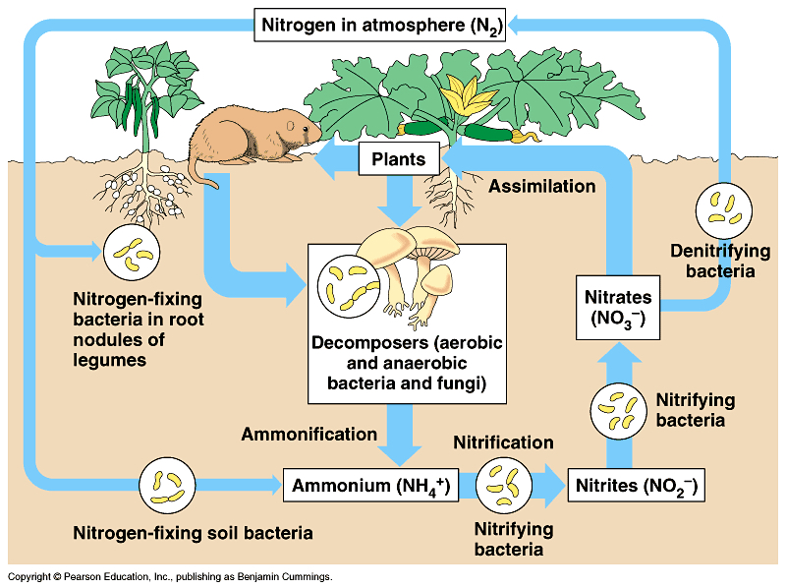
Ecosystem Ecology:
Study of interactions between living (biotic) and non-living (abiotic) components of the ecosystem
Example:
Nitrogen Cycle
Notes:
Add pictures

Slide 2
Important dates:
Last day of class & workshop – Today
Exam 4 will be a timed multiple choice to be taken within a 4-day window 3-6 May (& due Wed 6 May---instructions provided by email).
Thank you for taking this class! I wish you the best in all endeavors. I hope to see again.
Notes:
Add slide with clicker questions for timing of review session

Slide 3
Ecosystem Ecology
Ecosystem: A biological community (or multiple communities) along with their chemical and physical environments
Ecosystem ecology focuses on pools of resources (how much is in a compartment) and fluxes (how much moves between compartments) of energy, water, carbon, nutrients, and other abiotic components (elements and simple compounds).
There is greater movement of these resources within than between ecosystems

Slide 4
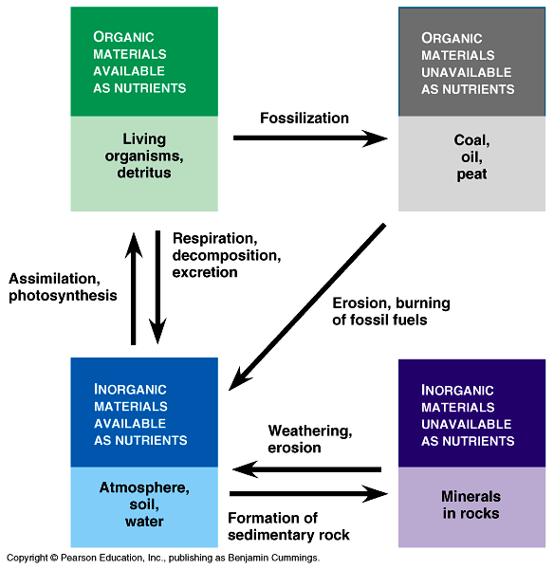

Slide 5
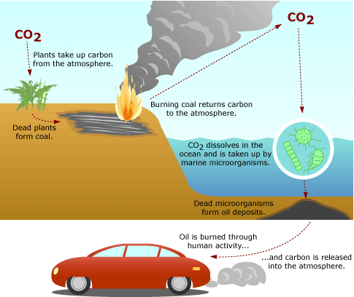
The carbon used to drive your car, where has it moved from and where will it go?
https://evolution.berkeley.edu/evolibrary/article/side_0_0/carbonatom_01

Slide 6
Combustion of gasoline:
C₈H₁₈ + 12.5 O₂ → 8 CO₂ + 9 H₂O
44,400 Joules for every gram of C₈H₁₈
4,600 kg CO₂ per 2,000 liters

Slide 7
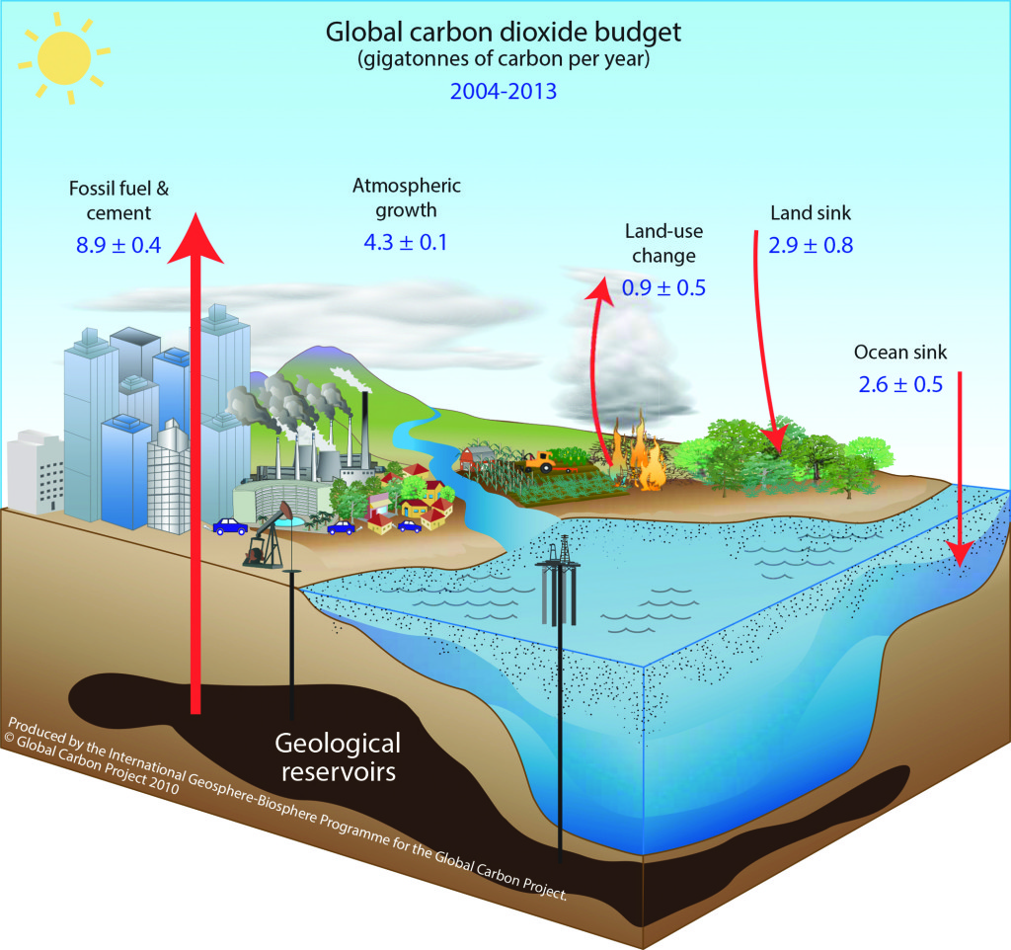
Global carbon cycle refers to exchanges of carbon within/between four major reservoirs:
Atmosphere
Oceans
Land
Fossil fuels
https://whrc.org/project/global-carbon/

Slide 8
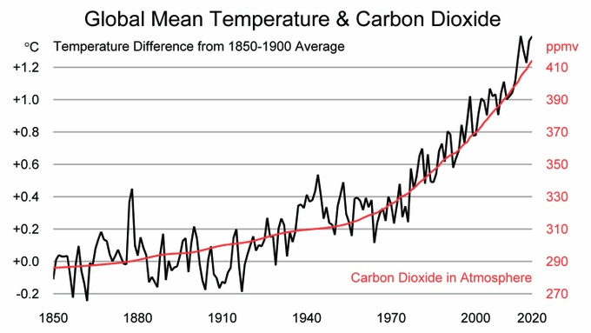

Slide 9
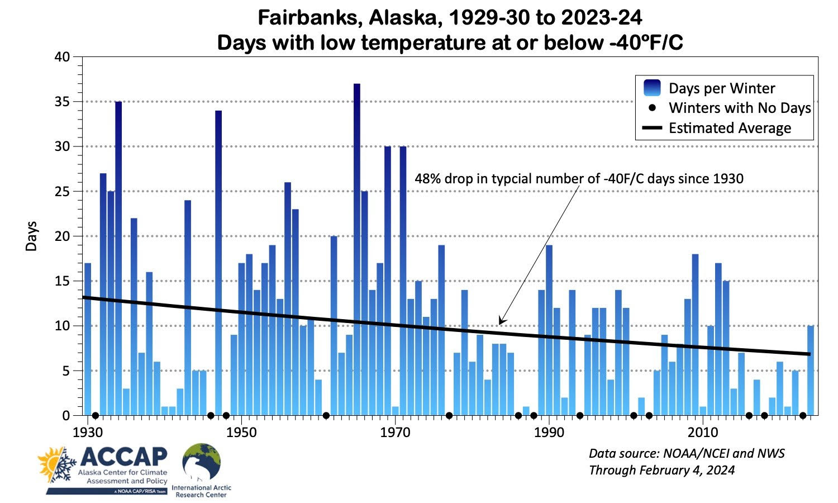

Slide 10
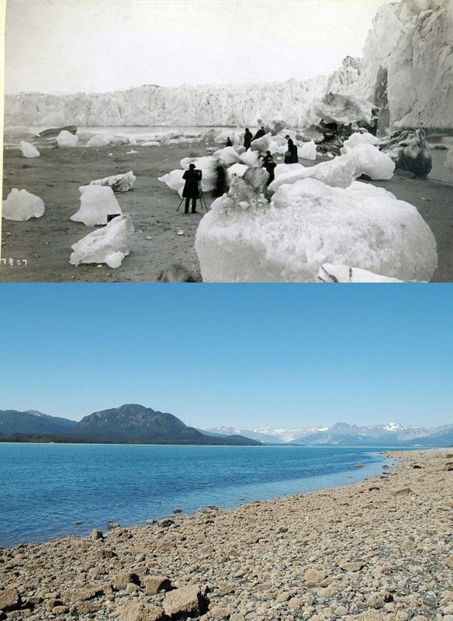
Muir Glacier
1880s vs 2005
https://petapixel.com/2015/10/25/these-before-and-after-photos-show-how-glaciers-in-the-us-are-melting/

Slide 11
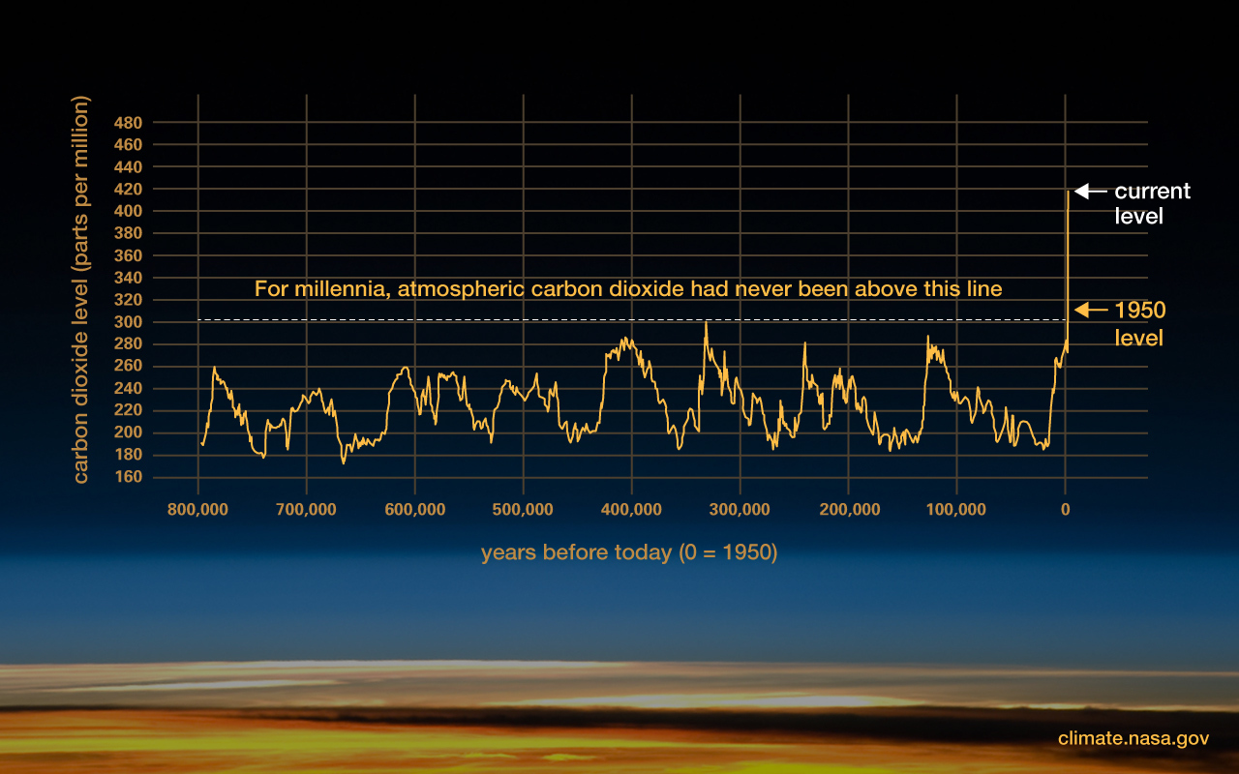

Slide 12

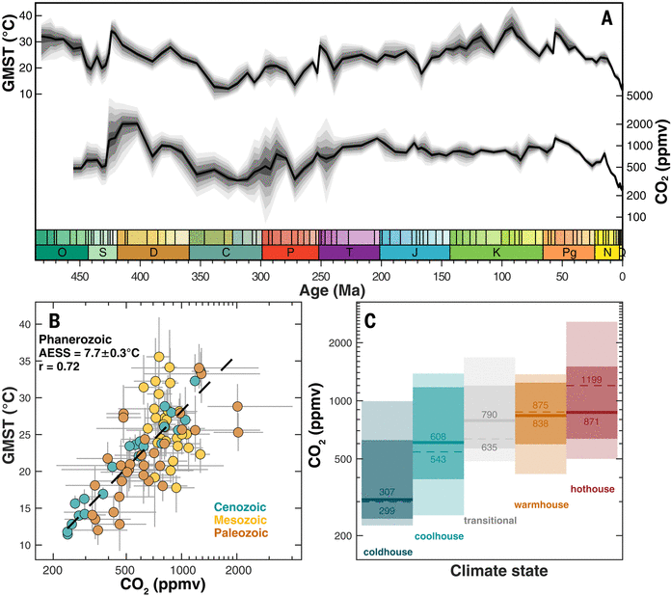
GMST and CO₂ are closely matched for 485 million years.
Humans evolved in a cool period.
More time has spent warm than cold.
A 485-million-year history of Earth’s surface temperature, Volume: 385, Issue: 6715, DOI: (10.1126/science.adk3705)

Slide 13
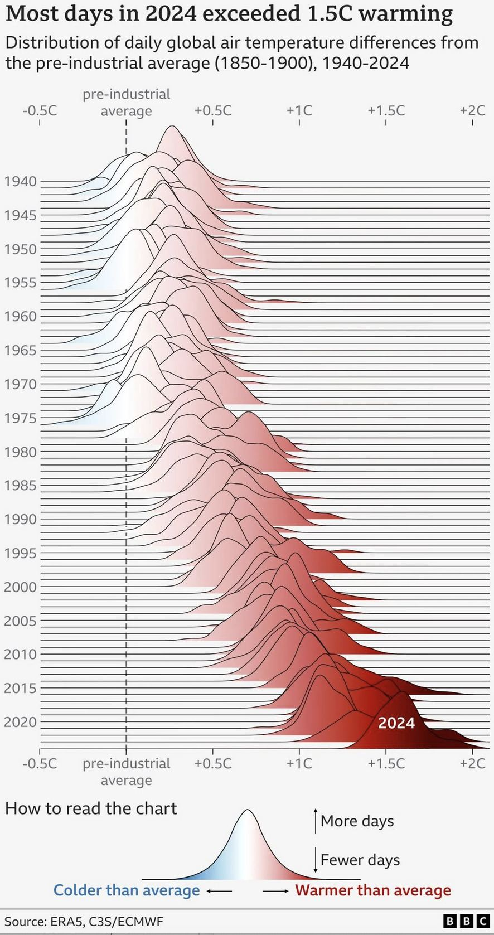

Slide 14
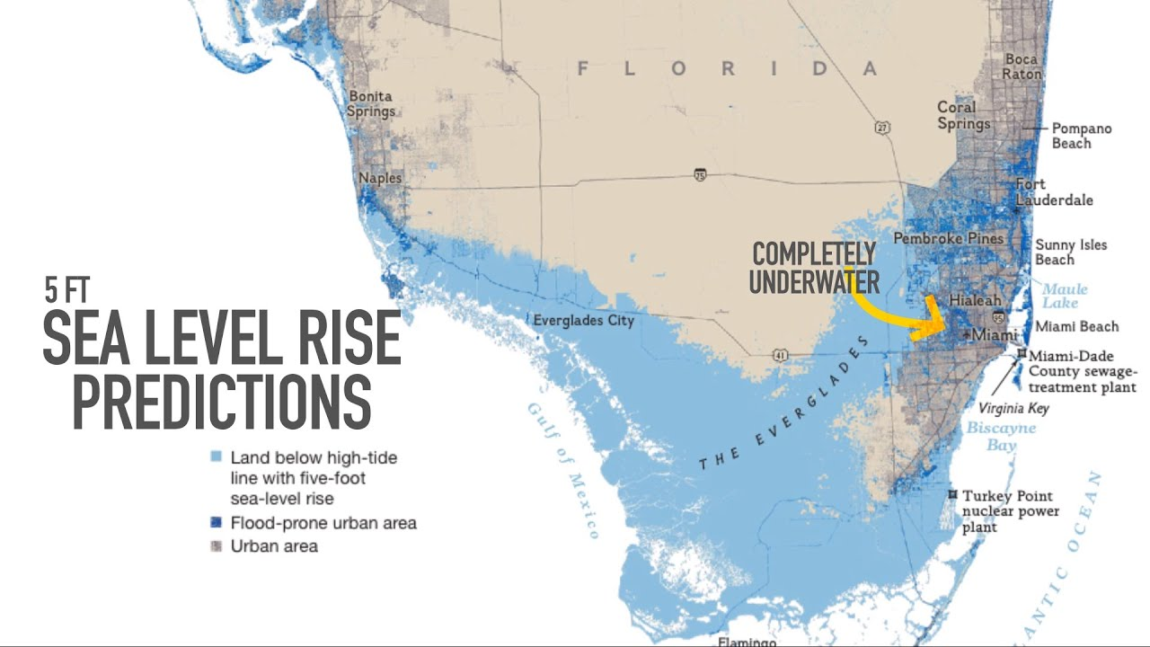
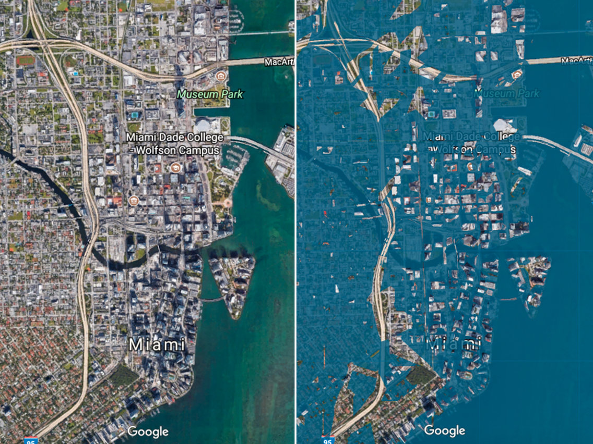
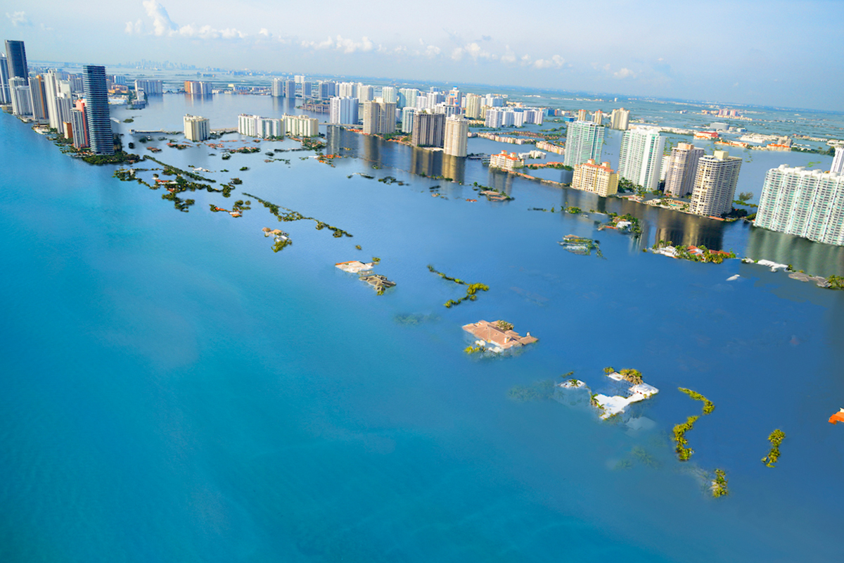

Slide 15


Slide 16
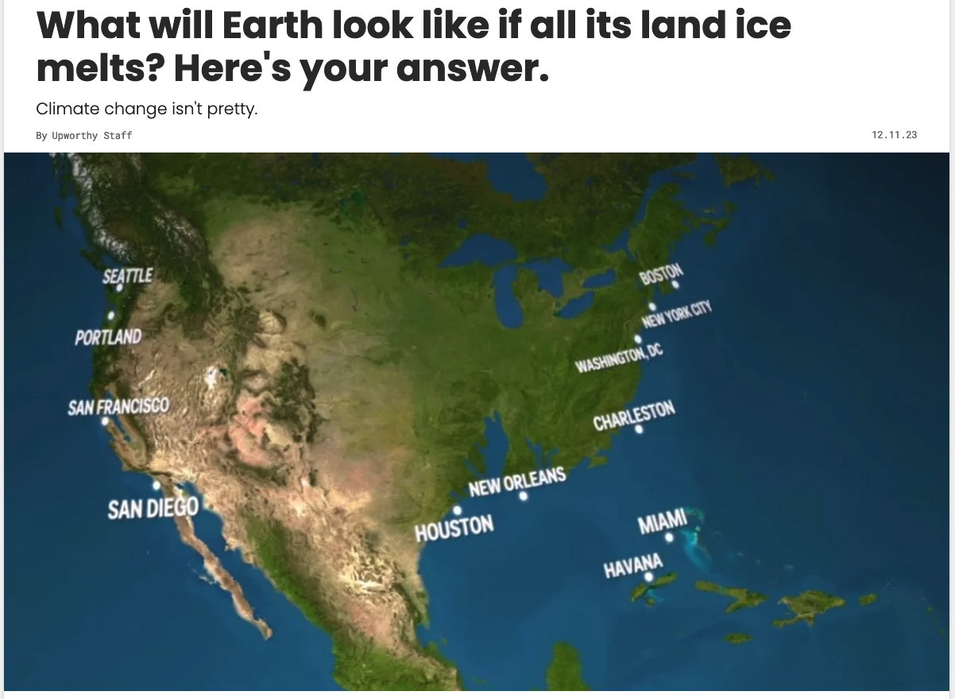
https://www.upworthy.com/what-earth-looks-like-if-all-ice-melts-rp4

Slide 17
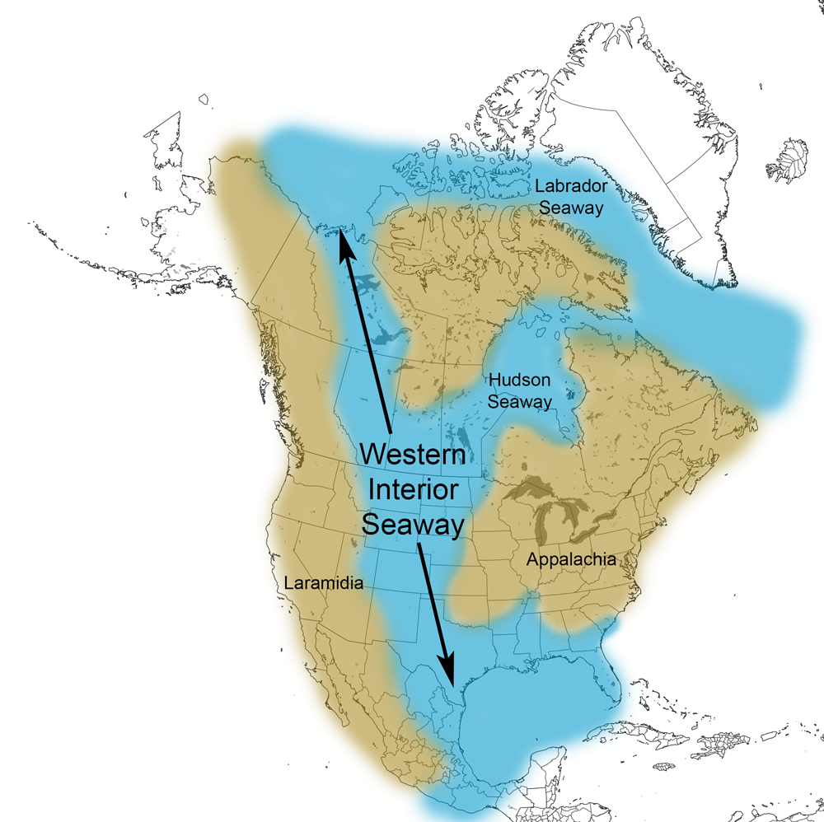
https://www.cretaceousatlas.org/geology/

Slide 18
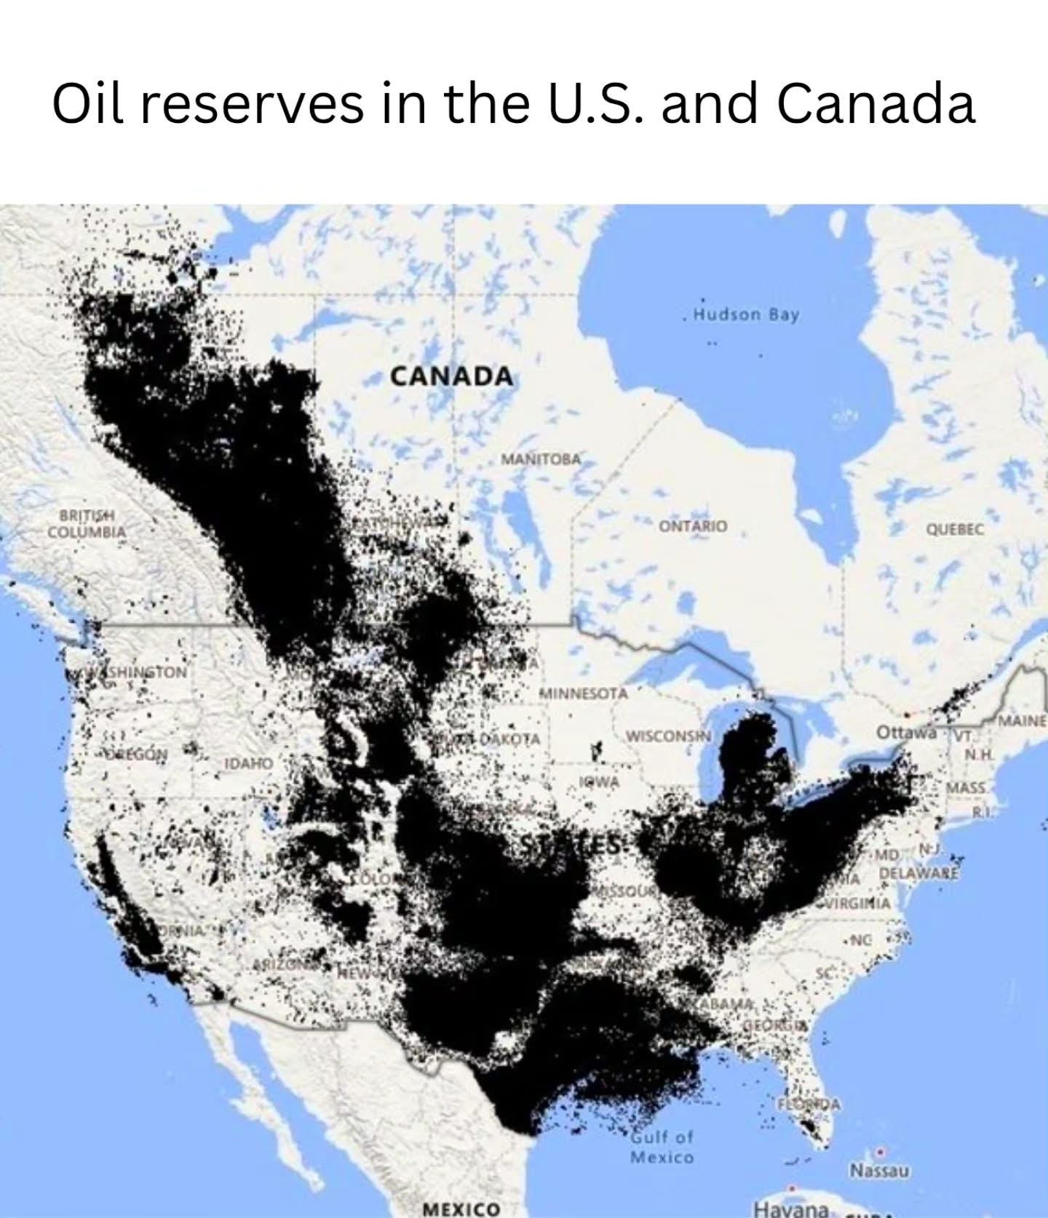

Slide 19
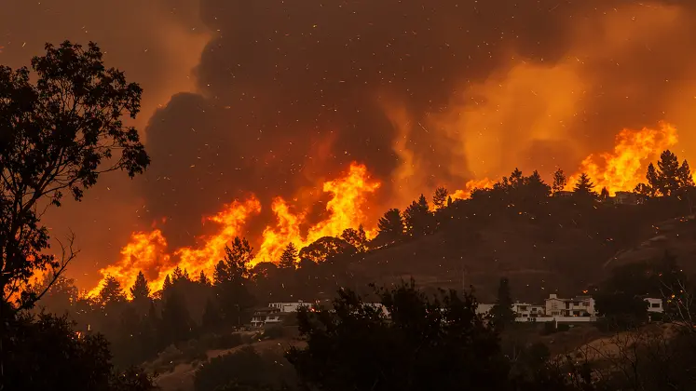
https://unu.edu/inweh/news/january-2025-los-angeles-wildfires-wake-call-once-generation-events-become-frequent

Slide 20
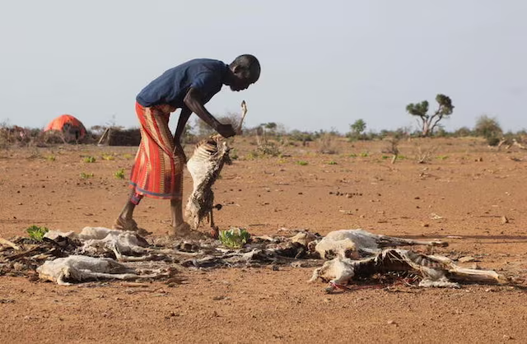
https://www.reuters.com/world/africa/countries-step-up-try-avert-famine-horn-africa-2022-09-21/

Slide 21
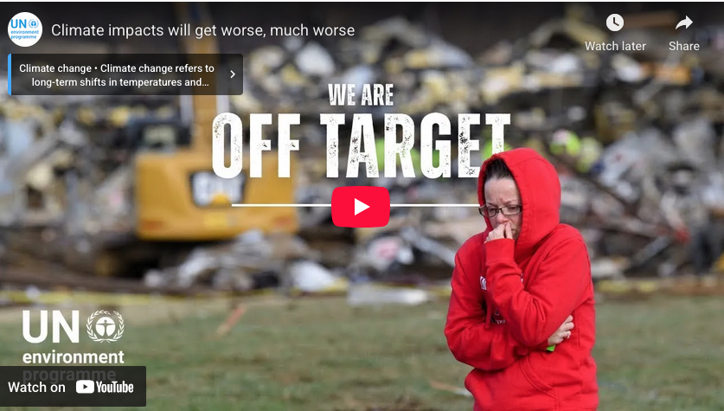
https://www.unep.org/news-and-stories/story/world-likely-exceed-key-global-warming-target-soon-now-what
1.5C has been exceeded
2.0C predicted by 2039
5.0C predicted by 2078

Slide 22

Predicted effects of 2.0
Twice the number of people exposed to dangerous heat every five years.
Tenfold increase in the frequency of Arctic summers with no sea ice.
Projected loss of 99% of coral reefs.
Greater increases in heat-related deaths and the expansion of tropical-insect borne diseases like malaria and dengue fever.
Decreases in key crops, such as wheat and corn.
5.0C will be catastrophic.

Slide 23
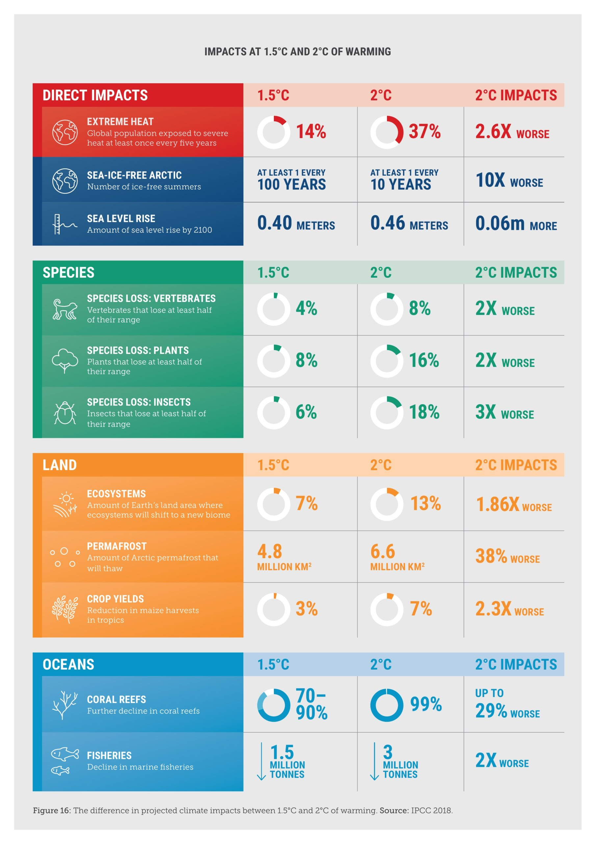

Slide 24
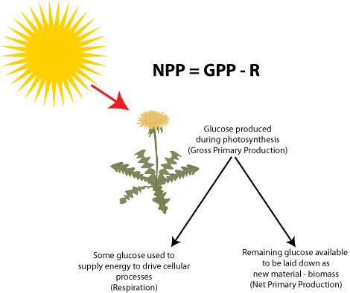
Net primary productivity (NPP)
Photosynthetic organisms (plants, algae, cyanobacteria, also known as primary producers) do two things during photosynthesis:
  Take energy from sunlight and store it in short-term bonds
  Take carbon from the air (CO₂) and, using energy produced in the previous step, combine it into organic compounds, in the process storing energy in long-term carbon bonds.
http://sciencebitz.com/

Slide 25
Net primary productivity (NPP)
NPP = amount of energy made available by primary producers to everything else: the total amount of carbon fixed minus the amount used in respiration during maintenance.
It is usually measured as carbon or dry mass in terrestrial plants, as chlorophyll concentrations in aquatic samples.
http://sciencebitz.com/

Slide 26
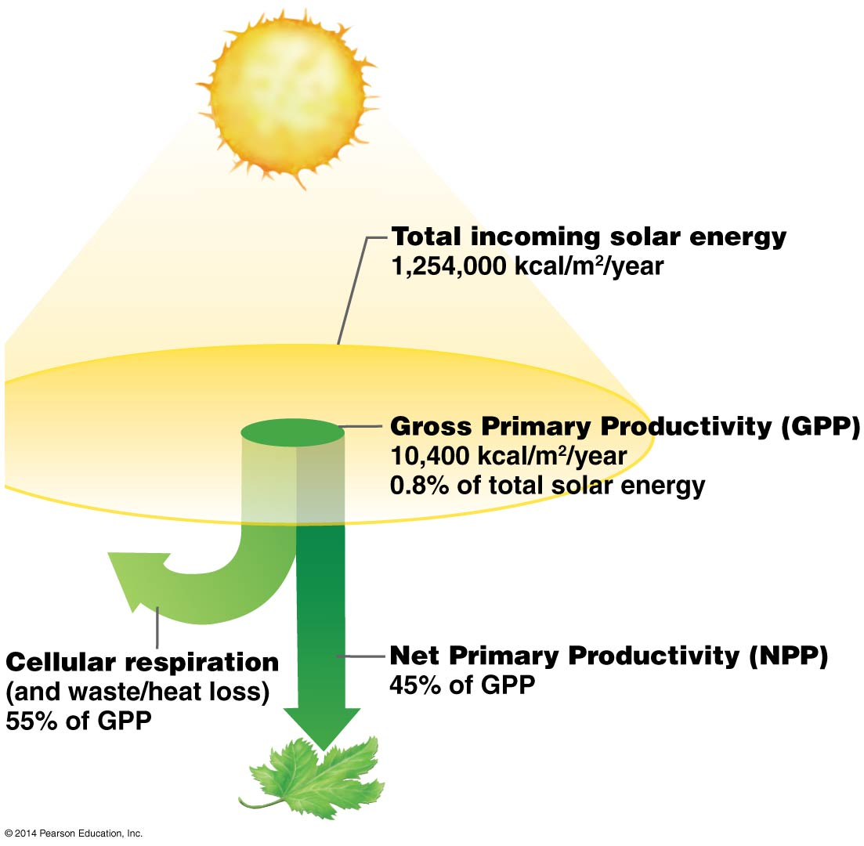
How much energy can plants get from the sun?

Slide 27
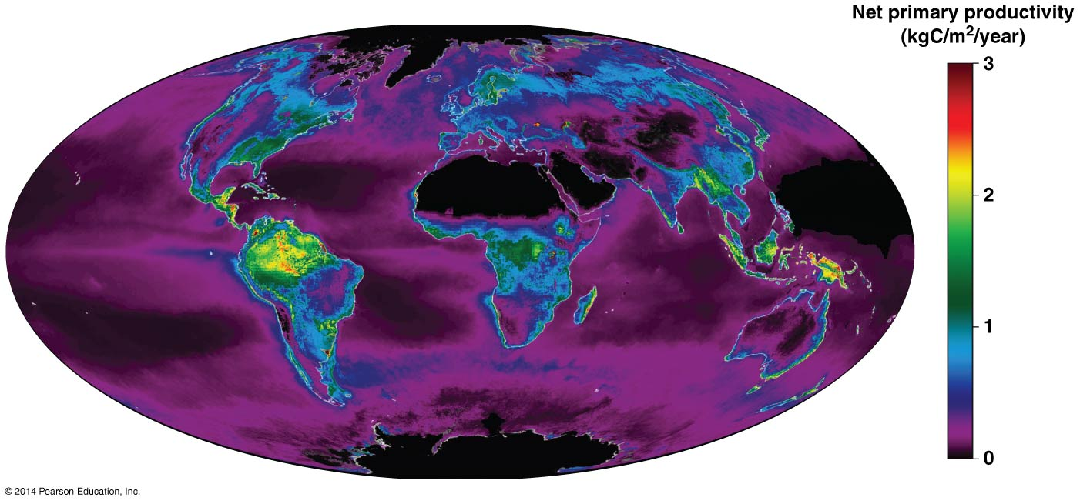
Productivity varies enormously across the globe

Slide 28
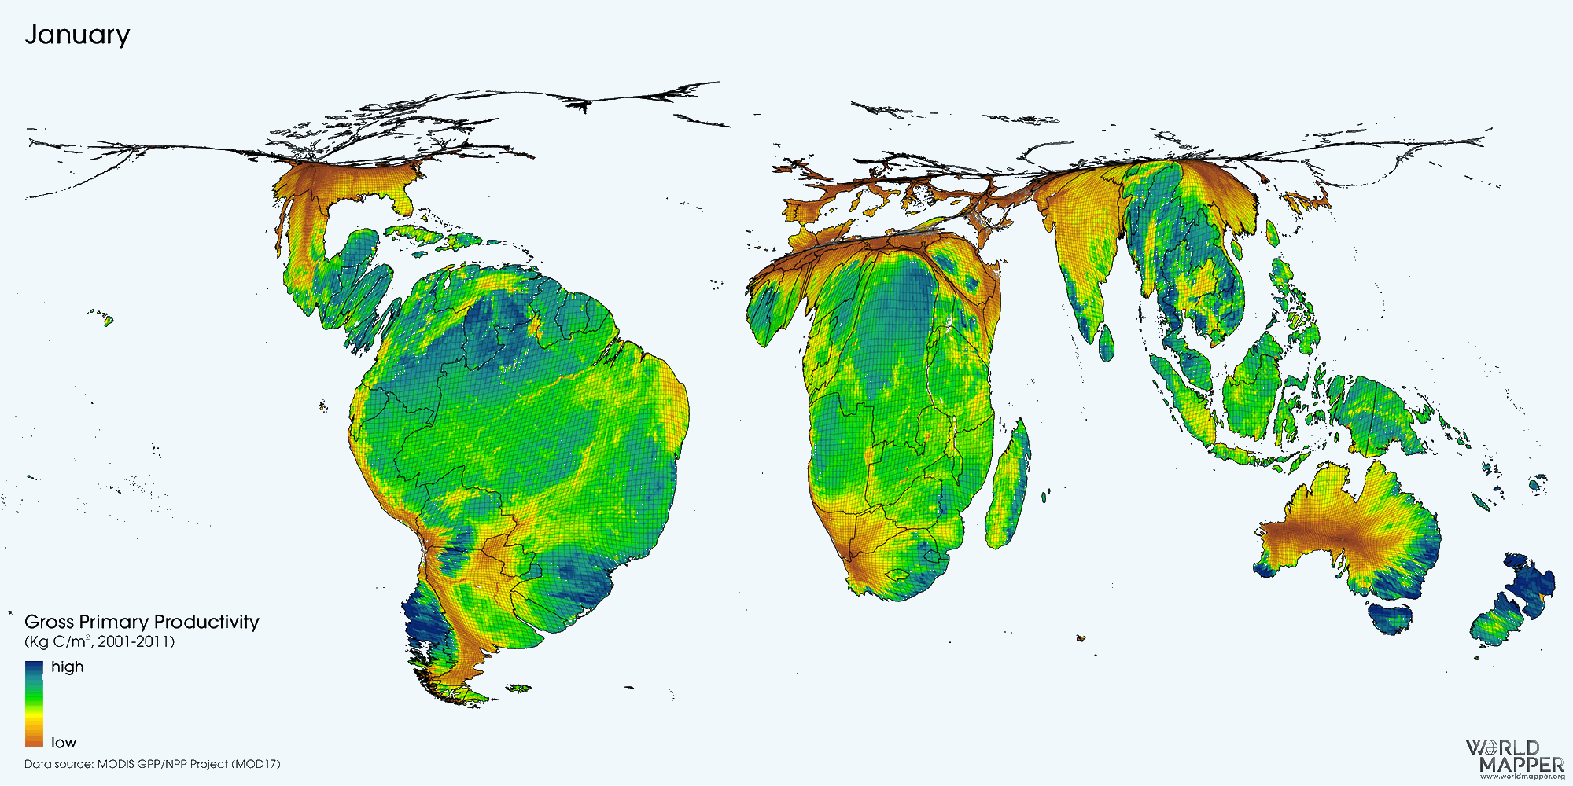
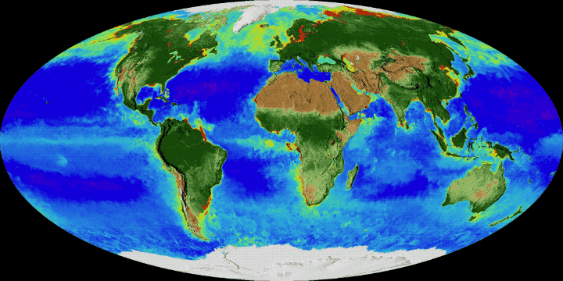

Slide 29
What usually determines primary productivity in terrestrial systems?
Temperature
Water
Nutrient
Temperature and water
Water and nutrients

Slide 30
What usually determines primary productivity in aquatics systems?
Temperature
Nutrients
Salinity
Temperature and nutrients

Slide 31
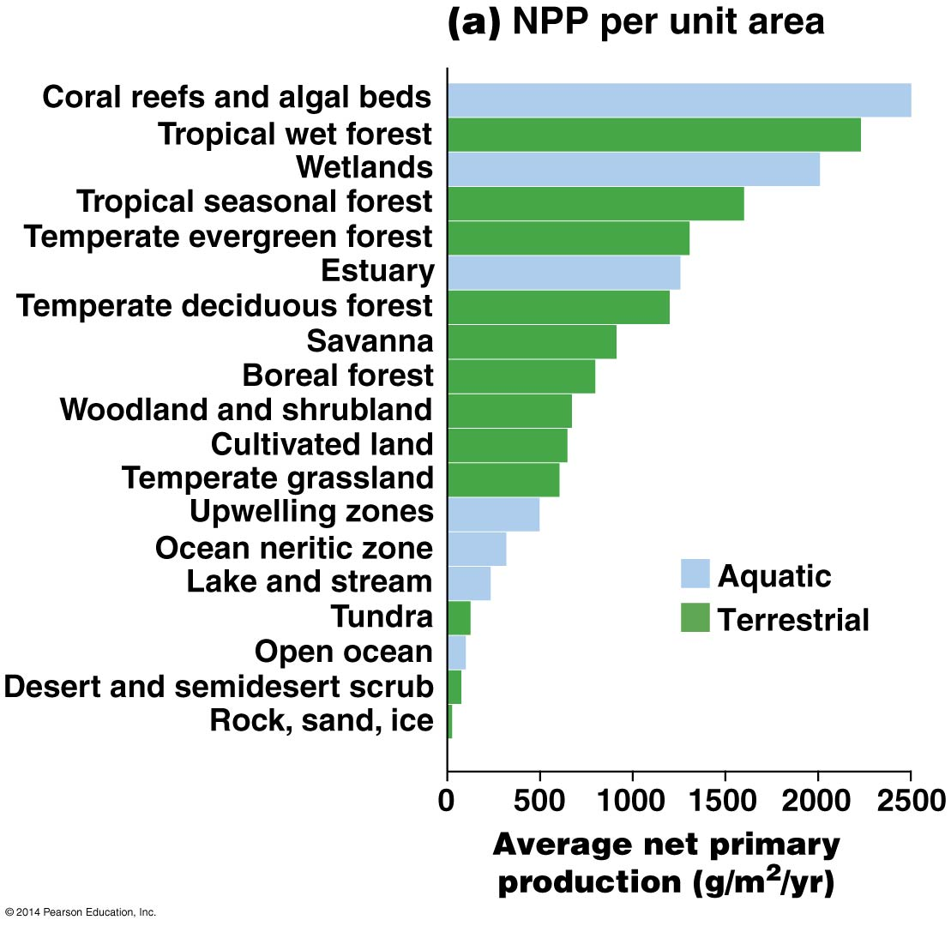

Slide 32
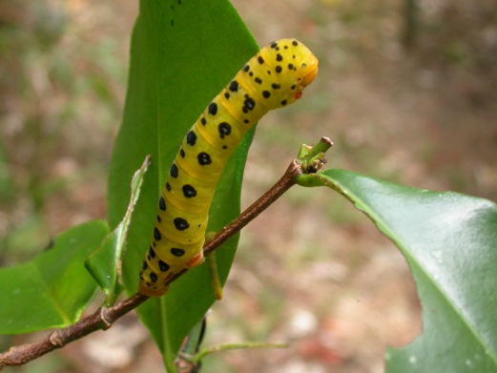
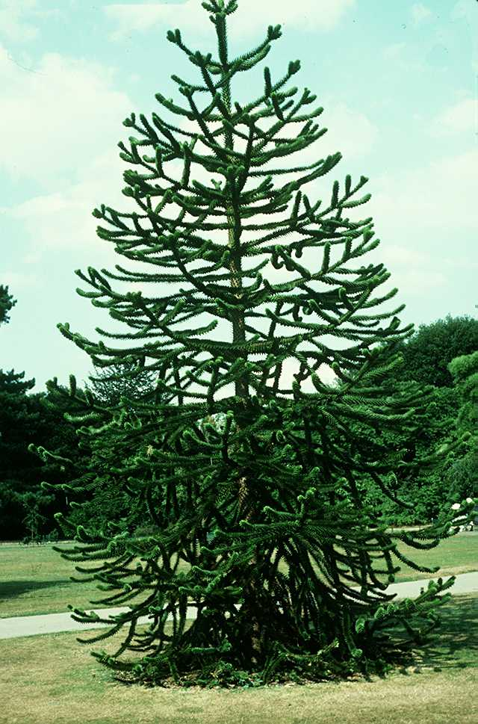
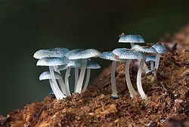
What happens to energy (organic compounds) after it enters the ecosystem?
Herbivores
CO₂
5-15%
Photo: A. Moles
85-95%
Detritivores Decomposers: bacteria, archaea, fungi
Respiration
Photo: Wisconsin teaching collection
http://en.wikipedia.org/wiki/Detritivore

Slide 33


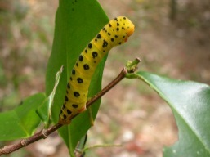
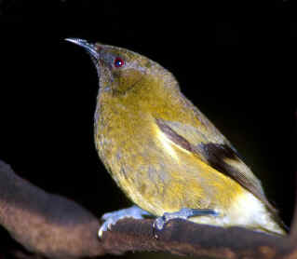
What happens to energy (organic compounds) after it enters the ecosystem?
CO₂
Photo: Wisconsin teaching collection
3º consumers
5-15%
85-95%
5-15%
5-15%
85-95%
Herbivores
2º consumers
Detritivores and respiration
85-95%

Slide 34
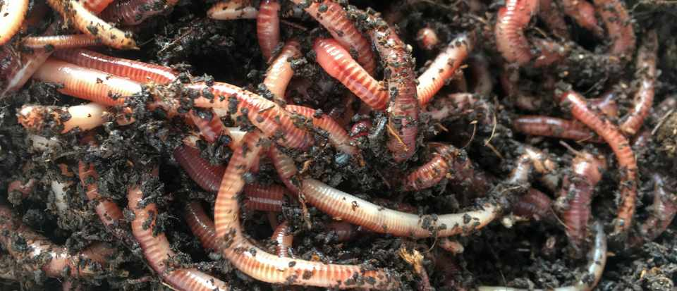
What happens to energy (organic compounds) after it enters the ecosystem?
Only 5-15% is transferred to herbivores or other consumers
85-95% always goes to the detritivores

Slide 35
Assume 15% of energy is transferred between trophic levels. If start with 100% at level 1 (primary productivity), what % will be transferred to level 4?
(15)⁴
1/(15)⁴
0.15+0.15+0.15+0.15
(0.15)⁴ * 100

Slide 36
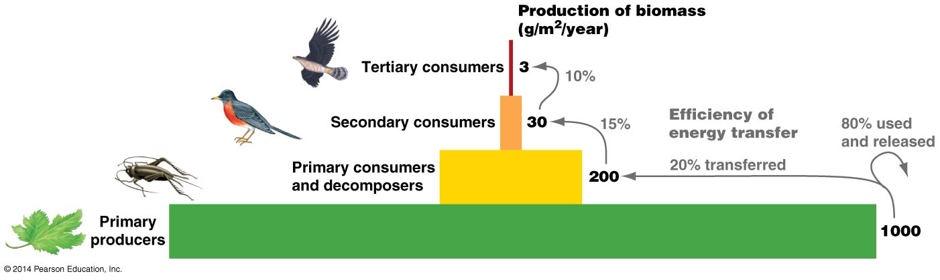
How much energy is lost between trophic levels?
0.3% is available to tertiary consumers

Slide 37
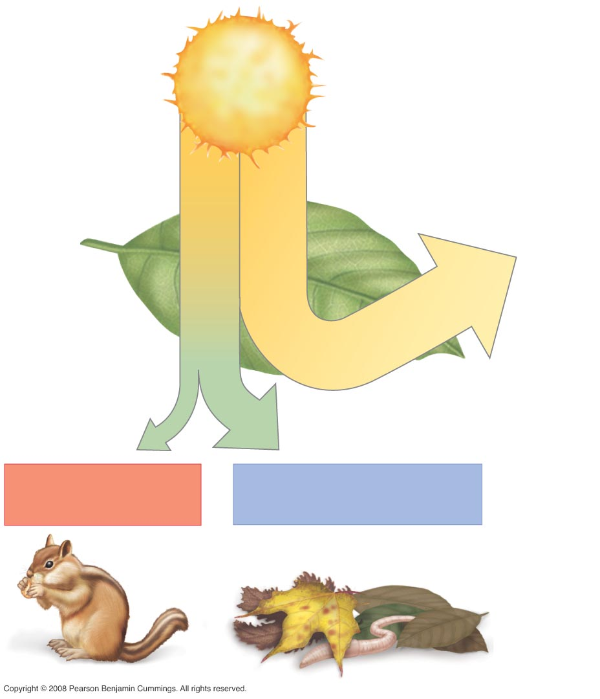
Figure 54-8
Much of the light that arrives can’t be used
All organisms use energy to keep themselves alive; all organisms lose carbon through respiration. This energy is NOT available to the next level.
Some of what is produced (growth/reproduction) is NOT available to the next level (indigestible, well-defended) → detritivores
Some of what is consumed is not assimilated → detritivores
Energy source:
1,254,000
kcal/m²/year
0.8% energy
captured by
photosynthesis.
Of this…
… 55% is lost to
maintenance activities
or as heat
… 45% supports (NPP)
…11% enters
consumer food web
… 34% enters decomposer
food web as dead material

Slide 38
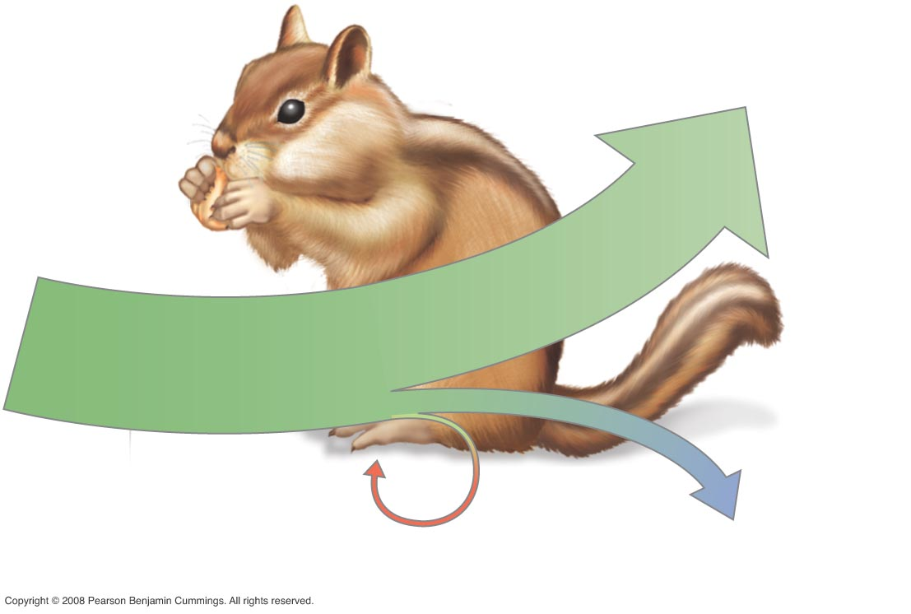
Figure 54-9
80.7% maintenance activities
Energy derived
from plants
1.6% growth and
reproduction
17.7% excretion

Slide 39
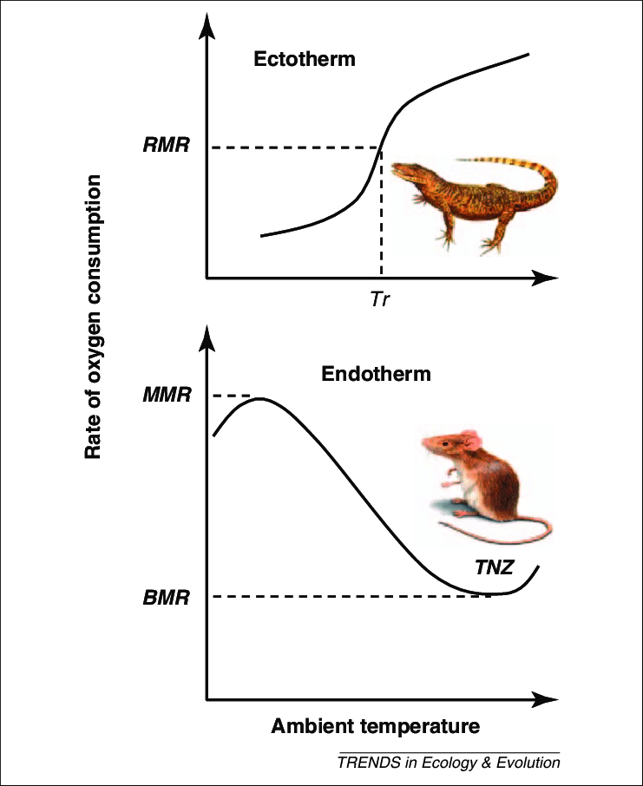
On average, which will have the higher energy efficiency (energy to growth and reproduction/energy taken in)?
Endotherms (“warm-blooded” animals)
Ectotherms (“cold-blooded” animals)
The same amount of food can usually maintain a larger population of similar-sized ectotherms.

Slide 40
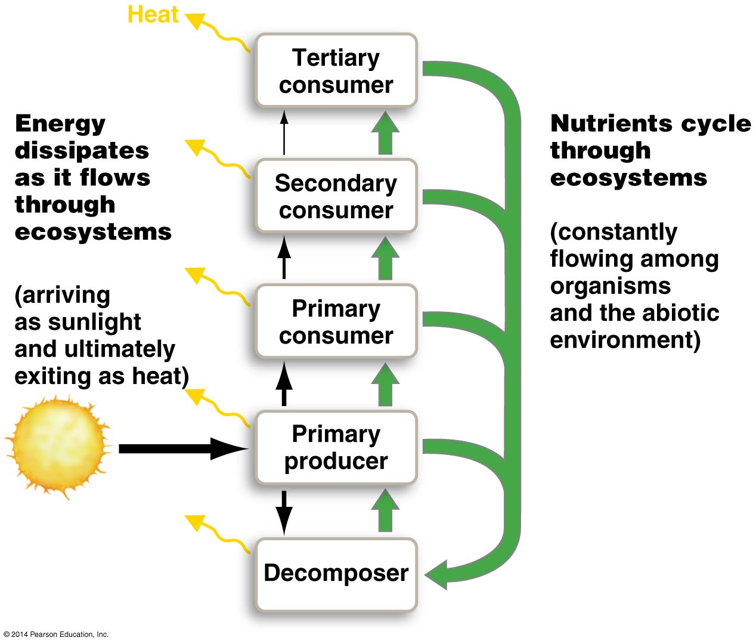
How many nutrient cycles are there?
Carbon
Sulfur
Nitrogen
Water
Phosphorus
Iron
Oxygen
Hydrogen
Trace minerals
Others

Slide 41
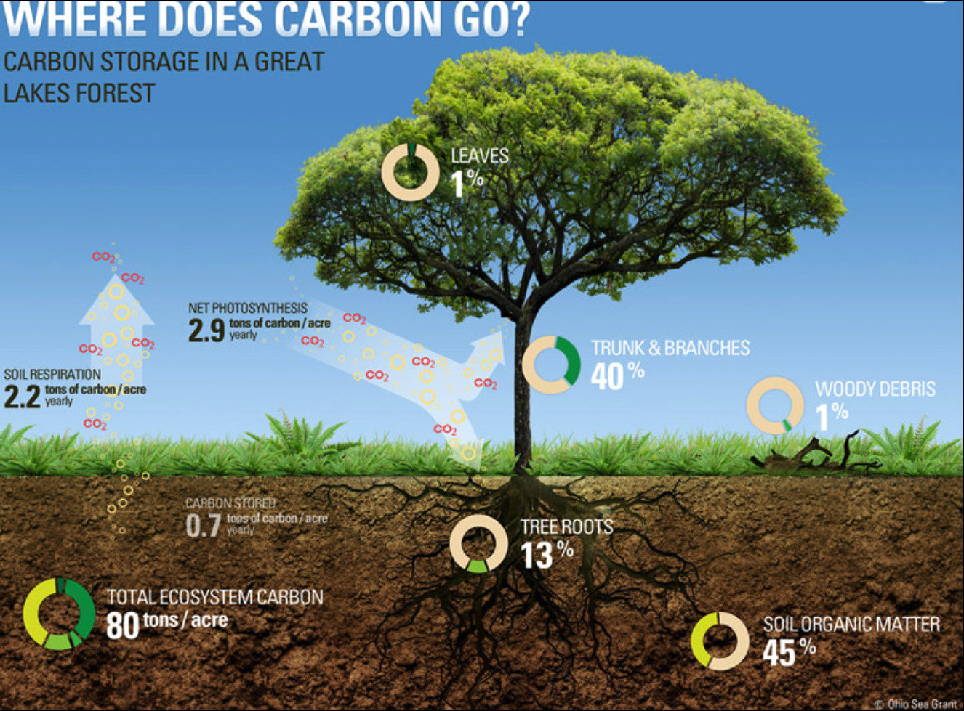
https://rgsgeogy.wordpress.com/mrcs-tree-carbon-content-calculator/

Slide 42
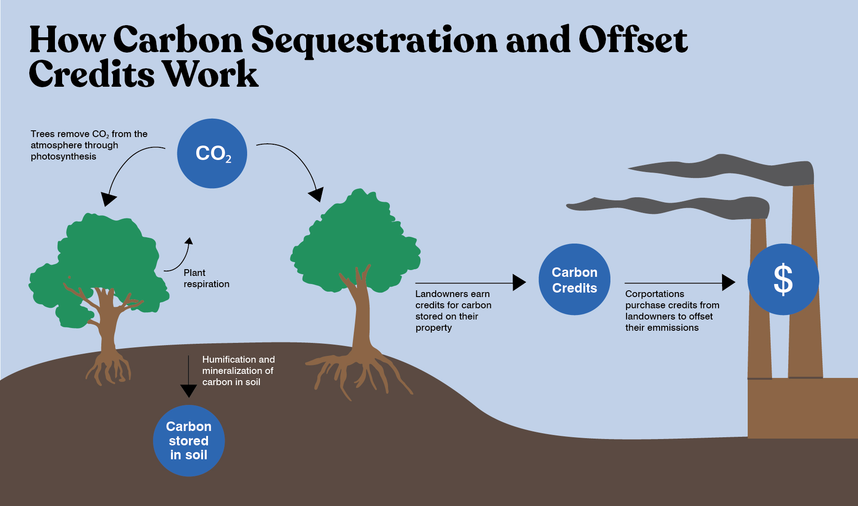
https://www.outdoors.org/resources/amc-outdoors/conservation-and-climate/how-amc-is-fighting-climate-change-through-carbon-credits/

Slide 43
Thank you for taking my class & enjoy your summer vacation

