Slide 1
Homework
Read Intro Evolution of Beauty if you got the book late and are not caught up.
Your workshop leader will email you no later than tomorrow with details how to find your group Thursday Aug 22nd at 5:05 PM.
Next read Ch. 1 for Next Week.

Slide 2

What is the Evidence for Evolution?
1) Microevolution (change in allele frequencies)
Illinois long term selection on maize
Evolution of soapberry bugs to new host
Pelvic bones in whales
2) Speciation
Ring species
Fossil record
3) Macroevolution (large dramatic evolutionary change)
4) Evidence of common ancestry
5) The earth is old
Notes:
Pelvic bones in whales are vestigial structures

Slide 3
Evidence of common ancestry
Homology (homologous characters) - possession by 2 or more species of a trait derived with or without modification from their common ancestor.
Outgroup
Ingroup (two sister taxa)
1st Common ancestor
2nd Common ancestor

Slide 4
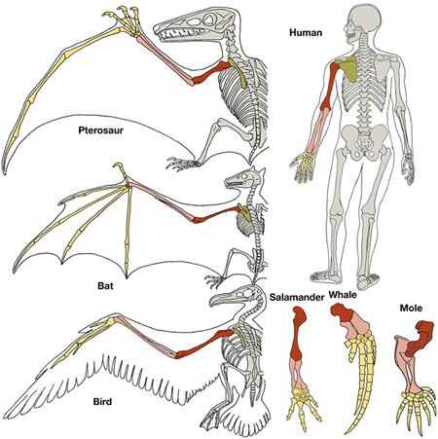
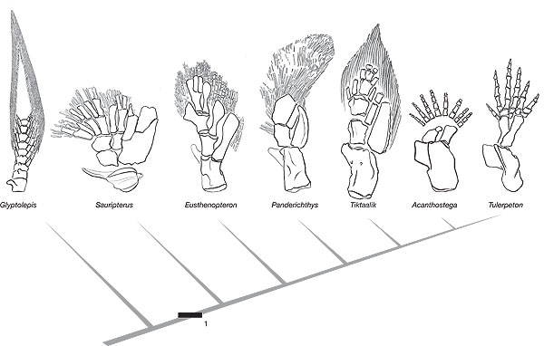
Forelimb homology in tetrapods
Structural homology
Fossil evidence for gradual evolution of tetrapod forelimb

Slide 5
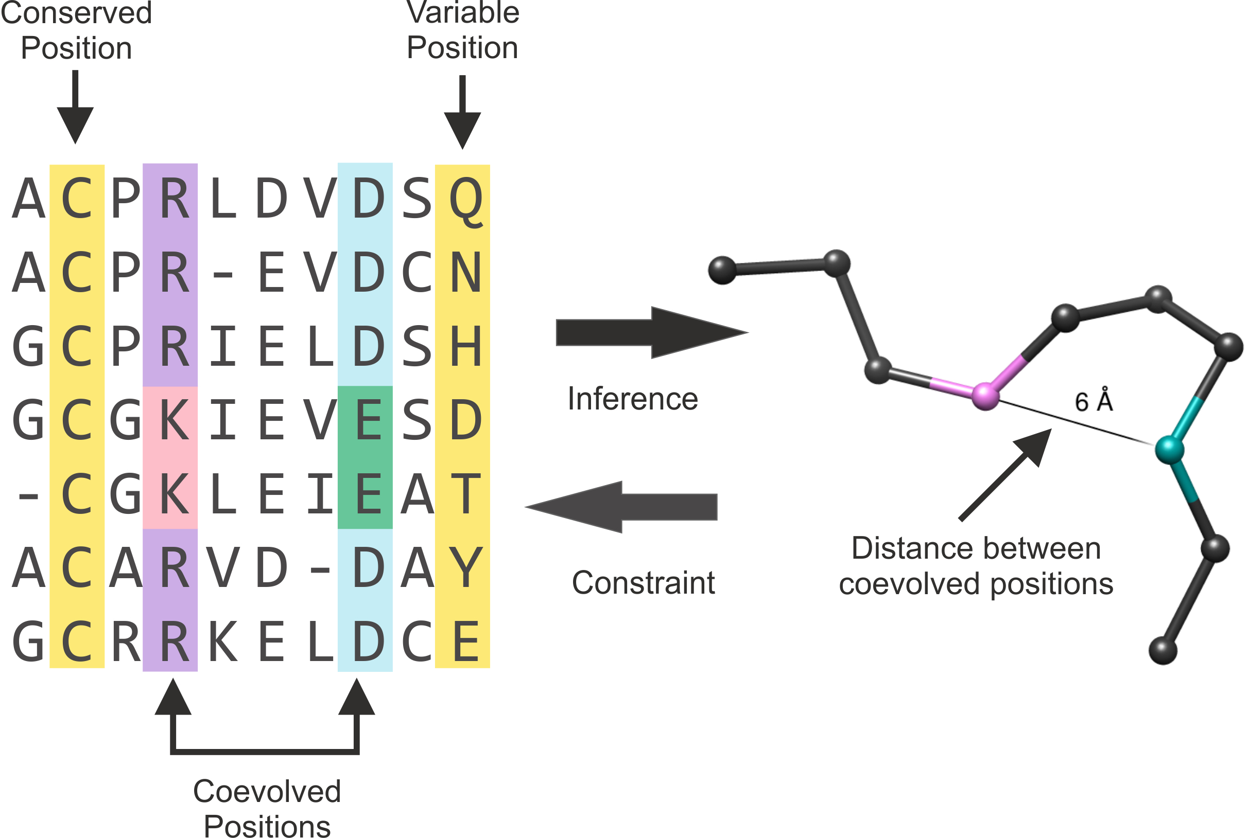
Examples of positional homology at the molecular level
http://mistic.leloir.org.ar/docs/help.html

Slide 6
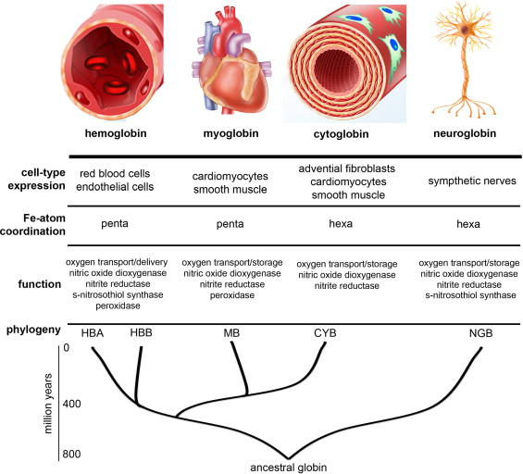
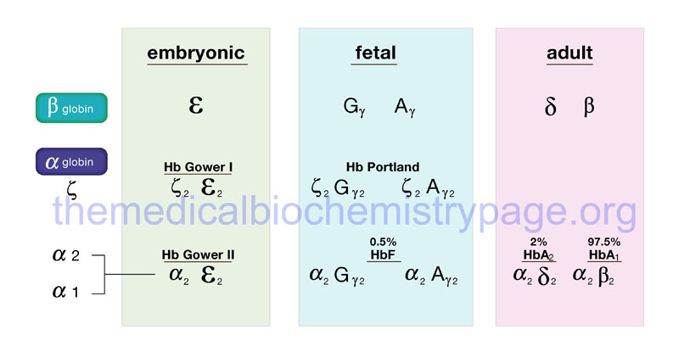
Globin proteins like hemoglobin, myoglobin, cytoglobin, and neuroglobin are an ancient protein family, evolved >>500 million years ago, with some forms before the divergence of plants and animals.
Oxygen-binding and transport has a deep, shared evolutionary history revealed by positional homology of different protein isoforms.
https://www.sciencedirect.com/topics/biochemistry-genetics-and-molecular-biology/globin

Slide 7
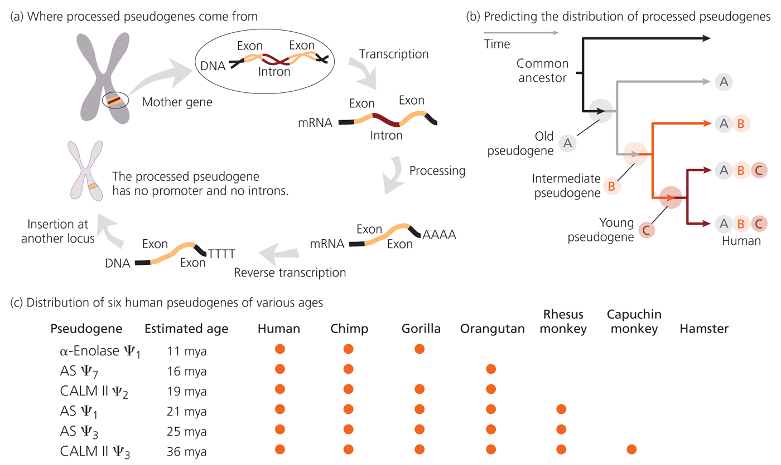
Pseudogenes
Shares the same sequence but not the same chromosomal position
Pseudogenes, share homology with gene itself but usually have no known function.

Slide 8
Convergent evolution
Similarity of traits gained through independent evolutionary pathways
Parallel evolution
Similarity of traits gained through evolution from the same underlying developmental mechanism
Reversal
Similarity of traits that occurs when one taxon reverts to an ancestral character state and shares it with a taxon that got it directly from common ancestor.
This taxon did not get character
State from most recent common
ancestor
reversal
“Blue” trait
Character state change
Most recent common ancestor
does not have shared trait
Common ancestor has shared trait

Slide 9
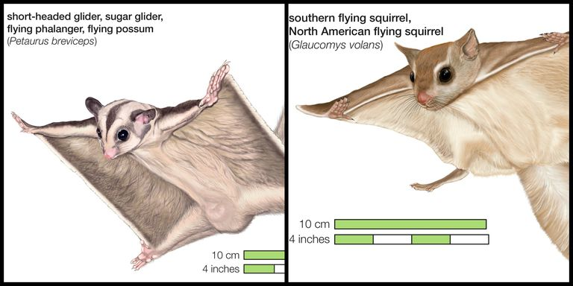
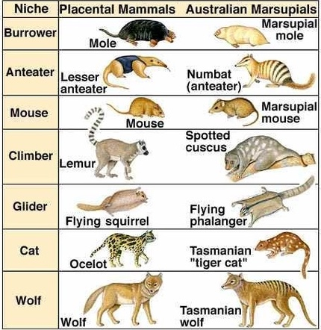
Example of convergent evolution
Placental vs. marsupial mammals
https://www.quora.com/Why-is-adaptive-radiation-considered-convergent-evolution

Slide 10
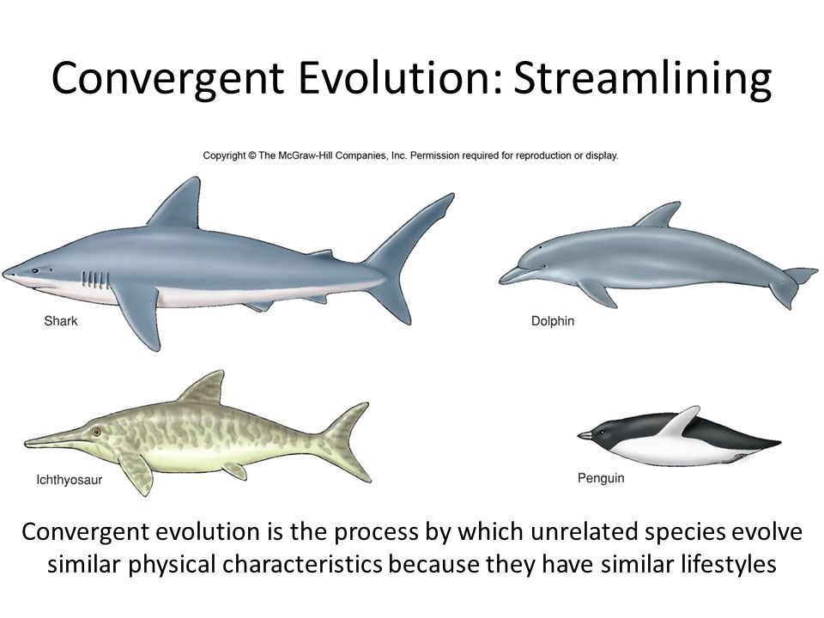

Slide 11
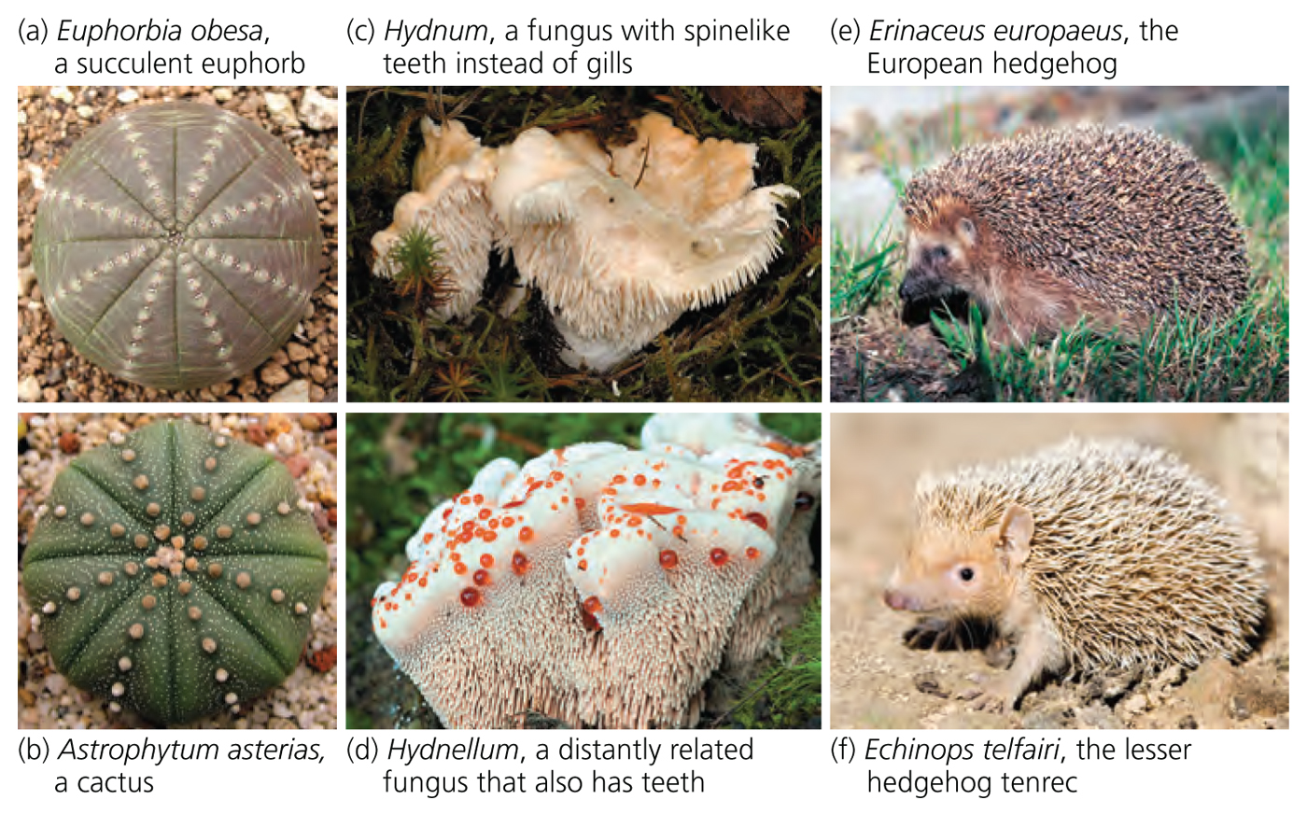
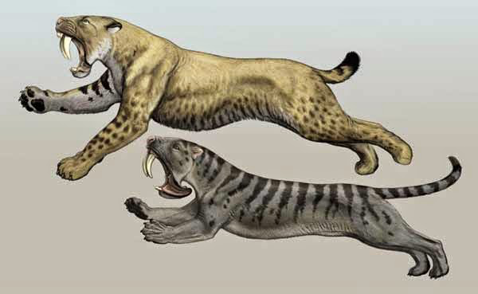
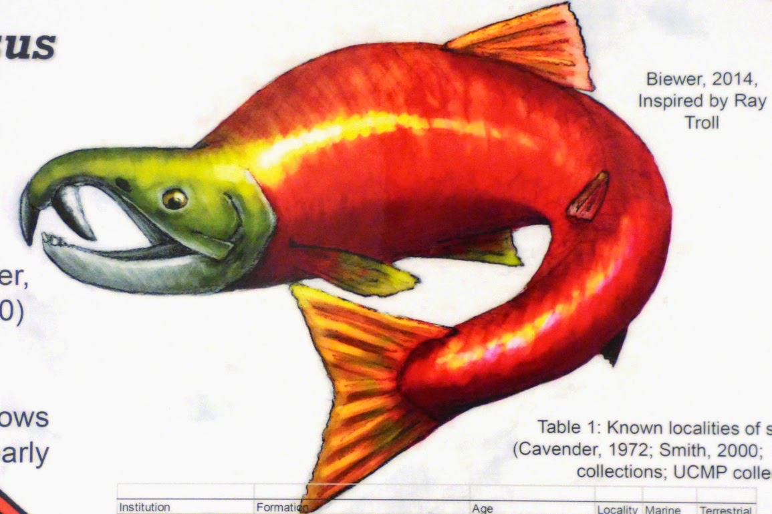
Homoplasy - possession by 2 or more species of a trait that has not been derived from their common ancestor.
placental
marsupial
Homoplasious canine teeth
Figure 19-7

Slide 12
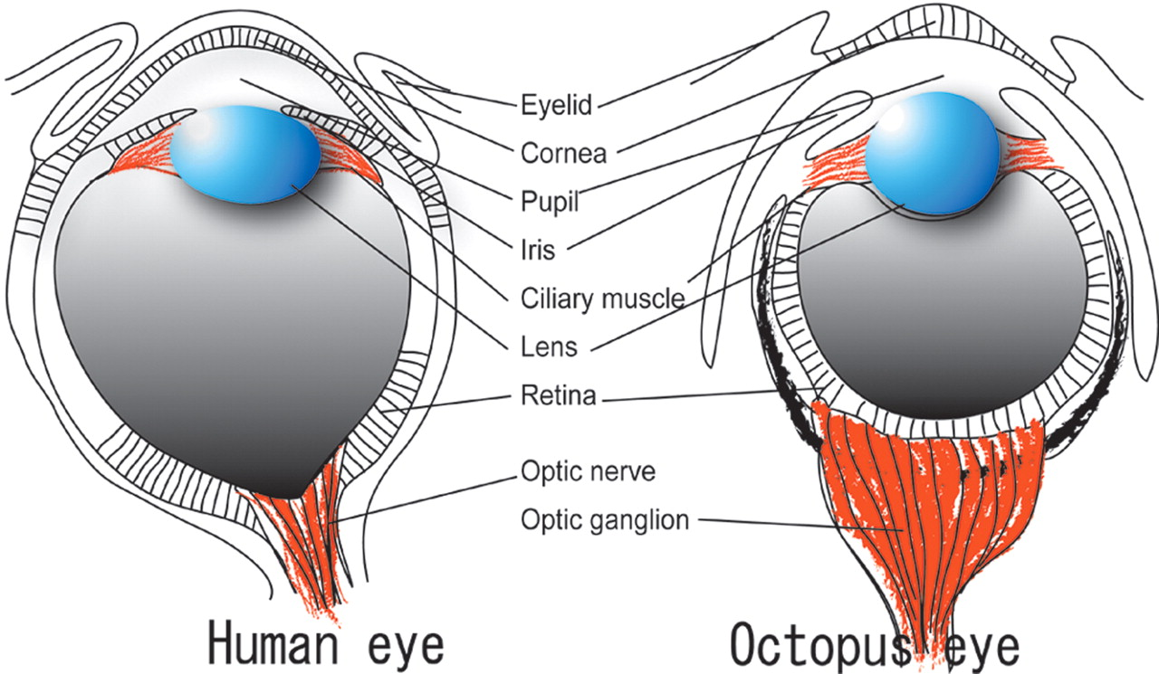

Structural similarities between human and octopus eyes.
Atsushi Ogura et al. Genome Res. 2004;14:1555-1561
Cold Spring Harbor Laboratory Press

Slide 13
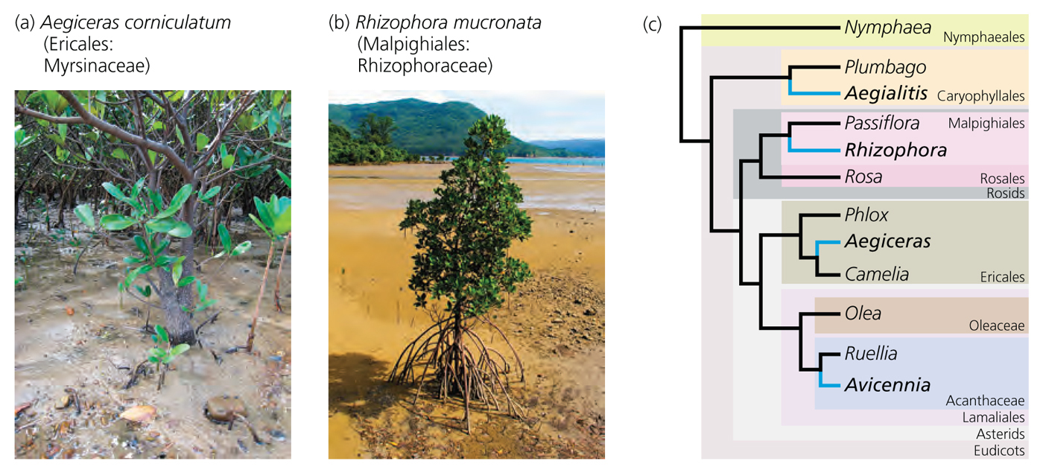
Example of parallel evolution
Mangrove physiology
Abscisic acid (ABA) confers salt tolerance and causes seed to germinate on plant
Underlying developmental physiology and gene regulation is the same for different mangroves

Slide 14
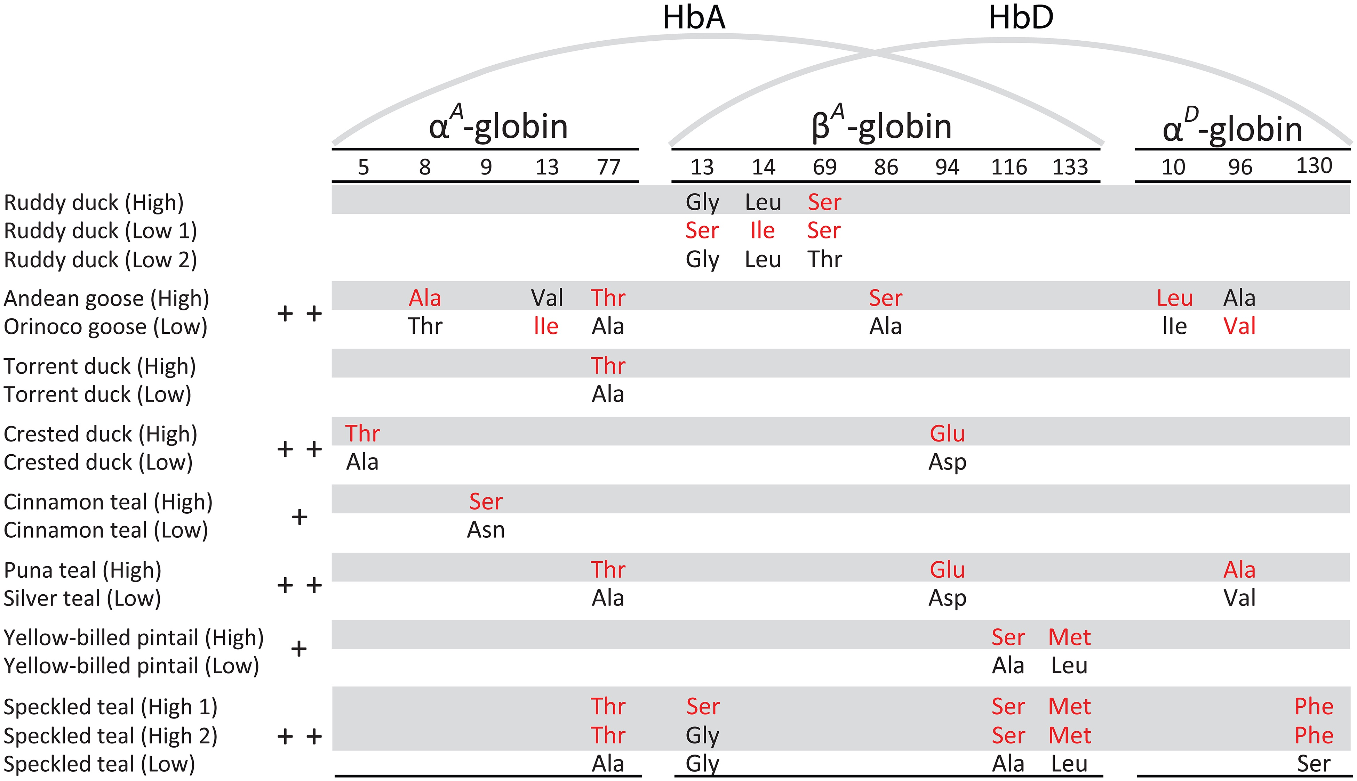
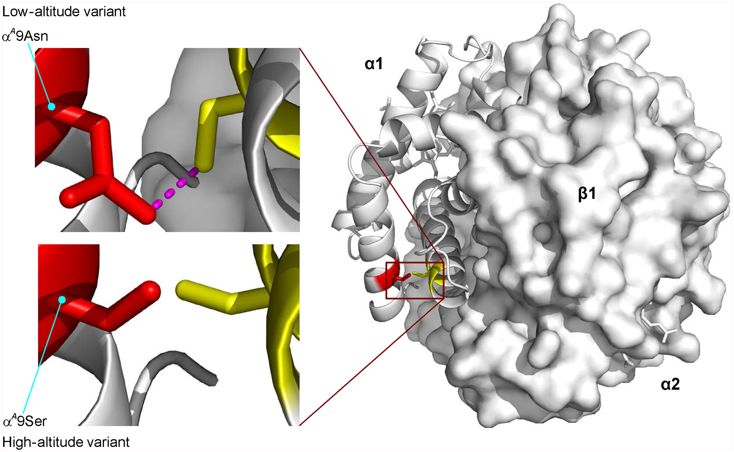
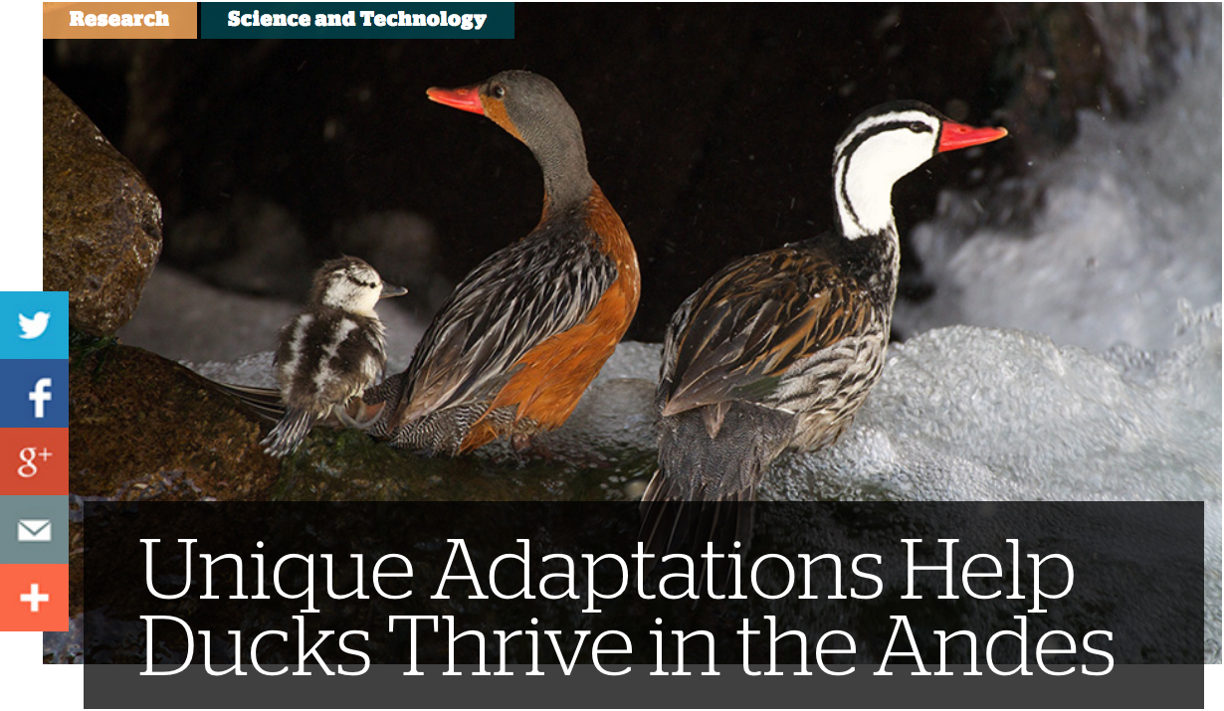
High-altitude
Hemoglobins
Increase
Hb-O₂
affinity

Slide 15
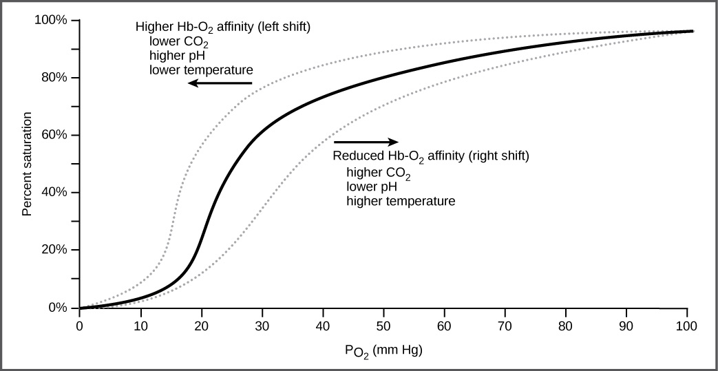
https://opentextbc.ca/biology/chapter/20-4-transport-of-gases-in-human-bodily-fluids/

Slide 16
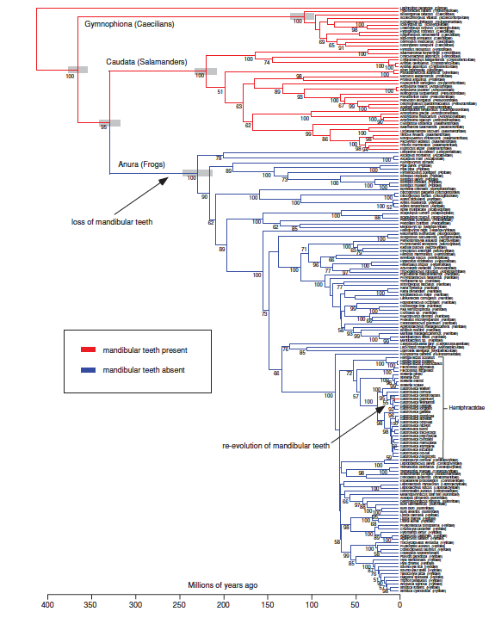
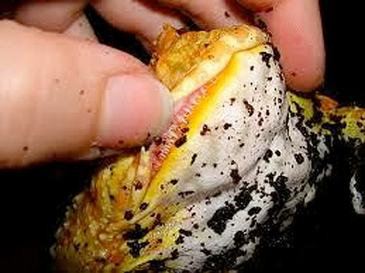
Example of reversal – lower jaw teeth (LJT) in frogs
Most modern frogs have no teeth in lower jaw
Their ancestor had these teeth
Salamanders and caecilians never lost lower jaw teeth
1 species regained lower jaw teeth
loss of mandibular teeth
re-evolution of mandibular teeth
Gastrotheca guentheri
marsupial frog
Wiens 2011 Evolution

Slide 17
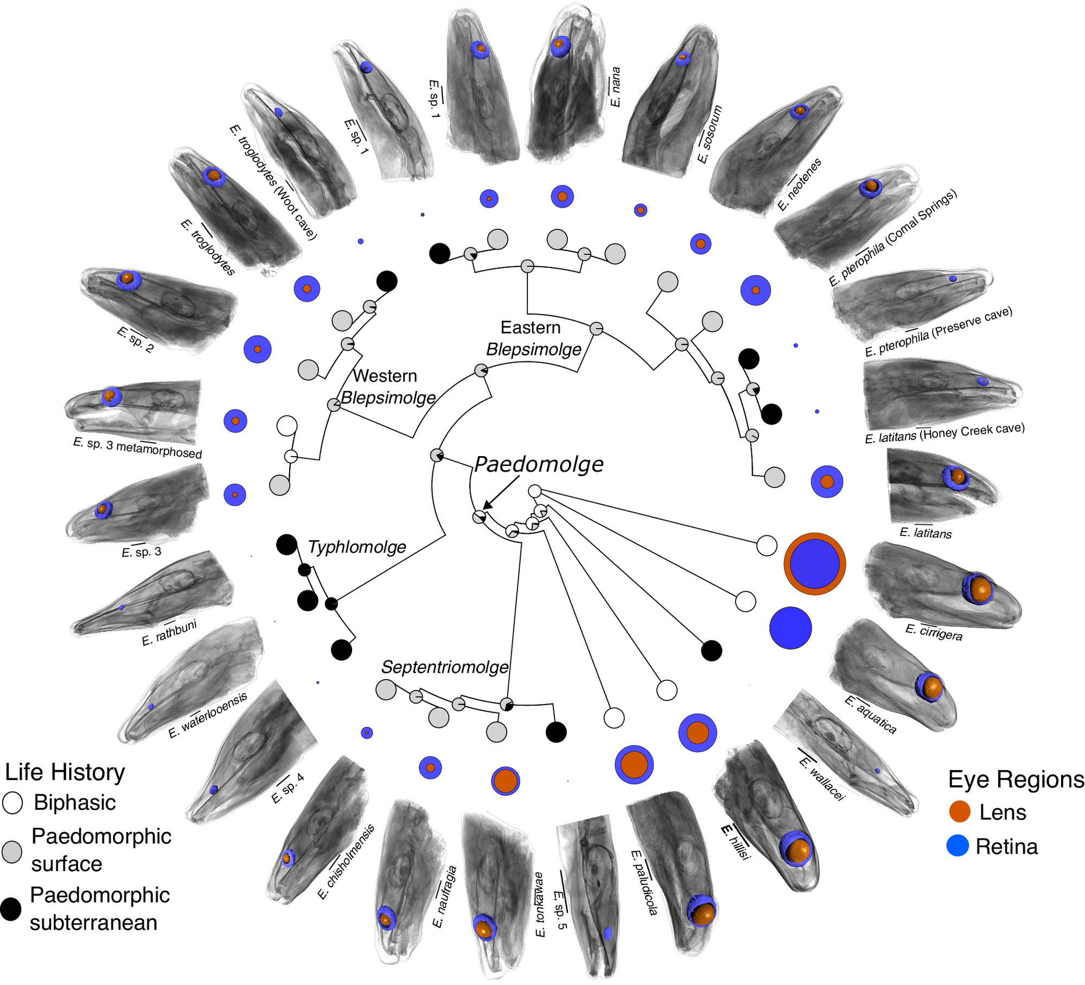
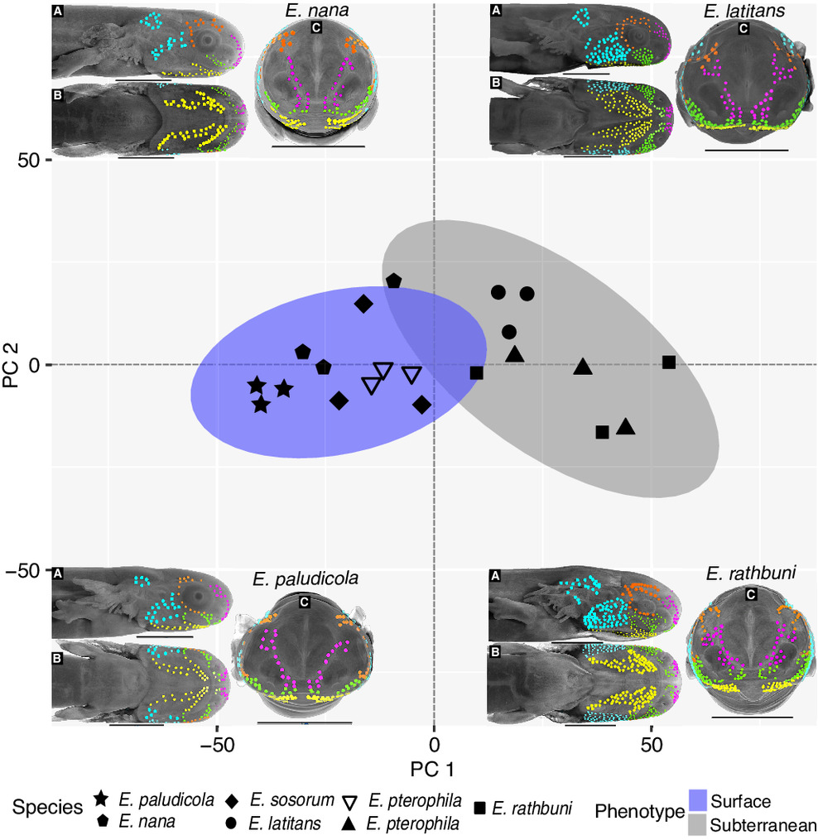
Parallel eye reduction (reversal) in cave-dwelling salamanders
R.U. Tovar, B.A. Dobbins, N.R. Hartman, S. Leelani, T.J. Devitt, D.M. García, P.M. Gignac, D.C. Cannatella, & D.M. Hillis, Parallel sensory compensation following independent subterranean colonization by groundwater salamanders (Eurycea), Proc. Natl. Acad. Sci. U.S.A. 122 (23) e2504850122, https://doi.org/10.1073/pnas.2504850122 (2025).

Slide 18
What is the Evidence for Evolution?
1) Microevolution (change in allele frequencies)
Illinois long term selection on maize
Evolution of soapberry bugs to new host
Pelvic bones in whales
2) Speciation
Ring species
Fossil record
3) Macroevolution (large dramatic evolutionary change)
4) Evidence of common ancestry
5) The earth is old
Notes:
Pelvic bones in whales are vestigial structures

Slide 19
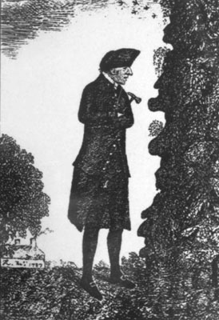
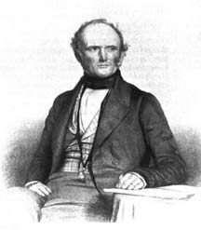
the earth is old
Uniformitarianism-
geological processes that occur now operated at similar rates in the past
James Hutton (1726-1797)
Charles Lyell (1797-1875)

Slide 20
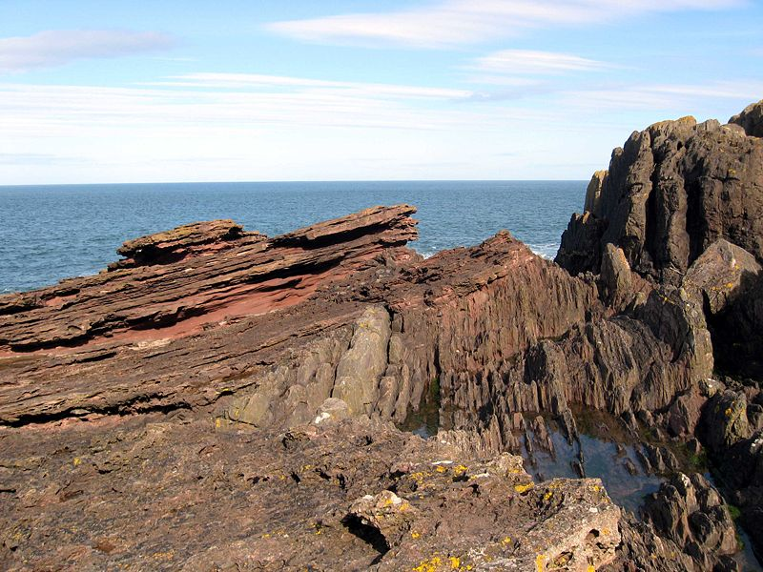
Evidence for Evolution
The earth is old
Hutton & Lyell - Simple rules for relative dating of geological strata
1) Younger strata are deposited on top of older strata.
2) Lava & sedimentary rocks are laid down in horizontal strata, so non-horizontal bending or tipping occurred after these strata were formed.
3) Intrusions and boulders are younger than host rocks.
4) Early fossils are simpler than more recent fossils.
Recent fossils are most similar to present day organisms.
Strata in different regions can be related by fossil similarity.

Slide 21
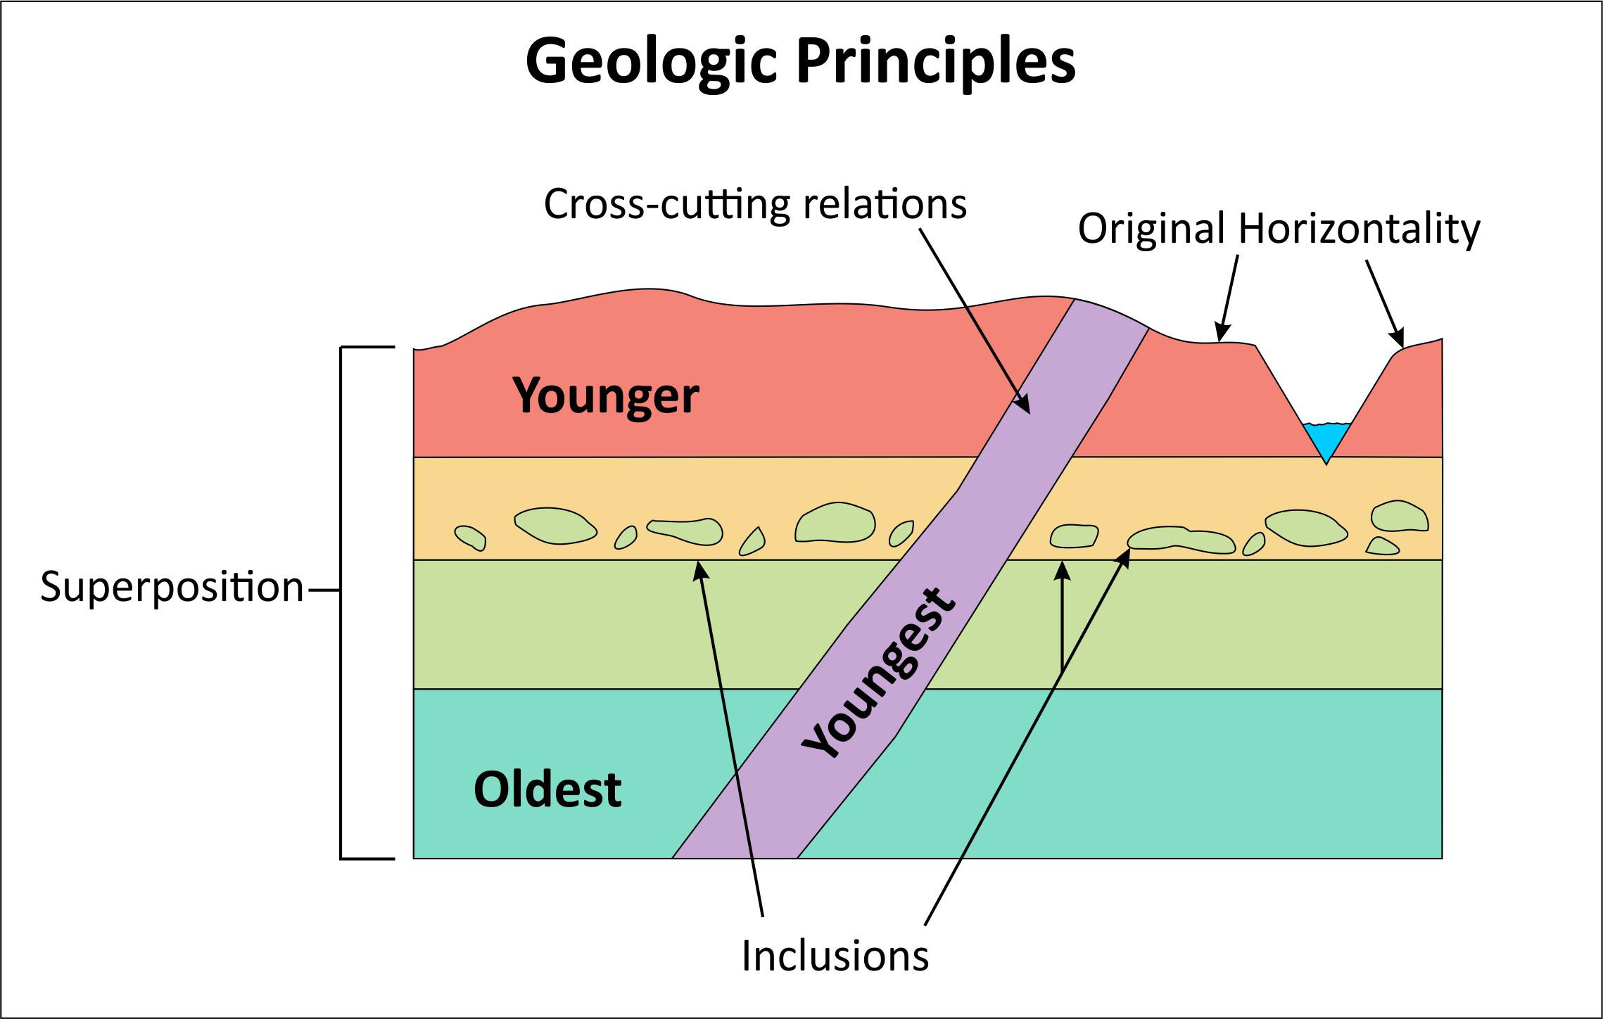
https://silurian-reef.fieldmuseum.org/narrative/411

Slide 22
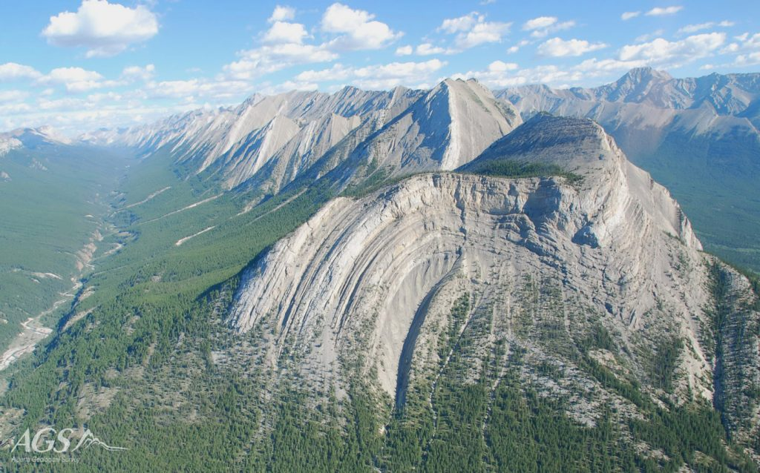

Slide 23
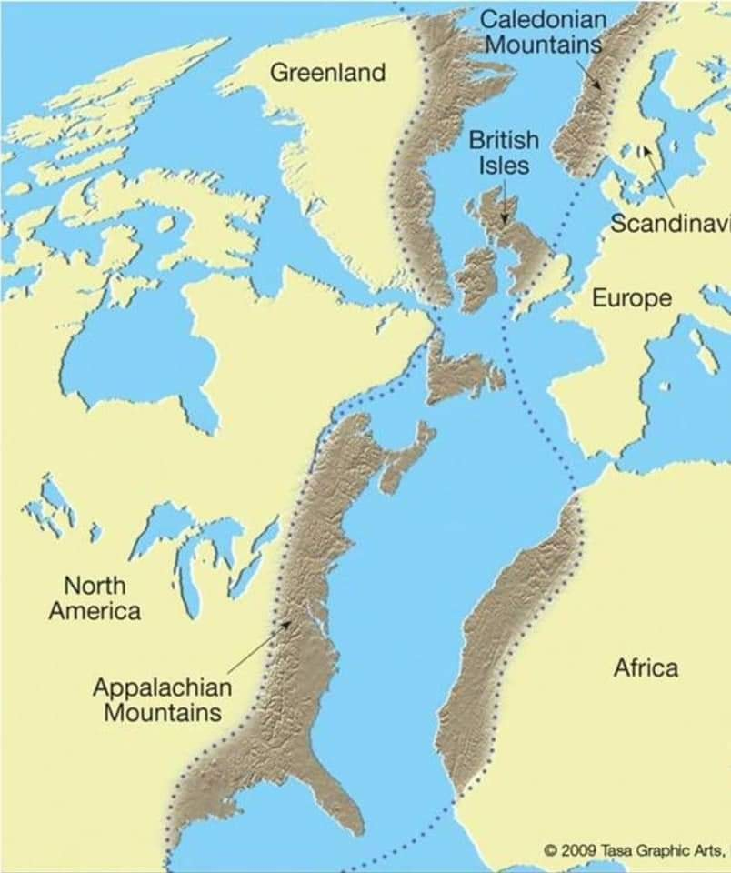
Remnants of a massive mountain range include the Appalachian Mountains of North America, the Little Atlas of Morocco, Africa, Ireland, much of the Scottish Highlands and part of Scandinavia

Slide 24
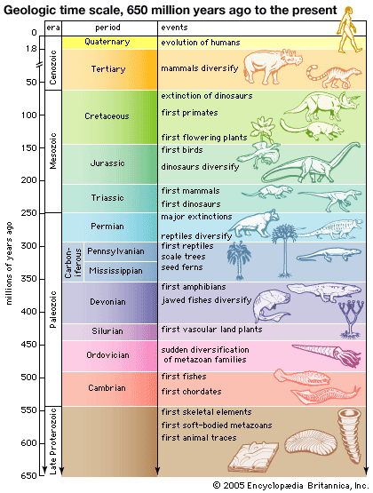
Evidence for Evolution
The earth is old
Based on relative dating and rates of mountain building and glacial retreat, Hutton and followers developed the geological timescale. They began working in scales of millions of years. The implication and conclusion that the earth must be older than 6,000 years

Slide 25

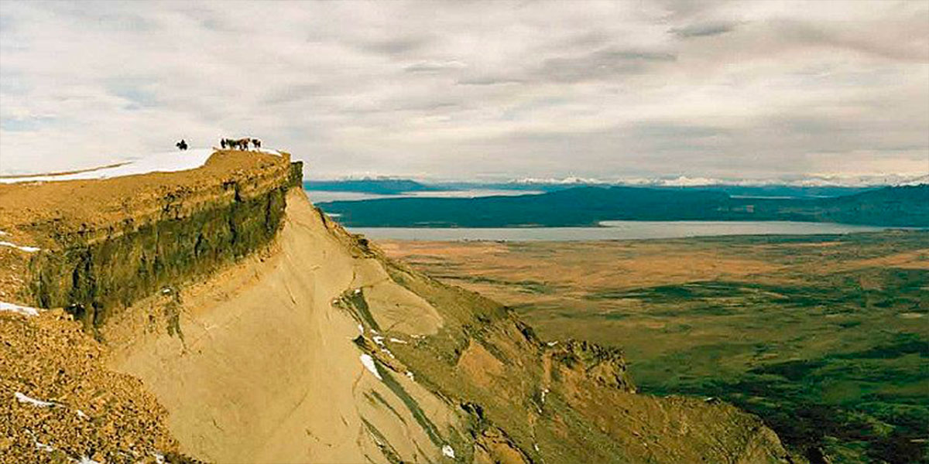
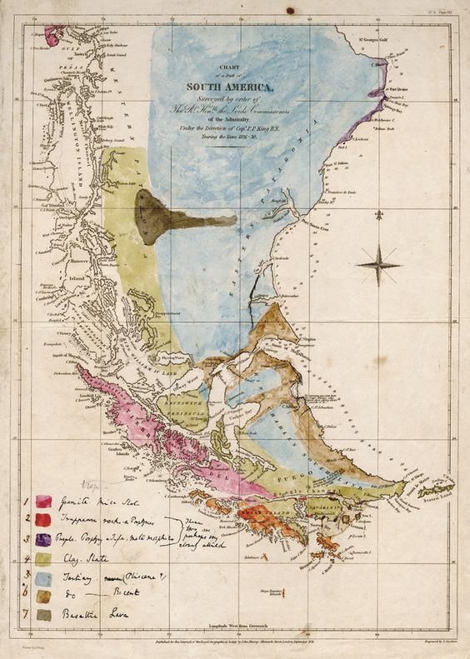
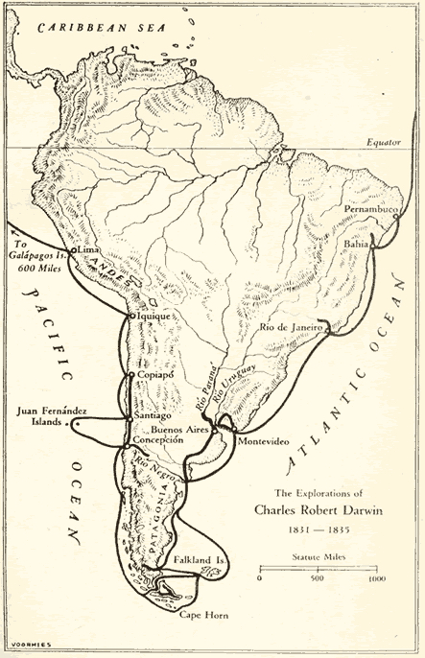
On the Voyage of the Beagle Darwin recognized the the Patagonian coast was uplifted with one raised beach on top of the other.

Slide 26
The earth is old
Modern Radiometric dating
Based on the property that unstable isotopes of naturally-occurring elements decay at a constant rate
Half-life- Time for ½ of the parent isotope to decay into daughter isotopes; can be determined empirically
Must assume the original ratio of parent and daughter isotopes; some of these can be predicted from recently formed volcanic rock (e.g. Potasium K-40 & Argon-Ar-40)

Slide 27
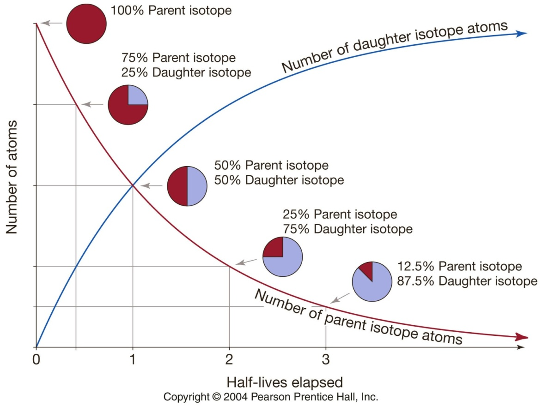
Modern Radiometric dating using unstable isotopes
Decay rates unaffected by the environment and act as natural clocks
Initial ratios confirmed by observation of newly formed rock

Slide 28

Ratios of
Ur-238:Pb-206
K-40:Ar-40
Indicate that moon rocks & meteorites are ~4.6 b.y. old
This provides an estimate for the age of the earth, assuming that the moon, earth, & solar system were formed at the same time.
https://www.theverge.com/2016/9/12/12879766/moon-planetary-collision-theory-earth-impact
Notes:
Ur-238:Pb-206 half life of 4.47 billion years
K-40:Ar-40 half life of 1.25 billion years

Slide 29
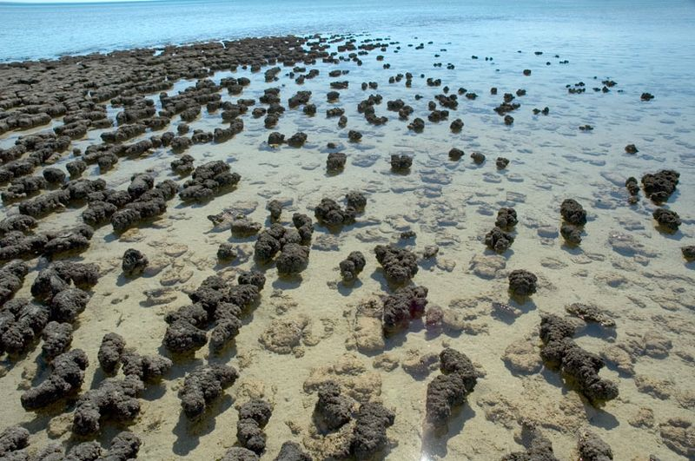
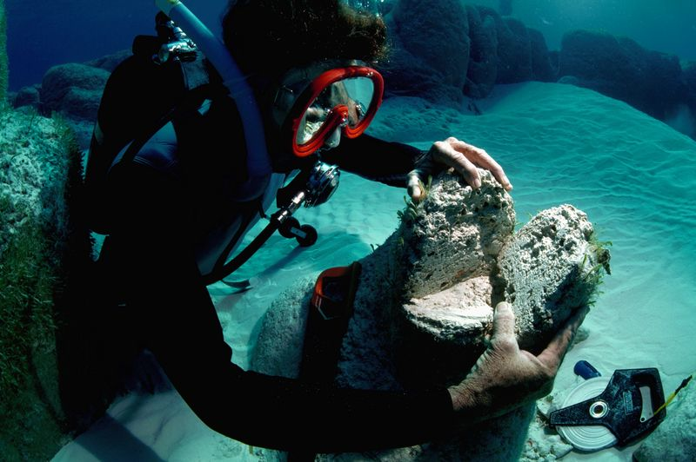
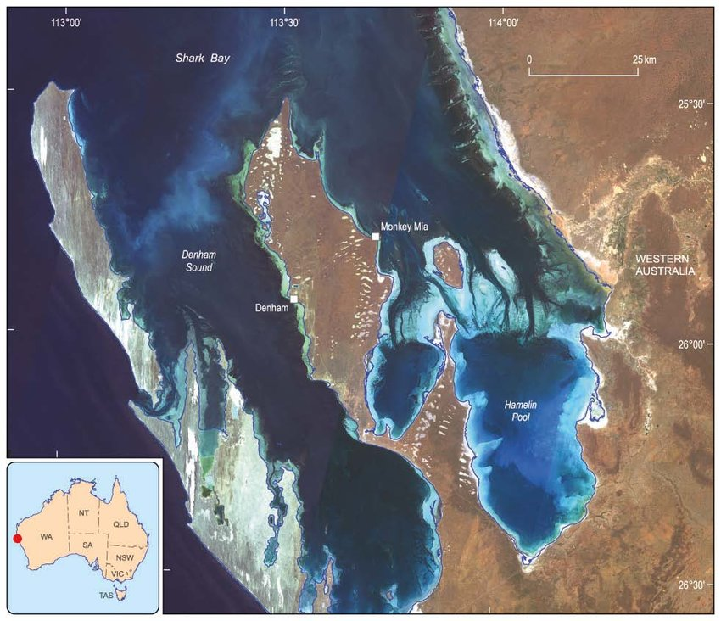
Oldest fossil life 3.4 – 3.5 by
Stromatolites
Bacterial fossils found in Shark Bay, Western Australia

Slide 30
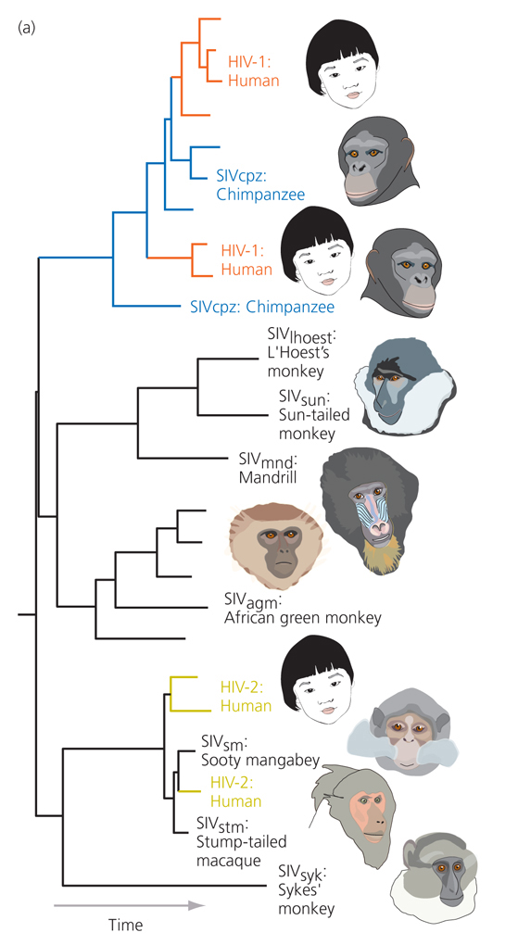
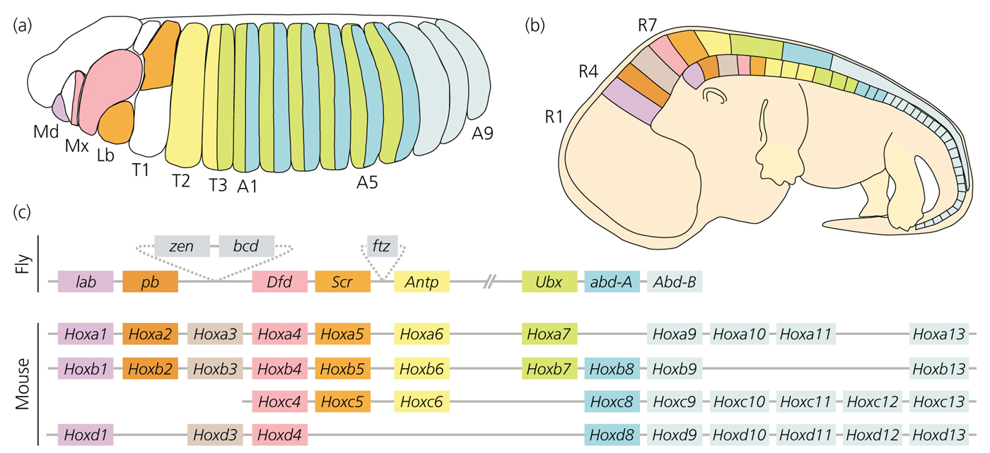
HIV Evolution
Why study evolution ?
1. It is a research tool
Hox genes control development
Notes:
Have used properties of homology and shared ancestry to understand HIV evolution.
Have used these properties of understand evolution and development and shown that development of he vertebrate body plan is modular
Not required to know the details of these examples based on their presentation in this slide (However, they may be presented later in the course)

Slide 31
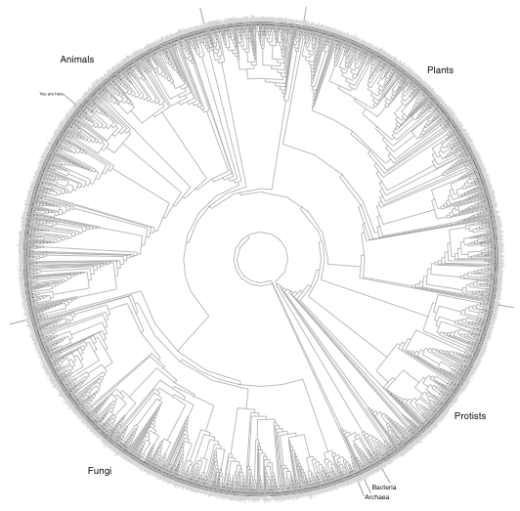
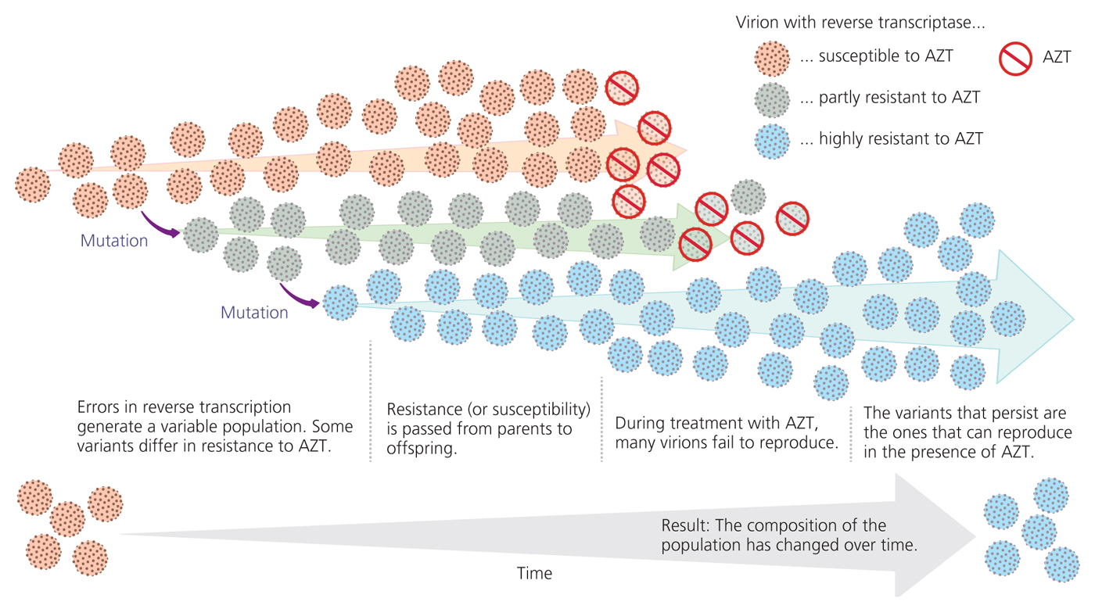
Why study evolution ?
2. It is the unifying theory of biology
You are here
Tells us how viruses evolve
Figure 1-15
"Nothing in Biology Makes Sense Except in the Light of Evolution”
- Theodosius Dobzhansky
Notes:
Not required to know the details of these examples based on their presentation in this slide (However, they may be presented later in the course)

Slide 32
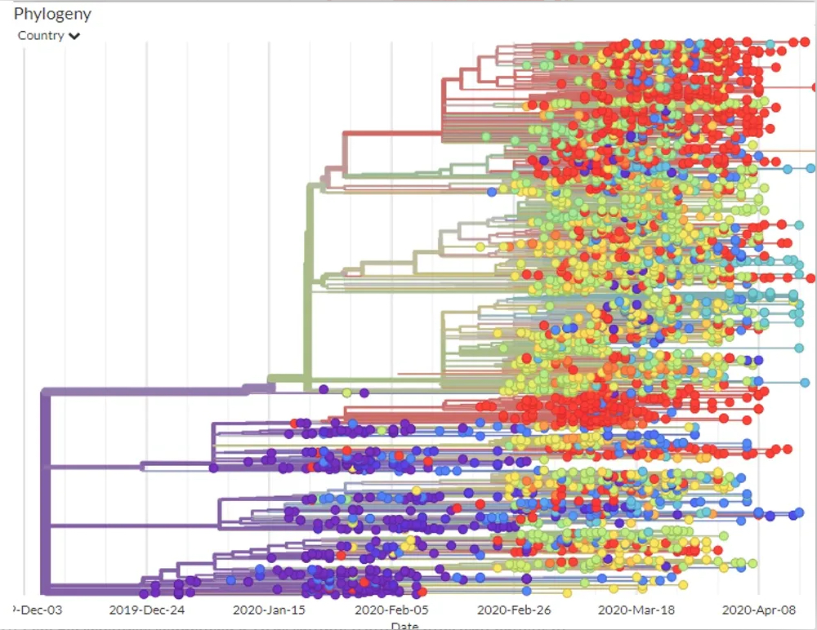
The coronavirus genome is like a shipping label that lets epidemiologists track where it’s been
April 27, 2020 8.08am EDT Updated April 30, 2020 3.55pm EDT
https://theconversation.com/the-coronavirus-genome-is-like-a-shipping-label-that-lets-epidemiologists-track-where-its-been-136826

Slide 33
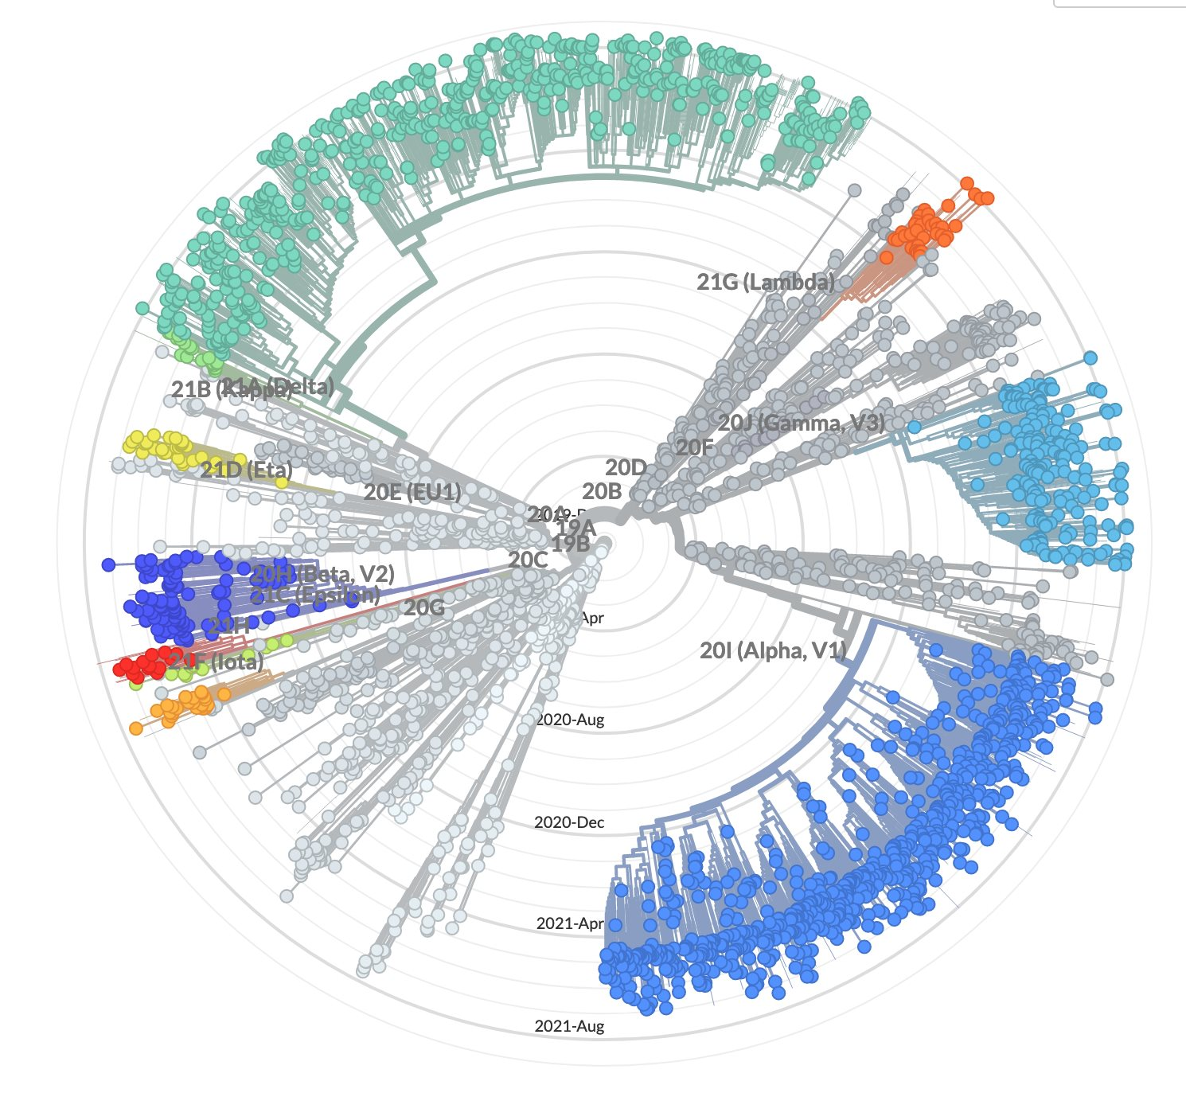
SARS CoV-2 Evolution
Circular phylogeny
shows when different
strains evolved.

Slide 34
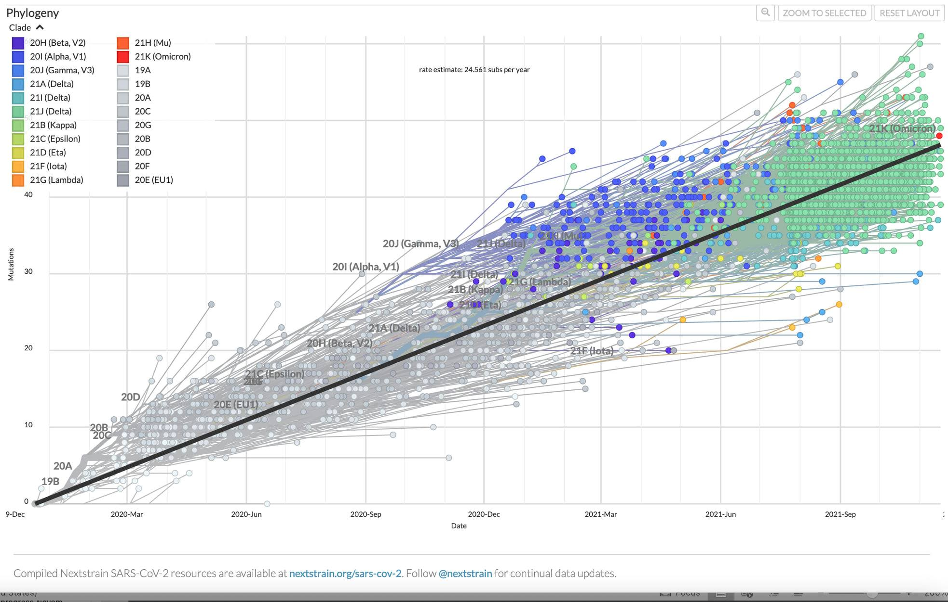

Slide 35
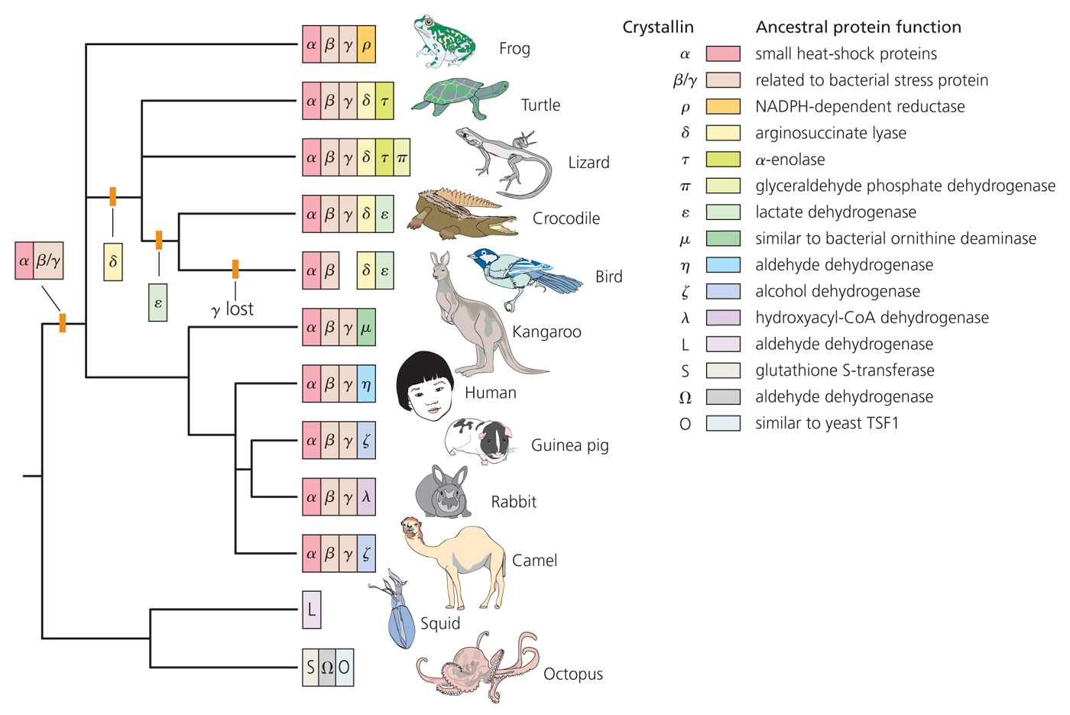
Why study evolution ?
2. It is the unifying theory of biology
Evolution of the crystallins of eye lenses
Notes:
Not required to know the details of these examples based on their presentation in this slide (However, they may be presented later in the course)

Slide 36
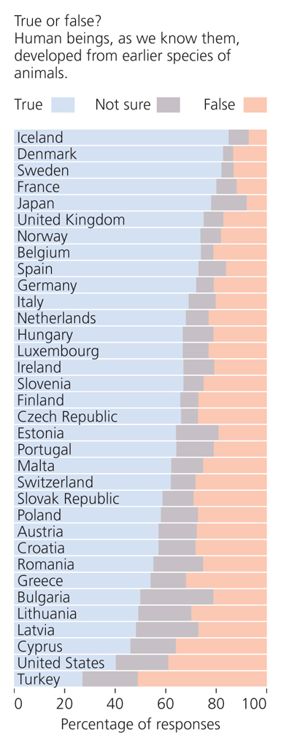
How accepted is evolution?
U.S. ranks lowest

Slide 37

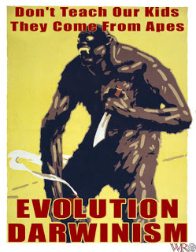
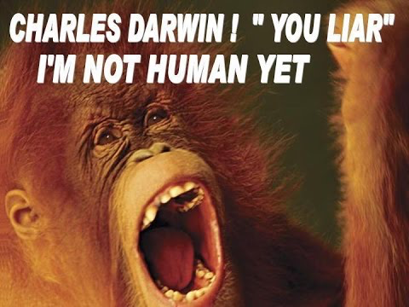
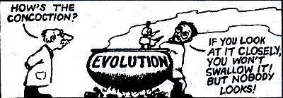
Notes:
Evolution is presented as a fearful doctrine

Slide 38
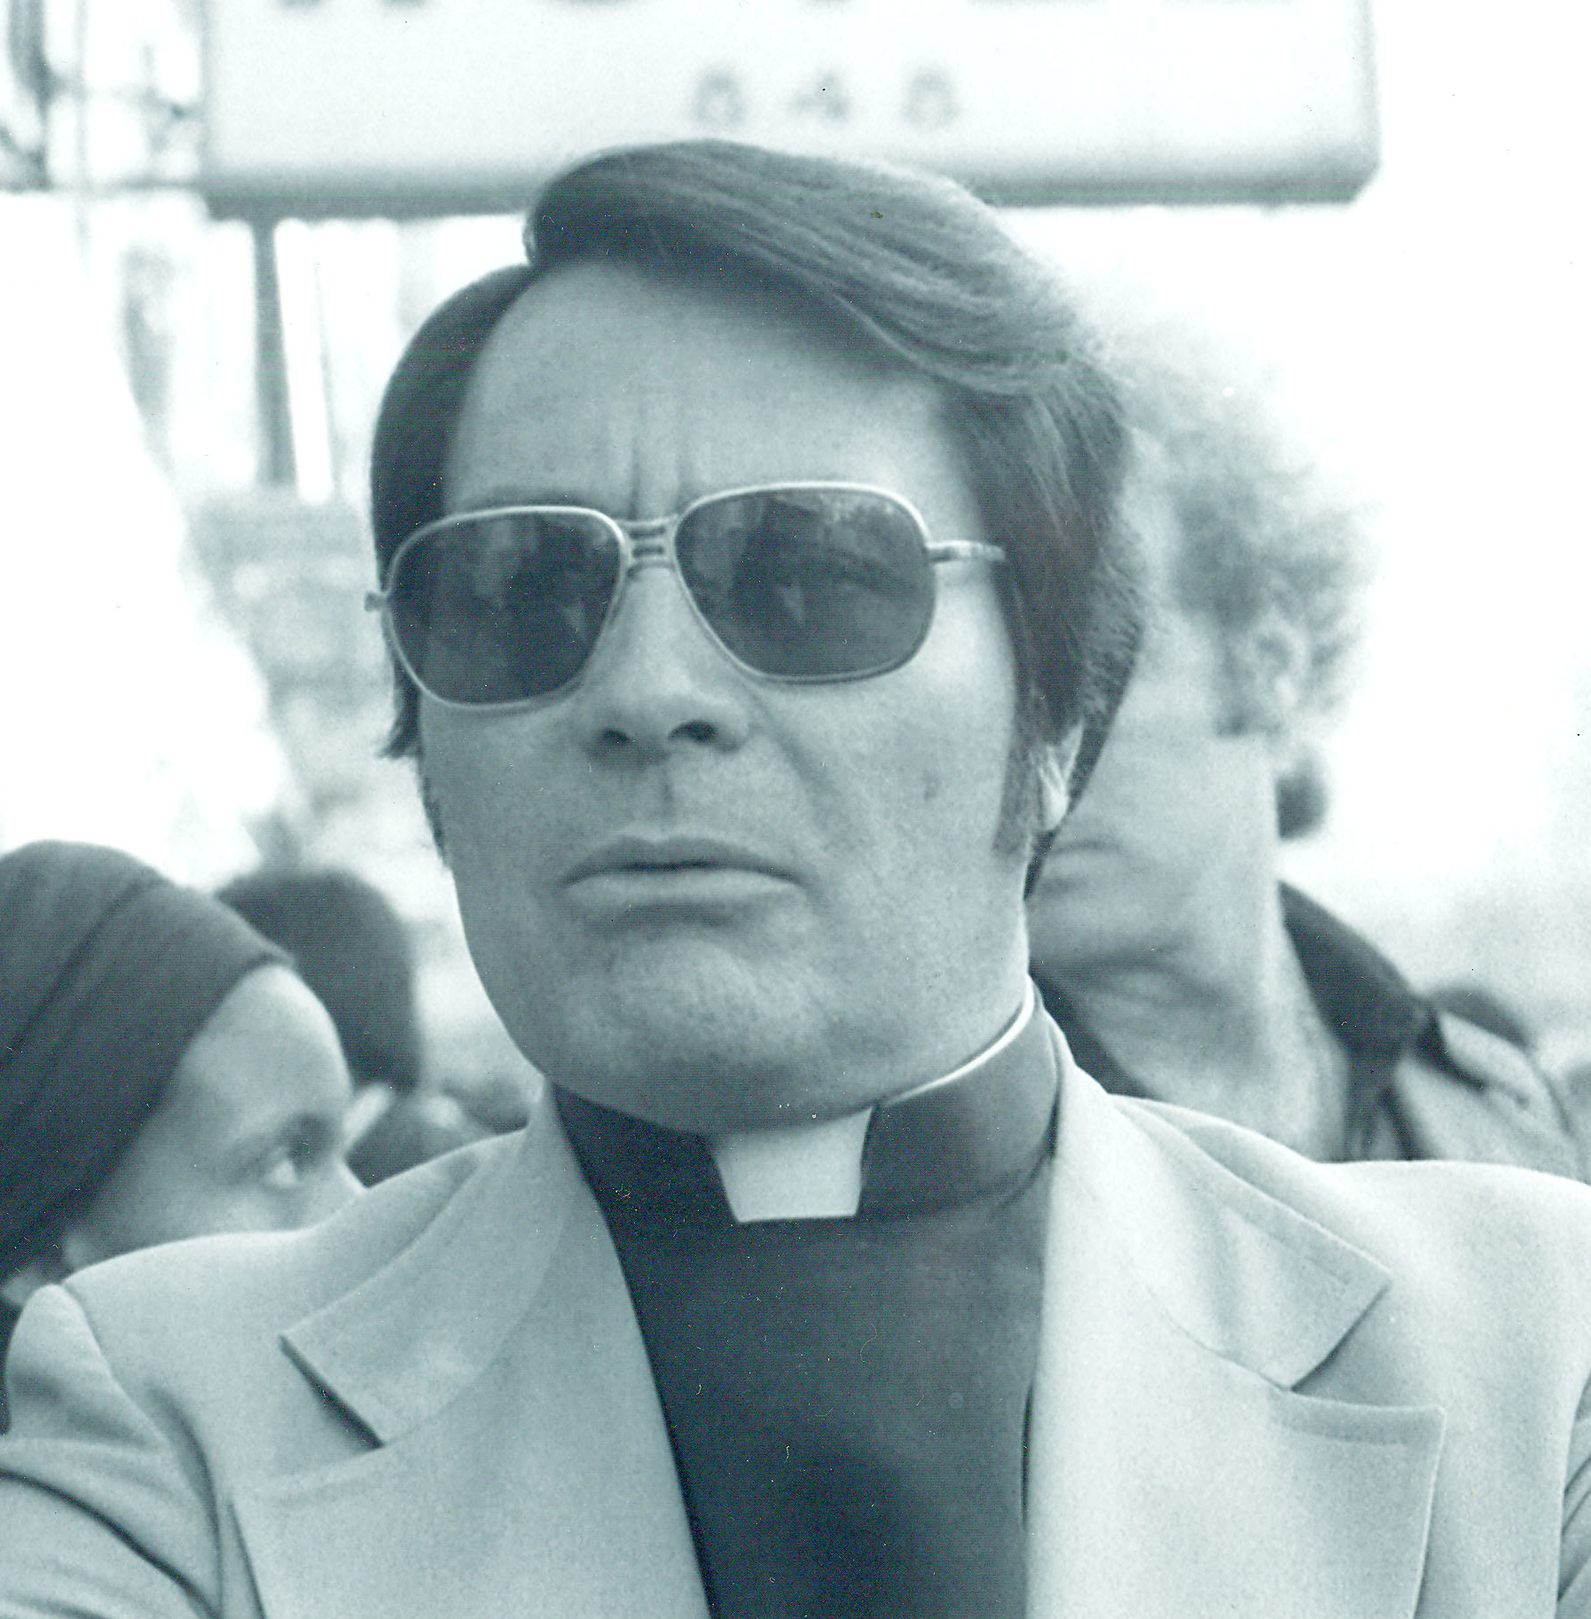


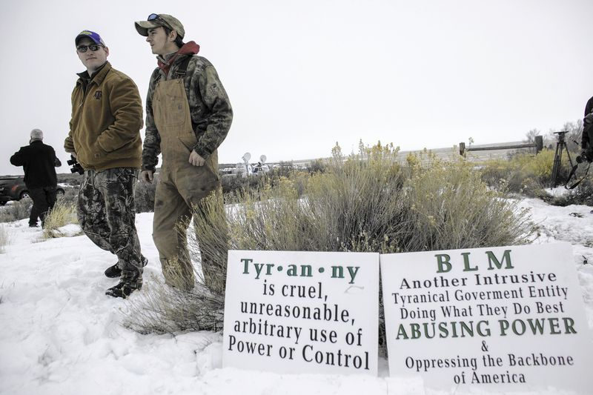
Conspiracy theory, extremist ideology, & cult thinking have a robust history!

Slide 39


Slide 40

Some would argue that anti-Evolutionists create a false dichotomy between those who believe in God and those who believe in Evolution
Notes:
It just isn’t that way……

Slide 41
Flat Earthers
Special
Creation
Young Earth
Geocentrists
Young Earth Creationism
Gap Creationism
“Intelligent Design”
Day Age Creationism
Progressive Creationism
Old Earth
Theistic Evolutionism
Evolution
Agnostic Evolutionism
Atheistic Evolutionism
Anti-theistic Evolutionism
From Evolution vs. Creationism by Eugenie Scott; figure by Alan Gishlick

Slide 42
More Biblical literalism
Flat Earthers
Special
Creation
Young Earth
Geocentrists
Young Earth Creationism
Gap Creationism
“Intelligent Design”
Day Age Creationism
Progressive Creationism
Old Earth
Theistic Evolutionism
Evolution
Agnostic Evolutionism
Atheistic Evolutionism
Anti-theistic Evolutionism
Less Biblical literalism
From Evolution vs. Creationism by Eugenie Scott; figure by Alan Gishlick

Slide 43
Flat Earthers
Special
Creation
Young Earth
Geocentrists
Young Earth Creationism
Gap Creationism
“Intelligent Design”
Day Age Creationism
Progressive Creationism
Old Earth
Theistic Evolutionism
Evolution
Agnostic Evolutionism
Atheistic Evolutionism
Anti-theistic Evolutionism
Believe in the special creation of “kinds,” which are groups at a higher taxonomic level than species. Examples are cats, dogs, Salmonids
From Evolution vs. Creationism by Eugenie Scott; figure by Alan Gishlick

Slide 44
Flat Earthers
Special
Creation
Young Earth
Geocentrists
Young Earth Creationism
Gap Creationism
“Intelligent Design”
Day Age Creationism
Old Earth
Progressive Creationism
Temporal gap between versus 1 & 2 of Genesis 1
Each day of Genesis was a long period of time
Accept many theories of modern physical science; believe that flowering plants, dinosaurs and humans created at the same time; fossil strata result from Noah’s flood
From Evolution vs. Creationism by Eugenie Scott; figure by Alan Gishlick

Slide 45
Flat Earthers
Special
Creation
Young Earth
Geocentrists
Young Earth Creationism
Gap Creationism
“Intelligent Design”
Day Age Creationism
Progressive Creationism
Old Earth
Theistic Evolutionism
Evolution
Agnostic Evolutionism
Atheistic Evolutionism
Anti-theistic Evolutionism
A form of creationism descended from William Paley. Believe that the presence of order and complexity proves a designer.
From Evolution vs. Creationism by Eugenie Scott; figure by Alan Gishlick

Slide 46


Flat Earthers
Special
Creation
Young Earth
Geocentrists
Young Earth Creationism
Gap Creationism
“Intelligent Design”
Day Age Creationism
Progressive Creationism
Old Earth
Theistic Evolutionism
Evolution
Agnostic Evolutionism
Atheistic Evolutionism
Anti-theistic Evolutionism
Accept all results of modern science; believe that God created the laws of nature and set them in motion; some believe that God occasionally intervenes, others do not believe this.
This includes all Popes since John Paul II: humans descended from common ancestors with other primates; God intervened by creating the human soul
https://www.youtube.com/watch?v=P2pZRyVX9bY
Kenneth
Miller
Cell Biologist
Francis
Collins
NIH Director
From Evolution vs. Creationism by Eugenie Scott; figure by Alan Gishlick

Slide 47

Flat Earthers
Special
Creation
Young Earth
Geocentrists
Young Earth Creationism
Gap Creationism
“Intelligent Design”
Day Age Creationism
Progressive Creationism
Old Earth
Theistic Evolutionism
Evolution
Agnostic Evolutionism
Atheistic Evolutionism
Anti-theistic Evolutionism
Accept the scientific theory of evolution and feel that it is unimportant whether or not a God was or is involved
Agnosticism - nothing is known or can be known about the existence of God
Thomas Huxley – Darwin’s Bulldog
From Evolution vs. Creationism by Eugenie Scott; figure by Alan Gishlick

Slide 48

Flat Earthers
Special
Creation
Young Earth
Geocentrists
Young Earth Creationism
Gap Creationism
“Intelligent Design”
Day Age Creationism
Progressive Creationism
Old Earth
Theistic Evolutionism
Evolution
Agnostic Evolutionism
Atheistic Evolutionism
Anti-theistic Evolutionism
Accept the scientific theory of evolution and do not believe in gods
Outspoken about their beliefs that there is no god
Richard Dawkins
From Evolution vs. Creationism by Eugenie Scott; figure by Alan Gishlick

Slide 49
Anti-Evolution and Anti-Science Legislation
Alabama
Florida
Iowa
Louisiana
Maryland
Michigan
Missouri
Oklahoma
South Carolina
New Mexico
Texas

Slide 50


