Slide 1
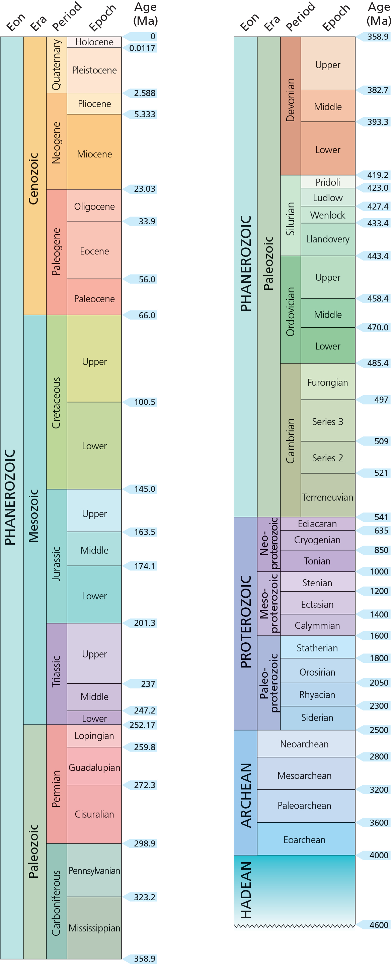
First organized differentiated multicellular eukaryotic fossils 635 mya
First Eukaryotic fossils 1.9 bya
Great oxygenation event 2.4-2.5 bya
First photosynthetic bacteria 3.4 bya (anoxygenic)
Oldest Stromatolites 3.7 bya
Oldest terrestrial rocks 3.8 bya
Earth forms 4.56 bya

Slide 2
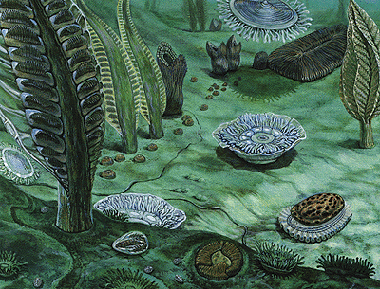
Ediacaran 635 – 541 mya
Last period of Proterozoic prior to Cambrian
First:
Soft-bodied organisms
Organized, differentiated multicellular constriction
Sizes larger than centimeters
Almost all forms of symmetry
Perhaps first embyros
Diversification coincided with a large increase in atmospheric oxygen

Slide 3
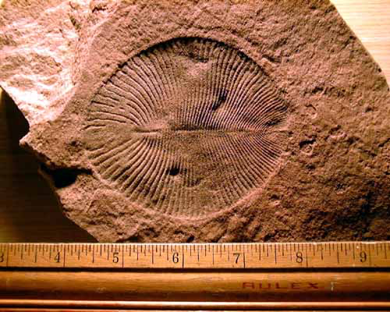
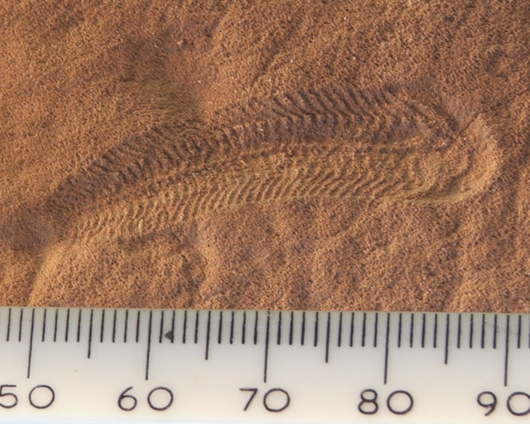
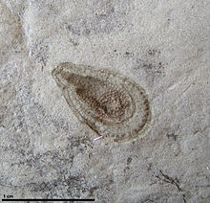
Ediacaran 635 – 541 mya
Last period of Proterozoic
Dickinsonia
Springgina
Kimberella*
Soft-bodied so primarily preserved under volcanic ash or sand.
➔ therefore rare
Perhaps an early ancestor of molluscs
Did early animals begin to diversify at this time?

Slide 4
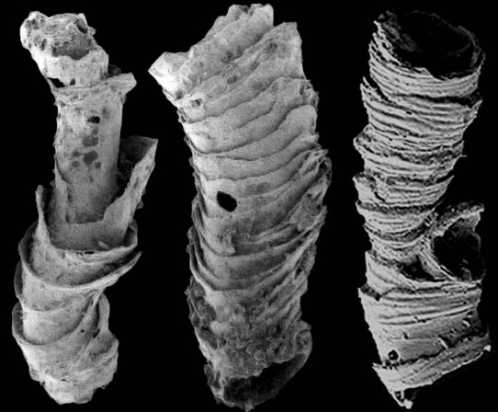
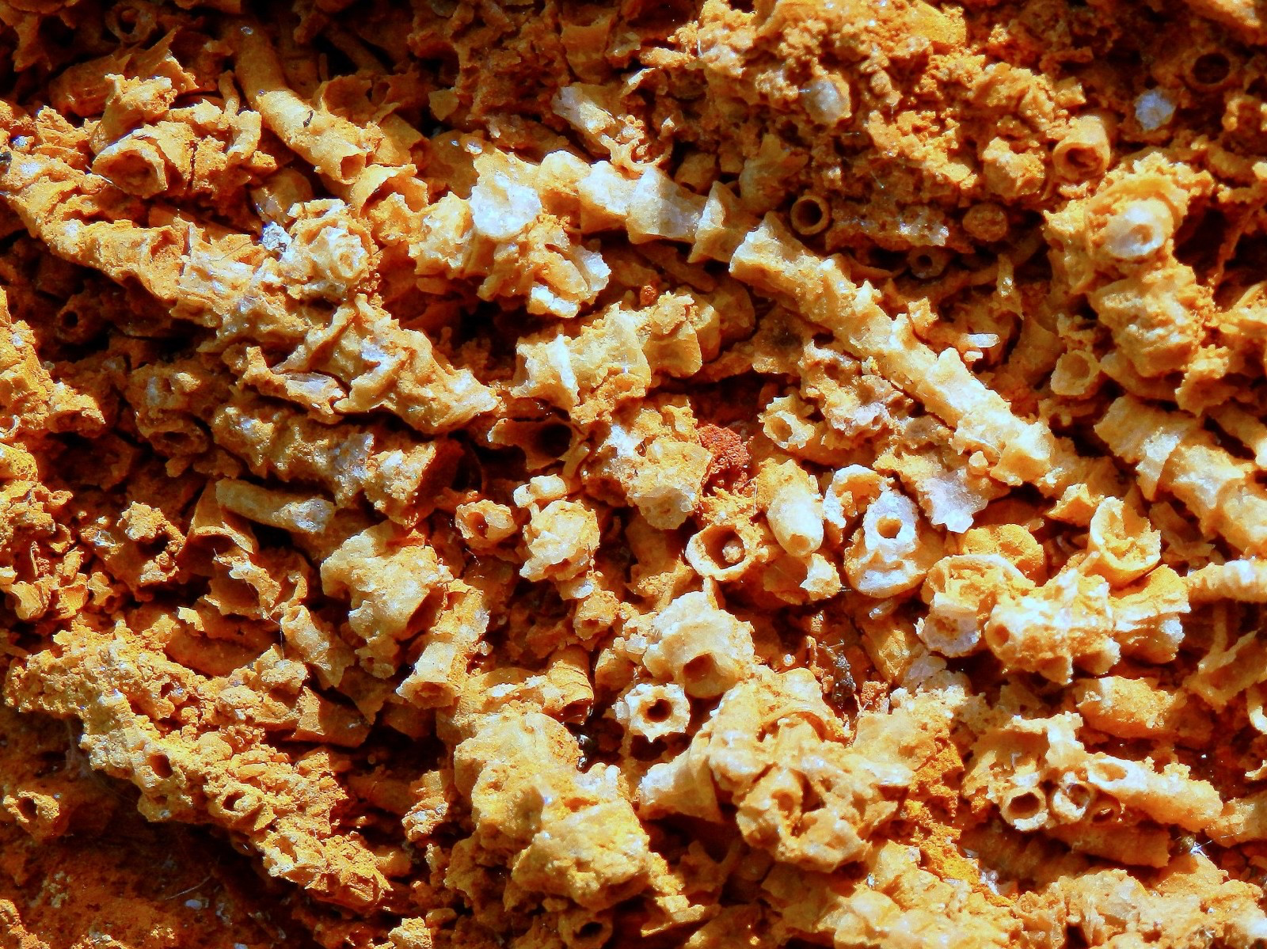
Cloudina
Earliest animal fossils with mineralized skeletonized (shells)
Shells suggest defense against predators; holes suggest attacks
Other early species with shells were not attacked suggesting an evolutionary arms race that may have influenced the Cambrian explosion

Slide 5
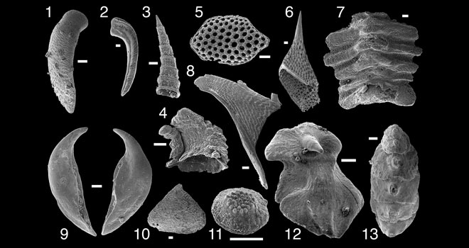
Small shelly fauna
Edicaran shelly fauna
Small shelly fauna examples
Complex structures
Skeletons of calcium carbonate, calcium phosphate, or silica characteristic of almost all extant animal phyla

Slide 6
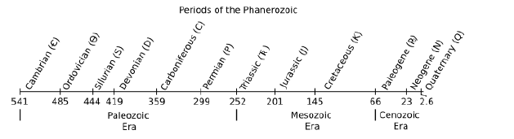
Phanerozoic
Mass extinction of Ediacaran biota
--> First trilobites arise (would survive ~300 my to Permian mass extinction 252 mya)

Slide 7
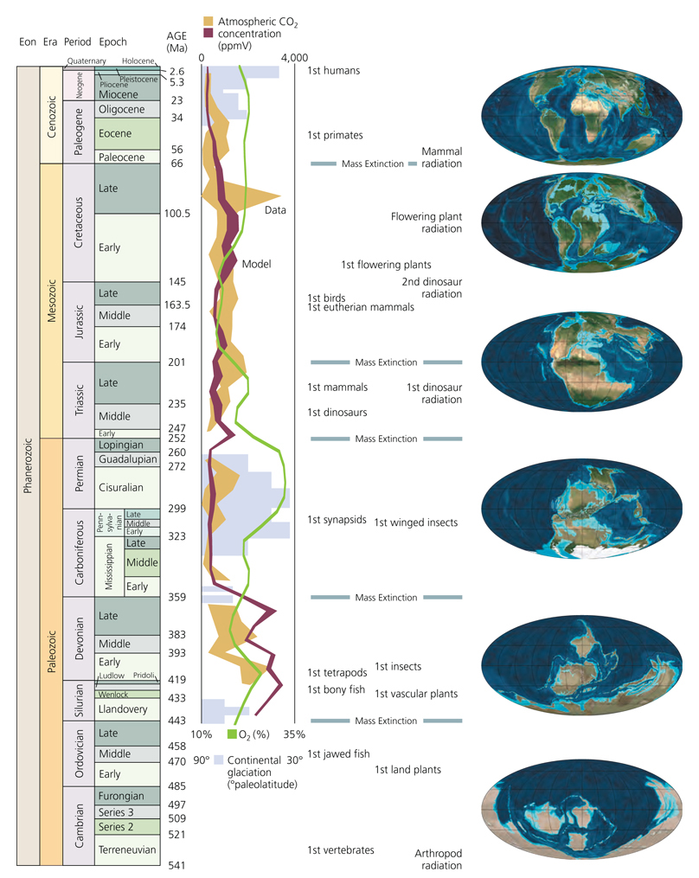
Homo sapiens
Cretaceous-Tertiary
Triassic-Jurassic
Permian- Triassic
Late Devonian
End Ordovician
5+ mass extinctions
since Cambrian

Slide 8
Why the Ediacaran extinction?
Earth’s 1st mass extinction.
Soft-bodied Ediacarans & hard-bodied Metazoans may have coexisted for a time, as shown in recent fossil deposits in Africa.
Introduction to new predators, more complex metazoan animals that could alter their environment.
Reversal of earth’s magnetic field.
Marked by negative δ¹³C excursion in rocks and increased shale deposition resulting from anoxia (O₂ depletion).

Slide 9
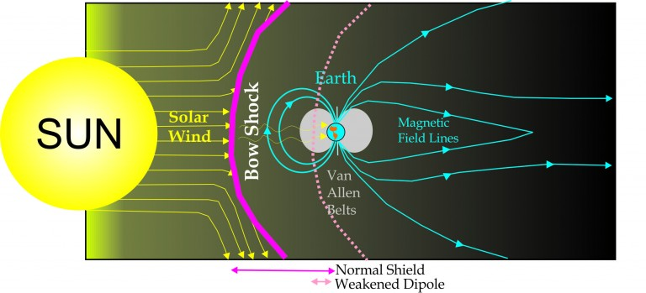
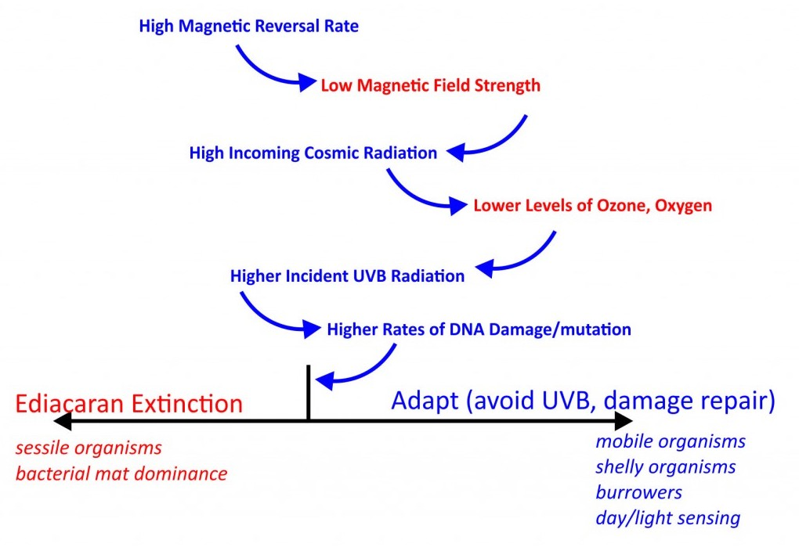
A model for the Ediacarian
mass extinction
https://geology.ufl.edu/news/2016/magnetic-reversals-mass-extinction/

Slide 10
First organized differentiated multicellular eukaryotic fossils 635 mya
Snowball Earth
635-850 mya; possibly wiping out most of the last pre-Cambrian life
First Eukaryotic fossils 1.9 bya
Great oxygenation event 2.4-2.5 bya
First photosynthetic bacteria 3.4 bya (anoxygenic)
Oldest Stromatolites 3.7 bya
Oldest terrestrial rocks 3.8 bya
Earth forms 4.56 bya

Slide 11
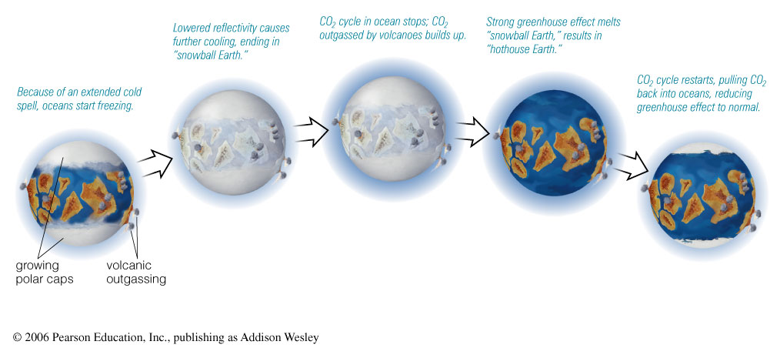
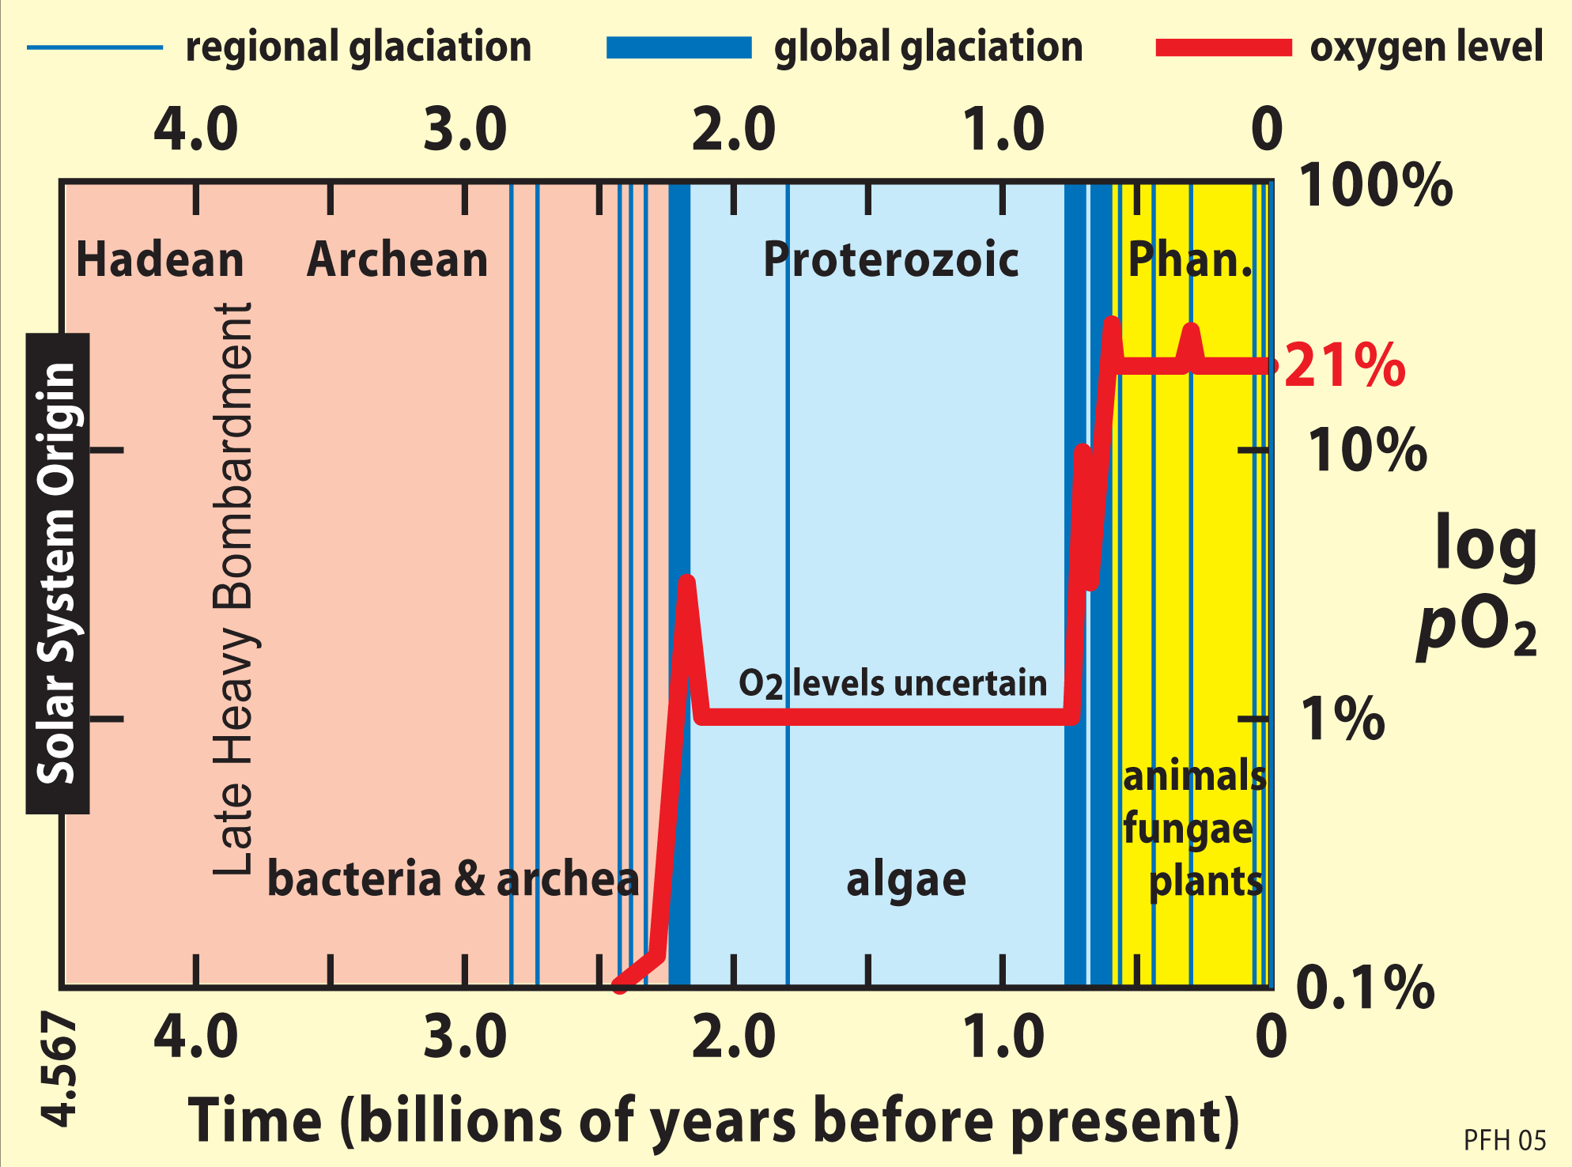
Snowball Earth – up to 5 such events prior to 550 mya
Snowball Effect Melts Itself!

Slide 12
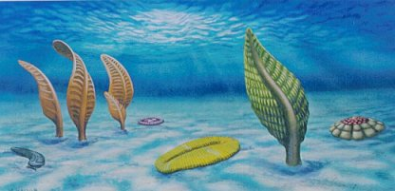
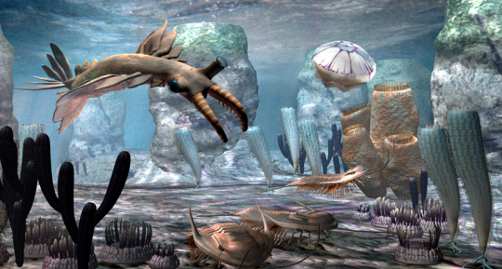
Ediacaran
Cambrian
http://a-dinosaur-a-day.com/post/139813247995/extinction-week-end-ediacaran-extinction

Slide 13
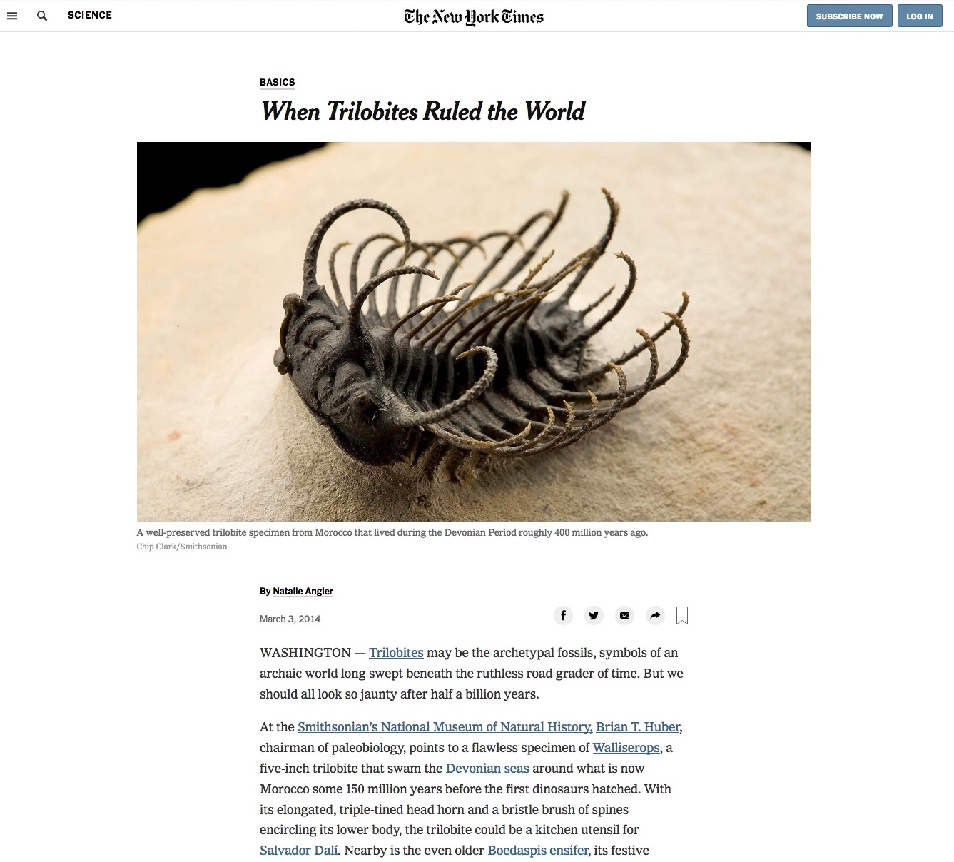

Slide 14
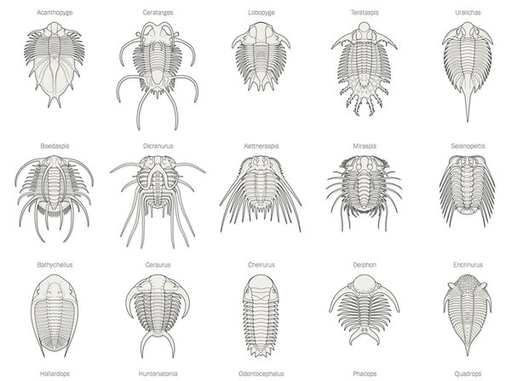
Trilobites: Variations on a Theme
MARCH 3, 2014
Over 300 million years, trilobites evolved a diverse and successful array of forms while maintaining a simple, common body plan.
New York Times – by Natalie Angier
First appeared 521 mya at the very beginning of Cambrian

Slide 15
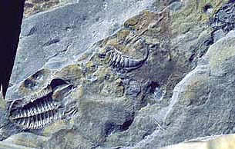
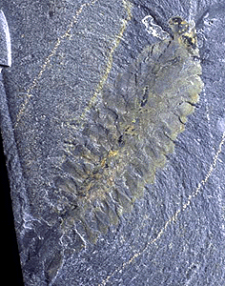
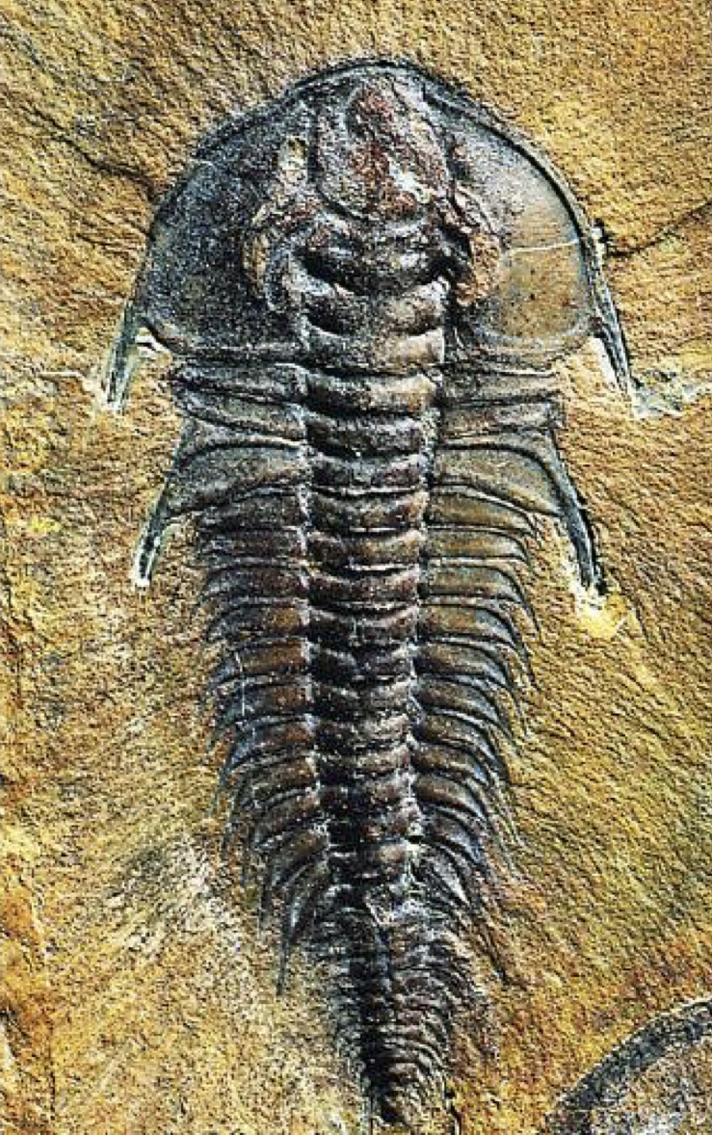
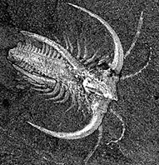
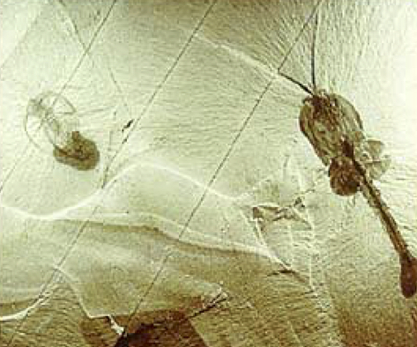
The Cambrian Explosion 540 Mya
Most major animal groups appear
Mollusks, Arthropods, Chordates, Echinoderms, Brachipods, Annelids, etc.
Complex bilaterally symmetric organisms proliferate
Burgess Shale

Slide 16
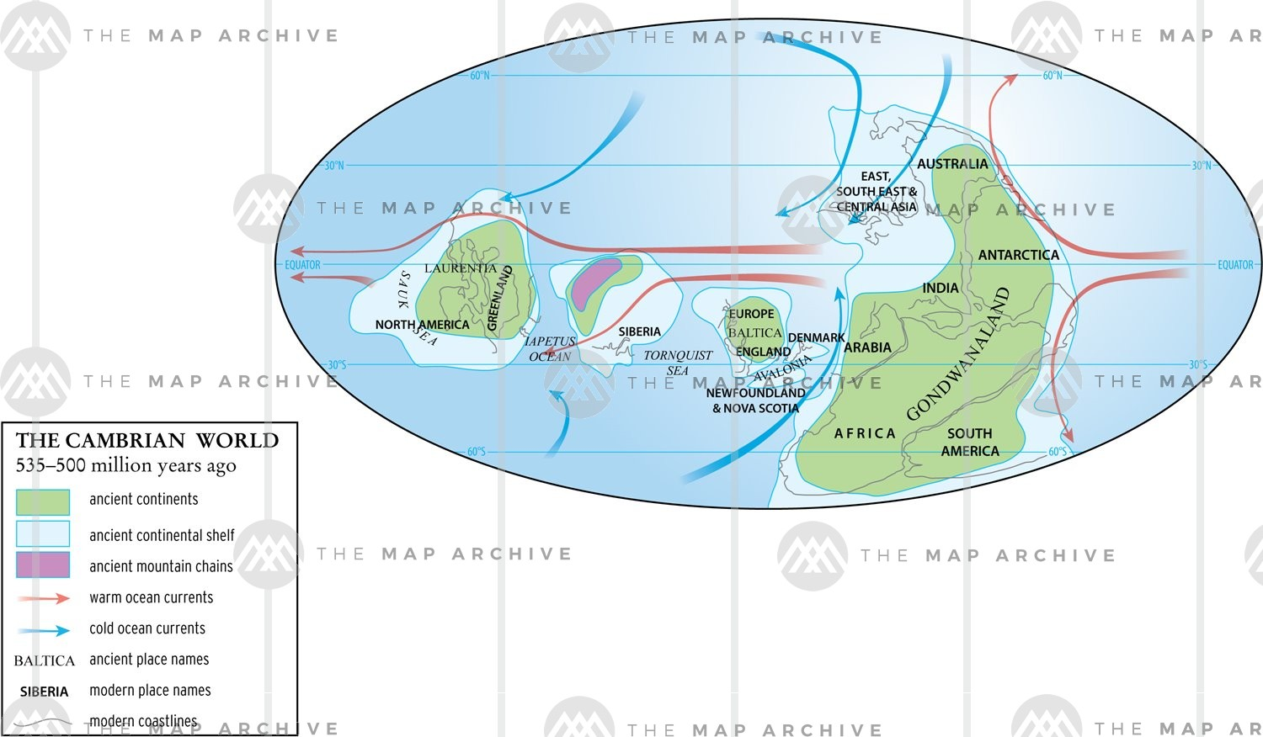
Where on earth was the Burgess Shale?
*

Slide 17
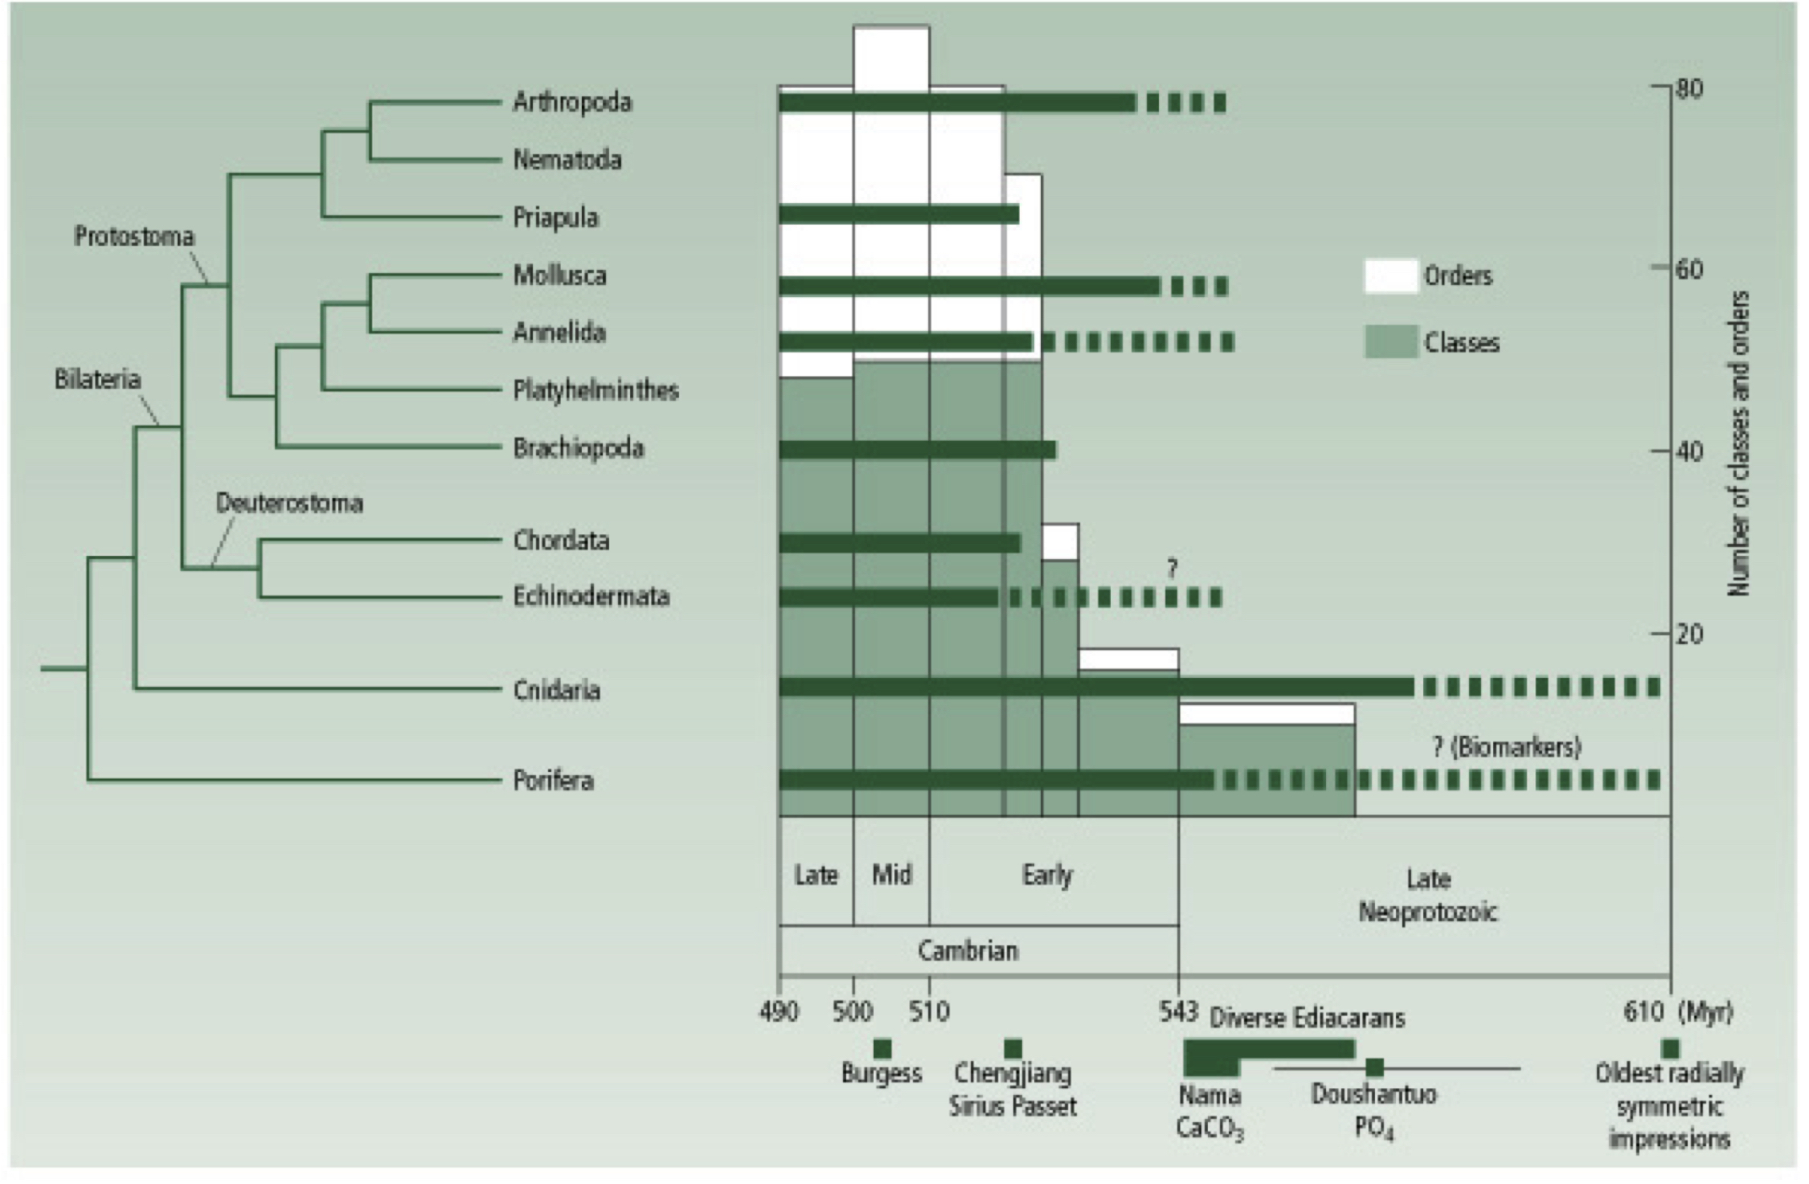
Most major groups emerge from the fossil record in the Cambrian

Slide 18
Phyla/major taxonomic groups present in the Burgess Shale that are extinct or have no modern representatives:
Radiodonta (Dinocaridida): stem-group arthropods such as Anomalocaris and Peytoia.
Lobopodia (Xenusia): Hallucigenia and Aysheaia, represent unique, extinct body plans often called "walking worms".
Chancellorids: originally thought to be sponges, unique to the Cambrian, with no clear living descendants.
Opabiniids: e.g., Opabinia, with five eyes, a flexible proboscis with a claw at the end, does not fit into modern phyla.
Scleritome-bearing Animals: e.g. Wiwaxia (a slug-like, plated, and spined creature) is notoriously difficult to classify and ais considered a stem-group to mollusks or annelids, rather than belonging to any modern, defined phylum.

Slide 19
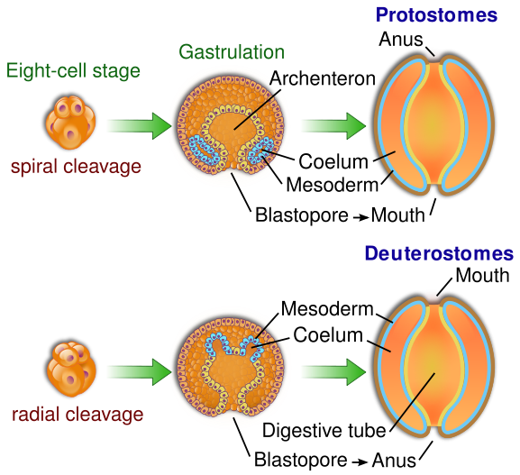
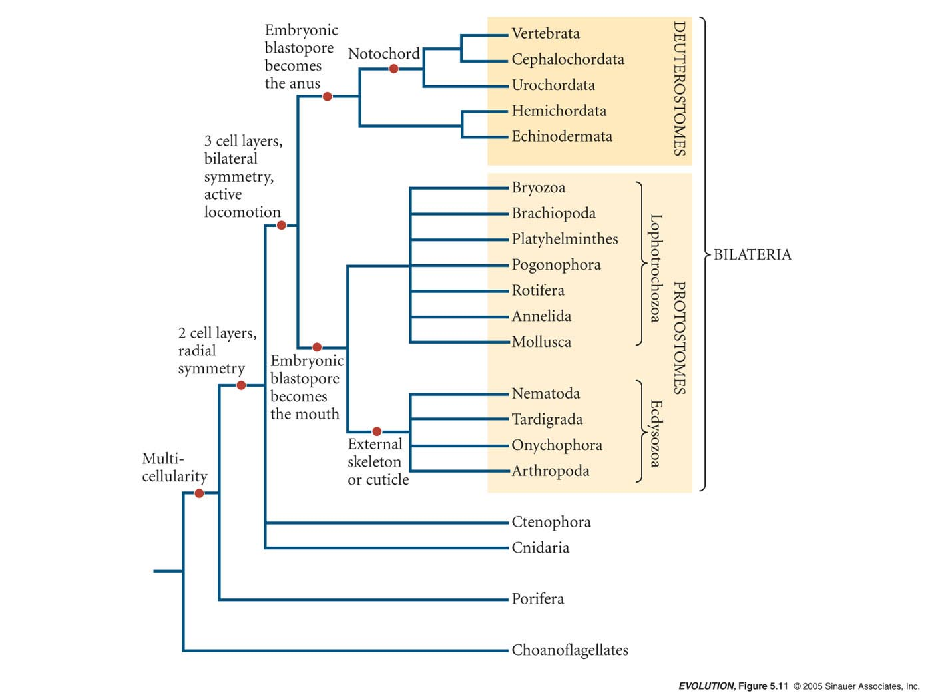
About this time or a little before was the split between the Prostomes & Deuterostomes
Distinguished by their embryonic development;
In deuterostomes, the first opening (the blastopore) becomes the anus.
In protostomes it becomes the mouth.
https://commons.wikimedia.org/w/index.php?curid=8062105

Slide 20
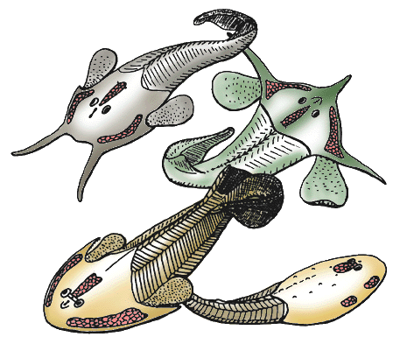
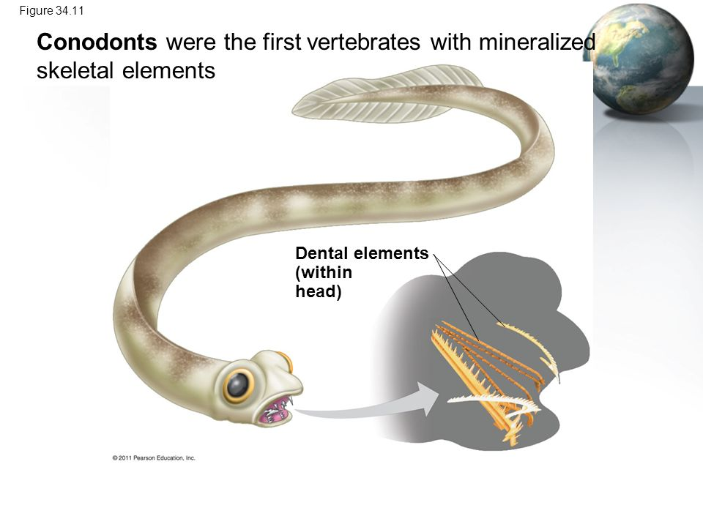
First jawless fishes also arise during the Cambrian Explosion
530 mya
Agnatha (e.g., lamprey)
Gills used for respiration not feeding
Bony heads w/plates
Ostracoderms
By Philippe Janvier - http://tolweb.org/Osteostraci/14842, CC BY 3.0, https://commons.wikimedia.org/w/index.php?curid=22708910

Slide 21
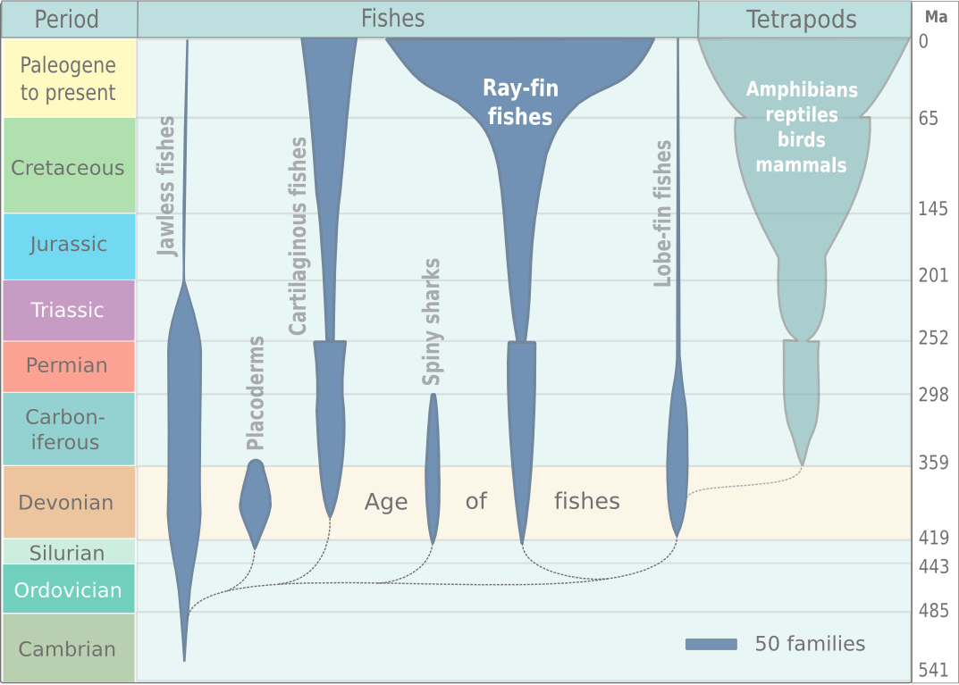
https://en.wikipedia.org/

Slide 22
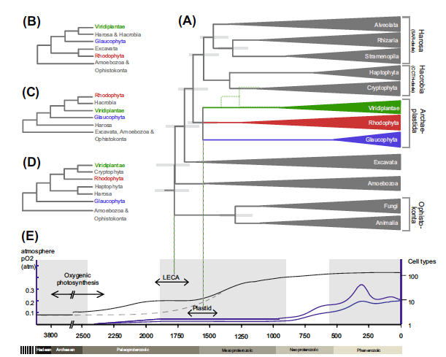
The Evolution of Plants
Red, green, and glaucophyte algae arose ~ 1.5-1.6 bya
De Clerk, O., K.A. Bogaert, and F. Leliaert. 2012. Om Advances n Botanical Research Vol. 64.

Slide 23
The Evolution of Plants
Phanerozoic
First terrestrial nonvascular plants - Bryophytes
Appearance in fossil record of several multicellular phyla
“Cambrian Explosion” - occurred over 10s of millions of years

Slide 24
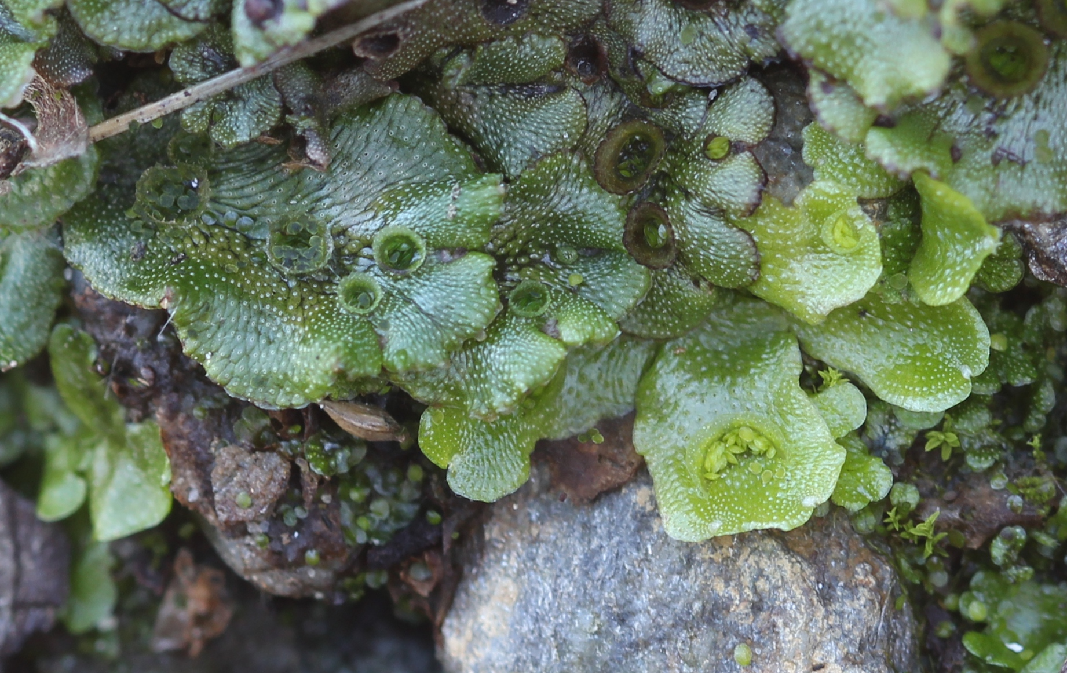
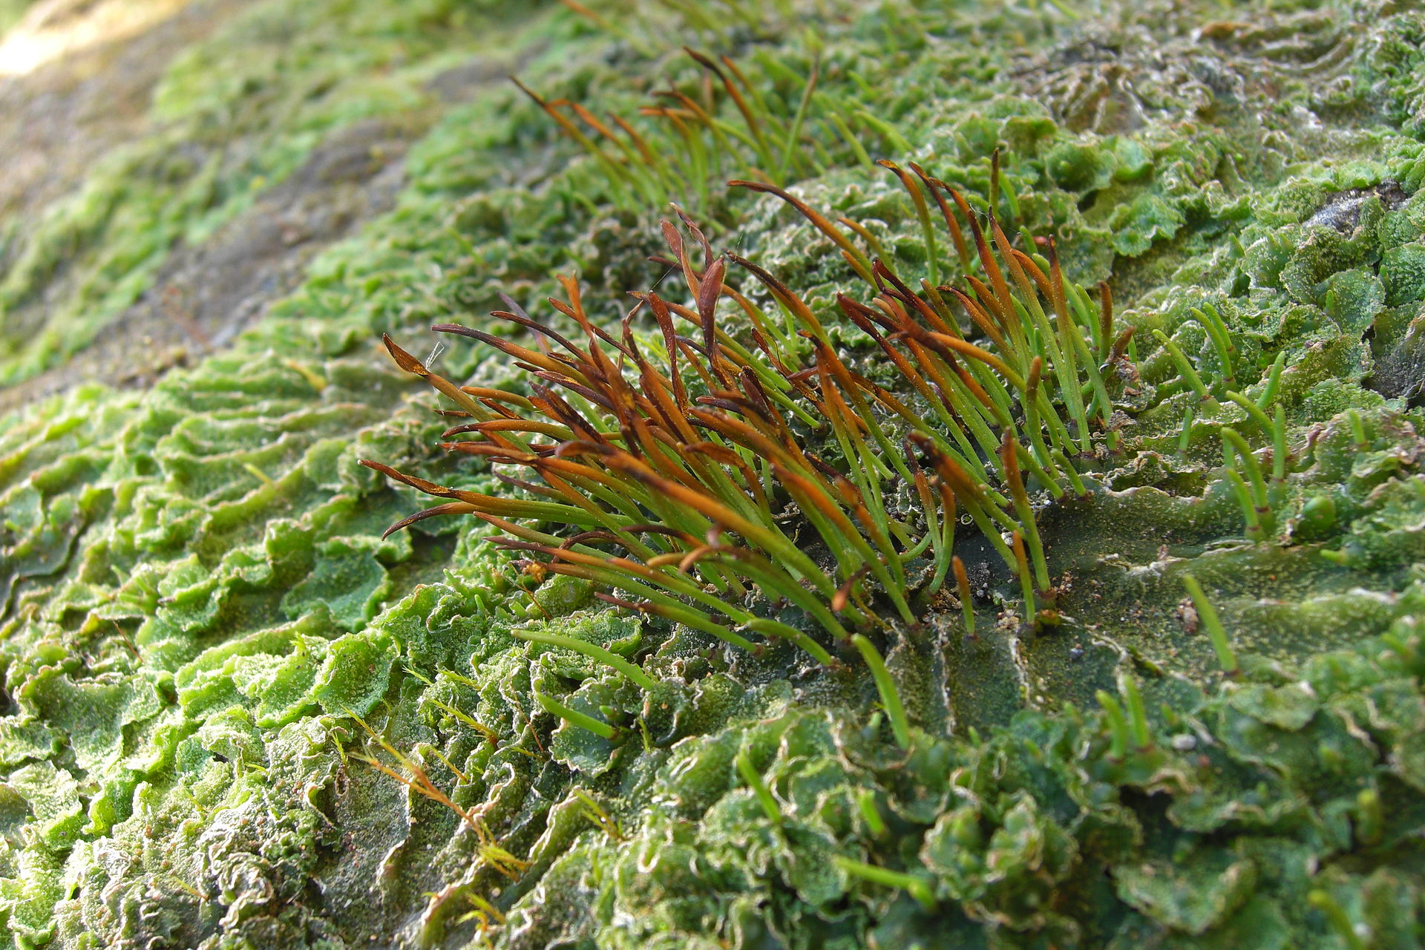
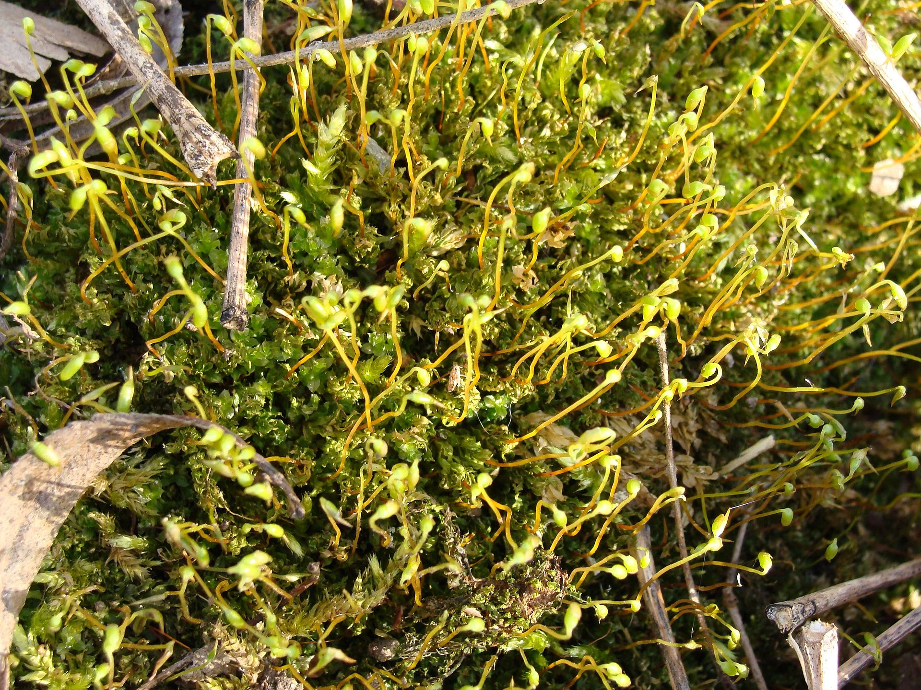
Bryophytes
liverwort
hornwort
moss

Slide 25
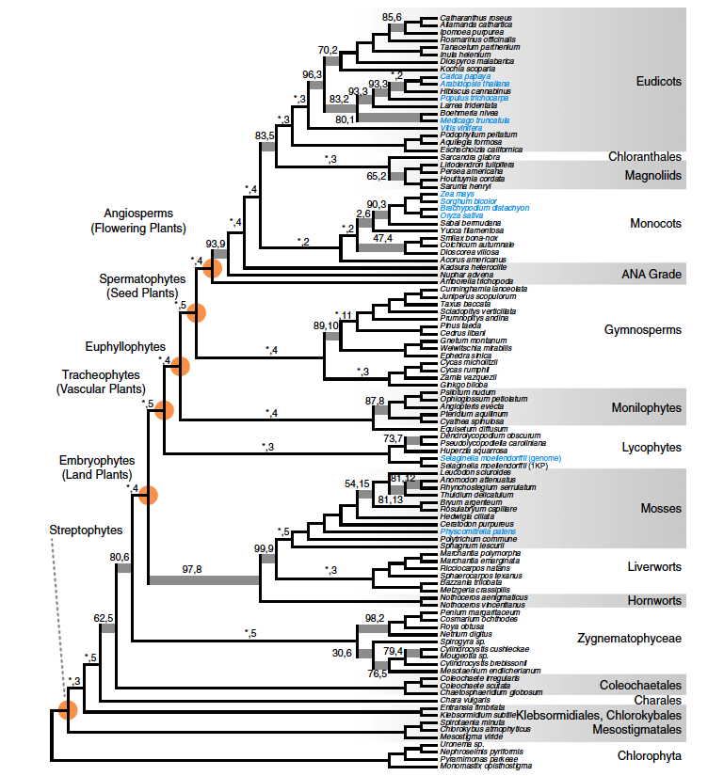
Plant Evolution Proceeded in Two Directions from a Common Ancestor
Vascular Plants
Bryophytes
(Non-vascular)
Sporophyte nurtured on gametophyte
Flagellated sperm
(Green algae - Outgroup)

Slide 26
The Evolution of Plants
Phanerozoic
First vascular plants
First terrestrial nonvascular plants - Bryophytes

Slide 27
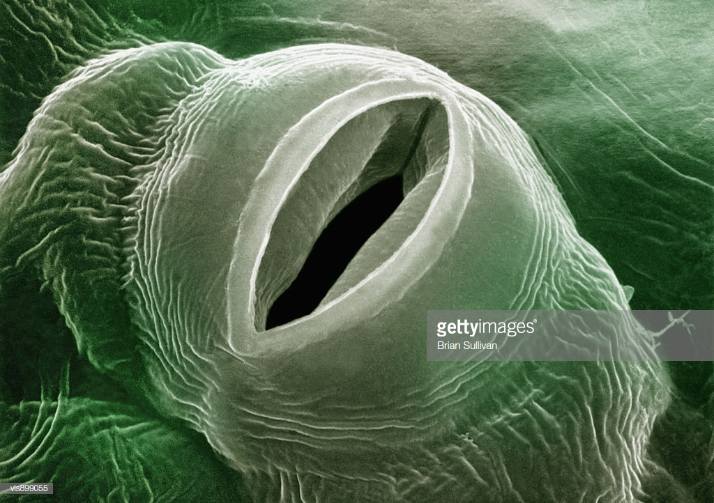
Features required to live on land (not found in Bryophytes)
Mechanisms to reduce water loss
Cuticle
Guard cells to open and close stomata
Mechanism to absorb water from soil (roots & vasculature)
Mechanism to move water around the plant (vasculature)
Mechanism to get the sperm to the egg without swimming through water for sexual reproduction
Stomata

Slide 28
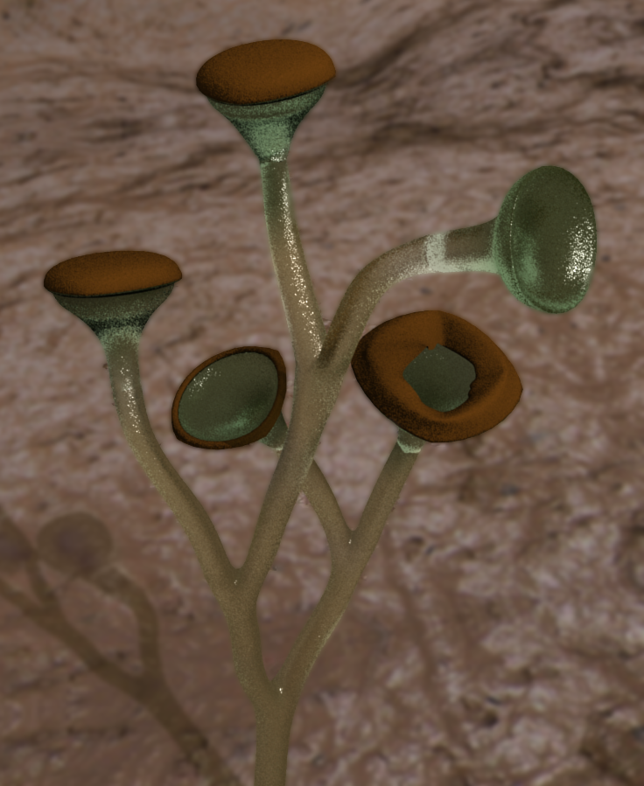
Cooksonia pertoni – artists rendering from fossils of the first vascular plant species
https://commons.wikimedia.org/wiki/File:Cooksonia_pertoni_revised.png

Slide 29
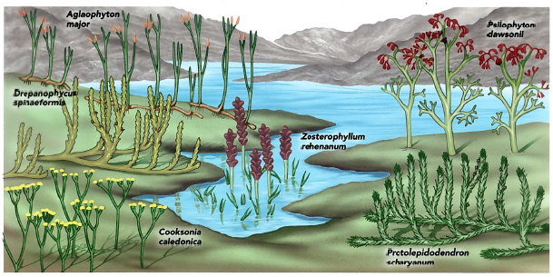
Seedless Vascular Plants
Modern representatives are whisk ferns, lycopods, quillworts, horsetails, ferns

Slide 30
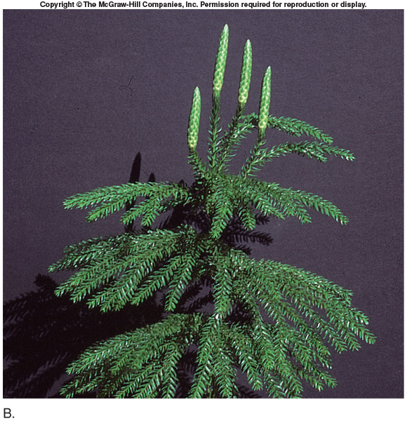
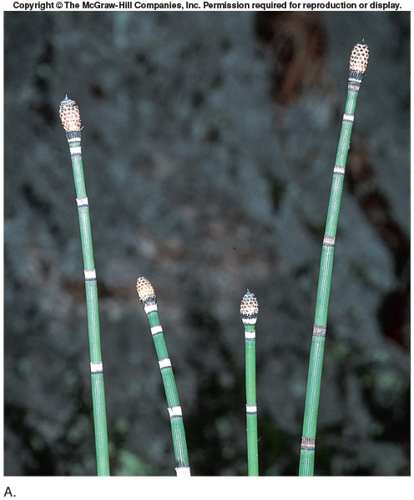
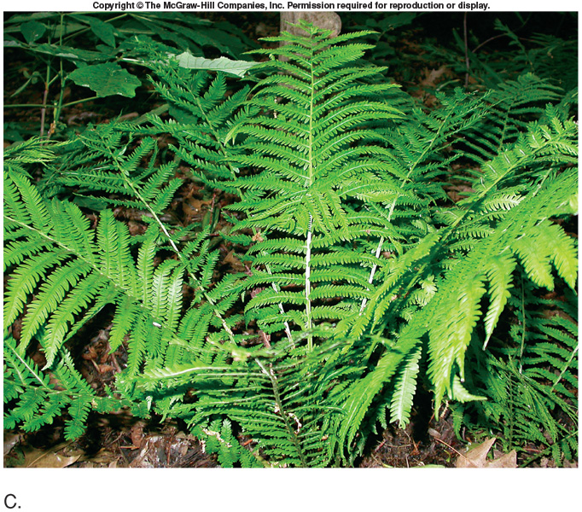
Lycopodium - Clubmoss
Equisetum - Horsetail
Fern

Slide 31
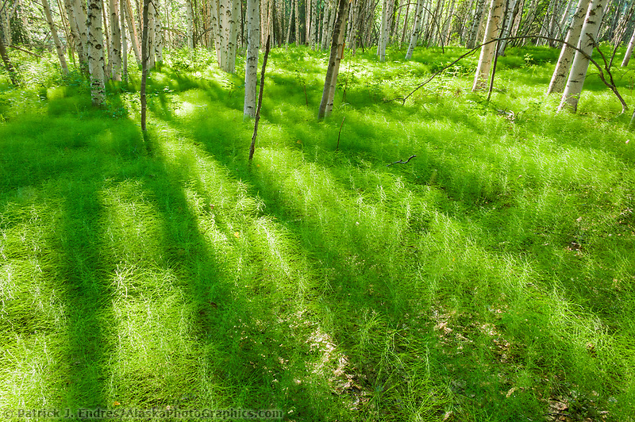
Birch forests with carpet of Equisetum in Fairbanks, Alaska
Equisetum in the boreal forest

Slide 32
Phanerozoic
Carboniferous = Coal age – 60 M years
Large forests of Lycophytes, Equisetums, and Ferns
First vascular plants

Slide 33
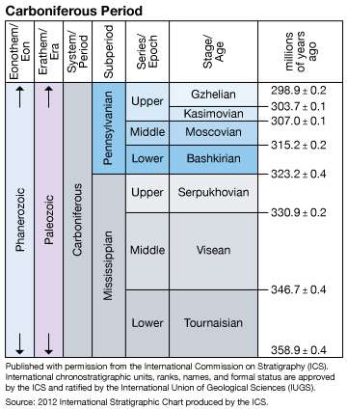
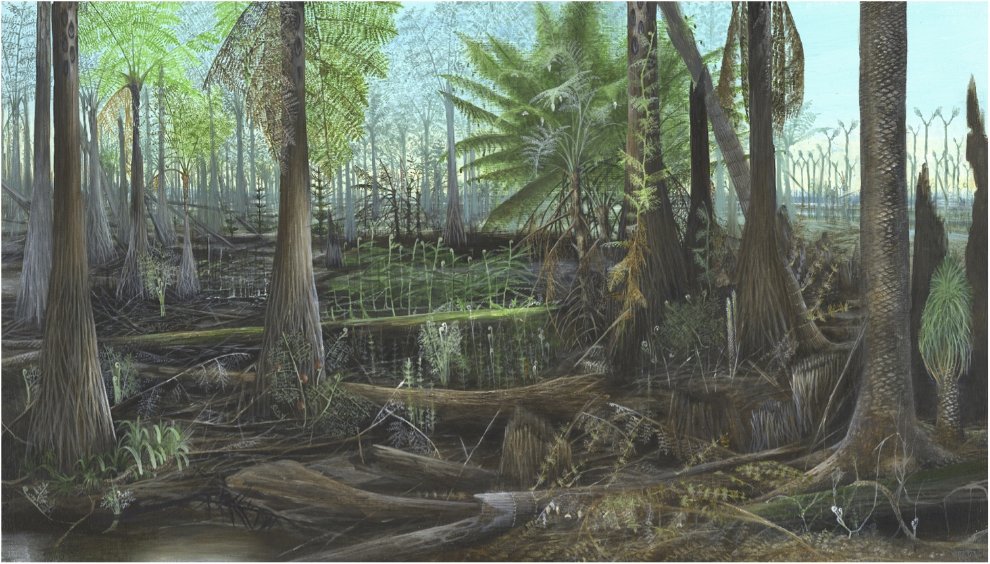
Willard, D.A., Phillips, T.L., Lesnikowska, W.A. and DiMichele, W.A. 2007. Paleoecology of the Late Pennsylvanian-Age Calhoun coal bed and implications for long-term dynamics of wetland ecosystems, International Journal of Coal Geology, 69:21-54. ETE publication 129.

Slide 34
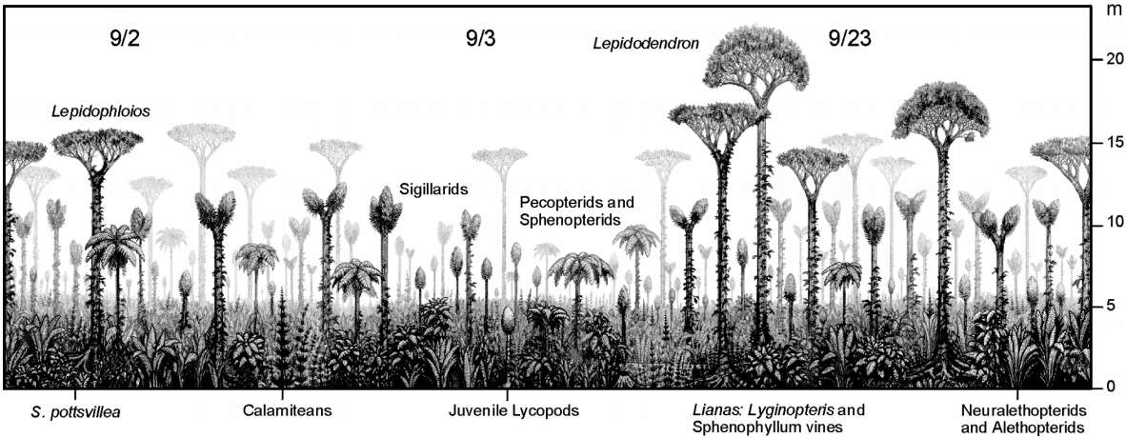
No flowering plants, fern like plants, giant horesetails
Carboniferous flora, up to 100 ft tall
https://www.fossilguy.com/sites/ambridge/index.htm
Why?

Slide 35
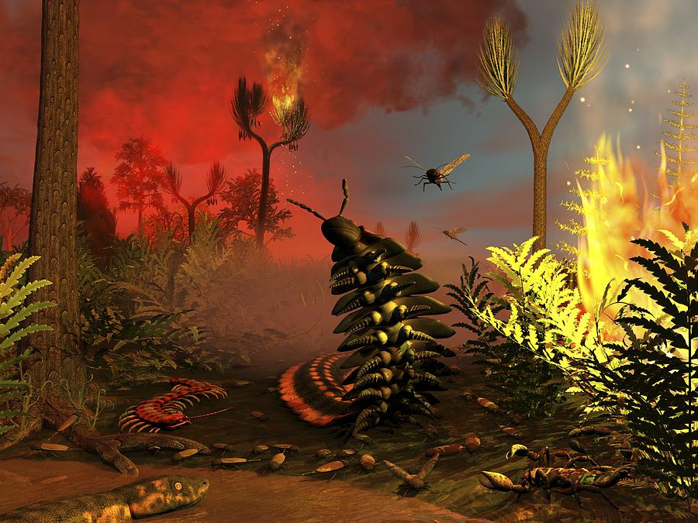
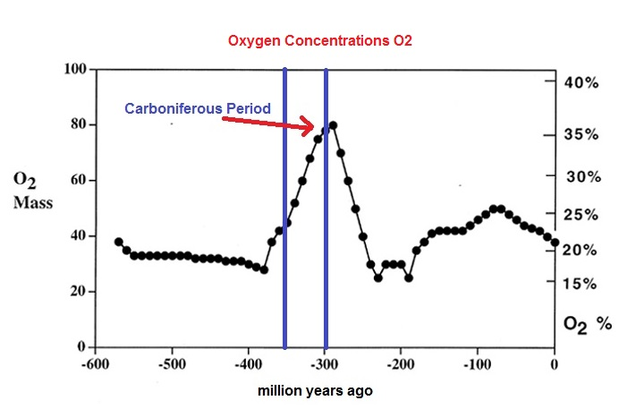
https://pixels.com/featured/carboniferous-forest-fire-artwork-science-photo-library.html
O₂ as high as 35%
Lots of CO₂
sequestered in plants
and underground

Slide 36
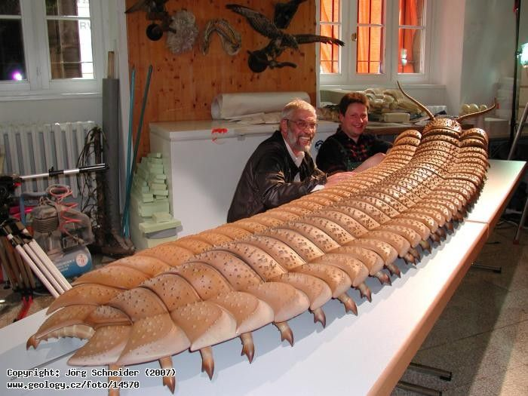
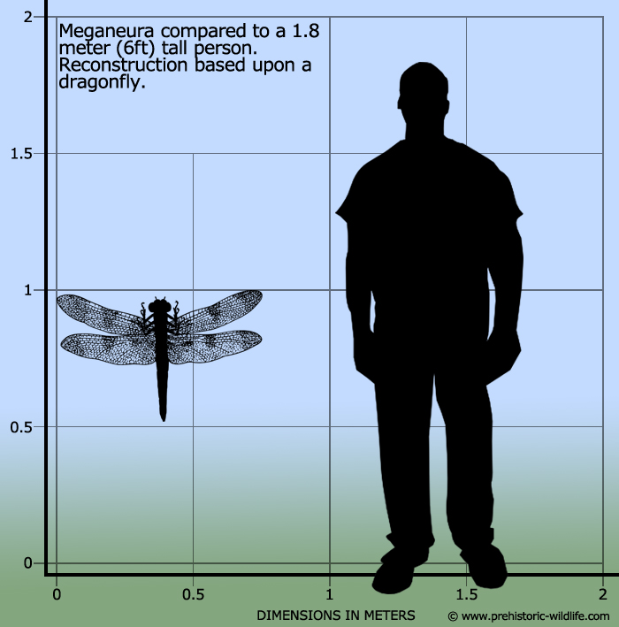
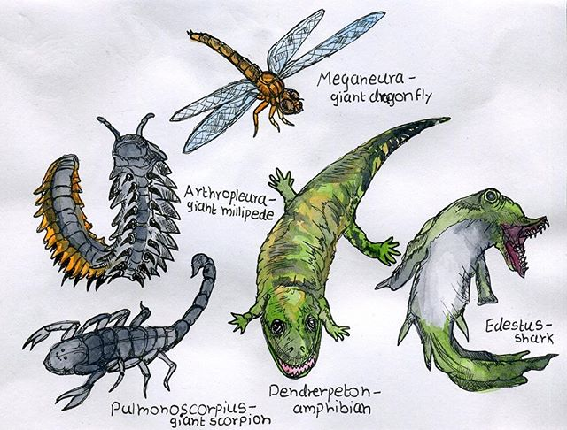
Dragonfly 1 m wingspan
Millipede 3 m long
First sharks
Giant Scorpion
Edmund Rogers @edmundrogers98
Giant amphibians own the alligator niche

Slide 37

Episode 2 -
Life Before the Dinosaurs
https://www.youtube.com/watch?v=Gwo62OmuUGA

Slide 38




Lowland, coastal swamps during the Coal Age
Little decomposition due to low oxygen in the swampy waters
Over geologic time the organic matter was compressed into coal
The carboniferous is still burning!

Slide 39

The first seed-producing plants (Gymnosperms) appeared in the fossil record during the Carboniferous (Coal Age)
In a relatively brief time, they became the most abundant plants on earth
(still not flowering plants)

Slide 40



http://www.garthlenz.com/forests/web-temperate-rainforest-1
Common in Triassic
Monkey puzzle tree, Araucaria araucana
This lineage evolved 300 mya

Slide 41

https://www.gettyimages.com/videos/araucaria-araucana
Araucaria forest near the Chile/Argentina border

Slide 42

Common in Florida gardens
Endemic to Norfolk Island (near Australia between NZ and New Caledonia)
Planted around the the world
Brittle, so can’t be used for ship masts
Norfolk Island Pine (Araucaria heterophylla)

Slide 43
End Permian extinction
2/3 of all terrestrial animals extinct
forests disappear briefly, increased CO₂,
decreased O₂
Phanerozoic
First seed plants
Gymnosperms
Gymnosperms dominant in Triassic & Jurassic
First vascular plants
First terrestrial nonvascular plants - Bryophytes

Slide 44
What caused the end Permian extinction?
P-T or Permian-Triassic Extinction, i.e. The Great Dying
96% of all marine species, 70% of terrestrial vertebrates, & only known mass insect extinction prior to now
e.g., trilobites, 97% of ammonites, spiny sharks
Long recovery period
Meteors, volcanic explosions, and coal fires led to => runaway greenhouse effect
Evidence – no coal deposits from early Triassic

Slide 45

https://www.skepticalscience.com/pollution-part-2.html
Does some of this look familiar now?

Slide 46

https://www.researchgate.net/profile/Gwenael-Caravaca

Slide 47


Slide 48


“… seagoing tetrapods were more ancient than traditionally supposed and probably paralleled the explosive reconfiguration of modern invertebrate marine biotas during the first ∼1 million years of the Triassic.”
“… heterogeneous marine vertebrate communities were well established by the late-earliest Triassic (Dienerian-Smithian, ∼251 ma) and integrated fully variegate tetrapod niches by ∼3 million years after the EPME.”
---Roberts et al. al. Science (2025)

Slide 49


The sixth mass extinction
History shows a net increase in # species
This follows each mass extinction
Will the same happen with a human causes mass extinction?
Extinction rates = 100-10,000X greater now

Slide 50

https://animalsurvival.org/is-the-planet-facing-its-next-mass-extinction/

Slide 51


Slide 52

https://share.google/images/86I1OFtdRmz9p6ufE

Slide 53

http://science.sciencemag.org/content/356/6335/270

Slide 54

Rise of the gymnosperms in Triassic/Jurassic coincides with a whole genome duplication (WGD) event
Genome duplications are common in plants, can lead to instantaneous speciation.
Jiao et al. 2011.Nature

Slide 55

chromosome
doubling
14 x 2
hybridization
event
28 + 14
http://www.sbs.utexas.edu/levin/bio213/evolution/speciation.html
Genome duplication led to modern wheat as we know it.

Slide 56

The dominance of gymnosperms also coincides with the development of the supercontinent, Pangaea; the continents have merged into 1 giant super continent.
Triassic =>
Early Triassic

Slide 57
Key evolutionary innovations of Gymnosperms
Seeds
Protective coat for the embryo
Food supply for the embryo
Potentially dormant for long periods
Water not required for fertilization
Fire resistant

Slide 58




Cycad
female
male
Ginko biloba
female
male
Welwitschia
mirabilis
Pines

Slide 59

Giant Sequoia - Sequoiadendron giganteum
Sequioa National Monument
https://www.sierraclub.org/sierra/giant-sequoia-national-monument-next-hit-list

Slide 60

Slash Pines (Pinus elliottii) https://en.wikipedia.org/wiki/South_Florida_rocklands

Slide 61

Cypress – Taxodium spp.

