Slide 1
Introduction to Population Genetics
Population Genomics
Cochabamba, Bolivia
Gen-Pob’25

Slide 2
What is Population Genetics?
  Population Genetics is the study of allele and genotype frequencies, how they change over time, and the factors contributing to these changes
  Population Genetics is a sub-discipline of Population Biology
    Population Ecology is the other subdiscipline
Population Biology
Population Ecology
Population Genetics
Populations defined in terms of population sizes; birth rates, death rates, immigration, & competition.
Populations defined in terms of genetic diversity; mutation rates, genetic drift, immigration, & natural selection.

Slide 3
What factors influence genetic diversity?
Immigration
Emigration
Population: Genetic Diversity
Mutation
Genetic Drift
Natural selection
Mutation – heritable change in DNA
Genetic drift – random fluctuations of allele frequencies resulting from the random sampling of gametes
Natural selection – the process by which heritable traits that increase the survivability or the reproductive potential of individuals become more common over time
Gene flow – exchange of genes between populations
immigration – movement of genes into a population
Nonrandom mating – Individuals more likely to mate with genetically similar (positive assortative mating) or dissimilar (negative assortative mating) individuals

Slide 4
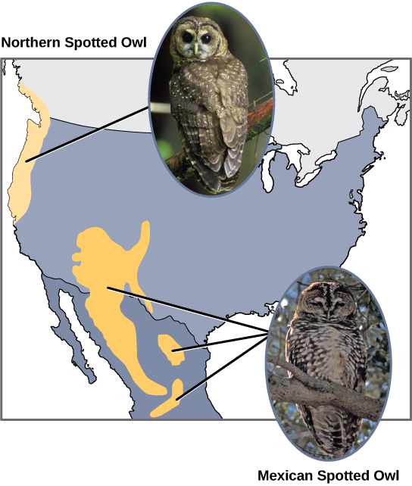
What is a population?
  A population is a group of inter-breeding individuals.
    Consists of members of the same species
    Any individual has the potential to mate with any other individual in the same population
    Geographically continuous
    Can be studied as a unit
  Caution: scientists often consider a specific group within a small geographic area as a population without really knowing the population boundaries (e.g., individuals within a study site).
https://cnx.org/resources/6e6c88a5135b9bb38f9b69f139d28fee5a11436d/Figure_18_02_04.jpg

Slide 5
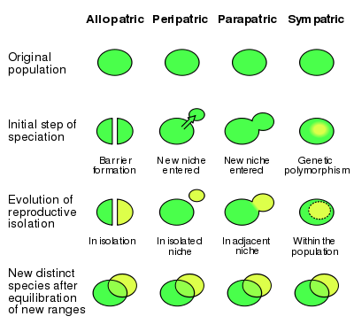
Purview of Population Genetics
Investigates genetic variation among individuals within groups (populations, gene pools).
Usually in natural populations, examining genetic variation over space and time.
Evolution: change in allele frequencies between generations
  Adaptation & speciation
https://en.wikipedia.org/

Slide 6
Role of Population Genetics in Human Medicine
Highly relevant to every heritable disease with a genetic or epigenetic basis, a majority of diseases we strive to treat or cure.
Enables an understanding of why a disease exists in the first place and how it is transmitted from one generation to the next.
Understanding and addressing the evolution of drug resistance in pathogens.
Human Genetics Departments employ population geneticists, statistical geneticists, genome scientists, bioinformaticians, and computer programmers in every medical school.

Slide 7
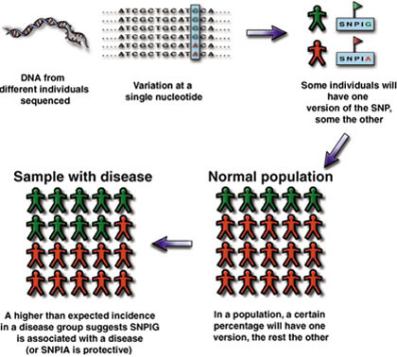
Medical Genetics: Genome-wide association studies use single nucleotide polymorphisms (SNPs) to link genes to disease
© Gibson & Muse, A Primer of Genome Science

Slide 8
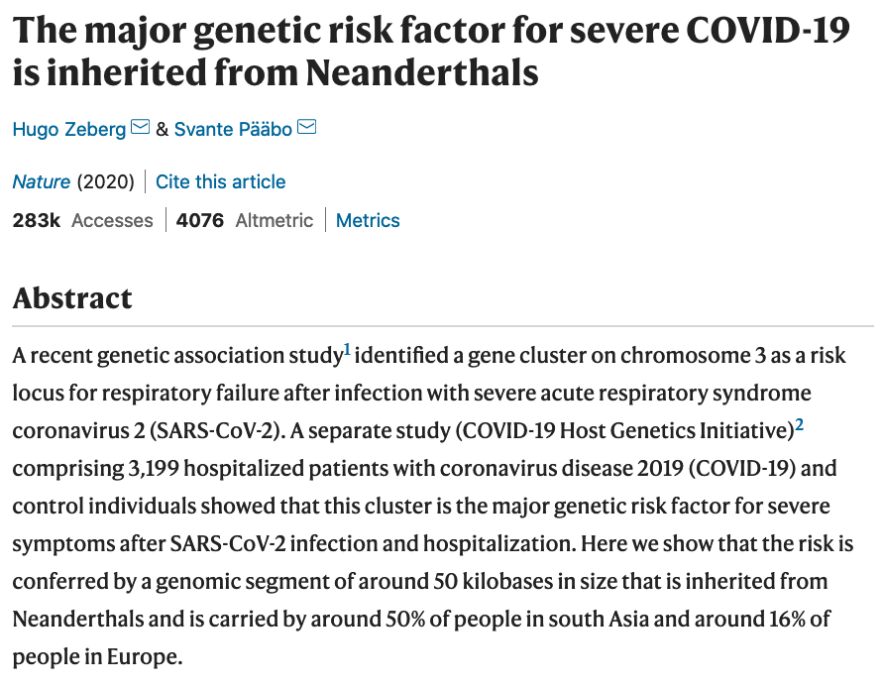
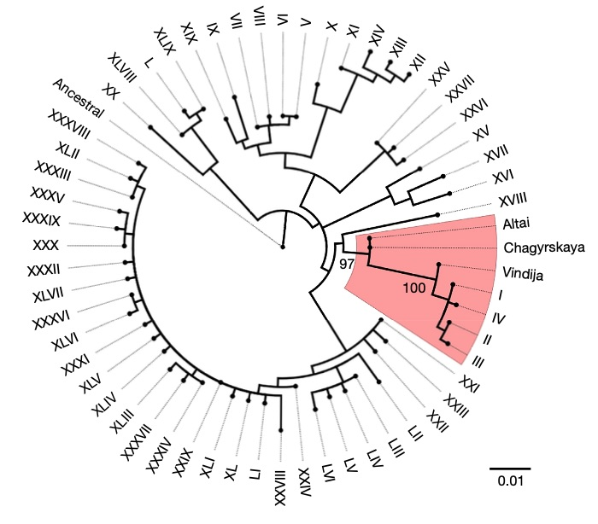
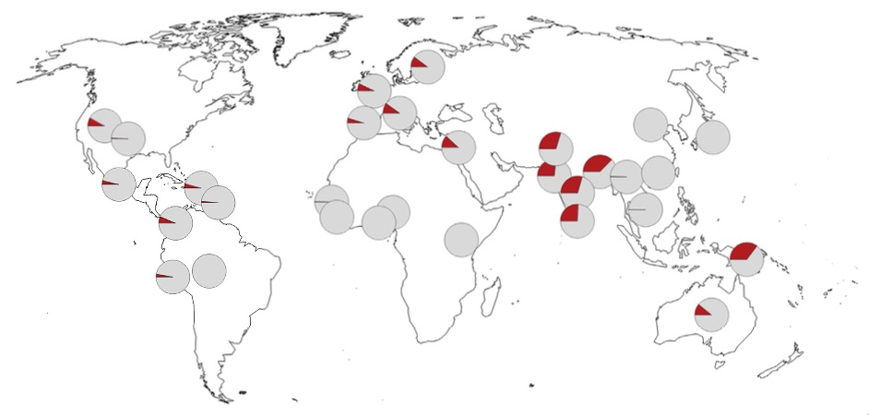
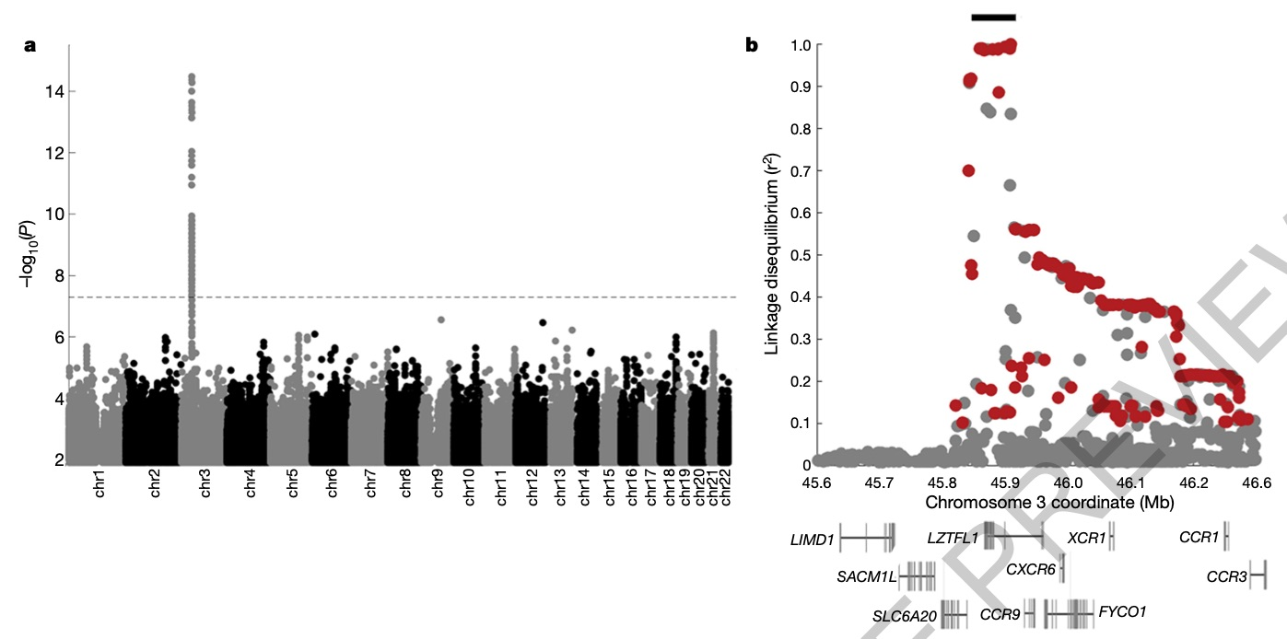

Slide 9
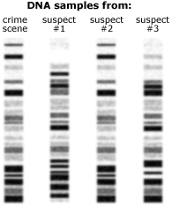
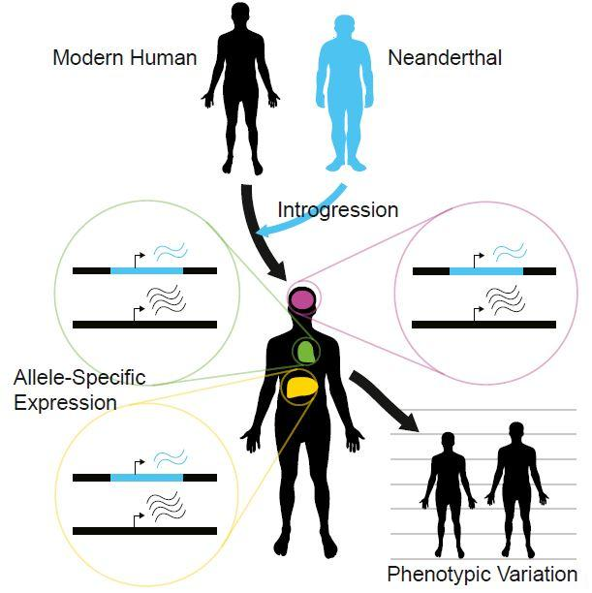
Additional Roles of Population Genetics
Plant and animal breeding systems.
Agriculture—Pesticide and herbicide resistance.
Forensics—DNA fingerprinting.
Conservation Biology—habitat fragmentation and endangered species.
Origins of modern humans and human evolution.
https://www.eurekalert.org/pub_releases/2017-02/cp-ndc021617.php

Slide 10
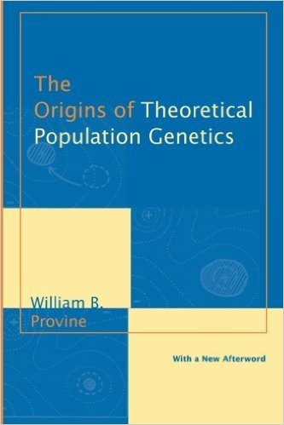
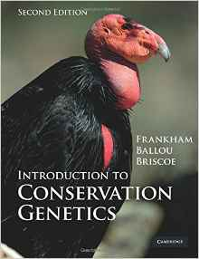
Different Types of Population Genetics
  Empirical population genetics: measures and quantifies aspects of genetic variation in populations.
  Theoretical (mathematical) population genetics: explains variation in terms of mathematical models of the forces that change allele frequencies (genetics drift, selection, gene flow, etc.).

Slide 11
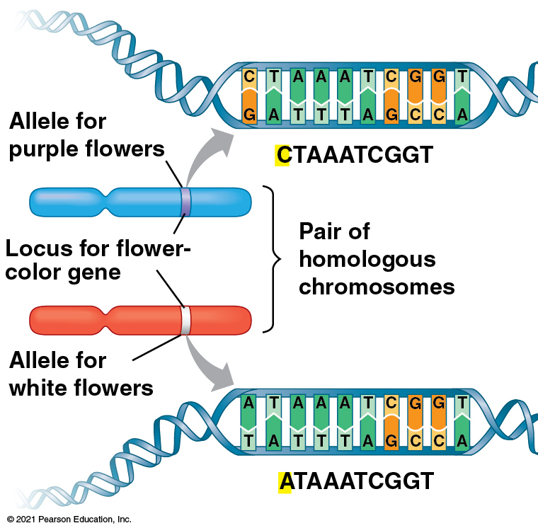
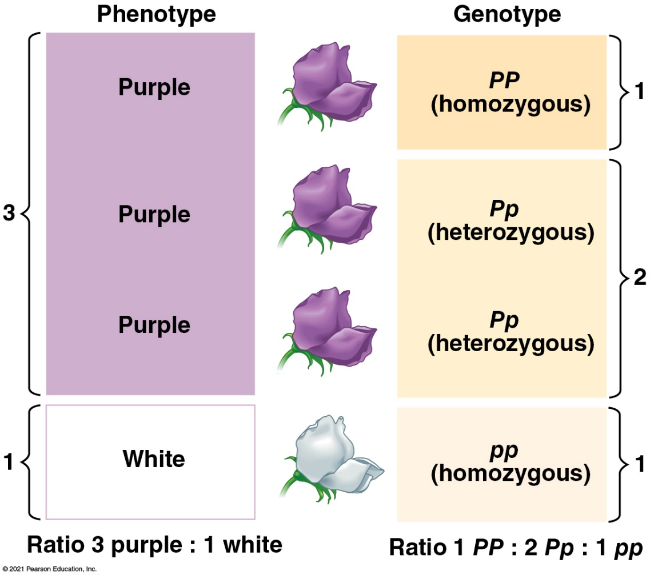
Vocabulary
Gene – a segment of DNA; often used specifically for a segment of DNA that codes for a protein (e.g., gene that codes for flower color in pea plants)
Alleles – alternate forms of a gene that have the potential to occupy the same space on a chromosome (Allele for purple flowers (P) vs. allele for white flowers (p))
Locus (plural loci) – the specific location of a gene or DNA sequence on a chromosome
Note: in the scientific literature, locus is often used to denote a specific segment or position of DNA that is being studied.
Genotype – the combination of alleles situated on corresponding chromosomes (PP, Pp, pp)
Gene pool – Complete set of alleles for a gene within a population

Slide 12
Common Types of Genetic Variation
Single nucleotide polymorphisms (SNPs)—variation in a single base pair in a DNA sequence
Allele 1: AGGCATTA
Allele 2: AGGTATTA
  Result from point mutations

Slide 13
Common Types of Genetic Variation
Indels—insertion or deletion of one or more bases in a DNA sequence
Allele 1: AGGCATTA
Allele 2: AG––ATTA
  Microsatellites (simple sequence repeats, SSRs)—insertion or deletion of repetitive units
    Alleles vary in length (number of bases or repeat units)
Allele 1: CTCTCTCT (4 repeats)
Allele 2: CTCTCT–- (3 repeats)
Allele 3: CTCT---- (2 repeats)

Slide 14
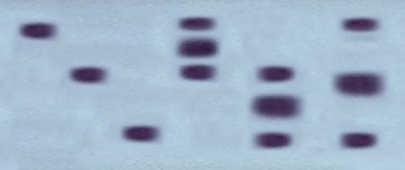
Measuring Genetic Variation
Protein electrophoresis (allozymes)— mid-1960s
  One of the first molecular markers applied to population genetics
  Differ in amino acid sequence, resulting in different net charges or shapes
  Different alleles migrate through gels at different rates through gels
  Advantage: Abundant data could be accumulated for many species
  Disadvantage: Hidden genetic variation
Homozygotes
Heterozygotes
Allele 1
Allele 2
Allele 3

Slide 15
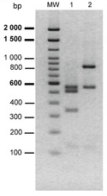
Measuring Genetic Variation
Restriction fragment length polymorphisms – late 1960s
  Restriction enzymes recognize specific sequences (usually 4, 5, or 6 bases) and cut DNA between specific sites
    E.g., HaeIII: 5’-GG/CC-3’; AlwI: 5’-GGAT/C-3’; EcoRI: 5’-G/AATTC-3’
    (‘/’ denotes the cut site)
  Variation in cut sites
    E.g., GAATTC vs. GTATTC (only the first allele is cut by EcoRI)
  Electrophoresis: Fragments of different sizes migrate through gel at different rates (smaller fragments migrate more rapidly)
  Advantage: Several hundred restriction enzymes available
  Disadvantage: Dominant marker system = hidden variation

Slide 16
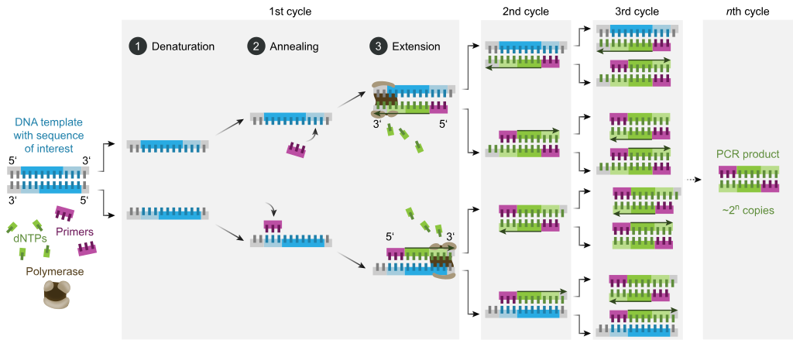
Measuring Genetic Variation
Polymerase chain reaction – 1980s
  Amplify specific regions of DNA (loci) – produce billions of copies
  Increased the ease of working with DNA
  Revolutionized population genetics
https://en.wikipedia.org/wiki/Polymerase_chain_reaction

Slide 17
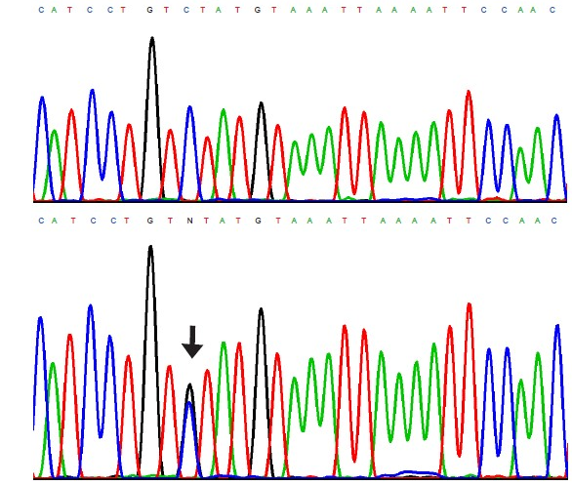
Measuring Genetic Variation
Sanger Sequencing
  Developed in mid-1970s; became popular in late-1980s with the development of PCR
  Determine the exact order of nucleotides within a locus or gene
  Advantage: detect all variation at a locus
  Disadvantages: Expensive, time-consuming, and need prior knowledge of sequences to design primers
https://www.nrronline.org/viewimage.asp?img=NeuralRegenRes_2014_9_10_1068_133173_f5.jpg

Slide 18
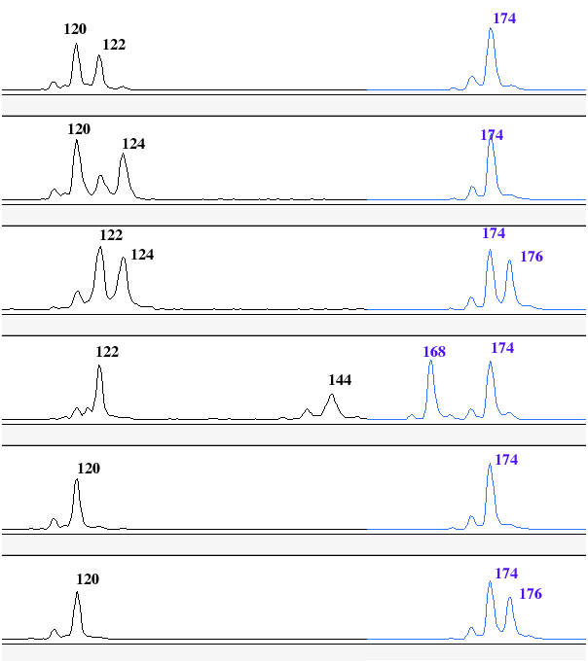
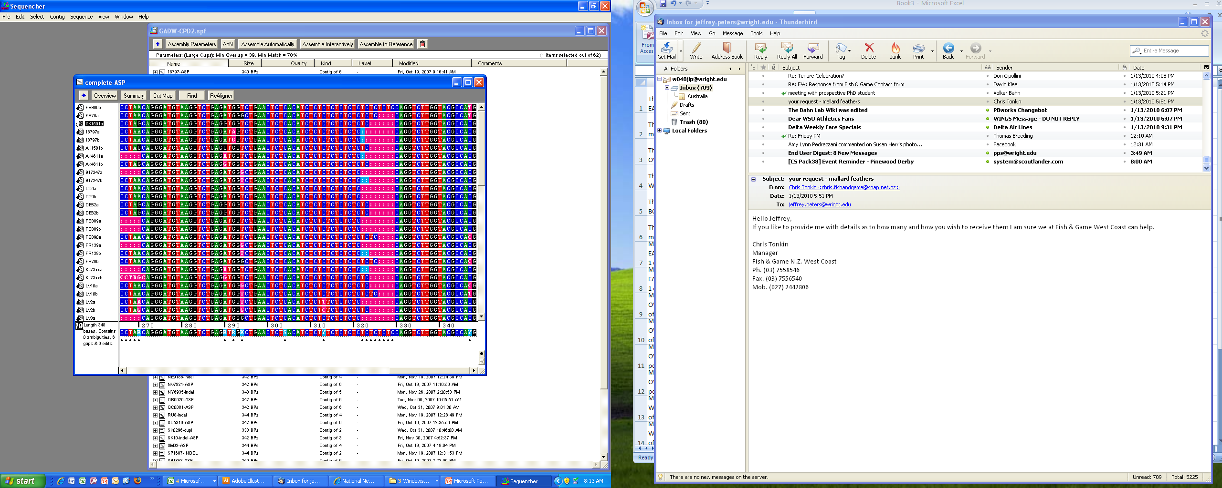
Measuring Genetic Variation
Microsatellites—early-1990s
  Alleles vary in length
  Alleles scored based on mobility through a gel or automated sequencer
  Advantage: often hypervariable (>50 alleles)
  Disadvantages: Need prior knowledge of sequences to design primers (requires PCR)
Distance traveled through medium (e.g., gel)

Slide 19
Measuring Genetic Variation
Next generation sequencing—2000s, current revolution in population genetics
  Full genome sequencing
    Amplify and sequence short fragments of the genome then piece them together
    Advantage: Measure nearly all genetic variation throughout the genome
    Disadvantage: Expensive, not well-suited for population genetics
  Reduced-representation sequencing (2010s)
    E.g., Restriction-Site-Associated DNA Sequencing (RADseq)
      Use restriction enzymes to fragment the genome at specific recognition sites
      Sequence selected size range of fragments that contain the restriction sites
      Results in DNA sequences for 1000s of loci scattered through the genome
      Advantages: measure all variation within the recovered loci, relatively cheap per sample, well-suited for population genetics
      Disadvantage: covers < 0.1% of the genome

Slide 20
Learning Outcomes
Define population genetics & populations.
Define the factors that influence genetic variation within populations
Describe the applications of population genetics to diverse fields.
Describe the common types of genetic variation.
Explain the methods used to measure genetic variation and which resulted in major advances (revolutions) in population genetics.

Slide 21

A lot of population geneticists have received MacArthur Awards
Kirsten Bomblies - plant evolutionary geneticist
Carlos Bustamante - human population geneticist
David Hillis - evolutionary geneticist
Marty Kreitman - experimental population geneticist
Russ Lande - conservation geneticist
Eric Lander - genomics & computational biologist
Nancy Moran - ecologist & evolutionary biologist
John Novembre - computational biologist
Sally Otto - evolutionary geneticist
Loren Rieseberg - botanist
Beth Shapiro - evolutionary biologist

Slide 22

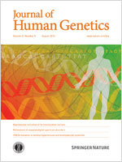
Top-ranked Journals
Nature Genetics
Nature Review Genetics
Annual Review or Genetics
Systematic Biology
Genome Biology
American Journal of Human Genetics
Molecular Biology & Evolution
Trends in Genetics
PLoS Genetics
Genetics
Genome Biology & Evolution
Genomics
Molecular Ecology
Evolution
BMC Genomics
Molecular Phylogenetics & Evolution
Heredity
Scientific Societies
Genetics Society (UK)
Genetics Society of America
American Society of Human Genetics
Society for Molecular Biology
& Evolution
Society for the Study of Evolution
Society of Systematic Biologists

