Slide 1
Infinite Sites & Alleles Models,
Site Frequency Spectrum & Tajima’s D,
Pop Growth/Decline
Population Genomics
Cochabamba, Bolivia
Gen-Pob’25

Slide 2
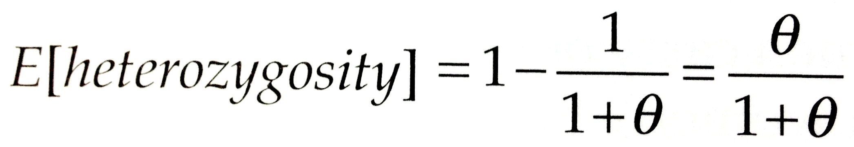
Infinite Alleles Model
Every new mutation generates a new allele.
Not so appropriate for DNA sequence data.
Only keeps track of whether alleles are different or identical, not how they relate.
Kimura & Crow (1964) The Number of Alleles that Can Be Maintained in a Finite Population.
Genetics 49:725–738.

Slide 3
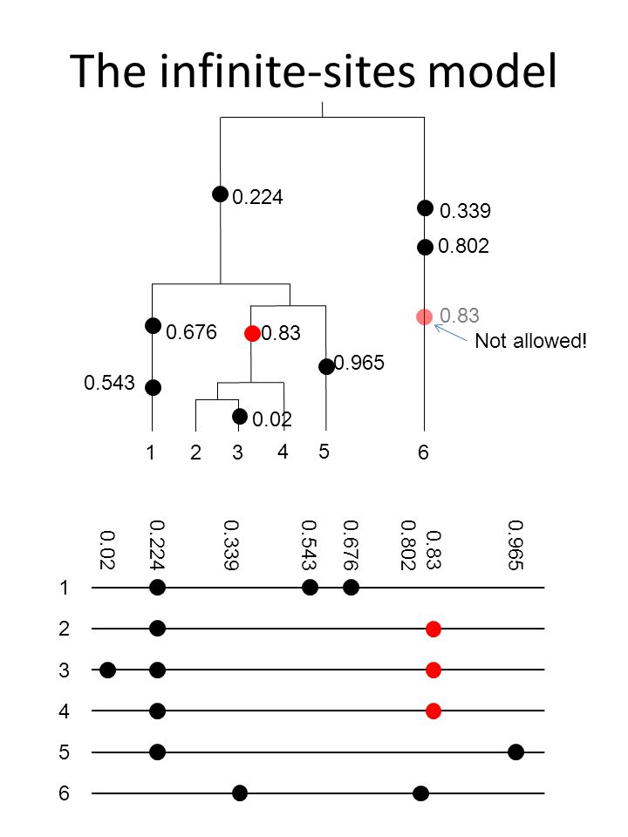
Infinite Sites Model
Mutations are rare, so each new mutation creates a new variable site.
No site experiences >1 mutation (i.e., the sequence is infinitely long).
So there is no homoplasy.
Applies to DNA sequence data (SNPs)
Biallelic /no triallelic sites*
Kimura (1969) The Number of Heterozygous Nucleotide Sites Maintained in a Finite Population Due to Steady Flux of Mutations. Genetics 61:893–903.

Slide 4
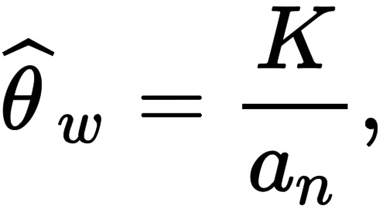
Number of Segregating Sites (S) is the Basis for Watterson’s θ
Unbiased estimator if Wright-Fisher assumptions are met.
However, downwardly biased in an exponentially growing population or if the assumptions of infinite sites model are not met, e.g. homoplasy.
Biased by population structure.
# segregating sites
(n - 1)^{th} harmonic #
Watterson, G.A. (1975) On the number of segregating sites in genetical models without recombination. Theoretical Population Biology 7:256–276

Slide 5
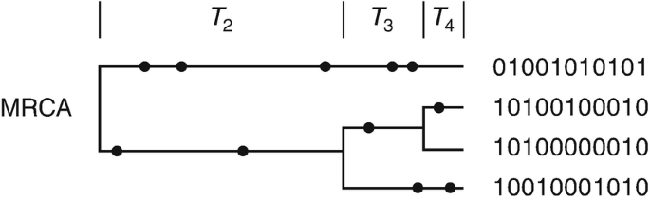
MS - by Dick Hudson at U. Chicago
Command line program to generate many (e.g., 100s or 1000s) replicate samples under Infinite Sites Model.
Including assumptions about migration, recombination, N_{e}, and population growth or decline. Genealogy generated using the coalescent; mutations placed on genealogy.

Slide 6
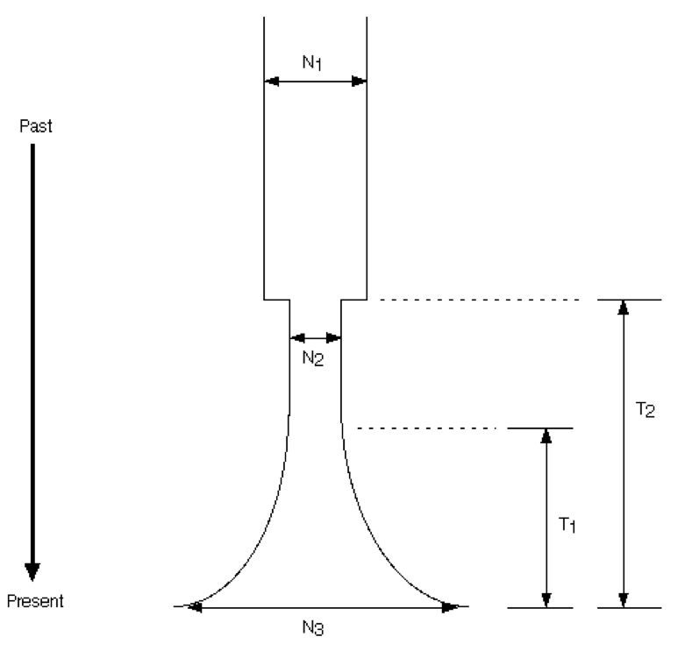
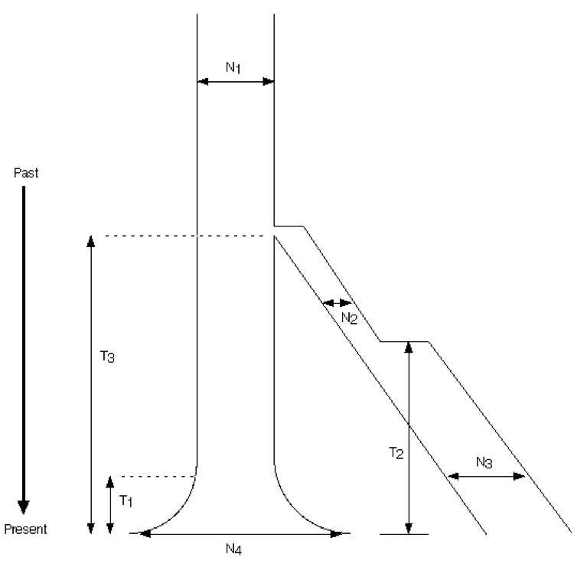
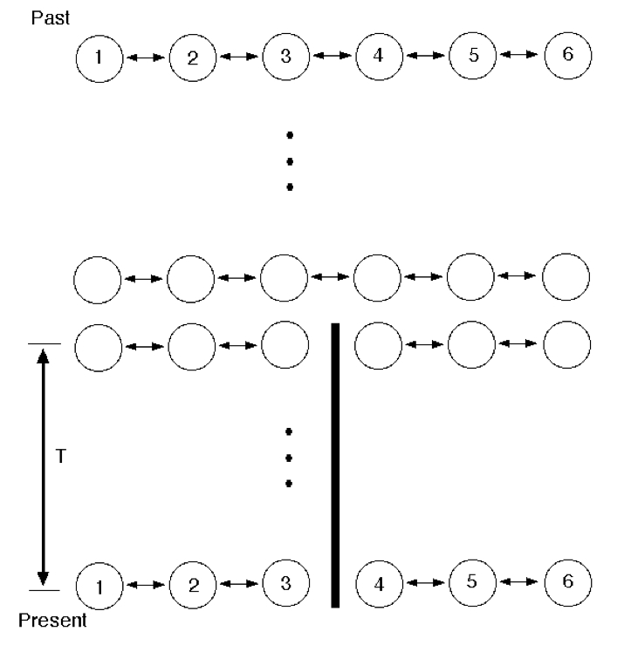
Hudson, R. R. (2002) Generating samples under a Wright-Fisher neutral model of genetic variation. Bioinformatics 18:337-338.

Slide 7
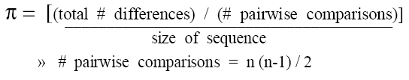
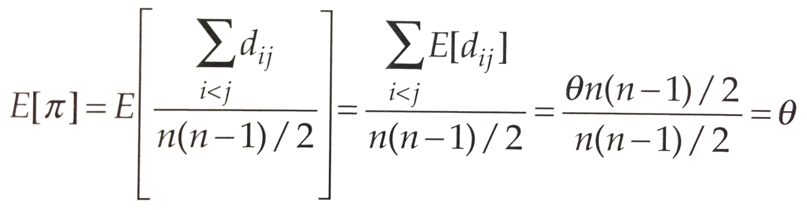
Tajima’s θ
Nucleotide diversity = π, average # pairwise differences
Expected # differences, E [d_{ij}] = θ
for two randomly sampled sequences, i and j, under Infinite Sites Model and standard coalescent model (i.e., # pairwise differences is good way to estimate theta).
π thus provides unbiased estimate of theta.
Tajima’s Estimator
θ = π
^
def. π
^ = estimator

Slide 8
Tajima’s D
Compare Tajima’s θ (π) to Watterson’s θ (S):
These two θ estimates should be same if Wright-Fisher and infinite sites assumptions hold.
Tajima, F. (1989). Statistical method for testing the neutral mutation hypothesis by DNA polymorphism. Genetics 123: 585–595.
θ = π
# segregating sites
^
vs.
(n - 1)^{th} harmonic #

Slide 9
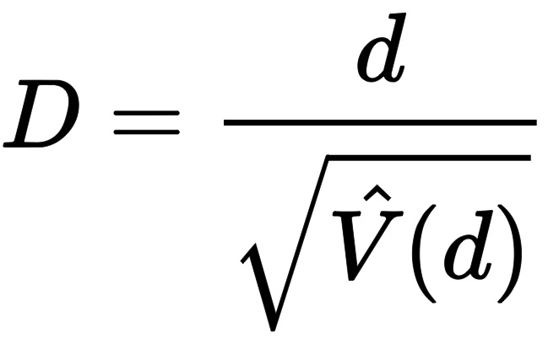
Tajima’s D
D is calculated as the difference (d) between the two estimates divided by the square root of its variance.
Differences either + or – are likely to reflect deviations from neutrality or changes in demography.

Slide 10
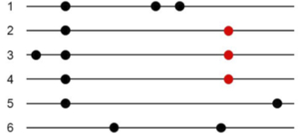
Site Frequency Spectrum
Two ways to summarize DNA sequence data
  # segregating sites (S)
  # pairwise differences (π)
  no allele freq. info
Site Frequency Spectrum
  Tabulates allele frequency for all mutations
f₁ = 1/6
f₂₊₄ = 2/6
f₃ = 1/6
f₅ = 1/6
f₆ = 1/6
identical

Slide 11
%
allele frequency

Slide 12
Site Frequency Spectrum
Site Frequency Spectrum can be written as a vector.
f = (f₁, f₂,… f_{n-1}).
Unfolded & folded Site Frequency Spectra
  Unfolded - it is known which allele is ancestral and derived.
  (typically involves outgroup)
  Folded SFS in previous slide makes no such assumptions; folded SFS bins together ith and (n – i)th entries in the matrix.
S and π can be derived from SFS but not the reverse.

Slide 13
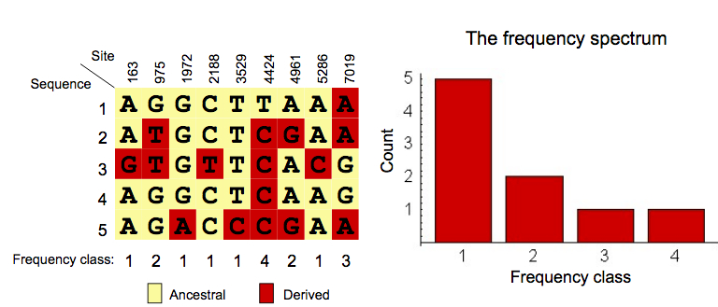
Non-stationary population genetic models with selection: Theory and Inference - Lecture
Scott Williamson and Carlos Bustamante, Cornell University
http://slideplayer.com/slide/5110366/

Slide 14
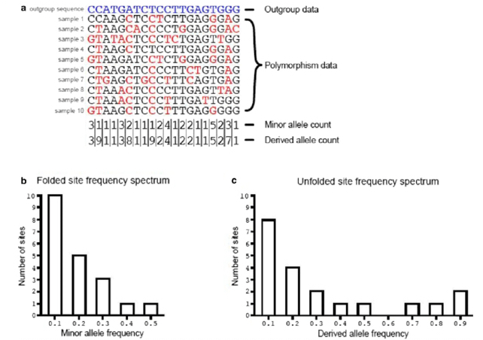
Booker, T.R., Jackson, B.C. and Keightley, P.D., 2017. Detecting positive selection in the genome. BMC Biology, 15:1-10.

Slide 15
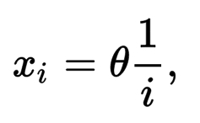

How is the SFS useful?
We calculate the expected SFS using the coalescent.
For selectively neutral alleles at equilibrium without population size changes or gene flow.
Deviations will change the expected distribution.

Slide 16
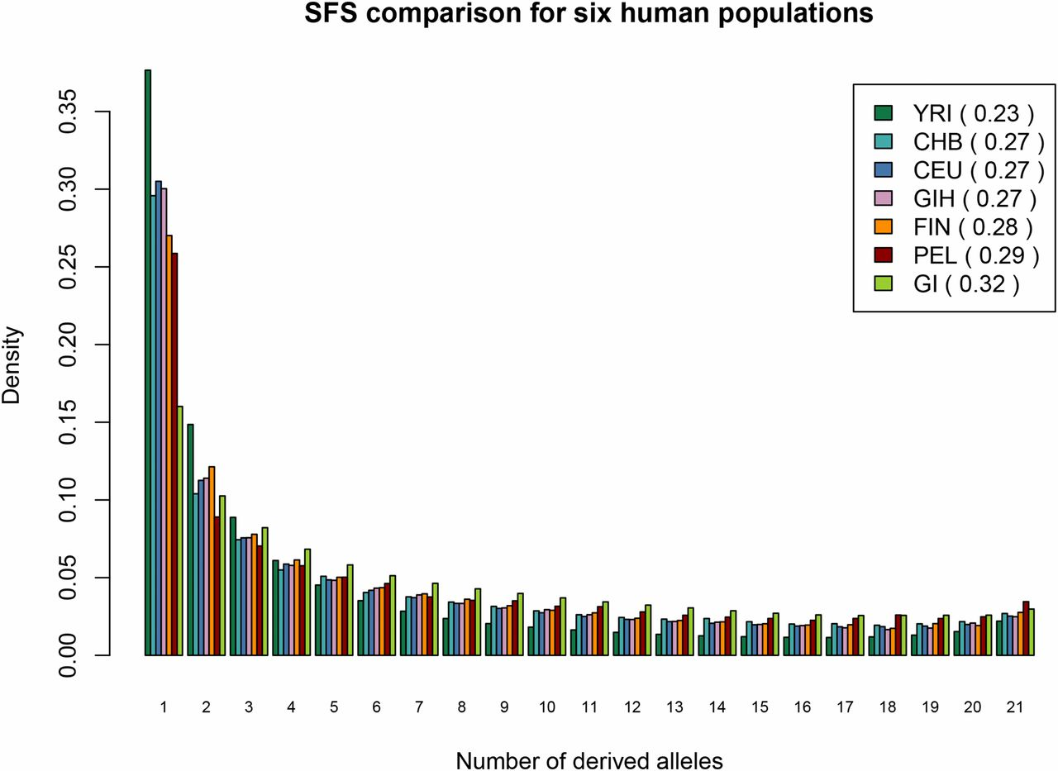
Pedersen, C.E.T., Lohmueller, K.E., Grarup, N., Bjerregaard, P., Hansen, T., Siegismund, H.R., Moltke, I. and Albrechtsen, A., (2016) The Effect of an Extreme and Prolonged Population Bottleneck on Patterns of Deleterious Variation: Insights from the Greenlandic Inuit. Genetics 116 (In press).

Slide 17
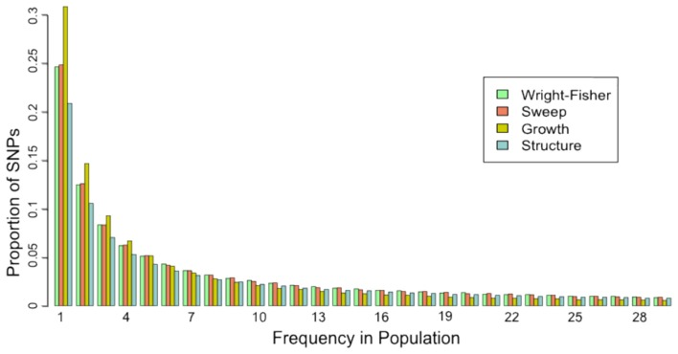
Crawford, J.E. and Lazzaro, B.P., (2012) Assessing the accuracy and power of population genetic inference from low-pass next-generation sequencing data. Frontiers in Genetics, 3, 66.

Slide 18
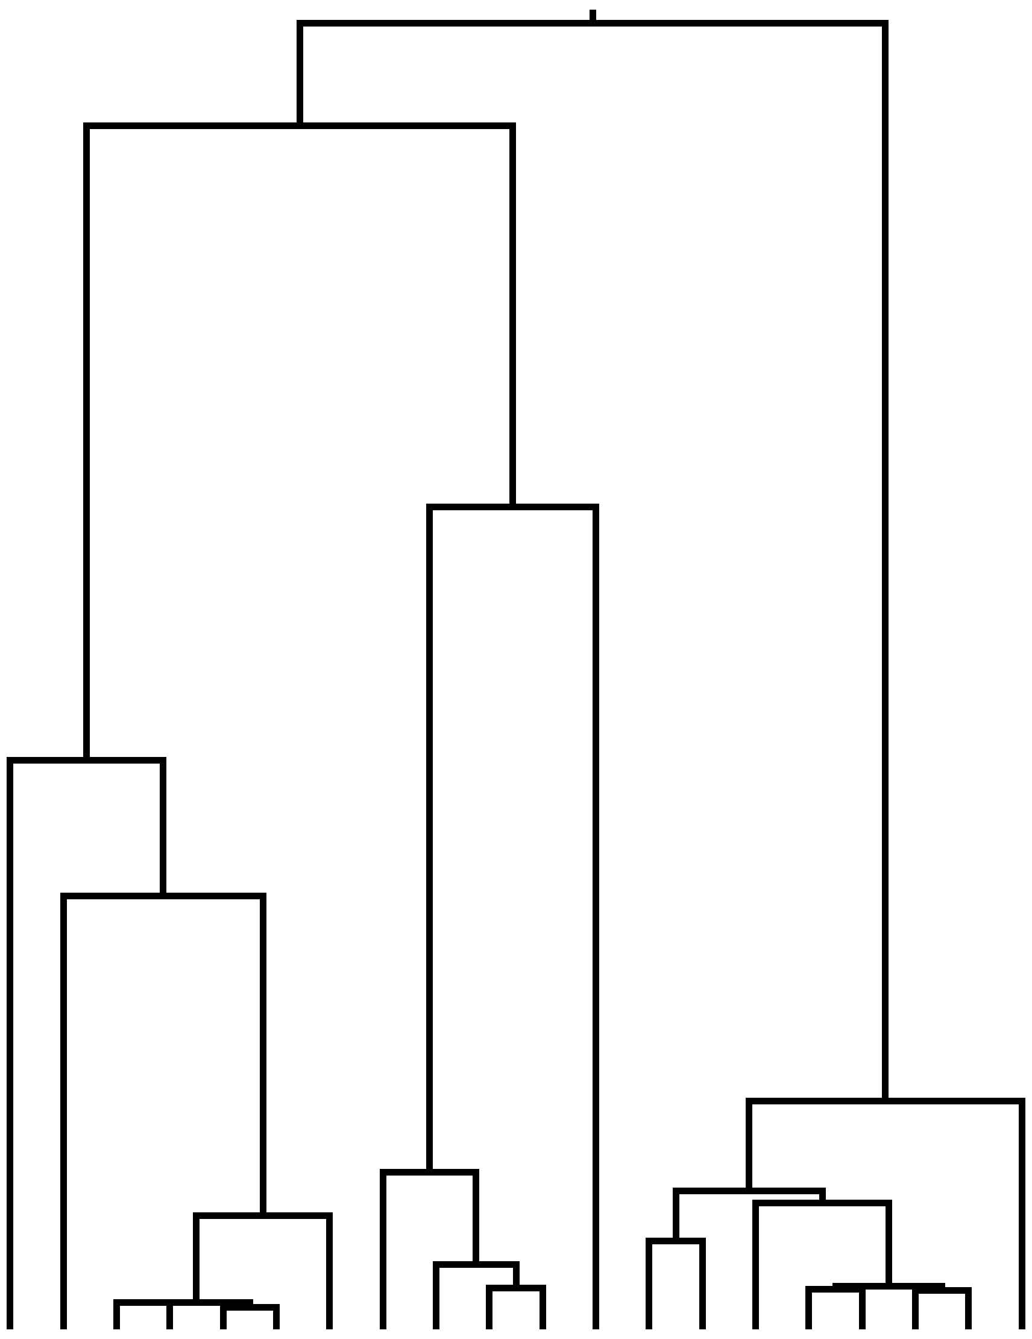
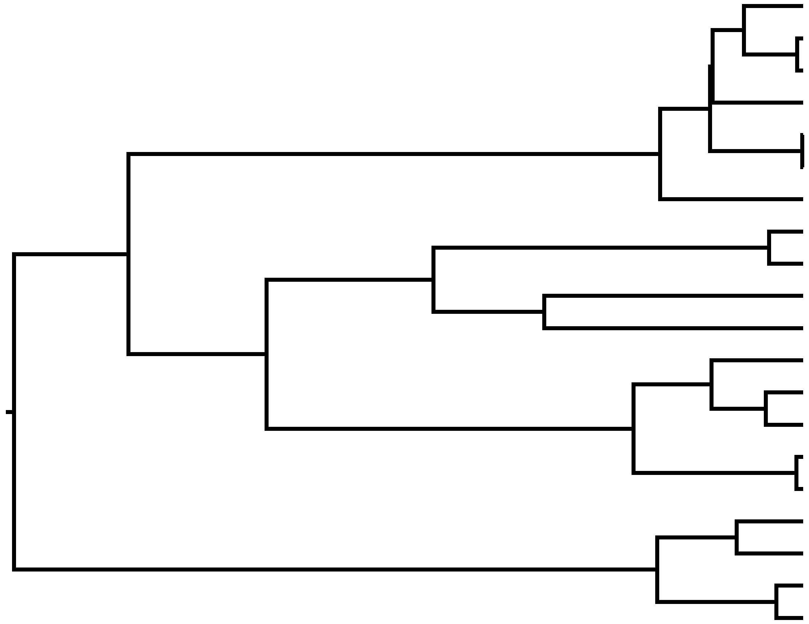
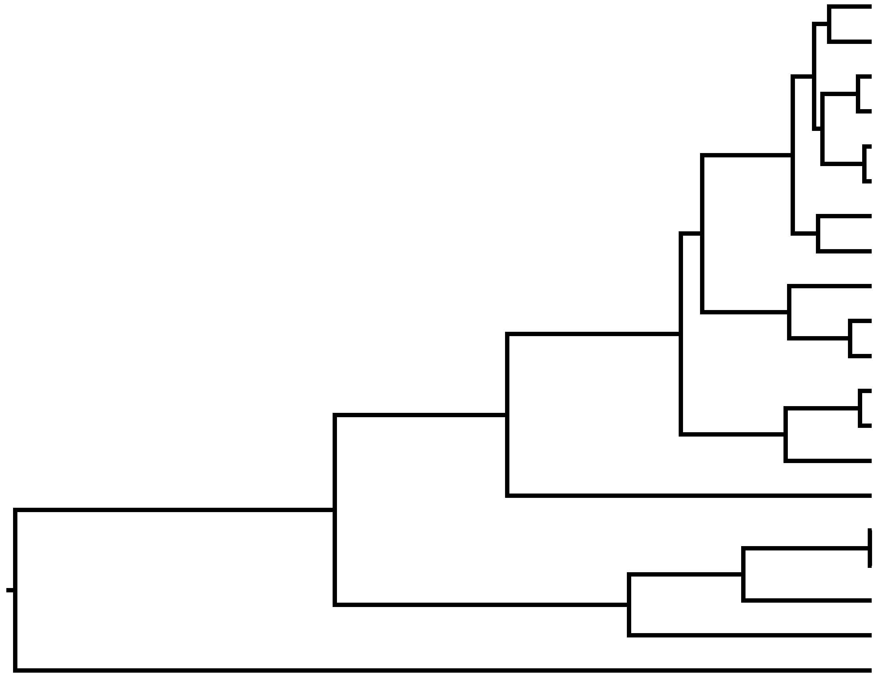
-Coalescence occurs more rapidly than expected
Constant: Alleles coalesce at a rate of 1/2N_{e}
-Coalescence occurs more slowly than expected
−
0
+
Tajima’s D

Slide 19
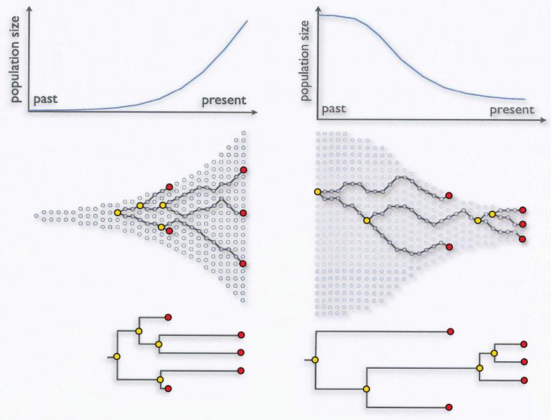
− Tajima’s D
+ Tajima’s D
Evolution and HIV: Using Computational Phylogenetics to Close In On a Killer
The study of HIV evolution is not only critical to fighting the virus; it has also driven advances in the computational tools used to study evolution in general. (2009) by Kristin Sainani

Slide 20
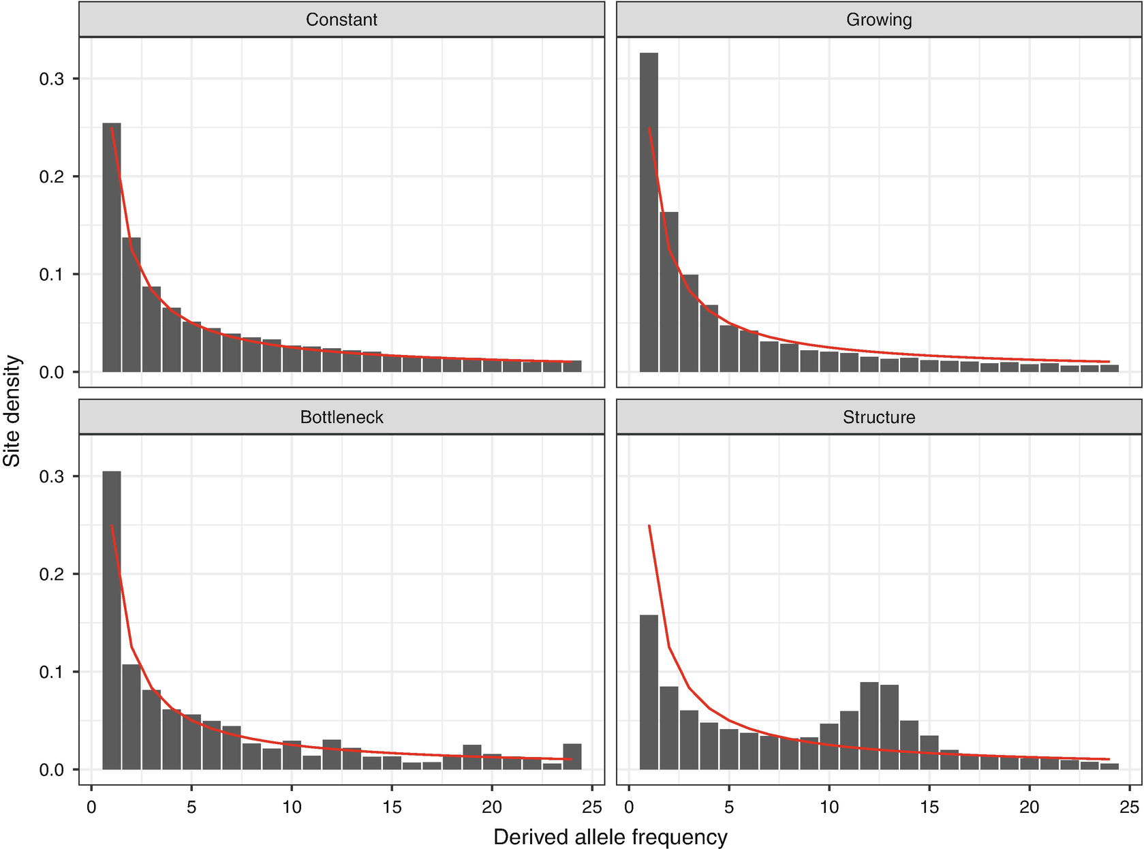
Tajima’s D 0
Tajima’s D -
Tajima’s D +
Tajima’s ++
Barroso G.V., Moutinho A.F., Dutheil J.Y. (2020) A Population Genomics Lexicon. In: Dutheil J.Y. (eds) Statistical Population Genomics. Methods in Molecular Biology, vol 2090. Humana, New York, NY. https://doi.org/10.1007/978-1-0716-0199-0_1

Slide 21
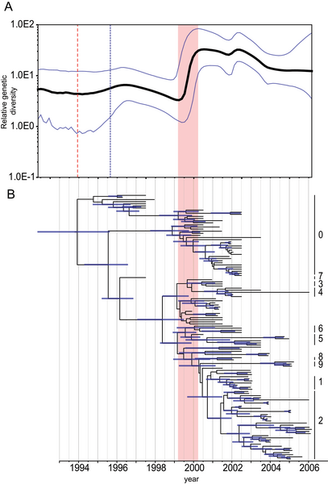
Bayesian Skyline Plot
Set this up with:
BEAST
Alexei Drummond
---for rooted, time measured phylogenies; uses MCMC
Vijaykrishna D, Bahl J, Riley S, Duan L, Zhang JX, et al. (2008) Evolutionary Dynamics and Emergence of Panzootic H5N1 Influenza Viruses. PLOS Pathogens 4(9): e1000161. doi:10.1371/journal.ppat.1000161

Slide 22
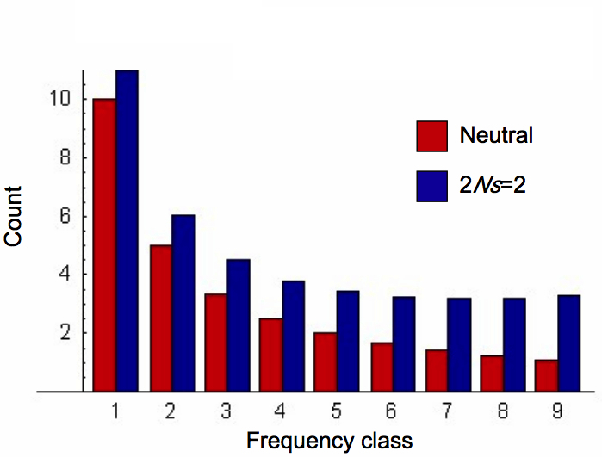
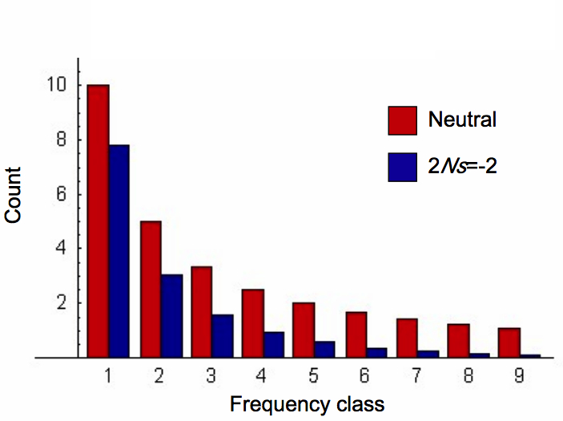
Effects of selection
Balancing Selection
Excess of common alleles
in population
Tajima’s D (+)
Directional Selection
Excess of rare alleles
in population
Tajima’s D (-)
Non-stationary population genetic models with selection: Theory and Inference - Lecture
Scott Williamson and Carlos Bustamante, Cornell University
http://slideplayer.com/slide/5110366/

Slide 23
Directional Selection
(Magnifies Effects of Drift)
Mimics Population
Expansion
Neutrality
Balancing Selection
(Impedes Effects of Drift)
Mimics Population
Decline
−
0
+
Tajima’s D

Slide 24
Summary of today’s most important concepts
Coalescence rate | Effects on Θ | Demography | Selection | Tajima’s D
Increasing | ⬇ | Pop expansion | Directional | −
Constant | Stays the same | Constant | Neutral | 0
Decreasing | ⬆ | Pop decline | Balancing | +

Slide 25
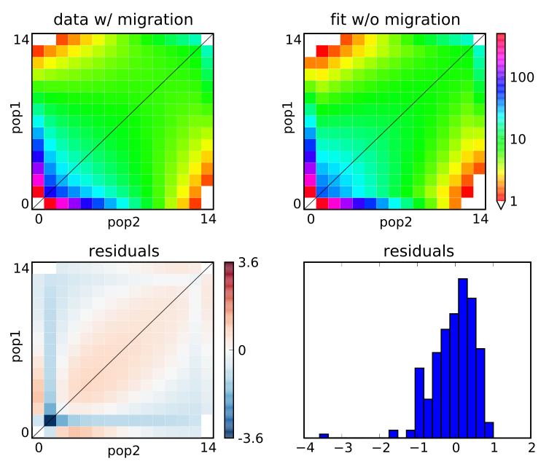
δaδi - by Ryan Gutenkunst
Problem with modest size genomic data sets is the extreme amount of loci involved; can’t use alleles to build genealogies effectively.
Solution: Use the Site Frequency Spectrum & Diffusion Approximations to infer demographic parameters.
Up to 3 populations with run time independent of # SNPs, runs fast.
Gutenkunst, RN, RD Hernandez, SH Williamson, CD Bustamante (2009) Inferring the joint demographic history of multiple populations from multidimensional SNP data" PLoS Genetics 5:e1000695.

Slide 26
Diffusion Approximations
“Diffusion equation is a parabolic partial differential equation. In physics, it describes the macroscopic behavior of many micro-particles in Brownian motion, resulting from the random movements and collisions of the particles (e.g., Fick’s Laws). In mathematics, it is related to Markov processes, such as random walks...”
---Wikipedia
“A diffusion approximation is a technique in which a complicated and analytically intractable stochastic process is replaced by an appropriate diffusion process. A diffusion process is a (strong) Markov process having continuous sample paths.”
---Peter Glynn, Stanford 1990

Slide 27
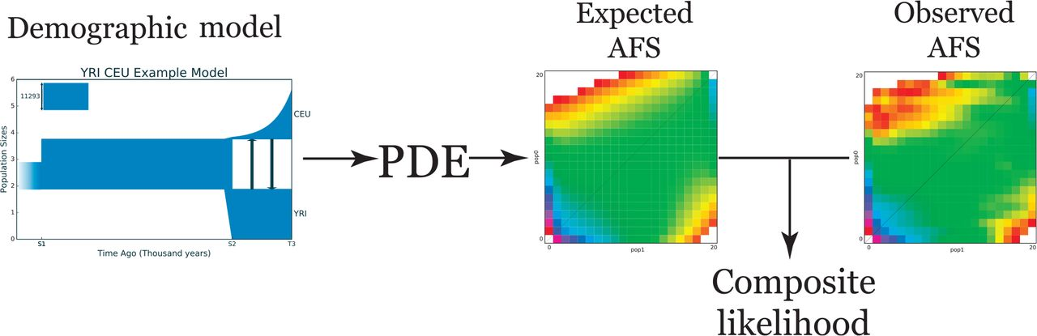
General scheme of ∂a∂i:
∂a∂i extracts the expected AFS from the demographic model using a numerical solution of the partial differential equation (PDE) that corresponds to that demographic model, and calculates the composite likelihood between the expected and observed allele frequency spectrum.
Noskova, E., Ulyantsev, V., Koepfli, K. P., O’Brien, S. J., & Dobrynin, P. (2020). GADMA: Genetic algorithm for inferring demographic history of multiple populations from allele frequency spectrum data. GigaScience, 9(3), giaa005.

Slide 28
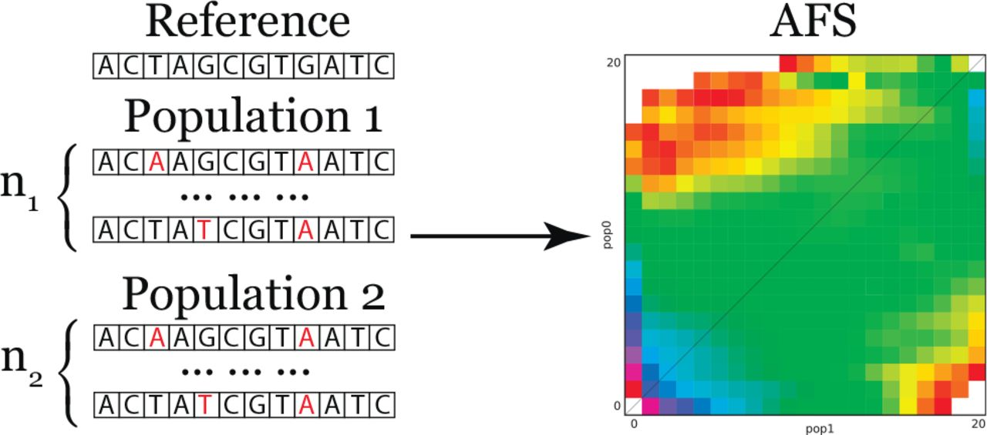
If P populations are observed (P = 2 in the figure), then for each population i there is genetic information for n_{i} chromosomes.
To build the allele frequency spectrum we call SNPs (relative to some reference) and calculate their frequencies.
Noskova, E., Ulyantsev, V., Koepfli, K. P., O’Brien, S. J., & Dobrynin, P. (2020). GADMA: Genetic algorithm for inferring demographic history of multiple populations from allele frequency spectrum data. GigaScience, 9(3), giaa005.

Slide 29
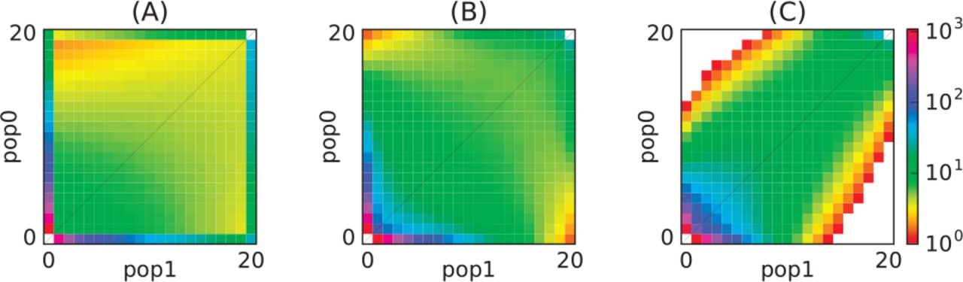
Examples of different allele frequency spectra:
(A) Isolation of a population after divergence
(B) Low symmetrical migrations between populations following divergence
(C) High asymmetrical rates of migrations between populations following divergence
Noskova, E., Ulyantsev, V., Koepfli, K. P., O’Brien, S. J., & Dobrynin, P. (2020). GADMA: Genetic algorithm for inferring demographic history of multiple populations from allele frequency spectrum data. GigaScience, 9(3), giaa005.

Slide 30
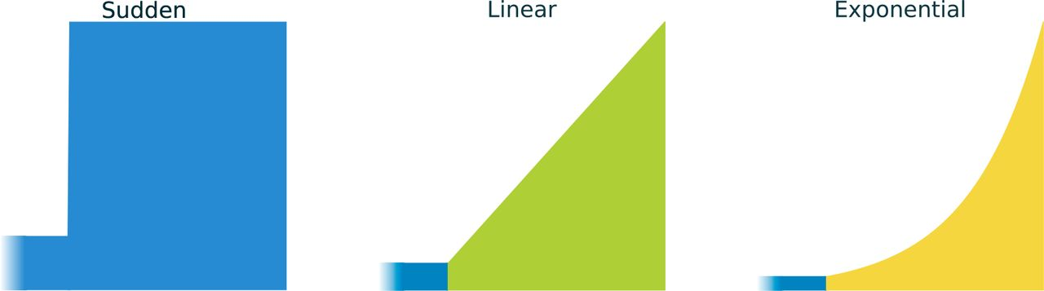
Three primary demographic dynamics of population size change:
(A) Sudden population growth
(B) Linear population growth
(C) Exponential population growth
Noskova, E., Ulyantsev, V., Koepfli, K. P., O’Brien, S. J., & Dobrynin, P. (2020). GADMA: Genetic algorithm for inferring demographic history of multiple populations from allele frequency spectrum data. GigaScience, 9(3), giaa005.

Slide 31
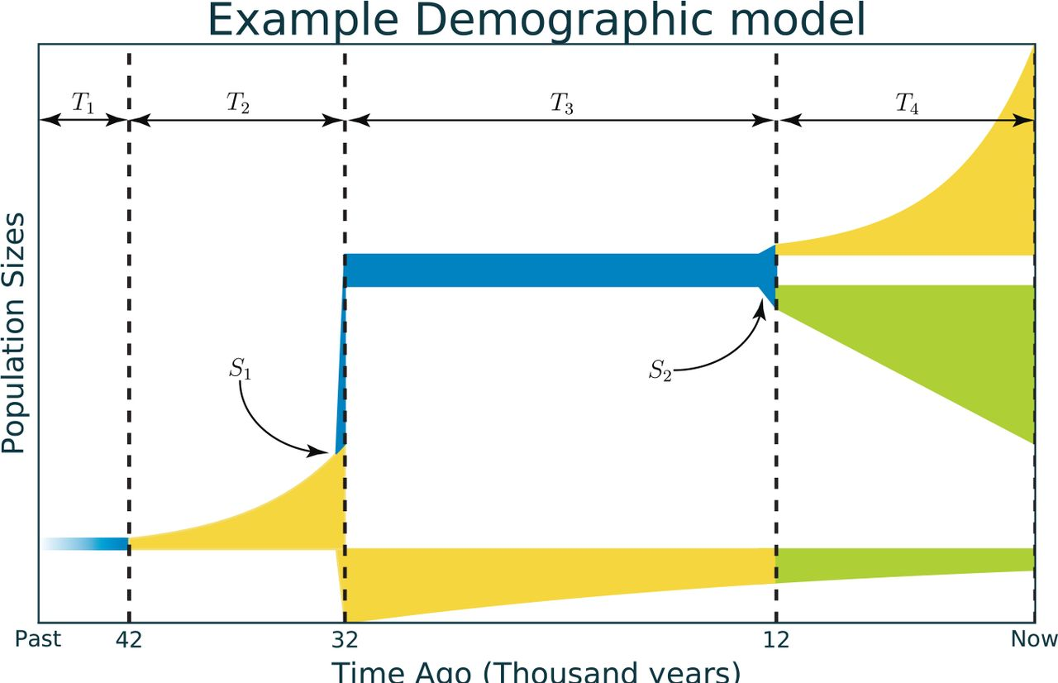
Time intervals labeled T, and population splits labeled S
Noskova, E., Ulyantsev, V., Koepfli, K. P., O’Brien, S. J., & Dobrynin, P. (2020). GADMA: Genetic algorithm for inferring demographic history of multiple populations from allele frequency spectrum data. GigaScience, 9(3), giaa005.

Slide 32
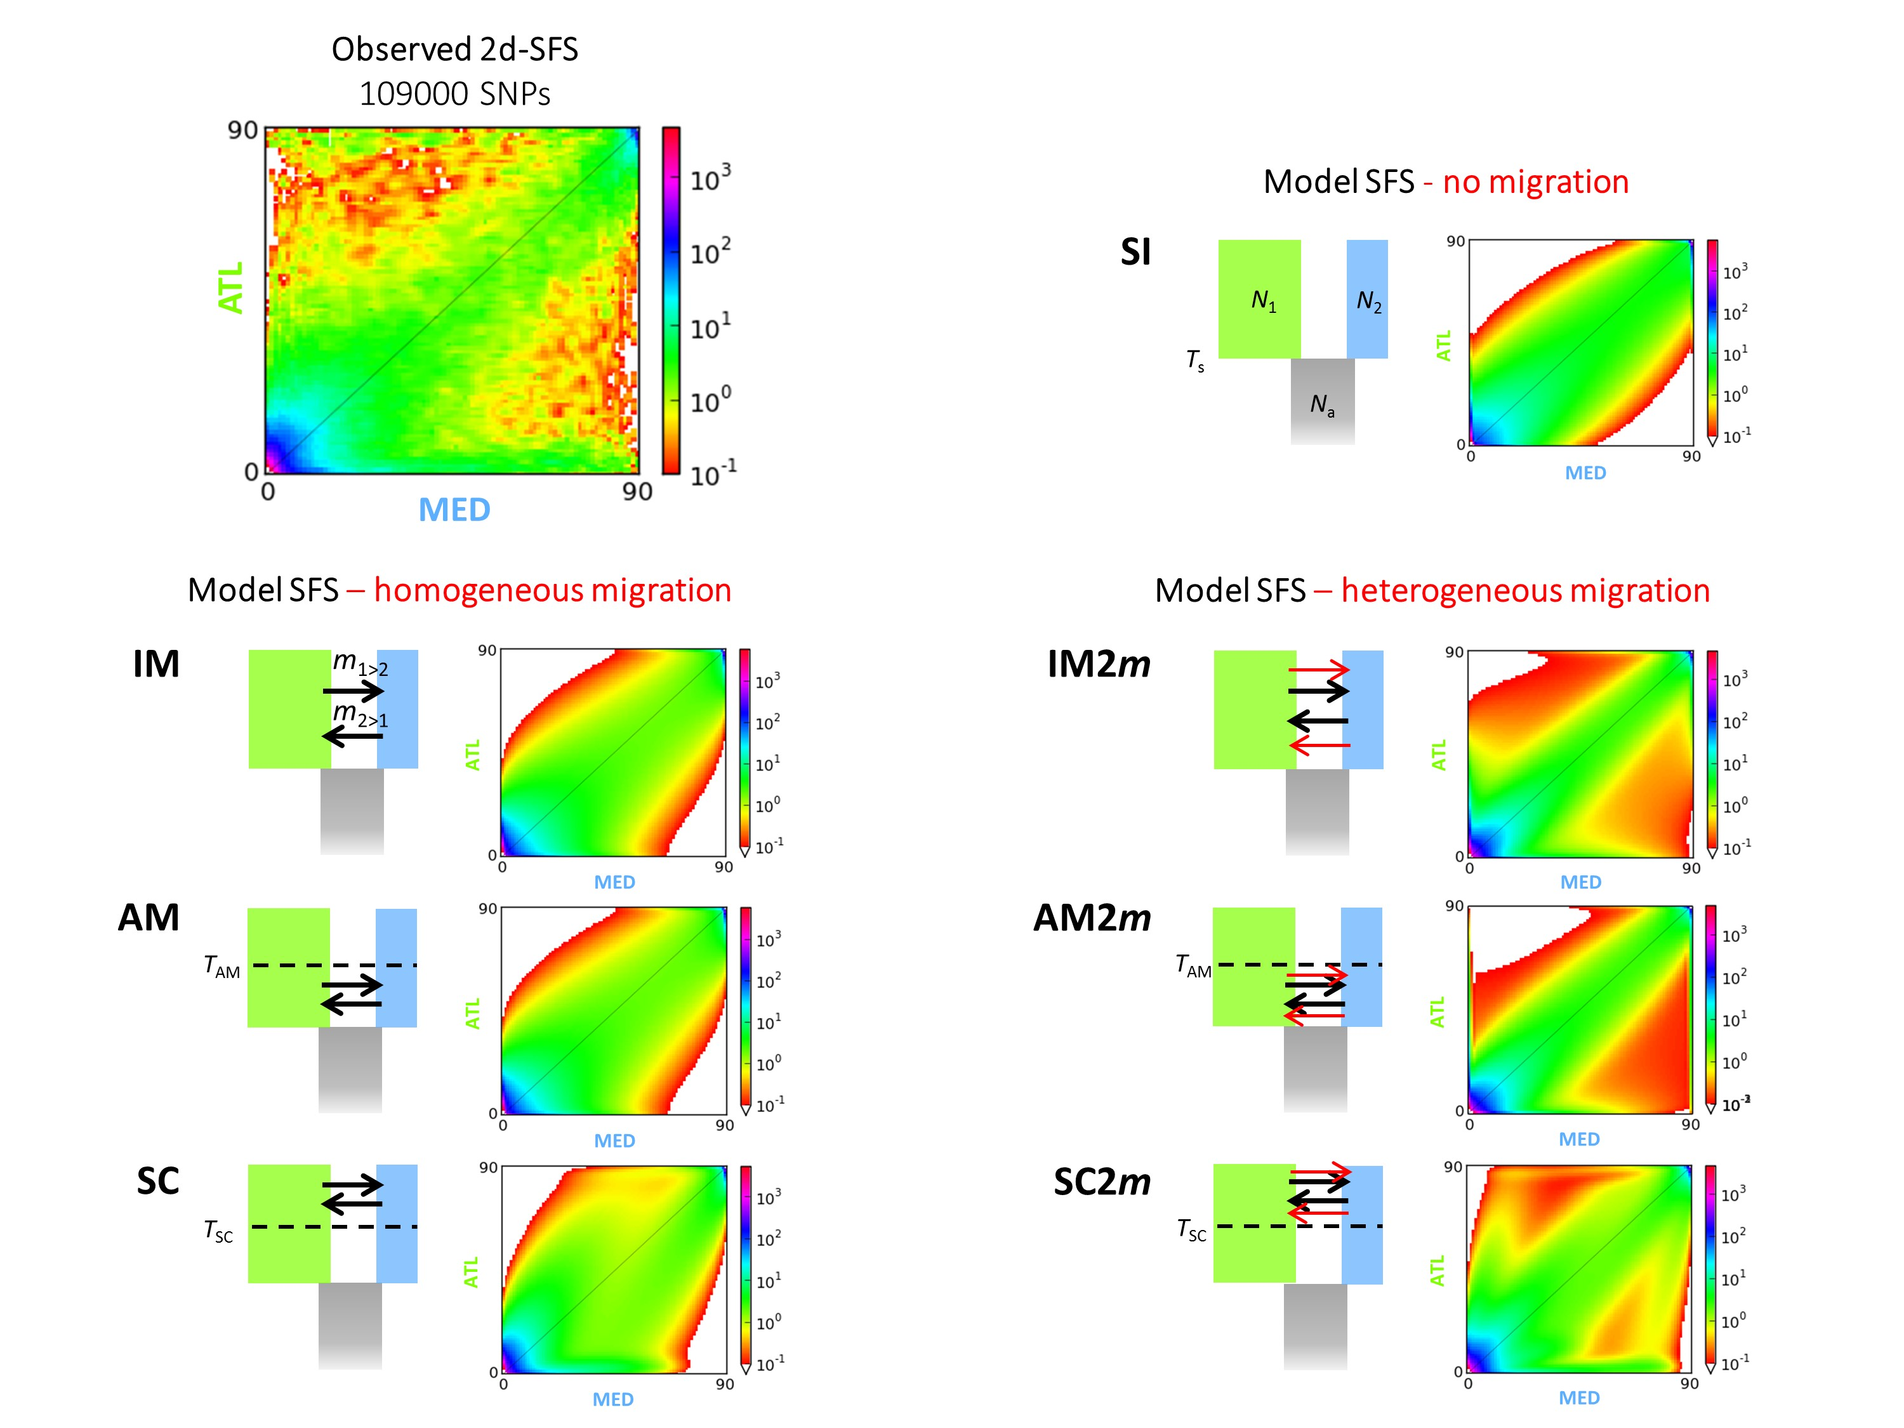
https://popgensealab.wordpress.com/dadi-inference/

Slide 33
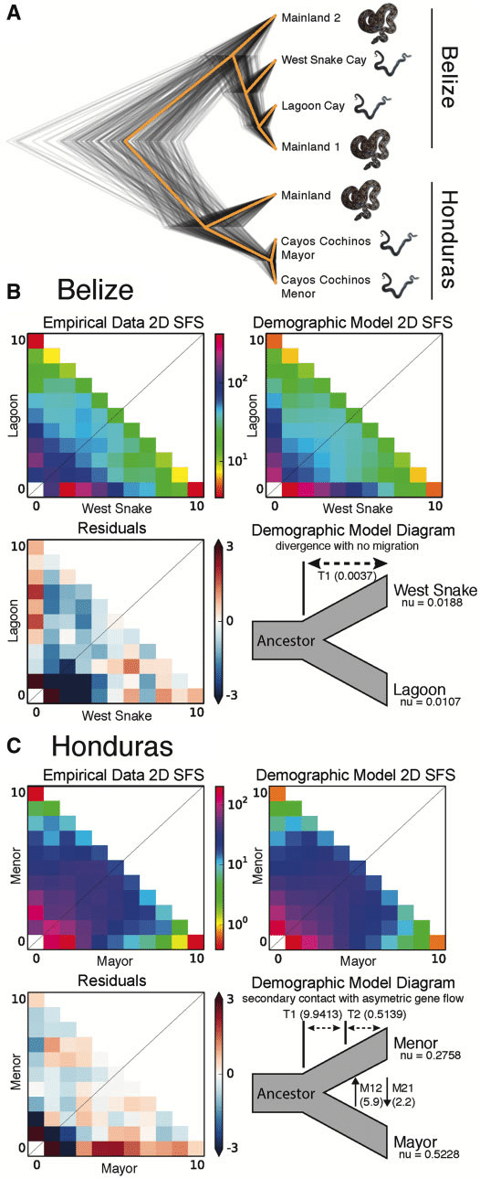
Model Comparison
Card, D. C., Adams, R. H., Schield, D. R., Perry, B. W., Corbin, A. B., Pasquesi, G. I., ... & Castoe, T. A. (2019). Genomic basis of convergent island phenotypes in boa constrictors. Genome biology and evolution, 11(11), 3123-3143.

Slide 34
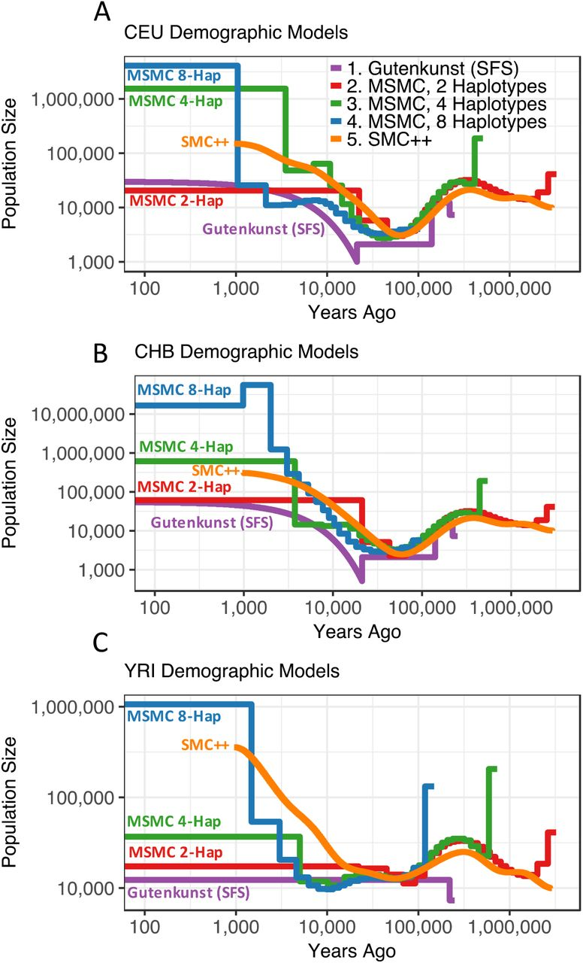
Skyline Plots
Beichman, A. C., Phung, T. N., & Lohmueller, K. E. (2017). Comparison of single genome and allele frequency data reveals discordant demographic histories. G3: Genes, Genomes, Genetics, 7(11), 3605-3620.

