Slide 1
Trees & Networks
Population Genomics
Cochabamba, Bolivia
Gen-Pob’25

Slide 2
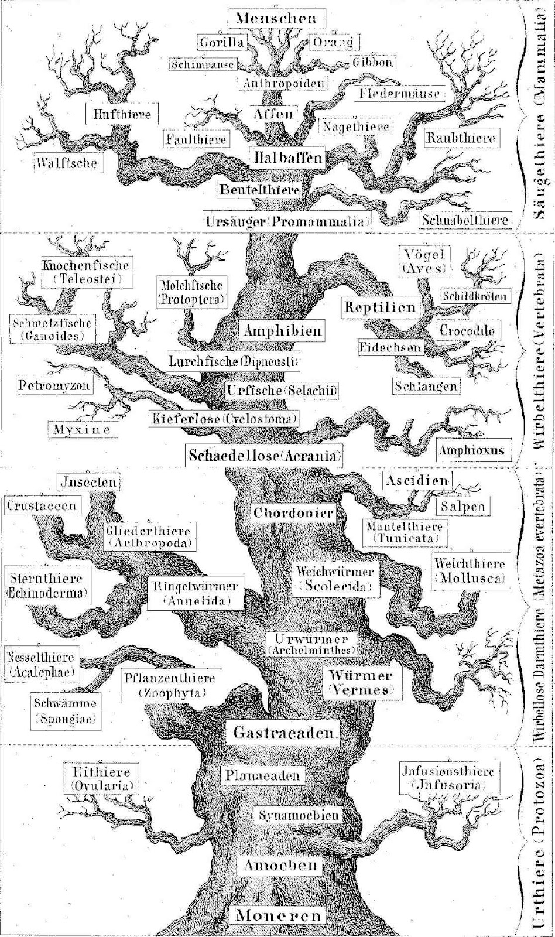
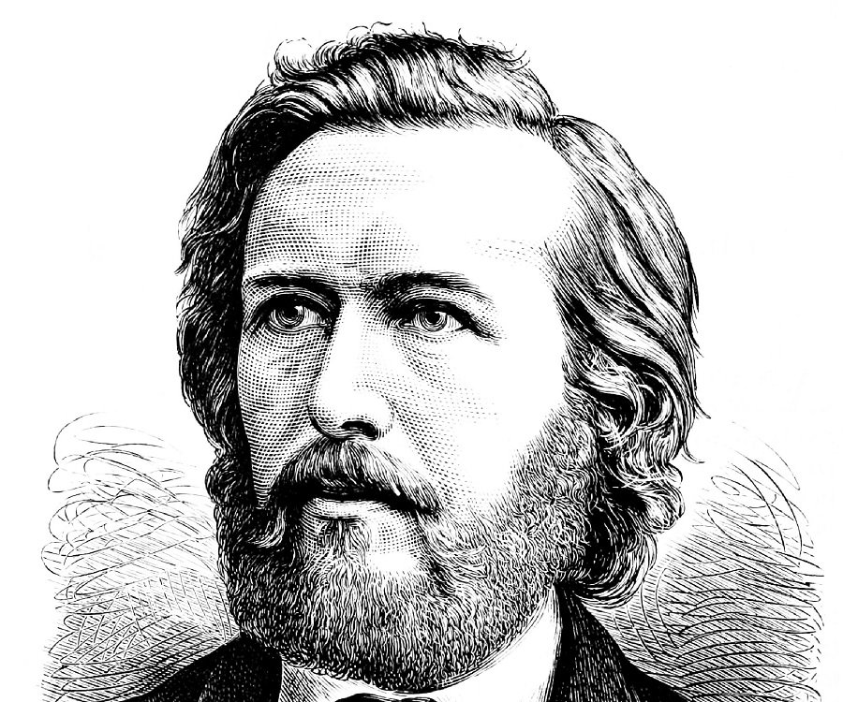
Concept of phylogenetic tree goes back to Ernst Haeckel 1866

Slide 3
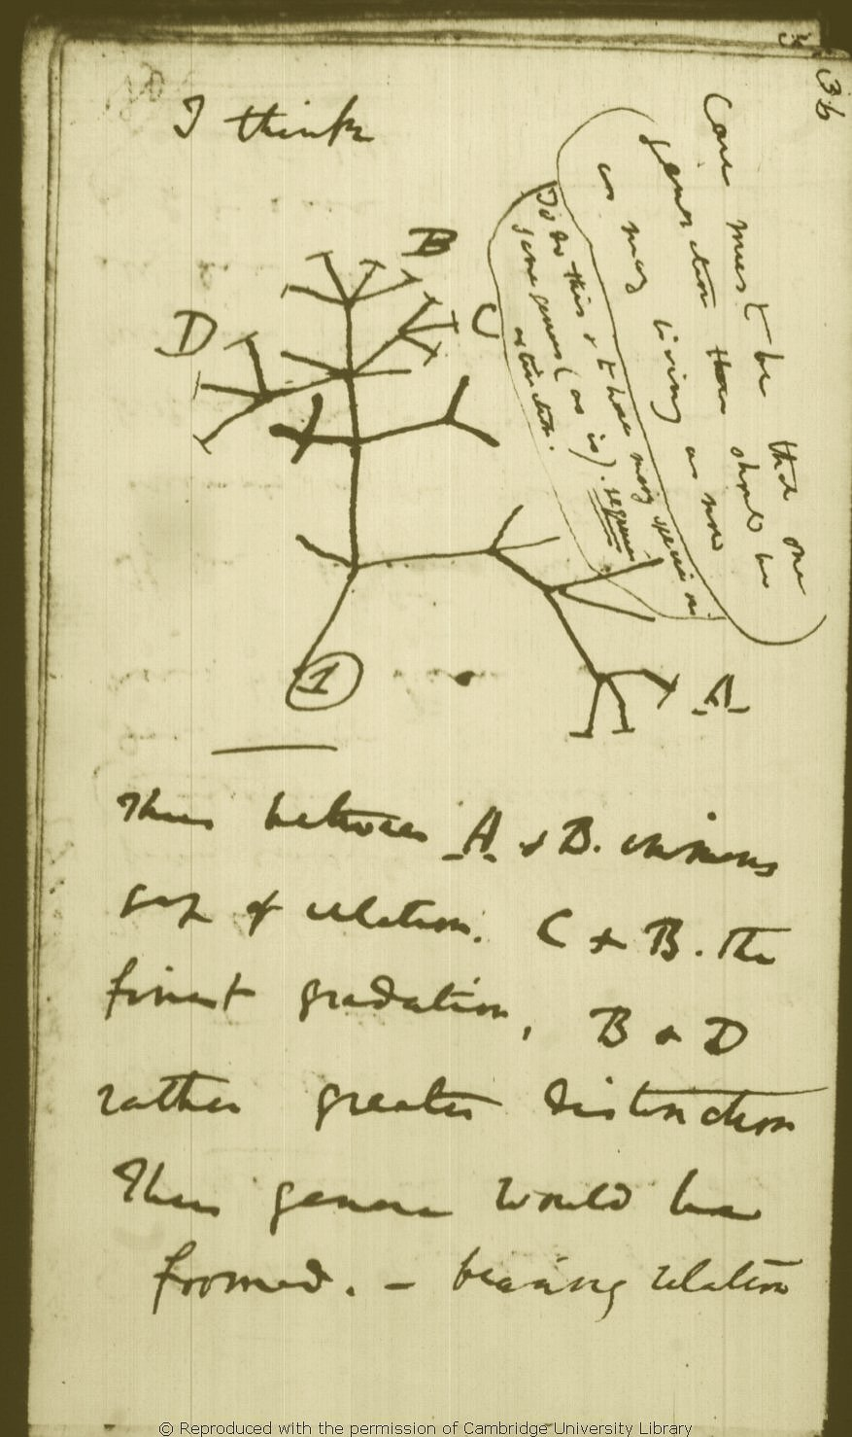
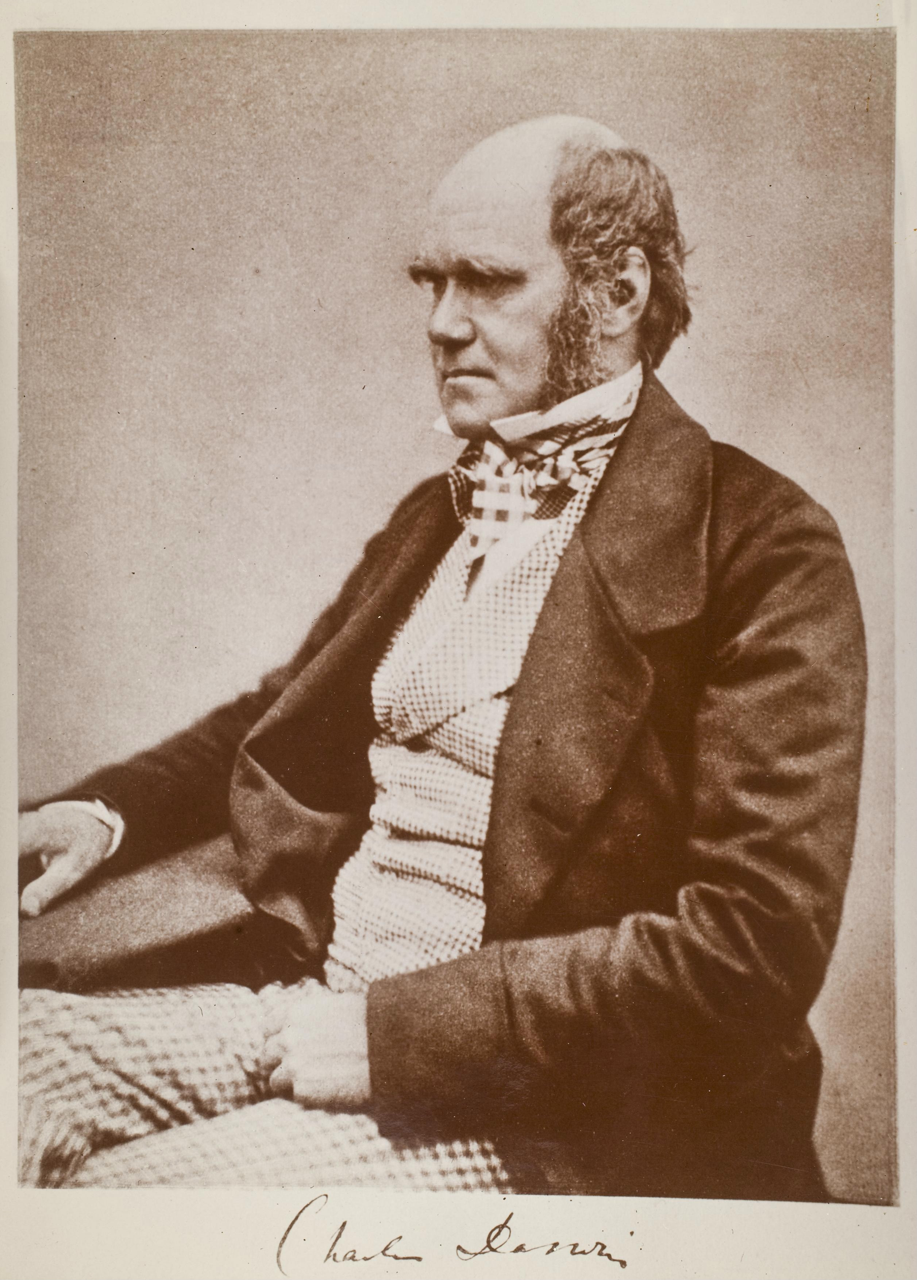
Charles Darwin probably illustrated the first phylogenetic tree in 1837

Slide 4
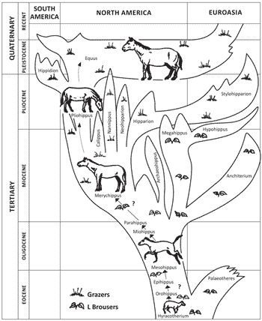
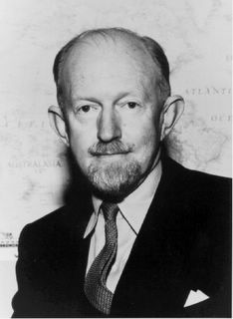
George Gaylord Simpson - Illustrated this tree depicting evolution of the horse in 1951

Slide 5
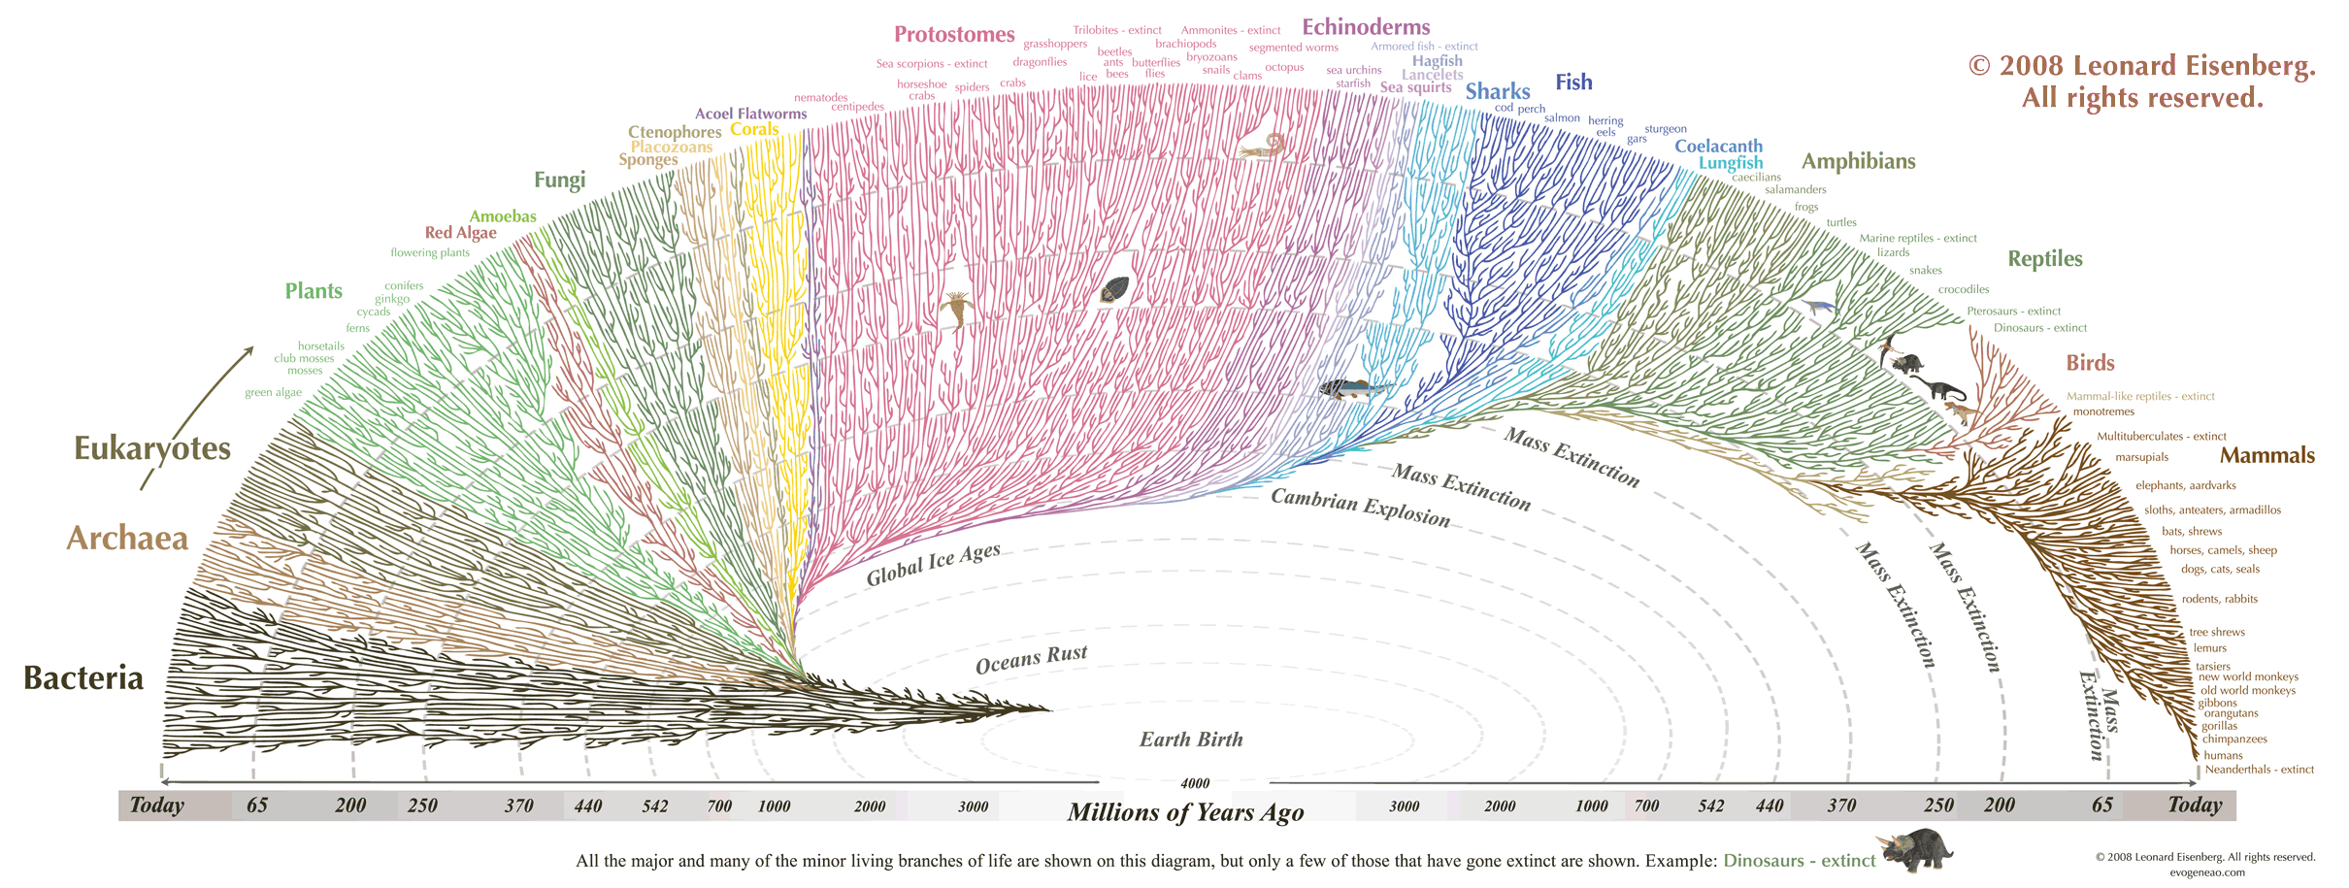

Slide 6
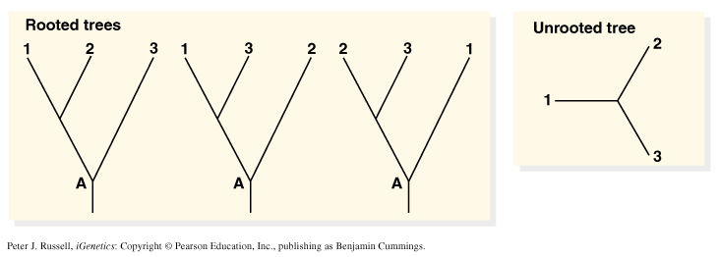
Simplest phylogenetic trees:
Branching patterns (trees) depict genealogical relationships
  Useful for molecular/non-molecular data
The 3-taxon example:

Slide 7
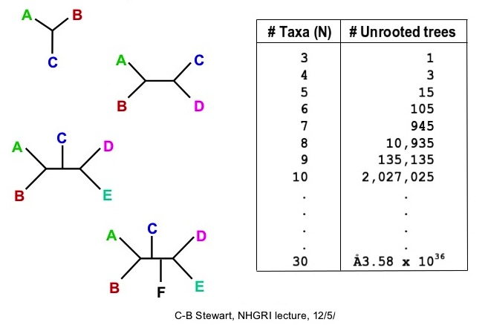
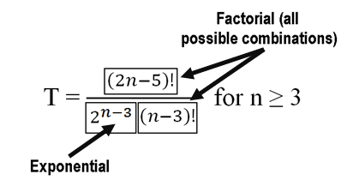
The # of possible unrooted trees grow by factorial:

Slide 8
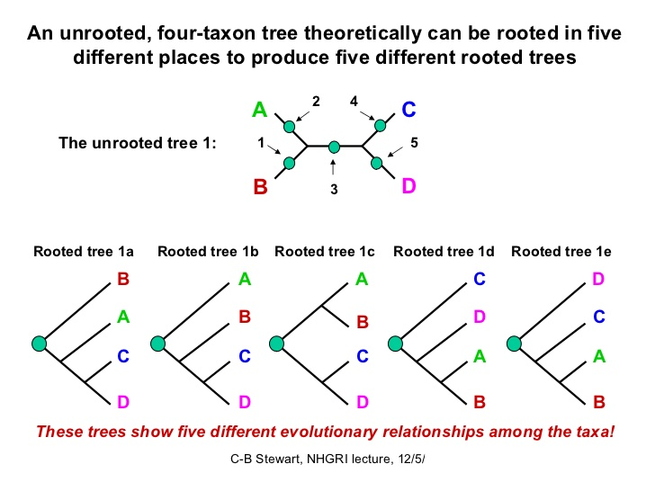

Slide 9
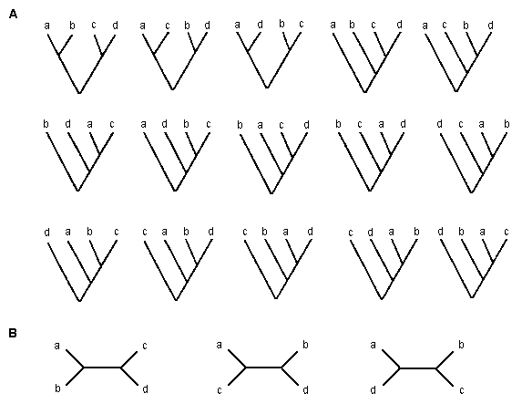
3 unrooted trees, each rooted to produce 5 trees = 15 trees total
https://www.ctu.edu.vn/~dvxe/Bioinformatic/Software/BIT%20Software/Phylogen.htm

Slide 10
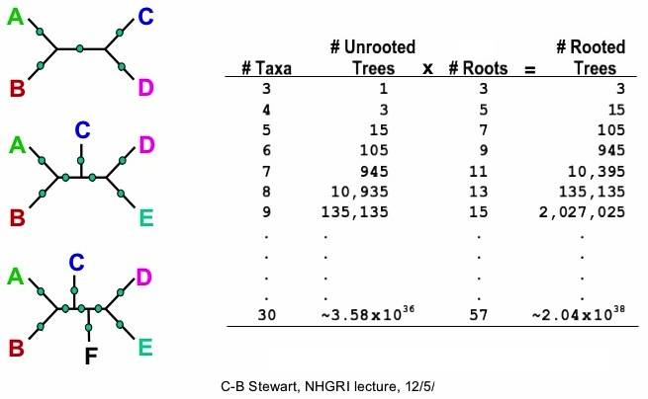

Slide 11
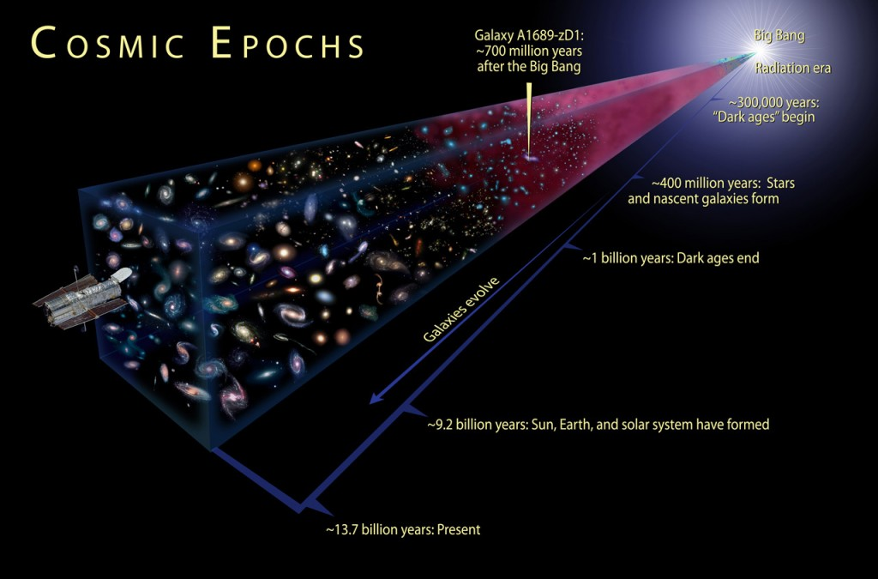
10⁷⁸ to 10⁸² atoms in the known, observable universe = between ten quadrillion vigintillion & one-hundred thousand quadrillion vigintillion atoms.
http://www.universetoday.com/36302/atoms-in-the-universe/
For 100 taxa there are 10¹⁸² possible unrooted trees!

Slide 12
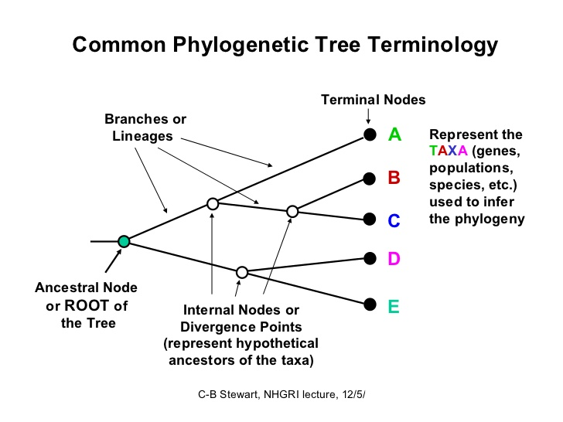

Slide 13
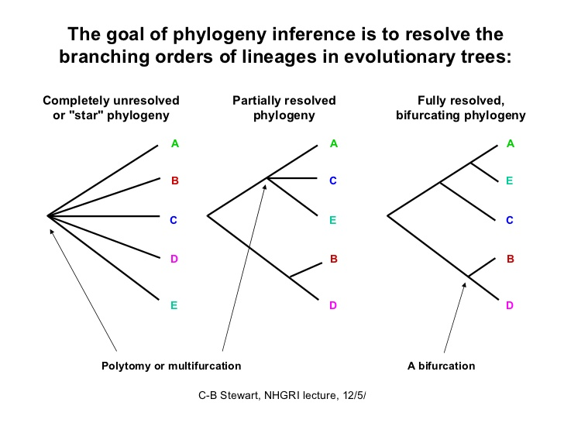

Slide 14
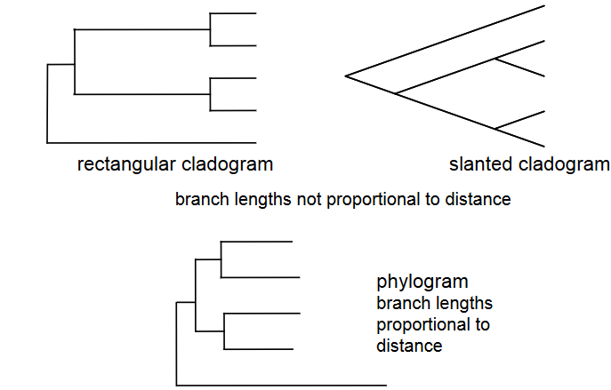
Types of Tree Representations

Slide 15
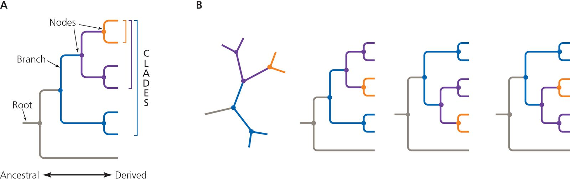
Reading a phylogenetic tree
Terminal node
Taxa can be rotated around nodes and still depict the same relationships

Slide 16
These are the same
C
A
B
C
A
A
B
A
B
B
C
C
Rotation
A
B
C
D
E
C
A
B
D
E
Congruent trees

Slide 17
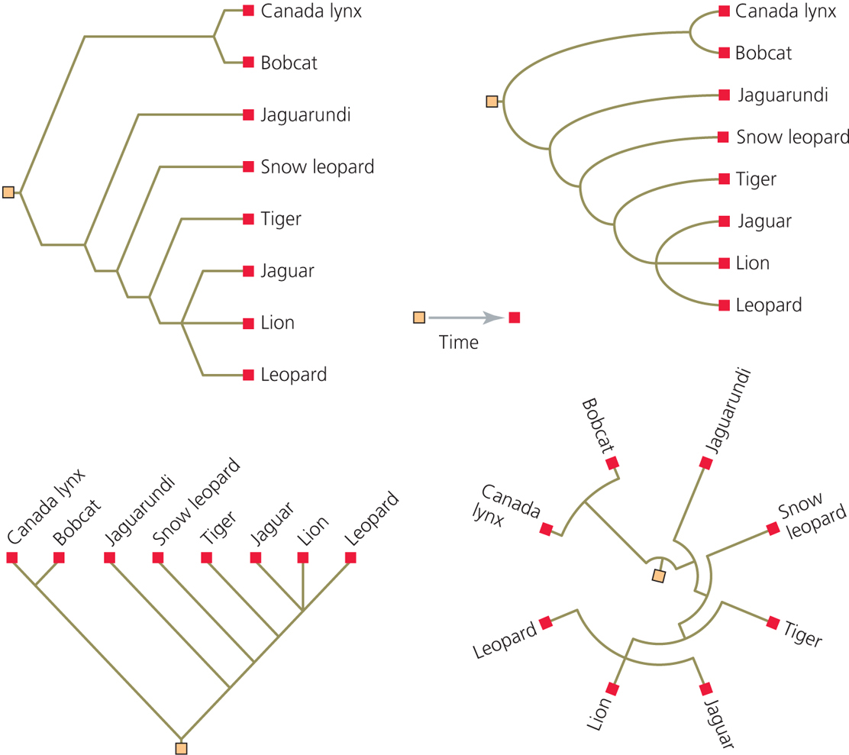
Figure 4-5
All the same topology

Slide 18
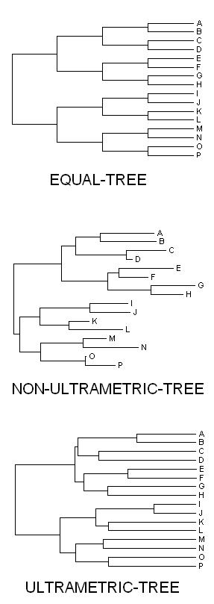
equal branch lengths
proportional branches
ultrametric branches
(UPGMA)

Slide 19
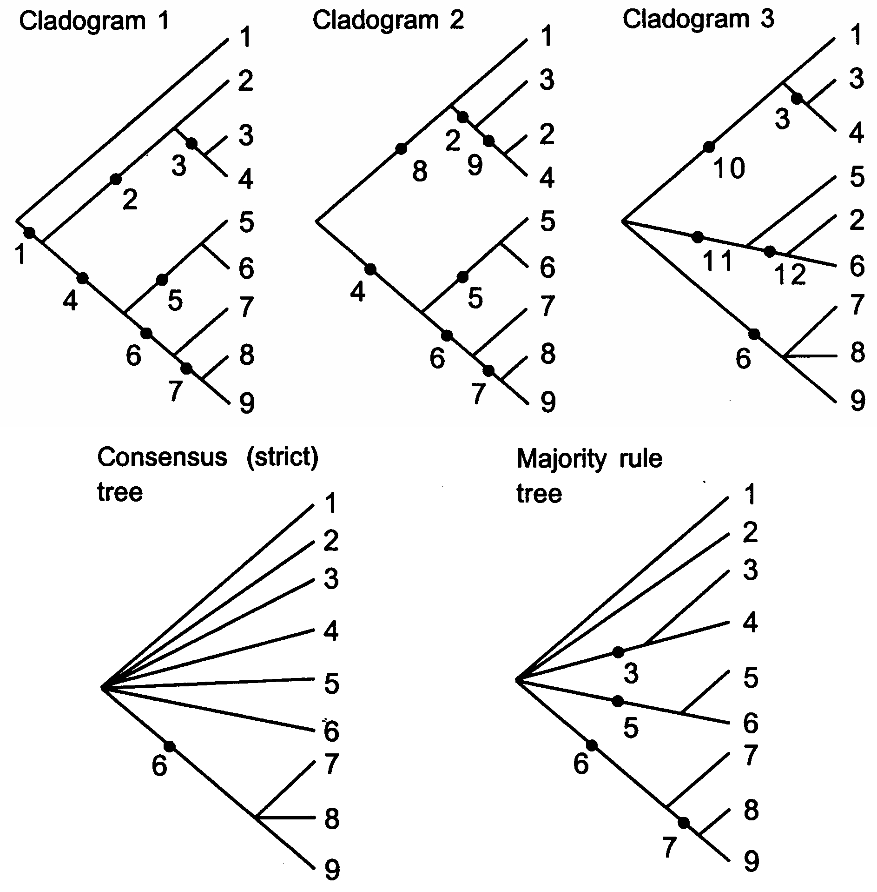
Consensus Trees
http://bio.slu.edu/mayden/systematics/bsc420520lect12.html

Slide 20
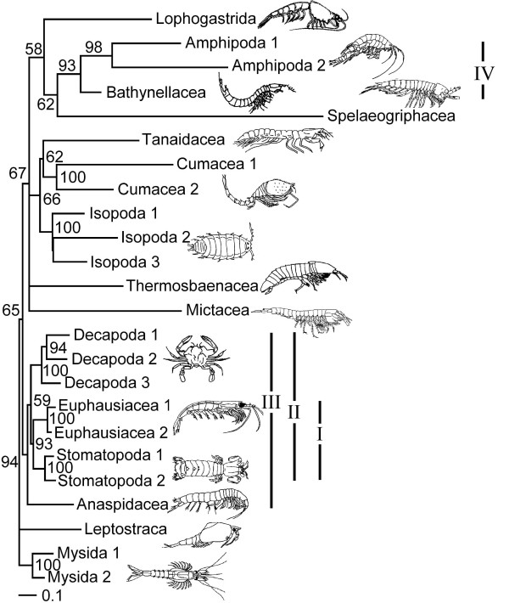
Branch Support – Clade Credibility Values
Values on branches
indicate proportion (%) of trees in posterior sample (i.e., n = 1000 from MrBayes analysis) supporting the particular clade.
Jenner, R. A., Dhubhghaill, C. N., Ferla, M. P., & Wills, M. A. (2009) Eumalacostracan phylogeny and total evidence: limitations of the usual suspects. BMC Evolutionary Biology, 9:21.

Slide 21
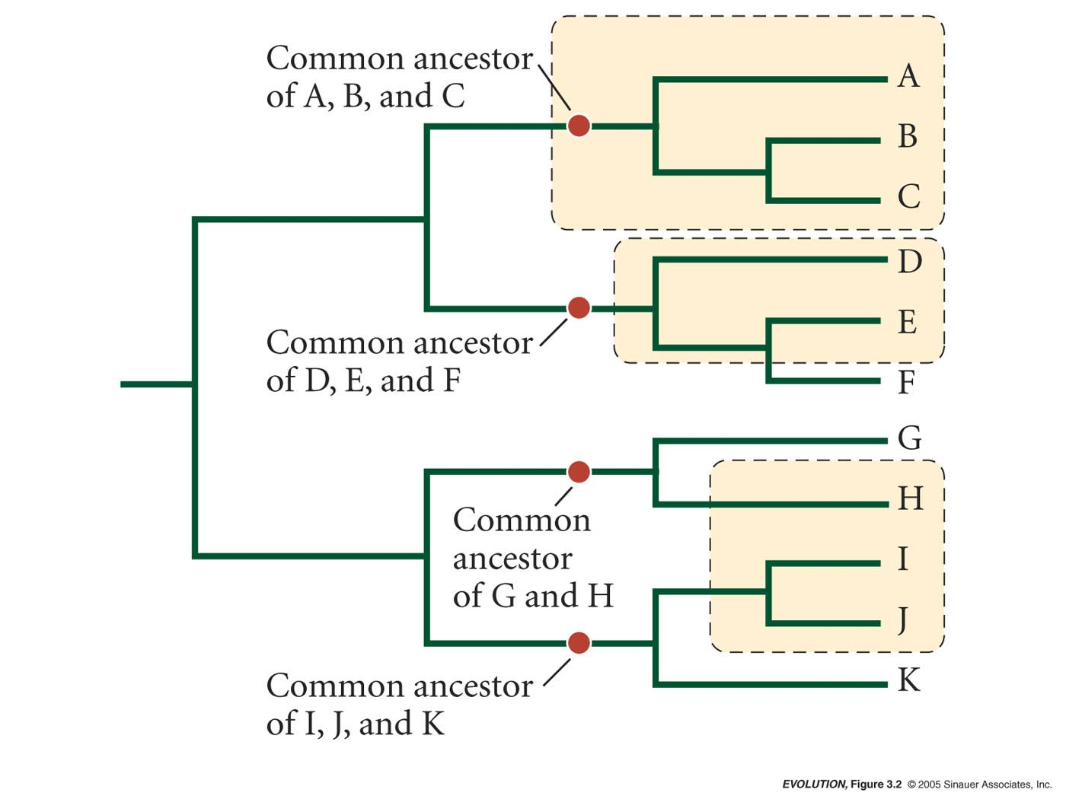
Monophyletic – a group consisting of all species descended from a single common ancestor
Paraphyletic – a group all descended from a common ancestor, but that does not contain all of the descendants from that ancestor
Polyphyletic – a group composed of members that do not share a common ancestor

Slide 22
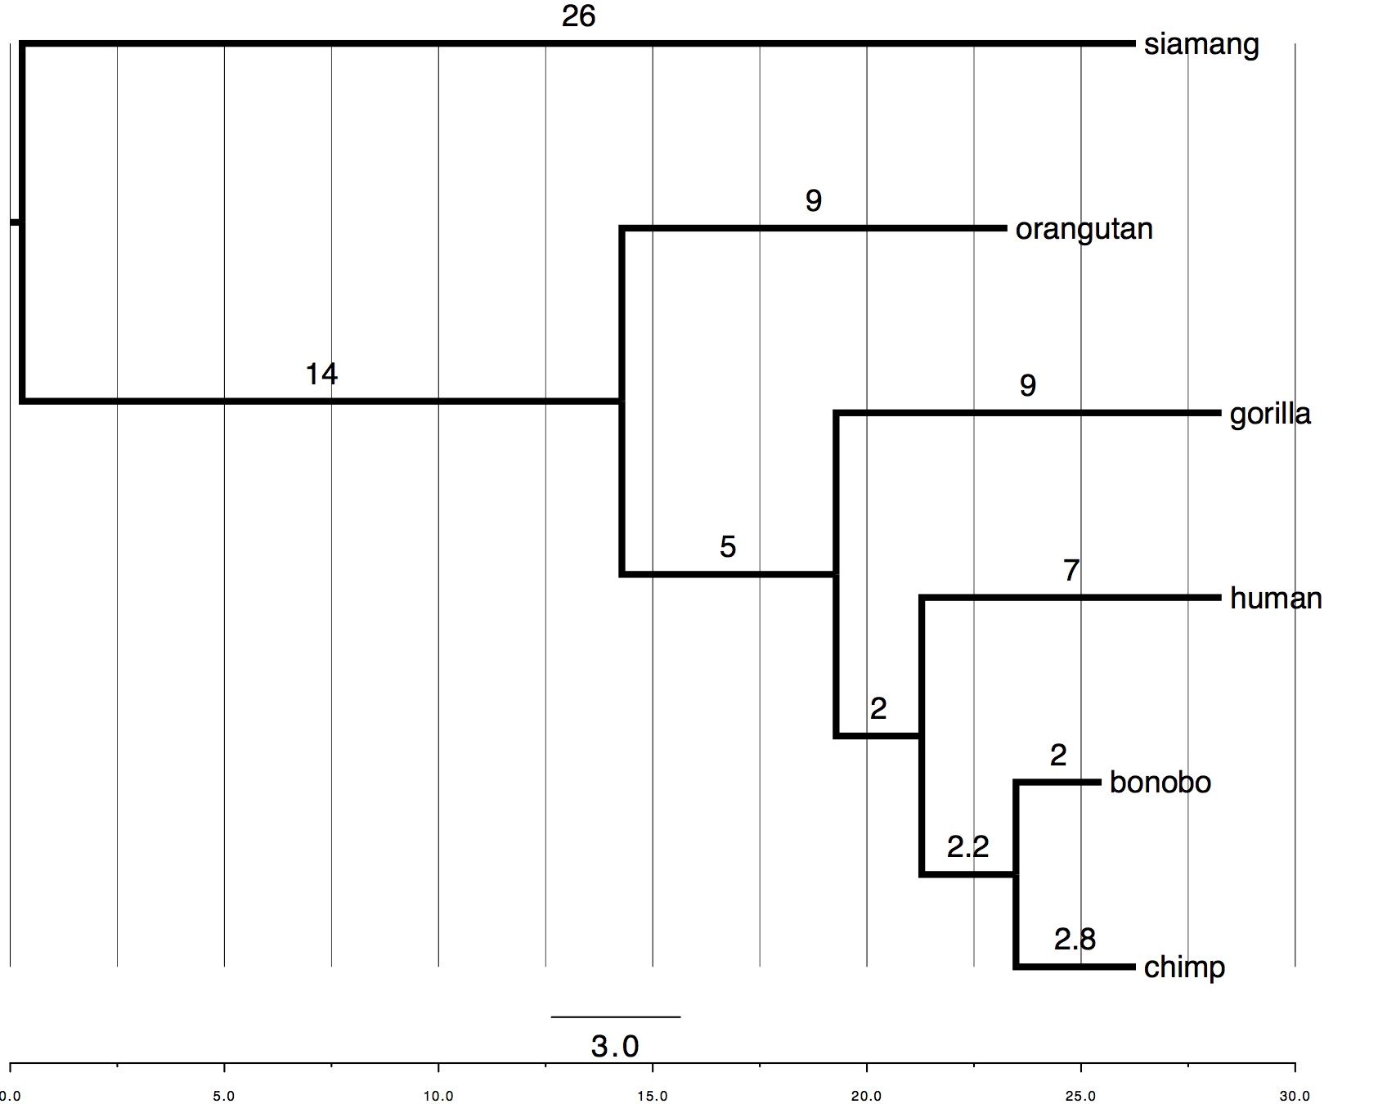
How do we code trees into data files?
Newick Tree Format
<newick id="startingTree">
((((human:7.0,(bonobo:2.0, chimp:2.8):2.2):2.0, gorilla:9.0):5.0, orangutan:9.0):14.0, siamang:26.0);
</newick>
Wikipedia Definition:
Newick Tree Format (or Newick notation or New Hampshire tree format) is a way of representing graph-theoretical trees with edge lengths using parentheses and commas. It was adopted by James Archie, William H. E. Day, Joseph Felsenstein, Wayne Maddison, Christopher Meacham, F. James Rohlf, and David Swofford, at the Society for the Study of Evolution Meeting in 1986, at Newick's restaurant in Dover, New Hampshire, U.S.

Slide 23
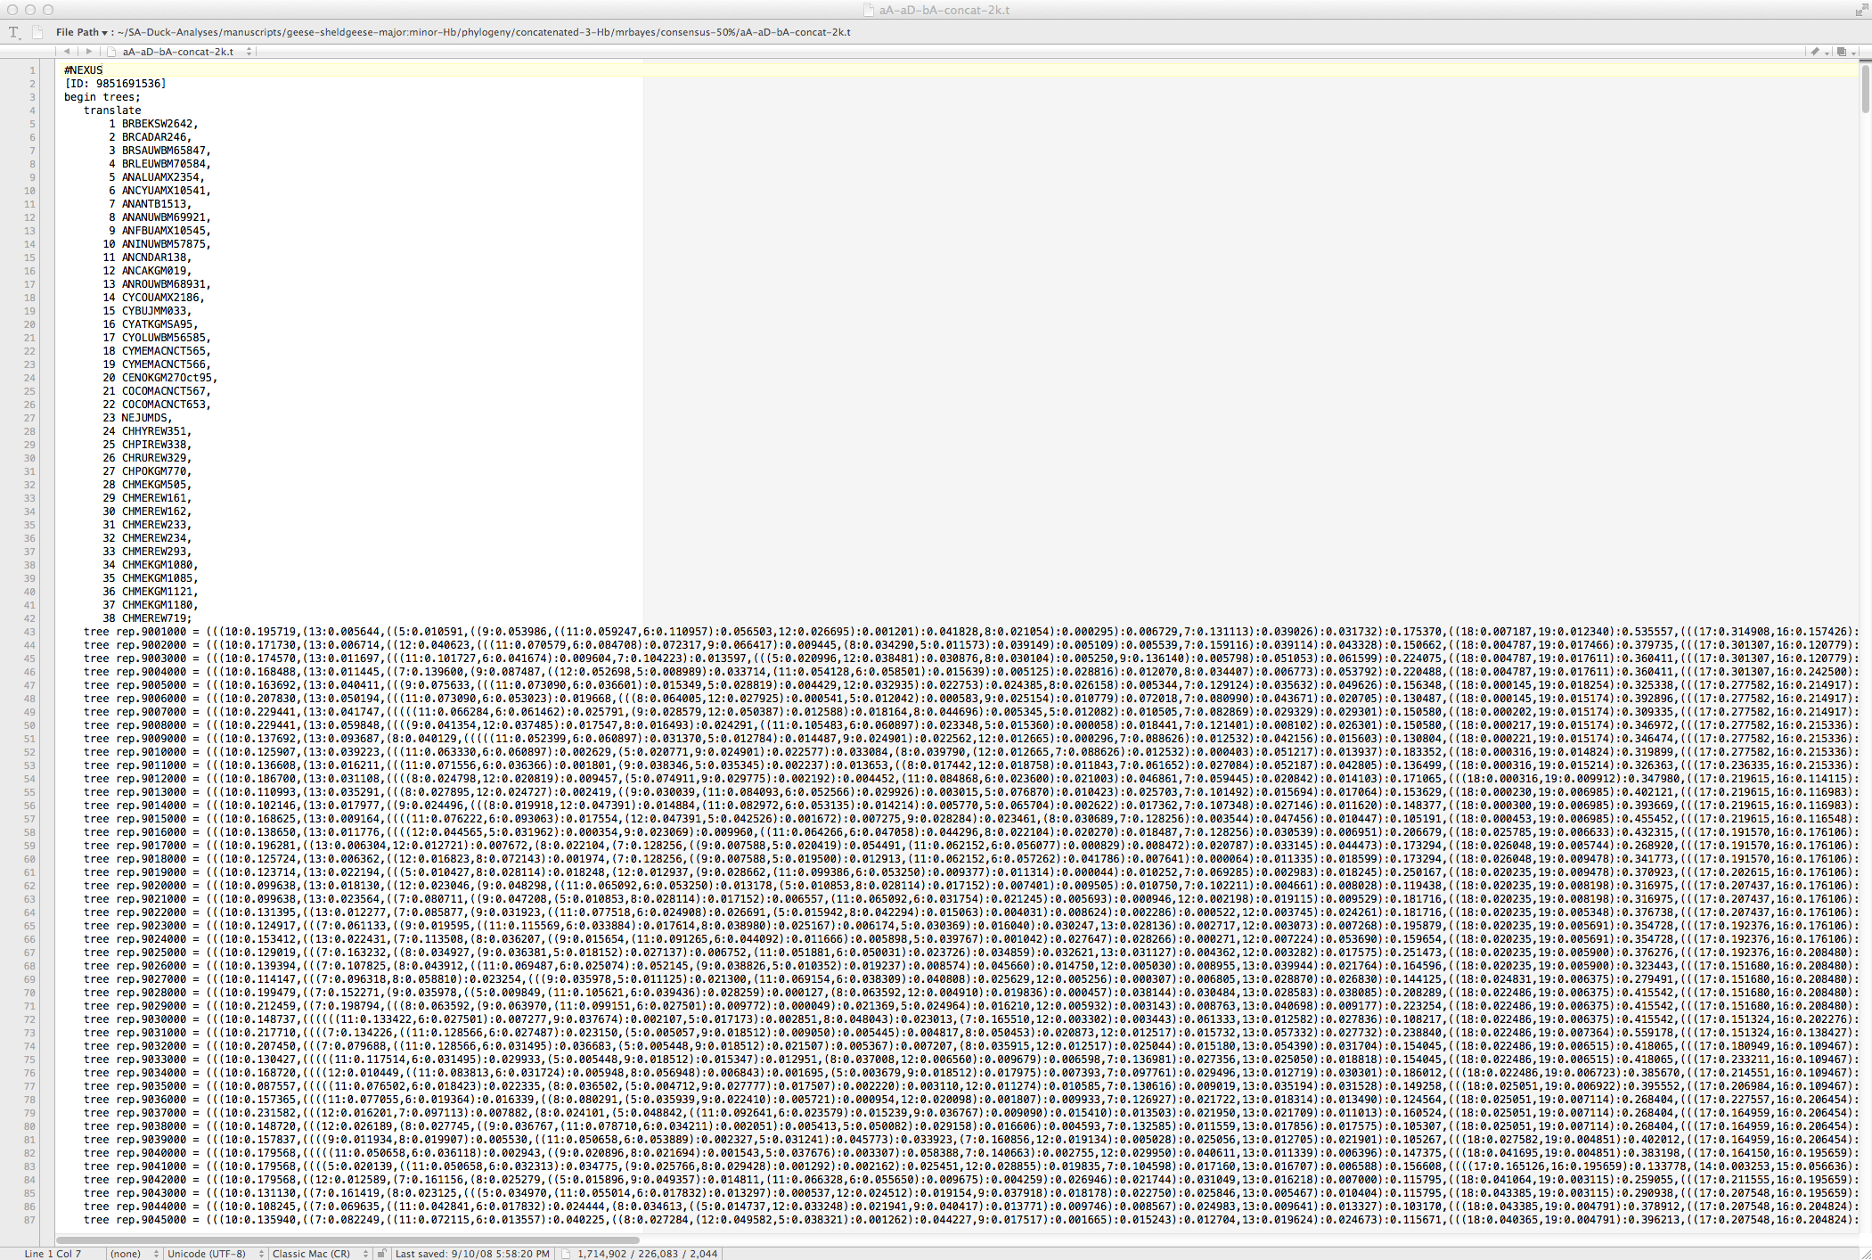

Slide 24
Finding the “best” tree:
Long tradition of using characters (morphological and molecular).
Beginning with Ernst Haeckel (1866)
1950-1960s - first computers, clustering algorithms developed – Phenetics
Willi Hennig (1966) - Cladistics via principle of parsimony
    PAUP - Phylogenetic Analysis Using Parsimony (Dave Swofford)
Maximum Likelihood (1980-1990s) - Joe Felsenstein (Phylip) & PAML (Yang)
Bayesian – MrBayes (John Huelsenbeck)
Multilocus Coalescent (BEAST & Others)

Slide 25
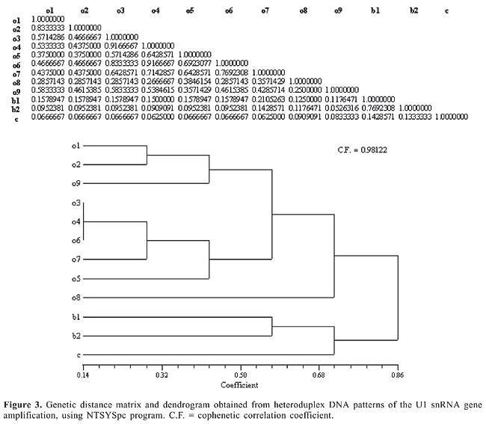
Genetic Distance – Build Tree with Distance Matrix and Clustering Algorithm:
1. Create a matrix describing genetic distances between all pairs of taxa.
2. Select tree that minimizes total distance (distances can be weighted or unweighted and may or may not conform to molecular clock).
http://www.funpecrp.com.br/gmr/year2006/vol3-5/gmr0187_full_text.htm

Slide 26
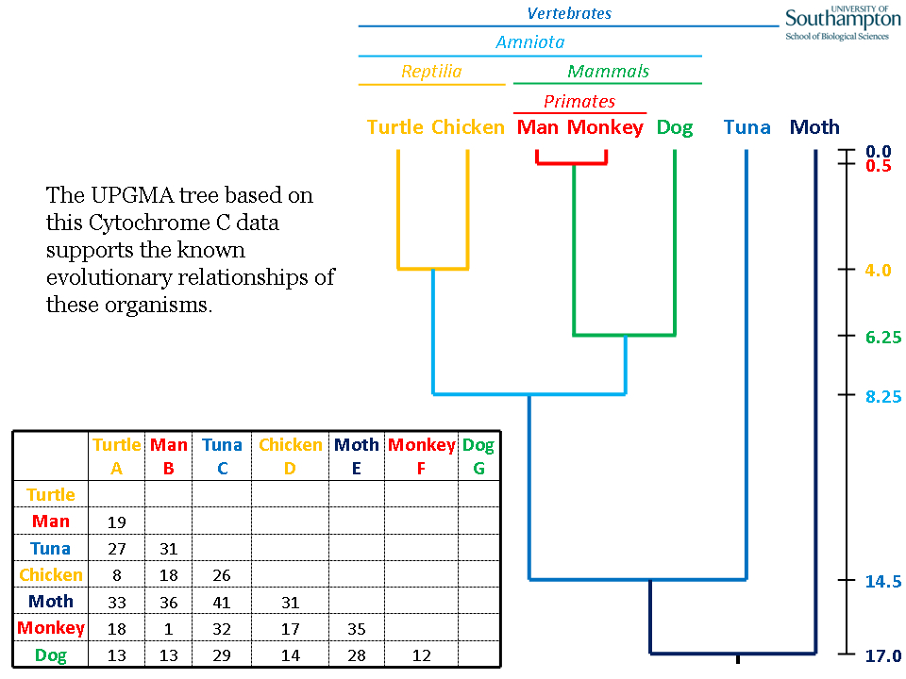
Ultrametric distance trees like UPGMA satisfy the assumption of a molecular clock.
http://www.slimsuite.unsw.edu.au/teaching/upgma/

Slide 27
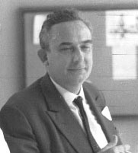
Cladistics vs. Phenetics Debate
Proponents of distance method quickly yielded to cladistics:
Criticisms of phenetic approaches by cladists:
Classifications based on overall similarity, not specific characters.
Cladists took issue with equal weighting of characters.
Phenetic analyses were unrooted, as there is no distinction between ancestral and derived characters.
Argued about definition of monophyly.
Willi Hennig
Cladistics

Slide 28
Cladistic principles:
Synapomorphy: shared derived homologous characters inferred to have been present in the nearest common ancestor of two or more taxa, but not in earlier ancestors outside this group.
INFORMATIVE---ONLY THESE CHARACTERS ARE USEFUL
Symplesiomorphy: shared ancestral homologous characters inferred to have been present in the nearest common ancestor of two or more taxa, and in earlier ancestors outside this group.
NON-INFORMATIVE---NOT USEFUL
Autapomorphy: unique derived character present in one of two sister groups.
NON-INFORMATIVE---NOT USEFUL
Parsimony: Map characters on the tree by principle of parsimony.

Slide 29


Minimize number of steps required to evolve characters on the tree, repeat for every character. Shortest tree is the best tree by principle of parsimony.
taxon 1
taxon 2
outgroup
taxon 1
taxon 2
Most parsimonious
outgroup
Less parsimonious

Slide 30
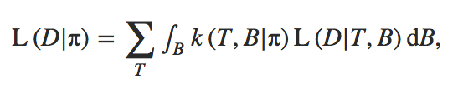

Maximum Likelihood/Bayesian methods:
Similar character based approaches but use‘statistical’ methods such as maximum likelihood and attempts to model DNA evolution as we know it (assuming different frequencies of nucleotides, substitution rates, etc.).
Maximum Likelihood – goal is to find the best tree
Bayesian Estimate – goal is to estimate a parameter from a set of trees
Trees have likelihood, but clades have posterior probabilities.
(similar to bootstrap resampling probabilities)
<-- a posterior probability from set of trees

Slide 31
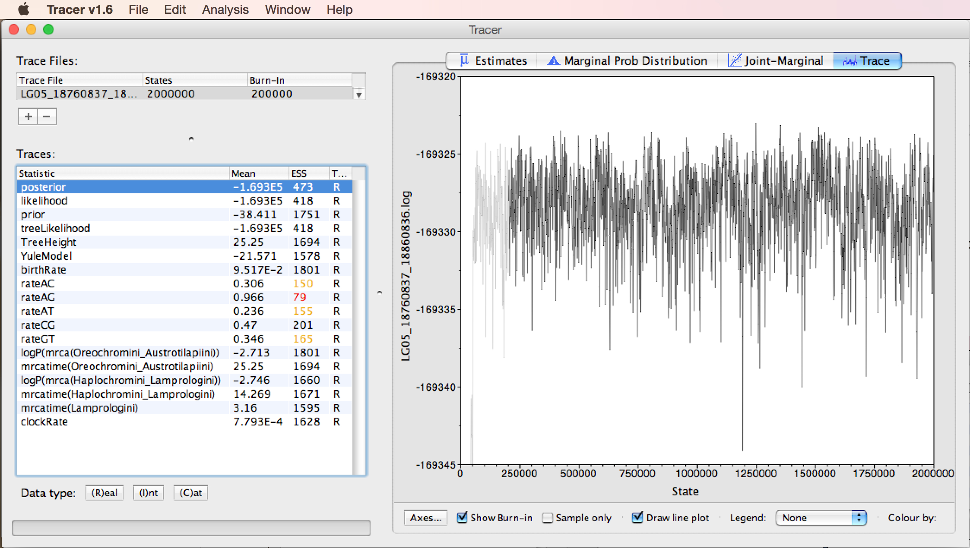

Slide 32
Posterior Probabilities – Bayesian Clade Credibility Values
Values on branches
indicate proportion (%) of trees in posterior sample (i.e., n = 1000 from MrBayes analysis) supporting the particular clade.
Jenner, R. A., Dhubhghaill, C. N., Ferla, M. P., & Wills, M. A. (2009) Eumalacostracan phylogeny and total evidence: limitations of the usual suspects. BMC Evolutionary Biology, 9:21.

Slide 33
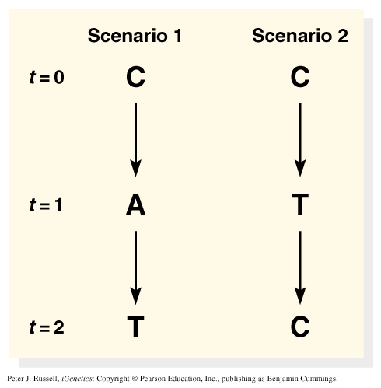
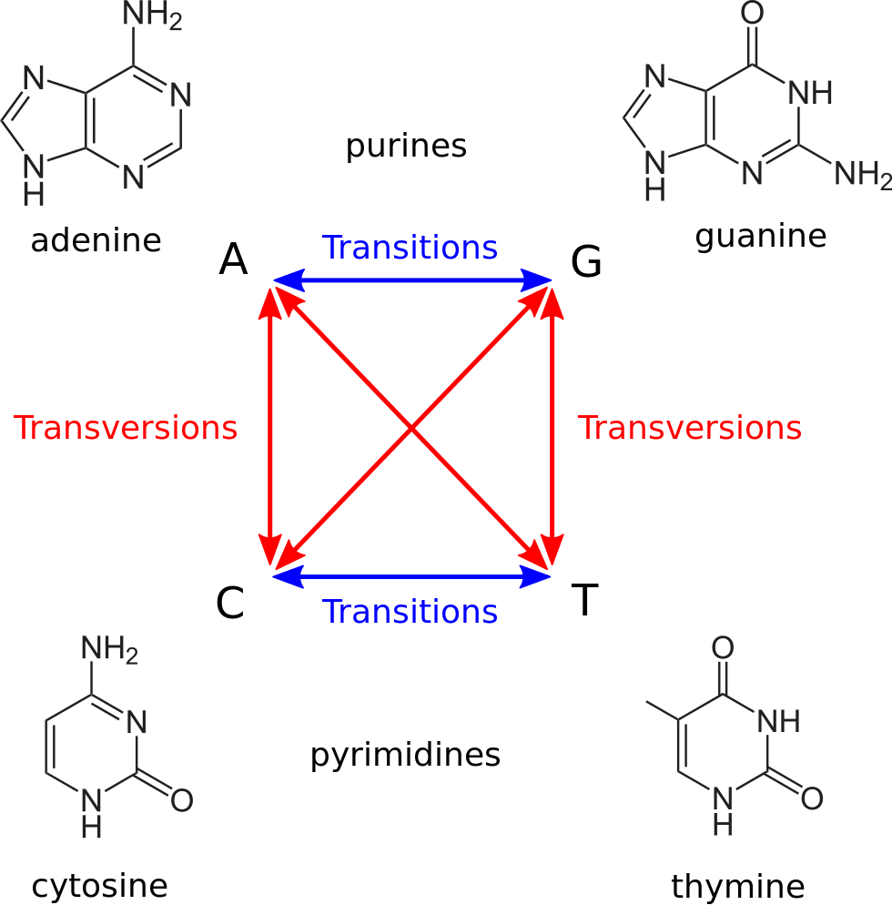
Models of nucleotide substitution:
Alignment of sequences with many differences underestimates the actual number of substitutions.
Different types of substitutions have different rates.

Slide 34
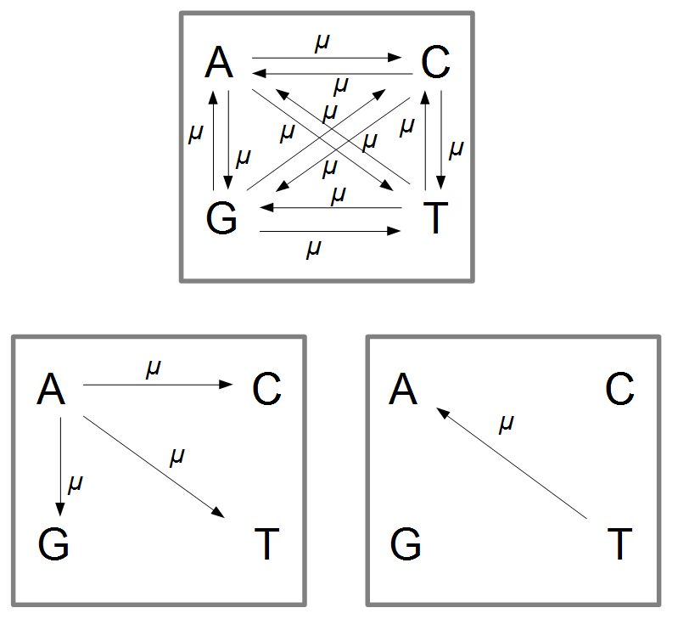
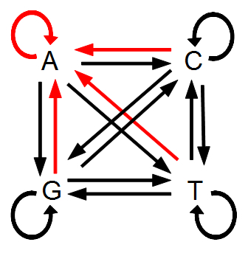
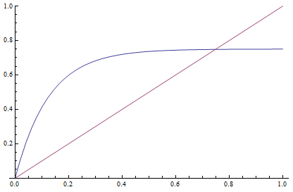
Jukes-Cantor (1969) Models of Nucleotide Substitution:
Simplest model
Equal base frequencies, all substitutions equally likely
P_{C(t)} = 1/4 + (3/4)e^{-4αt} where α = rate of substitution
# substitutions/site = D = -3/4ln(1-4/3d)
d = % difference (raw count)
JC Model
Raw Distance
http://treethinkers.org/jukes-cantor-model-of-dna-substitution/

Slide 35
Jukes-Cantor (JC, nst=1)
equal base frequencies, all substitutions equally likely (Jukes and Cantor 1969)
Felsenstein 1981 (F81, nst=1)
variable base frequencies, all substitutions equally likely (Felsenstein 1981)
Kimura 2-parameter (K80, nst=2)
equal base frequencies, one transition rate and one transversion rate (Kimura 1980)
Hasegawa-Kishino-Yano (HKY, nst=2)
variable base frequencies, one transition rate and one transversion rate (Hasegawa et. al. 1985)
Tamura-Nei (TrN)
variable base frequencies, equal transversion rates, variable transition rates (Tamura Nei 1993)
Kimura 3-parameter (K3P)
variable base frequencies, equal transition rates, two transversion rates (Kimura 1981)
Transition model (TIM)
variable base frequencies, variable transition rates, two transversion rates
Transversion model (TVM)
variable base frequencies, variable transversion rates, transition rates equal
Symmetrical model (SYM)
equal base frequencies, symmetrical substitution matrix (A to T = T to A) (Zharkikh 1994)
General time reversible (GTR, nst=6)
variable base frequencies, symmetrical substitution matrix (e.g., Lanave et al. 1984, Tavare 1986, Rodriguez et. al. 1990)

Slide 36
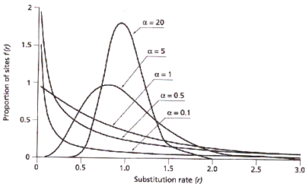
Nucleotide Substitution Rates
Need to also consider rate variation among sites in a sequence:
  gamma distribution (G): gamma distributed rate variation among sites (α = shape parameter)
  proportion invariable sites (I): extent of static, unchanging sites in a dataset

Slide 37
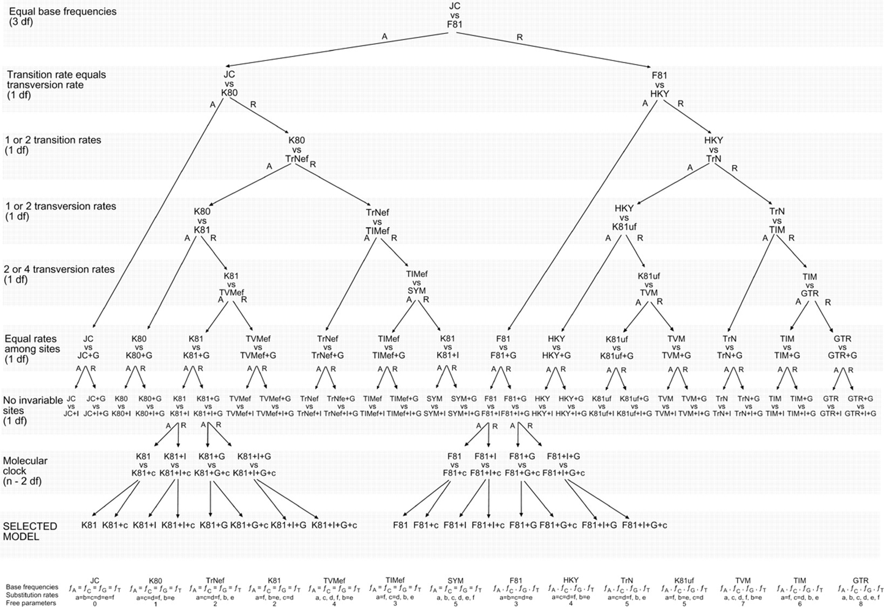
Lots of DNA substitution models to choose from:

Slide 38
How do we choose among substitution models?
Akaike Information Criterion (AIC)
Measure of relative quality of statistical models for given data.
Tradeoff between goodness-of-fit (likelihood) and complexity of the model (degrees of freedom).
Adding parameters to a model usually improves fit, but also adds complexity. A simpler model may be preferable.
AIC = 2k – 2ln(L), where k = # free parameters
AICc is corrected for sample size.

Slide 39
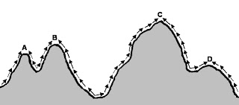
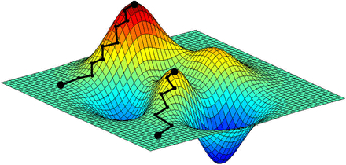
How we efficiently search through very large sets of trees to estimate parameters?
Exhaustive Search Algorithm – search all possible trees, useful for up to ~10 taxa
Heuristic Search Algorithm – search a subset of trees, use algorithm to find global optimum (usually involves random # seed to build tree followed by breaking branches in tree and reevaluating –lnL using MCMC; # chains and heating help algorithm run faster).

Slide 40
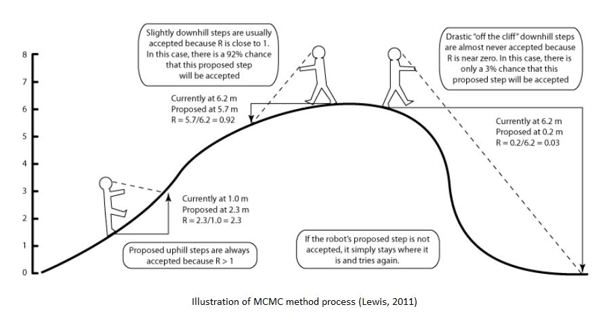
Robot analogy for Markov Chain Monte Carlo

Slide 41
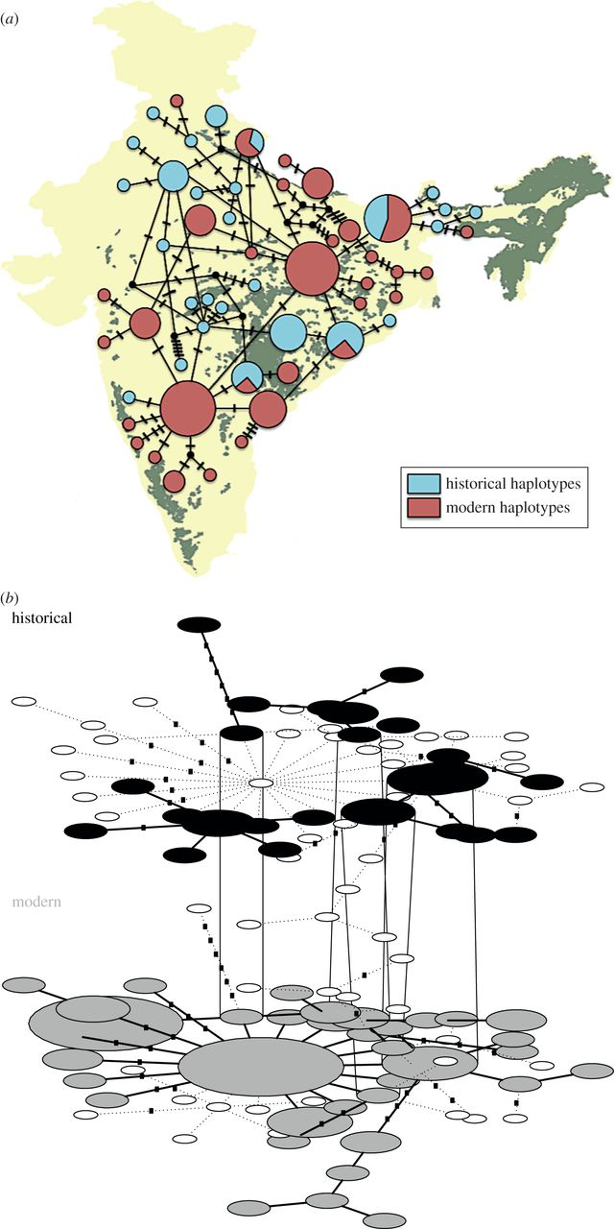
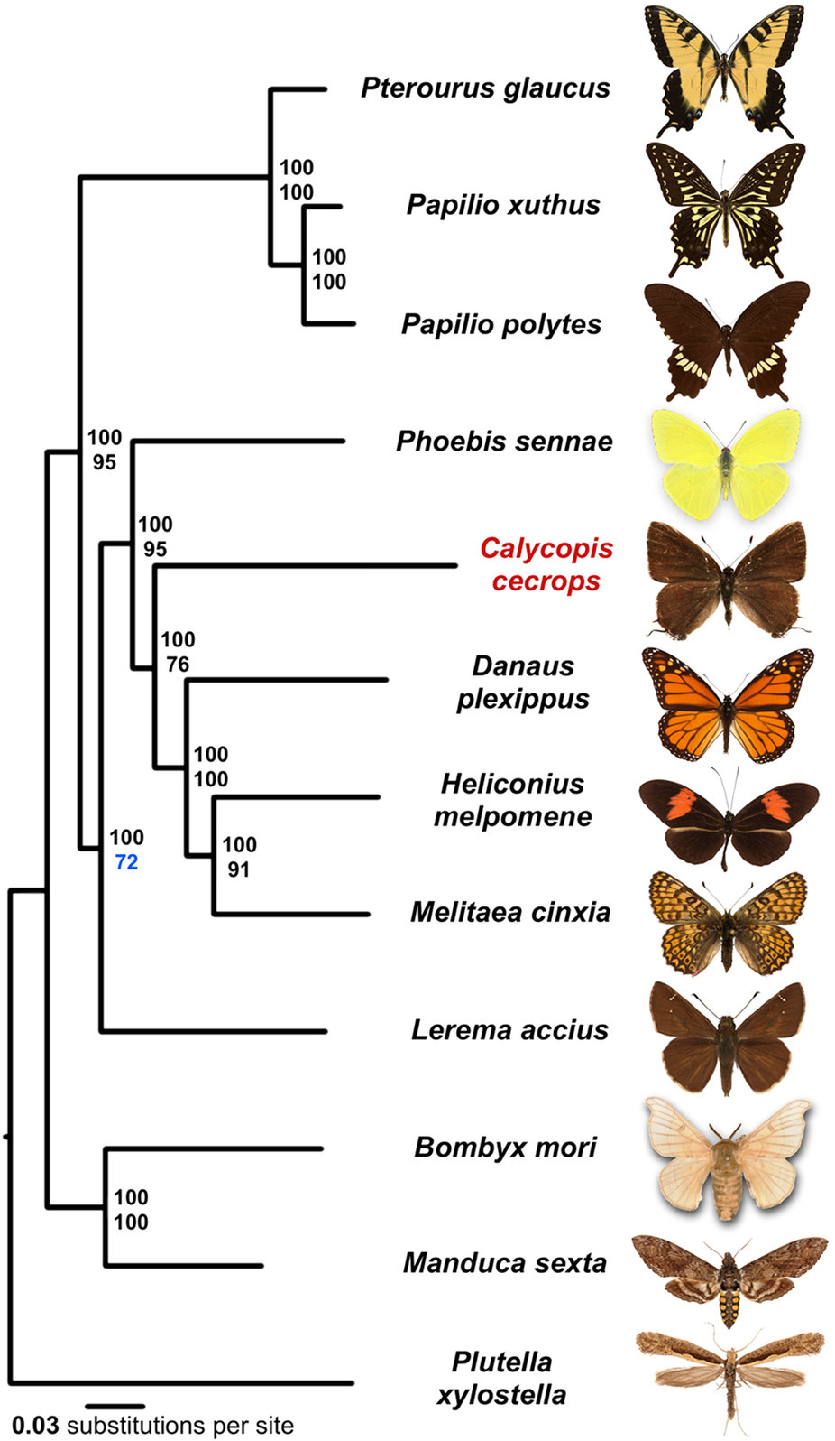
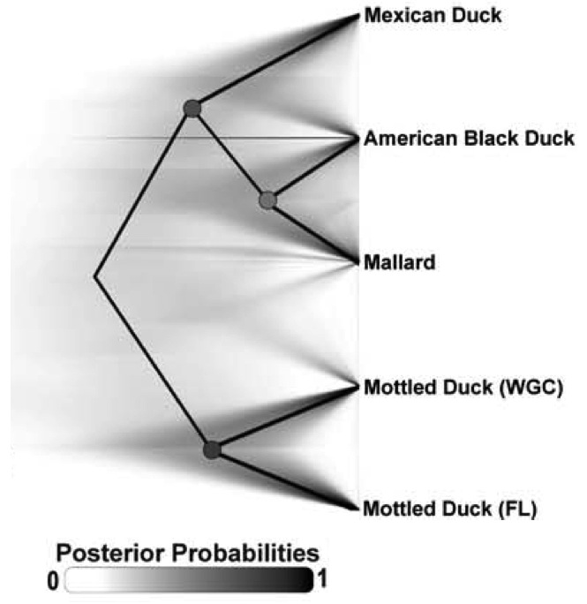
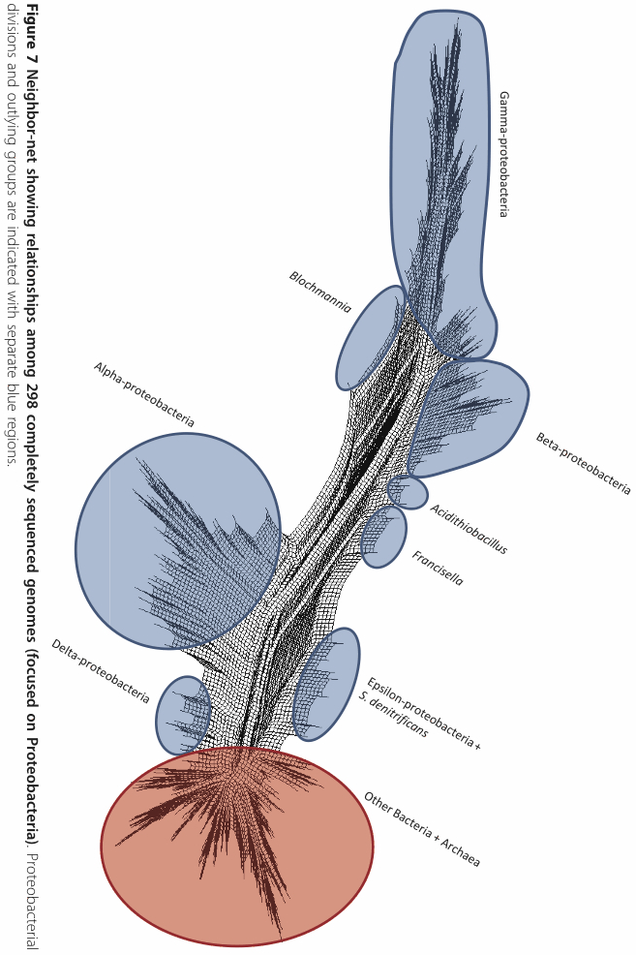
Some of the tools people are using to analyze large genomic datasets:
Mondol et al. 2013
TempNet
Cong et al. 2016
RAXML
Morrison et al. 2013
SplitsTree
Lavretsky et al. 2015
SNAPP

Slide 42
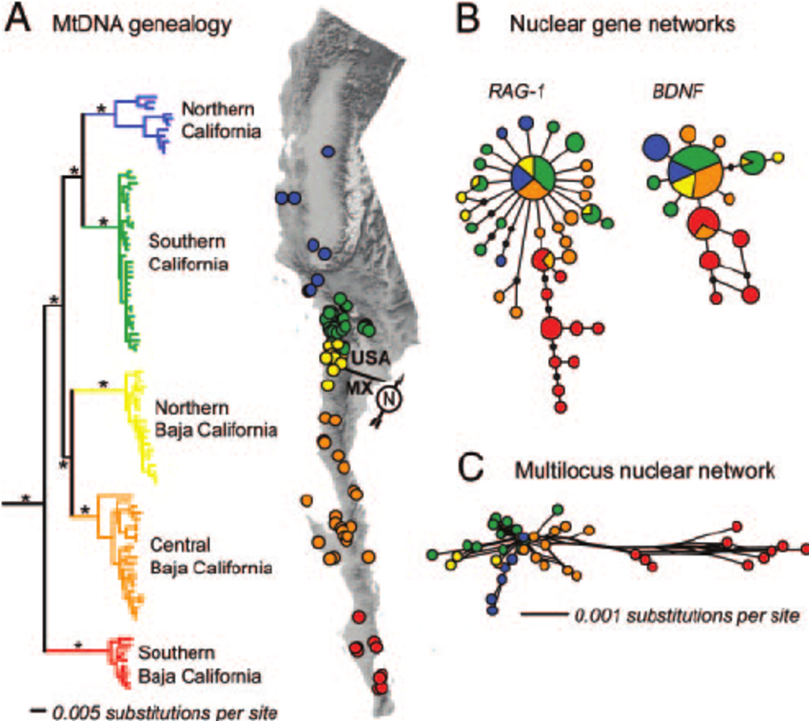
Trees vs. Networks
Leaché, A. D., Koo, M. S., Spencer, C. L., Papenfuss, T. J., Fisher, R. N., & McGuire, J. A. (2009). Quantifying ecological, morphological, and genetic variation to delimit species in the coast horned lizard species complex (Phrynosoma). Proceedings of the National Academy of Sciences, 106(30), 12418-12423.

Slide 43
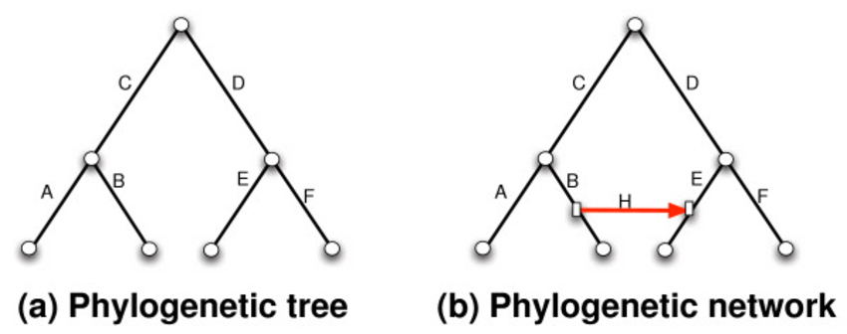
Networks
Created a reticulation, reflects uncertainty, typical of what we encounter from homplasy…

Slide 44
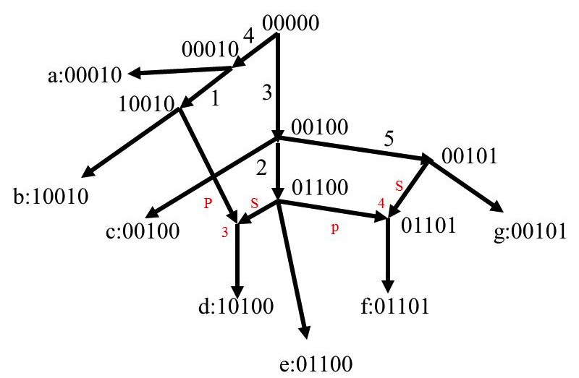

Slide 45
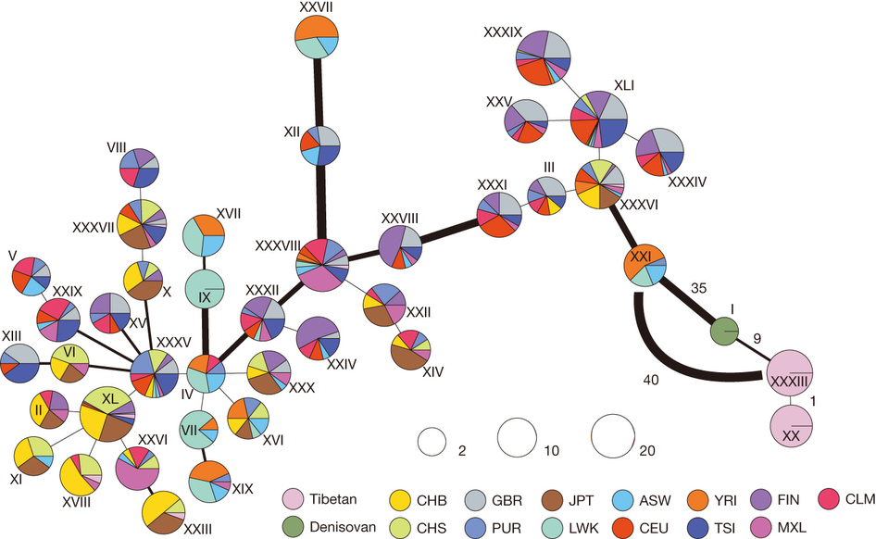
Huerta-Sánchez (2014) Altitude adaptation in Tibetans caused by introgression of Denisovan-like DNA. Nature 512: 194-197.

Slide 46
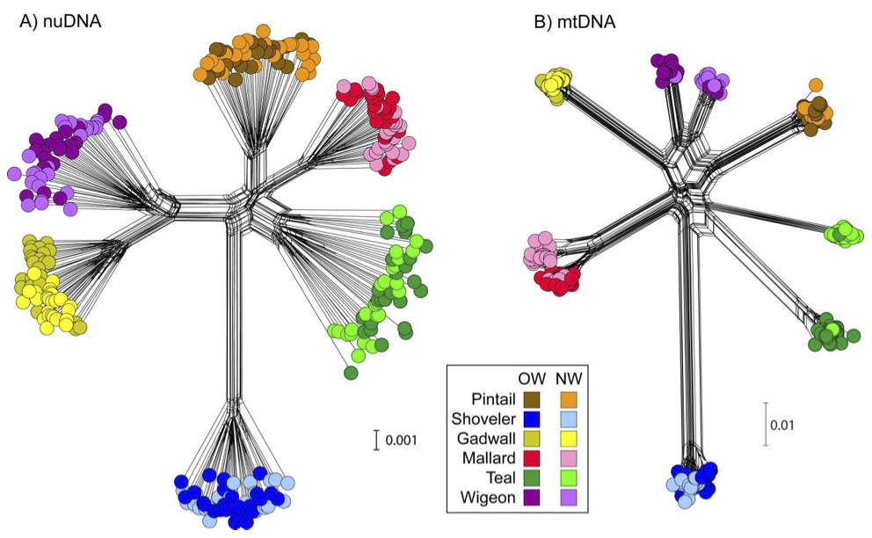
SplitsTree4 - Software
Peters, J. L., K. Winker, K. C. Millam, P. Lavretsky, I. Kulikova, R. E. Wilson, Y. N. Zhuravlev, and K. G. McCracken (2014) Mito-nuclear discord in six congeneric lineages of Holarctic ducks (genus Anas). Molecular Ecology 23:2961-2974

Slide 47
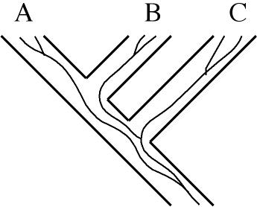
Incomplete Lineage Sorting
Gene trees vs. species trees:
A gene tree does not necessarily reflect the species tree.
Common ancestor or two gene lineages can predate species split because of ancestral polymorphism.
Leading to incomplete lineage sorting, i.e., trees derived from different genes
or linkage groups may conflict and/or show different patterns.
Species tree = straight lines
(A, B), C
Gene tree = curvy lines
(B,C), A

Slide 48

Nature Reviews Genetics (2014) 15:347-359

Slide 49
Worst case scenario is three-way tie with equal frequencies of different gene trees
A
B
C
B
C
A
A
C
B
or
or
3-way polytomy

Slide 50

Why is so much noise to be expected?
Peters, J. L., K. Winker, K. C. Millam, P. Lavretsky, I. Kulikova, R. E. Wilson, Y. N. Zhuravlev, and K. G. McCracken (2014) Mito-nuclear discord in six congeneric lineages of Holarctic ducks (genus Anas). Molecular Ecology 23:2961-2974.
Sorted
Not Sorted

Slide 51

Peters, J. L., T. E. Roberts, K. Winker, and K. G. McCracken (2012) Heterogeneity in genetic diversity among non-coding loci fails to fit neutral coalescent models of population history. PLoS ONE 7:e31972.

Slide 52

Stages of intermediate polyphyly
1) Not sorted (alleles shared), clades not monophyletic
2) Sorted (alleles not shared), clades not monophyletic
3) Sorted (alleles not shared), clades monophyletic
Omland, K.E., Baker, J.M. and Peters, J.L. (2006) Genetic signatures of intermediate divergence: population history of Old and New World Holarctic ravens (Corvus corax). Molecular Ecology, 15(3), pp.795-808.

