Slide 1
Natural Selection 2
Population Genomics
Cochabamba, Bolivia
Gen-Pob’25

Slide 2
Effects of drift are important to selection when allele frequencies are low.
Probability of fixation is 1/2N.
Most neutral mutations are lost, some persist.
Trajectory for single neutral mutation is unpredictable but average properties can be calculated from the variance.

Slide 3
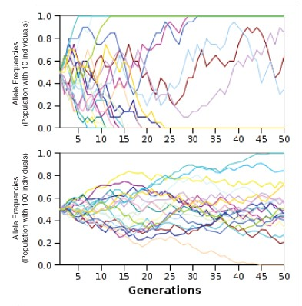
Trajectories are Ne dependent

Slide 4
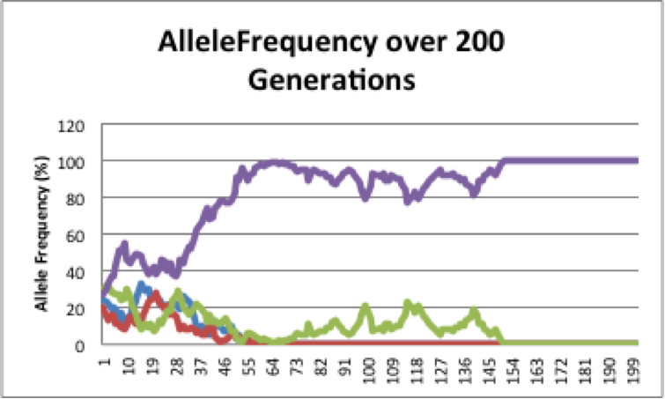
← One allele went to fixation. Was this caused by drift or selection?
← Most alleles went extinct as predicted

Slide 5
Effects of drift are important to selection when allele frequencies are low.
Neutral alleles go to fixation on average within 4N generations.
No neutral alleles stay at intermediate frequency forever; all alleles ultimately go to f = 0 or 1.

Slide 6
Effects of drift are important to selection when allele frequencies are low.
Alleles at initial high frequency are more likely to be fixed than low frequency alleles.
Selection favoring the a new mutation increases the probability of fixation.

Slide 7
Probability that mutation is fixed:
Function of the selection coefficient s and Ne:
u (s, N) = (1 – e^{-2s}) / (1 – e^{-4Ns})
… when N is large and s is small

Slide 8
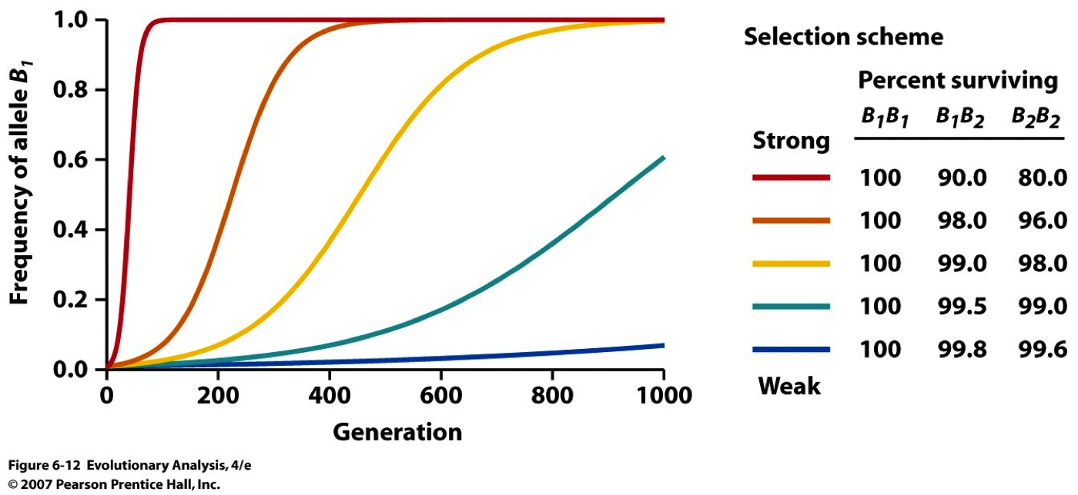
Probability of fixation for allele B₁ does not depend on N_{e} when B₁ is strongly advantageous, if 2Ns > 1.
As s becomes large, u becomes approximately 2s

Slide 9
Strongly advantageous allele
If 2Ns > 1, probability of fixation does not depend on N_{e}.
Nearly neutral (weaker selection)
If -1 < 2Ns < 1, fate of all these alleles are strongly affected by N_{e}.
Strongly deleterious allele
If 2Ns < -1, extinction is also independent of N_{e}.

Slide 10
Strongly Advantageous
Weakly Advantageous
Allele frequency
Strongly Deleterious
Slightly Deleterious
t in generations

Slide 11
End result:
Genetic drift can inhibit efficacy of selection.
Not all highly advantageous alleles become fixed in the population, some will be lost.
Some slightly deleterious alleles can also become fixed.
Causing a population to not be as well adapted as it might be if all beneficial alleles were fixed and all deleterious alleles lost.
This is a genetic load.

Slide 12
Selection is more efficient in a larger population:
A strongly advantageous allele may by chance behave as nearly neutral in a small population.
A strongly deleterious allele that has no chance of being fixed in a large population may become fixed in a small population by chance.
Drift dominates a small population!

Slide 13
Drift dominates
(N_{e}s << 1)
Selection dominates
(N_{e}s >> 10)
Jeff Peters - Wright State University

Slide 14
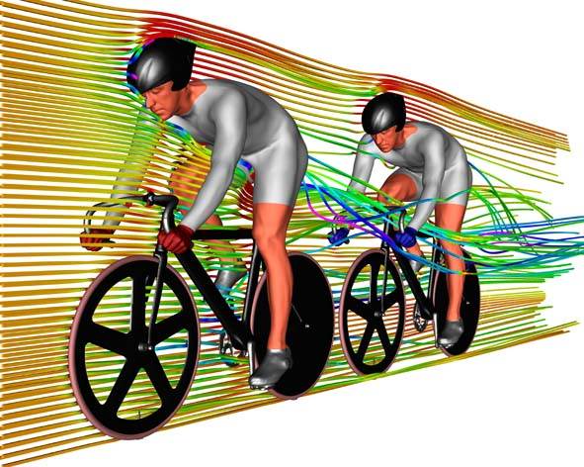
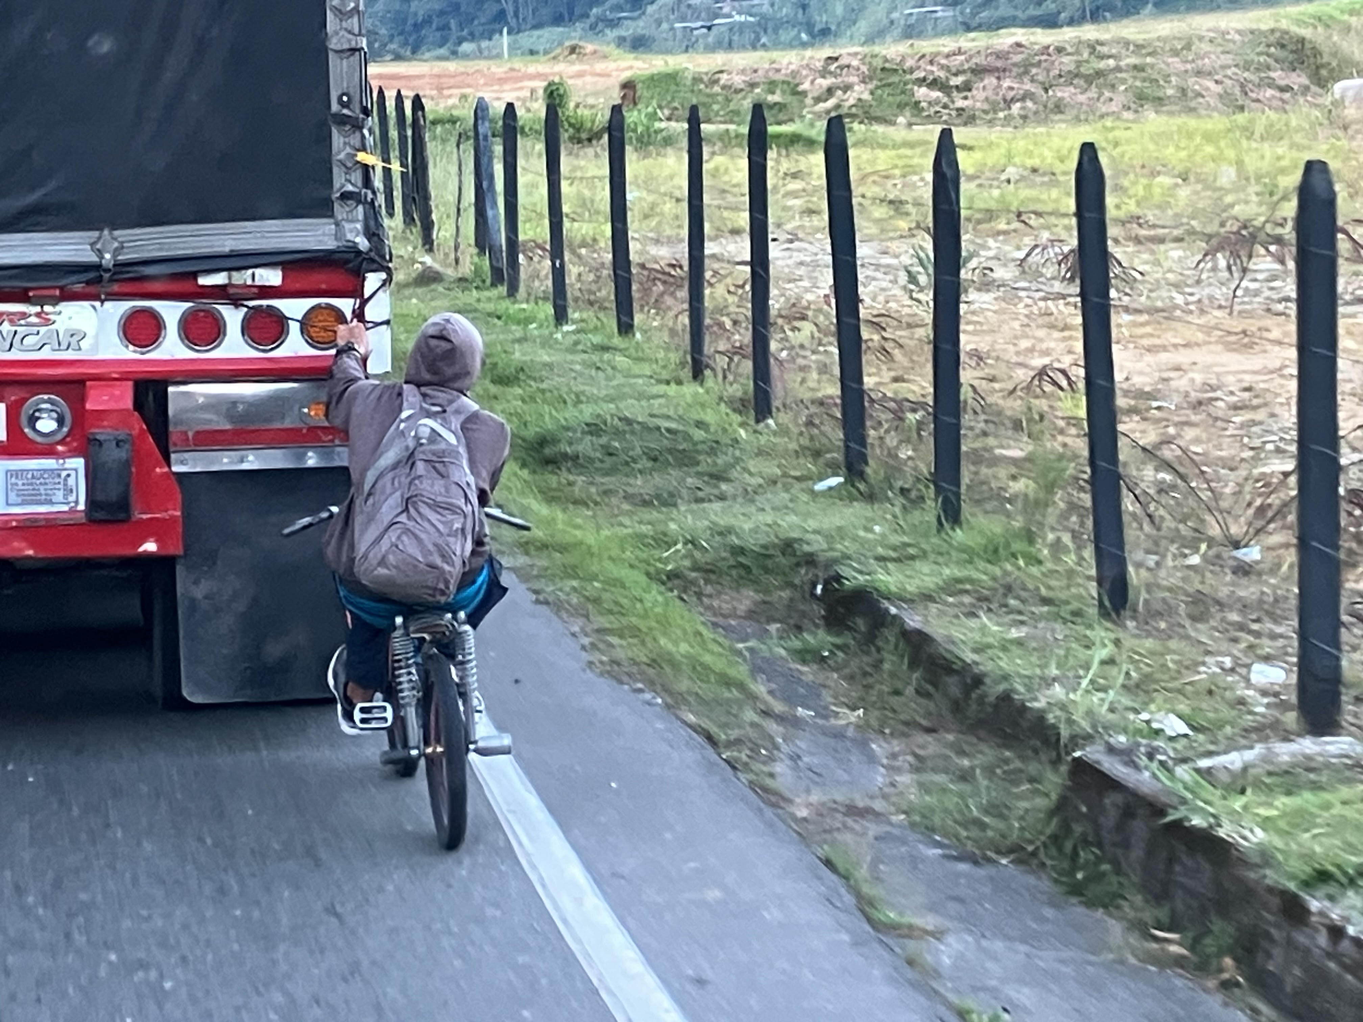
Genetic Hitchhiking (or Genetic Draft)
Region of DNA linked to a favorable allele becomes overrepresented in the population. Effects of selection are apparent not only at the selected locus but also in flanking DNA sequences.
If there is a lot of linkage disequilibrium (LD) like in
humans, these markers can tell us a lot about the
general location of particular genes.

Slide 15
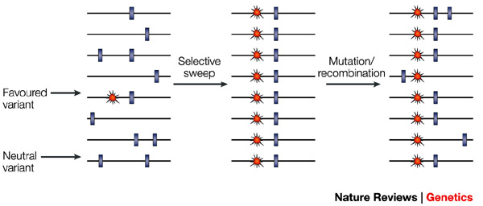
Selective Sweep by Directional Selection
Creates linkage disequilibrium
Entire region has gone to fixation.
All genetic variation is eliminated.

Slide 16
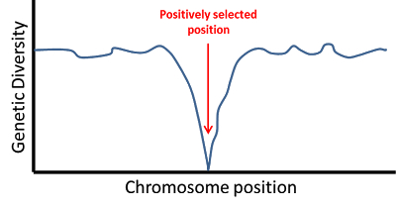
Effect of selective sweep on linked variation:
Effect of the selected sweep is much more pronounced closer to the selective site.
Leaves a characteristic pattern of genetic variability.
    Low near selected site
    Higher farther away
In case of two populations, directional selection creates peak in F_{ST} in these regions of low variability.
Effects are strong if the recombination distance (c) is less than the selection coefficient (s).

Slide 17
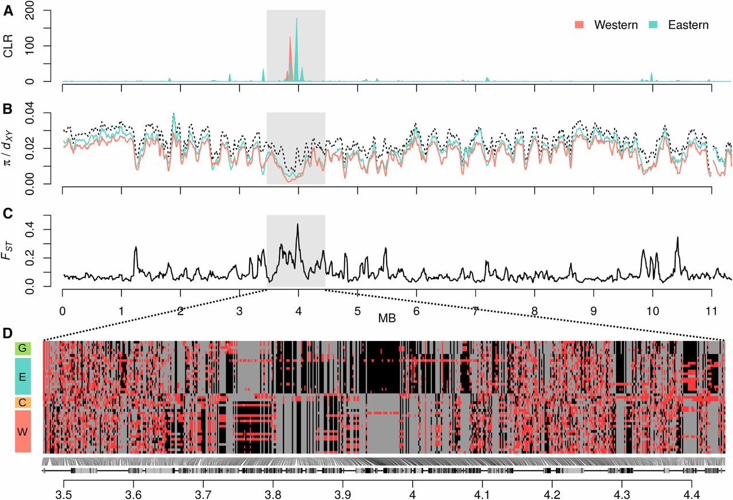

Putative selective sweep on chromosome 11.
Simon H. Martin et al. Natural Selection and Genetic Diversity in the Butterfly Heliconius melpomene. Genetics (2016) 203:525-541
Copyright © 2016 Martin et al.
Notes:
Putative selective sweep on chromosome 11. (A) Composite likelihood ratio (CLR) values calculated by SweeD (Pavlidis et al. 2013) for the Eastern and Western populations for 1000 windows across chromosome 11. Scaffolds are shaded light and dark. (B) Nucleotide diversity (π) for the Eastern and Western populations (in color) and divergence (d_{XY}) between these two populations (black dashed line), calculated for 50-kb sliding windows across chromosome 11, sliding in increments of 10 kb. (C) F_{ST} between the Eastern and Western populations was calculated in windows as in B. (D) Individual genotypes at 600 biallelic SNPs on scaffold HE672079, which harbors the putative selective sweep. Homozygous genotypes are colored gray (major allele) and black (minor allele), and heterozygotes are colored red. To optimize the detection of differences between populations, SNPs with a high degree of polymorphism (minor allele frequency ≥0.25) were considered. The 600 SNPs plotted were sampled semirandomly, ensuring that no two sampled SNPs were >1000 bp apart. Protein coding genes are indicated below the plot, with exons shown in black.

Slide 18
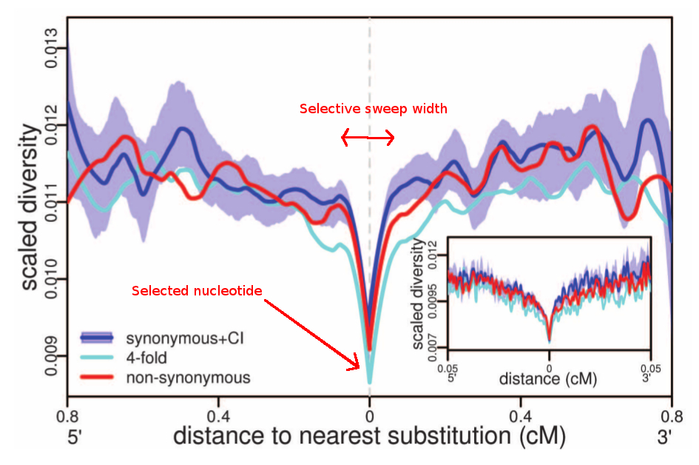
http://genomeeee.blogspot.com/2011/12/hard-selective-sweeps-dont-seem-to-be.html

Slide 19
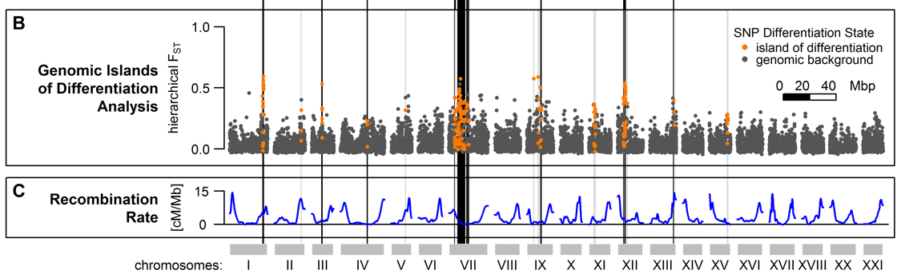
F_{ST} (a measure of LD) and Recombination Rate Show Inverse Relationship
Marques, David A., et al. (2016) Genomics of Rapid Incipient Speciation in Sympatric Threespine Stickleback. PLoS Genet 12.2:e1005887.

Slide 20
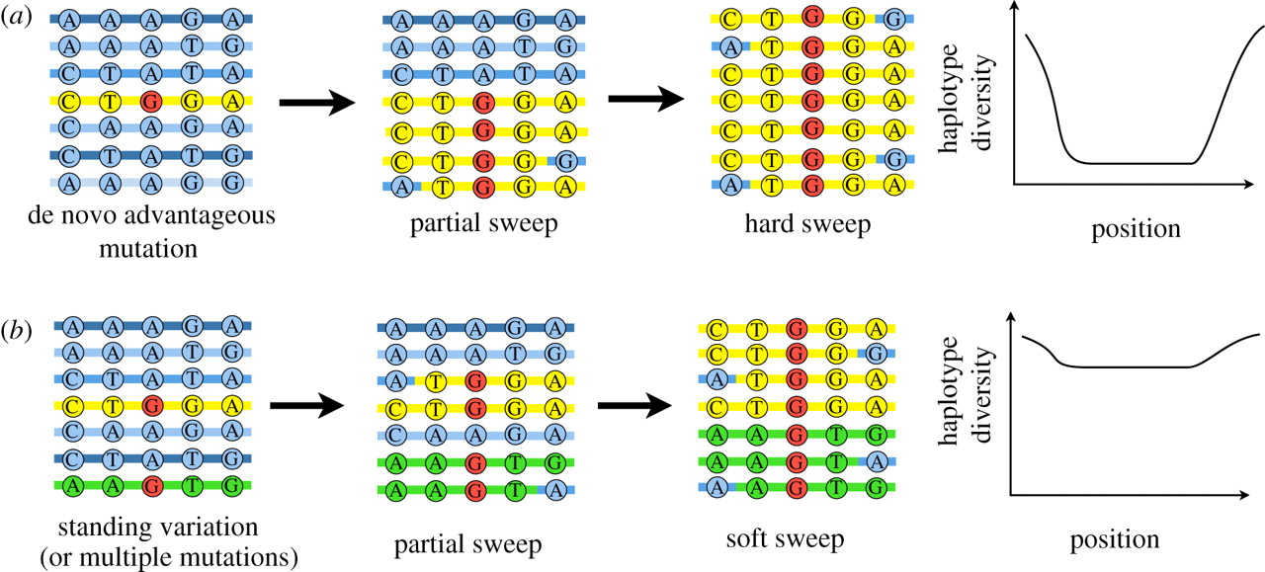
Hard Sweep vs. Soft Sweep:
Novembre, J., & Han, E. (2012). Human population structure and the adaptive response to pathogen-induced selection pressures. Phil. Trans. R. Soc. B, 367, 878-886.

Slide 21
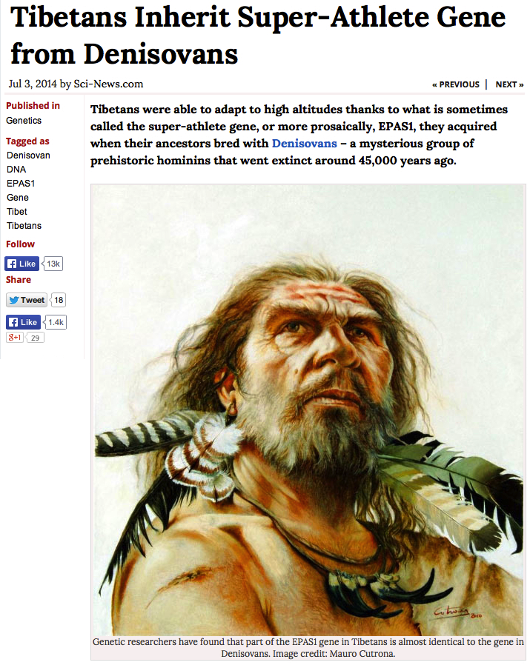
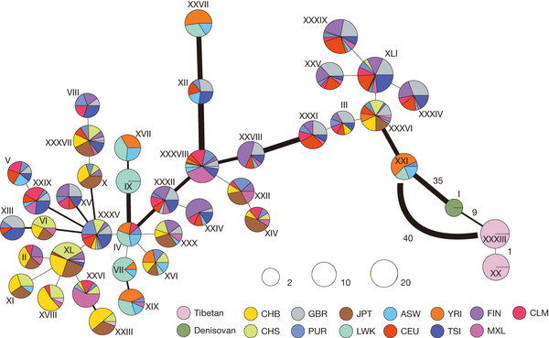
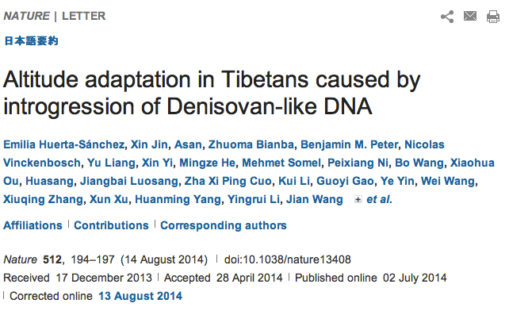
EPAS1

Slide 22
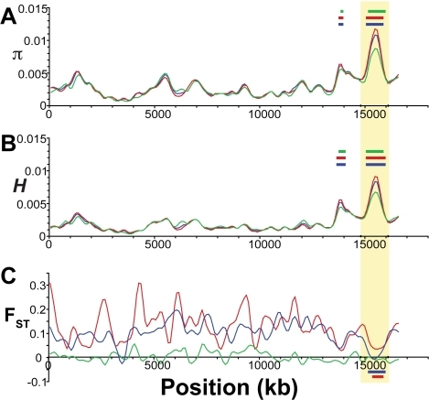
Assortative Overdominance
Opposite of directional selection. Balancing selection creates local increase in heterozygosity near the selected locus/decrease in F_{ST}.
Hohenlohe, P. A., Bassham, S., Etter, P. D., Stiffler, N., Johnson, E. A., & Cresko, W. A. (2010).
Population genomics of parallel adaptation in threespine stickleback using sequenced RAD tags.
PLoS Genet, 6, e1000862.

Slide 23
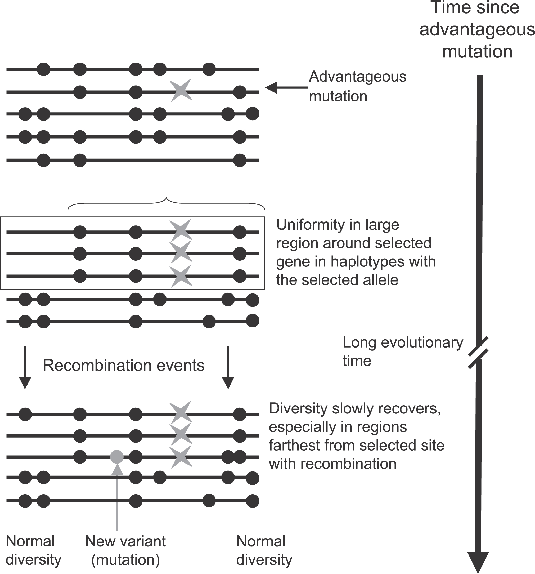
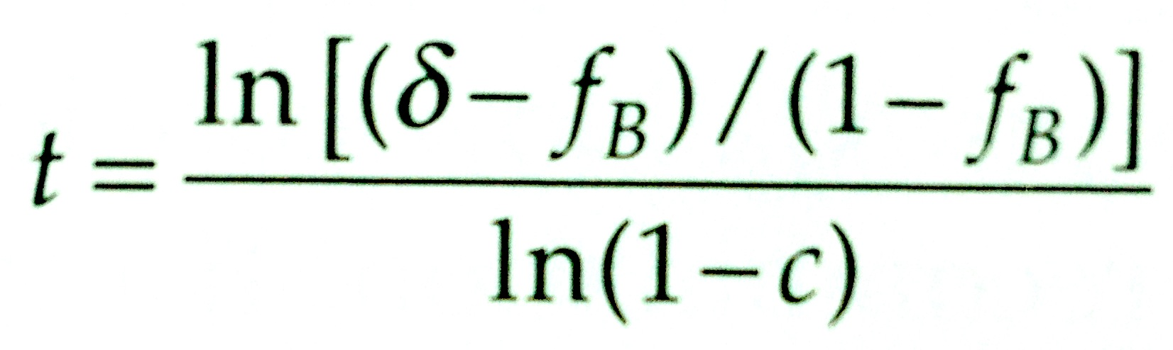
Can estimate age of mutation if know recombination rate (c) and have measure of linkage disequilibrium (δ).
Charlesworth, D. (2006). Balancing selection and its effects on sequences in nearby genome regions. PLoS Genet, 2(4), e64.

Slide 24
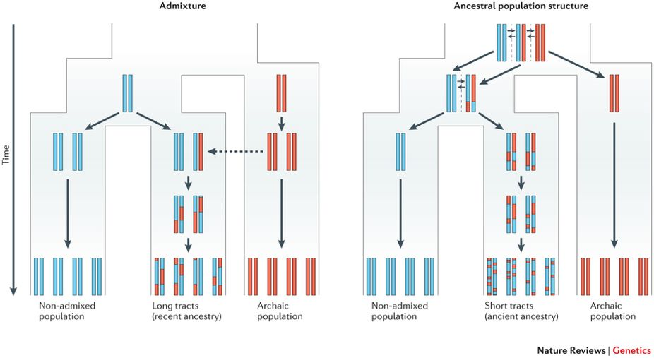
Racimo, F., Sankararaman, S., Nielsen, R., & Huerta-Sánchez, E. (2015). Evidence for archaic adaptive introgression in humans. Nature Reviews Genetics, 16(6), 359.
Because there is less time for recombination to break down the migrant tracts (red) in the admixed population (left), the expected tract length in this case will be longer than in the case of ancestral population structure (right).

Slide 25
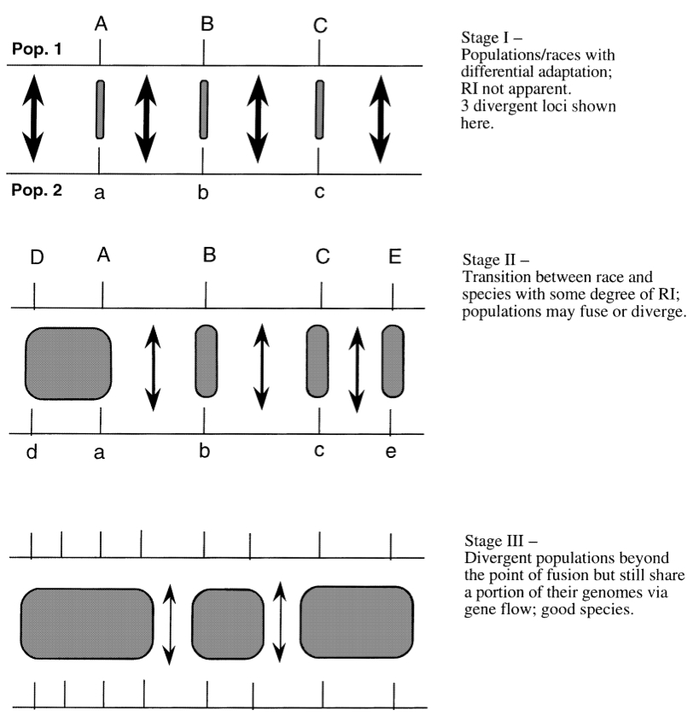
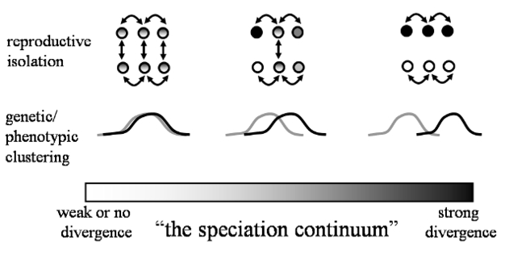
Migration - Selection Balance
Selection can cause some alleles to move between populations while inhibiting others.
Resulting in heterogeneous patterns among loci.
Genic View of Speciation – Chung-I Wu

Slide 26
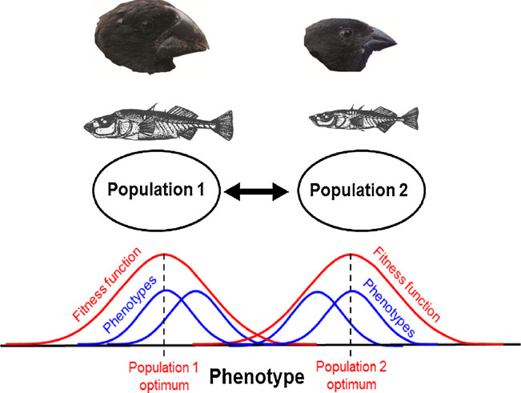
Why do we see these patterns?
Different genotypes/phenotypes are adapted to different environments and intermediate phenotypes have reduced fitness (selection against immigrants and hybrids).
Effects of selection are usually locus specific, whereas effects of population demography operate genome-wide.
Some hybrids reproduce and contribute immigrant genes to future generations → gene flow.

Slide 27
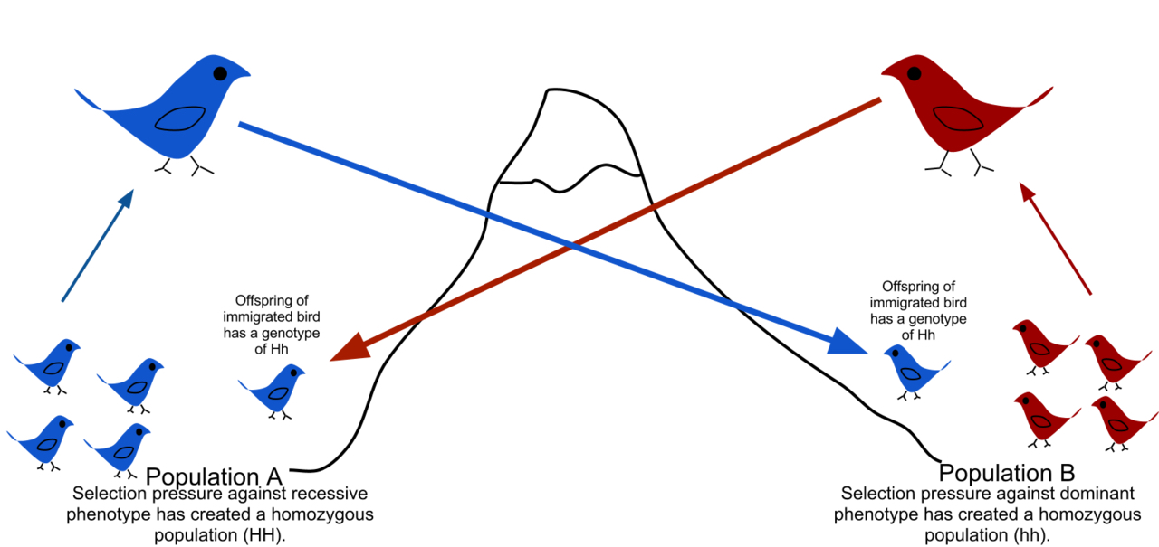
Gene flow is the transfer of alleles from one population to another.
Transfer of h allele
Transfer of H allele
Blue dominant to Red
H dominant to h
Each population has low frequency of heterozygotes due to immigrants backcrossing to other population. Can be difficult to detect in large population if migration rates are low.

Slide 28
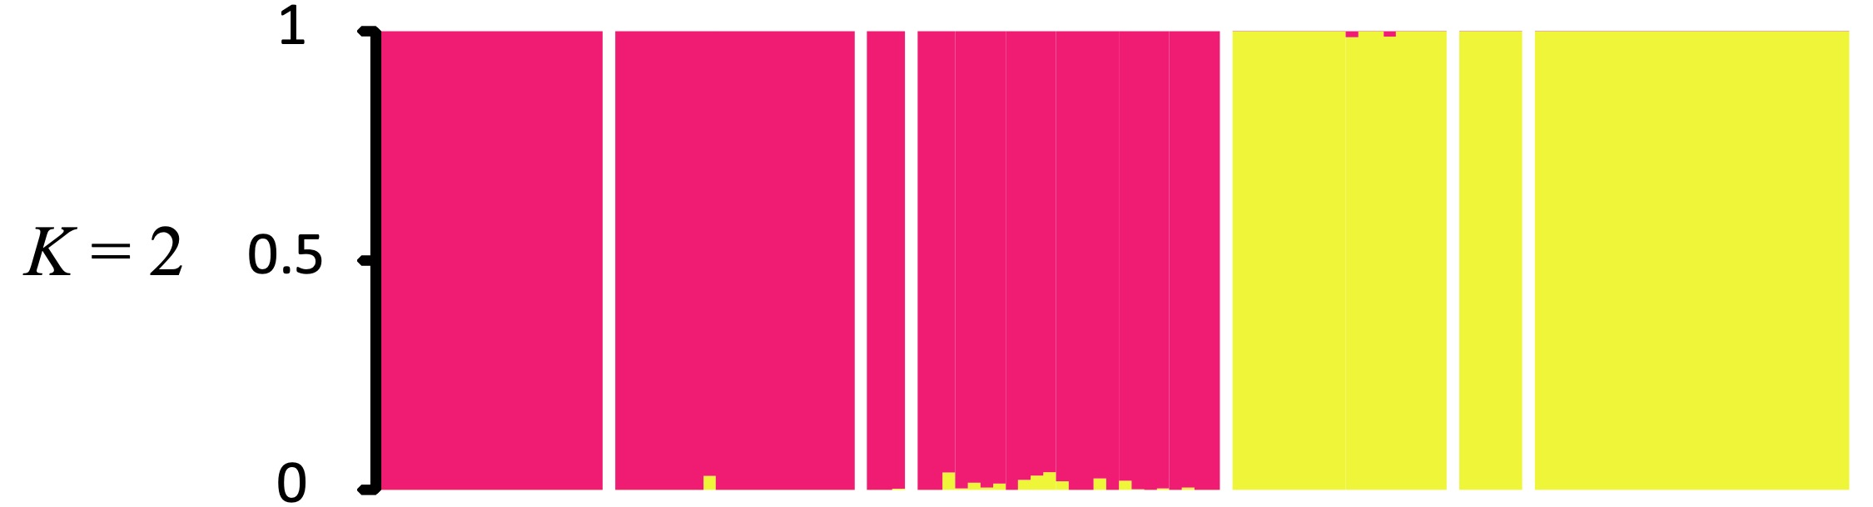
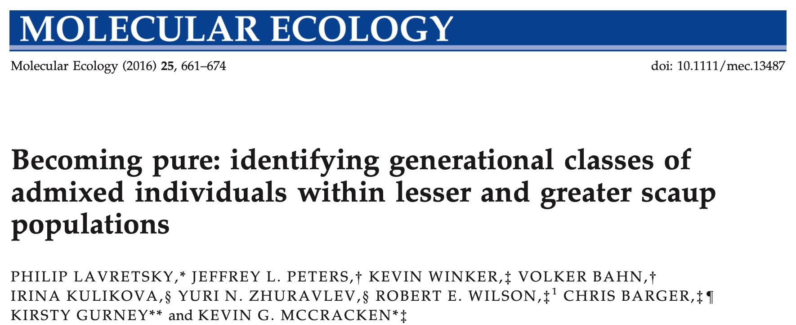
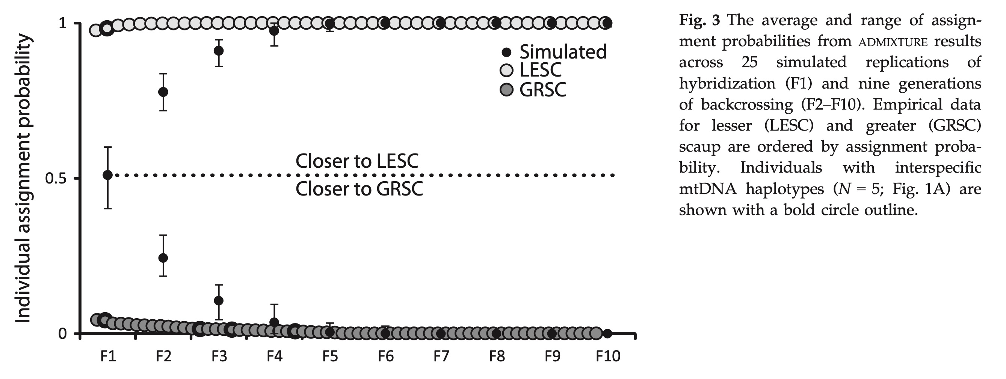
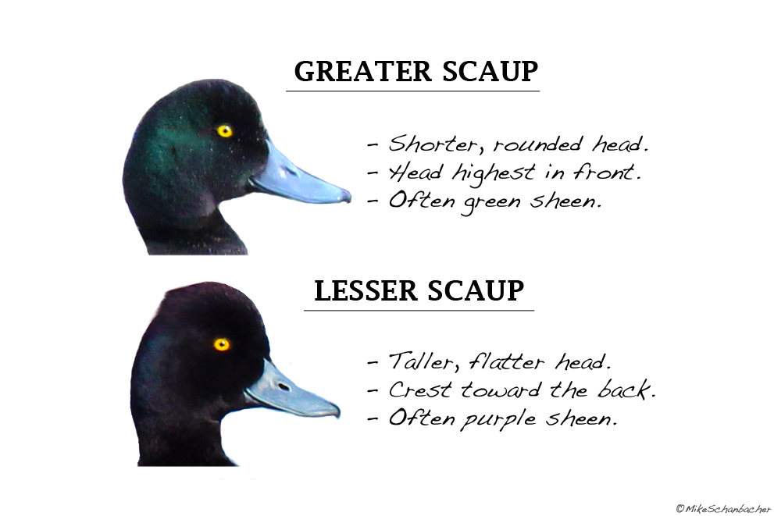
Hybrid-mediated gene flow

Slide 29
Functional Barriers to Gene Flow are not often complete barriers
Pop1
Pop2
If s > m for a given locus, adaptation can proceed in the face of gene flow

Slide 30
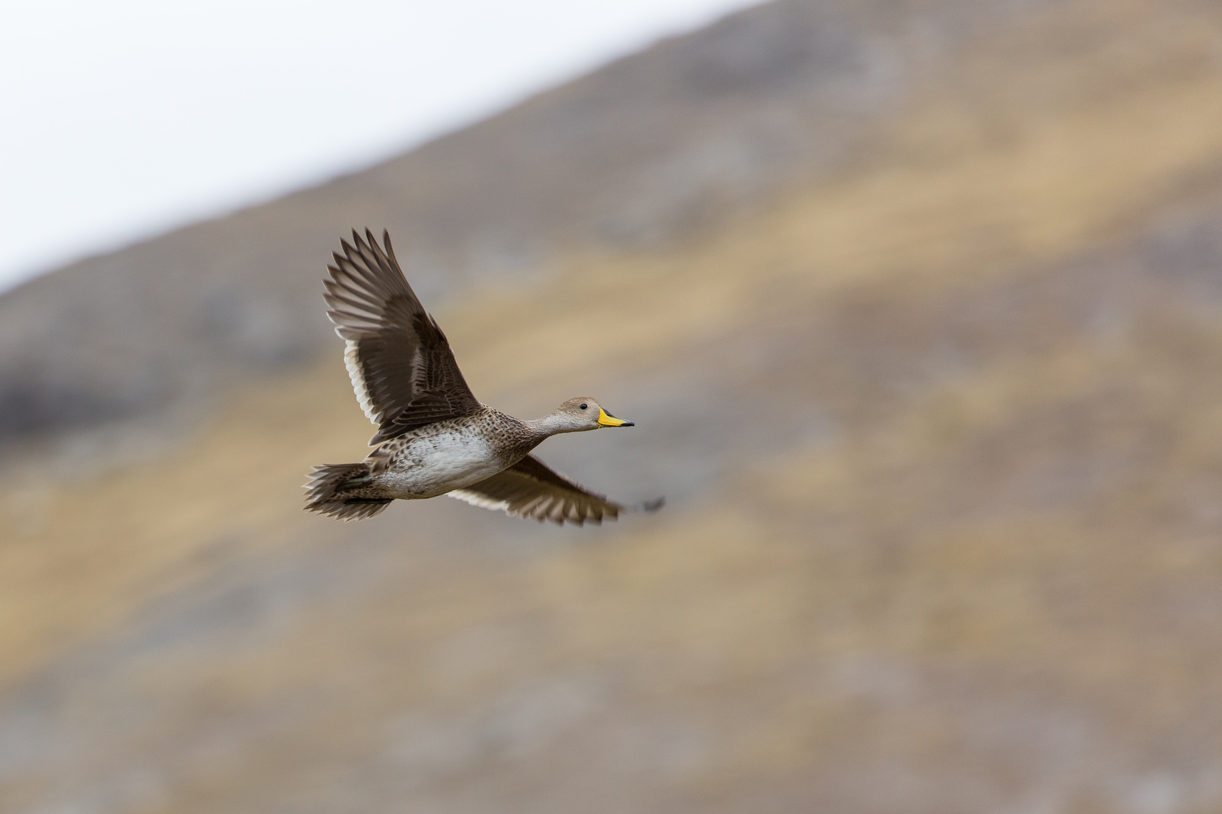
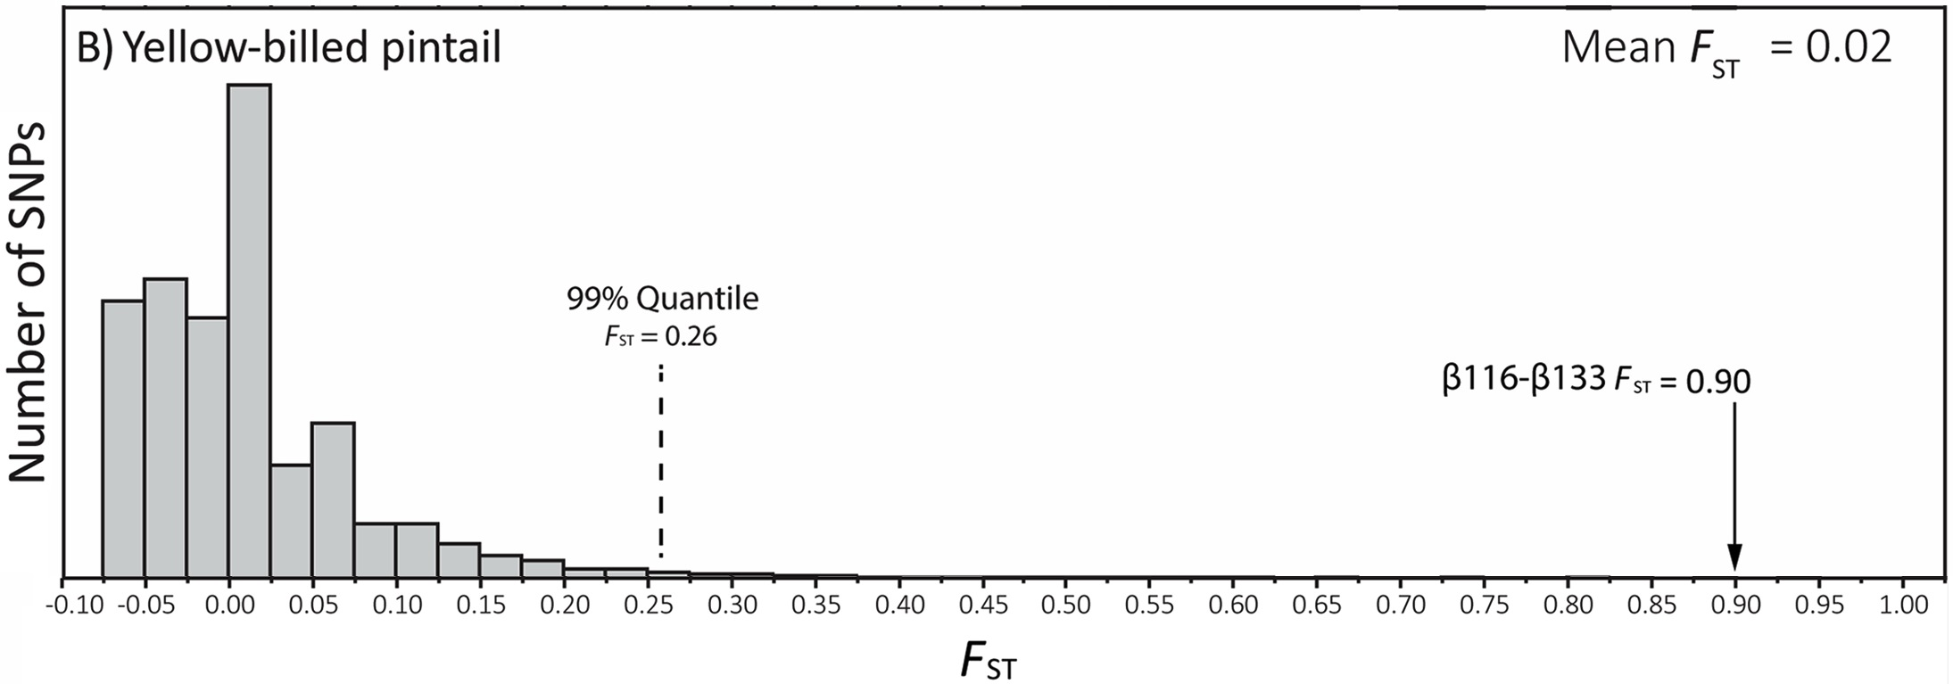
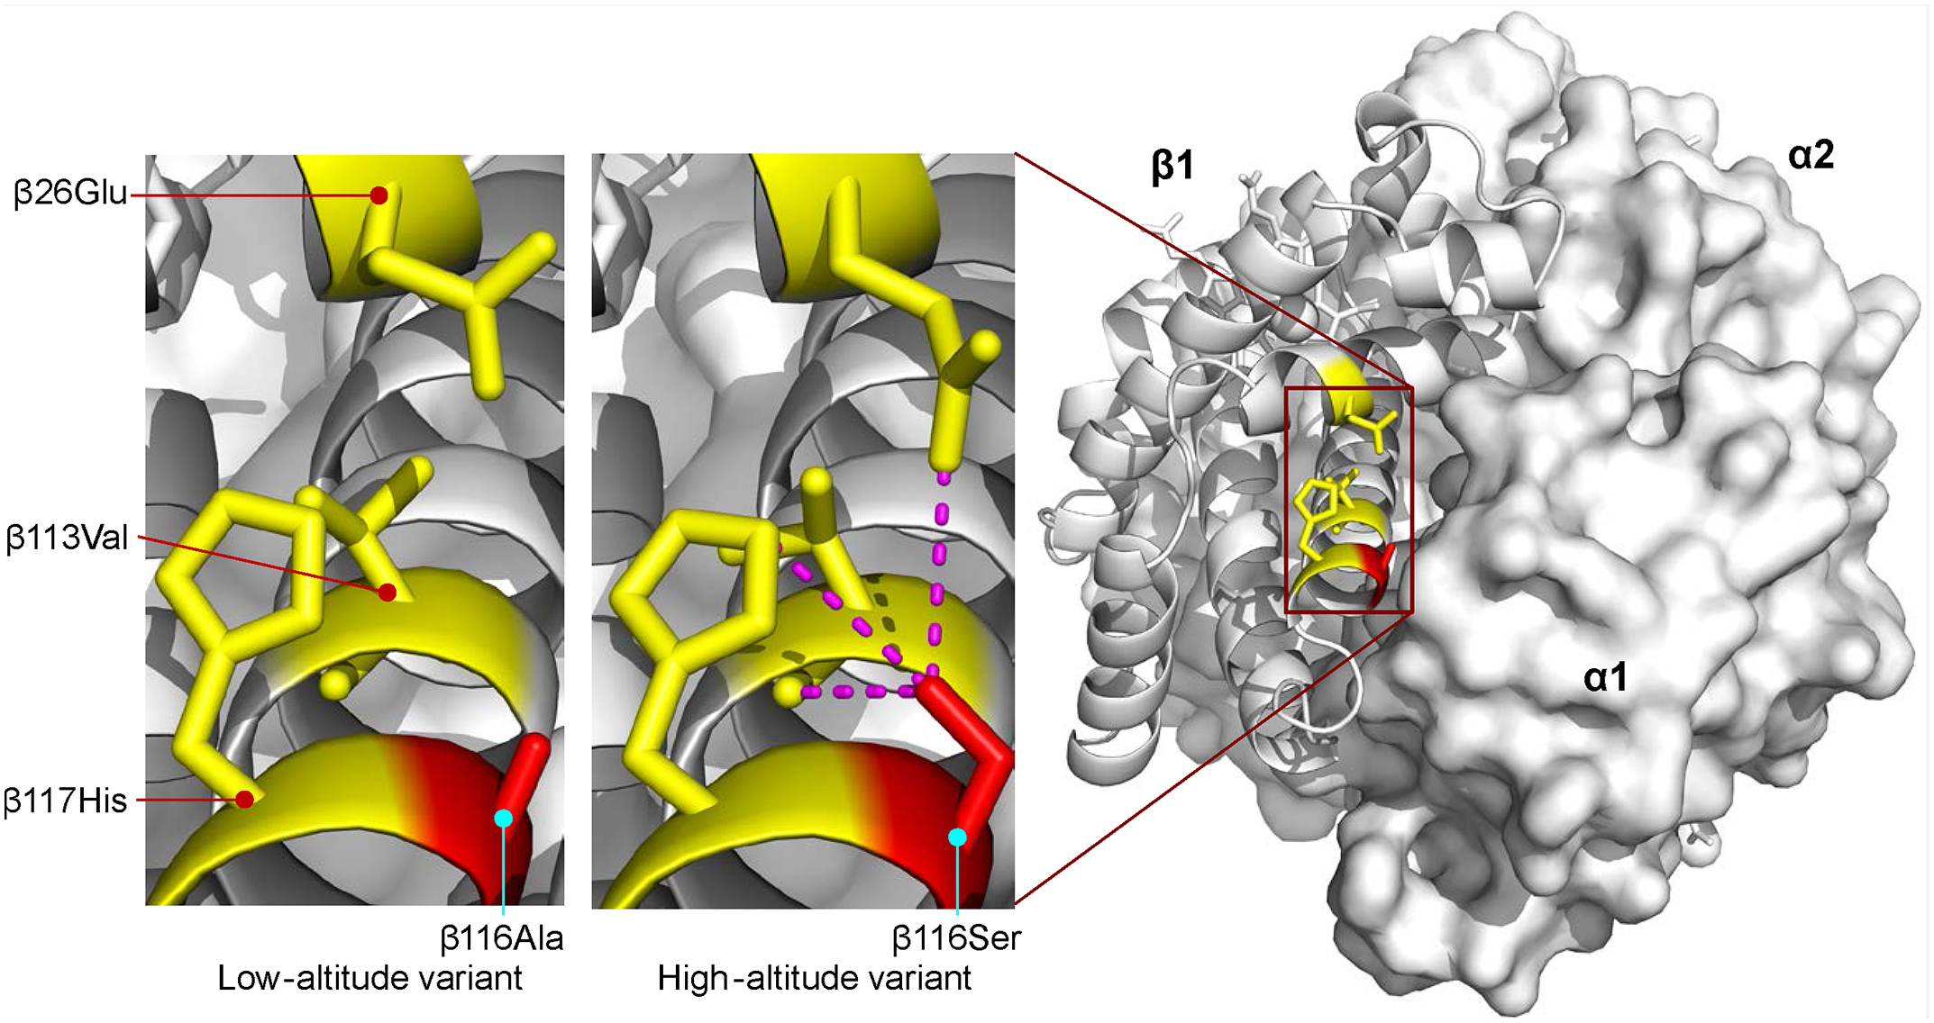
Yellow-billed Pintail ducks in the Andes are an example.
Gene flow levels between low and high populations are ~100x the mutation rate.
F_{ST} across the genome averages 0.02
F_{ST} for the β-globin locus = 0.90

Slide 31
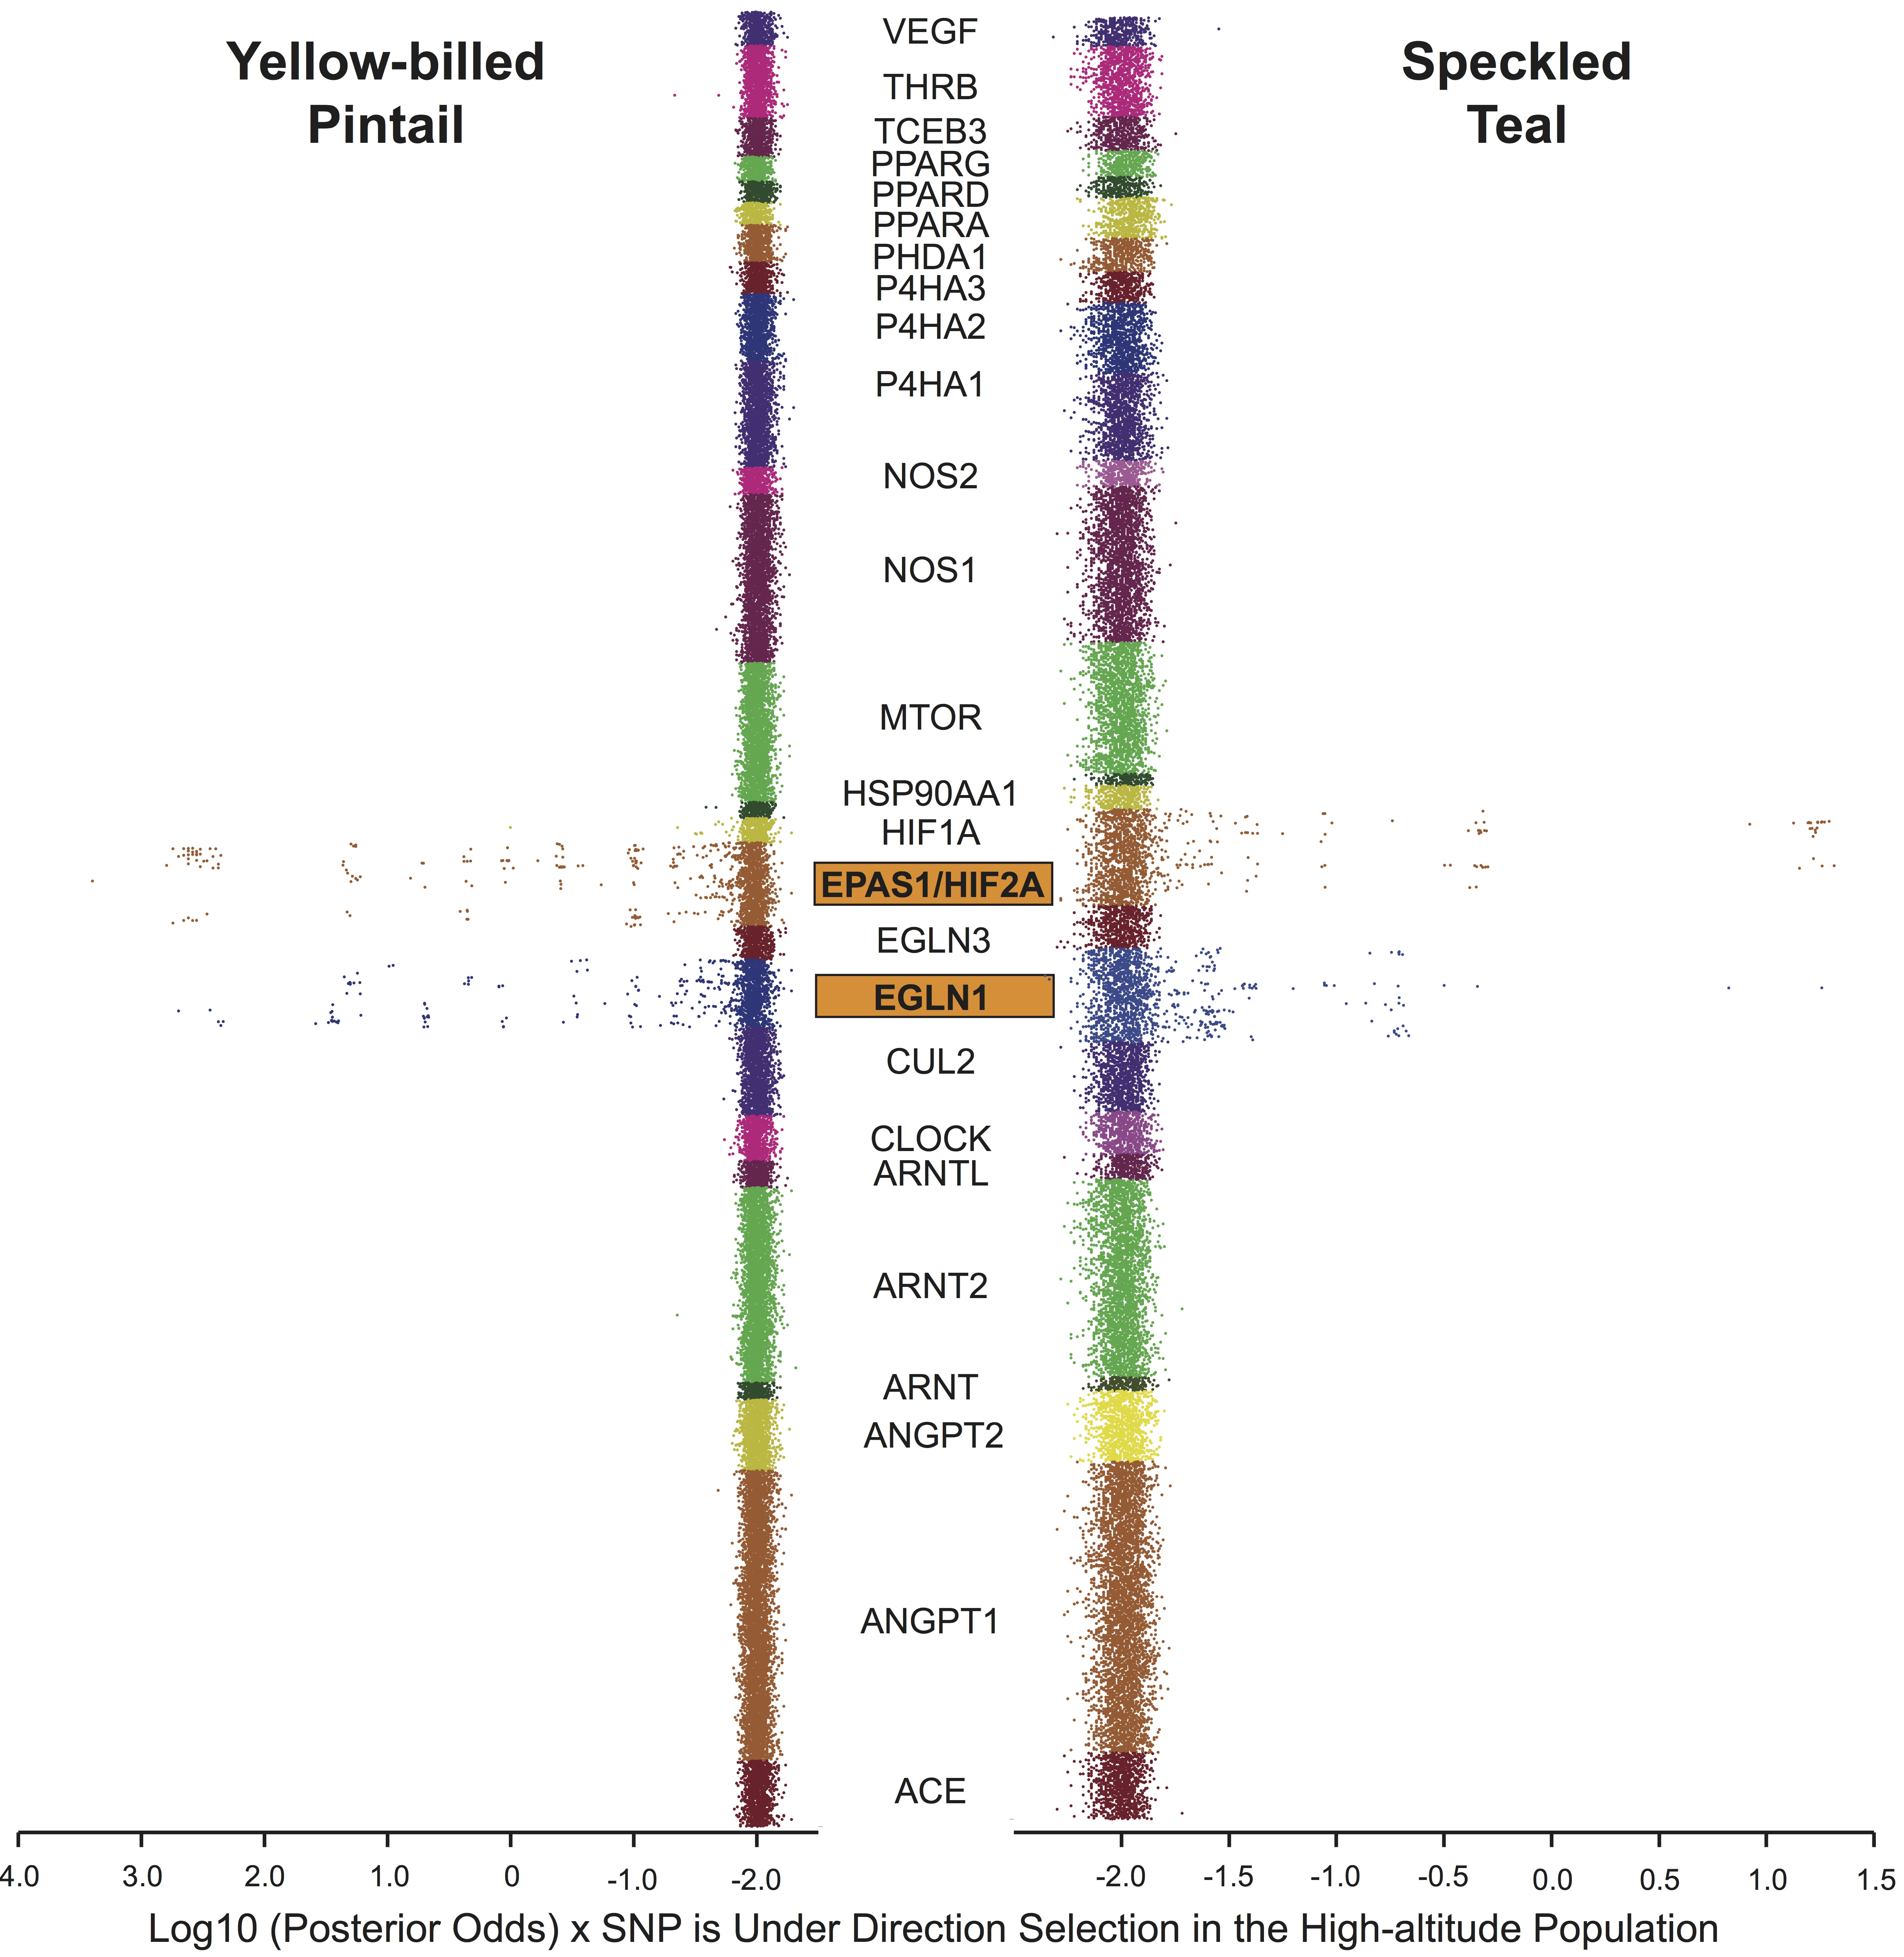
Yellow-billed Pintail has lower average F_{ST} → more power to detect outliers.
Speckled Teal has higher average F_{ST} → less power to detect outliers.
HIF Pathway - Allie Graham

Slide 32
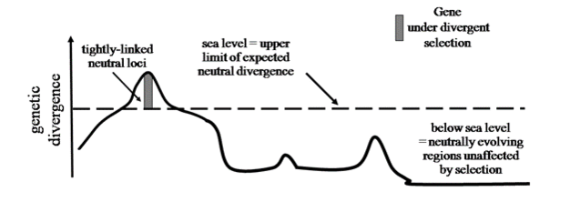
Islands of Genomic Divergence
Selected loci exhibiting low gene flow have high F_{ST}.
Neutral loci with high gene flow have low F_{ST}.
Easier to detect outliers when background F_{ST} is low.
Safran, R. J. & Nosil, P. (2012) Speciation: The Origin of New Species. Nature Education Knowledge 3(10):17
High F_{ST} outlier
Low F_{ST} background

Slide 33

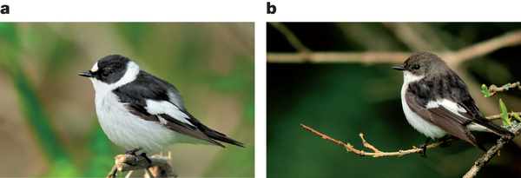
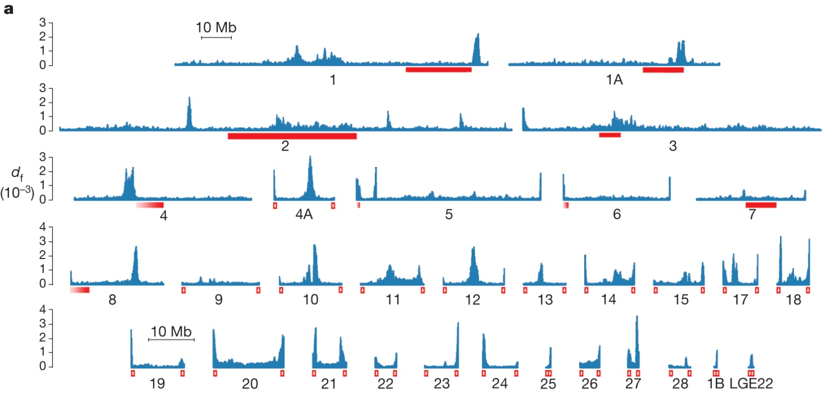
The genomic landscape of species divergence in flycatchers.
Islands of differentiation = Peaks indicate regions of the genome subjected to selection and restricted gene flow.
Ellegren, H., Smeds, L., Burri, R., Olason, P.I., Backström, N., Kawakami, T., Künstner, A., Mäkinen, H., Nadachowska-Brzyska, K., Qvarnström, A. and Uebbing, S., 2012. The genomic landscape of species divergence in Ficedula flycatchers. Nature, 491(7426), pp.756-760.

Slide 34
Population
History
Immigration (gene flow)
+
Genetic Variation within Population
Mutation
+
-
Genetic Drift
Natural selection
Increases or decreases frequency of alleles introduced by mutation; can rapidly lead to fixation or extinction (rapid coalescence).
Balances with drift - more effective in larger population; can inhibit effect of drift in case of balancing selection (slow coalescence).
Balances with gene flow

