Slide 1
The Neutral Theory
Population Genomics
Cochabamba, Bolivia
Gen-Pob’25

Slide 2

Population
History
Immigration (gene flow)
2N_{e}m
+
Genetic Variation within Population
$$\frac{1}{2N_{e}}$$
2N_{e}µ
Genetic Drift
Mutation
-
+
2N_{e}s
Natural selection
If loci are selectively neutral we can infer aspects of population history from DNA polymorphisms.
Different forms of natural selection can mimic genetic signatures of population history.

Slide 3
Learning Outcomes
Distinguish between the selection theory and the neutral theory of molecular evolution.
Define molecular clock and explain how it supports the neutral theory.
Explain the expected relationship between genetic variation within species and divergence between species among loci under neutrality.
Compare the expected number of substitutions in synonymous and nonsynonymous sites under neutrality.
Compare the expected number of substitutions in noncoding and coding DNA under neutrality.

Slide 4
Neo-Darwinism and Neutralism
Selectionist theory—Natural selection for advantageous mutations which improve fitness is the primary source of genetic variation (Neo-Darwinisim)
“Survival of the fittest”
Neutral theory of molecular evolution—At the molecular level, most evolutionary changes occur by random genetic drift of alleles which are selectively neutral (Kimura)
“Survival of the luckiest”

Slide 5
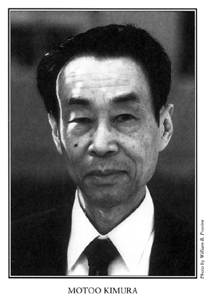
Neutral Theory of Molecular Evolution
“The vast majority of substitutions in DNA and proteins, and polymorphism within species, are caused not by positive Darwinian selection, but by random drift of alleles that are selectively neutral or nearly so.”
High levels of polymorphism (variation) in amino acid sequences among individuals and species
Discovery of the molecular clock—substitutions occur at a constant rate over time (Jukes and King 1969).
Both patterns can be explained by mutation & drift alone.
Ergo: Essentially all new mutations eventually fixed are neutral, and evolve only by genetic drift

Slide 6
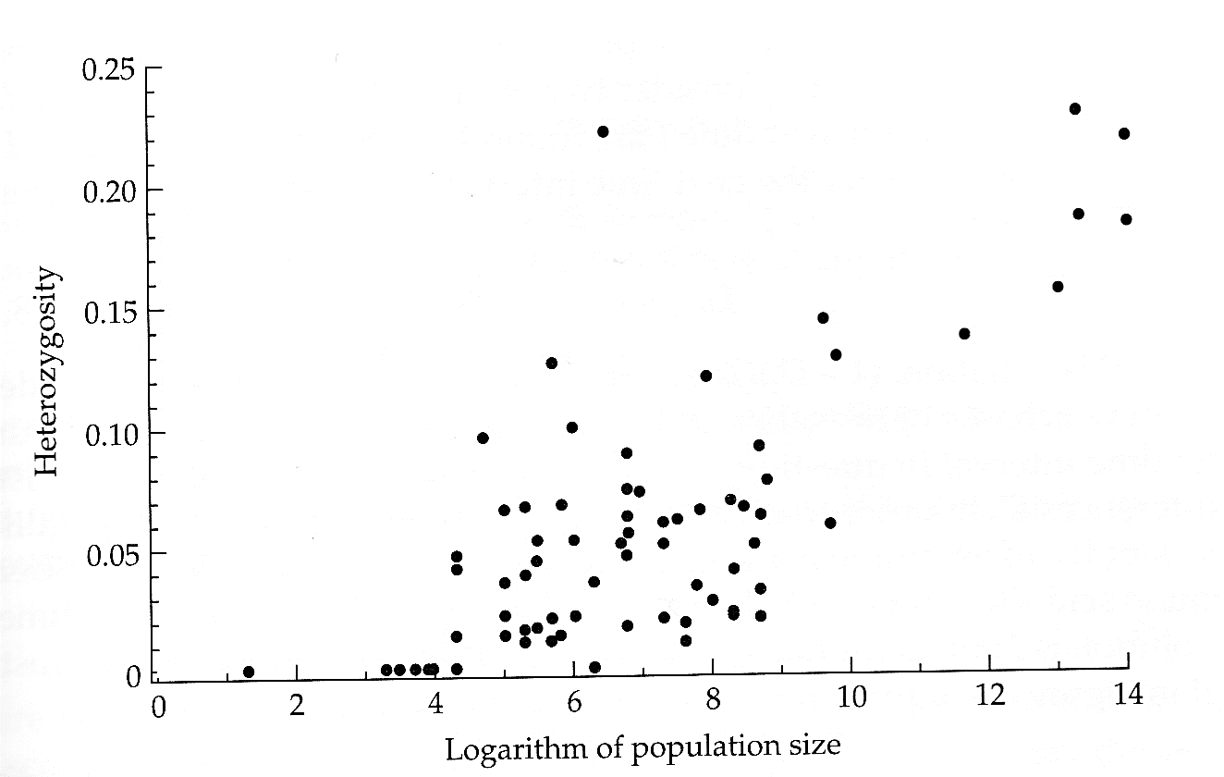
High levels of polymorphism (variation) in amino acid sequences
High levels of heterozygosity unexpected under mutation-selection balance.
Recall that a positive correlation between Ne & heterozygosity is expected at drift-mutation equilibrium.
Hartl & Clark (1997) Principles of Population Genetics
  Kimura reasoned that there were too many substitutions to be tolerable within the selectionist theory of natural selection.

Slide 7
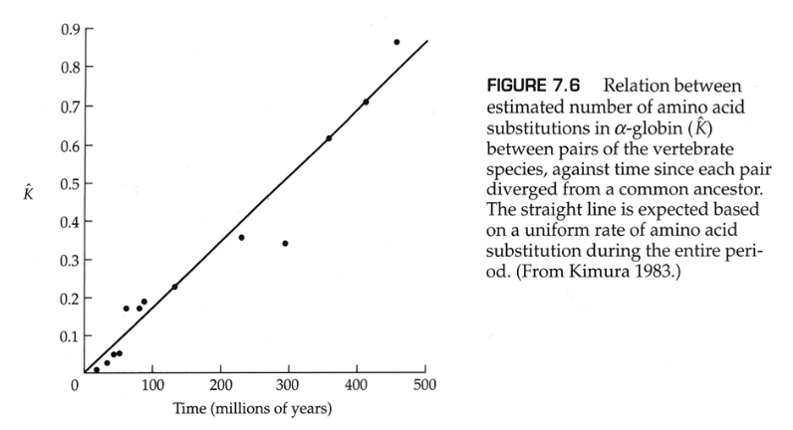
Molecular Clock—substitutions occur at a constant rate over time
The slope of the line gives the average rate of change (molecular clock) in amino acid substitutions
http://people.bu.edu/msoren/BI515_2014/LectureCh9A.pdf
Fossil calibrations
Kimura argued that this relationship reflects the actions of genetic drift and mutation.

Slide 8
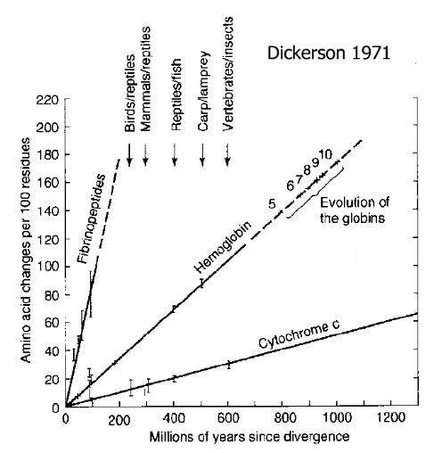
Molecular Clock—substitutions occur at a constant rate over time
Constant rates of amino acid substitutions for three genes = molecular clock
High rate variation among genes = functional constraints
  The neutral theory does not imply no selection, but rather that most mutations that affect fitness are deleterious
  Lower rates suggest higher functional constraints (i.e., more mutations are deleterious)

Slide 9
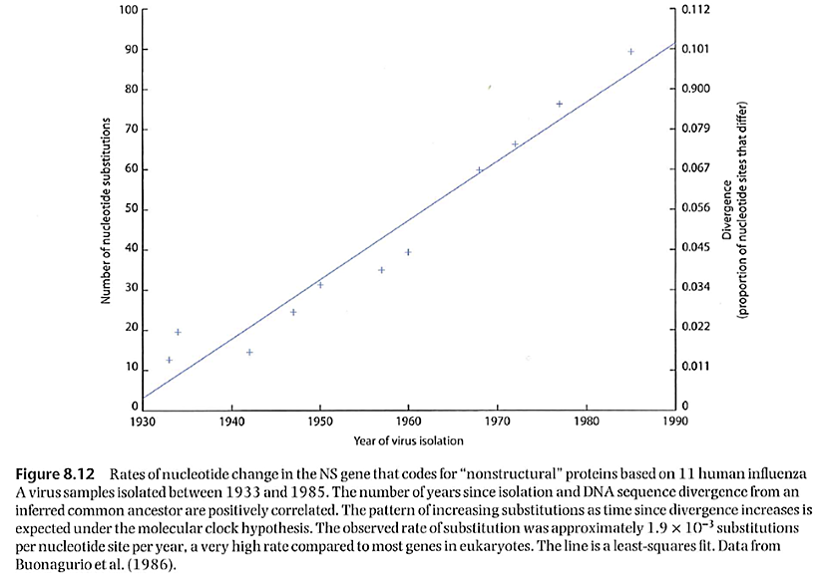
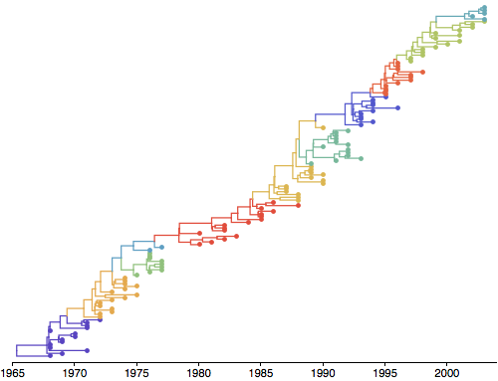
Molecular Clock in viruses
Phylogeny of influenza A virus from 1968 to 2003 illustrating the molecular clock—over time substitutions accumulate at a constant rate (http://www.trevorbedford.com/writeups/interpretable_phylogenies.html)
http://people.bu.edu/msoren/BI515_2014/LectureCh9A.pdf

Slide 10
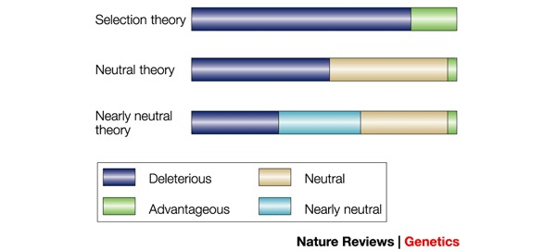
Selectionist vs. Neutralist Theories
Bromham & Penny “The modern molecular clock” Nature Rev Genet 4:216, 2003
Most mutations are deleterious & removed by negative selection.
Evolutionary change results from advantageous mutations that are driven to fixation by positive selection.
Genetic variation within and between species results from selection.
  Mutation-selection balance
Many mutations are deleterious & removed by negative selection, but many are neutral (no selection); advantageous mutations are rare.
Evolutionary change results from neutral mutations that drift to fixation.
Genetic variation within and between species results from genetic drift.
  Mutation-drift equilibrium

Slide 11
Review: Evolution by Genetic Drift
Diploid population size N
There are 2N alleles
μ is the mutation rate to neutral alleles
Every generation, there are 2Nμ new neutral mutations, each with frequency 1/2N
Chance of drifting to fixation = 1/2N
So 2Nμ /2N = μ neutral mutations will go to fixation every generation.
Rate of neutral evolution = μ

Slide 12
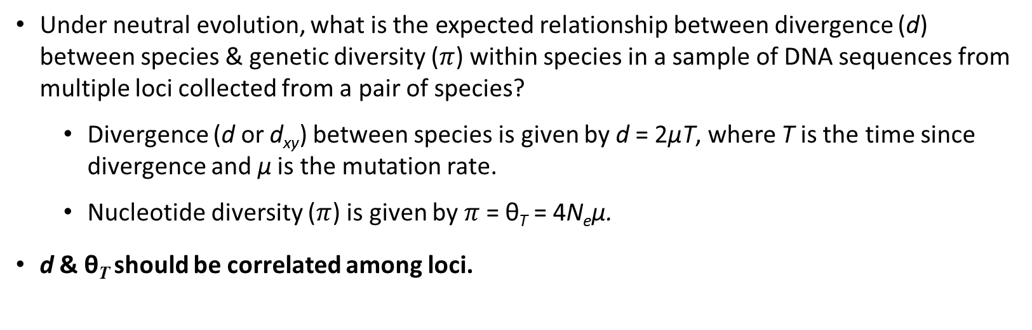
Application of neutral theory
Under neutral evolution, what is the expected relationship between divergence (d) between species & genetic diversity ($π$) within species in a sample of DNA sequences from multiple loci collected from a pair of species?
  Divergence (d or d_{xy}) between species is given by d = 2µT, where T is the time since divergence and µ is the mutation rate.
  Nucleotide diversity ($π$) is given by $π$= θ_{T} = 4N_{e}µ.
d & θ_{T} should be correlated among loci.
High substitution rate
Low substitution rate
Relationship between genetic diversity and divergence at 20 loci in ducks (Peters et al. 2014).

Slide 13
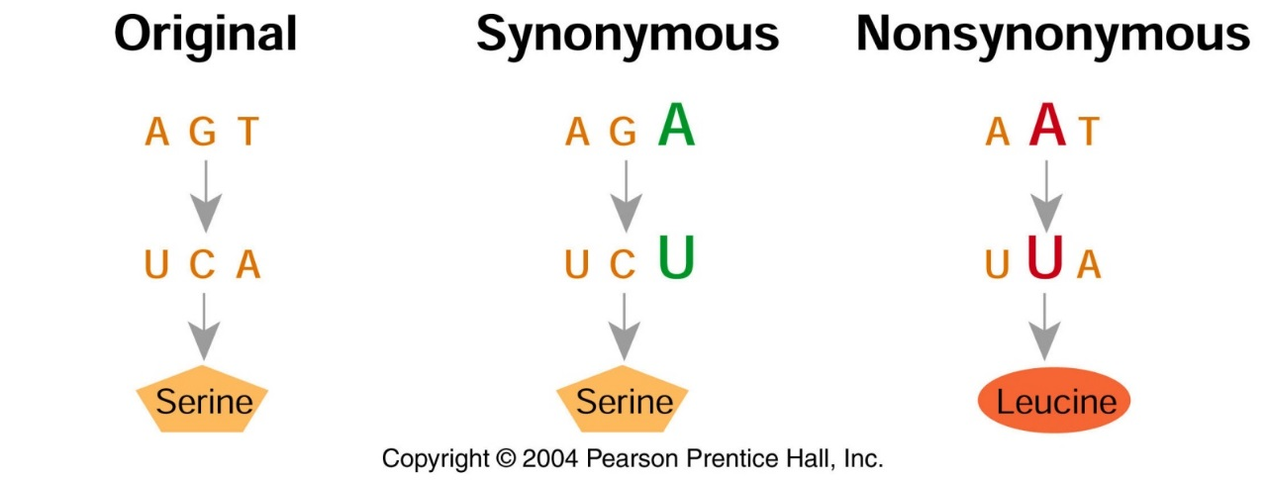
Application of neutral theory
Under neutral evolution, what is the expected relationship in diversity between synonymous (silent) & nonsynonymous (replacement) sites?
  Most mutations are deleterious or neutral, and nonsynonymous sites will be more prone to deleterious mutations.
  Synonymous sites should evolve faster than nonsynonymous sites.

Slide 14
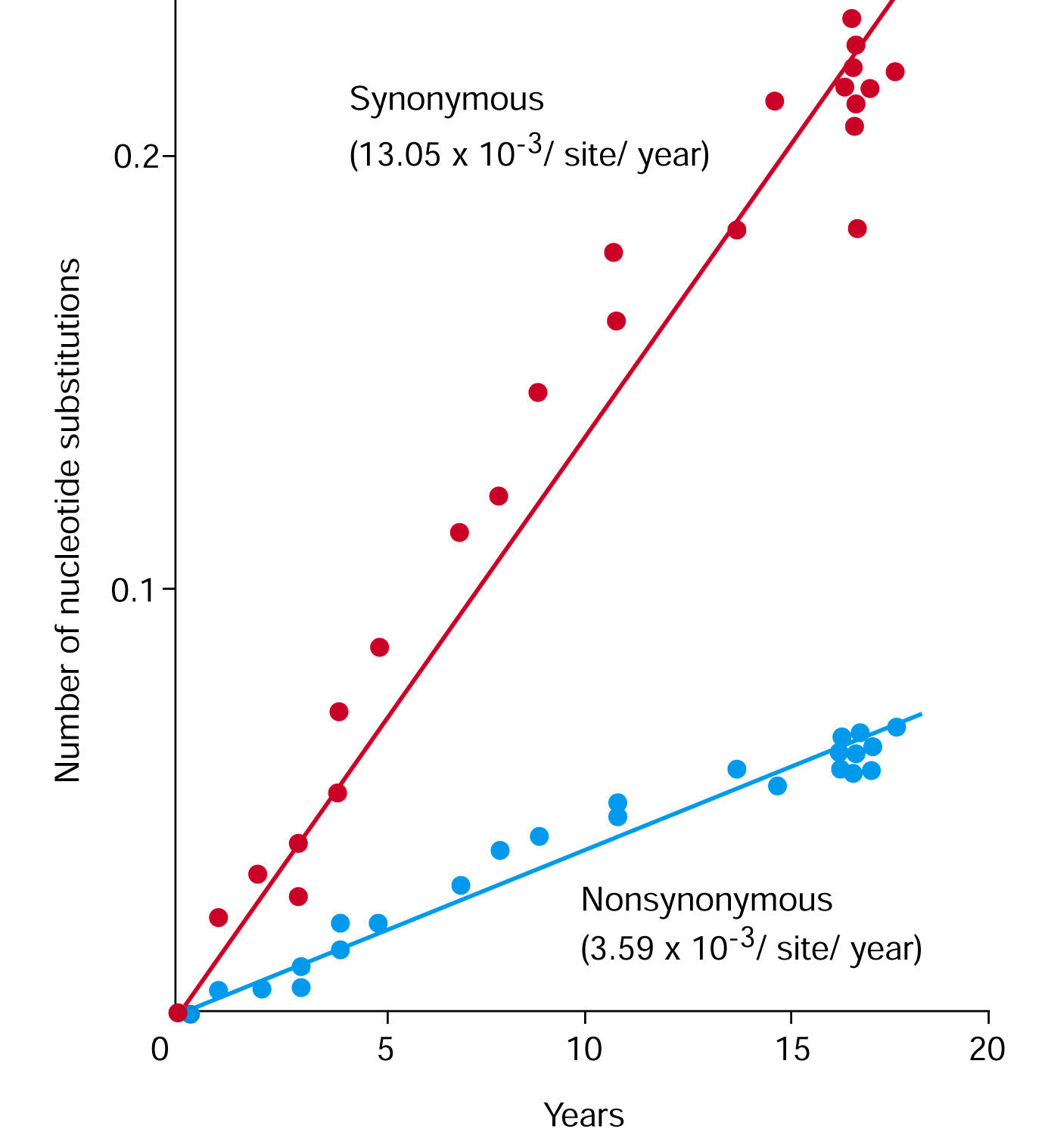
Prediction under neutral theory: Synonymous substitutions accumulate in genomes faster than do non-synonymous ones.
Influenza virus evolution over 20 years

Slide 15
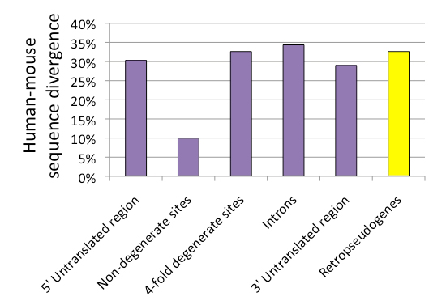
Prediction under neutral theory: changes that do not affect the function of the protein will occur more frequently.
Figure 1 : Average sequence divergence between human and mouse in different regions of genes and in retropseudogenes.
Duret, L. (2008) Neutral theory: The null hypothesis of molecular evolution. Nature Education 1(1)

Slide 16
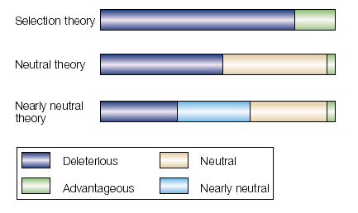
Summary
Selectionist theory: all mutations affect fitness; most mutations are deleterious
Neutral theory: most mutations are either deleterious or neutral; advantageous mutations are rare. More neutral sites would produce a faster overall rate of change.
Better supported by molecular data
Bromham & Penny “The modern molecular clock” Nature Rev Genet 4:216, 2003

Slide 17
Part II—Nearly Neutral Theory
Learning Outcomes
Compare the Nearly Neutral Theory, Neutral Theory, and Selectionist Theory.
Explain how the Nearly Neutral Theory can account for the lack of a relationship between rates of protein evolution and generation time.
Describe Lewontin’s Paradox and how the Nearly Neutral Theory can account for this apparent paradox.

Slide 18
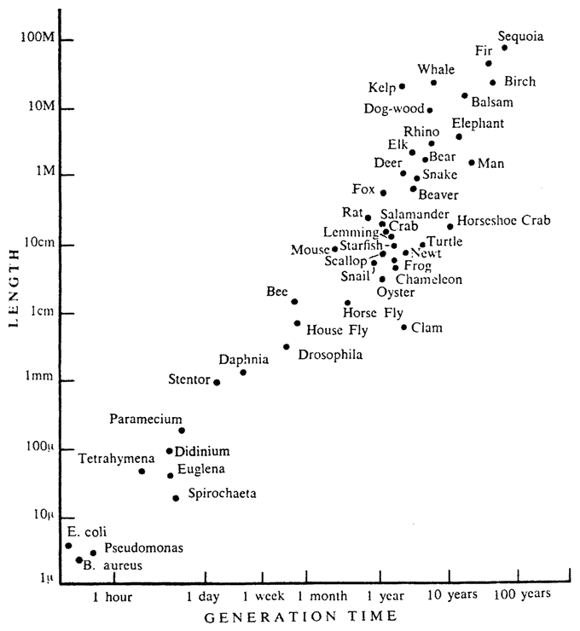
Problems with the Neutral Theory
The neutral mutation rate, µ, should vary among species as a function of generation time.
Larger organisms have longer generation times.
  Neutral theory predicts a slower rate of molecular evolution.
  Fewer meiotic events over a given time period = fewer opportunities for new mutations.
Smaller organisms have shorter generation times.
  Neutral theory predicts a faster rate of molecular evolution.
  More meiotic events over a given time period = more opportunities for new mutations.
Problem: Rates of protein evolution are fairly independent of generation time.
  E.g., some proteins have similar rates of evolution between chimps-humans and mice-rats.
https://www.evolbiol.ru/document/637

Slide 19

Nearly Neutral Theory
Many mutations are “nearly neutral” (i.e., selection is weak).
Recall that drift is a more powerful force when N_{e} is small.
If s << 1/(2N_{e}), where s is the selection coefficient, then mutations are effectively neutral and drift will dominate.
If s >> 1/(2N_{e}), then selection will dominate.
Tomoko Ohta (1973)

Slide 20
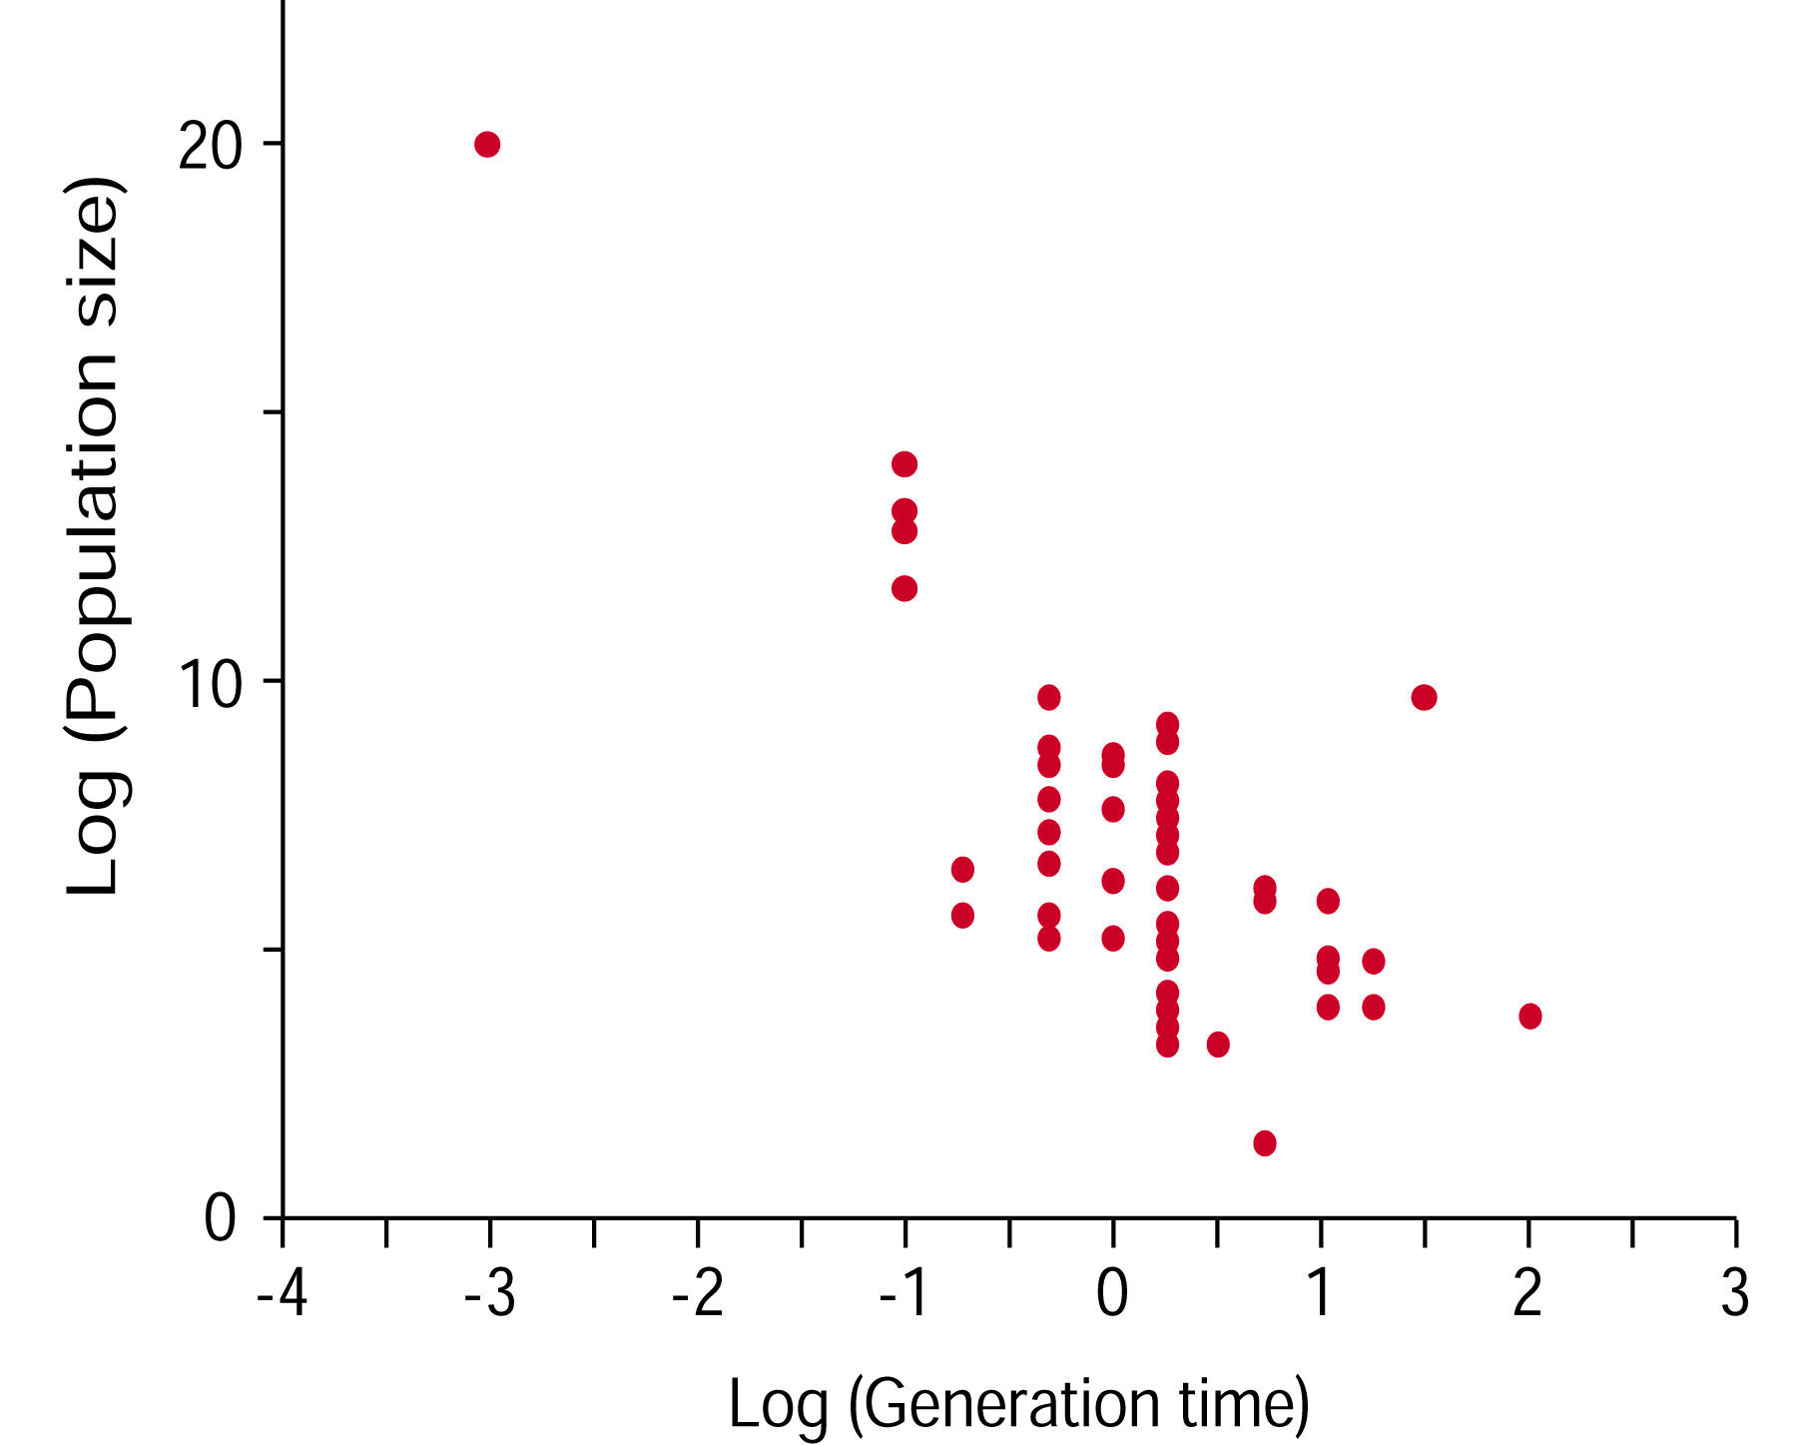
Nearly Neutral Theory
Population size is negatively correlated with generation time. Species w/ short generation time will have large N_{e}.
Selection more effective; fewer effectively neutral mutations
Selection less effective, more effectively
neutral mutations

Slide 21
Generation Time vs. Population Size
Why can rates of non-synonymous substitutions be constant in species with long and short generation times, for some proteins?
The difference between number of mutations and frequency of neutral mutations cancel out.
Short generation time | Long generation time
Many mutations per year | Few mutations per year
Few mutations are effectively neutral because N_{e} is large | Many mutations are effectively neutral because N_{e} is small

Slide 22
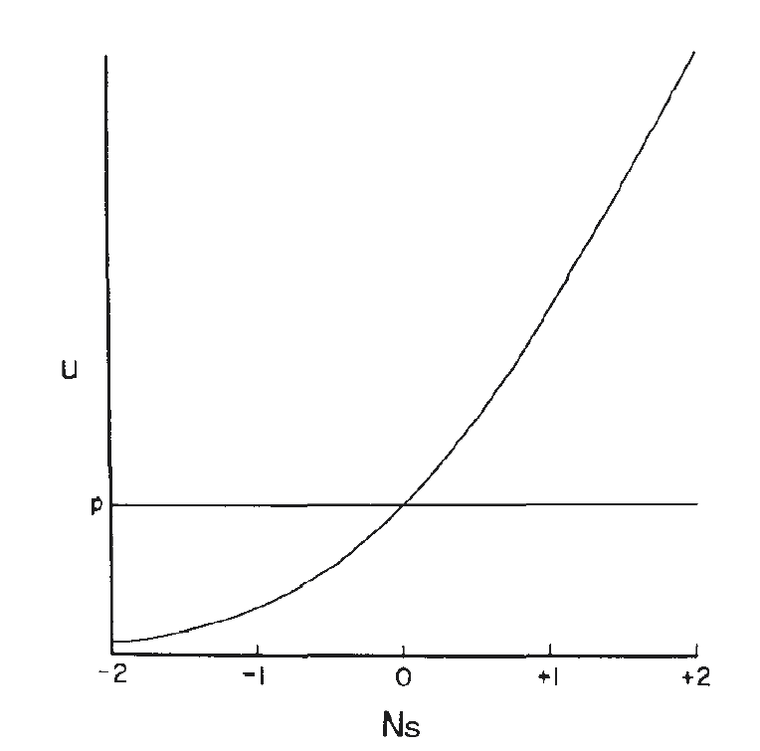
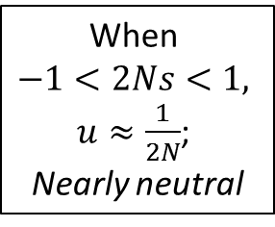
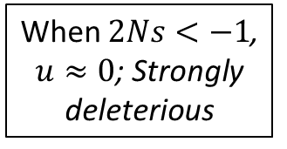
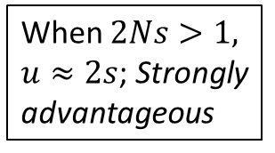

Fixation probability of nearly neutral mutations (u = substitution rate)
Fixation probability ($u$)
When $2Ns<−1$, $u≈0$; Strongly deleterious
When
$−1<2Ns<1,$
$u≈\frac{1}{2N}$;
Nearly neutral
When $2Ns>1,$ $u≈2s$; Strongly advantageous

Slide 23
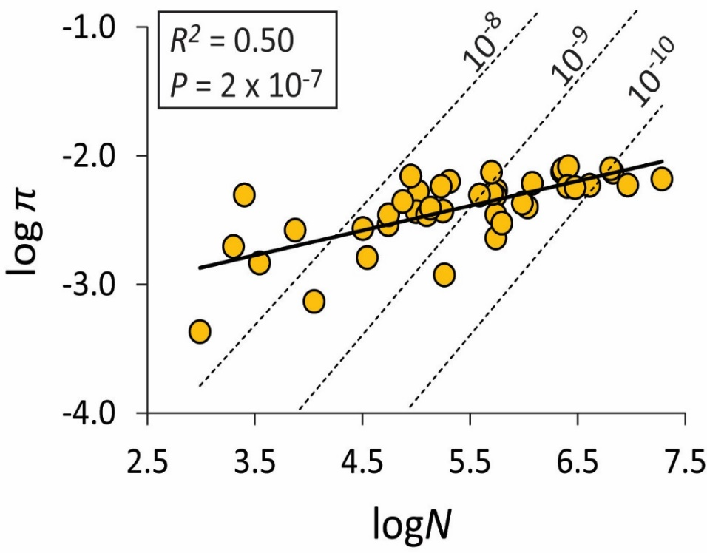
Problems with the Neutral Theory—Lewontin’s Paradox
Given the enormous variation in population sizes in natural populations, a wide range of variation is expected.
However, species with large population sizes tend to have lower heterozygosity than expected.
Lewontin’s Paradox—the magnitude of differences in population sizes is much greater than the magnitude of differences in genetic diversity.
Relationship between heterozygosity and N in proteins.
Relationship between N and π in DNA sequences from 41 species of ducks.
Hartl & Clark (1997) Principles of Population Genetics

Slide 24
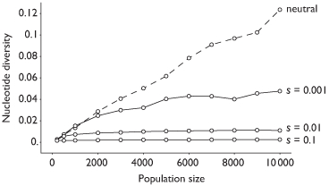
Lewontin’s Paradox & the Nearly Neutral Theory
Lewontin’s Paradox—the magnitude of differences in population sizes is much greater than the magnitude of differences in genetic diversity.
Selection constrains variation in larger populations but not smaller populations
http://www.trevorbedford.com/tree_topology/

Slide 25

Answer to Lewontin’s Paradox:
Selection constrains variation in larger populations but not smaller populations.
Consistent with Nearly Neutral Theory of Molecular Evolution.
↑N_{e}s,
Selection effective at removing weakly deleterious alleles
Selection places an upper limit on genetic variation.
↓N_{e}s,
Weakly deleterious alleles are effectively neutral.
Genetic drift drives genetic variation.
Relationship between N and π in DNA sequences from 41 species of ducks.

Slide 26
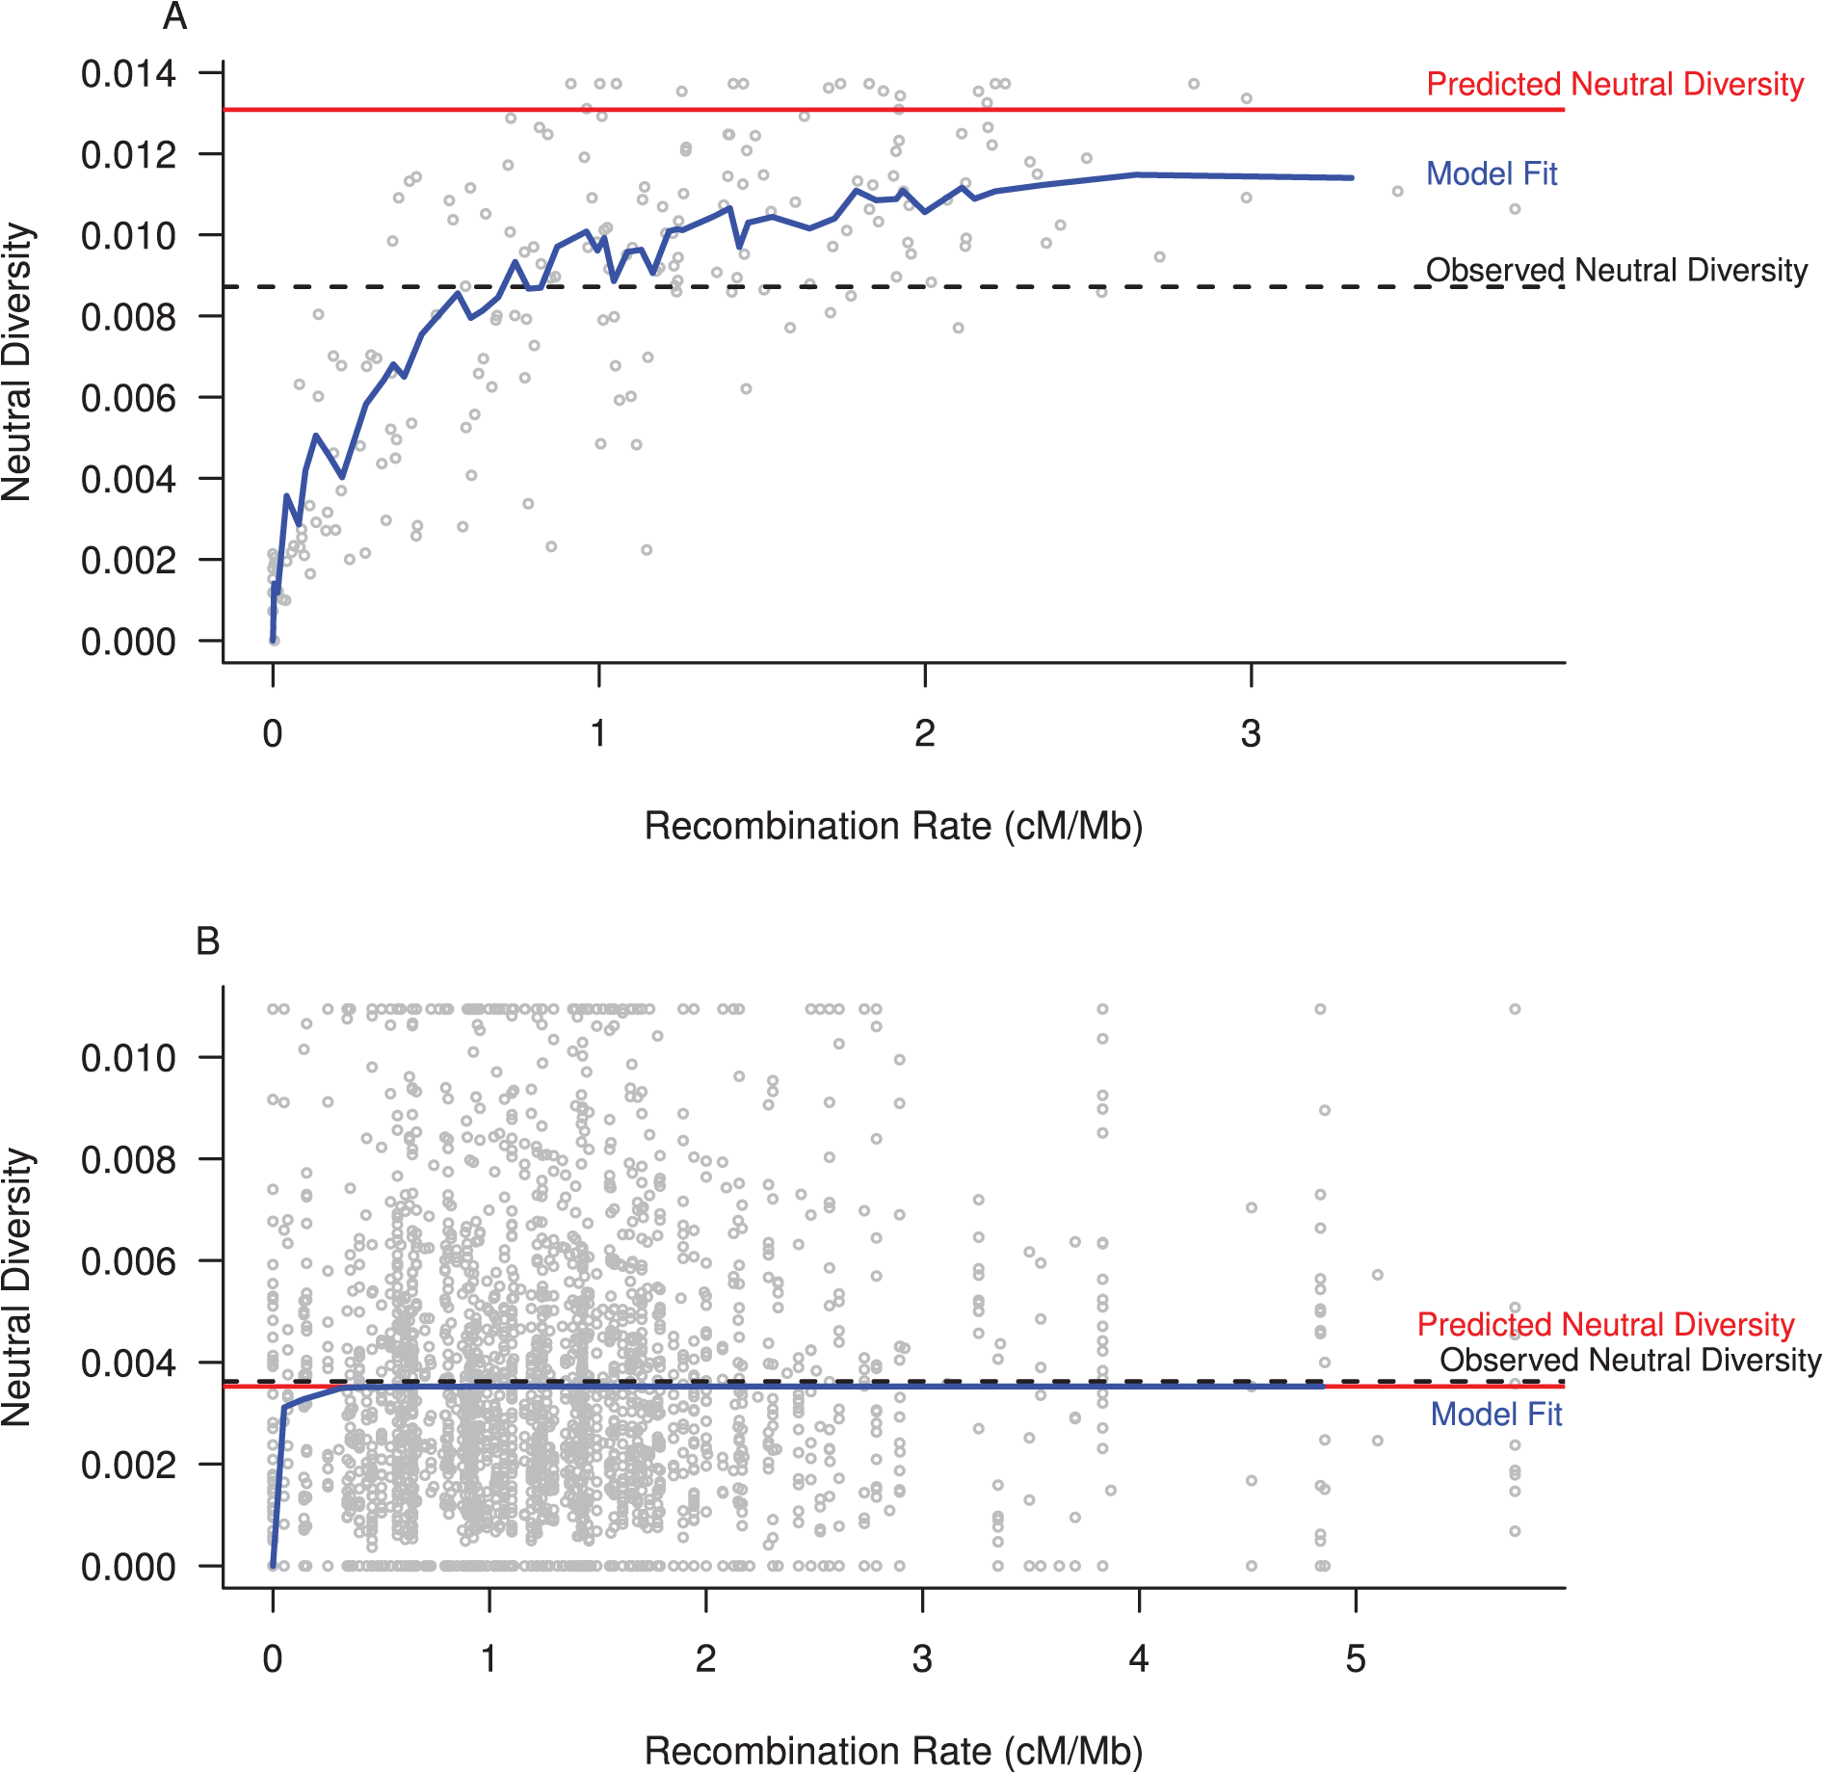

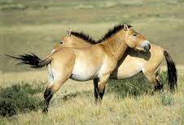
Drosophila melanogaster; Large N_{e}
Answer to Lewontin’s Paradox
Selection removes linked variation (background selection, genetic hitchhiking).
Genetic variation is reduced in regions of DNA with low recombination rates.
  The reduction in variation is much more pronounced in species with a large N.
Genetic variation at regions with high recombination rates is closer to the predicted neutral diversity based on N.
Equus ferus przewalskii ; Small N_{e}
Corbett-Detig RB, Hartl DL, Sackton TB (2015) Natural Selection Constrains Neutral Diversity across A Wide Range of Species. PLoS Biol 13

Slide 27
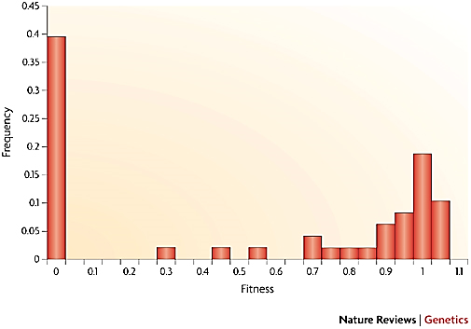
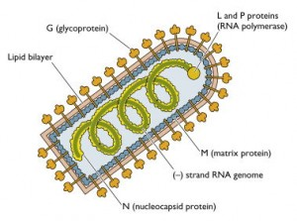
Distribution of fitness effects of random mutations in vesicular stomatitis virus.
Random mutations introduced into virus; fitness measured relative to wild type.
Lethal
Nearly neutral
Neutral
Deleterious
Advantageous
Eyre-Walker A, Keightley PD. 2007. The distribution of fitness effects of new mutations. Nature Rev. Genet. 8:610-618

Slide 28
Summary
Selectionist theory: all mutations affect fitness; most mutations are deleterious
Neutral theory: most mutations are either deleterious or neutral; advantageous mutations are rare. More neutral sites would produce a faster overall rate of change.
Nearly neutral theory: most mutations are deleterious, neutral, or “nearly” neutral; few are advantageous. Fate of mutations will depend on population size.
Bromham & Penny “The modern molecular clock” Nature Rev Genet 4:216, 2003

Slide 29
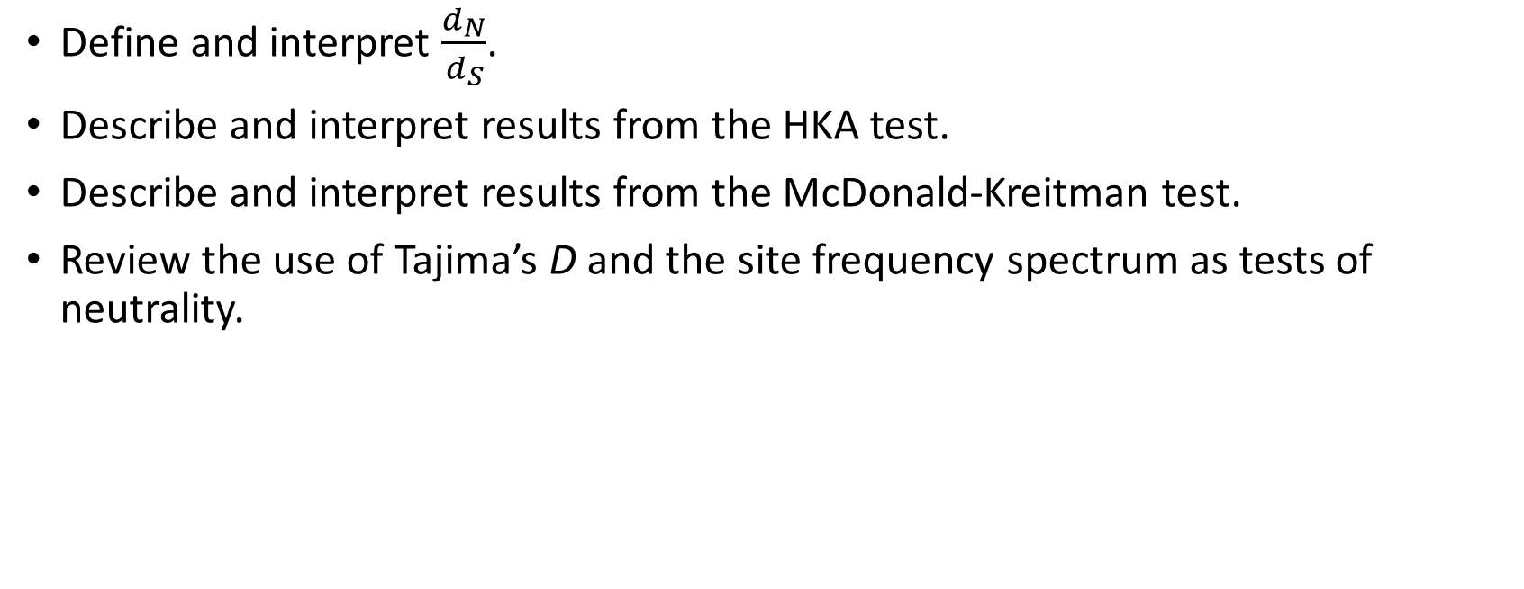
Part III—Tests of Neutrality
Learning Outcomes
Define and interpret $\frac{d_{N}}{d_{S}}$.
Describe and interpret results from the HKA test.
Describe and interpret results from the McDonald-Kreitman test.
Review the use of Tajima’s D and the site frequency spectrum as tests of neutrality.

Slide 30
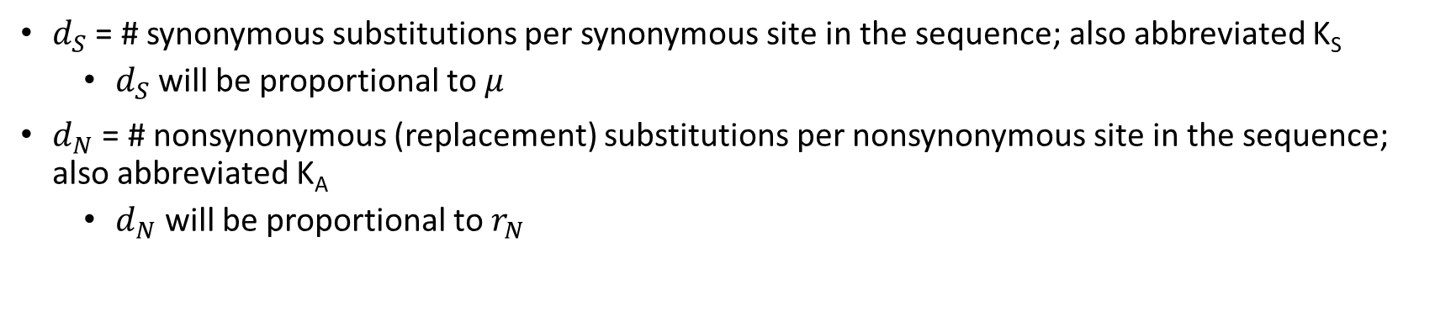
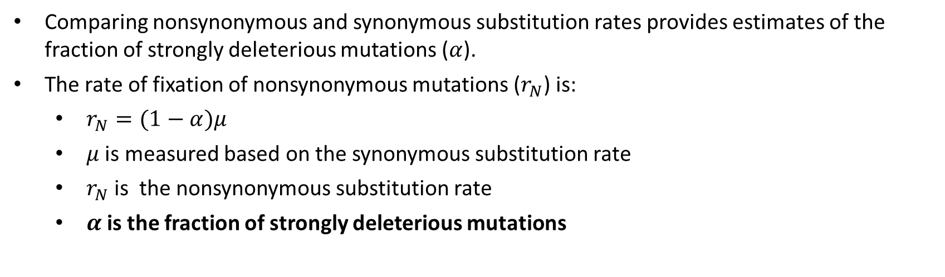
Negative (Purifying) Selection
Comparing nonsynonymous and synonymous substitution rates provides estimates of the fraction of strongly deleterious mutations ($α$).
The rate of fixation of nonsynonymous mutations ($r_{N}$) is:
  $r_{N}=(1−α)μ$
  $μ$ is measured based on the synonymous substitution rate
  $r_{N}$ is the nonsynonymous substitution rate
  $α$is the fraction of strongly deleterious mutations
$d_{S}$ = # synonymous substitutions per synonymous site in the sequence; also abbreviated K_{S}
  $d_{S}$ will be proportional to $μ$
$d_{N}$ = # nonsynonymous (replacement) substitutions per nonsynonymous site in the sequence; also abbreviated K_{A}
  $d_{N}$ will be proportional to $r_{N}$

Slide 31
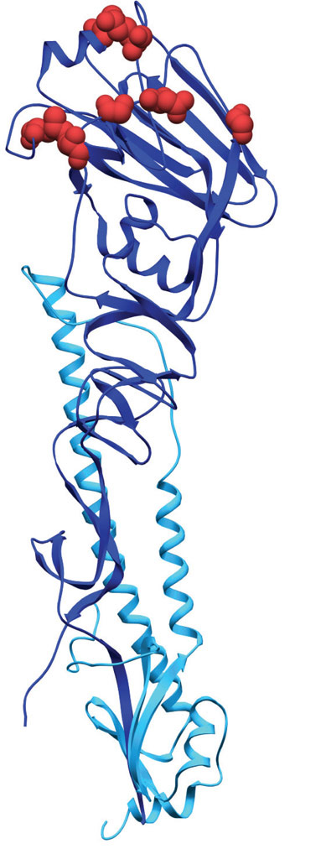
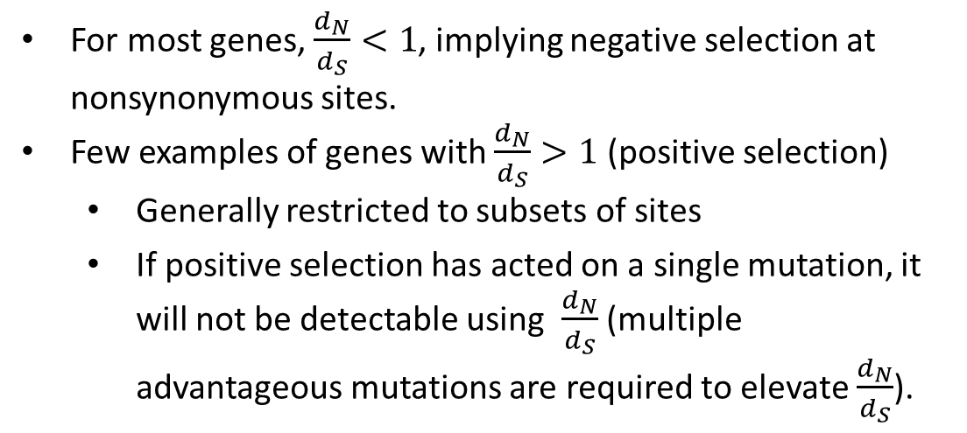


Tests for selection on sequences
$d_{S}$ = # synonymous substitutions per synonymous site in the sequence
$d_{N}$ = # nonsynonymous (replacement) substitutions per nonsynonymous site in the sequence
$\frac{d_{N}}{d_{S}}=1$, nonsynonymous substitutions are neutral
Figure 9.1 A cartoon structure of the influenza hemagglutinin molecule
$\frac{d_{N}}{d_{S}}<1$, nonsynonymous substitutions are deleterious
$\frac{d_{N}}{d_{S}}>1$, nonsynonymous substitutions are advantageous
Regions with $\frac{d_{N}}{d_{S}}>1$
These regions are targeted by the human immune systems
Results in strong positive selection for mutations that help the virus evade our immune system.
For most genes, $\frac{d_{N}}{d_{S}}<1$, implying negative selection at nonsynonymous sites.
Few examples of genes with $\frac{d_{N}}{d_{S}}>1$ (positive selection)
  Generally restricted to subsets of sites
  If positive selection has acted on a single mutation, it will not be detectable using $\frac{d_{N}}{d_{S}}$ (multiple advantageous mutations are required to elevate $\frac{d_{N}}{d_{S}}$).

Slide 32
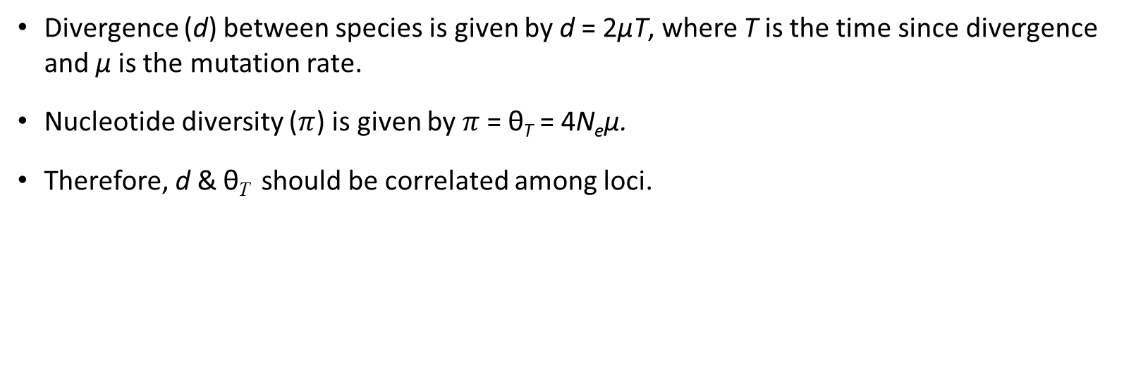
Application of neutral theory
Divergence (d) between species is given by d = 2µT, where T is the time since divergence and µ is the mutation rate.
Nucleotide diversity ($π$) is given by $π$= θ_{T} = 4N_{e}µ.
Therefore, d & θ_{T} should be correlated among loci.
High substitution rate
Low substitution rate
Low polymorphism relative to divergence
Relationship between genetic diversity and divergence at 20 loci in ducks (Peters et al. 2014).

Slide 33
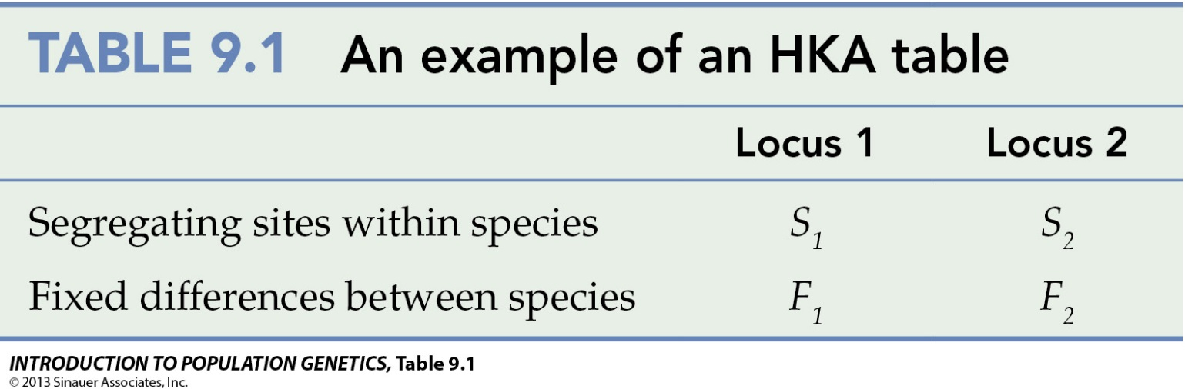
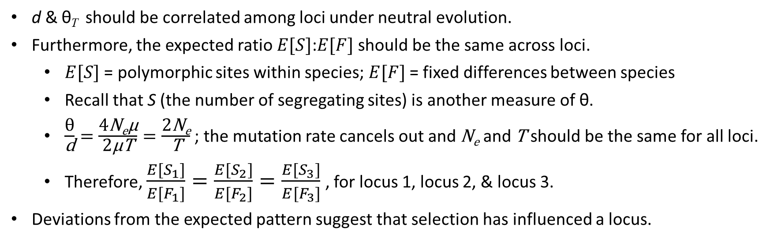
The HKA test (the Hudson-Kreitman-Aguadé test)
d & θ_{T} should be correlated among loci under neutral evolution.
Furthermore, the expected ratio $E[S]$:$E[F]$ should be the same across loci.
  $E[S]$ = polymorphic sites within species; $E[F]$ = fixed differences between species
  Recall that S (the number of segregating sites) is another measure of θ.
  $\frac{\text{θ}}{\text{d}}=\frac{\text{4}\text{N}\text{e}\text{µ}}{\text{2}\text{µ}\text{T}}=\frac{\text{2}\text{N}\text{e}}{\text{T}}$ ; the mutation rate cancels out and $\text{N}\text{e}$ and $\text{T}$ should be the same for all loci.
  Therefore, $\frac{E[S_{1}]}{E[F_{1}]}=\frac{E[S_{2}]}{E[F_{2}]}=\frac{E[S_{3}]}{E[F_{3}]}$ , for locus 1, locus 2, & locus 3.
Deviations from the expected pattern suggest that selection has influenced a locus.

Slide 34
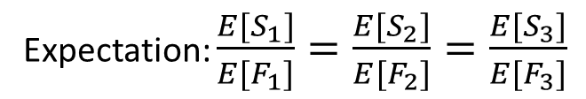
The HKA test
Expectation: $\frac{E[S_{1}]}{E[F_{1}]}=\frac{E[S_{2}]}{E[F_{2}]}=\frac{E[S_{3}]}{E[F_{3}]}$
High polymorphism relative to divergence
HKA table for Gadwall ducks (subset of loci)
Locus | S | F | S/F
CHD | 12 | 23 | 0.522
LDH | 9 | 44 | 0.205
ODC | 33 | 20 | 1.650
A27E1 | 6 | 10 | 0.600
ENO | 15 | 22 | 0.682
Low polymorphism relative to divergence
S = number of segregating sites within Gadwalls
F = number of fixed differences between Gadwalls and Snow Geese
LDH has a low S/F ratio, suggesting a selective sweep.
ODC has a high S/F ratio, suggesting balancing selection.

Slide 35
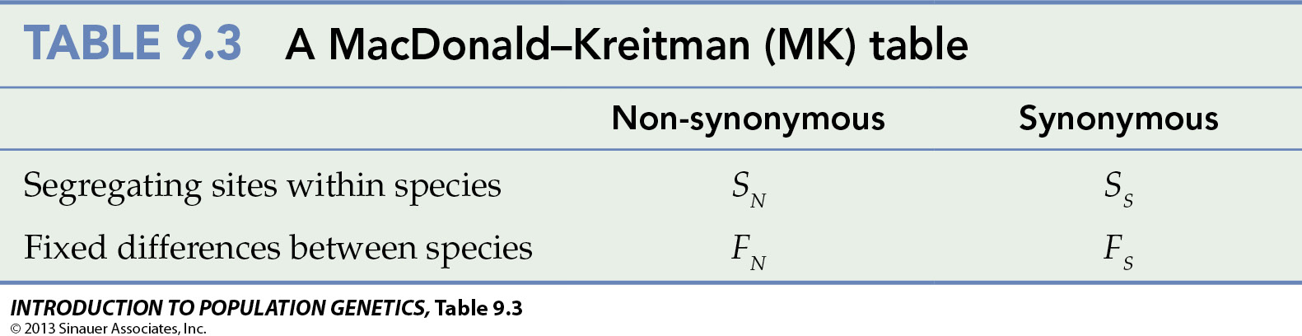
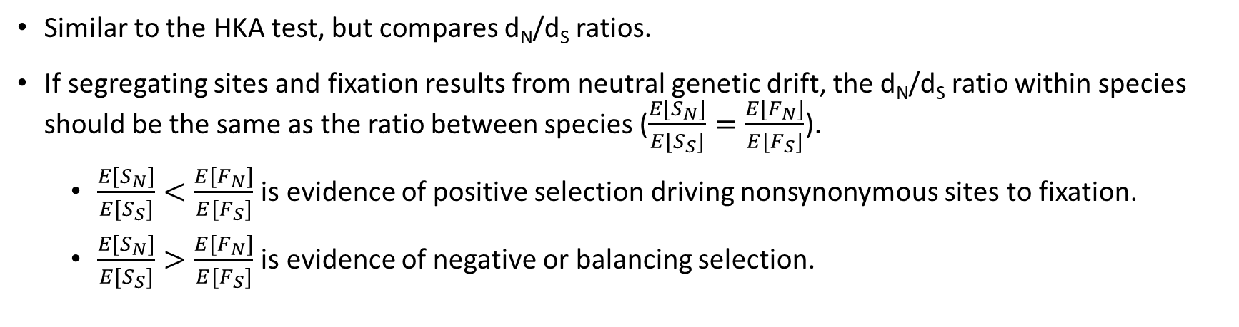
McDonald-Kreitman Test
Similar to the HKA test, but compares d_{N}/d_{S} ratios.
If segregating sites and fixation results from neutral genetic drift, the d_{N}/d_{S} ratio within species should be the same as the ratio between species ($\frac{E[S_{N}]}{E[S_{S}]}=\frac{E[F_{N}]}{E[F_{S}]}$).
  $\frac{E[S_{N}]}{E[S_{S}]}<\frac{E[F_{N}]}{E[F_{S}]}$ is evidence of positive selection driving nonsynonymous sites to fixation.
  $\frac{E[S_{N}]}{E[S_{S}]}>\frac{E[F_{N}]}{E[F_{S}]}$ is evidence of negative or balancing selection.

Slide 36
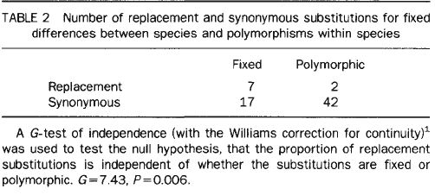
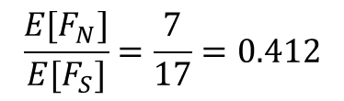
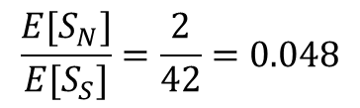
McDonald & Kreitman (1991) test
F between spp ->.
<- S within spp.
*Replacement = Nonsynonymous
$$\frac{E[S_{N}]}{E[S_{S}]}=\frac{2}{42}=0.048$$
Suggests positive selection
$$\frac{E[F_{N}]}{E[F_{S}]}=\frac{7}{17}=0.412$$

Slide 37
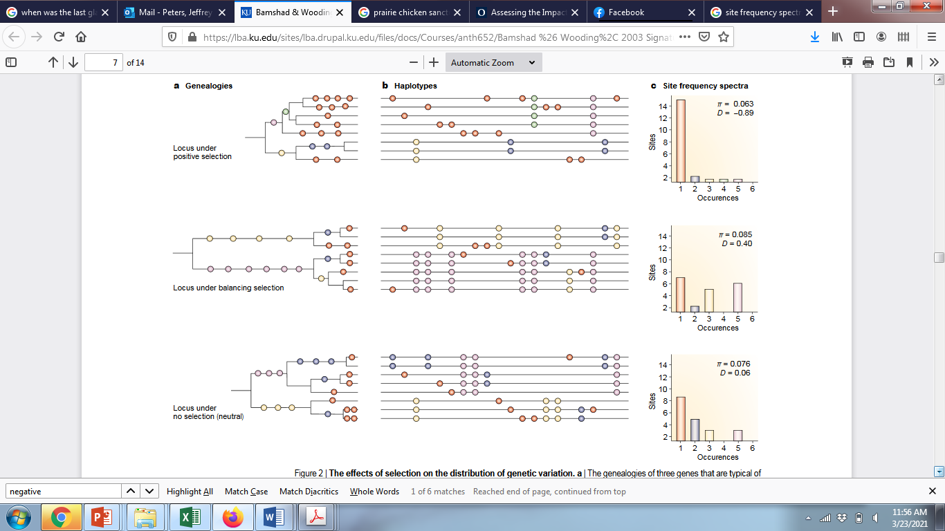



Other methods for testing neutrality (Review)
Neutral
Positive selection
Balancing selection
Site-frequency spectrum:
Excess of rare polymorphisms
Paucity of rare
polymorphisms
Tajima’s D:
$θ_{T}=θ_{W}$,
D = 0
$θ_{T}<θ_{W}$,
D < 0
$θ_{T}>θ_{W}$,
D > 0
Mimics genetic signatures of:
Population expansion
Population decline
Constant N
Recall that distinguishing between demography and selection requires examining multiple loci
Demography affects the entire genome
Selection acts locally within the genome (loci under selection and closely linked loci)

