Slide 1
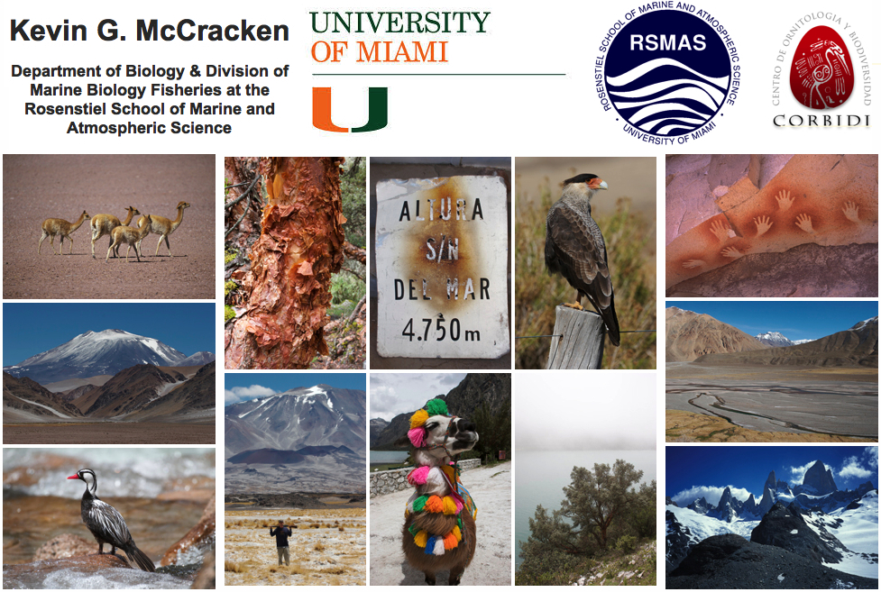
Genetic Adaptation & Phenotypic Plasticity in High-altitude Ducks

Slide 2
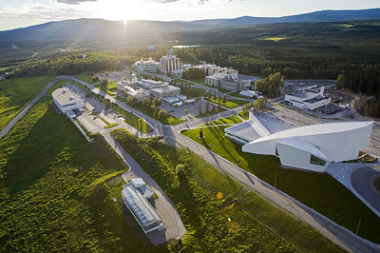
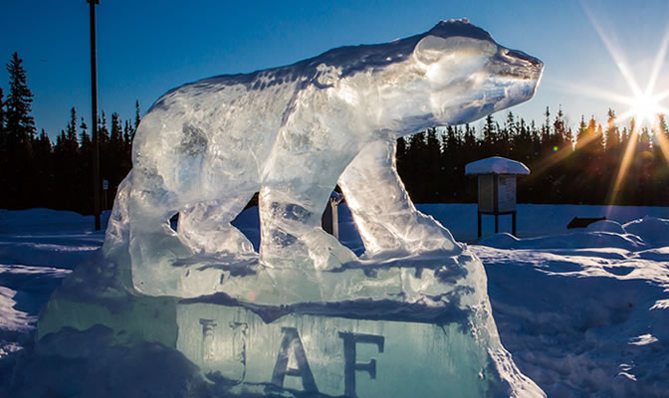
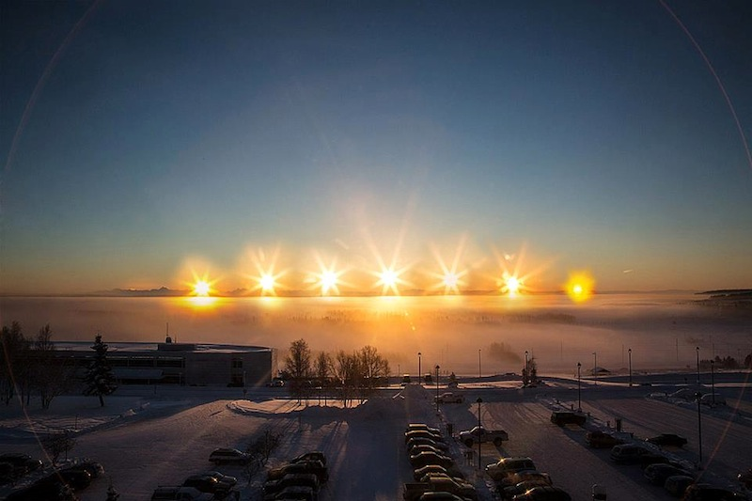
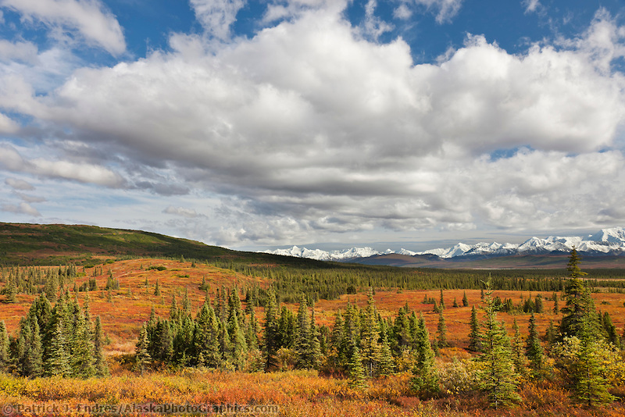
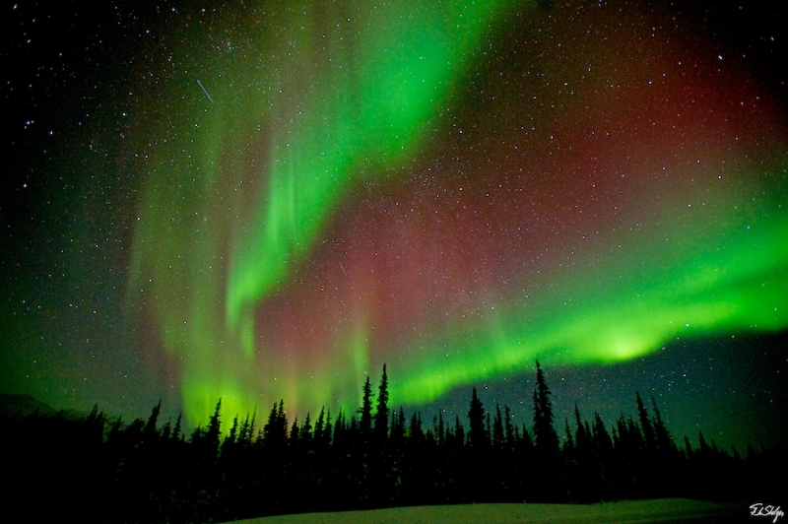

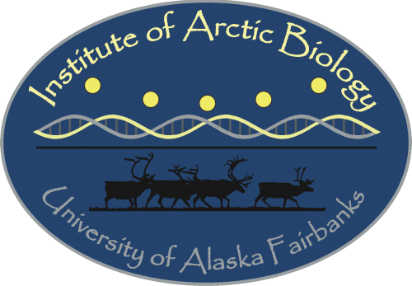



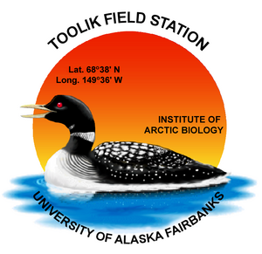

Slide 3
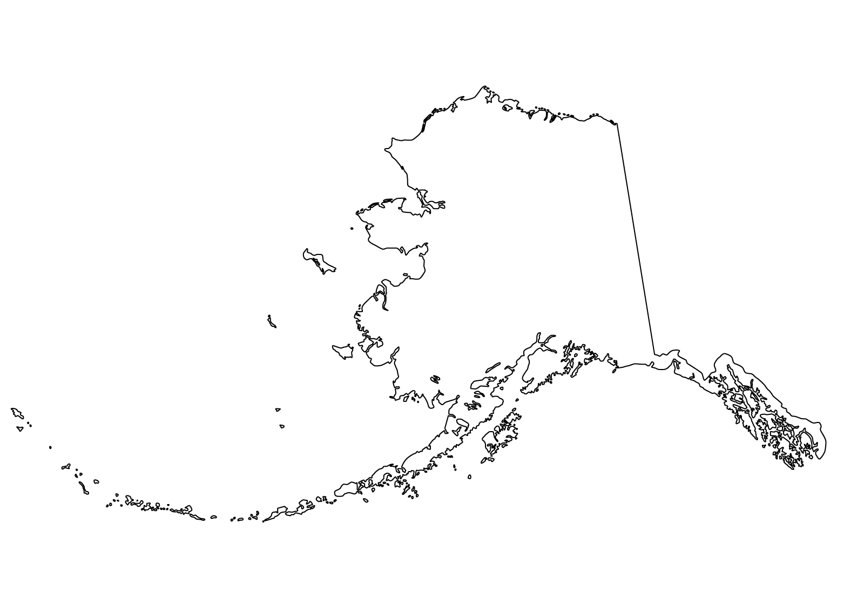
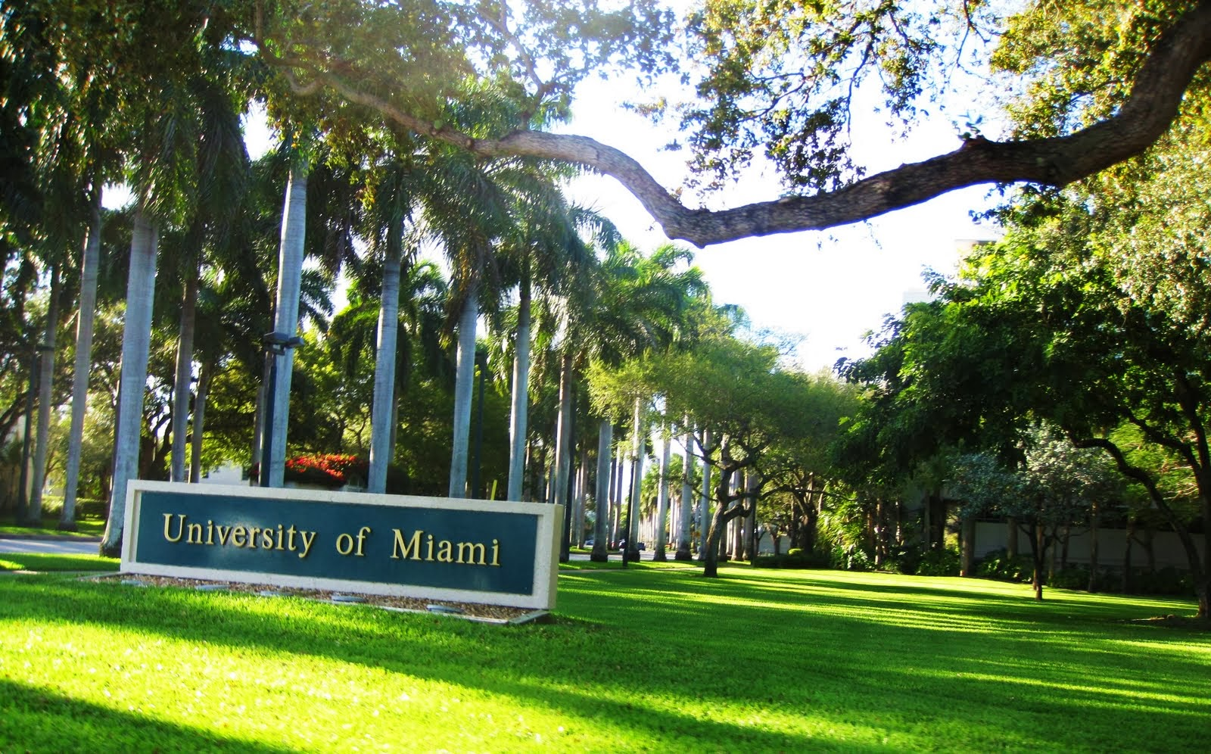
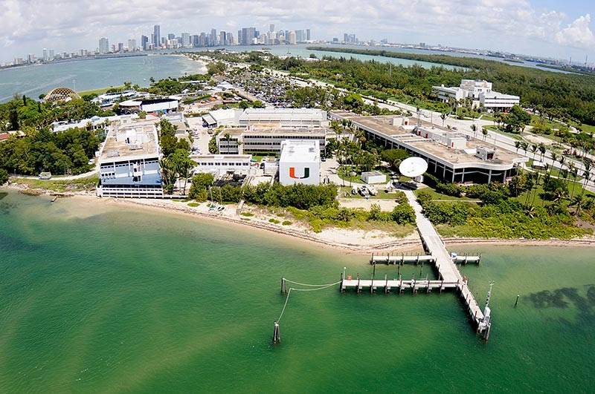


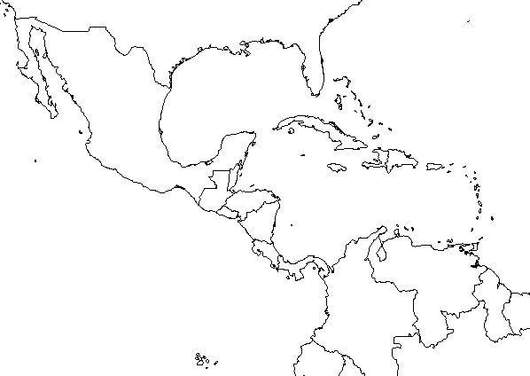

Slide 4
Collaborators
Protein Chemistry
Jay Storz, Chandru Natarajan & Joana Projecto-Garcia - University of Nebraska
Angela Fago & Roy Weber – University of Aarhus
Respiratory Physiology
Graham Scott, Catie Ivy & Neal Dawson - McMaster University
Bill Milsom, Sabine Lague & Bev Chua - University of British Columbia
Peter Frappell - University of Tasmania
Population Genetics
Luis Alza, Chris Barger, Mariana Bulgarella, Rebecca Cheek, Allie Graham Matt Smith, Daniela Wilner, Robert Wilson & Kevin Winker - University of Alaska Fairbanks/Miami
Jeff Peters & Phil Lavretsky - Wright State University & University of Texas El Paso
Violeta Muñoz-Fuentes - Estación Biológica de Doñana
Mary Kuhner - University of Washington
Collaborators in South America
Daniel Cadena, Natalia Gutierrez & Maria Lozano - Universidad de Los Andes
Pablo Tubaro & Cecilia Kopuchian - MACN Argentina
Andrea Astie - IADIZA Mendoza
Thomas Valqui & Emil Bautista - CORBIDI
Jorge Trucco - Patagonia Outfitters

Slide 5
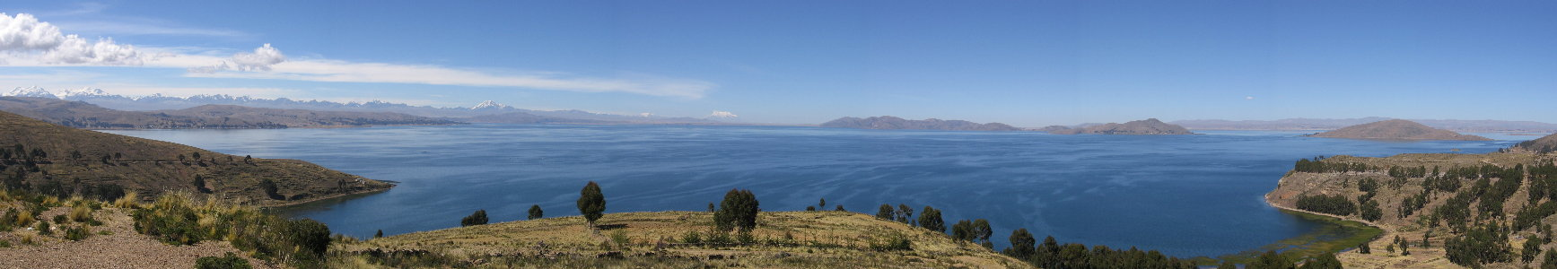
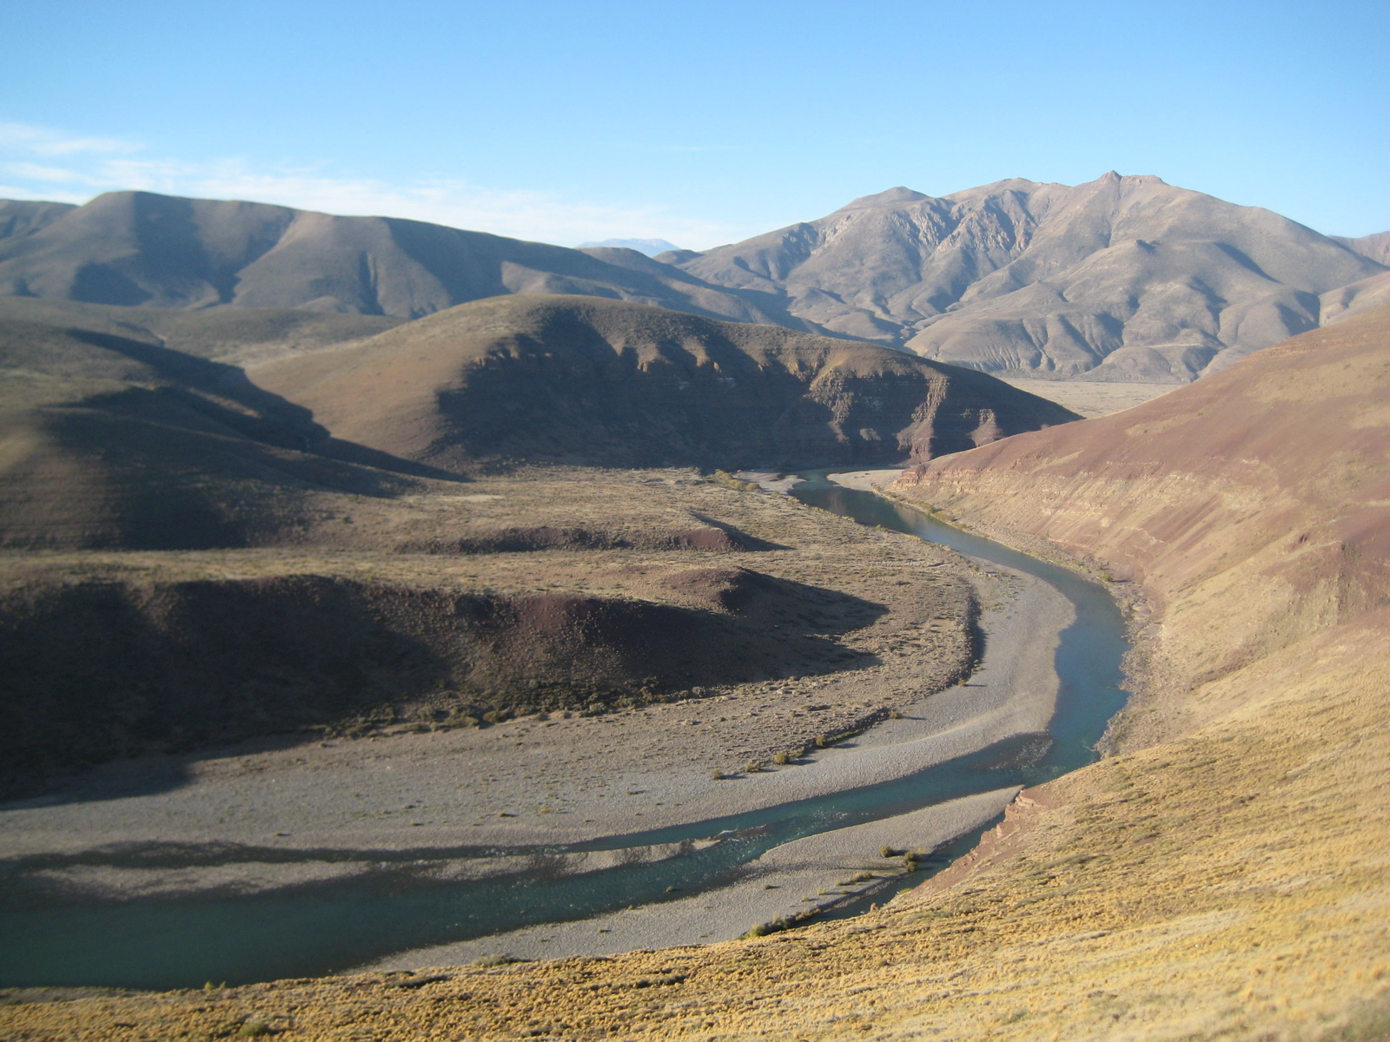
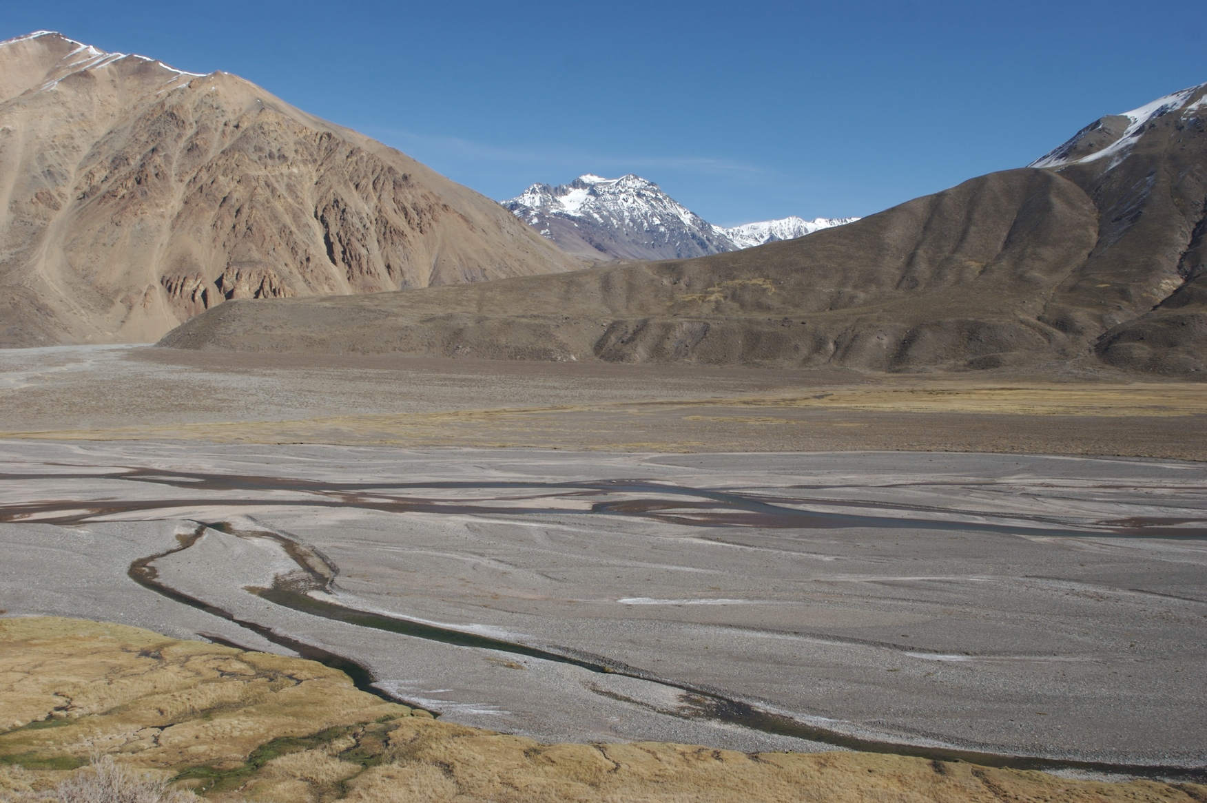
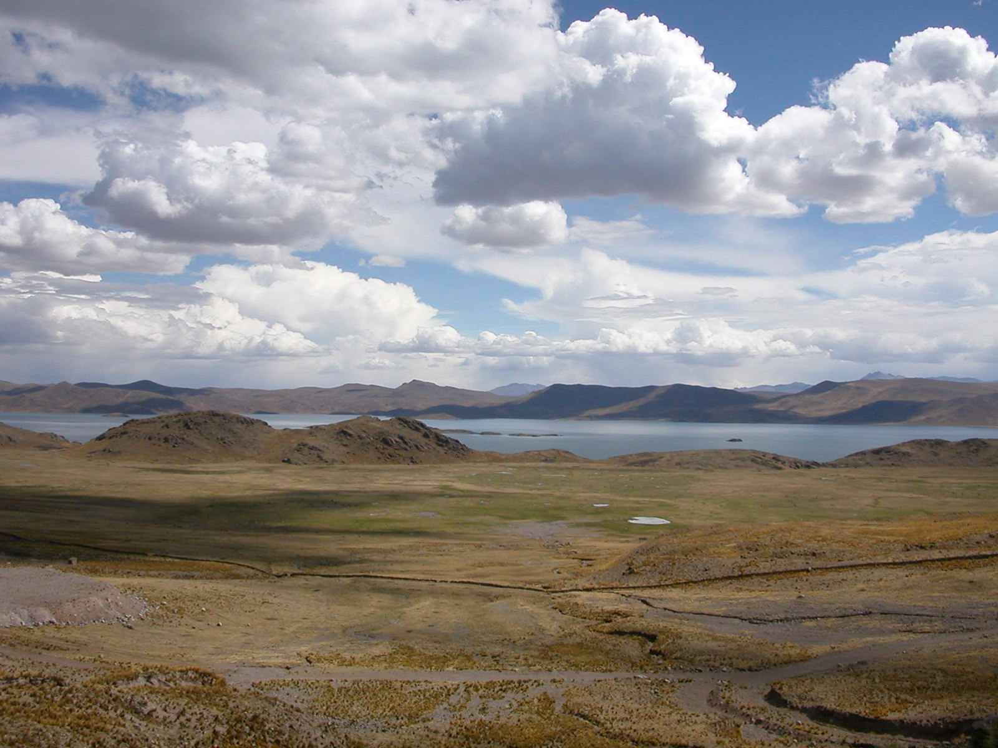
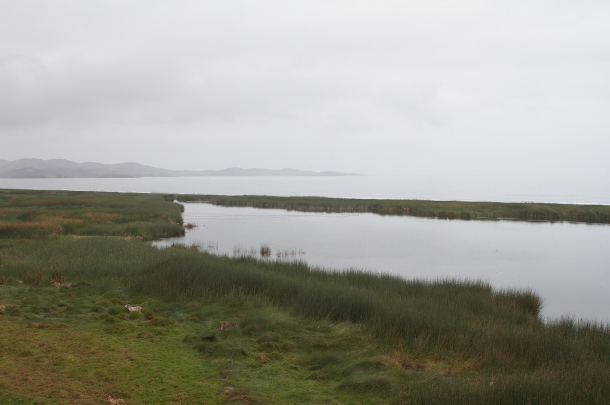
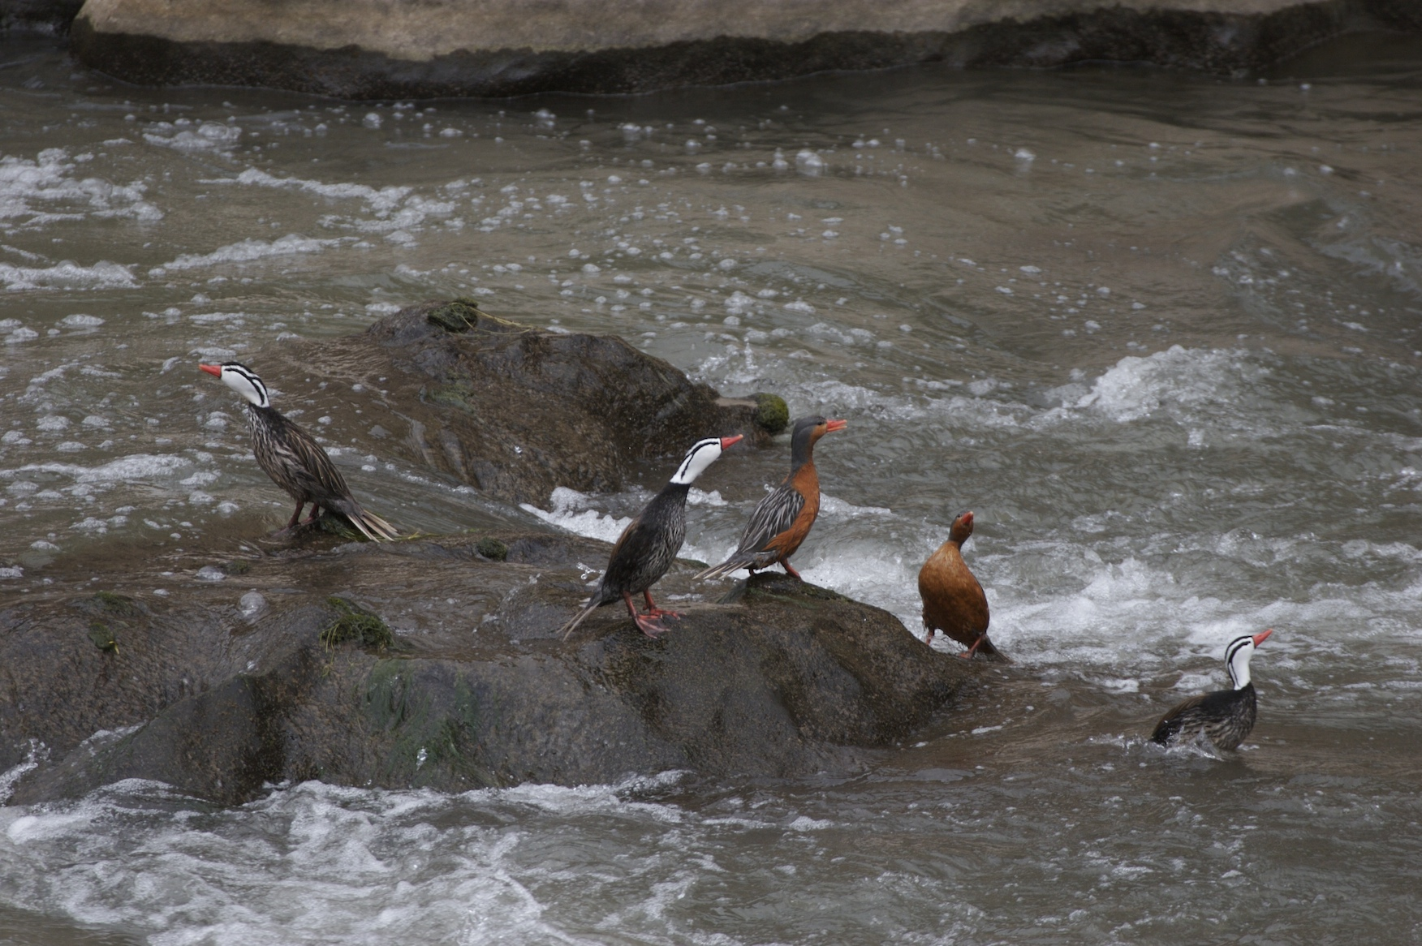
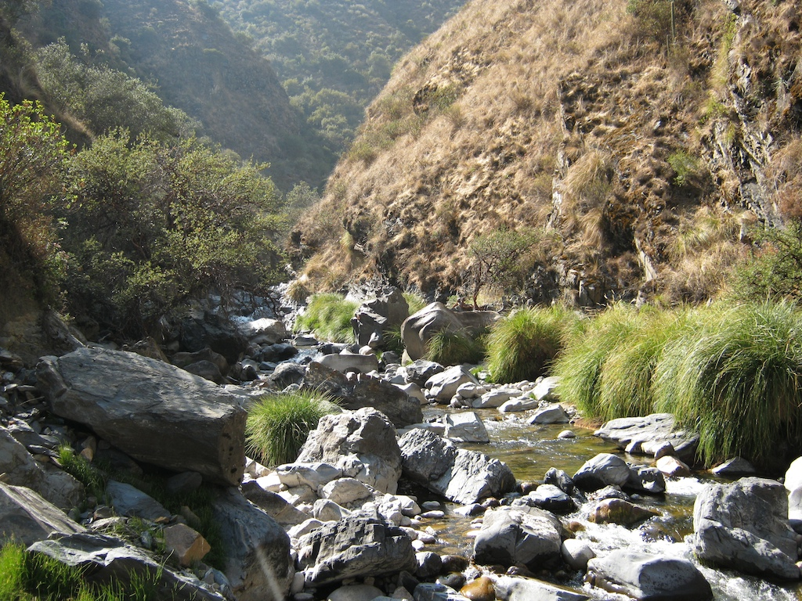
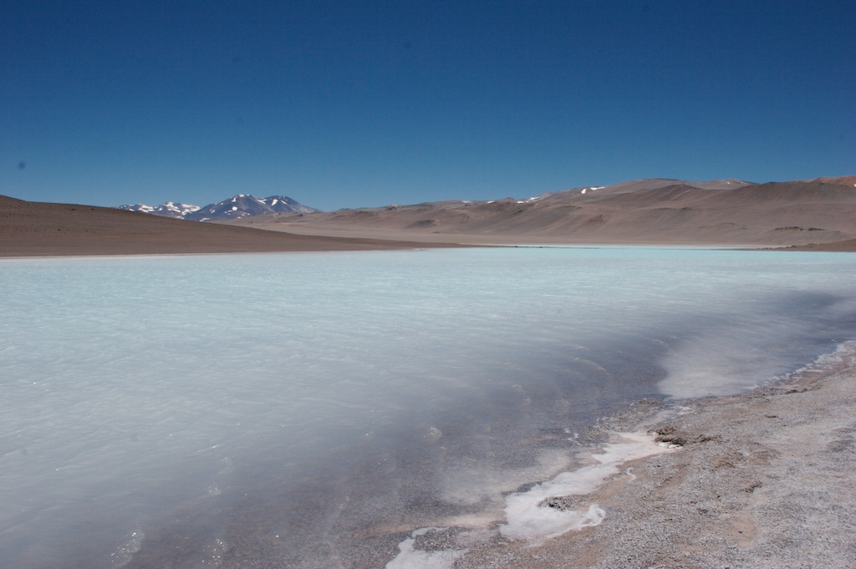
Wetlands can be found everywhere in the Andes at all elevations.

Slide 6
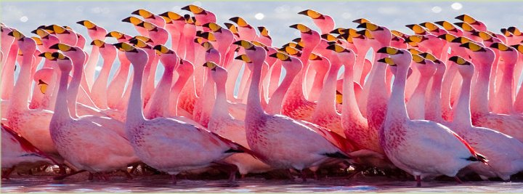
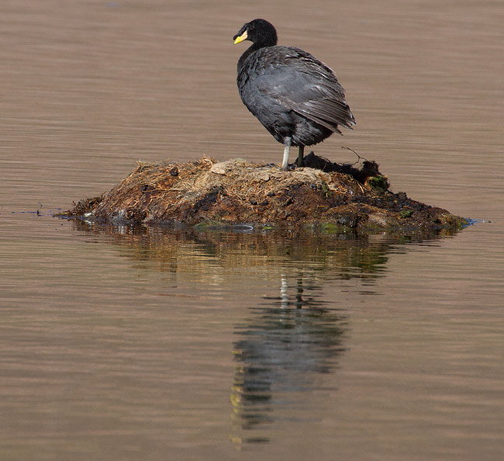
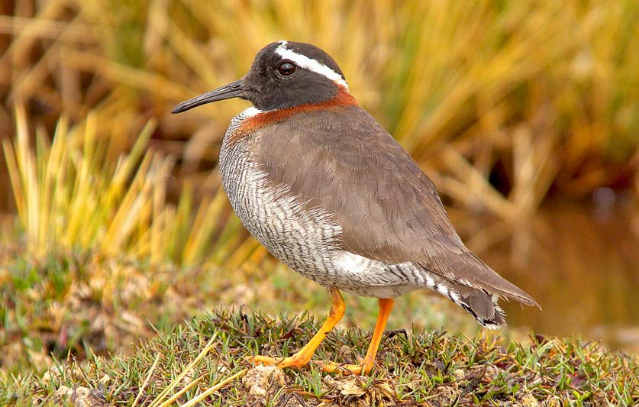
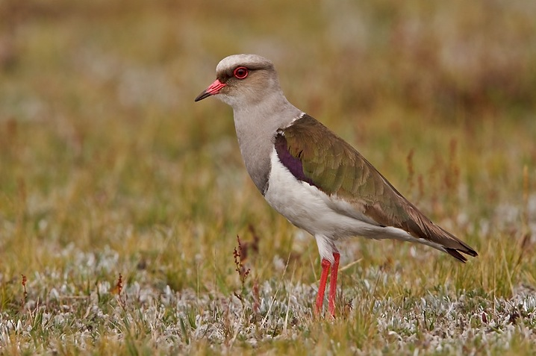
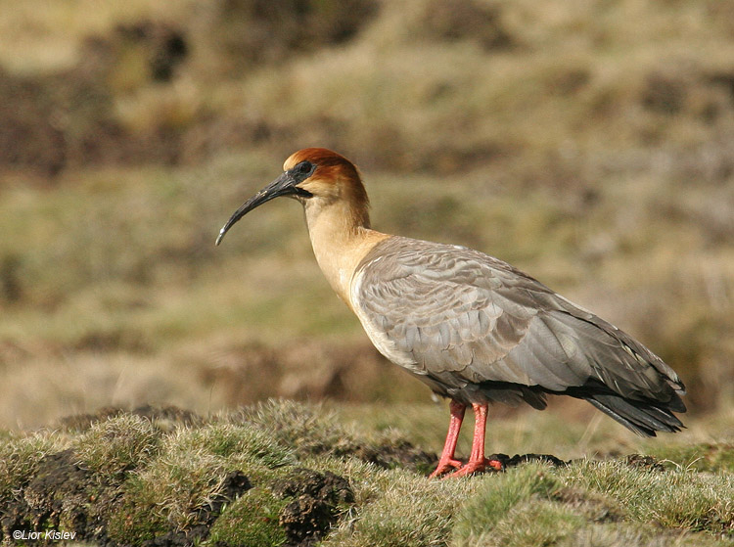
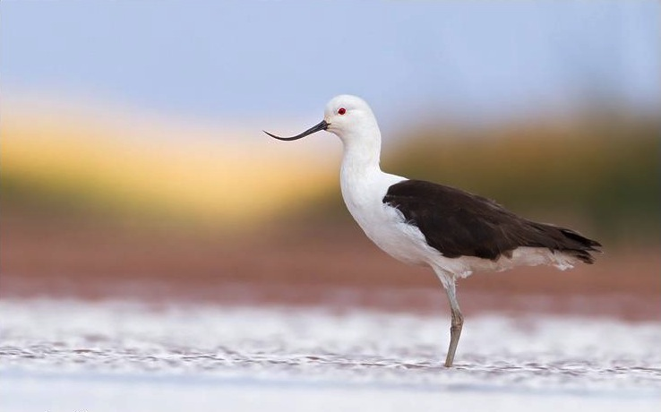
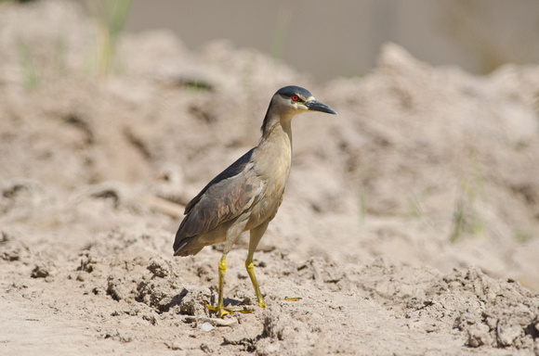
High-altitude Andean wetlands are full of fantastic waterbirds.

Slide 7
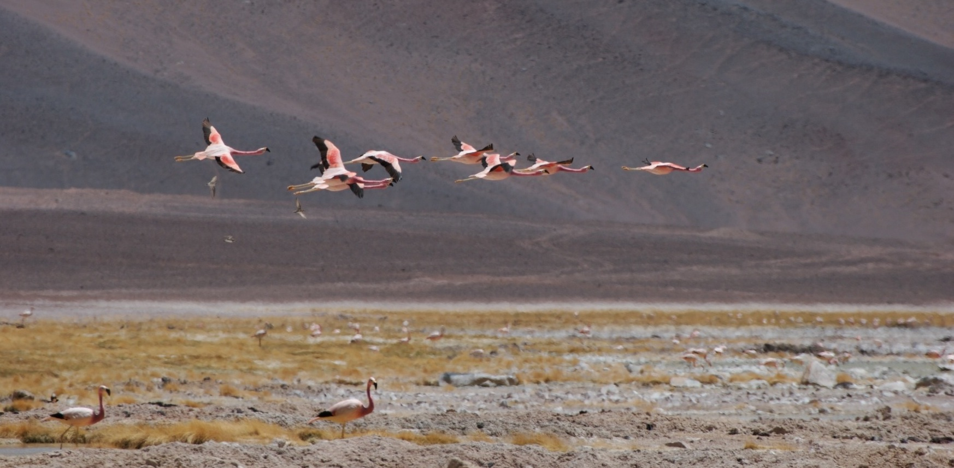
Species existing here are ecological specialists. Most of them are endemic to high-altitude. They harbor a treasure trove of information about mechanisms of adaptation and phenotypic plasticity.
Andean Flamingos – Catamarca, Argentina (2005)
Notes:
These species inhabit an extreme environment...

Slide 8

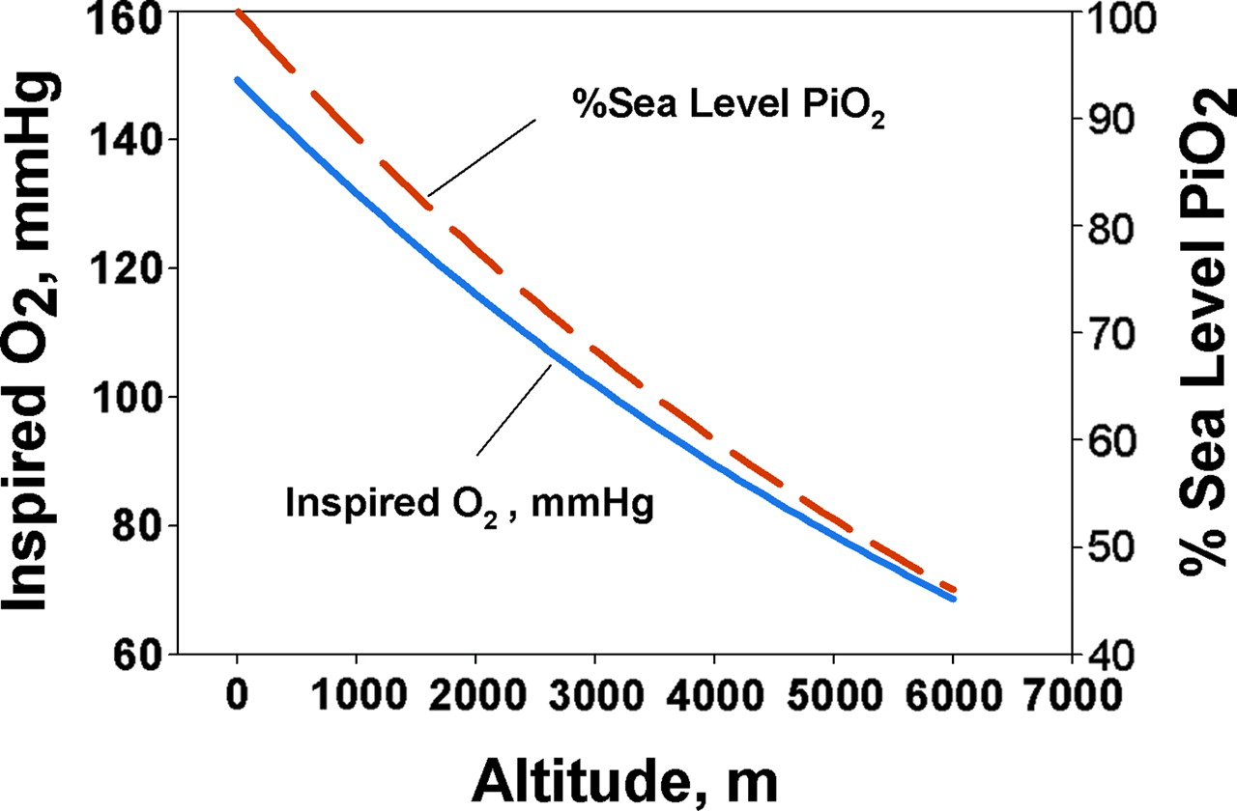
High-altitude hypoxia & cold resistance
High-altitude environments present physiological challenges.
Air density and O₂ partial pressure decline 10% per 1,000 meters.
Temperature decreases by 6.5° C per 1,000 meters.
Beall (2007) PNAS 104:8655-8660

Slide 9
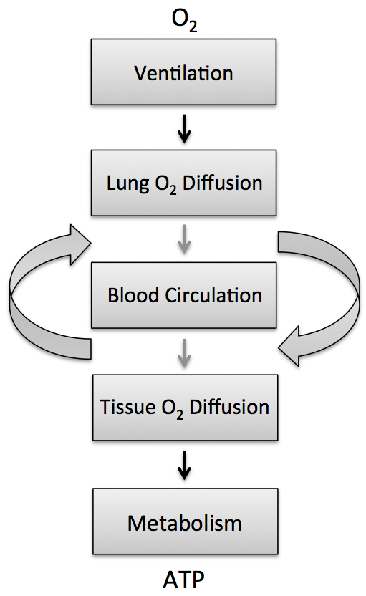
(1) The entire O₂ cascade is affected by hypobaric hypoxia.
(2) All low-altitude species exhibit an acute acclimatization response; However, not all high-altitude species exhibit these same responses, or are affected similarly at all points in the cascade.
(3) There is frequently a cost to particular elements of the high-altitude acclimatization response.
O₂ Transport Cascade
Notes:
O₂ deprivation first sensed by chemoreceptors in the carotid bodies stimulates breathing, followed by a cascade of environmentally induced changes (plasticity) in the O₂ transport cascade.

Slide 10
High-altitude Acclimatization in Humans
Blood-O₂ carrying capacity increases → erythropoietin stimulates red blood cell & hemoglobin synthesis. At 4,000 meters your Hb & RBC count will stabilize after 45 days.
Hypoxic ventilatory response (HVR) → increase in ventilation
Hypoxic pulmonary vasoconstriction and cardiovascular responses (HPV & HCVR) → redistributes blood flow to better ventilated parts of the lung (if it doesn’t kill you).
Tradeoffs between carbohydrate/lipid metabolism → lipid metabolism yields more ATP than carbohydrates but consumes more O₂ (6.33 vs. 5.60 ATP per O₂ molecule).

Slide 11
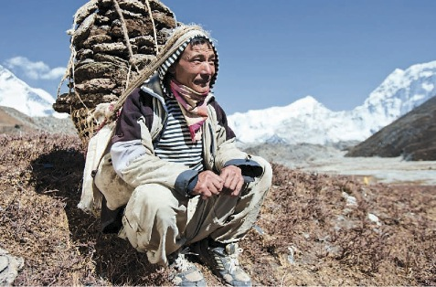
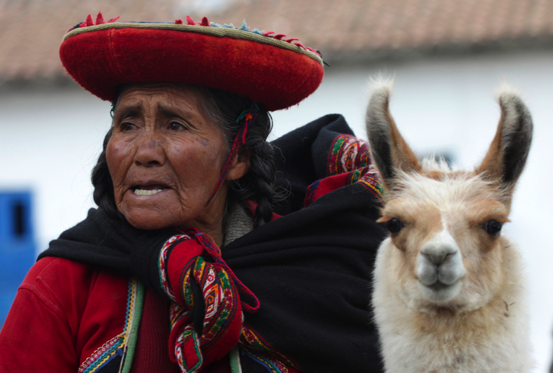
High-altitude Natives have blunted acclimatization responses for some traits but not others
Tibetan →
lower O₂ saturation,
blunted erythropoiesis
elevated HVR
Andean →
higher O₂ saturation,
elevated erythropoiesis
blunted HVR
Beall et al. (2007) Two routes to functional adaptation: Tibetan and Andean high-altitude natives. Proceedings of the National Academy of Sciences U.S.A. 104:8655-8660

Slide 12
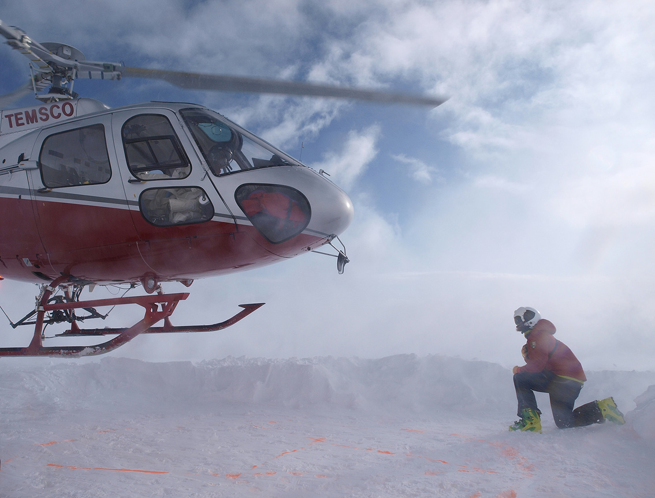
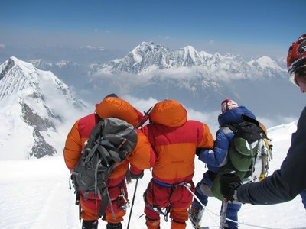
Examples where the acclimatization response may be maladaptive
High-altitude pulmonary edema & cerebral edema
Hypoxic cardiovascular response (HCVR) → Pulmonary hypertension can cause fluid to to leak into the alveoli of the lungs disrupting blood-gas exchange. In the brain, this hypertension can result in cerebral edema.

Slide 13
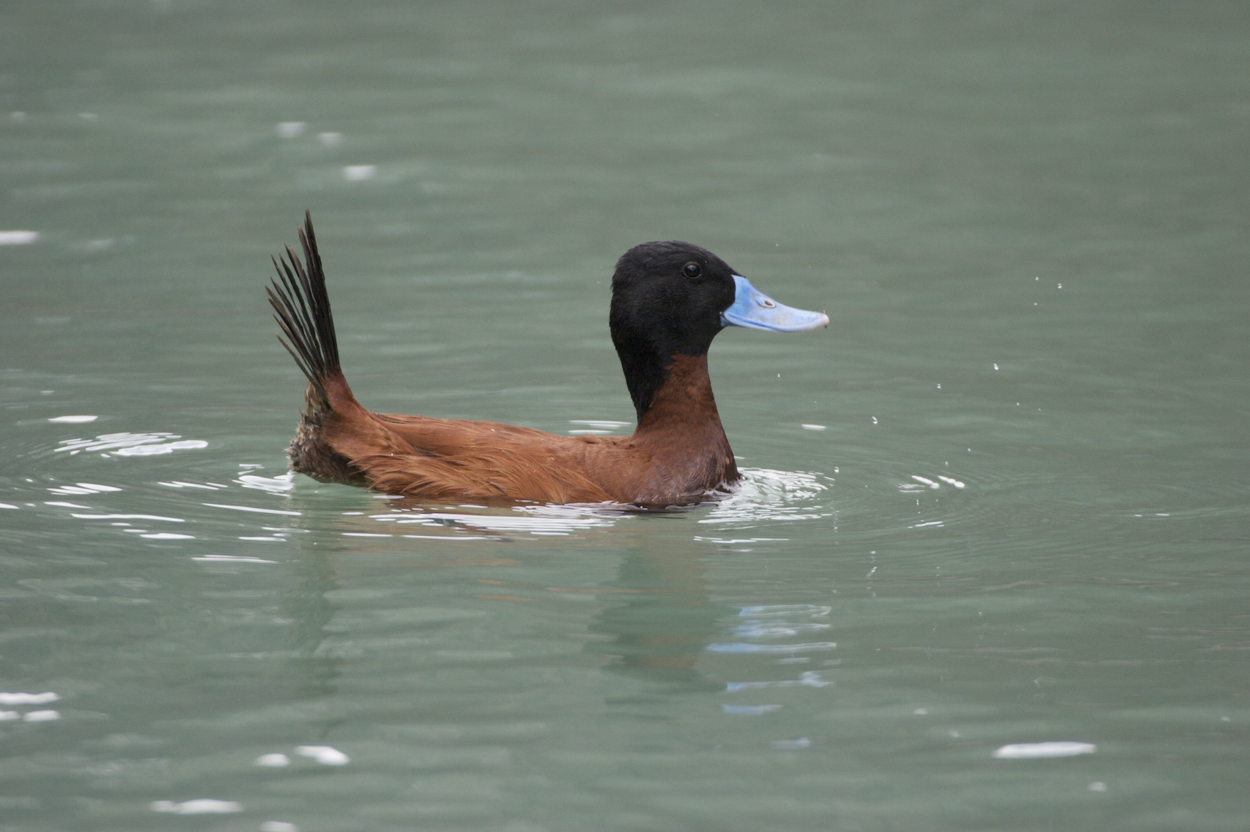
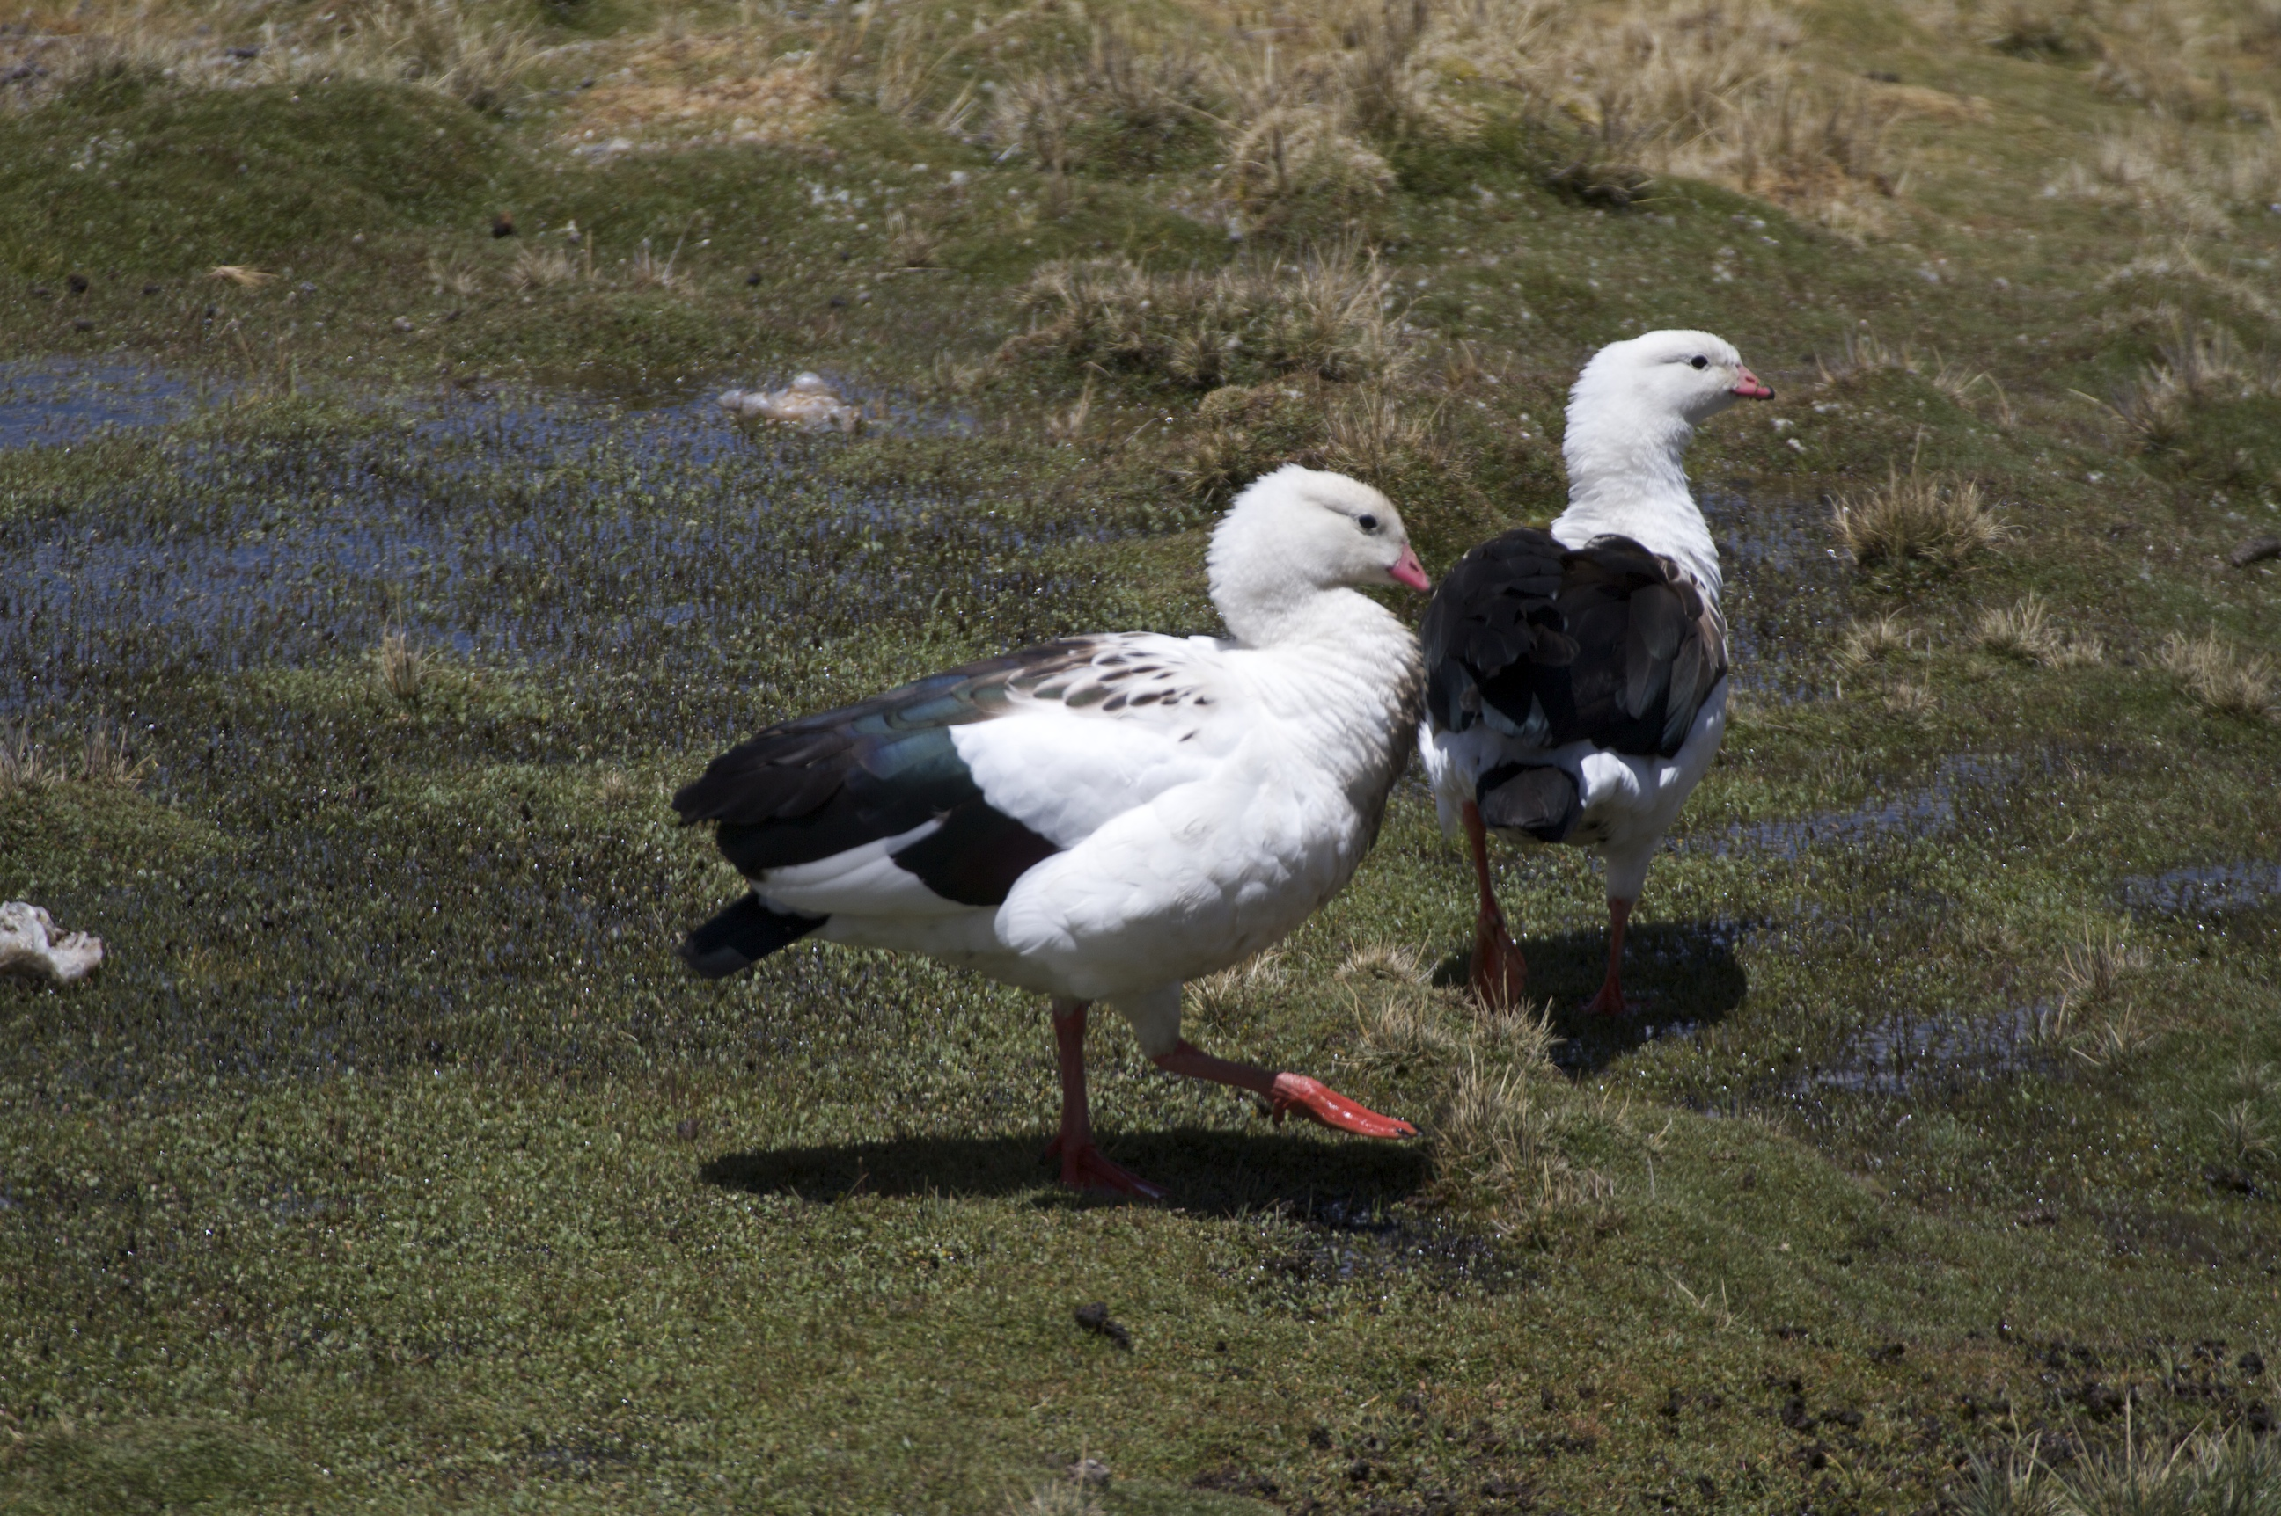
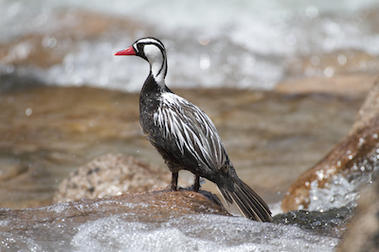
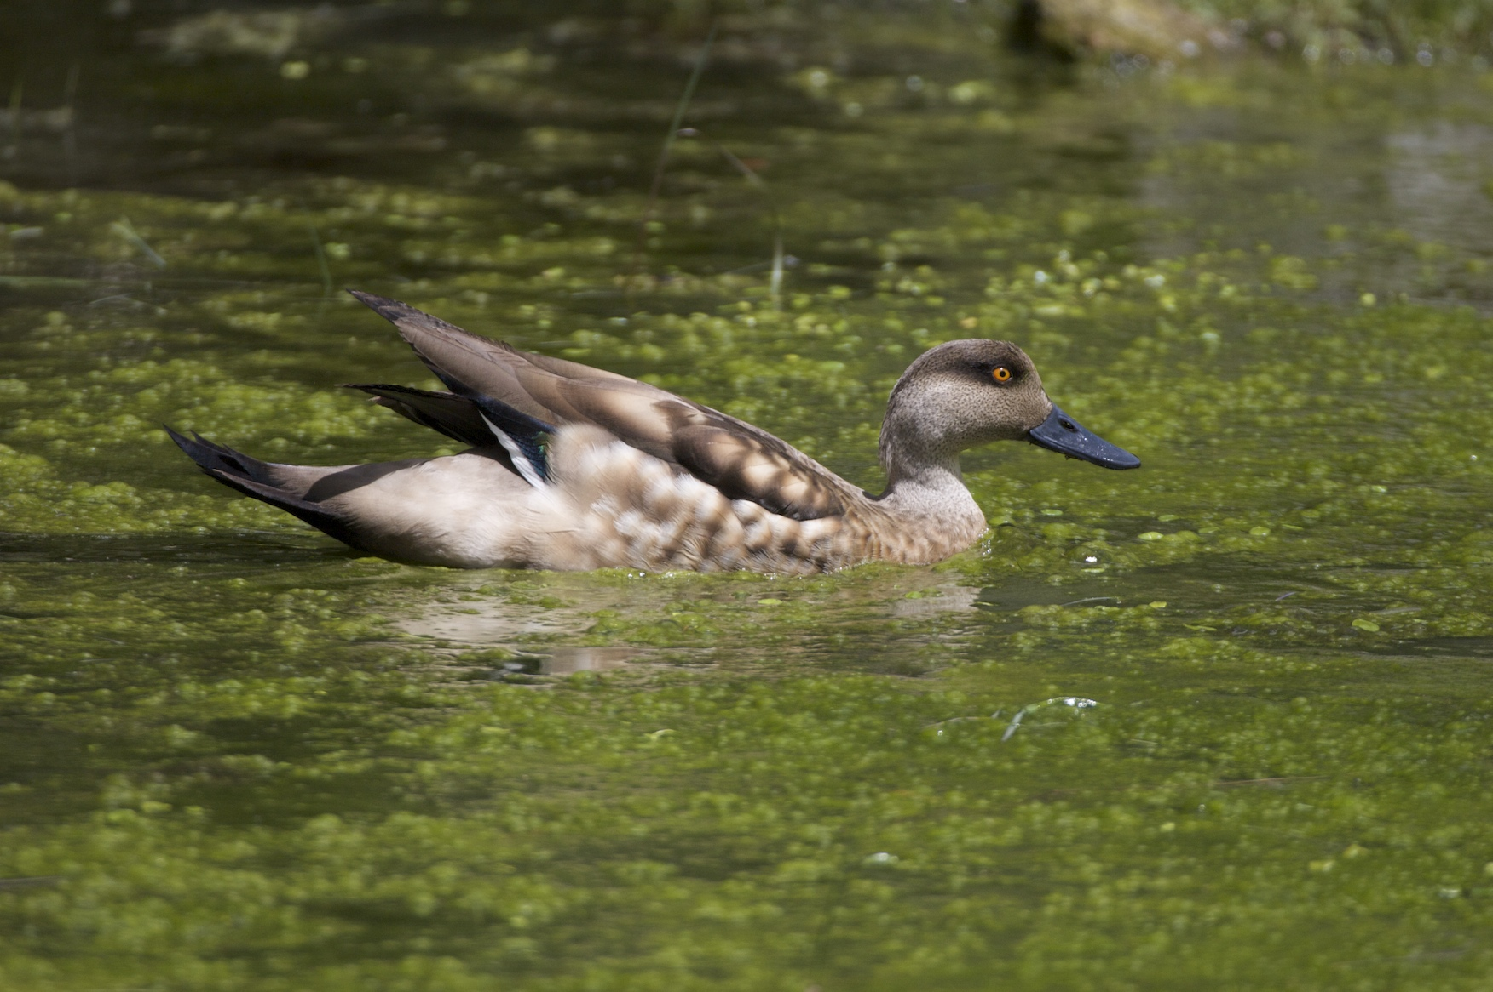
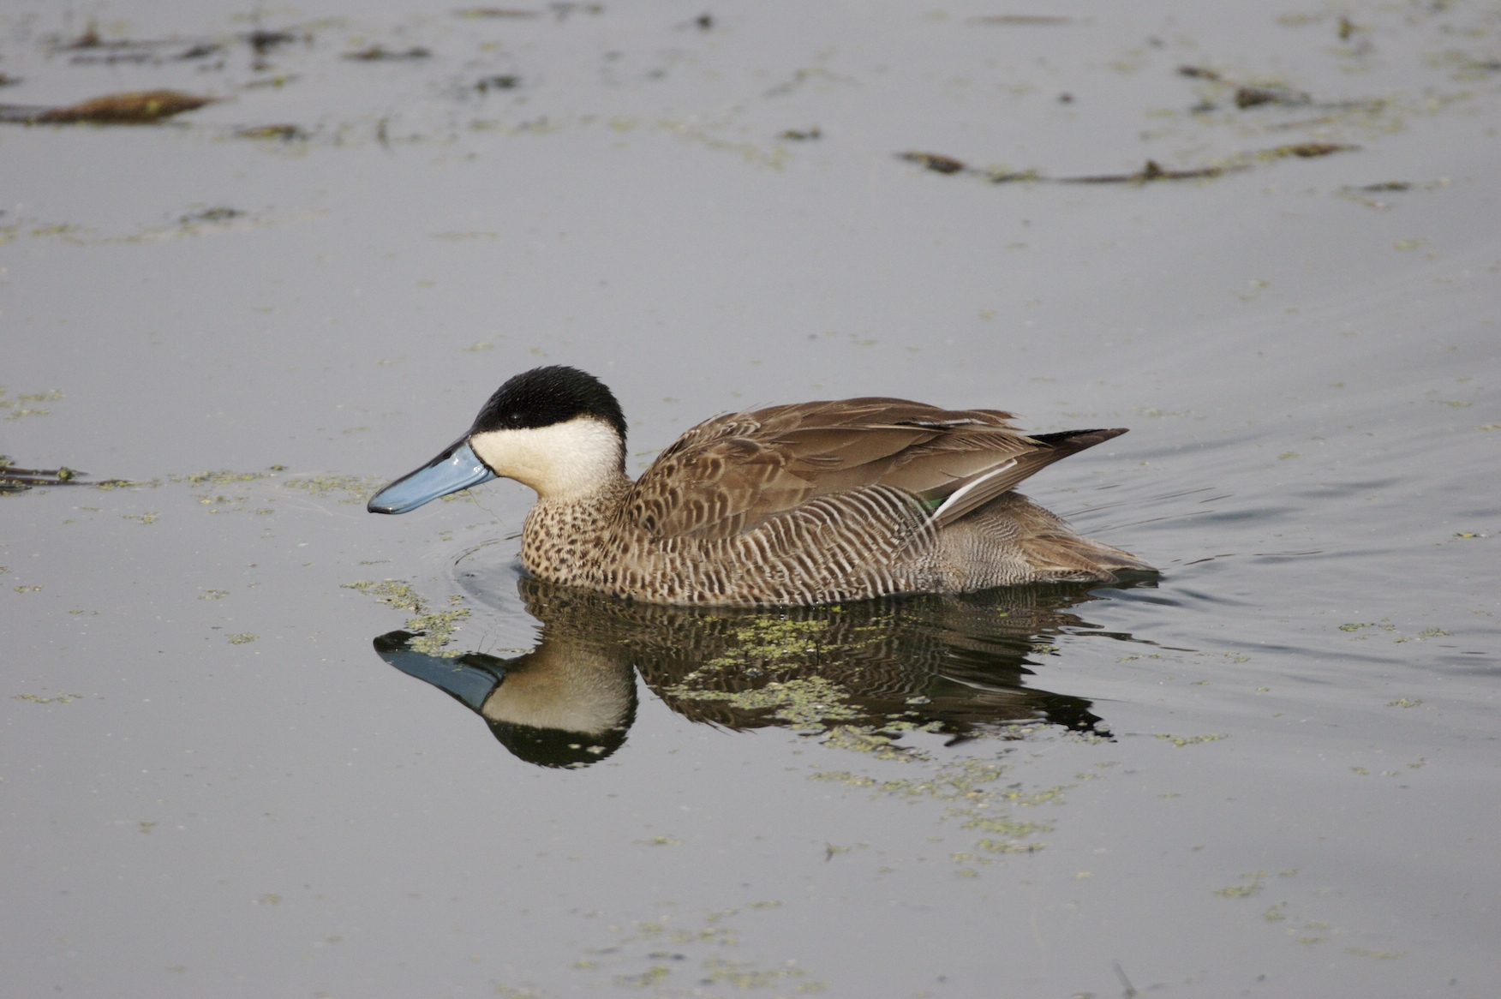
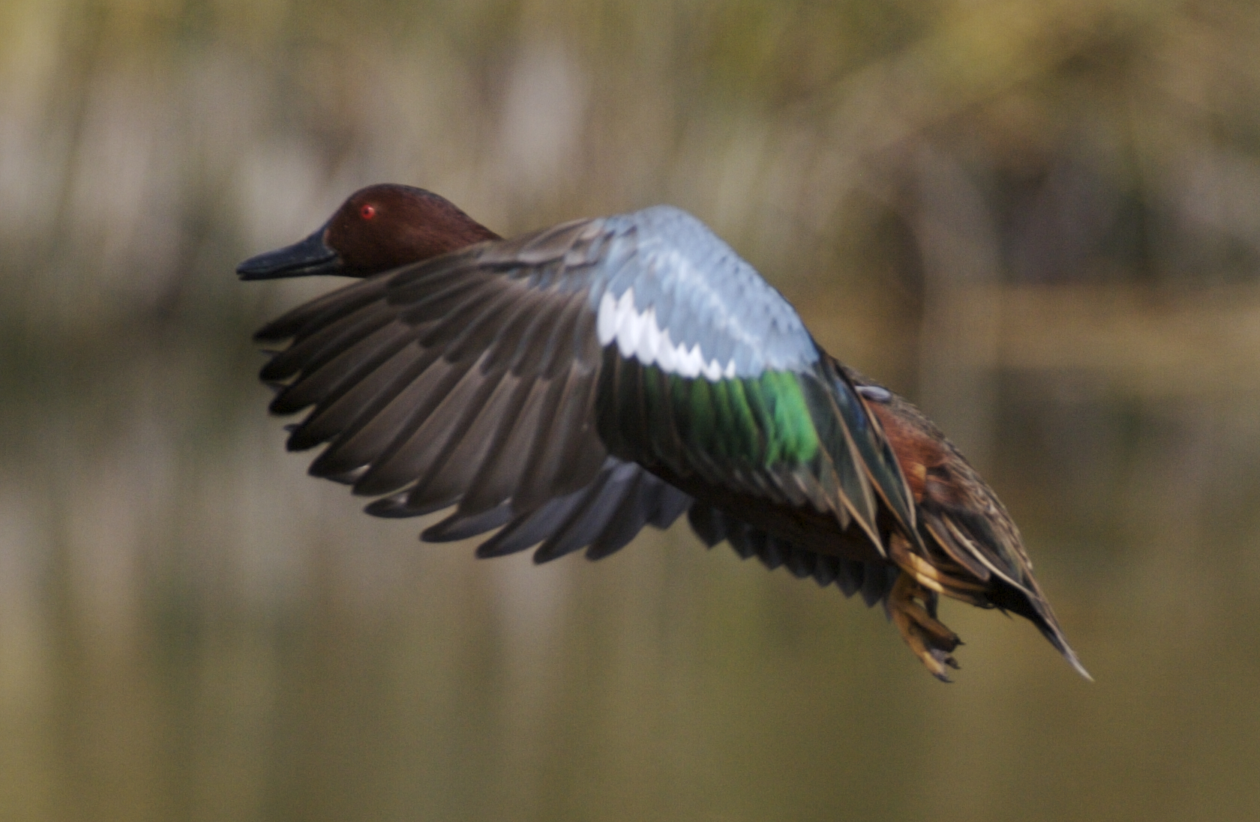
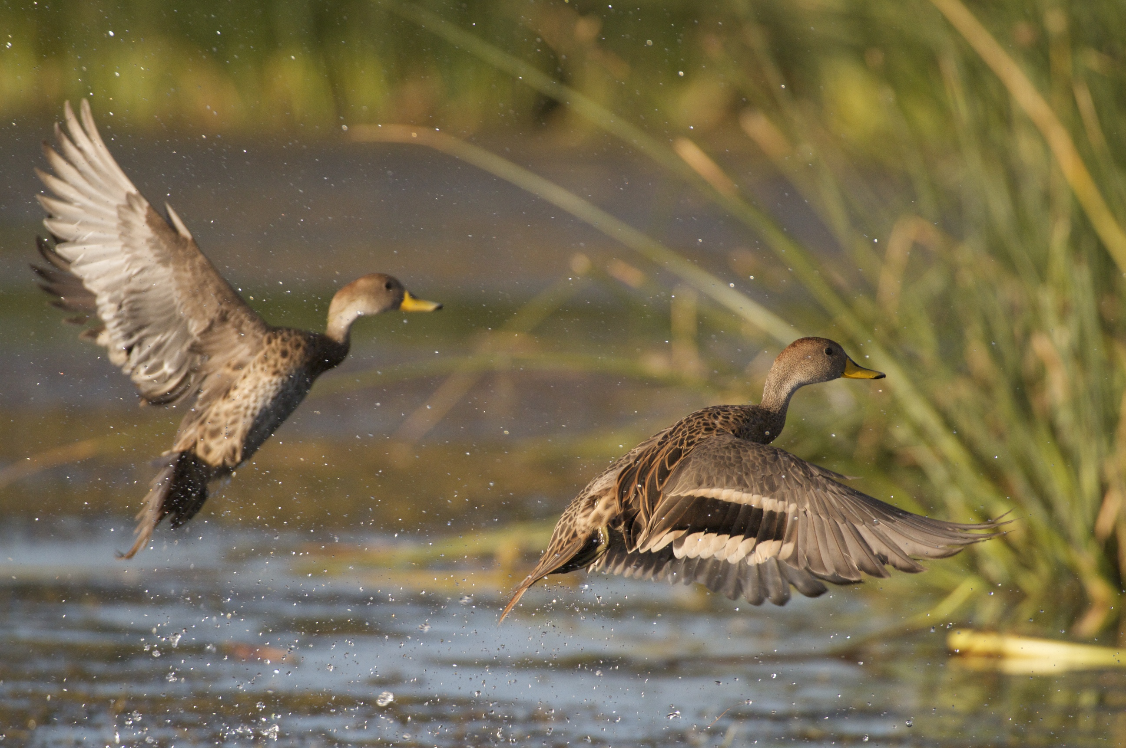
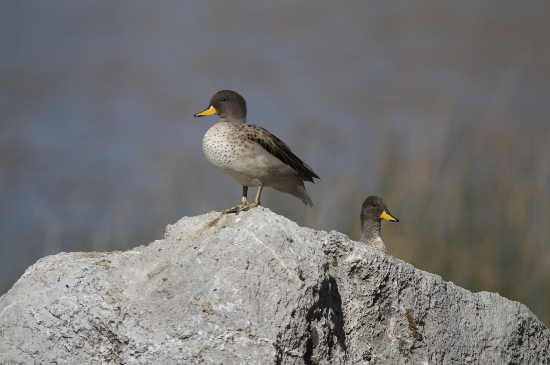
Eight species of Andean ducks
At different stages of the speciation process. Paired low- and high-altitude populations, sibling species, and full species vary in rank order of time since divergence (<50 kya to >1 mya) and gene flow levels by two orders of magnitude.
One population from each of the eight species colonized the high Andes from ancestral low-altitude habitats (in most cases from southern South America, in one case from North America).
Sufficiently closely related but not sister taxa.
Notes:
Ducks are the most common and conspicuous high-altitude avifuana.
In each case, there is both a low- and high-altitude population and they form pairs.
We also know where they came from.
Read slide.

Slide 14
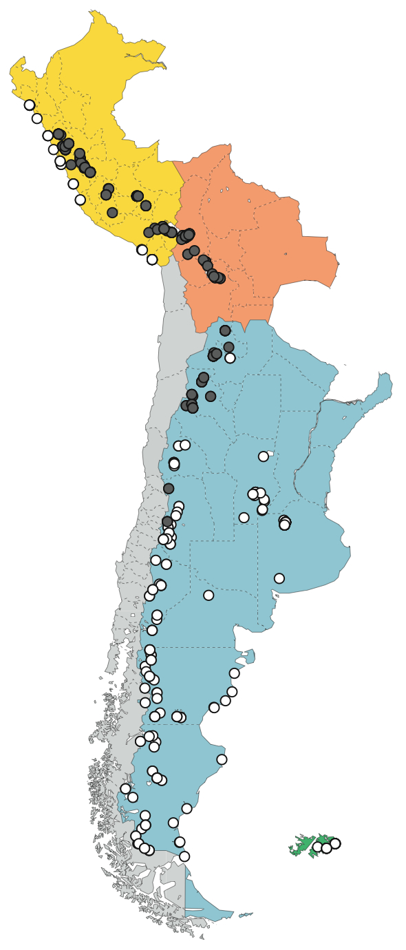

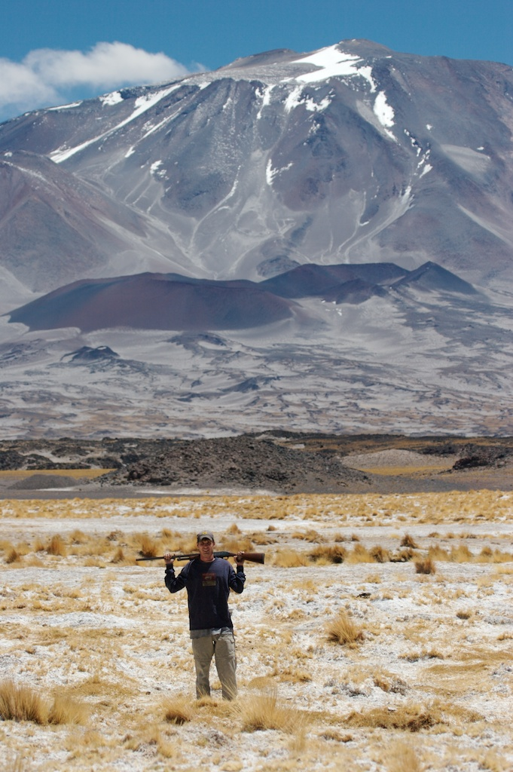
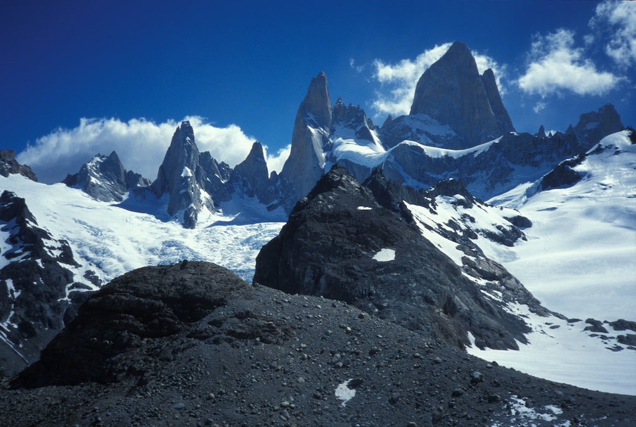
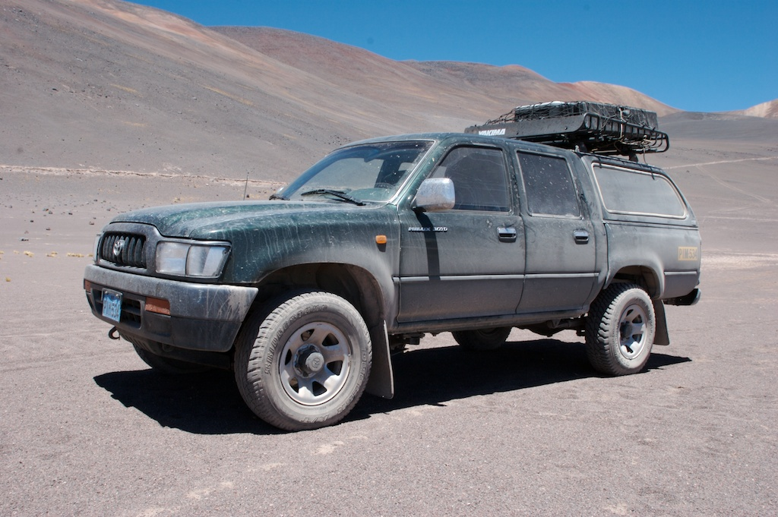
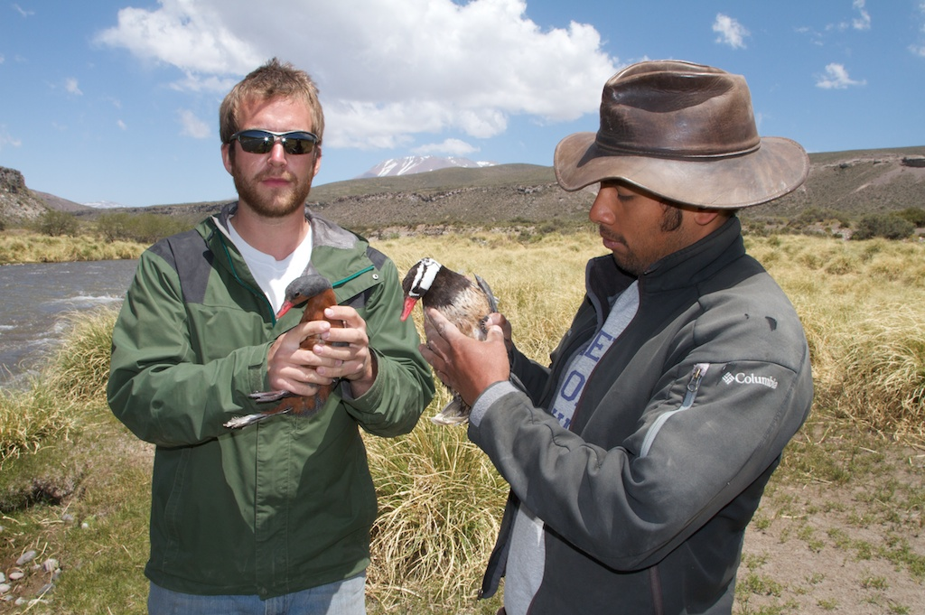
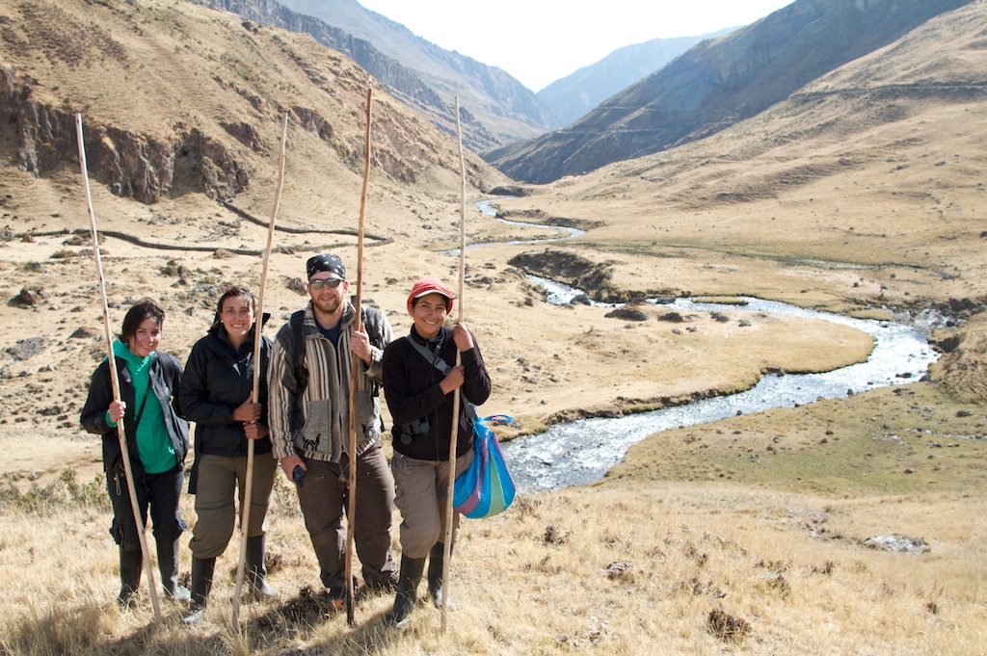
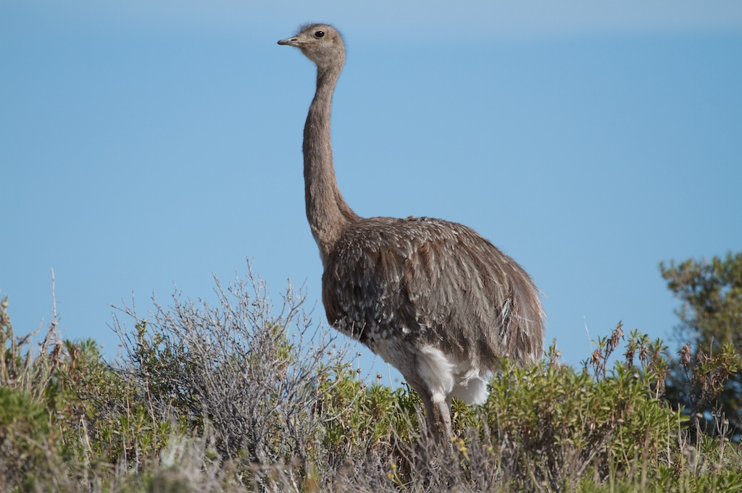
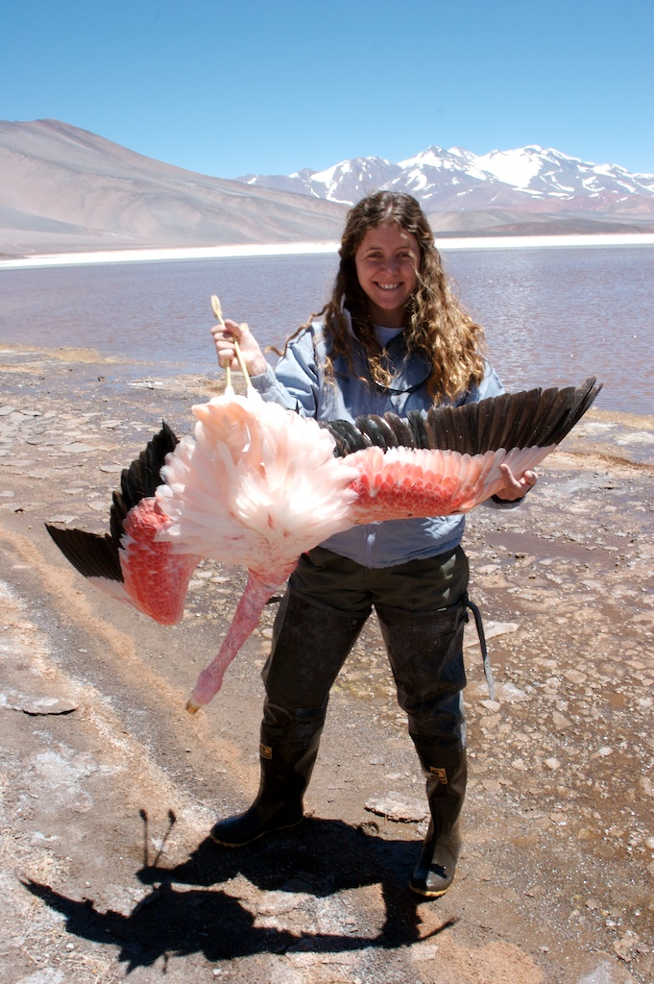



Sampling since 2001 at low- and high altitude sites in South America

Slide 15
Data from different points in the O₂ Transport Cascade
Hemoglobin polymorphism, parallel evolution, and genome-wide scans as evidence for natural selection
Experimental tests of Hb-O₂ affinity
Blood-O₂ capacity (erythropoiesis)
Hypoxic ventilatory response (HVR)
Metabolism & enzyme activity
Notes:
O₂ deprivation first sensed by chemoreceptors in the carotid bodies stimulates breathing, followed by a cascade of environmentally induced changes (plasticity) in the O₂ transport cascade.

Slide 16
General questions to ask among comparisons of different species.
Is selection strong or weak?
Is selection fast acting or slow acting?
Are the results uniform across species or more idiosyncratic? [Is there a predictable pattern?]
Are some trait variations due to plasticity instead of genotypic adaptation?

Slide 17

Data Sets #1
Polymorphism, parallel evolution, and genome-wide scans as evidence for natural selection on hemoglobin

Slide 18

Three patterns of Hb polymorphism in Andean ducks as calculated by F_{ST}
Lowland/highland populations mostly fixed for different Hb alleles.
(F_{ST} highly significant)
The high-altitude population has intermediate frequencies of the derived Hb alleles. Most high-altitude individuals are heterozygous for the Hb polymorphism (F_{ST} highly significant).
The highland population has rare private Hb alleles.
(F_{ST} not usually significant)
High F_{ST}
Intermediate F_{ST}
Low F_{ST}
5000
4000
Elevation (m)
3000
Ancestral
allele
Derived
allele
2000
1000
Note: F_{ST} is bounded by 0 and 1 (0 = no allele frequency difference, 1 = populations fixed for different alleles).
Notes:
The first thing I want to show is a complex table of candidate gene polymorphisms.
It is a little difficult to read, so want to give you an understanding of how we first identified polymorphisms of interest.
So what we did was divided our samples in low and high populations for each species, sequence the Hb genese, and calculate Fst for all observed amino acid variants.
We found three basic patterns.

Slide 19

F_{ST} for α-and β-chain HbA polymorphism in Andean ducks
Each high-altitude lineage possessed 1 to 5 derived amino acid substitutions that were significantly overrepresented in the highlands.
Many more identical amino acid replacements were observed than were simulated under a neutral coalescent model of evolution conditioned on the data.
In each case, there is little evidence to suggest that these are ancestral polymorphisms.
McCracken et al. (2009) Parallel evolution in the major hemoglobin genes of eight species of Andean waterfowl. Molecular Ecology 18:3992-4005

Slide 20









Similar types of amino acid replacements were observed at adjacent sites in the same region of the HbA protein.
Five different replacements were located in adjacent sites on the A helix and AB corner of the αA subunit, and five more occurred on the A and E helices of the βA subunit.
Five other replacements occurred within van der Waals distance of organic phosphate binding sites (IP₅ is the most potent allosteric effector influencing Hb-O₂ affinity).
Two pairs of independent amino acid replacements were observed at different α¹β¹ intersubunit contacts, regions that function in the rotational transition from deoxy- to the oxy-state conformation of the protein.
More than 1/2 the substitutions in the highland lineages resulted in the acquisition of a serine or threonine amino acid (18 gains versus 2 losses), both of which possess a hydroxyl group that hydrogen bonds to polar substrates, including inorganic phosphate.
α5, 8, 9, 12, 18 β13, 14 β62, 69, 73
β4, 86, 94, 133 α77
α119/β55 α111/β116
Serine
Threonine
McCracken et al. (2009) Parallel evolution in the major hemoglobin genes of eight species of Andean waterfowl. Molecular Ecology 18:3992-4005
Notes:
The second thing we did was map the substitutions on the Greylag Goose hemoglobin crystal structure produced by Yuhe Liang at Peking University.

Slide 21
Genome-wide scan for three low- and high-altitude pairs with smallest average F_{ST}
18,145 SNPs from 4,428 RAD-Seq loci
49,670 SNPs from 5,854 RAD-Seq loci
47,731 SNPs from 6,407 RAD-Seq loci

Slide 22

Data Sets #2
Experimental tests of Hb-O₂ affinity with naturally purified and recombinant hemoglobin

Slide 23




8.65
8.45
8.15
7.35
6.55
5.85
5.20
4.55
3.50
Jay Storz, Chandru Natarajan, & Hideaki Moriyama at University of Nebraska
Roy Weber & Angela Fago at Aarhus University

Slide 24

Cinnamon Teal Hb-O₂ affinity with KCl + IHP treatment
α5
Crested
Duck
P₅₀ is left-shifted 8 Torr
α8
Andean Goose
Crested Duck
x
x
α12
Bar-headed
Goose
α9
Cinnamon
Teal
α18
Bar-headed
Goose

Slide 25
Homology model of Cinnamon Teal HbA. Replacement of the ancestral Asn with Ser at α^{A}9 eliminates an intrasubunit hydrogen bond (shown in magenta) in deoxyHb. The loss of this noncovalent bond is predicted to destabilize the low-affinity T-state quaternary structure, thereby shifting the allosteric equilibrium in favor of the high-affinity R-state.
Natarajan et al. (2015) Convergent evolution of hemoglobin function in high-altitude Andean waterfowl involves limited parallelism at the molecular sequence level. PLoS Genetics 11:e1005681

Slide 26

Torrent Duck Hb-O₂ affinity with KCl + IHP treatment
α77
Torrent Duck
Salvadori’s Duck
Andean Goose
Blue-winged Goose
Speckled Teal
Puna Teal

Slide 27

Torrent Duck Hb-O₂ affinity with KCl + IHP treatment
Thr-β62
Val-β111
P₅₀ is left-shifted 10 Torr
x
x

Slide 28
⬆P₅₀ =
⬇O₂ affinity
←
←
⬇P₅₀ =
⬆O₂ affinity
⬆P₅₀ =
⬇O₂ affinity
Natarajan et al. (2015) Convergent evolution of hemoglobin function in high-altitude Andean waterfowl involves limited parallelism at the molecular sequence level. PLoS Genetics 11:e1005681

Slide 29


Data Sets #3
Blood-O₂ capacity (erythropoiesis)
Hematocrit
Normal
Low
High

Slide 30



Blood Hb-O₂ capacity often increases at high altitude.
While this is beneficial for most low-altitude organisms because it helps increase the blood-O₂ saturation, elevated Hb is not without a significant cost.
Increased viscosity of the blood and vascular resistance increase the cardiac work load.
What is the optimal [Hb] for a high-altitude organism?
Optimal [Hb]
Schmidt-Nielsen (1984) - Blood & Gas Transport
Notes:
Other factors being equal, the optimal Hb concentration in native high-altitude populations may not be all that different from the typical values found at sea level (Villafuerte et al. 2004).

Slide 31
Tibetan people exhibit blunted erythropoiesis but Andean people do not.
Tibetan →
lower O₂ saturation,
blunted erythropoiesis
elevated HVR
Andean →
higher O₂ saturation,
elevated erythropoiesis
blunted HVR
Beall et al. (2007) Two routes to functional adaptation: Tibetan and Andean high-altitude natives. Proceedings of the National Academy of Sciences U.S.A. 104:8655-8660

Slide 32



EPAS1

Slide 33
Rank order Hb concentration (g/dL) x hematocrit (%) for eight Andean ducks.
All eight species had higher hematocrit in the highlands than the lowlands.
Hb was higher for some high-altitude populations but not others (½ had significantly higher Hb and ½ didn’t---significantly different LSMEANS are shown in red).
Mean corpuscular hemoglobin concentration (MCHC = Hb/%Hct) was lower for all high-altitude populations (i.e., smaller blood cells at high altitude); however, the differences were significant for just two species (Puna Teal & Crested Duck).

Slide 34
Rank order Hb concentration (g/dL) x hematocrit (%) for eight Andean ducks.
The two species of diving ducks (Torrent Duck, Ruddy Duck) had the highest Hb & hematocrit, as high as 26.0 g/dL and 71.4% respectively.
Yellow-billed Pintail had relatively high [Hb] in both the highlands and the lowlands.
Puna Teal, Speckled Teal, and Andean Goose had the lowest Hb & hematocrit. Cinnamon Teal was more like yellow-billed pintail, and Crested Duck was intermediate.

Slide 35
So how can I summarize the [Hb] data without showing too many more slides?

Slide 36


Two Diving
Ducks
Torrent Duck
Ruddy Duck
High Hb-O₂ affinity (P₅₀) in all populations? | Yes 26.4 - 27.7 Torr | Yes 28.6 - 30.1 Torr
Highest hematocrits? | Yes 58.7 - 63.6% | Yes 53.6 - 58.3%
Highest Hb concentrations? | Yes 19.7 - 21.2 g/dL | Yes 20.0 - 20.7 g/dL
Highest myoglobin? | Yes 11.2 - 16.6 mg/g | (No) 6.9 - 7.2 mg/g

Slide 37



Hb & Mb concentrations in other diving animals
Emperor Penguin [Hb] = 18 g/dL
Mb = 6.4 mg/g
Sperm Whale [Hb] = 22 g/dL
Mb = 5.4 mg/g
Weddell Seal [Hb] = 18 g/dL
Mb = 5.4 mg/g

Slide 38

As for the other ducks, non-diving species:
Time since divergence from low-altitude population
New (10 kya)
Intermediate (100 kya)
Established (>1 mya)
Cinnamon
Teal
0.00014
Yellow-billed
Pintail
0.00052
Crested
Duck
0.0032
Puna
Teal
0.018
Speckled
Teal
0.020
Andean
Goose
0.045
t/site
10x deeper
100x deeper
Highest
[Hb]
Intermediate
[Hb]
Lowest
[Hb]

Slide 39
10 Kya
100 Kya
1 Mya
[Hb]
Elevation
Elevation
Elevation
Phenotypic
optimum favored
by selection
Environmentally-mediated plasticity associated with increased [Hb] results in short-term fitness benefit that facilitates process of genetic adaptation.
Long-term effects of ⬆ [Hb] on fitness are costly. Counter-gradient selection begins to dampen [Hb].
[Hb] returns to ancestral state.
Notes:
If we lead genotype aside, it is useful to just focus on the relationship between selection and the optimal phenotype.

Slide 40
Conclusions about erythropoiesis
Even though ⬆ hematocrit may be beneficial in the short term, the optimal Hb concentration is probably similar to [Hb] of the low-altitude populations.
Countergradient selection on [Hb] has acted slowly and blunted erythropoiesis over long but not short evolutionary time scales.
In contrast to Hb-O₂ affinity, which has evolved rapidly in the same direction with the same result in all species.

Slide 41








Data Sets #4
Cross-species comparisons of the hypoxic ventilatory response (HVR)
Notes:
If erythropoiesis is blunted for species that have resided at high altitude for long time periods, what about the HVR and other traits influencing lung and tissue O₂ extraction?

Slide 42


Control of breathing in Bar-headed Goose vs. low-altitude species like Greylag Goose and Mallard
Scott GR, Milsom WK (2007) Control of breathing and adaptation to high altitude in the bar-headed goose. American Journal of Physiology-Regulatory, Integrative and Comparative Physiology 293:R379-91.

Slide 43
Lague et al. (2016) High-altitude champions: Divergent strategies in geese for obtaining oxygen in extreme hypoxia. Proceedings of the Royal Society B Biological Sciences (in press).
Andean Goose
Crested Duck
Bar-headed Goose

Slide 44
Andean Goose
Crested Duck
Bar-headed Goose
Lague et al. (2016) High-altitude champions: Divergent strategies in geese for obtaining oxygen in extreme hypoxia. Proceedings of the Royal Society B Biological Sciences (in press).

Slide 45


Tibetan → not blunted HVR
Andean → blunted HVR

Slide 46
Andean Goose
Crested Duck
Bar-headed Goose
Lague et al. (2016) High-altitude champions: Divergent strategies in geese for obtaining oxygen in extreme hypoxia. Proceedings of the Royal Society B Biological Sciences (in press).

Slide 47


Andean Goose lung structures are exceptional
Highest respiratory surface area yet reported for birds; thin blood gas barrier; high pulmonary capillary blood volume; and high pulmonary diffusing capacity---among the highest values yet reported for birds.
Mania et al. (2016) Morphological and morphometric specializations of the lung of the Andean Goose, Chloephaga melanoptera: A lifelong high-altitude resident. Proc. Roy. Soc. B Biol. Sci. (in press).

Slide 48


What factors have likely influenced the differences observed between Himalayan and Andean species?
Migration?
Habitat differences?

Slide 49


One species is adapted for high-performance exercise; the other to a more sedentary life; in each case the set of adaptations that are best suited to these lifestyles are different.
It just happens by chance that Tibetan and Andean peoples share some of the same phenotypes, respectively.

Slide 50



Slide 51
HVR Data for 7 High-altitude Populations
New (10 kya)
Intermediate (100 kya)
Established (> 1 mya)
Breath
Freq.
⬆
Tidal Vol.
---
Breath
Freq.
⬆
Tidal Vol.
⬆
Breath
Freq.
⬆
Tidal Vol.
---
Breath
Freq.
---
Tidal Vol.
---
Breath
Freq.
---
Tidal Vol.
⬆
Breath
Freq.
⬆
Tidal Vol.
---
Breath
Freq.
---
Tidal Vol.
---
Cinnamon
Teal
0.00014
Yellow-billed
Pintail
0.00052
Ruddy
Duck
0.00081
Crested
Duck
0.0032
Puna
Teal
0.018
Speckled
Teal
0.020
Andean
Goose
0.045
t/site
10x deeper
100x deeper
These patterns for the HVR appear to be more idiosyncratic than what we see for Hb-O₂ affinity or erythropoiesis.

Slide 52



Data Sets #5
Metabolic capacities and enzyme activities
Neal Dawson - McMaster University
Notes:
If erythropoiesis is blunted for species that have resided at high altitude for long time periods, what about the HVR and other traits influencing lung and tissue O₂ extraction?

Slide 53




Torrent Ducks
Few metabolic changes in flight muscle (swimming is probably more important than flight).
Increased mitochondrial respiration rates in the gastrocnemius leg muscle.
Enhanced capacity for fatty acid utilization in the left ventricle.
Highest myoglobin among high-altitude waterfowl.
Dawson et el. (2016) Mitochondrial physiology in the skeletal and cardiac muscles is altered in torrent ducks, Merganetta armata, from high altitudes in the Andes. Journal of Experimental Biology (in press).

Slide 54
HK = Hexokinase
PFK = Phosphofructokinase
Well established taxa have less glycolytic capacity than those newer to high altitude.

Slide 56















Acknowledgements:
Collaborators/major contributors:
Luis Alza - CORBIDI
Adrea Astie – CCT-Mendoza
Christopher Barger - UAF
Emil Bautista - CORBIDI
Mariana Bulgarella - UAF
Daniel Cadena - Universidad de los Andes
Peter Frappell - U Tasmania
Natalia Gutierrez - Universidad de los Andes
Kevin Johnson - Illinois Natural History Survey
Cecilia Kopuchian - MACN
Mary Kuhner - University of Washington
Maria Lozano - Universidad de los Andes
Anthony Martin - British Antarctic Survey
Bill Milsom - UBC
Violeta Muñoz-Fuentes - EBD-CSIC (Spain)
Jeffrey Peters - Wright State University
Daryl Richardson - DWA
Cynthia Sanchez – CORBIDI
Graham Scott - McMaster U
Matt Smith - USGS Alaska Science Center
Jay Storz - University of Nebraska
Jorge Trucco - Patagonia Outfitters
Pablo Tubaro - MACN
Thomas Valqui – CORBIDI
Roy Weber – U Aarhus
Robert Wilson - UAF
Kevin Winker - UAM
Christopher Witt - UNM/MSB
Computational support:
Greg Newby
Mac Campbell
Rob Cermak
Shawn Houston
Jim Long

Slide 57
Extra Slides

Slide 58
How long have these populations existed at high-altitude?
mtDNA Control Region Haplotypes
High-altitude Population
Low-altitude Population

Slide 59

Isolation-with-Migration (IM) can be used to infer time since divergence between lowland and highland populations
IM method incorporates population divergence and gene flow.
Yields estimate of time since divergence measured as t/site (i.e., tree height of the genealogy).
Can be used to determine whether differences in a trait like [Hb] concentration might be dampened following long intervals of time in the highlands.
Hey (2010)

Slide 60
10x deeper
100x deeper

